Slide 1
Cloud Security, Cloud Security Posture Management & Single Sign-On
Real-world cloud security — illustrated through Amazon, Flipkart, Swiggy, Zomato, Lenskart, and banking platforms
Author: Dinesh Wadhwani · Instructor Deck with Speaker Notes
Notes:
Welcome the class. Introduce yourself briefly and set expectations: this is a two-lecture, four-hour module covering three connected topics — cloud security fundamentals, Cloud Security Posture Management (CSPM), and Single Sign-On (SSO). Mention up front that every concept will be tied to apps they already use — Swiggy, Flipkart, Amazon, Lenskart, and banking apps — so this is not abstract theory. Ask a quick show of hands: 'who here has logged into an app using Continue with Google this week?' Nearly everyone will raise a hand — that's the hook: by the end of Lecture 2 they will know exactly what happens, technically, in that moment. Briefly preview the two-lecture structure shown on this slide: Lecture 1 builds the foundational mental model (shared responsibility) and the posture-monitoring discipline (CSPM); Lecture 2 is entirely devoted to identity and SSO. Mention that a companion course-material PDF exists with full written explanations, extra worked examples, a glossary, and answer keys, so students can treat today's slides as the guided tour and the PDF as the reference book to revisit later.

Slide 2
01
LECTURE 1 · 2 HOURS
Foundations of Cloud Security & Cloud Security Posture Management (CSPM)
Notes:
Frame Lecture 1 in one sentence: the first half is the mental model for how responsibility for security is split between a cloud provider and its customers; the second half is about the tooling — CSPM — that continuously checks organizations are actually holding up their side of that split. Everything in Lecture 2 (SSO) will build on the vocabulary introduced here. AGENDA (read/write on board): (1) Cloud recap & why cloud security is different, (2) The Shared Responsibility Model + the Capital One case study, (3) The Five Pillars & the Threat Landscape, (4) A real-world architecture case study, (5) Classroom Exercise 1, (6) What CSPM is and how it works, (7) Compliance, tools, and the CNAPP landscape, (8) Classroom Exercise 2. OBJECTIVES (tell students this is effectively today's checklist): by the end of this lecture they should be able to (a) explain the Shared Responsibility Model and correctly place a given control on it for IaaS/PaaS/SaaS, (b) explain why misconfiguration — not sophisticated hacking — is the leading cause of cloud breaches, (c) define CSPM and describe step by step how a CSPM platform works, and (d) distinguish CSPM from CWPP, CIEM, and KSPM. Mention there will be one short classroom exercise at the end of each hour — ask students to keep a notebook or phone note open for the scenario cards.

Slide 3
1.1 – 1.2 · FOUNDATIONS
Cloud Recap & Why Cloud Security Is Different
Quick recap: IaaS / PaaS / SaaS
  IaaS = raw VMs (EC2) · PaaS = provider manages OS/runtime (Elastic Beanstalk) · SaaS = provider runs the whole app (Salesforce, Zoom)
Deployment models: Public, Private, Hybrid — most large Indian banks run hybrid
Three shifts that make cloud security its own discipline:
  Shared control — you no longer own every layer of the stack
  Speed & scale — infrastructure is created/destroyed through code in seconds
  API-driven everything — a leaked API key can do as much damage as a stolen server key
Module 1
Cloud Security · CSPM · SSO
Notes:
Spend 60-90 seconds on the IaaS/PaaS/SaaS recap — assume they've seen this before, so don't linger, but make sure the distinction is crystal clear because the Shared Responsibility diagram in a moment depends entirely on it. Use the example: 'when you order on Swiggy, the app itself might run on virtual machines (IaaS/PaaS), but the internal support-ticket tool the delivery team uses might just be a SaaS product like Zendesk — a single company routinely uses all three models at once.' Mention hybrid cloud briefly: large Indian banks typically keep core banking systems in a private cloud or on-premises due to RBI data-localization expectations, while running customer-facing apps and analytics on public cloud — this foreshadows the banking SSO case study in Lecture 2. Then pivot to why cloud security is a DIFFERENT discipline, not just 'the same security, somewhere else.' Traditional security assumed a fixed perimeter — servers in your own building, behind your own firewall. Ask: 'if your company's database now lives in a data center you've never seen, in a country you may never visit, what does perimeter even mean anymore?' Walk through the three shifts. On the API-driven point, give a vivid real example: a single leaked cloud access key, accidentally posted to a public GitHub repository, has been the root cause of real, widely reported breaches and unexpected massive cloud bills — all without the attacker writing a single line of exploit code.

Slide 4
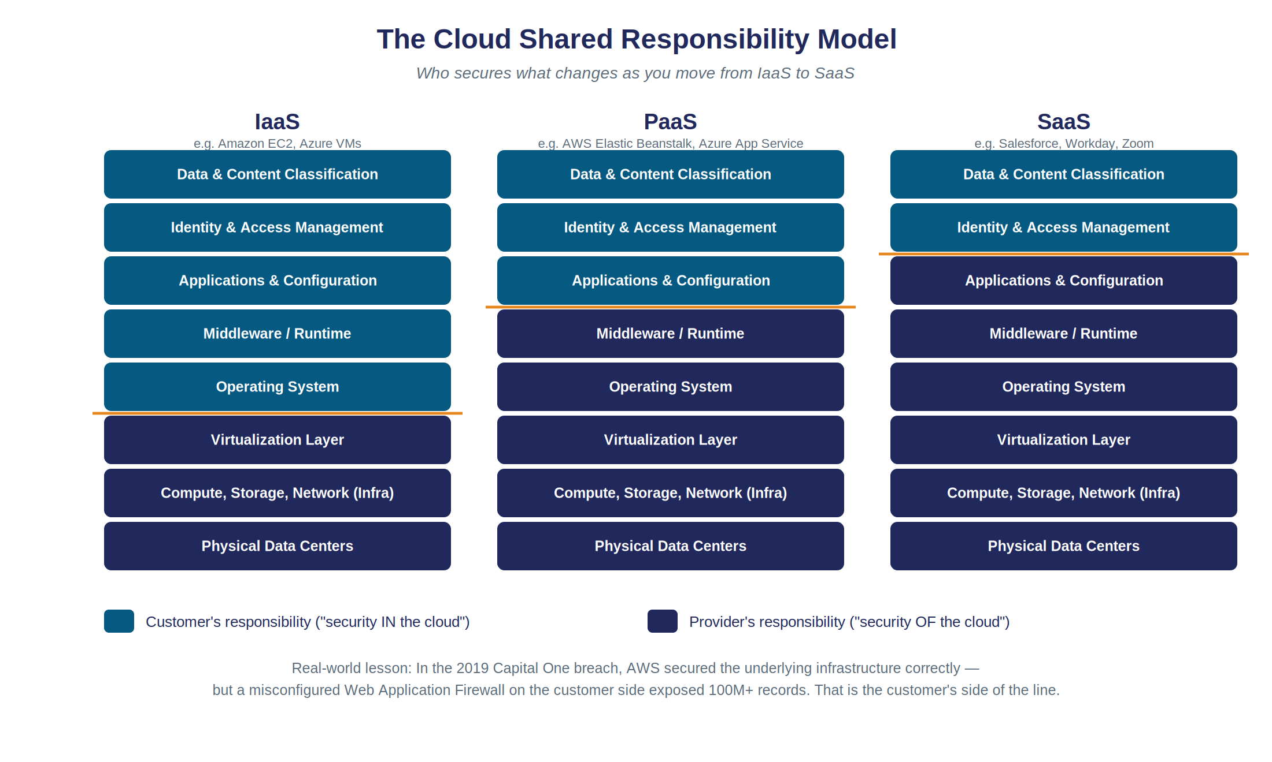
1.3 · THE CORE MENTAL MODEL
The Shared Responsibility Model
Module 1
Cloud Security · CSPM · SSO
Figure 1.1 — Who secures what, across IaaS, PaaS, and SaaS.
Notes:
This is the single most important diagram in the entire course — slow down here, this slide can easily take 6-7 minutes well spent. Walk column by column: in IaaS, the customer's blue zone extends all the way down through the operating system; in PaaS, the provider takes over OS and runtime, and the customer's responsibility shrinks to data, identity, and application configuration; in SaaS, the customer is only left with data and identity & access management. Point at the amber line moving down the stack as you go left to right. Then land the key point hard: 'notice that data and IAM never leave the customer's side, no matter which model you use. If you remember one thing from this entire hour, remember that sentence.' Now walk through a worked example verbally: on AWS, running your own code on an EC2 virtual machine (IaaS) means YOU patch the operating system; running the same code on AWS Lambda (serverless/PaaS-like) means AWS patches the OS for you automatically — but in BOTH cases you remain 100% responsible for what your code does with the data it touches, and who is allowed to invoke it. Ask the class: 'if I use Lambda and forget to restrict who can invoke my function, whose fault is that?' (Entirely the customer's — AWS never promised to police your function's permissions for you.) This is a good moment to also mention the CIA triad briefly in passing — Confidentiality, Integrity, Availability — and note that cloud-specific versions of each (public buckets breaking confidentiality, tampered Infrastructure-as-Code breaking integrity, DDoS breaking availability) are all, ultimately, shared-responsibility failures on the customer's side of this same diagram.

Slide 5
1.4 · CASE STUDY
The Capital One Breach (2019)
100+ million customer records exposed — credit scores, balances, SSNs
Capital One ran its infrastructure on AWS
Root cause: a misconfigured Web Application Firewall (WAF) — on the CUSTOMER side
  The WAF had excessive permissions and could be tricked into requesting temporary credentials, later used to read S3 storage buckets
AWS secured ‘the cloud’ exactly as promised
  The failure was entirely on the customer's side of the shared-responsibility line
Module 1
Cloud Security · CSPM · SSO
Notes:
Tell this like a story, not a bullet list, and take your time — this is the anecdote students will remember years from now. 'In 2019, one of the largest US banks, running on AWS, had a breach affecting over 100 million people. A former employee of a third-party firm found a misconfigured firewall the bank's OWN team had set up — it had way more permission than it needed, and could be tricked into fetching temporary AWS credentials, which were then used to read directly from the bank's own storage.' Pause. Ask: 'whose fault was this — AWS's, or Capital One's?' Let a few students answer, then confirm: entirely Capital One's, on their side of the responsibility line. Tell students explicitly: 'if you're ever asked in an interview to give an example of a cloud security failure, this is your go-to answer — it's specific, factual, and demonstrates you understand shared responsibility rather than just knowing the term.' You can also mention this connects to identity concepts coming in Lecture 2: the attacker's path involved abusing an over-privileged role to fetch credentials it should never have been allowed to fetch — a preview of the least-privilege and CIEM ideas coming up shortly.

Slide 6
1.5
The Five Pillars of Cloud Security
1. Identity & Access Management (IAM) — least privilege, always
2. Data Protection — encryption at rest & in transit, tokenization, classification
3. Network Security — VPCs, security groups, segmentation
4. Compliance & Governance — ISO 27001, PCI-DSS, RBI framework, DPDP Act
5. Monitoring, Detection & Response — logging, alerting, continuous posture checks
  This course goes deep on Pillar 1 (via SSO, Lecture 2) and Pillar 5 (via CSPM, this hour)
Module 1
Cloud Security · CSPM · SSO
Notes:
Present this as the map of the whole field, then tell students explicitly where this course sits on that map: 'we're going deep on identity — that's Lecture 2's SSO topic — and on monitoring/posture — that's this hour's CSPM topic. The other three pillars (data, network, compliance) will come up as supporting context throughout, but aren't our main focus.' This helps students file incoming information correctly for the rest of the day. If time allows, ask the class to each name one real control they can think of for one pillar — e.g. 'encryption of card numbers' for Data Protection, or 'a security group blocking direct internet access to a database' for Network Security. This is a light, fast way to check the room is still following along before moving into the denser threat-landscape material.

Slide 7
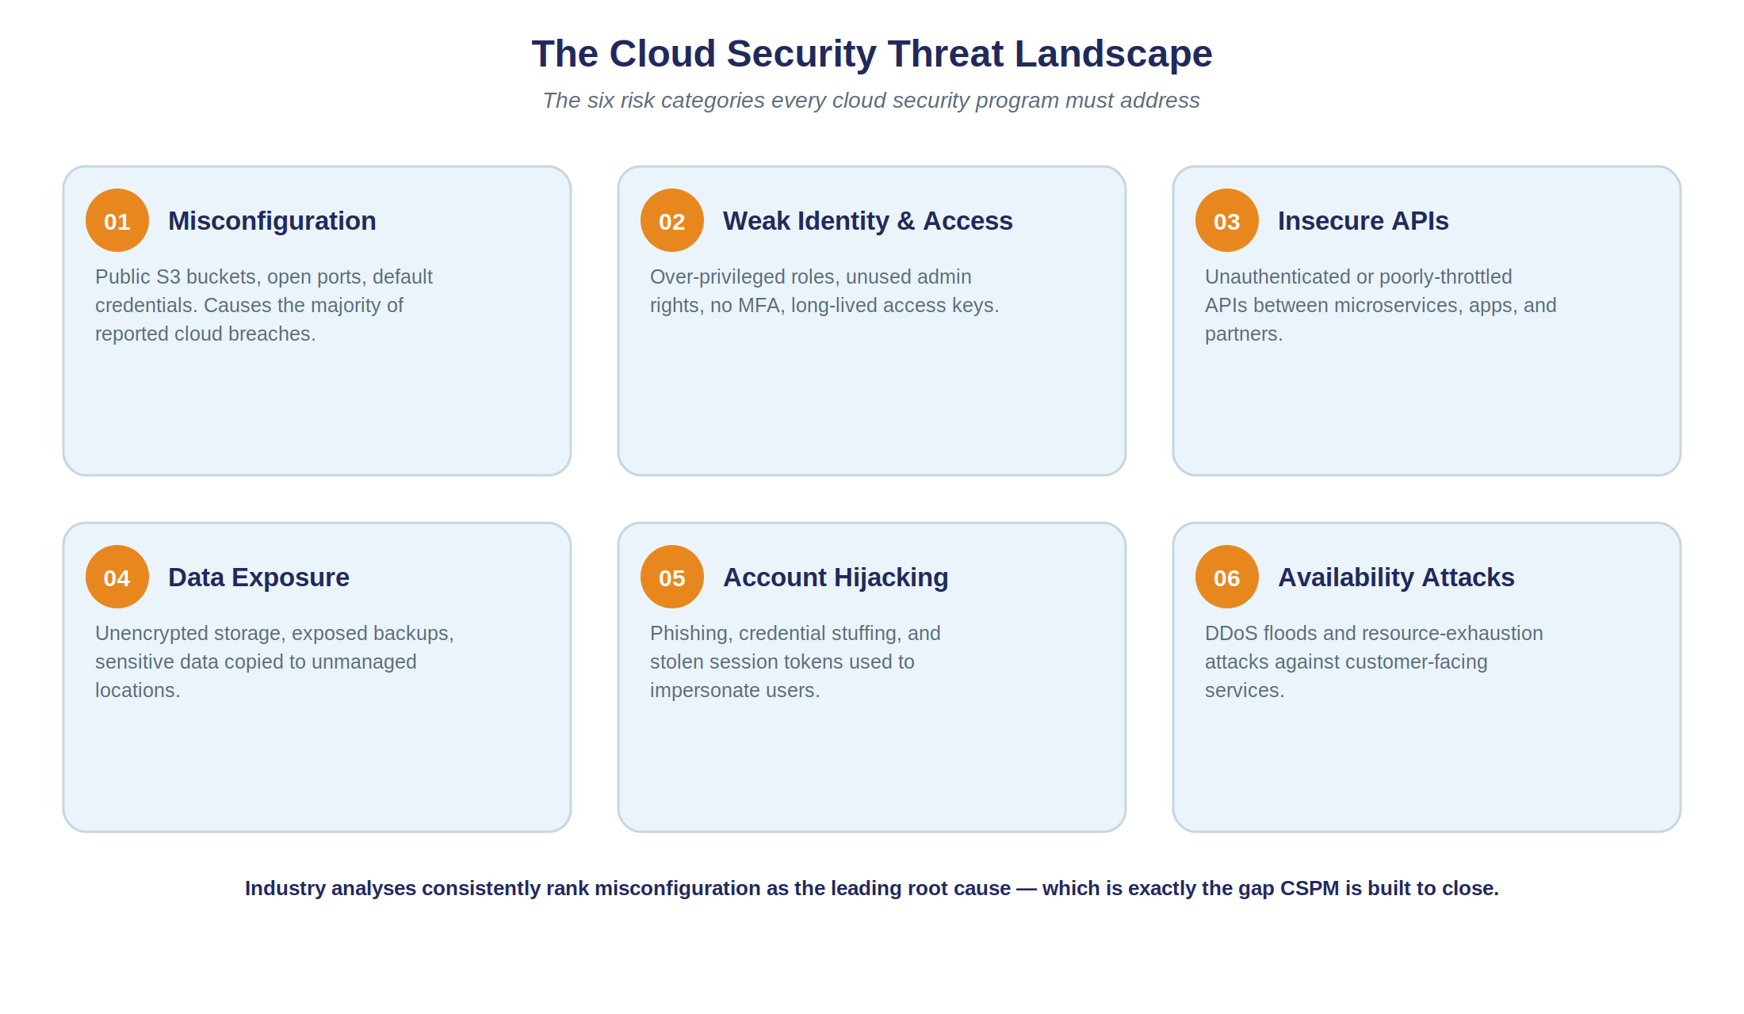
1.6
The Cloud Security Threat Landscape
Module 1
Cloud Security · CSPM · SSO
Figure 1.2 — Six risk categories behind almost every publicly documented cloud breach.
Notes:
Go around the six cards briefly, but spend real time on two of them. First, Misconfiguration: emphasize that this requires ZERO hacking skill — it's a checkbox left in the wrong state. That's precisely why it's the leading cause: the barrier to 'exploiting' it is nearly zero, for the attacker and for whoever left it that way. Second, Account Hijacking: point out that modern attackers increasingly steal SESSION TOKENS rather than passwords — flag that this connects directly to Lecture 2's SSO risks section, where token theft is discussed in detail. Briefly touch the remaining four (weak IAM, insecure APIs, data exposure, availability attacks) with one sentence each — they don't each need their own long discussion, but naming them now means they aren't unfamiliar vocabulary when they resurface later in the CSPM and SSO risk sections.

Slide 8
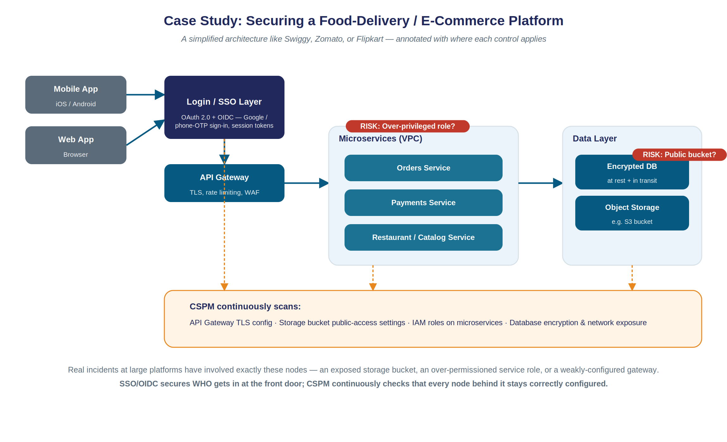
1.7 · CASE STUDY
Securing a Food-Delivery / E-Commerce Platform
Module 1
Cloud Security · CSPM · SSO
Figure 1.3 — A simplified architecture like Swiggy, Zomato, or Flipkart, annotated with where controls apply.
Notes:
This diagram is the emotional center of Module 1 — it's the moment abstract theory becomes a picture of an app every student has personally used. Walk left to right: mobile/web app, then the login/SSO layer (flag explicitly: 'this is all of Lecture 2'), then the API gateway, then microservices sitting inside a private network (VPC), then the data layer. Point at the amber dashed arrows and the 'CSPM continuously scans' box underneath and say explicitly: 'this orange box is everything we're about to spend the second half of this lecture on.' Point at the two red risk badges (over-privileged role, public bucket) and say these are not hypothetical — these exact two failure patterns appear over and over in real, publicly reported incidents across many industries, including e-commerce and fintech. Land the key point: 'notice this single diagram already contains both halves of this course — the Login/SSO layer decides WHO is allowed in, while CSPM continuously checks that every other node stays correctly configured. Identity and posture are the two questions a mature cloud security program must always be able to answer.'

Slide 9
1.8 · CLASSROOM EXERCISE 1
Whose Responsibility Is It?
In pairs: for each item below, decide — Cloud Provider, Customer, or Shared?
Patching a vulnerability in the physical server's firmware
Setting a cloud storage bucket to ‘private’ instead of ‘public’
Enforcing MFA for admin console logins
Encrypting customer data before storing it in a managed database
Ensuring the data center has backup power and physical guards
Configuring which microservices can talk to each other inside a VPC
Module 1 · Exercise
Cloud Security · CSPM · SSO
Notes:
Give pairs about 4 minutes to discuss, then cold-call two or three pairs for their answers before revealing the correct ones. Answers: (1) Provider, (2) Customer, (3) Customer, (4) Customer, (5) Provider, (6) Customer. If a pair gets (3) wrong by saying 'Provider', use it as a teaching moment: the vendor provides the MFA CAPABILITY, but whether it's actually turned on and enforced is always a customer configuration decision — exactly the same pattern as the Capital One WAF story. CLOSE OUT MODULE 1 HERE with a 60-second recap before moving to CSPM: 'cloud security is shared, the split moves as you go from IaaS to SaaS, but data & IAM never leave the customer's side; real breaches like Capital One are usually configuration and process failures, not exotic hacking; and we now have five pillars and six threat categories as our shared vocabulary for the rest of the day.' This is a natural point for a brief 2-3 minute stretch break before moving into CSPM.

Slide 10
2.1 – 2.2 · CSPM
Why CSPM Exists, and What It Is
The misconfiguration problem, at scale:
  Volume — a mid-size company can run tens of thousands of cloud resources
  Velocity — Infrastructure as Code + CI/CD means resources change constantly, all day
  Drift — a correctly configured resource can be quietly ‘fixed’ badly later, and nobody re-reviews it
Manual review cannot keep up with any of this — hence CSPM:
  Cloud Security Posture Management: tooling that CONTINUOUSLY and AUTOMATICALLY discovers cloud resources, checks their configuration against best practices, and surfaces or auto-fixes problems, across EVERY account
Module 2
Cloud Security · CSPM · SSO
Notes:
Set up the 'why' before the 'what.' Ask: 'if your company has 40,000 cloud resources across three cloud providers, changing every single day — how many security engineers would you need to manually review every change?' Let the absurdity of the number land, then say: 'that's exactly why this has to be automated and continuous, not a quarterly audit checklist.' The word DRIFT deserves emphasis — it's a term students should walk away knowing: configuration that was fine yesterday isn't necessarily fine today. Then read the formal CSPM definition slowly, it's worth writing down verbatim since 'define CSPM' is a common exam-style question. Unpack the three bolded words — continuously (not a one-time audit), automatically (no human clicking through consoles), every account (multi-cloud visibility) — spending about 20 seconds on each, since they are the differentiators between real CSPM and 'someone manually reviewing a cloud console once a quarter,' which is what many smaller companies mistakenly think passes for a security review.

Slide 11
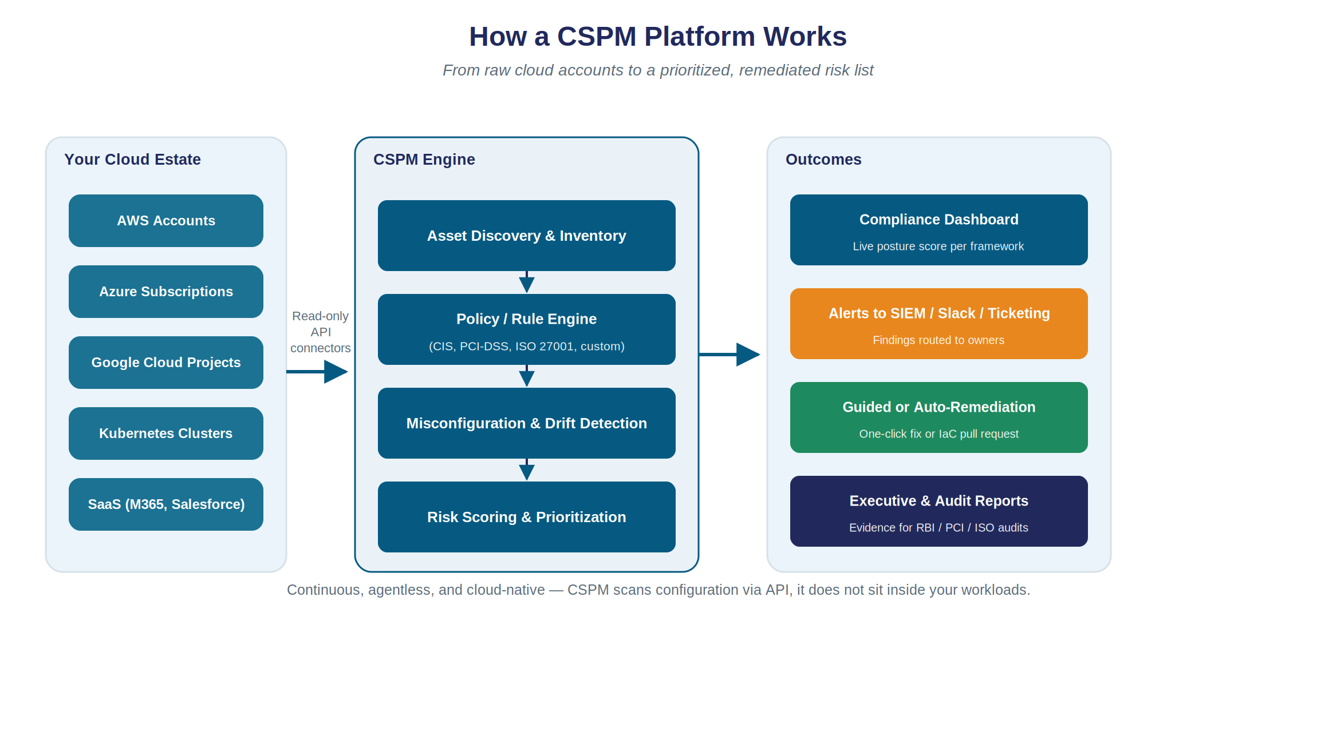
2.3
How a CSPM Platform Works
Module 2
Cloud Security · CSPM · SSO
Figure 2.1 — From raw cloud accounts to a prioritized, remediated risk list.
Notes:
Walk left to right across the three panels. Left: your actual cloud estate — note it includes SaaS and Kubernetes, not just 'the cloud' in the narrow sense. Middle: the engine itself — discovery, then a policy/rule engine (mention this is where CIS/PCI/ISO rules live), then misconfiguration & drift detection, then risk scoring. Right: the outcomes — dashboards, alerts routed into tools the team already uses (Slack, ticketing), remediation, and audit-ready reports. Emphasize the caption at the bottom: CSPM is agentless — it talks to the cloud provider's own management API, the same API the console itself uses. It does not install anything inside your virtual machines or containers — that's a different category of tool (CWPP), which comes up on the CNAPP landscape slide shortly.

Slide 12
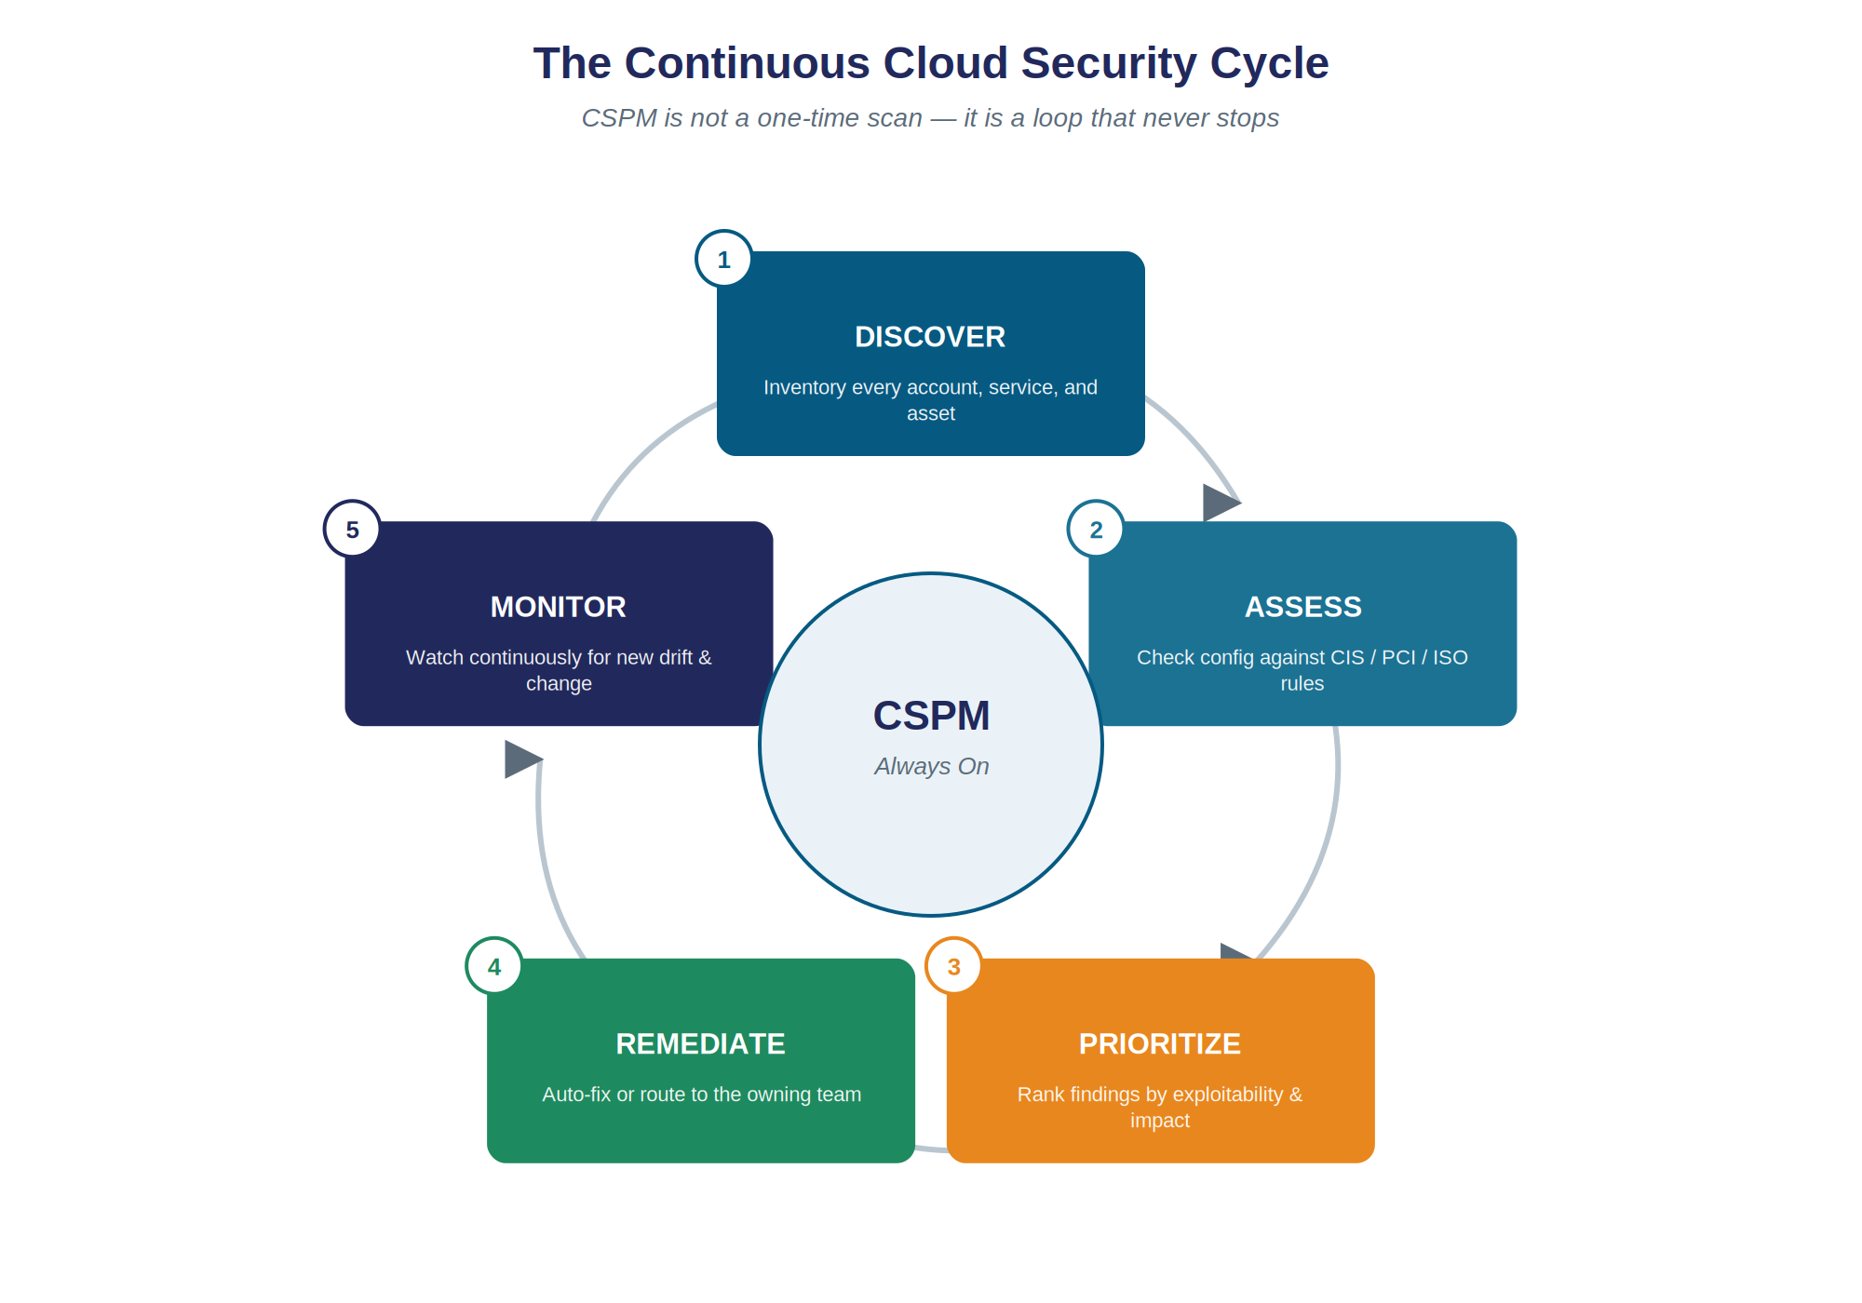
2.4
The Continuous Cloud Security Cycle
Figure 2.2 — CSPM is a loop that never stops: Discover → Assess → Prioritize → Remediate → Monitor.
Module 2
Cloud Security · CSPM · SSO
Notes:
Walk around the circle stage by stage. Discover: build a live inventory, including 'shadow' resources an individual engineer spun up without telling anyone. Assess: check every resource against CIS/PCI/ISO rules. Prioritize: NOT every finding is equally urgent — contrast 'a public bucket full of customer PII' against 'an unused test resource with a minor issue' to show why ranking by exploitability and impact matters, not just raw finding count. Remediate: either auto-fixed for well-understood low-risk issues, or routed as a clear, actionable ticket — ideally with a one-click fix or a ready-made Infrastructure-as-Code pull request. Monitor: and then the loop starts again, forever. Land the point: 'this is why we call it posture MANAGEMENT, not posture AUDITING — it never really finishes.' This is also a good moment to briefly tell the exposed-bucket story as a narrative if time allows: a bucket opened for a narrow, legitimate reason (sharing marketing images with an agency) is set to public read, never revisited, and eighteen months later gets reused by another team to stage a sensitive analytics export — found by internet scanners within hours. No hacking occurred at all; the data was simply public. Continuous scanning, exactly like this cycle, would have caught it on day one instead of eighteen months later.

Slide 13
2.5 – 2.7
Compliance Frameworks & CSPM Tools
Compliance Frameworks CSPM Maps To
Popular CSPM Tools
CIS Benchmarks — the default hardening baseline
PCI-DSS — mandatory for payment card data
ISO/IEC 27001 — common in vendor contracts
RBI IT Framework — Indian banks & NBFCs
DPDP Act, 2023 — India's personal data law
Cloud-native: AWS Security Hub/Config, Microsoft Defender for Cloud, Google SCC
Third-party: Wiz, Prisma Cloud, Orca Security, CrowdStrike Falcon Cloud Security
Third-party tools are multi-cloud from day one — often more valuable than native tools for a company like Lenskart or Flipkart running multi-cloud
Module 2
Cloud Security · CSPM · SSO
Notes:
Left column reframes CSPM as much a COMPLIANCE tool as a security tool — that's often the actual budget justification companies use internally to buy these platforms. Spend a moment on the Indian-specific rows (RBI framework, DPDP Act) since these are directly relevant to students likely to work at Indian banks, fintechs, or any company handling Indian users' personal data — which, practically, is almost every consumer app discussed in this course. Right column is reference material — move through it briskly. The one point worth making out loud: a fast-growing company like Lenskart or Flipkart, running across more than one cloud provider plus many SaaS tools, often gets more value from a third-party multi-cloud tool than from any single provider's native tool, precisely because native tools have blind spots outside their own provider.

Slide 14
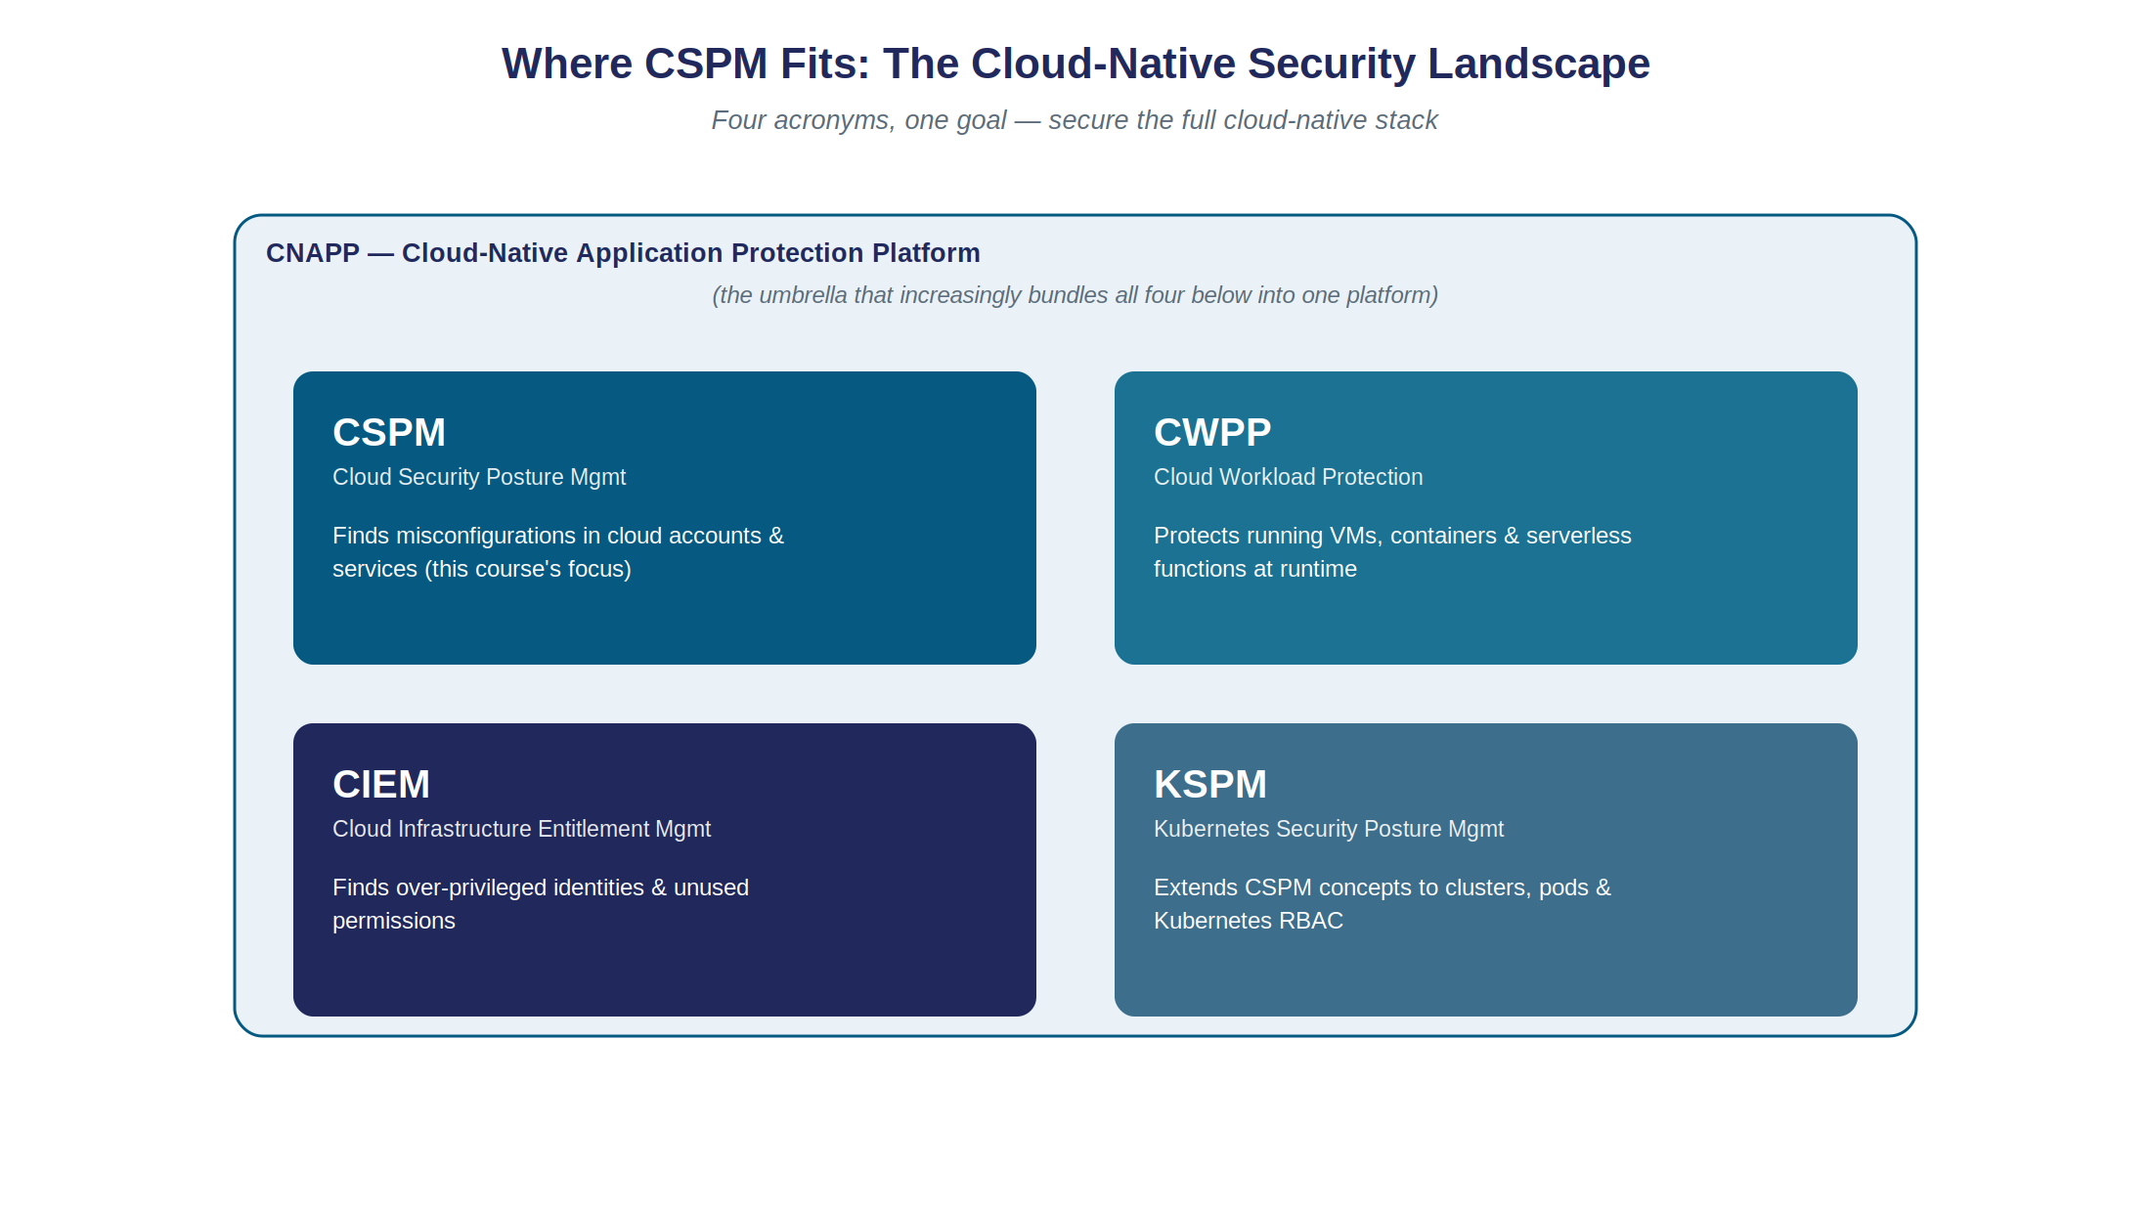
2.6
Where CSPM Fits: The Cloud-Native Security Landscape
Figure 2.3 — CSPM, CWPP, CIEM, and KSPM, increasingly bundled as CNAPP.
Module 2
Cloud Security · CSPM · SSO
Notes:
This is a HIGH-VALUE interview slide — tell the class explicitly. Give the one-line test for each: CSPM asks 'is this resource configured securely?'; CWPP asks 'is this RUNNING workload behaving securely right now?' (it runs inside the VM/container, unlike CSPM); CIEM asks 'does this identity have more access than it needs?' (directly echoes the Capital One story's over-privileged role); KSPM is CSPM's questions, applied specifically to Kubernetes clusters and RBAC — relevant as companies like Lenskart or a food-delivery unicorn move backend services into containers spread across multiple regions and providers. CNAPP is the umbrella marketing term for a single platform that bundles all four — the direction most vendors have moved in over the last few years. Tell students: 'if an interviewer asks you the difference between CSPM and CWPP, this slide is your entire answer.'

Slide 15
2.8 · CLASSROOM EXERCISE 2
Spot the Misconfiguration
A simplified real cloud storage bucket policy. In groups: what's wrong, and what's the single most urgent fix?
Bucket name: prod-customer-exports · Public access: ALLOWED (read + list)
Encryption at rest: Disabled · Access logging: Disabled · Versioning: Disabled
Attached IAM role: ‘AdministratorAccess’ (full account access)
Q1: Which setting is most urgent to fix, and why?
Q2: Which setting, if fixed, would reduce IMPACT even if the bucket had still been found?
Q3: Which setting is a least-privilege violation rather than a data-exposure issue?
Module 2 · Exercise
Cloud Security · CSPM · SSO
Notes:
Give groups 5 minutes. Answers: Q1 — public access, since it's an ACTIVE, ongoing exposure of data, especially given the bucket's name literally says 'customer-exports'. Q2 — encryption at rest, which wouldn't have prevented discovery but would reduce the impact if the data were somehow accessed. Q3 — the AdministratorAccess role, completely disproportionate to whatever this bucket needs to do; this directly rehearses the CIEM concept from the CNAPP slide. CLOSE OUT MODULE 2 AND LECTURE 1 HERE with a short recap: 'CSPM continuously discovers, assesses, prioritizes, and helps remediate misconfigurations — it's a loop, not a one-time audit; it's agentless, unlike CWPP; and CSPM/CWPP/CIEM/KSPM are increasingly bundled as CNAPP.' Then bridge to Lecture 2: 'we've now covered how organizations make sure everything BEHIND the front door is configured correctly. Lecture 2 is entirely about the front door itself — how does an application know who you are in the first place? That's Single Sign-On.'

Slide 16
02
LECTURE 2 · 2 HOURS
Single Sign-On (SSO) Authentication
Notes:
Welcome the class back. Recap Lecture 1 in a few sentences: 'the Shared Responsibility Model taught us data & identity never leave the customer's side, on any service model; misconfiguration is the #1 cause of real cloud breaches, not sophisticated hacking; and CSPM continuously discovers, assesses, prioritizes, and remediates those misconfigurations.' Then frame today in one sentence: 'today is entirely about the front door itself — how does an app know who you are, and how does it let you skip creating yet another password?' Point out explicitly that SSO sits inside Pillar 1 (IAM) from the five-pillars slide in Lecture 1 — tying the two lectures together as one coherent course rather than two disconnected topics. AGENDA: (1) Why SSO, and the core concepts — User, IdP, SP, (2) The three protocols: SAML, OAuth 2.0, OpenID Connect, with full flow diagrams, (3) Two real-world case studies — banking and Lenskart, (4) SSO security risks, MFA, and the tools landscape, (5) Two classroom exercises to close. OBJECTIVES: by the end of this lecture, students should be able to explain SSO conceptually and name its three actors, clearly distinguish authentication from authorization, trace the SAML and OAuth/OIDC flows step by step, choose the right protocol for a given scenario, and identify common SSO security risks and mitigations. Flag Part 2 (the protocols) as the technical heart of the lecture — tell students to have a notebook ready, since redrawing these flows from memory is a very common interview ask.

Slide 17
3.1 – 3.2
Password Fatigue, and What Is SSO?
A typical smartphone user: Swiggy/Zomato, Flipkart/Amazon, Lenskart, net-banking, UPI, work email…
  One of two things happens: password reuse everywhere, or constant ‘forgot password’ flows
This is PASSWORD FATIGUE — the human problem SSO exists to solve
Single Sign-On (SSO):
  Log in ONCE, with one set of credentials, and gain access to multiple independent apps — without logging in again to each one
  You already use SSO constantly: ‘Continue with Google’ · your office laptop signing you into email, chat, HR without re-prompting
Module 3
Cloud Security · CSPM · SSO
Notes:
Open with a relatable question: 'how many different apps did you log into this week?' Let a few students answer out loud — numbers like 8, 10, 12 are common. Then ask: 'realistically, how many DIFFERENT passwords do you actually use across all of them?' The honest answer, for most people, is far fewer than the number of apps — which is exactly the password-reuse problem. This personal, slightly uncomfortable moment of self-recognition is the best possible hook for why SSO matters. Then give the formal SSO definition, and immediately ground it: 'you have ALL used SSO, probably today.' List the two everyday examples on the slide and let that land before moving to the diagram.

Slide 18
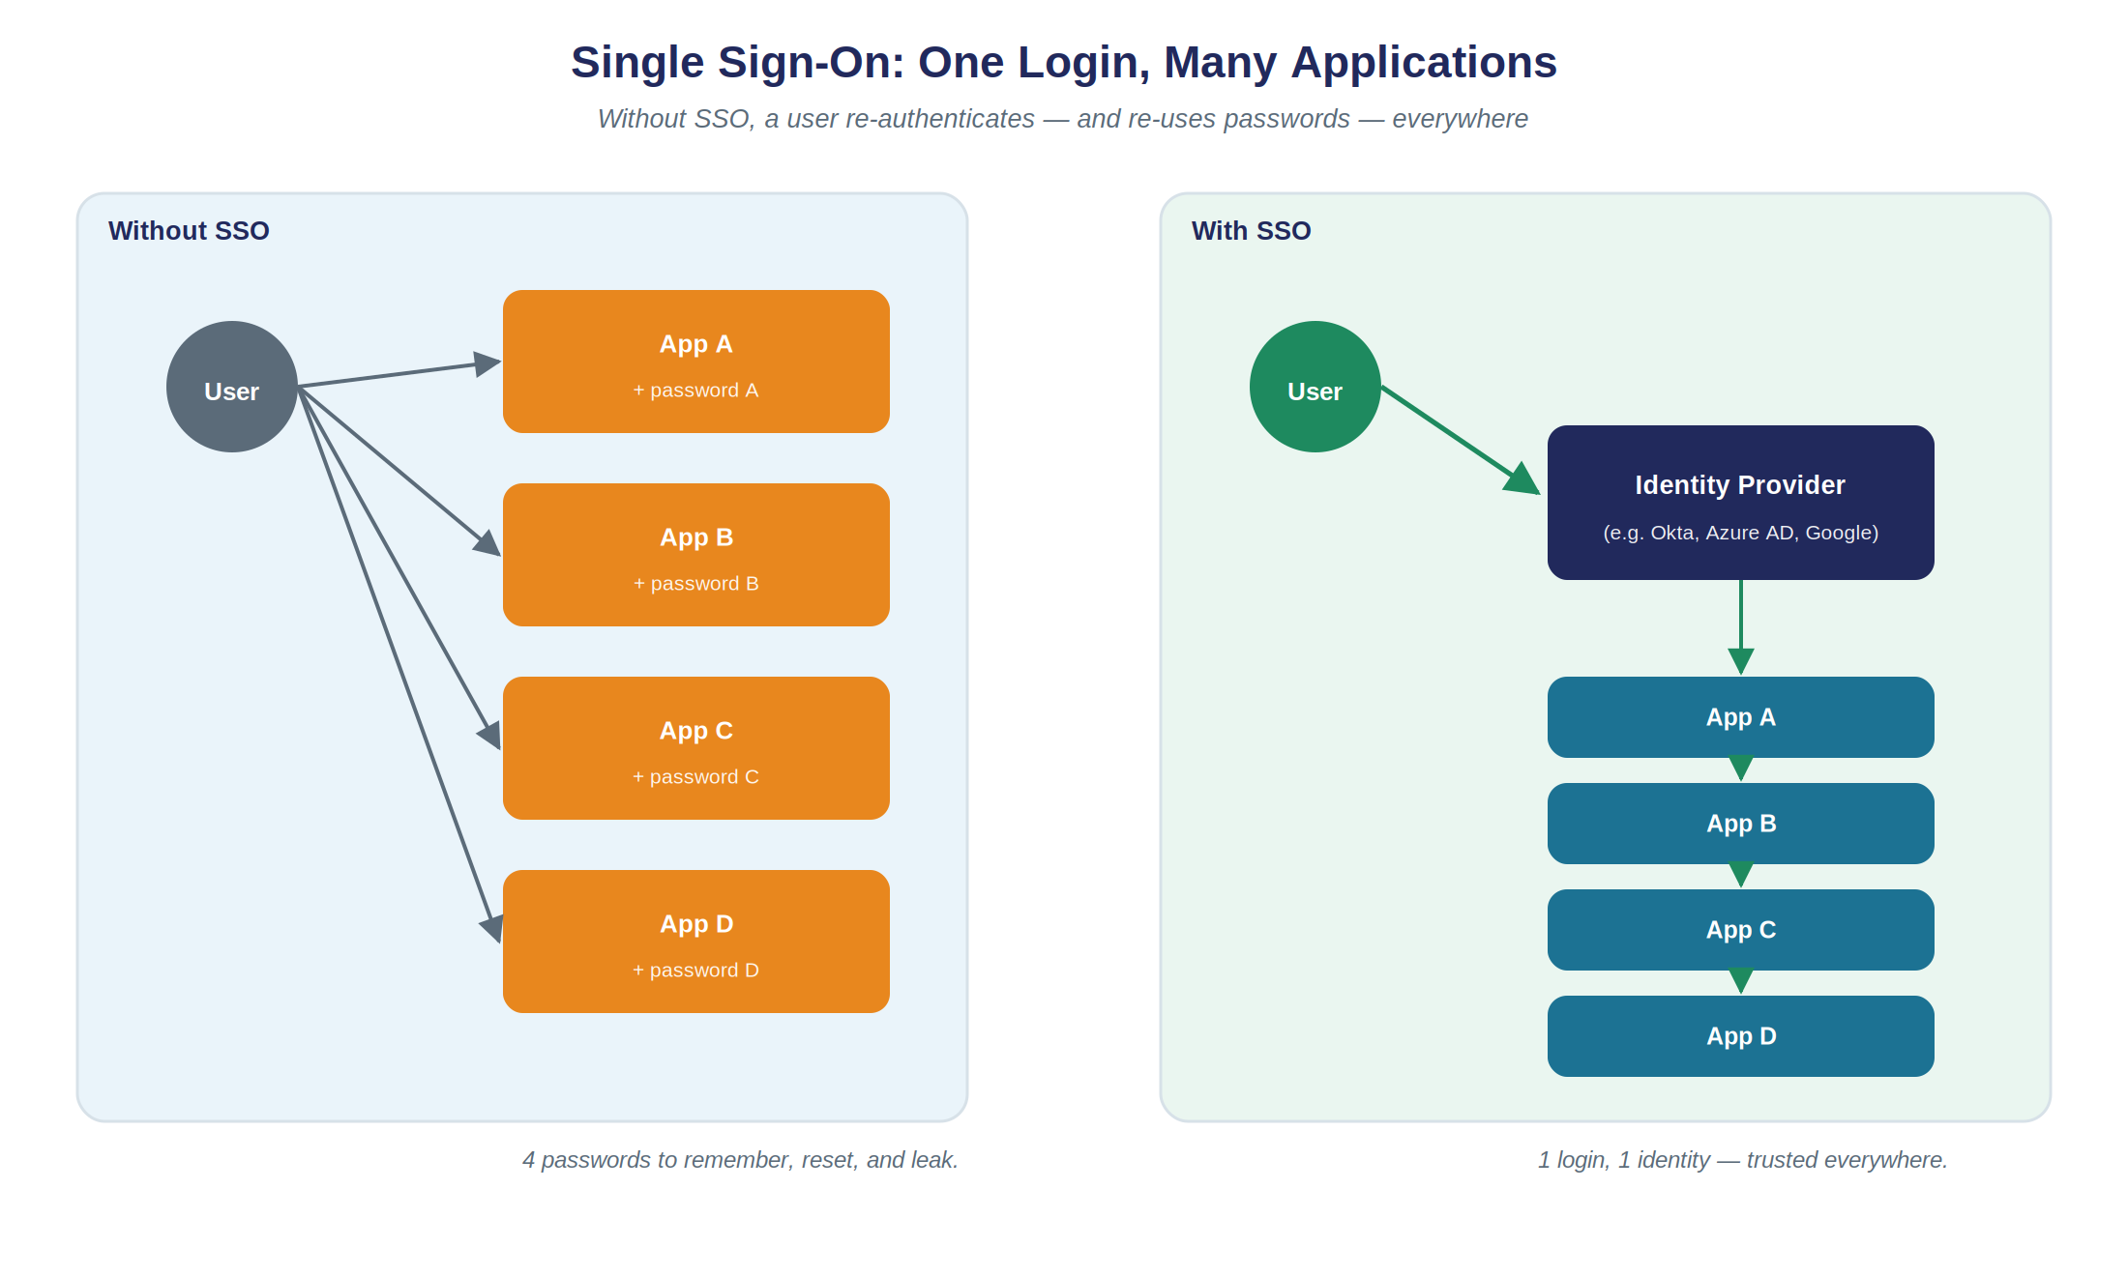
3.2
One Login, Many Applications
Module 3
Cloud Security · CSPM · SSO
Figure 3.1 — Without SSO: one password per app. With SSO: one trusted Identity Provider vouches for the user everywhere.
Notes:
Contrast the two halves of the diagram. Left: four separate passwords, four separate attack surfaces, four separate 'forgot password' flows. Right: one login to a trusted Identity Provider, which then vouches for the user to every connected app. Ask: 'if App B in the left-hand diagram gets breached and its password database leaks, what happens to Apps A, C, and D?' (Answer: nothing directly, unless the user reused passwords — which they very often do. That's the hidden danger of the 'without SSO' world.) Introduce the three core actors verbally here, ahead of the next slide: the User (the human), the Identity Provider or IdP (the trusted system that actually verifies who the user is — e.g. Google, Microsoft Entra ID, Okta, a bank's own auth server), and the Service Provider or SP / Relying Party (the app the user wants to use, which trusts the IdP's word instead of checking the password itself). State the single most important sentence in this whole section clearly: 'the Service Provider NEVER sees or handles the user's actual password — it only ever receives a signed statement from the IdP.'

Slide 19
3.3 – 3.4 · GET THIS DISTINCTION RIGHT
Authentication vs. Authorization
Term | Question It Answers | Everyday Analogy
Authentication (AuthN) | Who are you? | Showing your ID card at a building's front desk
Authorization (AuthZ) | What are you allowed to do? | The visitor badge that only opens certain floors
Module 3
Cloud Security · CSPM · SSO
Notes:
Slow down here — this is, without exaggeration, the most commonly confused pair of terms in this entire field, including among working developers. Use the ID-card / visitor-badge analogy verbatim, it tends to stick. Then deliver a deliberate twist as its own beat: 'you'd think OAuth, being an SSO-adjacent protocol, is about authentication… it is NOT. OAuth 2.0 is fundamentally an AUTHORIZATION protocol, even though it is extremely commonly used as the foundation for consumer login. Using raw OAuth 2.0 alone to log a user in, without OpenID Connect on top, is a well-known anti-pattern that has caused real security vulnerabilities in production apps.' Tell students we'll see exactly how developers patched this gap — that's OpenID Connect, coming up in a few slides — framing it as the resolution to a cliffhanger rather than just more content.

Slide 20
3.5 · ENTERPRISE SSO
SAML 2.0
Security Assertion Markup Language — XML-based, published 2005
  Still dominant for ENTERPRISE SSO — one corporate credential unlocks email, HR, a dozen internal tools
Core artifact: the ASSERTION
  A signed XML document stating who the user is, and what attributes are true about them (role, department, email)
Module 3
Cloud Security · CSPM · SSO
Notes:
Set SAML up as 'the old, enterprise-grade workhorse.' It's from 2005 — older than most students in the room — but still extremely widely deployed in large enterprises, banks, and government. The word to anchor is ASSERTION: that's the noun SAML people use constantly, equivalent to what we'll later call a 'token' in the OAuth/OIDC world. Tell the class we're about to trace the full flow, step by step, on the next slide — this is the first of two full whiteboard-style walkthroughs today.

Slide 21
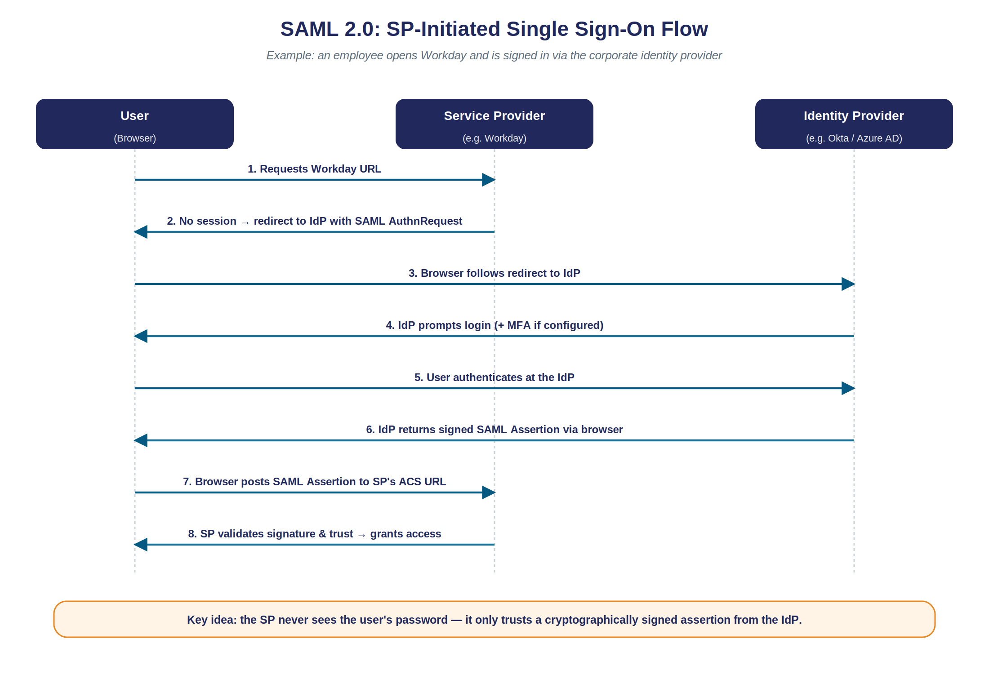
3.5
SAML 2.0: SP-Initiated SSO Flow
Module 3
Cloud Security · CSPM · SSO
Figure 3.2 — An employee opens Workday and is signed in via the corporate Identity Provider.
Notes:
Budget 6-7 minutes here. Narrate each numbered arrow as a sentence: '1: the employee's browser asks for the Workday URL. 2: Workday sees there's no session, so it bounces the browser to the corporate IdP with a SAML request. 3: the browser follows that redirect. 4: the IdP prompts for login, plus MFA if configured. 5: the employee actually authenticates AT THE IdP, not at Workday. 6: the IdP sends back a signed assertion, via the browser. 7: the browser POSTs that assertion to Workday's ACS URL. 8: Workday validates the signature and trust relationship, and grants access.' Land the closing amber box hard: 'Workday, the Service Provider, NEVER saw the employee's password. It only trusted a cryptographically signed piece of paper handed to it by the IdP.' Then give the real-world enterprise example: a bank configures its corporate IdP (Okta, Entra ID) as the single source of truth for employee identity; opening Salesforce or Workday redirects the employee to the bank's OWN login page, enforcing the bank's own password policy and mandatory MFA; only after succeeding there does the employee land back inside Salesforce, already signed in. Emphasize the offboarding win: ask 'without SSO, if an employee with access to 15 internal tools resigns, how many accounts does IT need to disable?' (Fifteen.) 'With SSO?' (One — just the IdP account.) This offboarding argument is frequently the actual business case companies use to adopt enterprise SSO in the first place.

Slide 22
3.6 · DELEGATED AUTHORIZATION
OAuth 2.0
Solves a DIFFERENT problem than SAML:
  How can a user grant one app LIMITED access to their data on another service — without handing over their password?
Classic motivating example:
  Letting a photo-printing website access only your Google Photos, without ever giving it your Google password (which could also read your Gmail)
Module 3
Cloud Security · CSPM · SSO
Notes:
Use the photo-printing example verbatim — it's the canonical, textbook motivating example for OAuth and makes the 'delegated, LIMITED access' idea concrete immediately. Contrast explicitly with SAML: 'SAML answers who are you; OAuth answers what limited slice of MY data can you touch on my behalf.' Tell the class this is whiteboard walkthrough number two, and arguably the single most exam/interview-relevant diagram in the whole course.

Slide 23
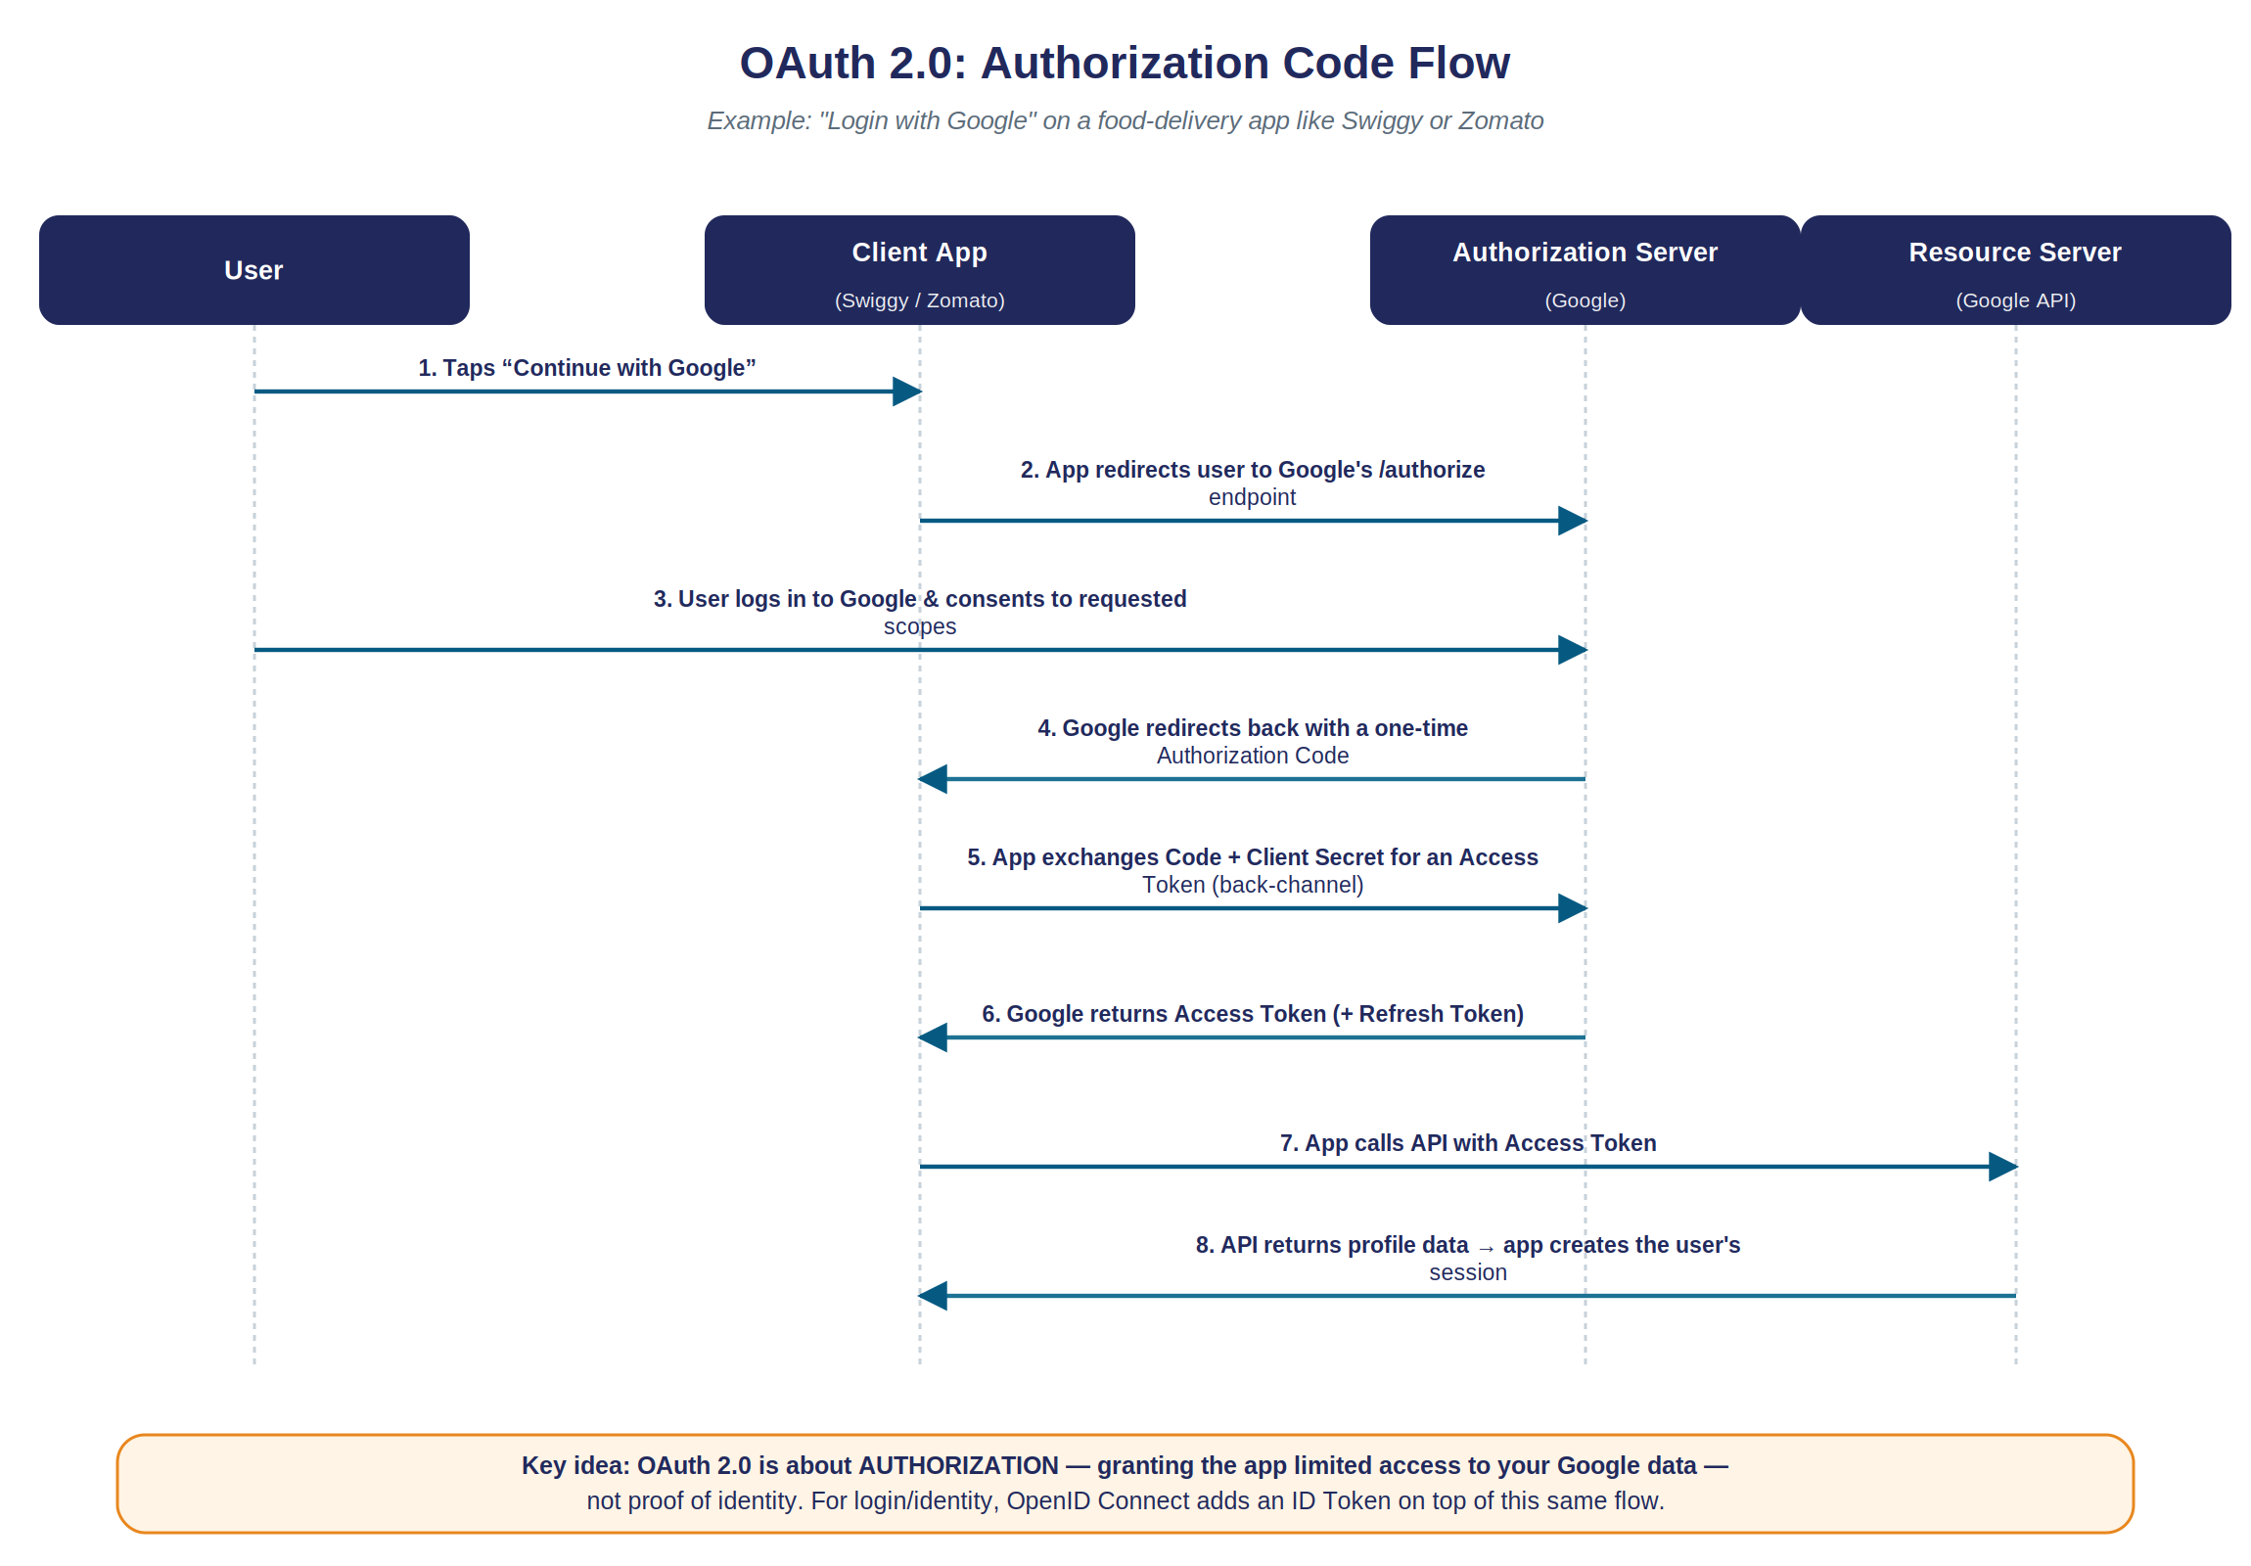
3.6
OAuth 2.0: Authorization Code Flow
Module 3
Cloud Security · CSPM · SSO
Figure 3.3 — ‘Login with Google’ on a food-delivery app like Swiggy or Zomato.
Notes:
Budget 7-8 minutes — this is the deck's centerpiece. Narrate: '1: user taps Continue with Google inside the client app. 2: the app redirects to Google's /authorize endpoint. 3: the user logs into Google and approves the requested scopes — this consent step is critical, the user sees exactly what they're granting. 4: Google redirects back with a short-lived, SINGLE-USE authorization code — emphasize single-use, it can't be replayed. 5: HERE is the step to slow down on — the app exchanges that code for an access token over a BACK-CHANNEL, server-to-server request that also includes the app's own client secret. This never touches the user's browser, which is what keeps the secret confidential and prevents the code from being intercepted and reused. 6: Google returns the access token, often with a longer-lived refresh token. 7: the app calls Google's API using the access token. 8: Google returns the data, and the app creates the user's session.' Emphasize the amber box: OAuth is about AUTHORIZATION, not proof of identity — setting up the very next topic. Mention PKCE briefly: mobile and single-page apps can't safely store a secret, so PKCE achieves the same protection — proving only the real app can complete the exchange — without needing one, by generating a one-time local secret and proving possession of it later in the flow.

Slide 24
3.7 · RESOLVING THE CLIFFHANGER
OpenID Connect: OAuth 2.0 + Identity
If OAuth is about authorization, how does ‘Login with Google’ work as a LOGIN?
OpenID Connect (OIDC) = a thin identity layer built directly on top of OAuth 2.0
  Adds one crucial artifact: a signed ID TOKEN (a JSON Web Token, JWT)
A JWT has three parts: HEADER (algorithm) . PAYLOAD (claims: user ID, email, expiry) . SIGNATURE
  The signature can be verified using only the IdP's public key — no extra network call needed
Module 3
Cloud Security · CSPM · SSO
Notes:
This slide resolves the cliffhanger from the AuthN vs AuthZ slide. Say: 'remember the twist — OAuth alone can't tell an app who you are. OpenID Connect is the fix: it's OAuth 2.0, plus exactly one new thing — a signed ID Token.' This framing makes OIDC feel like an elegant, minimal addition rather than a whole new competing protocol — which is accurate: OIDC deliberately reuses the entire OAuth flow just covered. Walk through the three JWT parts: header (signing algorithm), payload/claims (the actual identity facts — subject ID, email, issuer, expiry), and signature. Explain the punchline: 'because the signature can be verified using only the IdP's public key, the app never needs to call Google back to check if the token is real — it can verify it completely locally.' This is WHY JWT-based OIDC scales so well for huge consumer platforms: no extra network round-trip needed just to validate a token on every single request. If you have the earlier diagram handy or drew it on a board, this is a good moment to point back at where in the OAuth flow this ID Token actually rides along (returned together with the access token in step 6).

Slide 25
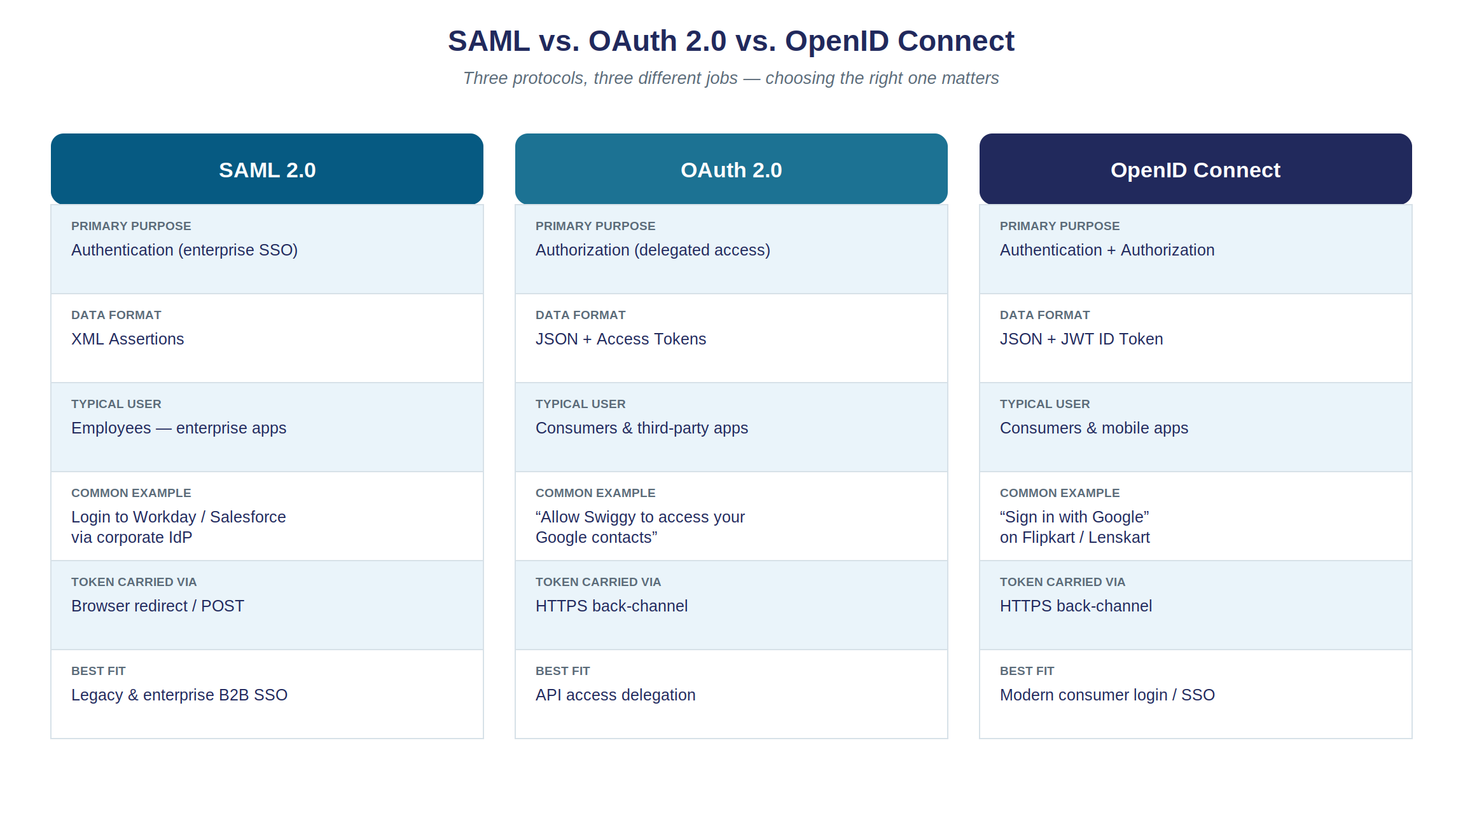
3.8
SAML vs. OAuth vs. OpenID Connect — Choosing the Right Protocol
Module 3
Cloud Security · CSPM · SSO
Rule of thumb: enterprise workforce SSO → SAML/OIDC · delegated API access → OAuth 2.0 · ‘Sign in with…’ → OpenID Connect.
Notes:
Use this as a structured recap of everything since the SAML slide — go row by row across all three columns rather than column by column, since that reinforces the compare/contrast better: 'primary purpose' row across all three, then 'data format' row, and so on. This repetition is deliberate and helps it stick. Then deliver the rule-of-thumb caption as the practical payoff of the entire protocol section — tell students this exact three-line decision tree is worth memorizing verbatim; it answers a very common systems-design interview question ('which auth protocol would you use for X?').

Slide 26
3.9 – 3.10 · CASE STUDIES
SSO in Banking, and at Lenskart
Two real-world flavors of the same underlying idea:
Banking: net-banking + mobile + UPI for customers, plus a fully separate internal SAML-style SSO layer for staff
RBI guidelines mandate strong MFA; session tokens are short-lived; identity is anchored to mobile number + device trust
UPI PIN / biometrics act as STEP-UP authentication on top of the initial login for sensitive transactions
Lenskart: ‘Continue with Google’ (full OIDC) AND phone + OTP, where the platform's own backend acts as the IdP
Both are conceptually SSO — trusting an already-established identity signal instead of a new password
Module 3
Cloud Security · CSPM · SSO
Notes:
Cover both case studies in one pass, roughly 3-4 minutes each. For banking: introduce the term STEP-UP AUTHENTICATION explicitly — it's important and exam-relevant. Ask: 'why would a bank want extra verification right before a money transfer, instead of just trusting the original SSO login for everything?' Guide them to: session tokens can be stolen; requiring a fresh, hard-to-fake proof right before a high-value action limits the damage even if a session was somehow compromised. For Lenskart: make the conceptual leap explicit — 'even though an OTP text message feels totally different from a Google login button, it is philosophically the same idea as SSO: you're trusting a separate, already-established identity signal (control of a phone number) instead of asking the user to create yet another password.' Mention briefly, if time allows, that OTP flows need their own careful engineering — rate-limiting requests to prevent SMS-bombing abuse, short expiry windows, and binding verification to the requesting device.

Slide 27
3.11 – 3.13
SSO Risks, MFA, and the Tools Landscape
Top SSO Risks | Mitigation / Related Concept
Token theft / replay — stolen session token reused to impersonate a user | Short token lifetimes, device binding, secure storage
Phishing via consent screens — a malicious app requests excessive OAuth scopes | IdP app vetting, minimal scope requests, user review
Open redirect / session fixation | Allow-listed redirect URIs; always issue a new session ID at login
Centralizing identity makes the IdP the single highest-value target | → MFA AT THE IdP protects every connected app at once
Enterprise IdPs in use today | Okta, Microsoft Entra ID, Ping/OneLogin, AWS IAM Identity Center, Google Workspace
Module 3
Cloud Security · CSPM · SSO
Notes:
Don't read every cell verbatim — pick two rows to genuinely dwell on. First, token theft/replay: connect it back explicitly to the account-hijacking threat from Lecture 1's threat-landscape slide, closing that loop. Second, phishing via consent screens: make it vivid — 'imagine a fake app registers with Google and asks you to Continue with Google — the consent screen LOOKS legitimate because it genuinely IS Google's own screen, but the permissions being requested are excessive.' Then pivot to the concentration-of-risk row and emphasize it strongly: 'SSO is a double-edged sword. It removes lots of small attack surfaces (many app-specific passwords), but it creates one BIG attack surface — the IdP itself. This is exactly why enforcing MFA at that one IdP is one of the single highest-leverage security decisions an organization can make: you protect everything downstream, all at once, with one control.' Mention adaptive/risk-based authentication briefly: many modern IdPs only prompt for a second factor when a login looks unusual (new device, new country, impossible travel time). Move quickly through the tools row — it's reference material — noting Google's dual role as both an enterprise IdP (Workspace) and the consumer OIDC provider we've used as our running example all lecture.

Slide 28
3.14 – 3.15 · CLASSROOM EXERCISES 3 & 4
Map the OAuth Flow, and a Rapid-Fire Quiz
Exercise 3 (pairs, 4 min): fill in the blanks using Figure 3.3 as reference.
1. The user taps ‘Continue with Google’ inside the ______ (name the role, not the company)
2. Google redirects back with a short-lived, single-use ______
3. The app exchanges that value for a token using a ______-channel request
4. Which artifact, added by OpenID Connect, tells the app WHO the user is?
Exercise 4 (whole class, verbal): True or False — ‘OAuth 2.0 alone is safe for logging a user into an app’? ‘A JWT's signature can be verified without calling the IdP back’? ‘MFA and SSO are redundant together’?
Module 3 · Exercises
Cloud Security · CSPM · SSO
Notes:
Exercise 3 answers: (1) Client App / Service Provider, (2) Authorization Code, (3) back(-channel), (4) the OpenID Connect ID Token (JWT). If groups struggle with question 4, redirect them to the AuthN/AuthZ 'twist' framing from earlier — OAuth alone never answers this; OIDC's ID Token is specifically the fix. Exercise 4 is a fast-paced, verbal, whole-class quiz: read each statement, have the class shout 'True' or 'False' together. Answers: OAuth alone for login — FALSE (use OIDC); JWT signature verified without calling IdP back — TRUE; MFA and SSO redundant — FALSE, they're complementary. If a statement gets a mixed response from the room, pause for 30 seconds to re-explain rather than plowing ahead — mixed answers usually mean a real, worthwhile misconception to correct. This is a good energy booster near the end of a long lecture.

Slide 29
COURSE WRAP-UP
How It All Fits Together — and Thank You
Recall the Module 1 case-study architecture (Swiggy/Zomato/Flipkart-style app):
  The Login/SSO layer decides WHO gets in — all of Lecture 2
  CSPM continuously verifies everything BEHIND that front door stays configured correctly — Lecture 1
  Both operate against the Shared Responsibility Model, which defines whose job each control even is
Before you go — be ready to: draw the Shared Responsibility Model from memory · explain CSPM vs CWPP vs CIEM in one sentence each · whiteboard the OAuth flow · explain why OAuth alone isn't authentication
Questions & discussion — thank you!
Course Wrap-Up
Cloud Security · CSPM · SSO
Notes:
Bring back the Module 1 case-study diagram mentally (or re-show it if you have time) and literally point at where each of today's three topics lives on it. This is the single best way to leave students with one coherent mental model, rather than three separate topics that feel unrelated. Say explicitly: 'if an interviewer asks you to design the security of a system like this, these two questions — who's getting in, and is everything behind them still locked down — are the two-sentence summary of your entire answer.' Then walk through the exam/interview checklist bullet — present it as literally the study guide for anyone revising later: draw the shared responsibility model with 5+ example controls placed correctly, explain CSPM vs CWPP vs CIEM in one sentence each, whiteboard the OAuth 2.0 Authorization Code flow labeling the back-channel step, explain precisely why OAuth 2.0 alone is not an authentication protocol, and have the Capital One breach ready as a go-to real-world example. Open the floor for questions. Good closing prompts if time remains: 'which of the two case studies today — banking or Lenskart — surprised you more, and why?' or 'can anyone think of an app they use where they're not sure whether it uses SAML, OAuth, or OIDC under the hood — what would you look for to find out?' (Hint: a 'Sign in with...' button is almost certainly OIDC.) Thank the class and remind them the course material PDF covers everything in more depth, including the glossary and answer keys for all four exercises.

