Slide 1


EMPLOYEE MANAGEMENT SYSTEM

Slide 2

About Me
Name : Marthala Dinesh Narasimha Reddy
Background : CSE
LinkedIn : LinkedIn

Slide 3
INTRODCUTION
The Employee Management System (EMS) is designed to streamline the management of employee data, job roles, and departmental information within an organization. This system allows for efficient tracking of employee details, job assignments, qualifications, and performance metrics.
Key domain knowledge elements for this system include :
Employee Information Management
Job Role Assignment
Departmental Structure
Payroll and Compensation
Qualifications and Skills Tracking
Leave and Absence Management
This system ensures that all employee-related information is stored securely, easily accessible for reporting, and aligned with organizational goals for performance, compensation, and growth.

Slide 4
OBJECTIVE
The objective of the Employee Management System using SQL is to design and implement a relational database that efficiently stores, manages, and retrieves employee-related information.
The system uses SQL tables and queries to maintain employee details, job roles, departments, payroll information, qualifications, and leave records.
It ensures data integrity through primary and foreign keys, enables quick data access using SQL queries, and supports effective decision-making by generating reports related to employee performance, salaries, and departmental activities.
This system helps organizations manage employee data in a structured, secure, and efficient manner.

Slide 5
PROBLEM STATEMENT
The objective of this project is to design and implement an Employee Management System that efficiently stores and manages employee-related data within an organization. The system needs to track various aspects of employee information, including personal details, job roles, salary structures, qualifications, leave records, and payroll data.
The system should ensure the integrity and consistency of data by using relational tables with appropriate foreign keys and cascading actions. The system should allow for easy management and querying of employee data, providing insights such as payroll calculation, leave tracking, and department-specific job roles. The goal is to streamline HR operations, ensuring that all relevant employee data is accessible and accurately updated across different modules.

Slide 6
TABLES
TABLES_IN_EMS
1. JOBDEPARTMENT
2. SALARYBONUS
3. EMPLOYEE
4. QUALIFICATION
5. LEAVES
6. PAYROLL

Slide 7
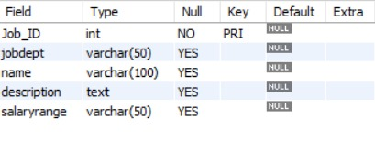
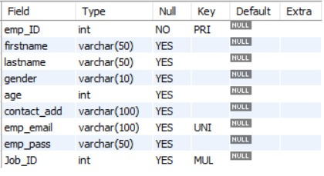
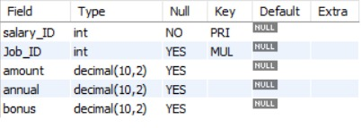
TABLES STRUCTURES
JOBDEPARTMENT
EMPLOYEE
SALARYBONUS

Slide 8
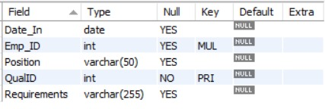
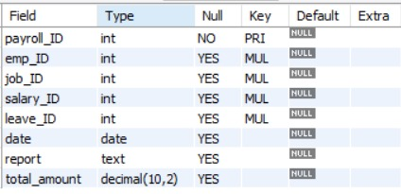
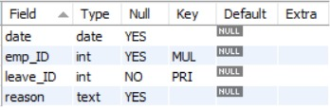
TABLES STRUCTURES
QUALIFICATION
LEAVES
PAYROLL

Slide 9
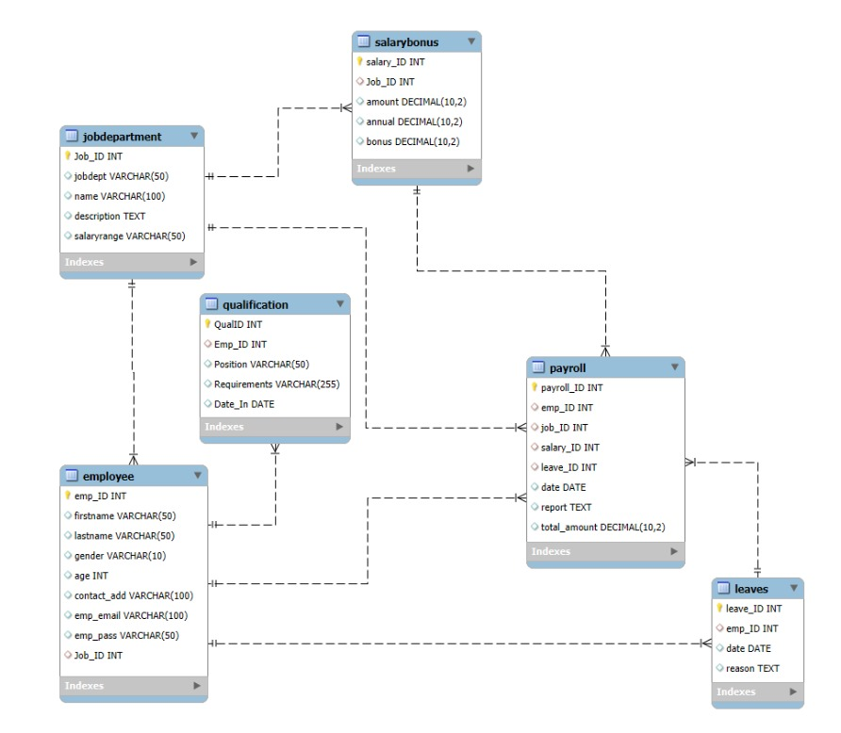
ER DIAGRAM

Slide 10
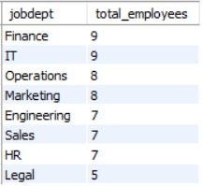
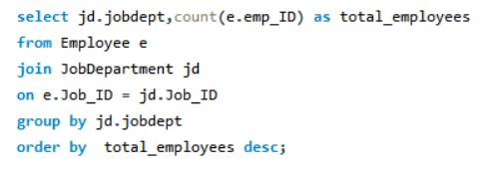
EMPLOYEE ANALYSIS
A. Which departments have the highest number of employees?
OUTPUT:
QUERY:
KEY INSIGHTS:
Finance and IT departments have the highest workforce, with 9 employees each, indicating greater staffing requirements.
The Legal department has the fewest employees (5), suggesting it operates with a smaller team compared to other departments.

Slide 11
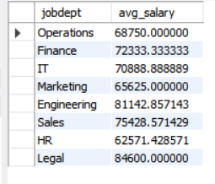
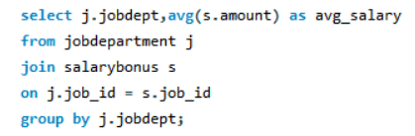
EMPLOYEE ANALYSIS
B . What is the average salary per department?
OUTPUT:
QUERY:
KEY INSIGHTS:
The Legal department offers the highest average salary (84, 600), indicating higher compensation compared to other departments.
The HR department has the lowest average salary (approximately *62, 571), while most other departments have average salaries between 65, 000 and -81, 000.

Slide 12
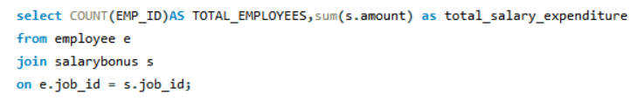

EMPLOYEE ANALYSIS
C .What is the total salary expenditure across the company?
QUERY:
OUTPUT:
KEY INSIGHTS:
The company has a total of 60 employees with an overall salary expenditure of -43, 21, 000.
The total salary expenditure provides a clear view of the company's payroll budget, helping in financial planning and resource allocation.

Slide 13
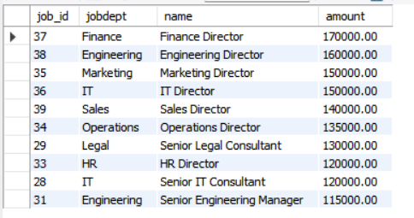
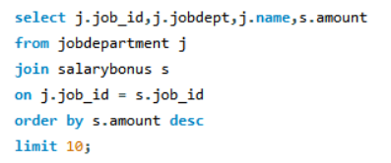
JOB ROLE AND DEPARTMENT ANALYSIS
Which job roles offer the highest salary?
OUTPUT:
QUERY:
KEY INSIGHTS:
Finance Director is the highest-paid job role with a salary of 1,70, 000, followed by Engineering Director (1,60, 000) and Marketing Director (1,50, 000).
Director-level positions dominate the top salary rankings, highlighting that leadership roles receive the highest compensation across departments.

Slide 14
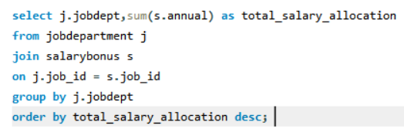
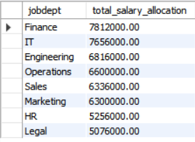
JOB ROLE AND DEPARTMENT ANALYSIS
Which departments have the highest total salary allocation?
QUERY:
OUTPUT:
KEY INSIGHTS:
The Finance department has the highest total salary allocation (78,12, 000), indicating the largest payroll investment among all departments.
The Legal department has the lowest total salary allocation (50,76,000), reflecting a comparatively smaller salary budget.

Slide 15
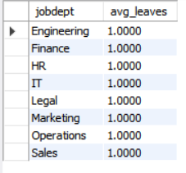
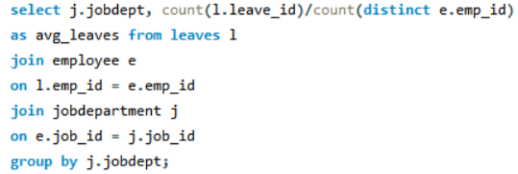
LEAVE AND ABSENCE ANALYSIS
What is the average number of leave days taken by its employees per department?
QUERY:
OUTPUT:
KEY INSIGHTS:
All departments have the same average leave count of 1 day per employee, indicating a uniform leave pattern across the organization.
There is no significant variation in leave usage between departments, suggesting consistent leave management practices.

Slide 16
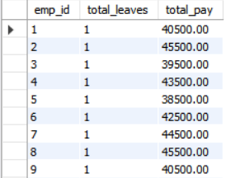
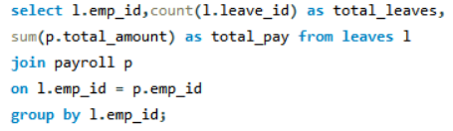
LEAVE AND ABSENCE ANALYSIS
How do leave days correlate with payroll amounts?
OUTPUT:
QUERY:
KEY INSIGHTS:
All employees have taken one leave day, but their payroll amounts differ based on their respective salary structures.·
Since the leave count is the same for all employees, there is no noticeable correlation between leave days and payroll amounts in this dataset.

Slide 17


PAYROLL AND COMPENSATION ANALYSIS
What is the total monthly payroll processed?
QUERY:
OUTPUT:
KEY INSIGHTS:
The company processes a total monthly payroll of "277, 800, representing the combined salary payments to all employees.
The total monthly payroll provides a clear overview of the organization's monthly salary expenditure, supporting payroll planning and budgeting.

Slide 18
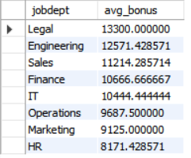
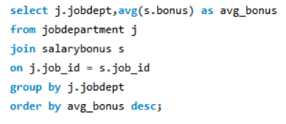
PAYROLL AND COMPENSATION ANALYSIS
What is the average bonus given per department?
QUERY:
OUTPUT:
KEY INSIGHTS:
The Legal department receives the highest average bonus (713, 300), indicating the highest bonus allocation among all departments.
The HR department has the lowest average bonus (18, 171.43), while the average bonuses of other departments range between 49, 125 and -12, 571.

Slide 19
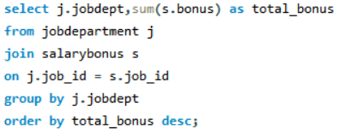
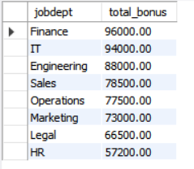
PAYROLL AND COMPENSATION ANALYSIS
Which department receives the highest total bonuses?
QUERY:
OUTPUT:
KEY INSIGHTS:
The Finance department receives the highest total bonus (F96, 000), indicating the largest overall bonus allocation among all departments.
The HR department has the lowest total bonus (57, 200), while the bonuses of other departments range from 66, 500 to र94, 000.

Slide 20
CHALLENGES FACED
Designed proper relationships between tables using Primary Keys and Foreign Keys.
Maintained data integrity using constraints like ON DELETE CASCADE, ON UPDATE CASCADE, and SET NULL.
Wrote complex SQL JOIN queries to retrieve data from multiple related tables.
Handled date fields in the YYYY-MM-DD format for accurate analysis.
Prevented duplicate records by applying UNIQUE constraints, especially for employee email addresses.

Slide 21
CONCLUSION
The Employee Management System analysis provides a comprehensive view of workforce structure, salary distribution, qualifications, and payroll management within the organization.
The analysis highlights department-wise employee distribution, salary allocation, leave patterns, and bonus structures, helping identify key workforce and financial trends.
Insights from the data support better decision-making in HR management, payroll planning, and employee performance evaluation.
Overall, this analysis demonstrates how SQL can be effectively used to manage and analyze employee data to support organizational efficiency and strategic planning.

Slide 22



