Slide 1

The Global Trade Shift: Impact of the Russia–Ukraine War
Howthe February 2022invasion reconfigured energy flows, commodity
markets, logistics networks, and the politics of trade — and what businesses and nations must do to adapt.

Slide 2
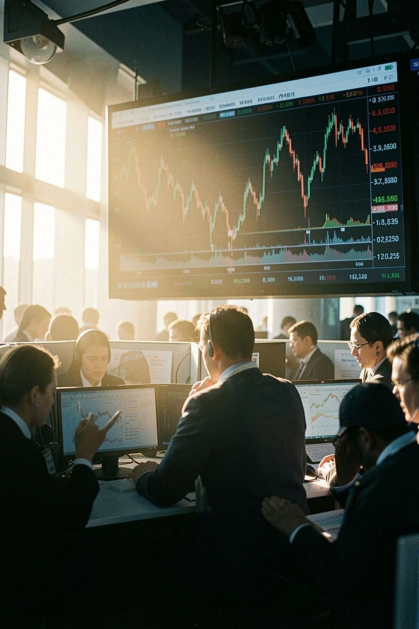
February 2022: The Sudden Shock
Immediate market volatility
Global economic instability surfaced within days as risk premia and FX volatility surged.
Energy price shock
Brent crude rose >25% in two weeks — a direct hit to energy- importing economies.
Gas price crisis
European gas spot prices spiked ~580% year-on-year, disrupting industry and household budgets.

Slide 3
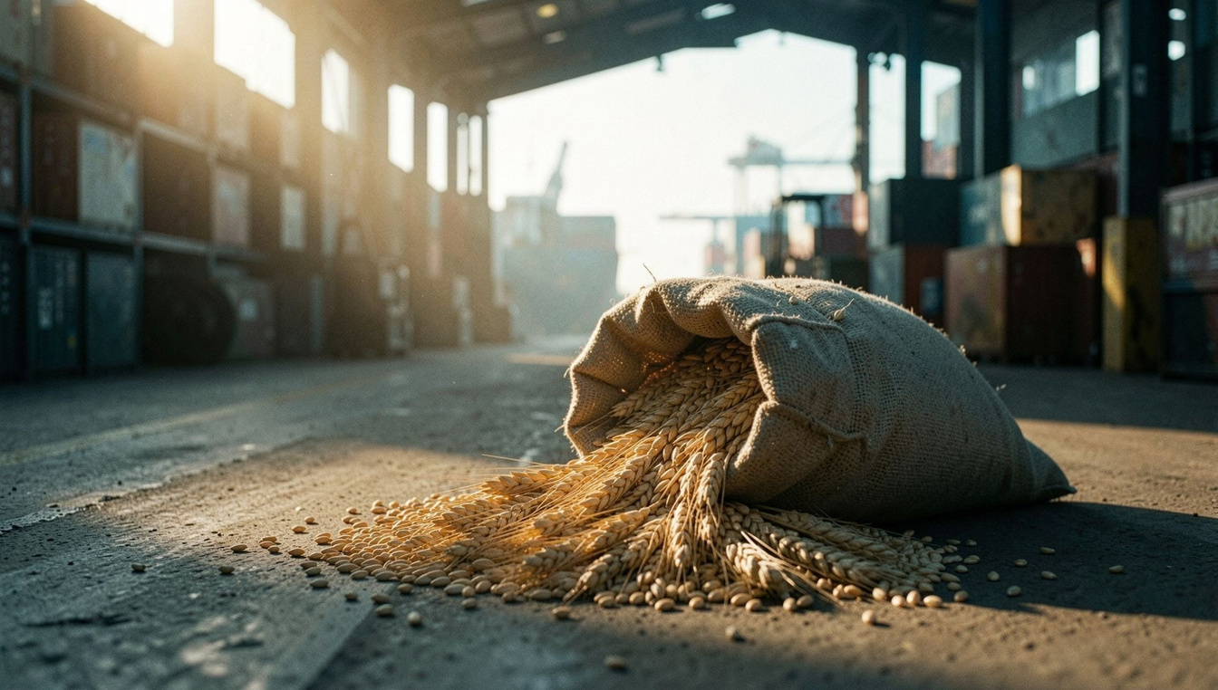
The Commodity Crisis: Food and Energy
Scale of disruption
Russia andUkraine accountedfor roughly
36% of global wheat exports and over 50% of sunflower oil — a shock that cascaded through food supply chains and prices.
Global food insecurity rose: 258M people in acute need (2022) vs 193M (2021).
Fertilizer and energy costs pushed input prices higher for farmers worldwide.

Slide 4
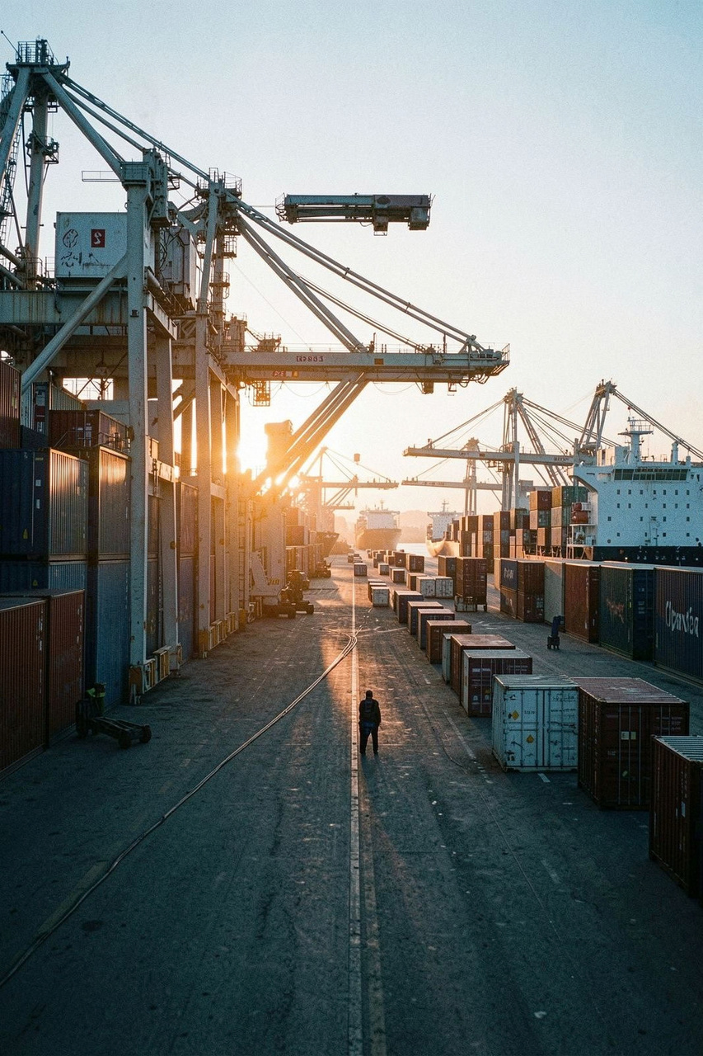
Supply Chain Paralysis
RoutesthroughRussia/Belaruscollapsed;air andsealogisticsstrained —
container shortages, port delays, and soaring air-cargo rates amplified shortages and lead-time uncertainty.
Air freight shock
Technology inputs
Air cargo costs jumped as reroutes and airspace closures limited capacity.
Shortages of neon and palladium disrupted semiconductor production and automotive supply chains.

Slide 5
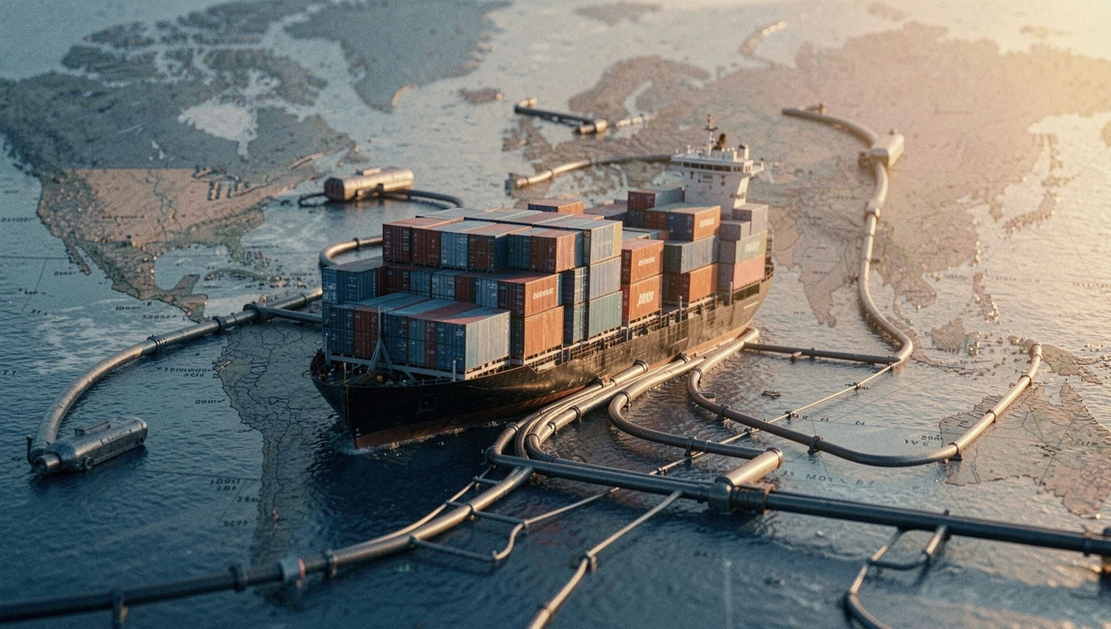
The Sanctions Era: 2022–2023
Widespread sanctions targeted Russian banks, shipping, and key export sectors, reshaping trade corridors and prompting rapid policy responses from affected firms and governments.
Russian GDP contraction was notable but milder than some early forecasts.
Q1 2023 federal budget deficits reached ~2,400 billion roubles amid fiscal re-prioritization.

Slide 6

Sectoral Fallout: Autos to Agriculture
Automotive
Chip and component shortages forced production cuts and order delays across global OEMs.
Agriculture
Fertilizer price spikes threatened yields and raised food import bills for vulnerable countries.
Emerging importers
Countries like India experienced higher import bills for oil and key commodities, pressuring trade balances.

Slide 7
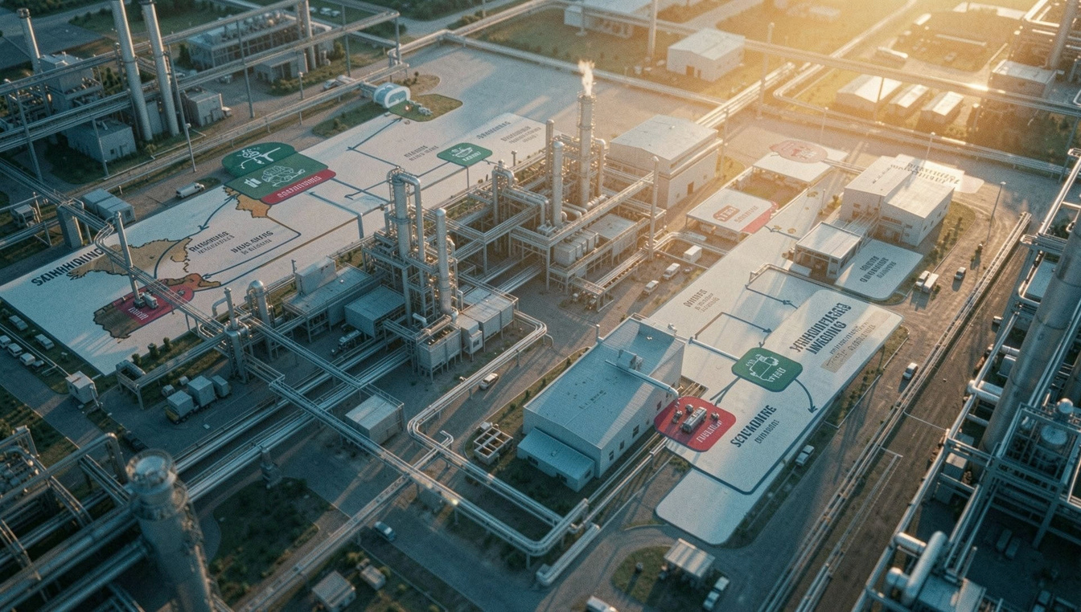
The Death of Just‐in‐Time
Firms moved from single-source, lean models to redundancy-first strategies:
Nearshoring and regional diversification to reduce geopolitical exposure.
Investment in real-time visibility, inventory buffers, and multi-sourcing.
Resilience now trades off against efficiency — a deliberate strategic pivot.

Slide 8

The New Geopolitical Reality
Tradepolicy risk roseaseconomiespolarised.Analystsestimatean
opportunity cost of geopolitical rivalry at ~8.7% of global real income, with vulnerable states facing up to 11.3% losses.
Decoupling risks
Fragmentation of supply chains into rival blocs increases duplication and cost.
Strategic trade policy
Export controls and subsidies reshape comparative advantage and investment flows.

Slide 9
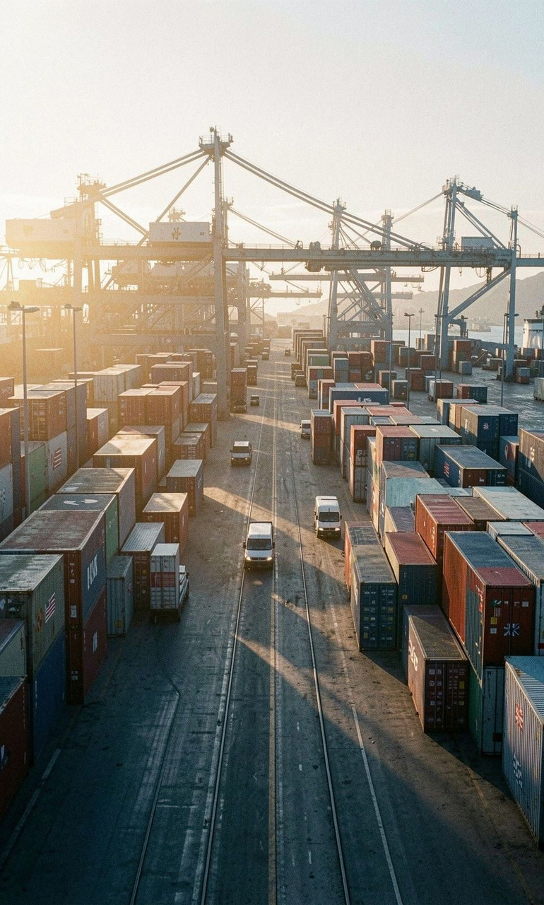
The Current Landscape: Resilience and Adaptation
Despite the shocks, global trade has
shown resilience. Governments and
firms rerouted suppliers, diversified
markets, and adopted policies to
stabilise supply.
Industrial resilience
Capacity reallocation and inventory policies reduced disruption risk.
Import sourcing shifted toward unaffected regions and alternative suppliers.
Longer-term investments target redundancy, security, and strategic stockpiles.
Diplomatic pivots
Trade agreements and pragmatic diplomacy stabilized crucial supply corridors.

Slide 10

Conclusion: A Transformed Global Order
Hyper-globalisation has givenwayto security-first trade.The newmetricfor
success is resilience — built through redundancy, geographic diversification, and transparent supply chains.
Action: Diversify suppliers
Establish multiple regional sources for critical inputs.
Action: Strategic stockpiles
Maintain targeted buffers for energy and food-critical items.
Action: Invest in visibility
Real-time monitoring and scenario planning to navigate future shocks.

