Slide 1
5G-Driven SMART TRAFFIC LIGHT SYSTEM
TEAM 18
Dinesh Prabhu S - 21C026
Hari Haran K - 21C124
Mohammed Thanseem Khan R - 21C131
Vignesh M - 21C144
1

Slide 2
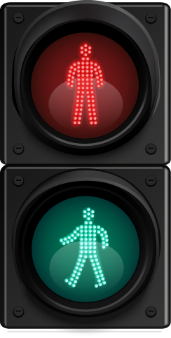
PROBLEM STATEMENT
TRAFFIC LIGHT
Urban traffic congestion is a growing problem, leading to increased travel times, fuel consumption, and pollution. Current Traffic Light systems lack the ability to communicate efficiently with vehicles and other traffic infrastructure, limiting their potential for dynamic response. The challenge is to design a smart traffic light system that utilizes advanced sensors, real-time data analysis, and 5G technology to enhance traffic flow, reduce congestion, and improve safety at intersections. The system should dynamically adjust signal timings based on real-time traffic patterns and vehicle communication, providing a more efficient, responsive, and future-proof solution for urban traffic management.
2

Slide 3
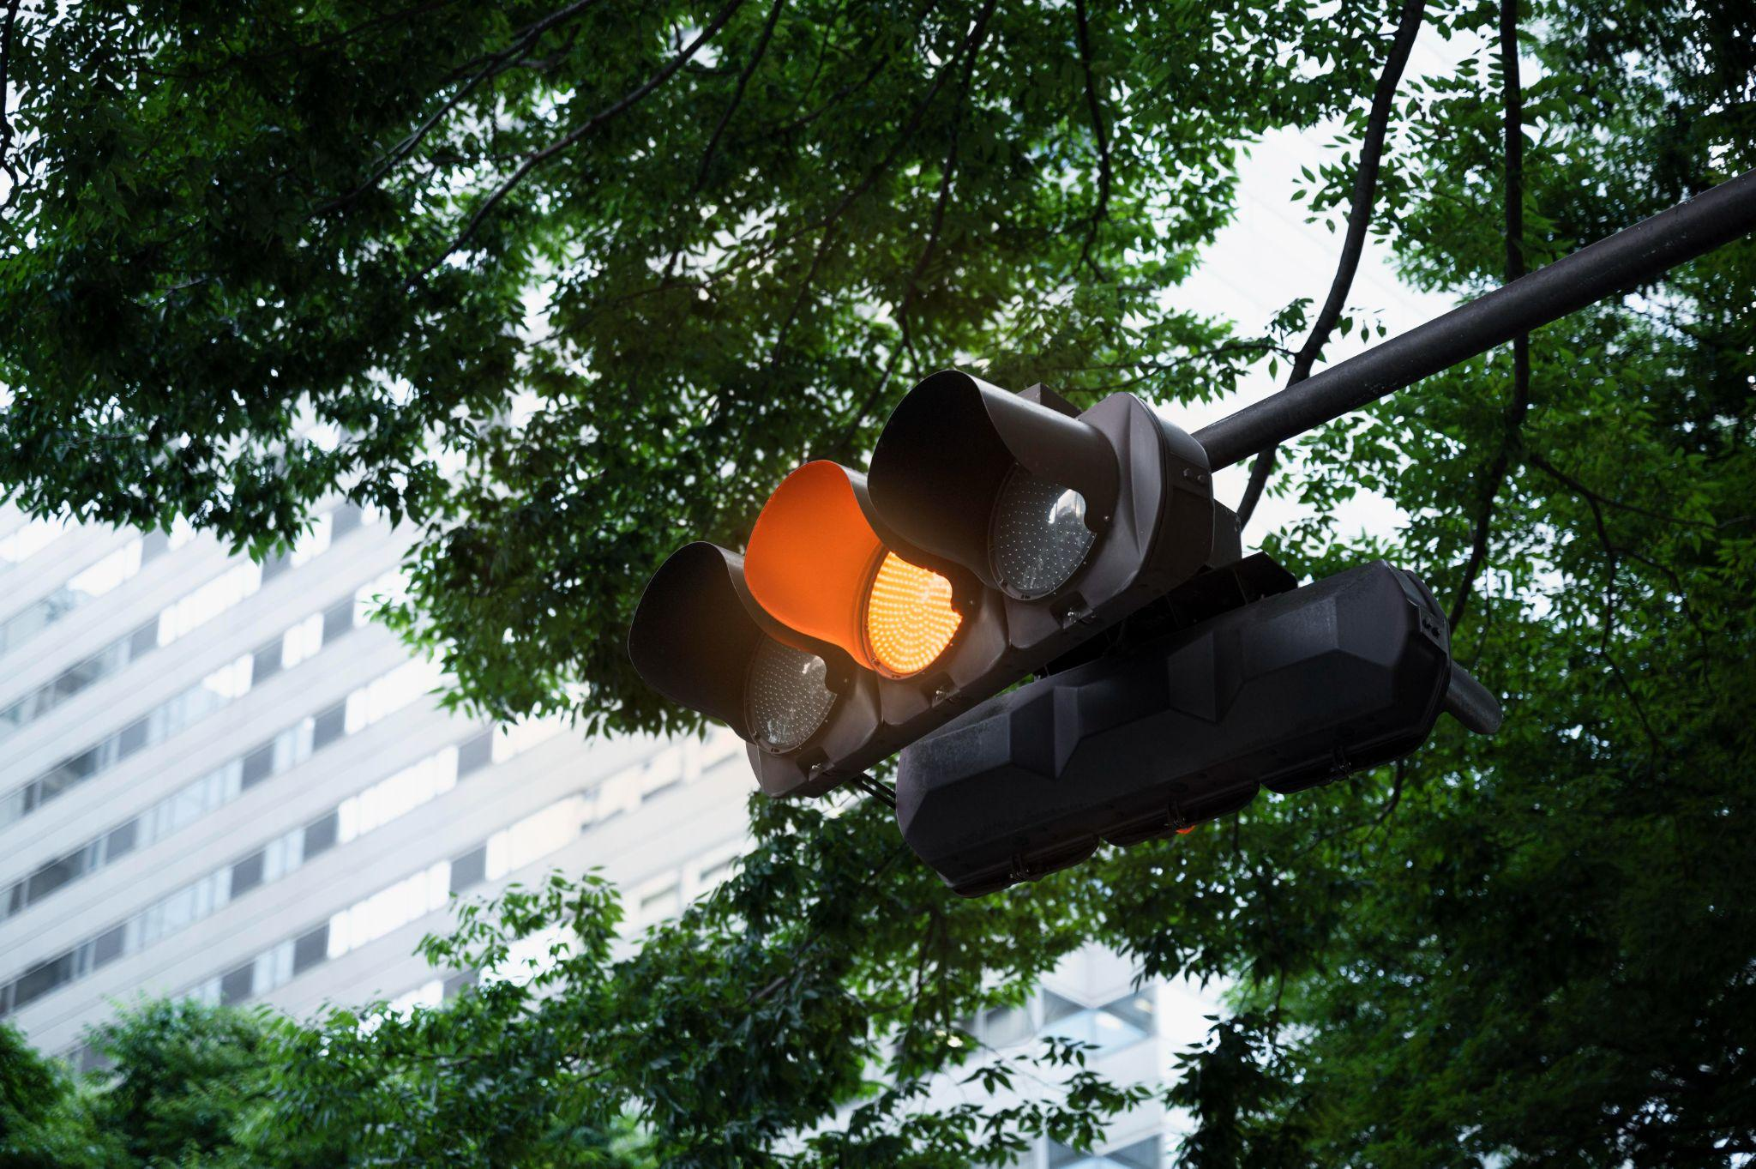
SOLUTION
The proposed solution is to develop a smart traffic light system that leverages sensors, real-time data analytics, and 5G technology to dynamically manage traffic flow at intersections. The system will be equipped with IoT-enabled sensors to monitor vehicle count, speed, and congestion levels in real-time. Using 5G's ultra-low latency communication, the system will instantly transmit traffic data to a central traffic management system, where algorithms will analyze the data and adjust traffic signal timings accordingly.

Slide 4

OBJECTIVES
Vehicle-to-Infrastructure Communication (V2I)
Real-Time Traffic Monitoring
Traffic Flow Optimization
Dynamic Signal Control

Slide 5

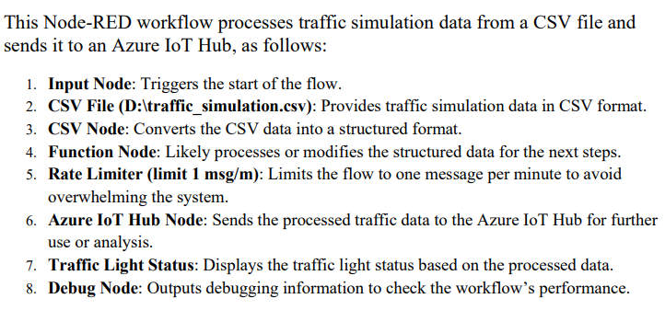
SIMULATION using Node-Red
TRAFFIC LIGHT
2022

Slide 6
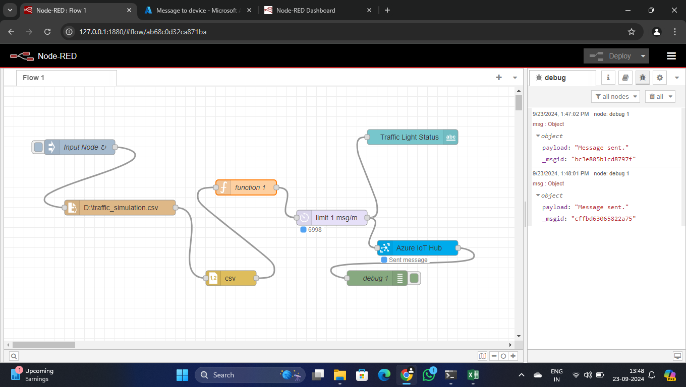
TRAFFIC LIGHT
6

Slide 7
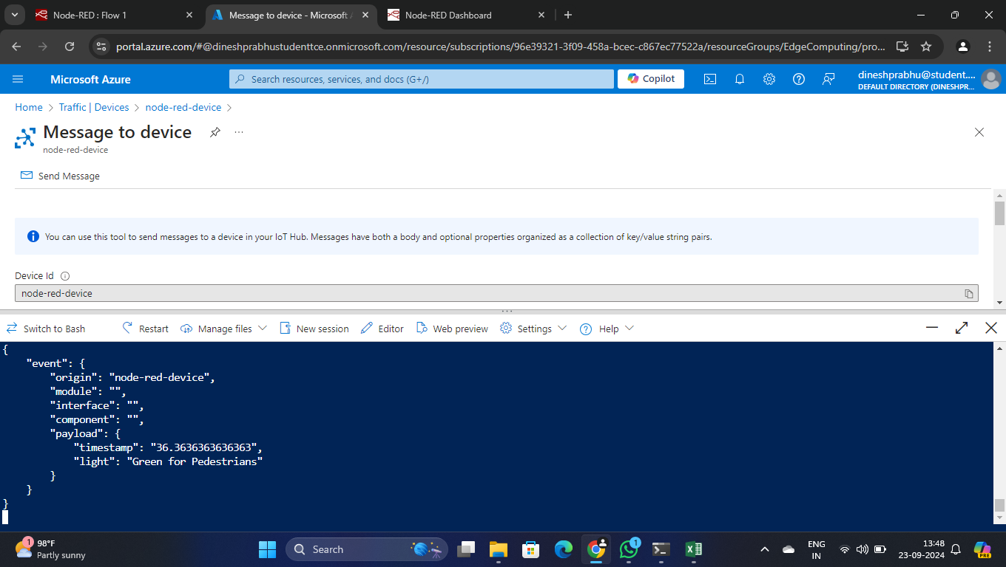
TRAFFIC LIGHT
7

Slide 8
THANK YOU!!

