Slide 1



S. A. ENGINEERING COLLEGE
(An Autonomous Institution, Affiliated to Anna University, Chennai)
DEPARTMENT OF CSE AND MCA ORGANIZES
AICTE SPONSORED (SPICES) HACKATHON
Solution By: Team SWING
Team Leader Name:Dinesh R

Slide 2
DFH – DRINK FROM HOME
g
DRINK FROM HOME – Online Liquor Selling Application
DRINK FROM HOME – Online Liquor Selling Application-
Tech Stack
1. Html & CSS
2. Bootstrap
3. Angular JS
4 Php with mysql
Resources Used
Visual Studio code
Apache Xampp
In order to control accidents caused by drunken drivers , to avoid queues in liquor shops and to control alcohol consumption level.

Slide 3


DFH - DRINK FROM HOME
APPROACH
Through our application , people can order alcohols and drink at home so that we can control drunk drive accidents , avoid queues in liquor shops.
In our application we are going to limit our customer on alcohol consumption basis where a person can buy liquor only once in a week.
Mixing different types of alcohol increases risk of getting sick , so we are limit the customer orders by not allowing them to buy different alcohols at a same time
Notes:
Use any image of your proposed solution here instead of this macbook image

Slide 4
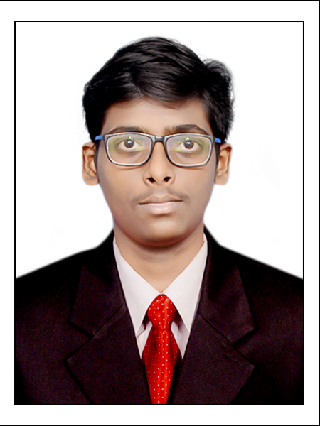
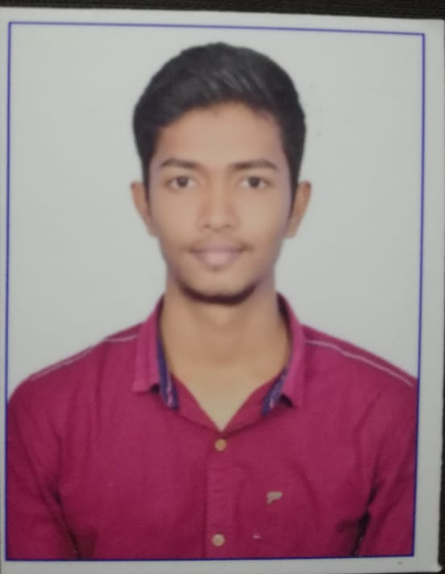
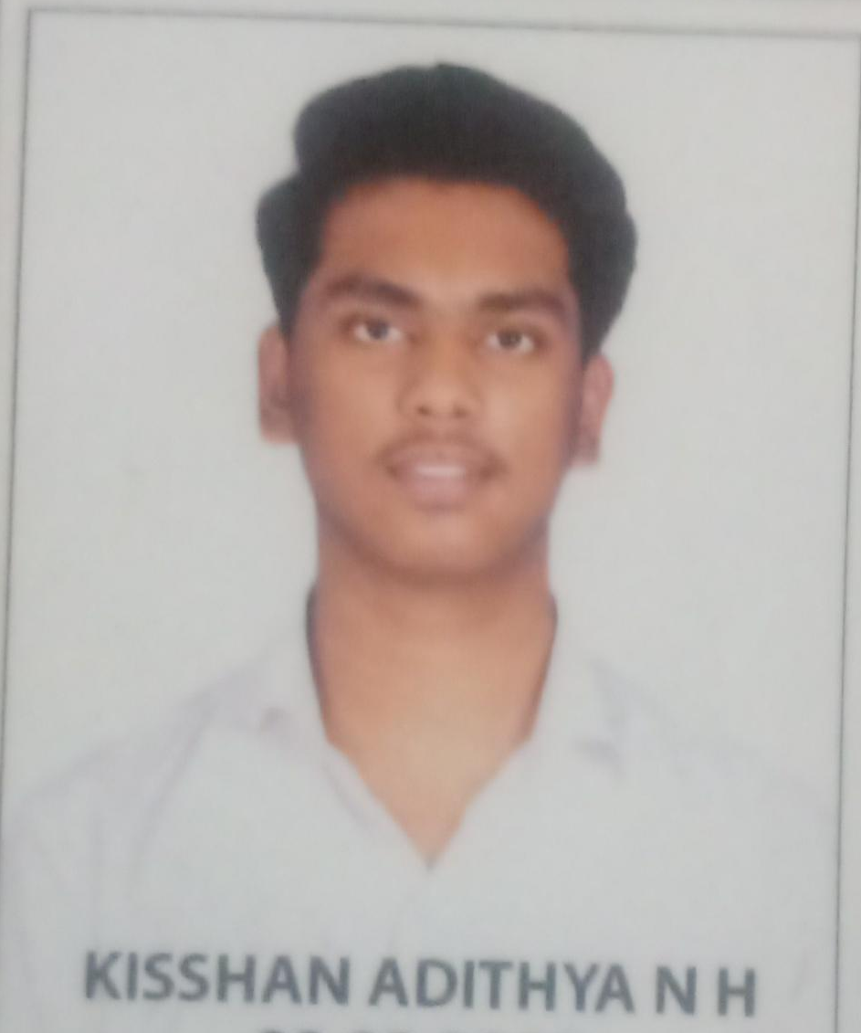
DRINK FROM HOME ( Online Liquor Selling Application )
Paste Photo
Paste Photo
Paste Photo
Paste Photo
Team leader Name: DINESH R
Department: CSE
Name(Member 1): DINESH R
Department: CSE
Name(Member 2): VENKATA VAMSI P
Department: CSE
Name(Member 3):KISSHAN ADITHYA NH
Department: CSE

Slide 5
Development Pipeline
Documents To be prepared for installation and evaluation
None
Any Third party API used, if yes please specify- None
Proposed Development Plan in pointers
1. Designing the layout
2. Coding
3. Testing
4. Launch
5. Maintaining
Repository Link :
https://github.com/dineshr16/DFH---DRINK-FROM-HOME.git
Proposed UI and functional flow in pointers
1. User Login
2. Search for product
3. Add to cart
4. Check for eligibility
5. Payments
Step A
Step B
Step C
Step D
Step E

Slide 6
Vision of Innovation/Idea/Solution
Vision of Idea :
Real time issues faced by peoples during TASMAC outlets reopen and Drunken drive accidents
Innovation :
Limitations in Alcohol consumption by certain time period.
Limitations in placing order
Benefits :
Control of drunken drive accidents
Control of consumption of alcohol mixiing side effects

