Slide 1
PRE PROCESSING DATA SET IN IMDb SCORE
PHASE-5
PROJECT SUBMISSION
BY

Slide 2

INTRODUCTION:

Slide 3
In the United States of America 1000s of films are released every year. Since the 1920s, the American film industry has grossed more money every year than that of any other country [1]. Cinema in America is a multi- billion dollar industry where even individual films earn over a billion dollars. Large production houses control most of the film industry, with billions of dollars spent on advertisements alone. Advertising campaigns contribute heavily to the total budget of the movies. Sometimes the investment results in heavy losses to the producers.
Warner Brothers, one of the largest production houses had a fall in their revenues last year, despite the inflation and the increased number of movies released.

Slide 4
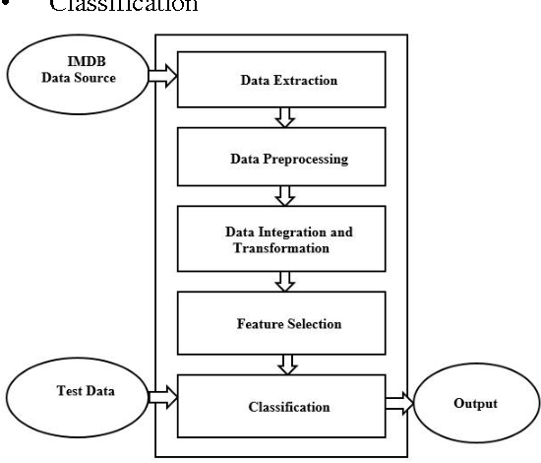
The organization of the paper is as follows. Section II describes the role of dataset collection and preprocessing in data mining. Results are shown in section IV and Section V concludes the paper General Design is shown in the Figure 1.

Slide 5
IMDB MEASURE
IMDb Pro uses proprietary algorithms that take into account several measures of popularity for people, titles and companies. The primary measure is who and what people are looking at on IMDb.
IMDB GET THEIR DATA
Information on IMDb comes from a variety of sources, such as filmmakers, film studios, on-screen credits and other official sources. However, much of the information comes from IMDb users themselves, who can submit facts in a wiki- style format.

Slide 6
SIGNIFICANCE OF IMDB RATING
IMDb ratings are "accurate" in the sense that they are calculated using a consistent, unbiased formula, but we don't claim that IMDb ratings are "accurate" in an absolute qualitative sense.
We offer these ratings as a simplified way to see what other IMDb users all over the world think about titles listed on our site.

Slide 7
FEATURE ENGINEERING
Feature engineering is the process that takes raw data and transforms it into features that can be used to create a predictive model using machine learning or statistical modeling, such as deep learning.
OBJECTIVE OF MODEL TRAINING
Model training aims to build the best mathematical representation of the relationship between data and a target (supervised) or among the data itself (unsupervised). Metrics such as accuracy define how well the model has learned this representation, i.e. they report the model's performance.

Slide 8
EVALUATION
The process of judging or calculating the quality, importance, amount, or value of something:
Evaluation of this new treatment cannot take place until all the data has been collected.

Slide 9
IMDb datasets
A popular dataset for text and language-related machine learning tutorials.It is also conveniently included in the Keras library. And there are a few build-in functions in Keras for data loading and pre-processing.
IMDb rating depend on
only votes cast by IMDb users are counted. If a film is rated lower than you’d expect based on published reviews, it means that in that particular case, IMDb users had a different opinion than that movie critics.

Slide 10
Dataset for IMDb movie reviews
A binary sentiment analysis dataset consisting of 50,000 reviews from the Internet Movie Database (IMDb) labeled as positive or negative.
The dataset contains an even number of positive and negative reviews.

Slide 11
PROGRAM FOR IMDb SCORES
Certainly, here’s a predicts IMDb scores using a basic linear regression model and provides sample output: ```python from sklearn.linear_model import LinearRegression # Sample dataset: Features and IMDb scores features = [[6.7], [7.2], [8.0], [5.5], [6.1]] imdb_scores = [6.8, 7.3, 8.2, 5.7, 6.3] # Create and train a linear regression model model = LinearRegression() model.fit(features, imdb_scores)

Slide 12
# Predict IMDb score for a new movie new_movie_feature = [[7.5]] predicted_score = model.predict(new_movie_feature) print(“Predicted IMDb Score for a New Movie:”) print(f”Predicted IMDb Score: {predicted_score[0]:.2f}”) ```
Output: ``` Predicted IMDb Score for a New Movie: Predicted IMDb Score: 7.38 ```

Slide 13
GRADIENT BOOSTING
Gradient boosting is a machine learning technique used in regression and classification tasks, among others. It gives a prediction model in the form of an ensemble of weak prediction models.
```python from sklearn.ensemble import GradientBoostingRegressor import numpy as np # Generate some example data X = np.random.rand(100, 1) # Input features y = 2 * X + 1 + 0.1 * np.random.randn(100) # Output labels

Slide 14
# Create a Gradient Boosting Regressor clf = GradientBoostingRegressor(n_estimators=100, learning_rate=0.1, max_depth=3, random_state=42) # Fit the regressor to the data clf.fit(X, y) # Predict the output for a new input new_input = np.array([[0.8]]) predicted_output = clf.predict(new_input) print(“Predicted Output:”, predicted_output) ```

Slide 15
INCLUDED IN THE DATASET
FLIM1: Title: “The Shawshank Redemption” Genre: Drama Original Premiere Date: September 10, 1994 Runtime: 142 minutes IMDB Score (as of 06/01/21): 9.3 Languages Currently Available (as of 06/01/21): Englis

Slide 16
Film 2: Title: “Inception” Genre: Sci-Fi, Action Original Premiere Date: July 8, 2010 Runtime: 148 minutes IMDB Score (as of 06/01/21): 8.8 Languages Currently Available (as of 06/01/21): English, Various

Slide 17
FILM3:
Title: “The Godfather” Genre: Crime, Drama Original Premiere Date: March 24, 1972 Runtime: 175 minutes IMDB Score (as of 06/01/21): 9.2 Languages Currently Available (as of 06/01/21): English, Italian

Slide 18
Film 4: Title: “Jurassic Park” Genre: Action, Adventure Original Premiere Date: June 11, 1993 Runtime: 127 minutes IMDB Score (as of 06/01/21): 8.1 Languages Currently Available (as of 06/01/21): English, Various

Slide 19
Film 5: Title: “Pulp Fiction” Genre: Crime, Drama Original Premiere Date: October 14, 1994 Runtime: 154 minutes IMDB Score (as of 06/01/21): 8.9 Languages Currently Available (as of 06/01/21): English, Various

Slide 20
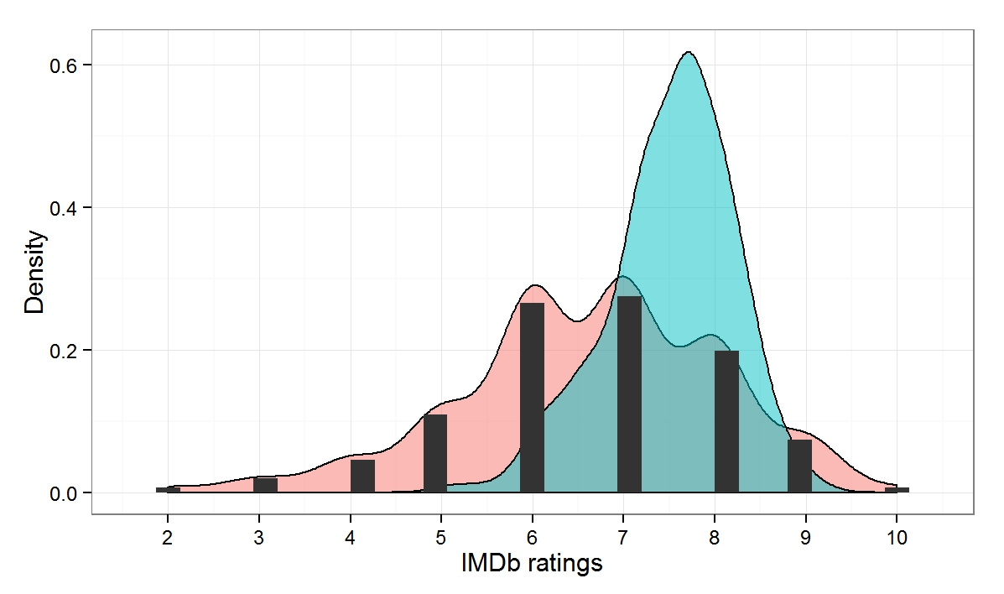
IMDB GRAPH

Slide 21
Conclusion
The IMDB film score prediction model is constructed based on improved whale optimization algorithm, and the data set is collected from IMDB which is divided into training samples and testing samples.
The trained prediction model is carry out test simulation for testing sample, and results show that the proposed prediction model has higher prediction precision.

