Slide 1
Analysis of Obesity Factors and Prediction Models
Dinesh Ram Veerappan Kosal
Dr.Itauma
Northwood University

Slide 2
Abstract
• Analysis of factors contributing to obesity levels
• Exploration of relationships between demographic, dietary, and lifestyle factors
• Use of exploratory data analysis, regression modeling, classification techniques, and clustering algorithms

Slide 3
Methodology
• Data collection and preprocessing
• Exploratory Data Analysis (EDA)
• Feature selection and engineering
• Application of machine learning models:
- Regression
- Classification
- Clustering
Tools Used:
VS Code
Minitab
MS Word

Slide 4
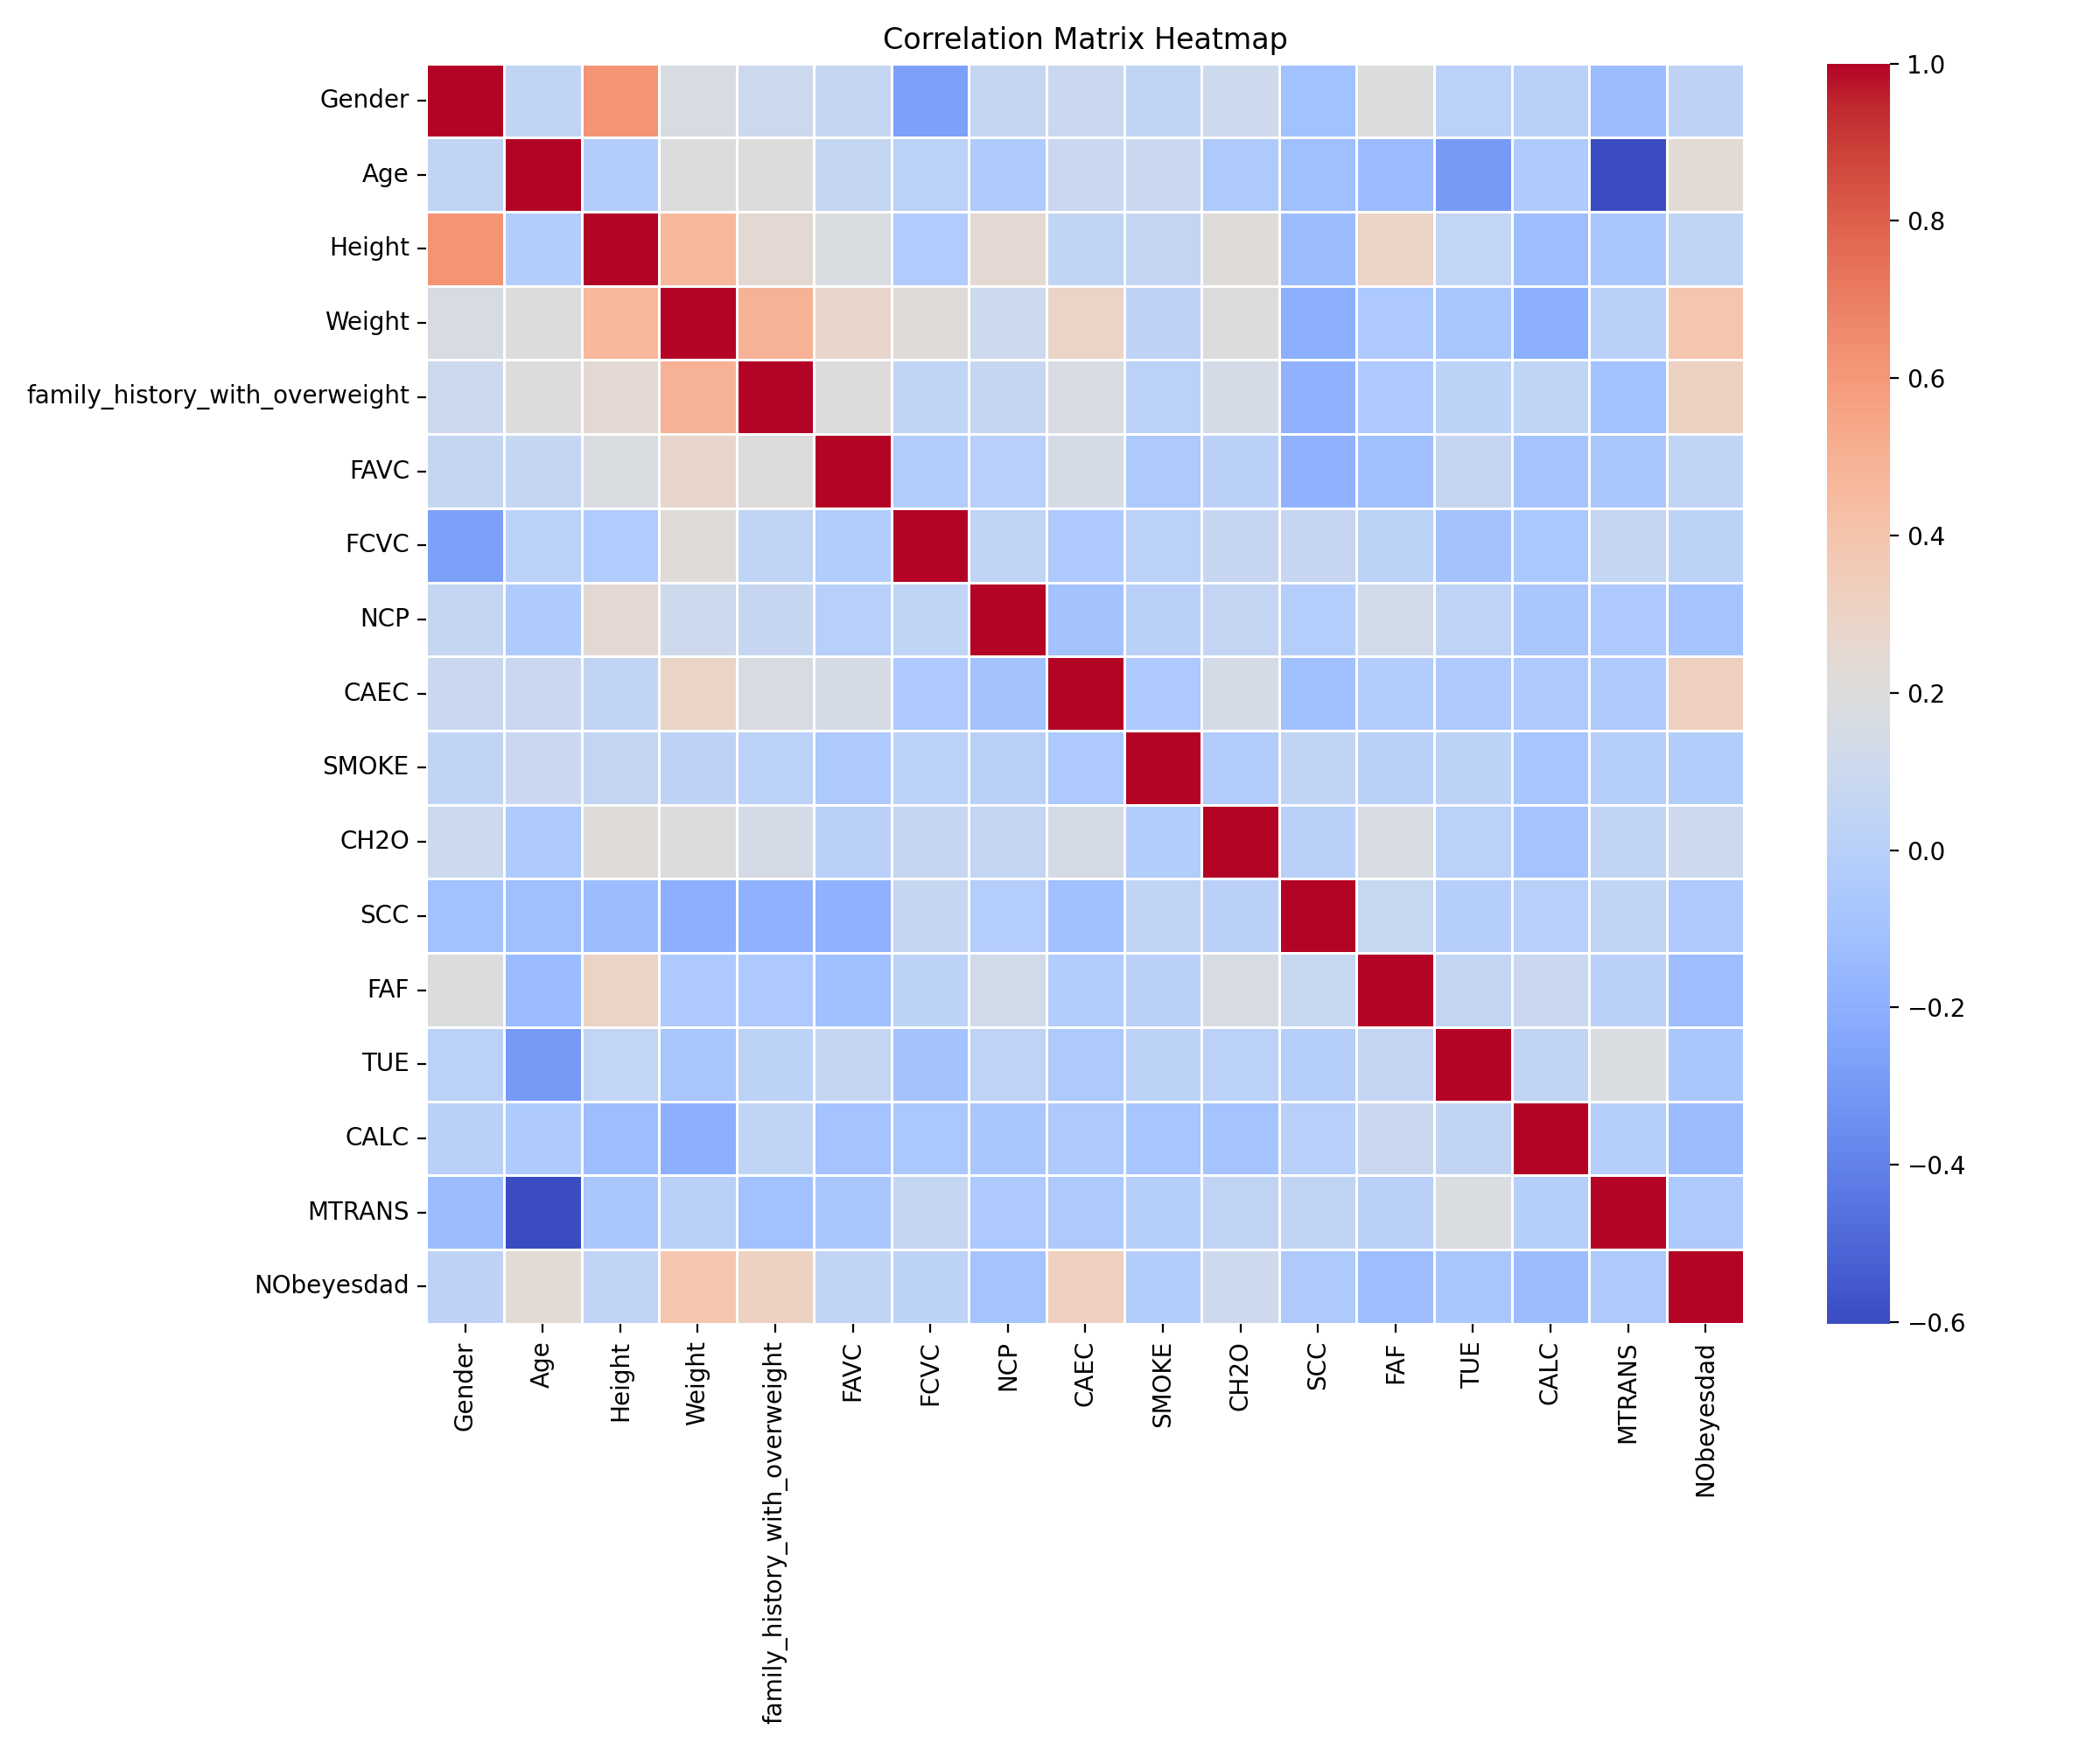
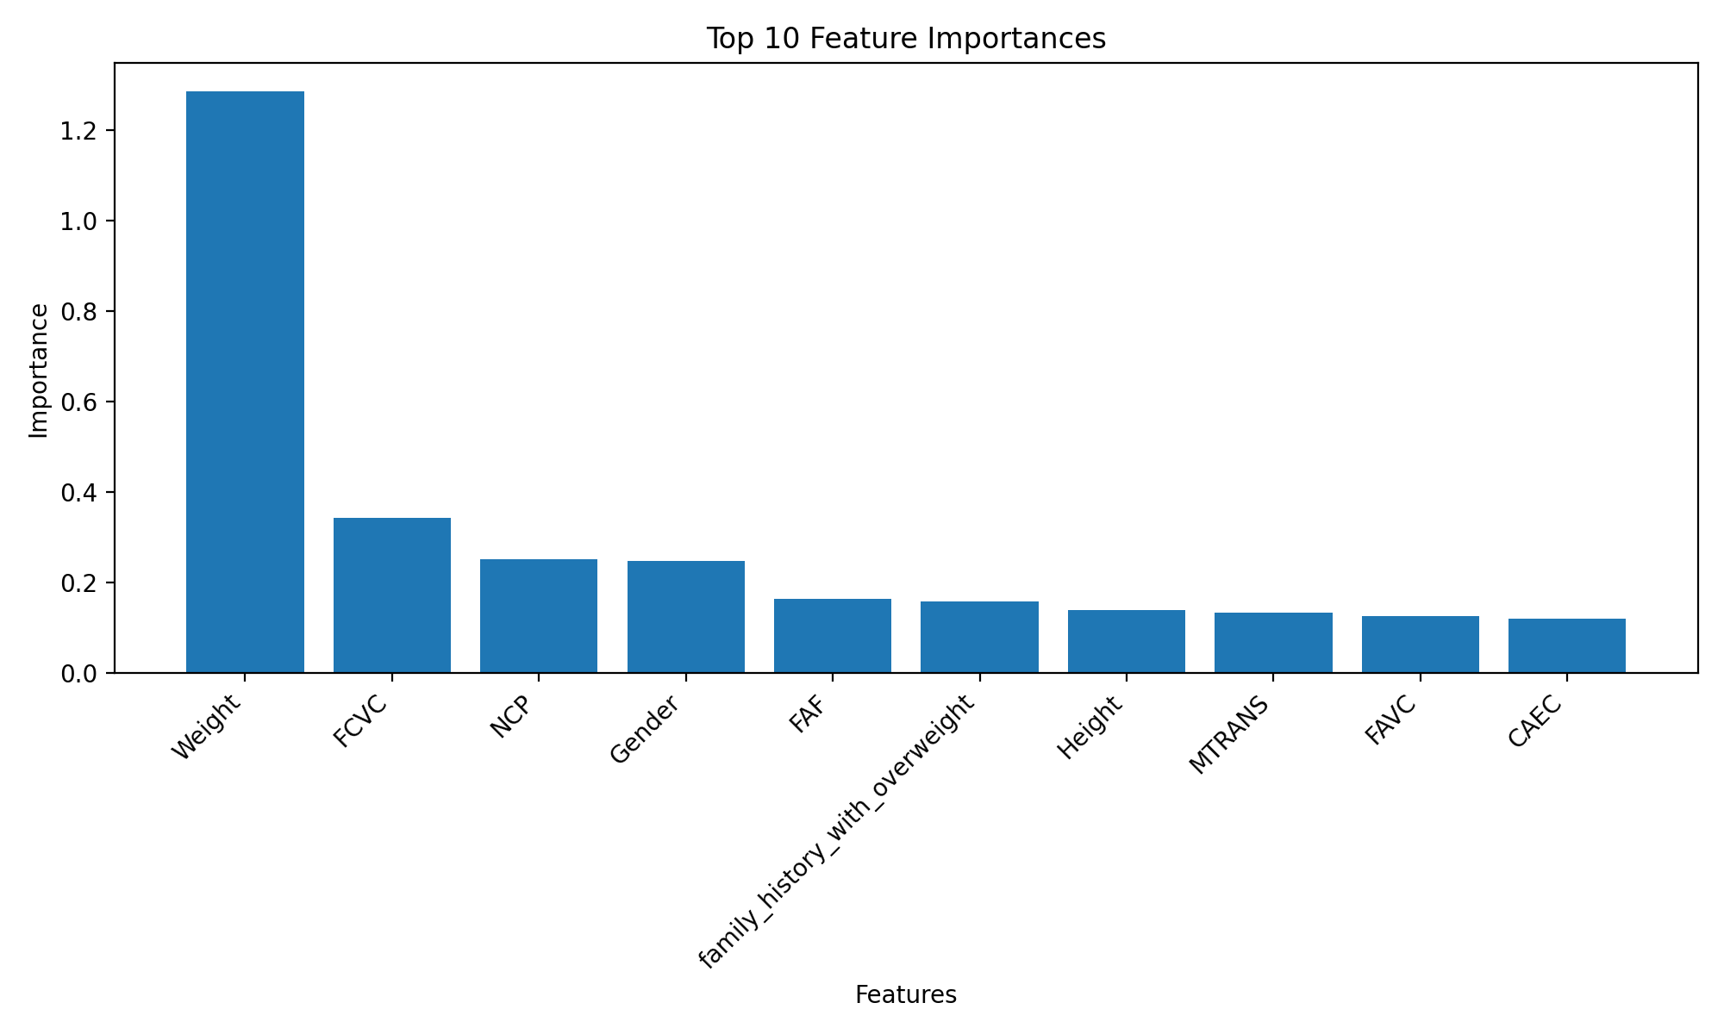
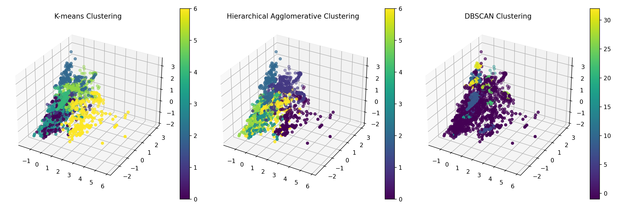
Key Findings
• Identification of significant factors influencing obesity
• Correlation between lifestyle choices and obesity levels
• Effectiveness of different prediction models
• Patterns and clusters in obesity data

Slide 5
Implications
• Insights for public health policies
• Personalized intervention strategies
• Importance of holistic approach to obesity management
• Potential for early identification of obesity risk

Slide 6
Conclusion and Future Work
• Summary of key contributions
• Limitations of the current study
• Recommendations for future research
• Potential applications in healthcare and policy-making

