Slide 1

BIOMETRIC SDK INTEGRATION
Savant De Silva savantd@99x.io

Slide 2

Agenda
Biometric SDK integration points
Biometric SDK Functions
MOSIP Capabilities to SDK

Slide 3

Biometric Integration Points Within The MOSIP Platform

Slide 4
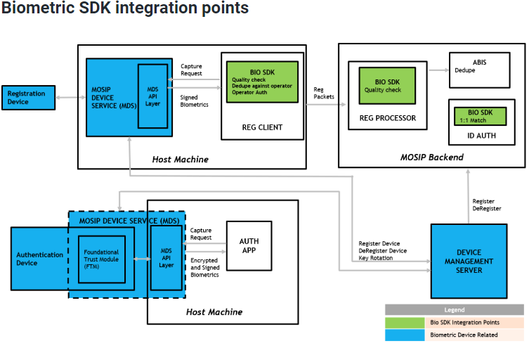
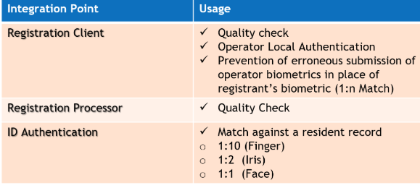
SDK Usages
docs.mosip.io, Platform

Slide 5
Biometric SDK Functions
SDK Initialization
Quality Checker
Matcher
Extractor
Segmenter
Converter

Slide 6
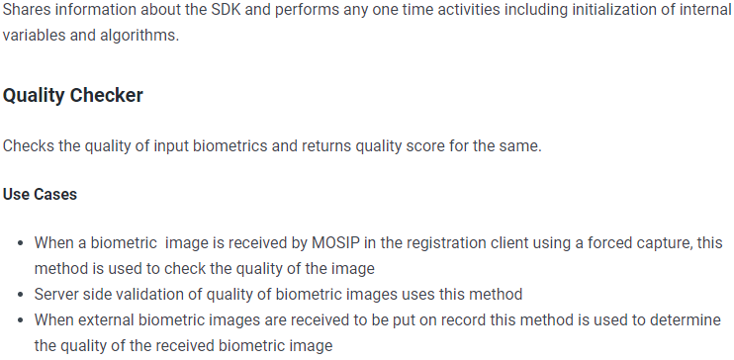

Biometric SDK Functions
SDK Initialization

Slide 7

Biometric SDK Functions
Matcher
Step 1: Matches the captured biometric record or a list of biometric records.
Step 2: Matches it against list of stored biometric records.
Step 3: It then returns a matching score against each stored biometric record or a composite matching score for the list of input biometric records
Matches one or multiple modes of biometric received in an auth transaction.
Authentication of operators in offline mode.
Prevention of erroneous submission of operator biometrics in place of registrant’s biometric .

Slide 8
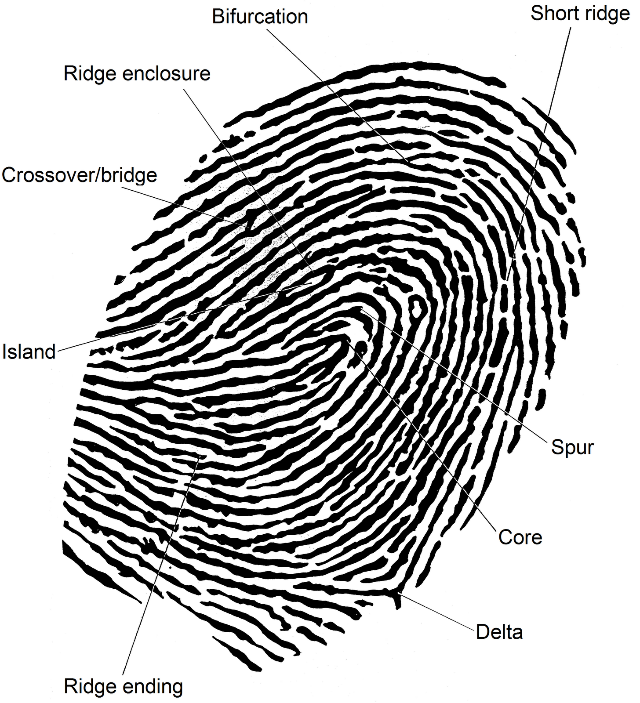
Biometric SDK Functions
Extractor
Extracts and returns the most important features and patterns of input biometric record to use in fast comparison
Identifies the Minutiae points if it’s a fingerprint.
Provides a standard representation of an ISO template for FMR (False Match Rate)

Slide 9
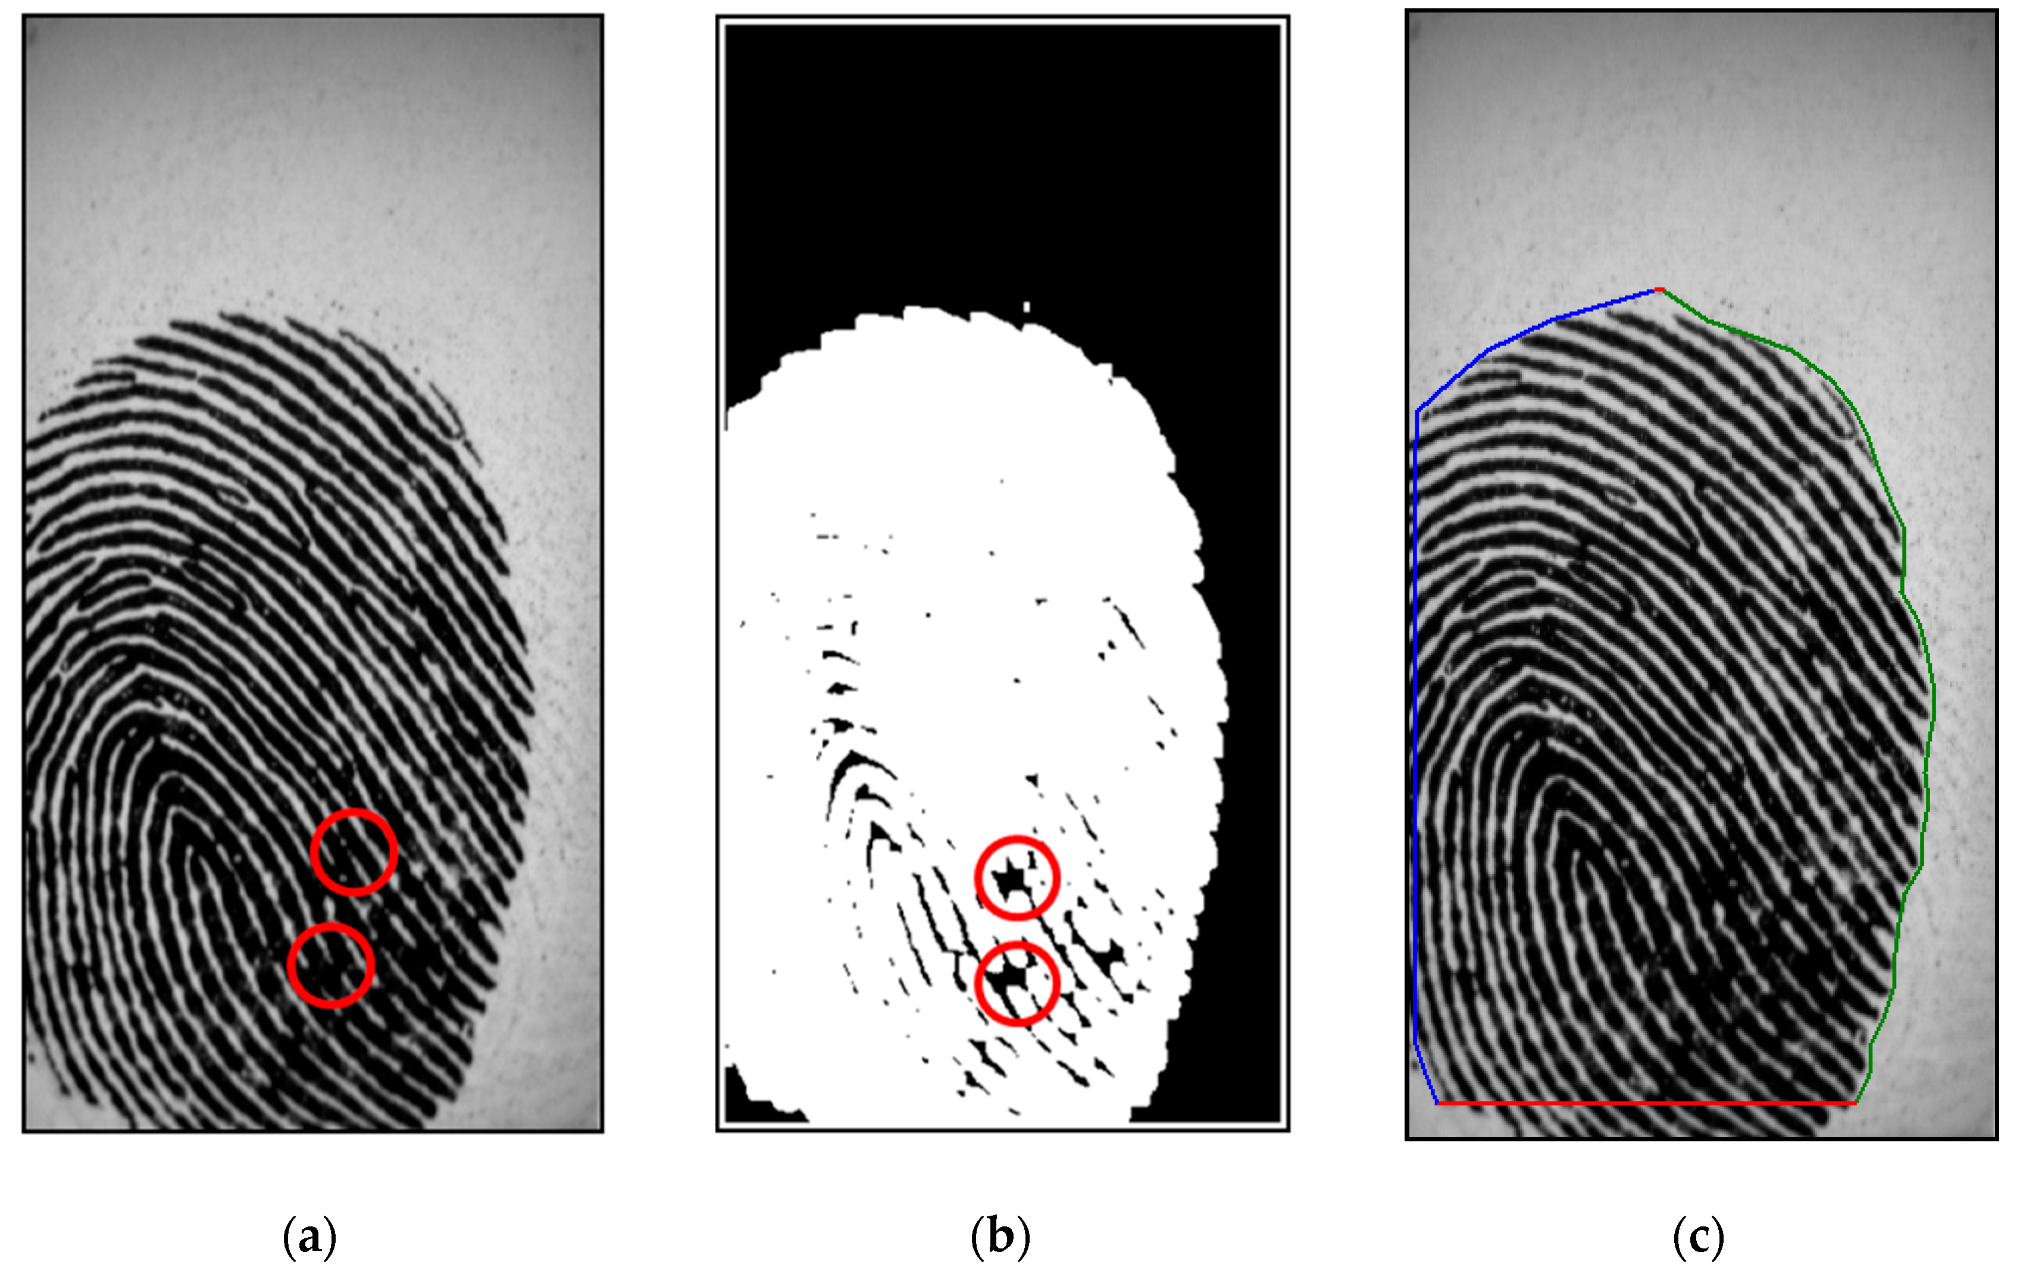
Biometric SDK Functions
Segmenter
Segments single biometric record into multiple biometric records.
Eg: Split thumb slab into multiple fingers and eyes into left and right eye.
Used to split images into individual biometric segments.nter
Converter
Converts images in all segments in the biometric record.

Slide 10


Slide 11
MOSIP Capabilities
MOSIP as a platform does not have any inbuilt capabilities to handle biometrics.
Relies on external components and subsystems to perform all activities pertaining to biometrics.
MOSIP defines formats, standards and interfaces for these external components.
Java based interface to support the biometric functions.
https://docs.mosip.io/platform/apis/biometric-sdk-api-specification

Slide 12
MOSIP Capabilities
Supported image formats
Fingerprint – Supports ISO 19794-4:2011
Iris - Supports ISO/IEC 19796-6:2011 Face Capture - Supports ISO 19794-5:2011
The biometric data is wrapped in CBEFF XML.

