Slide 1

Understanding MOSIP
Savant De Silva savantd@99x.io

Slide 2

Agenda
Introduction To MOSIP
MOSIP Infrastructure
Modular Architecture

Slide 3

What is MOSIP?

Slide 4
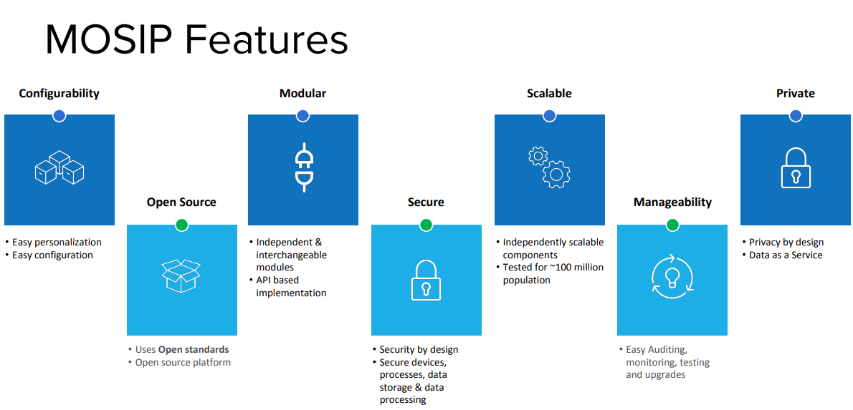
Introduction To MOSIP
MOSIP (Modular Open-Source Identity Platform) is an open source, open standards based foundational identity platform.
Affordable, Secure and Open-source Identity platform.
API first platform and building block towards governmental digital services.
Future ready open design.
Mosip.io, Platform

Slide 5
Basic Functionalities of MOSIP
Capture demographic data
Acquire an individual's identity and demographic data.
Process identity data
Process identity data to establish uniqueness, with the help of an ABIS provider.
UIN Generation
Generate and issue a Unique Identity Number to the individual.
Perform Authentication
Administer
Perform authentication on the generated UIN and the individuals Biometric data captured previously.
Provides capability for administration via various reporting and dashboarding techniques.

Slide 6
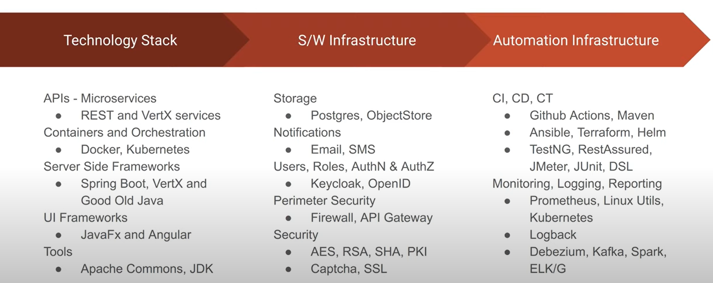
MOSIP Infrastructure And Tech Stack
MOSIP - IIIT Bangalore, youtube: Introduction and MOSIP Architecture overview

Slide 7

Modular Architecture of MOSIP

Slide 8
Modules In Brief
MOSIP Modules
Core Modules
Pre-registration
Registration client
Support Modules
Partner Management
Registration processor
ID Repository
Authentication
Resident Services
Administration
Reporting

Slide 9
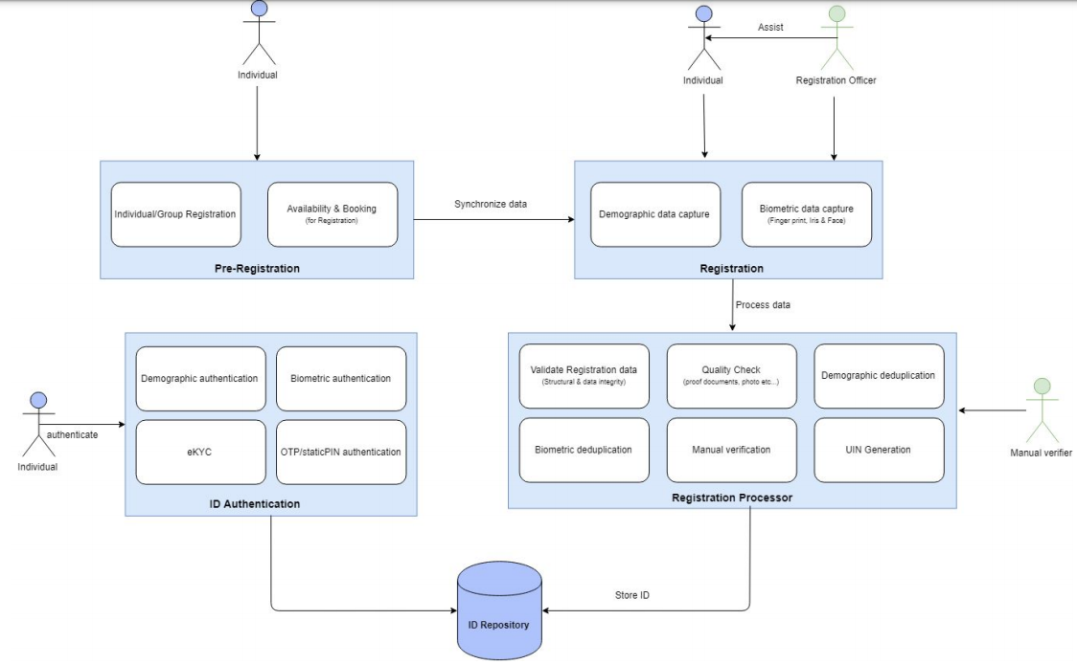
Mosip.io, Architectural Principle - Modularity and Configurability.pdf
Mosip.io, Modular architecture

Slide 10



Summary
Highly Customizable and low-cost solution.
System design for easy integration.
Future ready platform that supports improvements by the community.

