Slide 1
SoftHSM
Software only Hardware Security Module

Slide 2
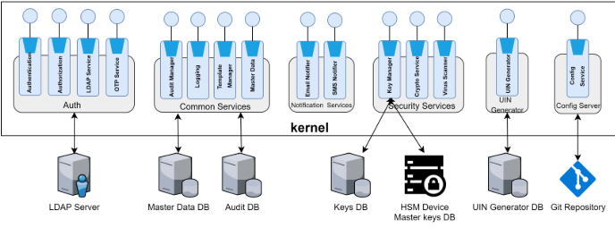
HSM in MOSIP Architecture

Slide 3
HSM (Hardware Security Module)
HSM is a secure physical device designed and used for crypto processing and strong authentication.
The HSM can encrypt, decrypt, create, store and manage digital keys, and can be used for signing and authentication.

Slide 4
HSM devices are used to store the Master keys which are used to encrypt the keys in the Key store.
The keys in the key store are used to encrypt sensitive information.

Slide 5
SoftHSM
SoftHSM is an implementation of a cryptographic store accessible through a PKCS #11 interface.
You can use it to explore PKCS #11 without having a Hardware Security Module.
SoftHSM uses Botan for its cryptographic operations.

Slide 6
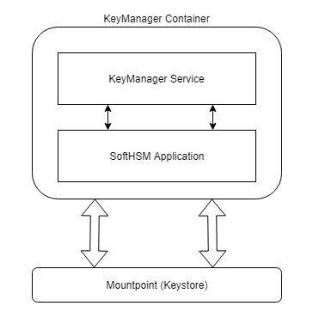
Key manager in MOSIP
Key manager uses softHSM to store keys
Each time the key manager service gets started, the SoftHSM will be installed and it will load all the keys from an external mount.

Slide 7
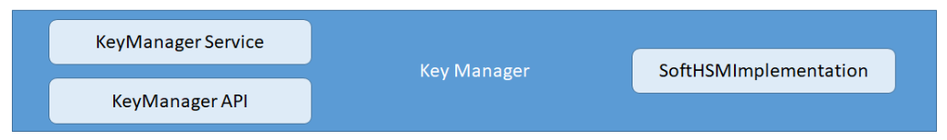
MOSIP key manager module
Key generation algorithms
Key rotation
Key manager API
Key store

Slide 8
How Data encryption works
Request received for data encryption
Generate a symmetric key and encrypt the data using it
Pass the symmetric key to keymanager service
Key manager receives request to encrypt key
Fetch private key from the softHSM
Encrypt the symmetric key using the private key retrieved
Combine the encrypted data and key and encode the data (base64)

Slide 9
How Data decryption works
Request received for data decryption
Decode the content (base64) and split data and symmetric key
Pass the symmetric key to keymanager service
Key manager receives request to decrypt key
Fetch private key from the softHSM
Decrypt the symmetric key using the private key retrieved
Use the decrypted symmetric key to decrypt the data

Slide 10
Key manager softHSM
Contains several methods to store and retrieve keys
It consists of an interface KeyStore that can be implemented where necessary
Perform operations using the stored keys in any MOSIP module

Slide 11
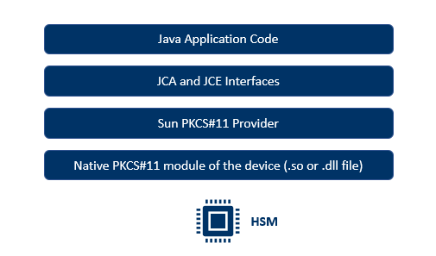
Interacting with HSM using Java

Slide 12
SoftHSM Installation
Clone the SoftHSMV2 from openDNSSEC github
Configure, compile and install the softhsm
Initialize the token database (create a token)
softhsm2-util --init-token --slot 0 --pin <pin> --so-pin <so-pin> --label <label>
Create a PKCS#11 configuration file

Slide 13
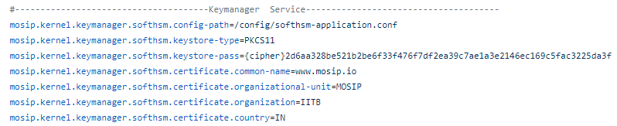
MOSIP configurations
Update the above properties in the kernel-mz.properties file

Slide 14
Thank You !

