Slide 1

CI / CD With JeNKINS & SonarQube

Slide 2
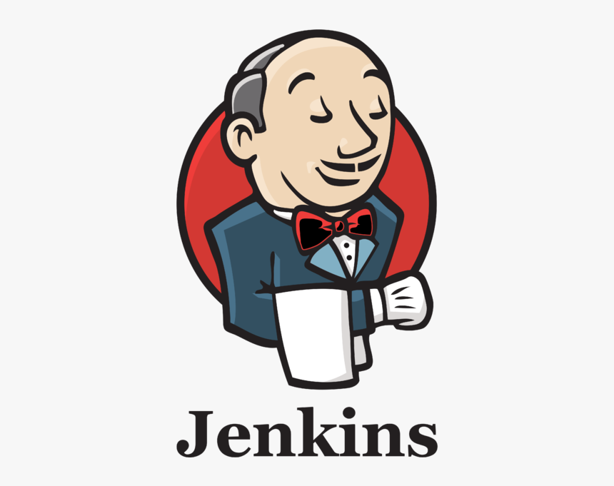

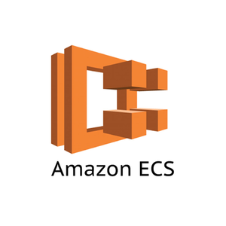
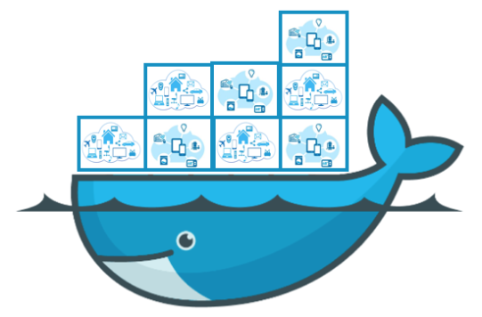
scalable Ci setup
As a standalone application - Low Scalability - Easy to Setup
As a container on a Host - Scalability limited to Host capacity
As a ECS cluster - High Scalability and Provisioning - Unlimited number of job agents - Efficient monitoring

Slide 3
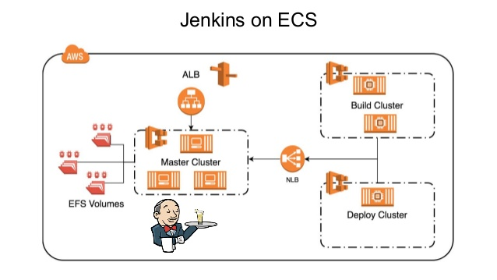
Jenkins on ECS cluster
Philipp Garbe, https://www.slideshare.net/

Slide 4
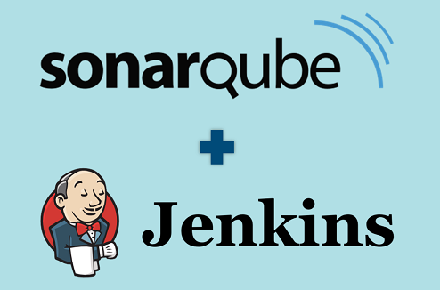
Overview of pipeline
We can have a two separated Jenkins jobs which is build job and deploy job.
Build job will trigger for every commit to selected branch (master) and also, we can manually run by selecting custom branch. - As a first step code will build with maven and if there is no build error job will continue. - As a second step committed code will scanned by SonarQube scanner. If there is no threat or faults only job will continue. - As a third step docker image will create with build. - Then it will be uploaded to docker hub with tag.

Slide 5
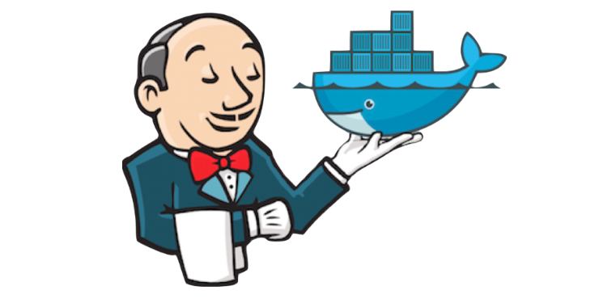
Overview of pipeline Contd..
In deploy job we can select the branch name or release version to deploy. (This will help to easily do rollback operation). - As a first step job will pick the relevant docker image from docker hub. - Then that image will be copied to the servers that is available in server inventory list. - After that docker image will execute for all servers.

Slide 6
Overview of pipeline Contd..
Job in brief Code Commit by Dev or Manual Run Jenkins job (build) - for every commit in selected branch will executes the Jenkins job - code build on top of maven - code scanned by sonar cube - if sonar cube report ok then build the docker image - docker image uploaded to docker hub Deploy Job - Select the relevant branch or release version - getting docker image from docker hub - select relevant inventory from given list - deploy and run docker image in given server

Slide 7


