Slide 1


PANIMALAR ENGINEERING COLLEGE
Department of Electronics and Instrumentation Engineering
DIAGNOSIS OF PNEUMOTHORAX
USING DEEP LEARNING
Batch No: 24
Batch Members:
Alex Moses Inbaraj.A (211418107004))
Dinesh.R (211418107026)
Gnana Sai.A.R (211418107029)
Internal Guide:
Dr. R. Manikandan, M.E.Phd,
Professor,
Department of EIE,
Panimalar Engineering College

Slide 2
ORGANIZATION
Objective of the Project
Introduction
Existing System/ Literature Survey
Problem Identification
Proposed system - Block Diagram
Algorithm Explanation
Software Requirements
Experimental Process
Results & Discussions
Conclusion And Future Work
References

Slide 3
OBJECTIVE OF THE PROJECT
To identify Pneumothorax by Deep Learning
Technique with the help of LENET and ALEXNET of CNN Architecture.

Slide 4
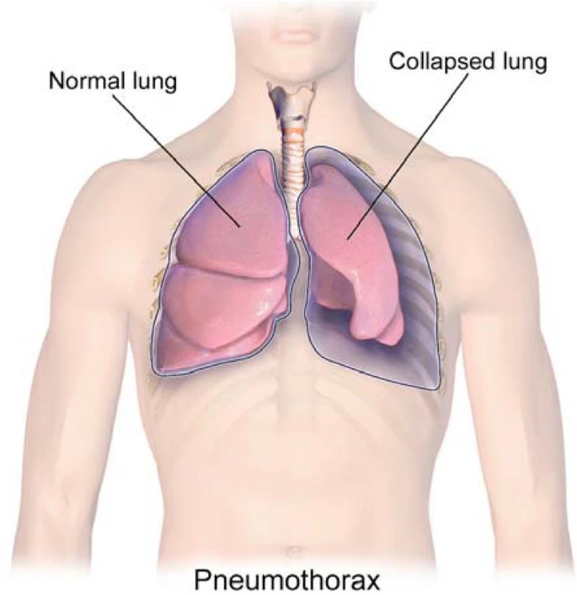
INTRODUCTION
A pneumothorax is an abnormal collection of air in the pleural space between the lung and the chest wall. Symptoms typically include sudden onset of sharp, one-sided chest pain and shortness of breath.

Slide 5
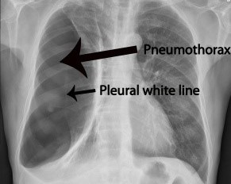
INTRODUCTION
In a minority of cases, a one-way valve is formed by an area of damaged tissue, and the amount of air in the space between chest wall and lungs increases; this is called a tension pneumothorax.

Slide 6
LITERATURE SURVEY
Author & Year | Title | Algorithms Used/ Achievements | Limitations
ErdiÇallı , EcemSogancioglu, Bramvan Ginneken,Kicky G.van Leeuwen, KeelinMurphy(2021) | Deep learning for chest X-ray analysis: A survey | Using deep learning on chest radiographs published before March 2021, categorizing works by task: image-level prediction (classification and regression), segmentation, localization, image generation and domain adaptation. | model may be complex and also inherits the disadvantages of wrapper model
Priyanka Malhotra , Sheifali Gupta , Deepika Koundal , Atef Zaguia , Manjit Kaur and Heung-No Lee.(2022) | Deep Learning-Based Computer-Aided Pneumothorax Detection Using Chest X-ray Images | The present work compares the operation of the proposed MRCNN model based on ResNet101 as an FPN with the conventional model based on ResNet50 as an FPN. The proposed model had lower class loss, bounding box loss, and mask loss as compared to the conventional model based on ResNet50 as an FPN | More Error rate

Slide 7
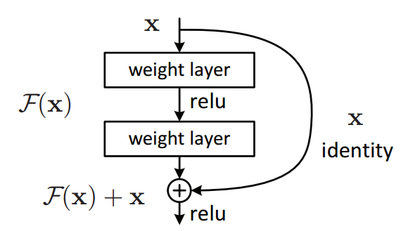
BLOCK DIAGRAM OF EXISTING SYSTEM

Slide 8
PROBLEM IDENTIFICATION/
LIMITATIONS OF EXISTING SYSTEM
Lesser efficiency.
High run-time.
Complex in process.
The Error rate in RESNet-50 is more.

Slide 9
OVERVIEW OF THE PROPOSED WORK
IMAGE DATABASE
PREPROCESSING
FEATURE EXTRACTION
IDENTIFICATION
RESULTS

Slide 10
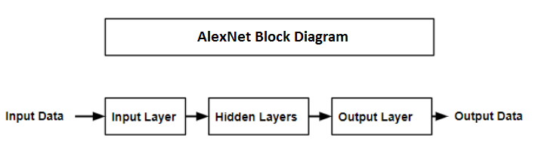
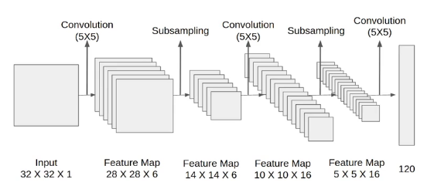
BLOCK DIAGRAM OF PROPOSED SYSTEM

Slide 11
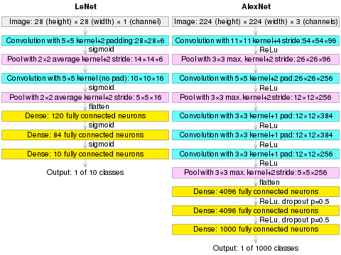
BLOCK DIAGRAM OF PROPOSED SYSTEM

Slide 12
PROPOSED SYSTEM
We are proposing recognition framework based on the structured two dimensional Convolutional Neural Networks (CNNs) type of AlexNet and LENET to identify the Pneumothorax and improve the accuracy of workflow.
The proposed method for this project is to train a Deep Learning algorithm capable of identifying and data preprocessing and visualizing the image then feature extracting to build LENET CNN using Pneumothorax image dataset. we classify it such as Pneumothorax or Normal this system using CNN model.
It is predicted that the success of the obtained results will increase if the CNN method is supported by adding extra feature extraction methods and classify successfully Pneumothorax. We have demonstrated the efficacy and potential of using deep CNN to images.

Slide 13
ALGORITHM EXPLANATION
Lenet is a convolutional neural network that is 7 layers.
You can load a pretrained version of the network trained images from the ImageNet database.
The pretrained network can Identify images of 1000 CT scan and can show whether it is Pneumothorax diesease or normal.
AS a result, the network has learned rich feature representations for a wide range of images.
The network has an image input size of 225-by-225

Slide 14
SOFTWARE REQUIRMENTS
HARDWARE REQUIREMENT:
Processor: Pentium Dual Core 2.3 GHz Processor
Hard Disk: 250 GB or Higher
RAM: 2 GB (Minimum)
SOFTWARE REQUIREMENT:
Operating System: Windows 7 or Higher
Languages used: Python (OpenCV and CNN)
Tools: Anaconda, Jupyter Notebook, Pycharm

Slide 15
EXPERIMENTAL PROCESS
STAGE 1 :
To increase the accuracy, We trained with number of images with ALEXNET model.
For Training :
Dataset : 917 images
For Testing :
Dataset: 217images
The Accuracy for images is 0.60

Slide 16
EXPERIMENTAL PROCESS
STAGE 2 :
To increase the accuracy, We trained with number of images with LENET-5 model.
For Training :
Dataset : 917 images
For Testing :
Dataset: 217images
The Accuracy for images is 0.90

Slide 17
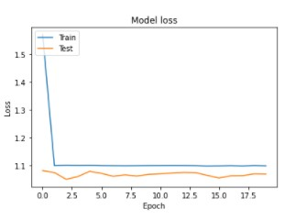
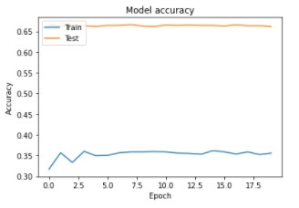
RESULTS & DISCUSSIONS
GRAPHS FOR TRAINED ALEXNET MODEL :

Slide 18
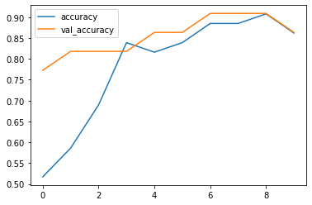
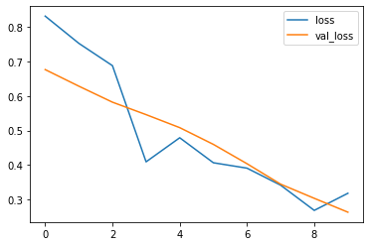
RESULTS & DISCUSSIONS
GRAPHS FOR TRAINED LENET MODEL :

Slide 19
RESULTS & DISCUSSIONS
FOR MORE IMAGES :
Comparison of Evaluation Matrices:
ARCHITECTURE | AUC | Sp(%) | Acc(%)
ALEX NET | 58 | 60.01 | 61.08
LENET | 90 | 89.03 | 88.02
Advantages:
The large amount of chest x-ray data can be train on artificial neural network.
It is best model for deep learning technique to easily identifying Pneumothorax

Slide 20
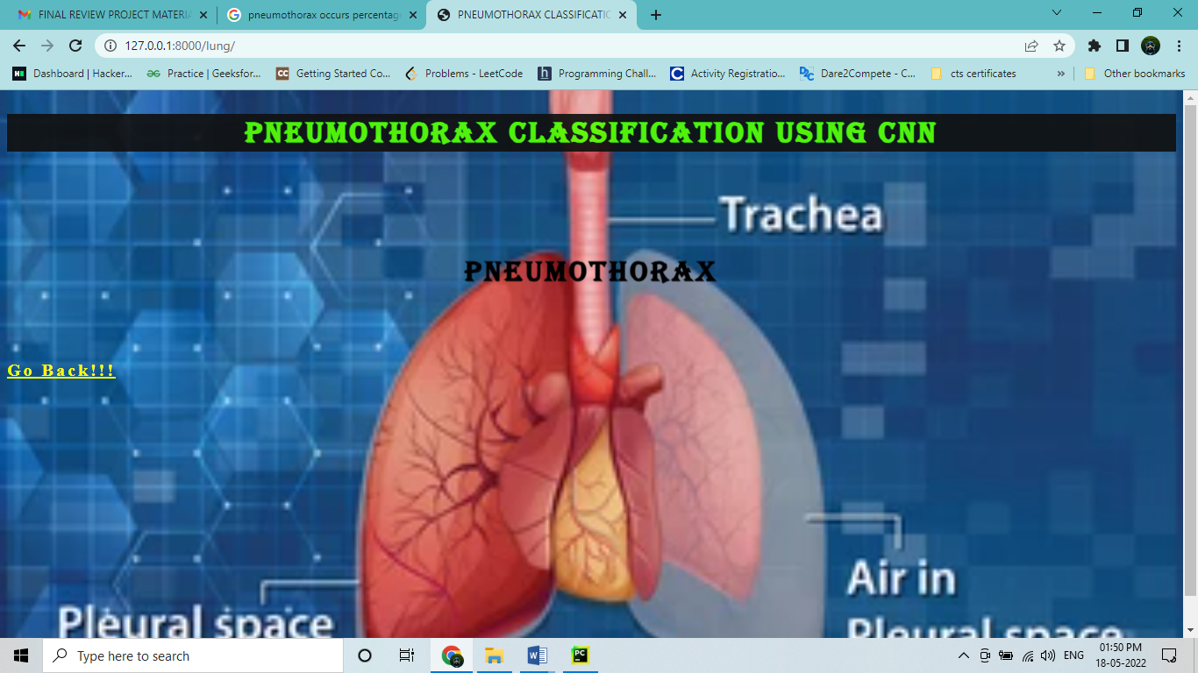
RESULTS & DISCUSSIONS
OUTPUT IMAGE :

Slide 21
REFERENCES
[1]L. Thomsen, O. Natho, U. Feigen, U. Schulz, and D. Kivelitz, “Value of Digital Radiography in Expiration in Detection of Pneumothorax,” RöFo - Fortschritte Auf Dem Geb. Röntgenstrahlen Bildgeb. Verfahr., vol. 186, no. 03, pp. 267–273, Mar. 2014, doi: 10.1055/s-0033-1350566.
[2] S. Sanada, K. Doi, and H. MacMahon, “Image feature analysis and computer-aided diagnosis in digital radiography: automated detection of pneumothorax in chest images,” Med. Phys., vol. 19, no. 5, pp. 1153–1160, Oct. 1992, doi: 10.1118/1.596790.
[3] O. Geva, G. Zimmerman-Moreno, S. Lieberman, E. Konen, and H. Greenspan, “Pneumothorax detection in chest radiographs using local and global texture signatures,” in Medical Imaging 2015: Computer-Aided Diagnosis, Mar. 2015, vol. 9414, p. 94141P, doi: 10.1117/12.2083128.
[4] Y.-H. Chan, Y.-Z. Zeng, H.-C. Wu, M.-C. Wu, and H.-M. Sun, “Effective Pneumothorax Detection for Chest X-Ray Images Using Local Binary Pattern and Support Vector Machine,” J. Healthc. Eng., vol. 2018, p. 2908517, 2018, doi: 10.1155/2018/2908517.
[5] A. Gooßen et al., “Deep Learning for Pneumothorax Detection and Localization in Chest Radiographs,” ArXiv, 2019.
[6] G. Kitamura and C. Deible, “Retraining an open-source pneumothorax detecting machine learning algorithm for improved performance to medical images,” Clin. Imaging, vol. 61, pp. 15–19, May 2020, doi: 10.1016/j.clinimag.2020.01.008.
[7] R. W. Filice et al., “Crowdsourcing pneumothorax annotations using machine learning annotations on the NIH chest X-ray dataset,” J. Digit. Imaging, Nov. 2019, doi: 10.1007/s10278-019-00299-9.
[8] M. Annarumma, S. J. Withey, R. J. Bakewell, E. Pesce, V. Goh, and G. Montana, “Automated Triaging of Adult Chest Radiographs with Deep Artificial Neural Networks,” Radiology, vol. 291, no. 1, pp. 196–202, Jan. 2019, doi: 10.1148/radiol.2018180921

Slide 22
CONCLUSION AND FUTURE WORK
Conclusion:
It focused how image from given dataset (trained dataset) and past data set used to predict the pattern of pneumothorax disease using CNN model. This brings some of the following insights about pneumothorax disease prediction. The major benefit of the CNN classification framework is the ability to classify images automatically. The pneumothorax diseases mainly contribute to misshape and often can’t be remedied because the patients are diagnosed too late with the diseases. We observed that deep learning is capable of achieving a relatively high diagnosis accuracy, is very much in agreement with human diagnostic performance, but still inferior to experienced radiologists in difficult-to-analyze cases.
In this study, we have discussed the overview of methodologies for detecting the abnormalities in pneumothorax images which includes collection of pneumothorax image data set, preprocessing techniques, feature extraction techniques.
Future Work:
Medical department wants to automate the detecting of pneumothorax disease from eligibility process (real time).
To optimize the work to implement in Artificial Intelligence environment.

Slide 23


