Slide 2
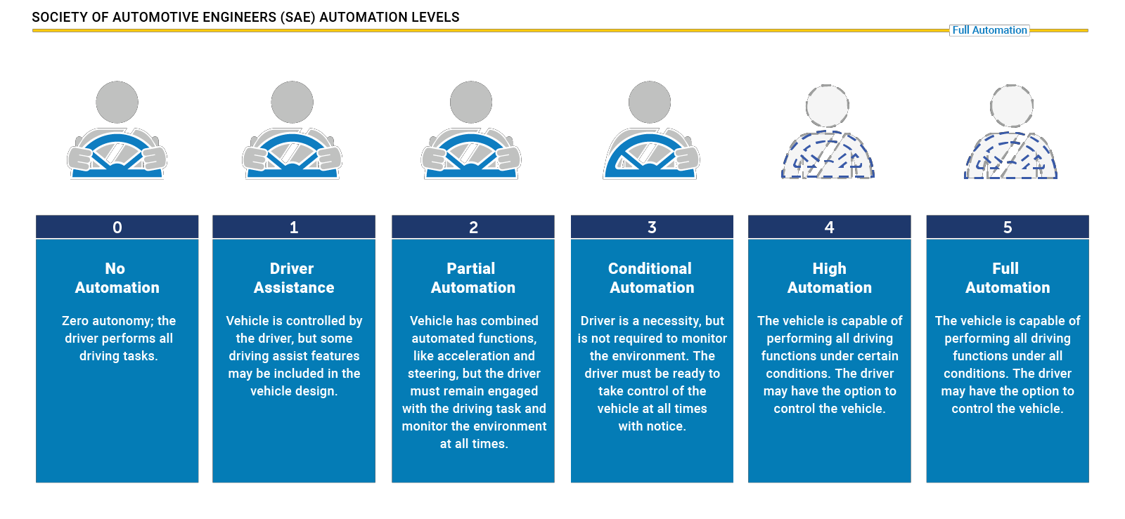
SAE Levels of Automation
Source: https://www.nhtsa.gov/technology-innovation/automated-vehicles-safety

Slide 3
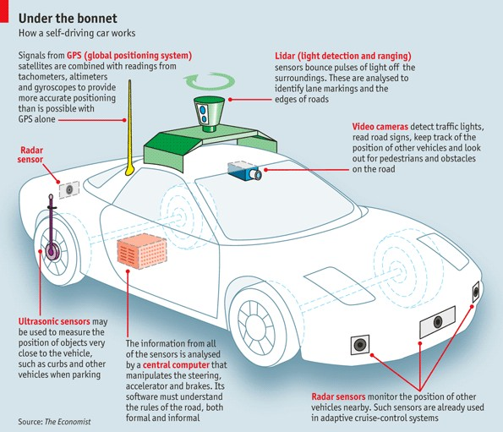
Basic Physical Ecosystem of an Autonomous Vehicle
Global Positioning System (GPS)
Light Detection and Ranging (LIDAR)
Cameras (Video)
Ultrasonic Sensors
Central Computer
Radar Sensors
Dedicated Short-Range Communications-Based Receiver (not pictured)
Source: The Economist, “How does a self-driving car work?”

Slide 4
3.1. Attacks on Internal Networks
3.1.1. Passcode and Key attacks
passcode and keys are one of the safety features of the connected cars. Multiple attempts may crack the password or keys which works on the IR based technologies can be easily hacked. Brute force attack on the passcode can crack the passcodes of the connected cars.

Slide 5
Key Physical Components of Autonomous Vehicles
Cameras – Provide real-time obstacle detection to facilitate lane departure and track roadway information (like road signs).
Radar – Radio waves detect short & long-range depth.
LIDAR – Measures distance by illuminating target with pulsed laser light and measuring reflected pulses with sensors to create 3-D map of area.
GPS – Triangulates position of car using satellites. Current GPS technology is limited to a certain distance. Advanced GPS is in development.
Ultrasonic Sensors – Uses high-frequency sound waves and bounce-back to calculate
distance. Best in close range.
Central Computer – “Brain” of the vehicle. Receives information from various components and helps direct vehicle overall.
DRSC - Based Receiver – Communications device permitting vehicle to communicate with other vehicles (V2V) using DSRC, a wireless communication standard that enables reliable data transmission in active safety applications. NHTSA has promoted the use of DSRC.

Slide 6
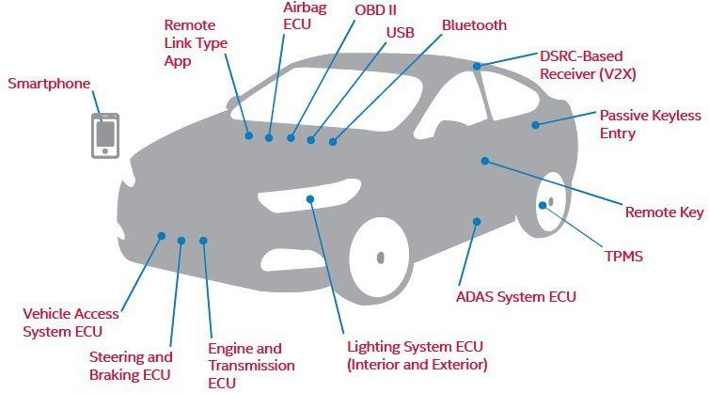
Potential Attack Gateways
Electrical Control Units (ECUs)
Airbag, Advanced Driver Assistant System, Engine, Steering & Brakes, etc.
On-Board Diagnostics (OBD) II Diagnostic Port
Dedicated Short-Range
Communications-Based Receiver
USB Ports
Passive Keyless Entry/ Remote Key
Remote Link Type App
Tire Pressure Monitoring System (TPMS)
Source: Telematics Wire: Cybersecurity – A Gating Issue for Safety in A Connected and Automated Vehicle Future

Slide 7
Explanation of Key Attack Gateways
Electronic Control Units (ECUs) – ECUs are embedded systems that control one or more electrical systems or subsystems within a vehicle and are connected via an internal network. They control systems like the engine and transmission, steering and brakes, infotainment, lighting, etc. Risks arise when access to ECUs (usually peripheral ECUs like an infotainment system) are breached and malicious actors are able to access certain ECUs or the whole network. Vehicles today have up to 100 ECUs onboard.
OBD II Diagnostic Port – Every car manufactured after 1996 and sold in the U.S. must have an OBD II installed. The port was originally mandated to permit monitoring of emissions, etc. It is increasingly used to facilitate non-diagnostic features like enabling Wi- Fi, or enabling an insurance company to track usage through attachment of a “dongle” to the port. These ports can provide a means of access for attackers into an otherwise secure system.
DSRC-Based Receivers – DSRC is being promoted as a means of encouraging V2V and vehicle-to-infrastructure (V2I) communications. The short-wave communications can be subject to spoofing and other attacks. There’s now a push to move to more advanced 5G- based communications.

Slide 8
Common Security Vulnerabilities
Software Glitches – Connected vehicles today contain more than 100 million lines of code. More code means more opportunity for bugs and mistakes. Glitches, even when inadvertent, can be exploited.
No Single Source of Knowledge of or Control Over Source Code – Software for different components of connected vehicles is being written by different developers, installed by different supplies, and no one source has knowledge of or control over the source code.
Increase Use of Apps Leave Vulnerabilities – Consumers are using an increasing number of smartphone apps to interface with their connected cars and help run certain functions. Researchers have already demonstrated weaknesses in some of these apps. Likely to see spread in use of malware.
Need for Constant Updates May be Overlooked – With the increased use of connected features comes an increased need for continuous updates to fix glitches and help protect vehicles. There is a risk these updates could be overlooked or that malicious actors could infect routine updates.

Slide 9
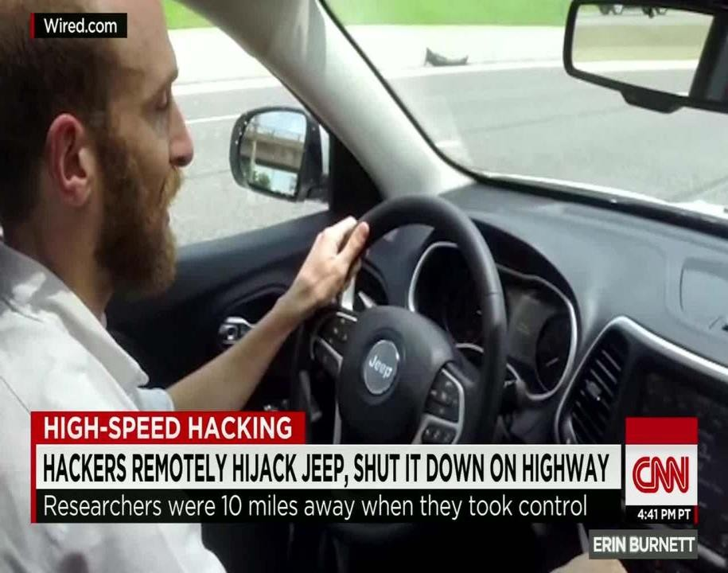
Cybersecurity Threats and Concerns
The same types of attacks that are possible in any connected device are generally possible in connected vehicles once access is gained.
For example – Denial-of-service (DoS) attacks (e.g., utilizing the Controller Area Network (CAN) Bus system), remote access and control (e.g., the 2015 Jeep event), man-in-the-middle (MiM) attacks, etc.
The difference between attacks like these against common IoT devices and attacks within a connected or autonomous vehicle is the likelihood for increased risk to life and property in the vehicle context.
Source: CNN: Jeep remotely carjacked, shut down on highway
The 2015 white hat attack on a Jeep Cherokee led to the recall of 1.4 million vehicles and highlighted risks.

