Slide 1


Sentiment analysis for depression based on reddit
Dinesh Saud(200570137)
Amit Magar (200567979)

Slide 2

Project Overview
The project aims to develop an entire sentiment analysis automation system to process Reddit posts originating from the r/depression subreddit. Our DAG implemented within Apache Airflow served to retrieve Reddit data through PRAW and process it before running NLTK VADER sentiment analysis. The system uses Docker to containerize its operations while Docker Compose provides management for ensuring consistent and re-executable workflows. The automation system executes an on-time schedule for fetching Reddit posts and processes these documents for sentiment analysis before creating organized CSV files for potential visualization or analysis needs. Real-world unstructured data becomes more actionable due to the successful integration of data engineering methods with natural language processing techniques.

Slide 3
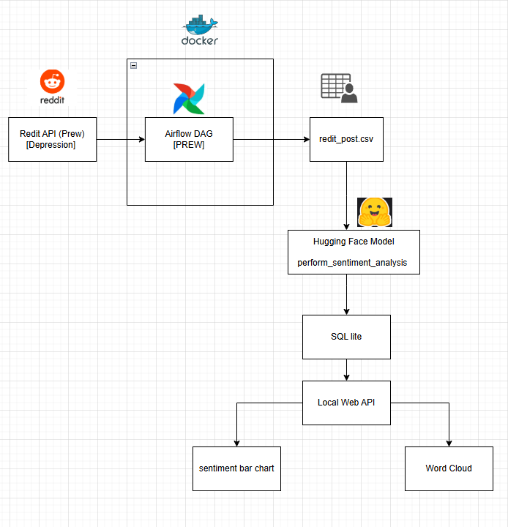
Tools and Technologies
Reddit API via PRAW – for scraping posts from r/depression
NLTK (VADER) – for sentiment analysis
Pandas – for data handling & CSV export
Apache Airflow – to orchestrate the pipeline (DAG)
Docker + Docker Compose – to containerize Airflow setup
PostgreSQL – as Airflow metadata DB

Slide 4
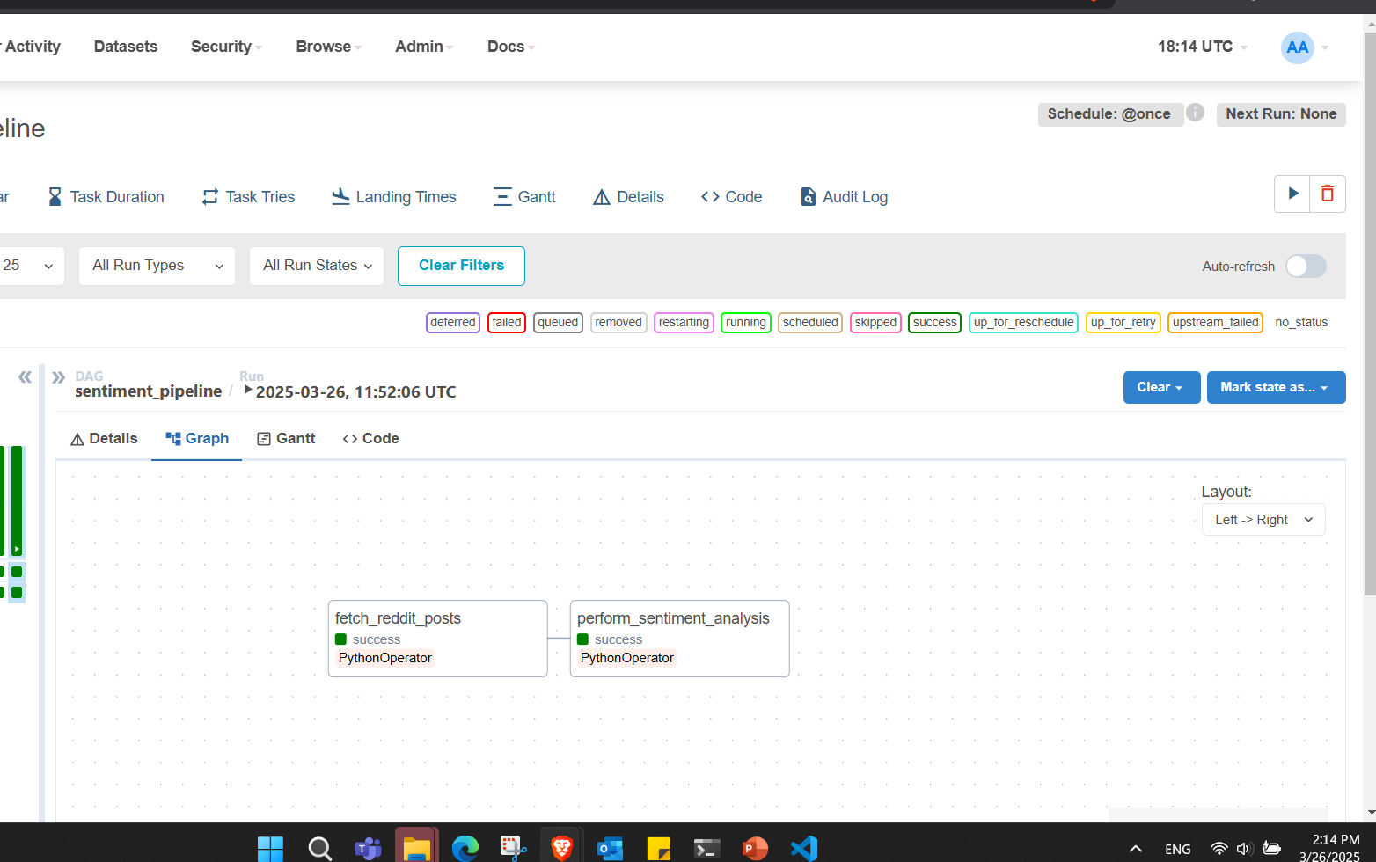
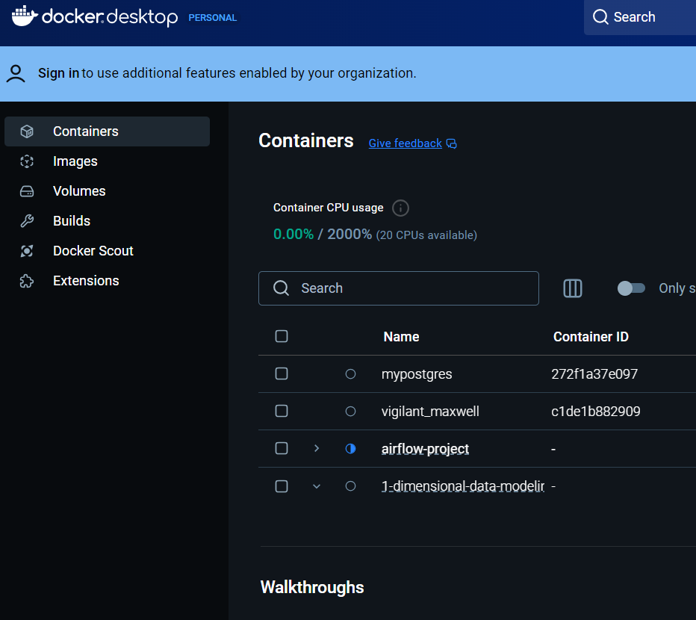
Airflow Dags for sentiment pipeline and Docker setup

Slide 5
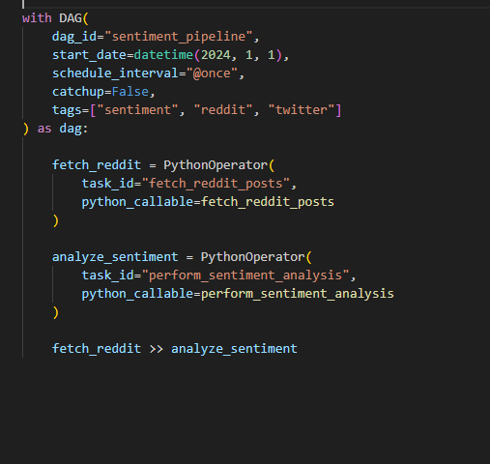
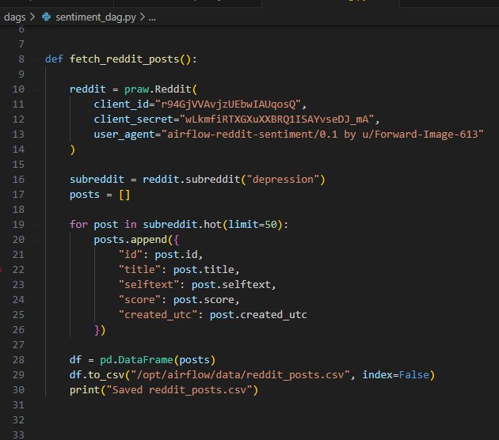
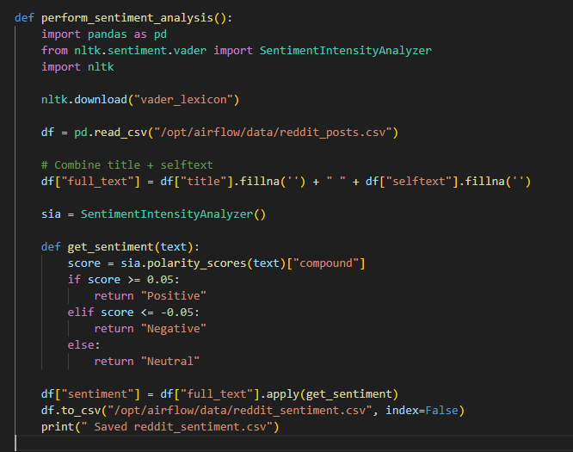
Airflow Pipeline for fetching data and sentiment analysis

Slide 6
Challenges and limitations
Data Imbalance: The dataset collected from Reddit posts under the keyword “depression” resulted in zero positive sentiment records, which caused skewed sentiment distribution and limited the effectiveness of visualizations.
Sentiment analysis pipeline with text bolb method was performing too poor.
Context Sensitivity: Some posts contained nuanced or supportive language within overall negative topics, which may have been misclassified due to limited context handling by the sentiment model.
Word Cloud Limitations: Since there were no positive posts, the positive word cloud appeared empty or sparse, making visual comparison across sentiment classes incomplete.
Polarity Graph Issues: Lack of positive polarity values resulted in empty or flat polarity distribution, reducing the analytical depth.
No Custom Training: The project relied entirely on a pre-trained Hugging Face model. Fine-tuning on depression-related text could improve classification accuracy and sensitivity.
Platform Bias: Data was collected from a single subreddit (r/depression), which naturally biases results towards negative sentiments and doesn’t represent broader public opinion.

Slide 7
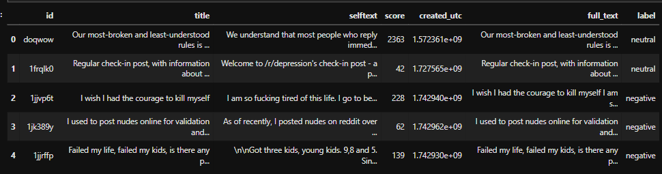
Data OverView

Slide 8
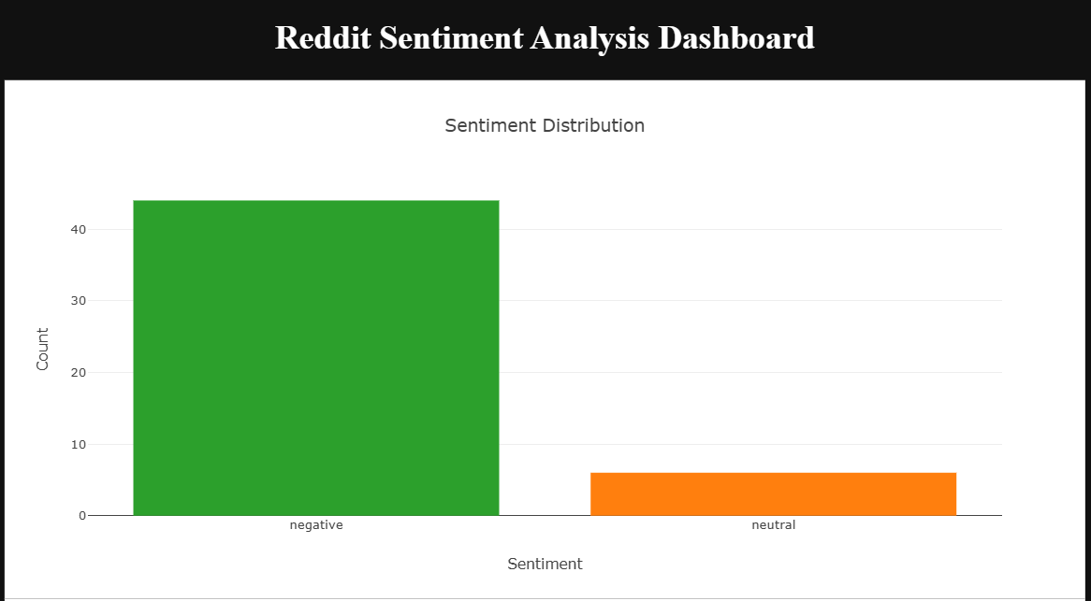
Sentiment Distribution

Slide 9
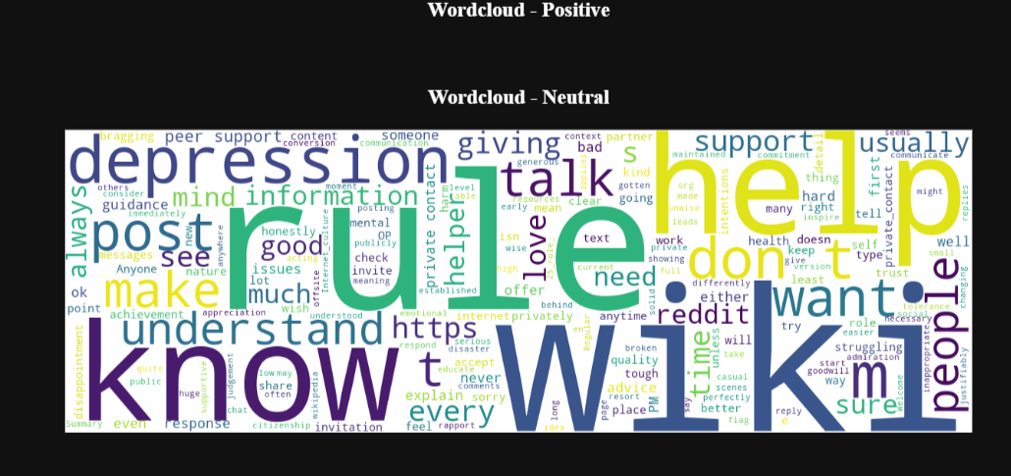
Positive (0) and Neutral World Cloud

Slide 10
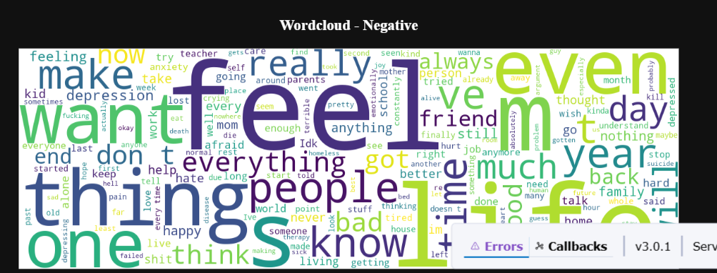
Negative World Cloud

Slide 11

Conclusion
This project successfully demonstrates how automated sentiment analysis can be achieved using Apache Airflow. By integrating the Reddit API for data collection, VADER from NLTK for sentiment classification, and orchestrating the entire process through Airflow DAGs, we created a scalable and maintainable pipeline. Containerization with Docker Compose further enhanced the deployment process, making it portable and reproducible. The modular design also allows future extensions, such as incorporating other subreddits, using advanced sentiment models like BERT, or connecting the output to visualization tools like Power BI or Tableau for real-time insights.

