Slide 1
Employee Data Analysis using Excel
DINESH S
312219410
BCOM(GENERAL)
SA COLLEGE OF ARTS AND SCIENCE
STUDENT NAME:
REGISTER NO:
DEPARTMENT:
COLLEGE

Slide 2
PROJECT TITLE
Employee Performance Analysis using Excel
Excel Project for Data Analysis: The Six Steps Approach

Slide 3


AGENDA
Problem Statement
Project Overview
End Users
Our Solution and Proposition
Dataset Description
Modelling Approach
Results and Discussion
Conclusion
3/21/2024 Annual Review

Slide 4

PROBLEM STATEMENT
This step, defines the problem statement to solve. Analyst collaborate with the stakeholders and understand their needs.
Prepare: Here, we will choose what type of data needs to be collected to solve the problem. How to organise this data.
Process: This step involves tasks related to data cleaning like error removal, data formatting, and combining data from various sources.
Analyse: To deep dive into the processed data to extract insights and draw conclusions, like Data Aggregation.
Share: The focus shifts towards communicating findings using charts, graphs, and other visualizations to make the data understandable and conclude insights derived from the analysis to relevant stakeholders.
Act: The emphasis is on taking action based on the insights and recommendations derived from the analysis.

Slide 5

PROJECT OVERVIEW
.Trend Analysis: Analysing the trends in electricity consumption over the years for planning and management.
City Comparison: Comparing electricity usage across different cities to identify high and low consumption patterns.
Sector Analysis: Understanding the consumption patterns across different sectors (Industrial, Residential, Commercial).
For the phase 1: The stakeholders want some details:
Consumption of Electricity (in lakh units) for Commercial purpose for Indore City.
Calculate the total electricity consumption by Indian cities.
Which city consume maximum and minimum amount of electricity for Industrial Purpose?
Total electricity consumption on yearly basis.
If there is any trend(increase/decrease) in the electricity consumption?

Slide 6

WHO ARE THE END USERS?
Step 3: Data Processing : Cleaning
Data integrity refers to the quality of data being accurate, complete, consistent, and trustworthy throughout its entire lifecycle, ensuring its reliability and suitability for analysis. Cleaning data, in this context, signifies that the data possesses these attributes before undergoing analysis.

Slide 7

OUR SOLUTION AND ITS VALUE PROPOSITION
Step 4: Analysing The dataset
After data cleaning, dataset can be analysed.
4. 1 To know the value of Consumption of Electricity (in lakh units) for Commercial purpose for Indore City.
For this, we will use VLOOKUP function, It searches for a certain value in a column to return a corresponding piece of information. The formula for VLOOKUP is given below:
=VLOOKUP(lookup value, range containing the lookup value, the column number in the range containing the return value, Approximate match (TRUE) or Exact match (FALSE)).
V_lookup-(1)
Example: Vlookup function (Indore City electricity consumption – Commercial purpose)
4.2 To determine the aggregate electricity consumption across Indian cities.
We will employ the SUM function for data aggregation. This function allows us to calculate the total consumption by summing up the values within the specified range, which in this case is from cell H2 to H48 using the formula: =SUM(H2:H48)
sum-(1)
Using Sum function to find the total consumption by all the cities
Additionally, the Pivot Table tool can serve as an alternative method for aggregating and summarizing data. By utilizing Pivot Tables, we can efficiently analyze and present the total electricity consumption across various cities in a structured and customizable format. It’s a powerful tool to calculate, summarize and analyze data that lets you see comparisons, patterns, and trends in your data.
For moving on to next problem statement, we will be using: Exploring Data with PivotTables in Excel
To accomplish the tasks in the project, we will leverage the functionality of PivotTables within Excel, facilitating a structured and comprehensive analysis of the provided dataset. Through this approach, we aim to derive detailed insights into the electricity consumption patterns of Indian cities, enabling informed decision-making by the stakeholders.
4.3 Now, next major problem, which city consumes maximum and minimum amount of electricity for Industry Purpose?

Slide 8
Dataset Description
Total electricity consumption on per year basis.
Steps to find the value:
Select the table and add Pivot Table.
In the Pivot Table options, click the dropdown symbol of Consumption of Electricity (in lakh units)-Total Consumption and select Add to Values.
In the
∑
∑ Values box, Consumption of Electricity (in lakh units)-Total Consumption is added. Click the Dropdown menu there and select Value Field Settings.
In the Summarize Value By, choose SUM and click OK.

Slide 9

THE "WOW" IN OUR SOLUTION
Employing graphical representations such as charts, we can effectively illustrate and present the conclusions drawn from our analysis. Utilizing charts enables us to visually depict various aspects of the data, including trends, comparisons, and distributions, thereby enhancing the clarity and comprehensibility of our findings
3/21/2024 Annual Review
9

Slide 10
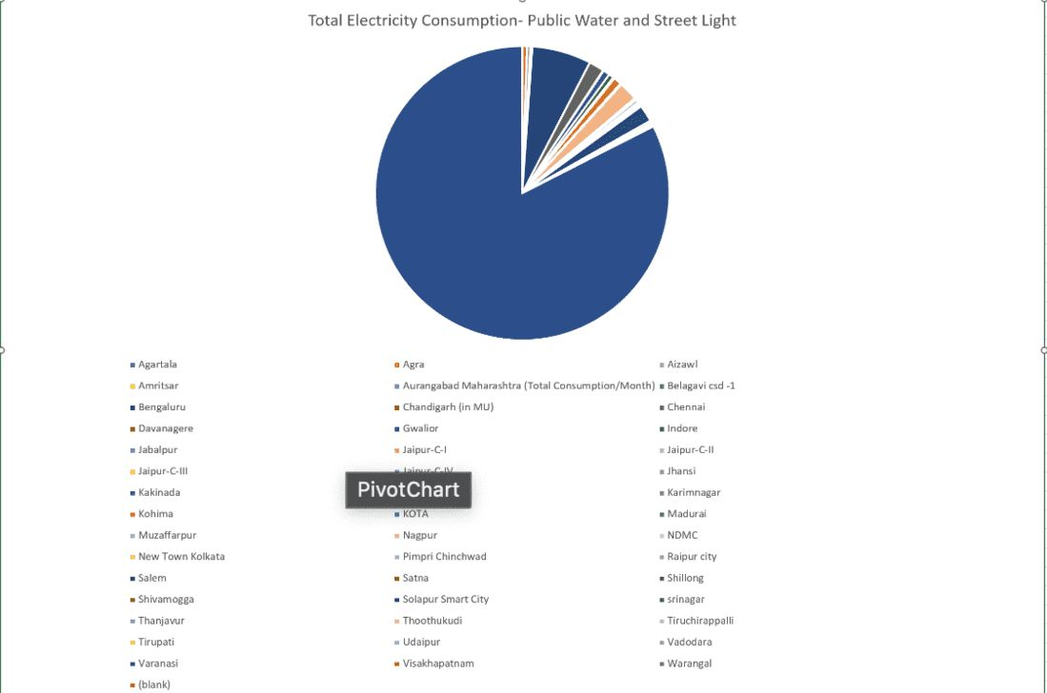
MODELLING
10

Slide 11
RESULTS
n the Act phase, stakeholders are presented with the opportunity to enact strategic decisions based on the insights derived from the analysis of electricity consumption patterns in Indian cities. These decisions may include:
Implementing targeted measures aimed at reducing electricity consumption in cities, particularly for industrial purposes. This could involve the introduction of energy-efficient technologies, the establishment of incentive programs for energy conservation, or the implementation of regulatory measures to promote sustainable energy practices.
11

Slide 12
conclusion
Data Analysts uses Excel to find some in-depth insights from the data which can blow everyone’s mind and use such insights to make the system more efficient.

