Slide 1
AI in web applications
Id : IN16CS225
By dinesh sonachalam,
keshav,
vignesh.

Slide 2
Abstract
Artificial Intelligence has gained more interest in the recent days. With Apple introducing Siri, an built-in "intelligent assistant" that enables users of Apple iPhone devices to speak natural language voice commands in order to operate the mobile device and its apps.
The feature uses a natural language user interface to answer questions, make recommendations, and perform actions by delegating requests. This technology is disruptive and can be applied to a wide variety of applications including the web

Slide 3
Introduction
Web applications and their programming languages have evolved quickly from the initial static HTML pages but the way of interaction pretty much remains the same.
Today’s web applications require either a keyboard and/or a mouse input to interact . Though this is traditional, it is time consuming and not human friendly.
A lot of potential information could be lost and web designers spend much of their time in designing their applications in a easy and human friendly way to make sure the information is not lost.

Slide 4
Existing technology
Most websites today still need a mouse and keyboard to be accessed.
This traditional method becomes tedious when handling complex websites.
When the website's layout is changed, it again introduces an hurdle in finding the exact article which is being searched.

Slide 5
system architecture
The system normally takes speech input from the user and coverts those it into a valid texts.
These texts are converted into some valid action by defining the required action .
So that as the user give a request by means of voice, so that he will be able to get some valid information.

Slide 6
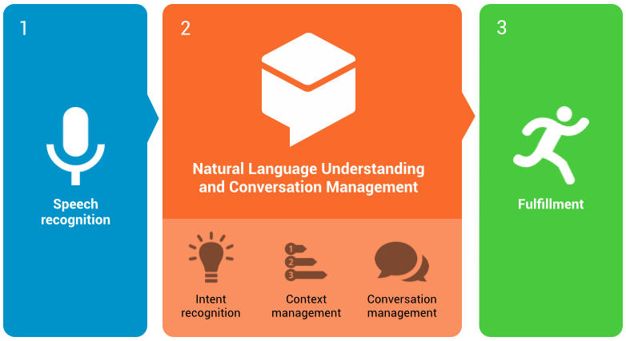
Proposed Solution
Natural language should we the way to interact as it is human friendly.
This increases usability and will be helpful for people with disability.

Slide 7
Advantage of Proposed Solution
It’s main objective is to make the user interaction healthy and user friendly, rather than becoming clumsy.
This system kindles the act of questioning and getting to know about useful facts.
The visual impaired people can easily interact with those voice integrated application and they will get a great sense of knowledge.

Slide 8
Business scope
Working on the domain of voice integrated application has a high potential of growth as there been huge hype over these concept recent days.
Companies like google ,Microsoft and facebook have already working and delivered a huge project of their own such as Siri and Cortana been a real time assit application.
My application can be used in the place of learning ,were learning by hearing from this virtual assistant paves to new extent of knowledge development.

Slide 9
Conclusion
Web application such as virtual assistants need to have capability of taking the voice input and process them into a valid response.
Natural language should be basic medium for interacting with those web application and giving a request.
Lot of potential might not be lost because user gets a valid response for the speech input.
Voice integrated system saves and complexity of interaction with the web application.

Slide 10
Future work
We are planning to reach the web application to new extend by pairing them with all the sites which needs them.
The voice integrated sites are able to respond to their request by means of this application.
Delivering a great sense of user friendliness among the users and the clients

Slide 11
Thank you!

