Slide 1


Stream cipher and Block Cipher Chapter-3: Block Ciphers and the Data Encryption Standard
Introduction & Programming with
ESP8266
Mohammad Asif
Assistant Professor
Department of Computer Science and Engineering

Slide 2

Content
Stream ciphers and block ciphers
Block Cipher Principles
Data Stream ciphers and block ciphers
Confusion & Diffusion
Data Encryption Standard (DES)
Avalanche Effect
Strength of DES
Design principles of block cipher
INDEX

Slide 3
Stream cipher and Block Cipher:
A stream cipher is one that encrypts a digital data stream one bit or one byte at a time.
Examples:
Autokeyed Vigenère cipher
A5/1 RC4
Vernam cipher.

Slide 4


Stream cipher and Block Cipher:
Key(k )
Bit-stream Generation algorithm
Key(k_{i}) 010101
Bit-stream Generation algorithm
i
010101
K_{i}
K_{i}
Plaintext(p_{i})
100101
Ciphertext(c_{i})
110000
Plaintext(p_{i})
100101
ENCRYPTION
DECRYPTION

Slide 5
Stream cipher and Block Cipher:
A block cipher is one in which a block of plaintext is treated as a whole and used to produce a ciphertext block of equal length.
Typically, a block size of 64 or 128 bits is used.
Examples: Feistel cipher DES
Triple DES AES

Slide 6
Stream cipher and Block Cipher:
b bits
b bits
Plaintext
Ciphertext
Key
(K)
Key
(K)
Decryption
Algorithm
Encryption Algorithm
Ciphertext
Plaintext
b bits
b bits

Slide 7
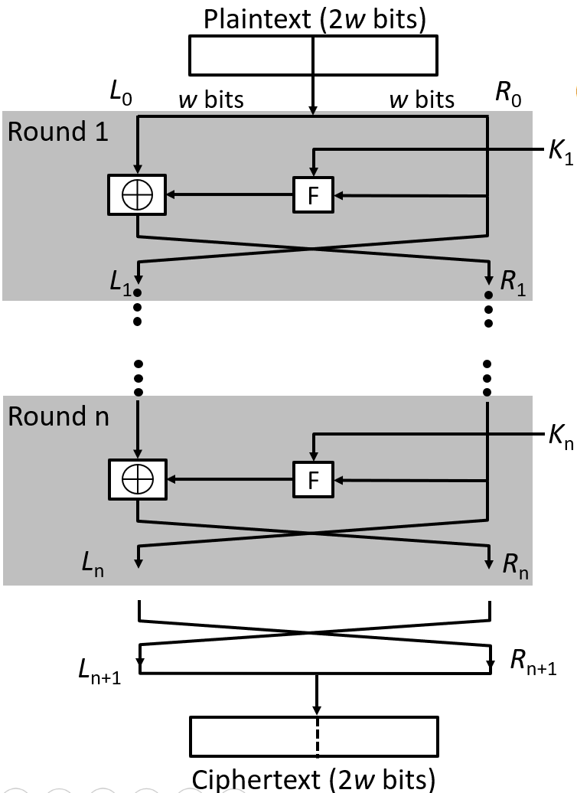

Block Cipher Principle – Fiestel Structure
Plaintext is split into 32- bit halves L_{i} and R_{i}
R_{i} is fed into the
function F.
The output of function F is then XORed with L_{i}
Left and right half are swapped.
^{L}i ^{= R} i – 1

Slide 8
Block Cipher Principle – Fiestel Structure
Block size: Common block size of 64-bit. However, the new algorithms uses a 128-bit, 256-bit block size.
Key size: Key sizes of 64 bits or less are now widely considered to be
insufficient, and 128 bits has become a common size.
Number of rounds: A typical size is 16 rounds.
Round function F: This phase consisting of sixteen rounds of the same function, which involves both permutation and substitution functions. Again, greater complexity generally means greater resistance to cryptanalysis.
Subkey generation algorithm: For each of the sixteen rounds, a different subkey (Ki) derived from main key by the combination of a left circular shift and a permutation. Greater complexity in this algorithm should lead to greater difficulty of cryptanalysis.

Slide 9
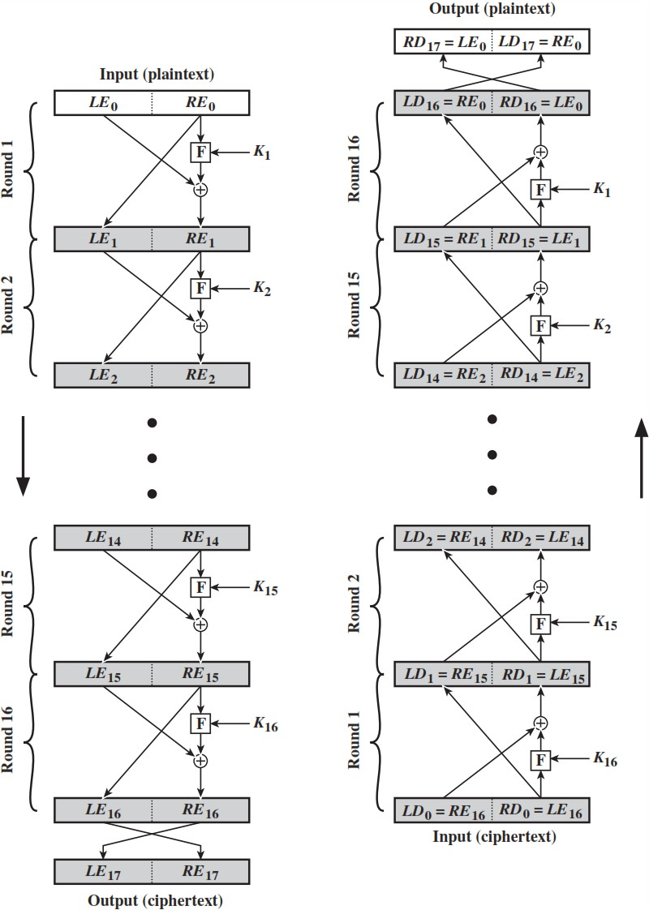
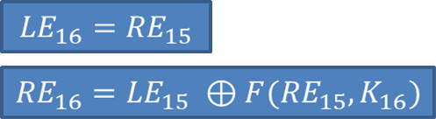
Block Cipher Principle – Fiestel Structure
Prove that o/p of first round of Decryption is equal to 32-bit swap o i/p of 16th round of Encryption LD1=RE15 & RD1=LE15
On Encryption Side:

Slide 10
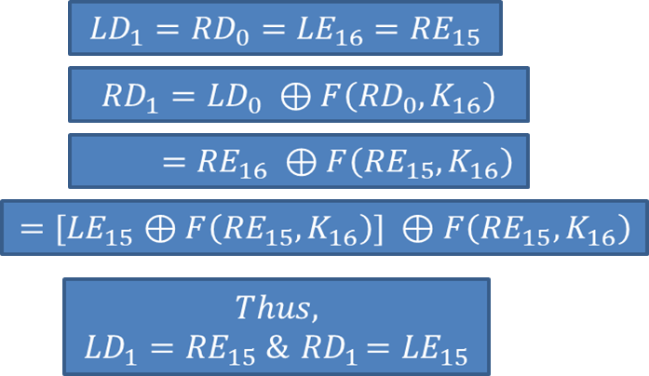
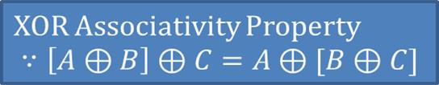
Block Cipher Principle – Fiestel Structure
On Decryption Side:

Slide 11
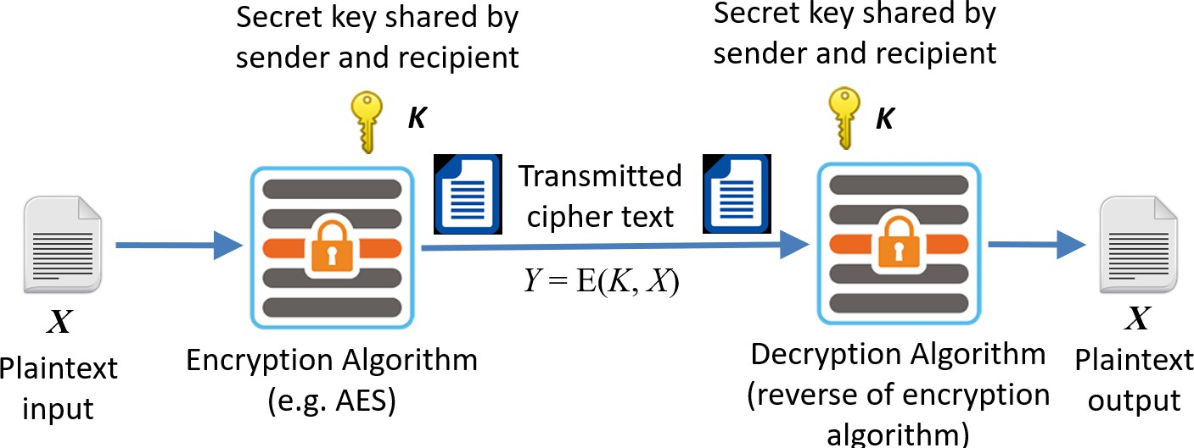
Symmetric Cipher Model

Slide 12
Stream cipher and Block Cipher:
A stream cipher is one that encrypts a digital data stream one bit or one byte at a time.
Examples:
Autokeyed Vigenère cipher
A5/1 RC4
Vernam cipher.

Slide 13
Stream cipher and Block Cipher:
Key(k )
Bit-stream Generation algorithm
Key(k_{i}) 010101
Bit-stream Generation algorithm
i
010101
K_{i}
K_{i}
Plaintext(p_{i})
100101
Ciphertext(c_{i})
110000
Plaintext(p_{i})
100101
ENCRYPTION
DECRYPTION

Slide 14
Stream cipher and Block Cipher:
A block cipher is one in which a block of plaintext is treated as a whole and used to produce a ciphertext block of equal length.
Typically, a block size of 64 or 128 bits is used.
Examples: Feistel cipher DES
Triple DES AES

Slide 15
Stream cipher and Block Cipher:
b bits
b bits
Plaintext
Ciphertext
Key
(K)
Key
(K)
Decryption
Algorithm
Encryption Algorithm
Ciphertext
Plaintext
b bits
b bits

Slide 16
Confusion & Diffusion:
Confusion
Confusion hides the relationship between the cipher text and the key.
This is achieved by the use of a complex substitution algorithm.
Diffusion
Diffusion hides the relationship
between the cipher text and the plaintext.
This is achieved by changing one
plaintext digit which affect the value of many cipher text digits.
Y1=1011 1001
X1=0010 1011
Diffusion
Y2=0110 1100
X2=0000 1011
Single bit flip
Many bit flips

Slide 17
Symmetric Cipher Model

Slide 18
Data Encryption Standard (DES):
Type: Block Cipher Block Size : 64-bit
Key Size: 64-bit, with only 56-bit effective
Number of Rounds: 16

Slide 19
64-bit key
64-bit plaintext
Initial Permutation
Permuted choice 1
6
4
5
6
K₁
4
8
Permuted choice 2
5
6
Left circular shift
Round 1
6
4
5
K₂
4
8
Permuted choice 2
5
6
Left ci⁶rcular
Round 2
shift
K₁
6
4
8
Permuted choice 2
5
6
Left circular
shift
Round 16
32-bit swap
6
4
Inverse Initial Permutation
64-bit

Slide 20


Data Encryption Standard (DES):
X
Initial Permutation
X
Encryption Round 1
64
K₁
DES
56
K_{i}
64
Encryption Round 16
^{K}16
Y
Final permutation
Y

Slide 21
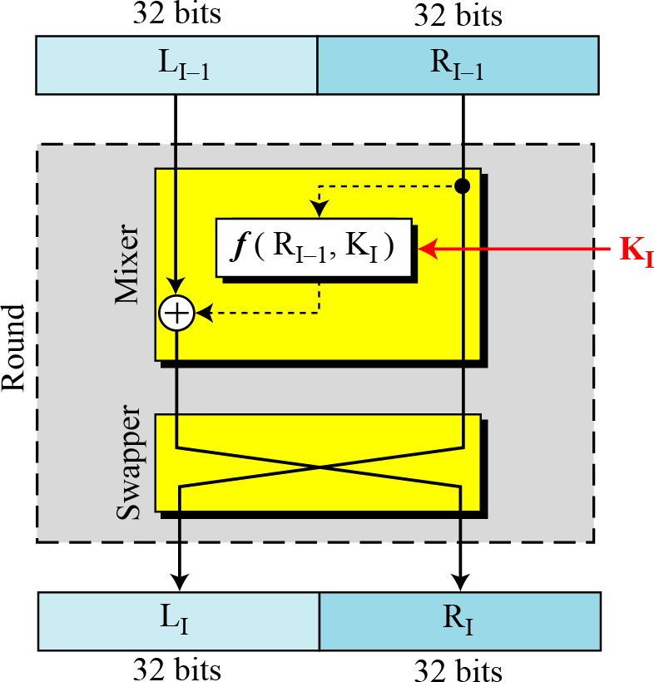
Data Encryption Standard (DES) – Single round of DES:

Slide 22








32-bits
32-bits
28-bits
28-bits
Expansion/ permutation (E table)
Left Shift (S)
Left Shift
(S)
48
K_{i}
Permutation/ compression (Permuted choice 2)
XOR
48
48
Substitution/choice (S-box)
32
Permutation (P)
32
XOR

Slide 23
Data Encryption Standard (DES):
Initial permutation: First, the 64-bit plaintext passes through an initial permutation (IP) that rearranges the bits to produce the permuted input.
The F function: This phase consisting of sixteen rounds of the same function, which involves both permutation and substitution functions.
Swap: L and R swapped again at the end of the cipher, i.e., after round 16 followed by a final permutation.
Inverse (Final) permutation: It is the inverse of the initial
permutation.
Subkey generation: For each of the sixteen rounds, a different subkey (Ki) derived from main key by the combination of a left circular shift and a permutation.

Slide 24
Data Encryption Standard (DES): - Initial Permutation
1 2 25 40
58 64
The permutation DES
initial
of the
algorithm
changes the order of the plaintext prior to the first round of encryption
1 2 8 25 40 58 64
16 Rounds
The final permutation occurs after the sixteen rounds of DES are completed. It is the inverse of the
1 2 25 40 58 64
initial permutation.
1
2
8
25
40
58 64

Slide 25
Data Encryption Standard (DES): Initial and Final Permutation
IP
58 | 50 | 42 | 34 | 26 | 18 | 10 | 2
60 | 52 | 44 | 36 | 28 | 20 | 12 | 4
62 | 54 | 46 | 38 | 30 | 22 | 14 | 6
64 | 56 | 48 | 40 | 32 | 24 | 16 | 8
57 | 49 | 41 | 33 | 25 | 17 | 9 | 1
59 | 51 | 43 | 35 | 27 | 19 | 11 | 3
61 | 53 | 45 | 37 | 29 | 21 | 13 | 5
63 | 55 | 47 | 39 | 31 | 23 | 15 | 7
_{IP}-1
40 | 8 | 48 | 16 | 56 | 24 | 64 | 32
39 | 7 | 47 | 15 | 55 | 23 | 63 | 31
38 | 6 | 46 | 14 | 54 | 22 | 62 | 30
37 | 5 | 45 | 13 | 53 | 21 | 61 | 29
36 | 4 | 44 | 12 | 52 | 20 | 60 | 28
35 | 3 | 43 | 11 | 51 | 19 | 59 | 27
34 | 2 | 42 | 10 | 50 | 18 | 58 | 26
33 | 1 | 41 | 9 | 49 | 17 | 57 | 25

Slide 26
Data Encryption Standard (DES): The f Function
^{R}i-1
32
Expansion/permutation (E table)
48
Main operation of DES
f-function inputs:
Ri-1 and round key ki
4 Steps:
K_{i}
XOR
48
48
1. Expansion E
6
6
6
6
6
6
6
6
2. XOR with round key
S1
S2
S3
S4
S5
S6
S7
S8
4
4
4
4
4
4
4
4
3. S-box substitution
32
4. Permutation
Permutation (P)
32

Slide 27
Data Encryption Standard (DES): The f Function – The Expansion
^{R}i-1
Function
Main purpose: Increases diffusion
32
Expansion/permutation (E table)
48
Since Ri-1 is a 32-bit input and Ki is a 48-bit key, we first need to expand Ri-1 to 48 bits.
Input: (8 blocks, each of them consisting 4 bits) - 32 bits
Output: (8 blocks, each of them consisting 6 bits) – 48 bits
Expansion Table E
32 | 1 | 2 | 3 | 4 | 5
4 | 5 | 6 | 7 | 8 | 9
8 | 9 | 10 | 11 | 12 | 13
12 | 13 | 14 | 15 | 16 | 17
16 | 17 | 18 | 19 | 20 | 21
20 | 21 | 22 | 23 | 24 | 25
24 | 25 | 26 | 27 | 28 | 29
28 | 29 | 30 | 31 | 32 | 1

Slide 28
Data Encryption Standard (DES): XOR round Key
XOR Round Key
After the
^{R}i-1
expansion
32
permutation, DES uses the XOR operation on the expanded right section and the round key.
Expansion/permutation (E table)
48
K_{i}
XOR
Note that both the right section and the key are 48-bits in length now.
48
48

Slide 29
Data Encryption Standard (DES): S-Box substitution
Eight substitution tables.
6 bits of input
4 bits of output.
Convert 48 bits to 32 bits
Non-linear and resistant to differential cryptanalysis.
^{R}i-1
32
Expansion/permutation (E table)
48
K_{i}
Crucial element for DES security!
Introduces confusion.
XOR
48
48
6
6
6
6
6
6
6
6
S1
S2
S3
S4
S5
S6
S7
S8
4
4
4
4
4
4
4
4
32

Slide 30
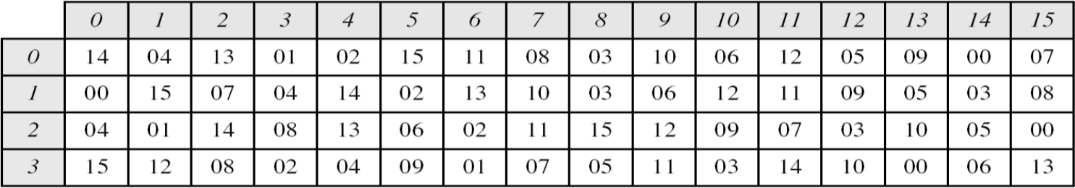
Data Encryption Standard (DES): S-Box substitution
The outer two bits of each group select one row of an S-box. Inner four bits selects one column of an S-box.
S-box 1
Example:
Input
0 | 1 | 1 | 0 | 0 | 1
Output
1 | 0 | 0 | 1
Row
Column

Slide 31
Data Encryption Standard (DES): The Permutatio3n2
^{R}i-1
Expansion/permutation (E table)
Permutation P
Bitwise permutation.
Introduces diffusion.
48
K_{i}
XOR
48
48
Permutation Table P |  |  |  |  |  |  |  | 6
16 | 7 | 20 | 21 | 29 | 12 | 28 | 17
 |  |  |  |  |  |  |  | S1
01 | 15 | 23 | 26 | 05 | 18 | 31 | 10 | 4
02 | 08 | 24 | 14 | 32 | 27 | 03 | 09
19 | 13 | 30 | 06 | 22 | 11 | 04 | 25
6
6
6
6
6
6
6
S2
S3
S4
S5
S6
S7
S8
4
4
4
4
4
4
4
32
Permutation (P)
32

Slide 32
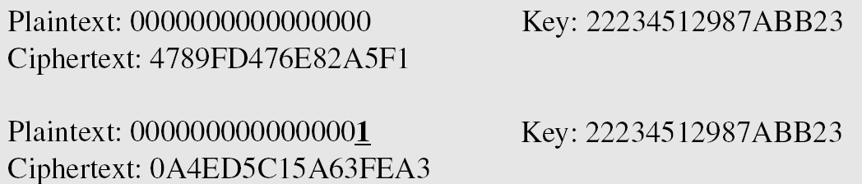
Avalanche Effect
Desirable property of any encryption algorithm is that a change in one bit of the plaintext or of the key should produce a change in many bits of cipher text.
DES performs strong avalanche effect.
Although the two plaintext blocks differ only in the rightmost bit, the cipher text blocks differ in 29 bits.
This means that changing approximately 1.5 % of the plaintext creates a change of approximately 45 % in the ciphertext.

Slide 33
Strength of DES
The use of 56-bit keys: 56-bit key is used in encryption, there are 256 possible keys. A brute force attack on such number of keys is impractical.
The nature of algorithm: Cryptanalyst can perform cryptanalysis by exploiting the characteristic of DES algorithm but no one has succeeded in finding out the weakness.

Slide 34
Design Principle of Block Cipher :
ConfusionPurpose: Make the relationship between the ciphertex
and the encryption key as complex as possible.Achieved by: Using substitution operations (like S-boxes).
Effect: Even a small change in the key or plaintext causes major,
unpredictable changes in ciphertext.
DiffusionPurpose: Spread the influence of a single plaintext bit across many ciphertext bits. Achieved by: Using permutation and mixing operations.
Effect: Changing one bit of the plaintext affects many bits of the ciphertext.

Slide 35
Design Principle of Block Cipher :
Kerckhoffs’s Principle : A cipher should remain secure even if everything about the system (except the key) is public knowledge. Focuses security entirely on the secrecy of the key, not the algorithm.
Iterative Structure (Rounds)Instead of a single operation, block ciphers apply multiple rounds of transformations. Each round improves confusion and diffusion.
Example: AES uses 10, 12, or 14 rounds depending on key size.
Key Expansion The key schedule algorithm generates a different subkey for each round from the original key. Strong key expansion ensures better security.

Slide 36


