Slide 1
The Korea Zinc Case
Two Tender Offers, One Sunday Night — A Pension Fund Decides

Slide 2



CASE SUMMARY • PART 1
Background & The 75-Year Partnership Fracture
1949–1974: Two Families
The Troika Drive Split
Treasury Share Swaps
Founded by Chang & Choi families. Chang side held Yeongpoong (~33%), Choi side ran operations at Korea Zinc.
Chairman Choi committed capex to green energy & battery recycling. Yeongpoong questioned returns & process.
Korea Zinc swapped treasury stock with partners (Hyundai, LG Chem) to revive voting rights into friendly hands.

Slide 3
CASE SUMMARY • PART 2
The Battle of Two Competing Offers
OFFER 1 • ATTACKERS
OFFER 2 • DEFENDERS
MBK Partners + Yeongpoong
Korea Zinc + Bain Capital
Launched at ₩660k, raised to ₩750k, finalized at ₩830,000 per share on 4 Oct.
Launched at ₩830k, raised to ₩890,000 per share on 11 Oct. Funded via bank debt.
VS
Closing Date: Monday, 14 Oct 2024
Closing Date: Wednesday, 23 Oct 2024
Treatment: Retained with voting rights intact
Treatment: 17.5% share cancelled in full
Exhibit 1 & Exhibit 2
Exhibit 1 & Exhibit 2

Slide 4
CASE SUMMARY • PART 3
NPS Position & The Sunday Night Dilemma
NPS STAKE
LEGAL TIMING
THE DILEMMA
1.55M Shares (7.48%)
Capital Markets Act Art. 136
Return vs Fiduciary vs Voice
Valued at ₩1.23 Trillion. NPS holds the crucial swing vote between both camps .
Amending an offer within 10 days pushes the closing date back 10 days, allowing players to buy time.
Should NPS lock in huge gains, avoid debt-funded buyback fallout, or keep voting power?
Exhibit 11

Slide 5
CORE QUESTION 1
Question 1: The decision. If you were Seo Ji-won, which of the five options would you recommend, and on what grounds? Then defend that recommendation, as you would before a parliamentary audit committee.
Option 1: Tender to MBK (₩830k)
Option 2: Tender to KZ Buyback (₩890k)
Closes Oct 14. Locks in premium immediately, but faces proration and aids hostile takeover.
Closes Oct 23. Higher headline price, but accepts proceeds from debt-funded corporate buyback.
Option 3: Sell On-Market (~₩790k)
Option 4: Hold Entire Position
Immediate cash & zero proration, but market cannot absorb 1.55M shares without price crash .
Preserves swing vote, but exposes fund to severe post-contest price collapse once premium vanishes.
Exhibit 11
Option 5: Split Strategy (RECOMMENDED) Tender ~50–60% of shares into ₩890k buyback to lock in profits, while holding ~40–50% to retain voting influence.

Slide 6
CORE QUESTION 1
Detailed Rationale for Option 5 (Split Strategy)
1. Profit Realization
2. Crash Risk Mitigation
3. Retaining Swing Vote
Tendering part of the stake at ₩890,000 locks in a massive +60.1% premium over pre-contest price of ₩556,000, fulfilling core duty to grow beneficiary assets .
Contest premiums vanish quickly after battles end (e.g. SM Entertainment fell >60%). Holding 100% leaves pensioners fully exposed to severe losses .
Holding the remaining ~40–50% stake (~3–4% voting share after 17.5% cancellation) keeps NPS as the decisive vote to police corporate leverage at future meetings .
Exhibit 10
Exhibit 3
Exhibit 5

Slide 7

CORE QUESTION 1 - PARLIAMENTARY DEFENSE
Defending Option 5 Before Parliamentary Audit
Fiduciary Return Defense:
Locked in substantial cash gains at a 60.1% premium .
Exhibit 5
"Honorable Committee members, our fiduciary duty is to protect pension savings while exercising corporate stewardship. Refusing to tender forfeits hundreds of billions in guaranteed capital gains for pensioners. Conversely, selling 100% abandons our voting seat. Option 5 secures immediate high returns while ensuring we remain at the table to hold management accountable for their heavy debt."
Market Risk Defense:
Protected beneficiaries from post-battle stock price crashes .
Exhibit 10
Stewardship Defense:
Maintained decisive swing-vote power for upcoming meetings .
Exhibit 3

Slide 8
CORE QUESTION 2
Question 2: Is ₩890,000 the right price? Argue it using Exhibits 5 through 7-B. The gap between the pre-contest close of ₩556,000 and ₩890,000 is ₩334,000. What is that ₩334,000 the price of?
PRE-CONTEST CLOSE
FINAL TENDER PRICE
₩556,000
₩890,000
+ ₩334k =
Smelting Business Baseline Value
+60.1% Total Premium
Exhibit 4
Exhibit 5
Verdict: ₩890,000 is NOT fundamental operating value. Typical Korean control premiums average 20–40%. The 60.1% figure represents an overheated auction for corporate control .
Exhibit 5

Slide 9
CORE QUESTION 2
What is the ₩334,000 Premium Paying For?
1. Control Rights Premium
2. Debt Leverage Risk
3. Value Transfer Fee
The price paid by bidders solely to secure or maintain board command, disconnected from smelting fundamentals .
Reflects ₩2.7T–₩3.22T in debt added to the company's balance sheet, pushing debt-to-equity to 245% by 2030 .
Wealth transferred directly from remaining long-term holders to tendering holders who cash out and leave .
Exhibit 5
Exhibit 6
Exhibit 7-B

Slide 10
CORE QUESTION 3
Question 3: The two break-evens. Reproduce Exhibit 7 and show why earnings per share falls 27% at a 20% cancellation. Then use Exhibit 7-B to test whether “EPS falls” and “shareholders lose value” are the same statement. Under what condition do the two measures diverge?
Cancellation % | Debt (₩T) | Interest (₩B) | Remaining Shares | Change in EPS
5% | 0.92 | 55.3 | 19.67M | -5.7%
10% | 1.84 | 110.5 | 18.63M | -12.1%
15% | 2.76 | 165.8 | 17.60M | -19.2%
20% | 3.68 | 221.1 | 16.56M | -27.1%
Mathematical Proof:
• Implied Earnings Yield = ₩25,604 ÷ ₩890,000 = 2.9%.
• Borrowing Cost Rate = 6.0%.
• Because borrowing rate (6.0%) > earnings yield (2.9%), interest expense (₩221.1B) outweighs the share count drop, diluting EPS by -27.1% .
Baseline EPS = ₩530B ÷ 20.7M = ₩25,604. Borrowing Rate = 6.0% p.a.
Exhibit 7
Exhibit 7

Slide 11
CORE QUESTION 3 - VALUE TEST
Testing Divergence: EPS vs. Shareholder Value
Are EPS & Value Equivalent?
Divergence Condition
NO. EPS is an accounting metric. Shareholder value depends on whether purchase price (P = ₩890k) exceeds true intrinsic value per share (V) .
Measures diverge if True Intrinsic Value (V) > ₩890,000. E.g., if Troika Drive succeeds and V = ₩950,000, remaining value rises by +₩15,000/share despite the EPS drop .
Exhibit 7-B
Exhibit 7-B

Slide 12
CORE QUESTION 4
Question 4: The arithmetic of supply. In Exhibit 3-B, the shares the two sides want to buy exceed the shares that can be tendered. Work out what this implies for (a) the likelihood of proration, (b) the bargaining power of NPS’s 7.5%, and (c) how the two offers compete with one another.
Shareholder Group | Stake % | Status
Yeongpoong / Chang side | 33.0% | Will not tender
Choi family & friendly holders | 34.0% | Will not tender
Existing treasury shares | 2.4% | Cannot tender
Total Tenderable Supply Pool | 30.6% | ~6.33M shares total
Supply Deficit:
Total Demand (34.6%) > Tenderable Supply (30.6%). Both bidders compete for a pool smaller than their combined demand (Demand/Supply ratio = 1.13) .
Exhibit 3-B
Total Buyer Demand = MBK (14.6%) + Korea Zinc (20.0%) = 34.6%.
Exhibit 3-B

Slide 13
CORE QUESTION 4 • MARKET DYNAMICS
Proration Risk, NPS Power & Offer Rivalry
(a) PRORATION RISK
(b) NPS POWER
(c) RIVALRY
Guaranteed Proration
Market Maker (24.5% Pool)
Zero-Sum Competition
Demand exceeding supply makes oversubscription 100% certain. Tendering holders will sell only a fraction of their shares .
NPS's 7.5% stake makes up nearly 1/4th of total supply (30.6%). Tendering to one side directly shifts allocation for all other holders .
Both offers compete directly. Stripping out passive index funds (which cannot tender), NPS's swing power becomes overwhelmingly dominant .
Exhibit 2-B
Exhibit 3-B
Exhibit 3-B

Slide 14
CORE QUESTION 5
Question 5: Defence or misuse? Is a company tender offer for its own shares a legitimate defence, or a misuse of corporate assets? If you had been an outside director of Korea Zinc, would you have voted for the increase to ₩890,000 on 11 October — and what would you have demanded to see before voting?
Legitimate Defence
Asset Misuse
Leveraging a net-cash company with ₩2.7T+ debt (5x net income) to defend founding family management shifts severe risk onto remaining holders .
With no poison pill or mandatory bid rules, the board had no other tool to block hostile takeover and protect national tech .
Exhibit 9
Exhibit 6

Slide 15

CORE QUESTION 5 - OUTSIDE DIRECTOR VOTE
Outside Director Vote & Pre-conditions
Pre-condition 1: Solvency & Debt Payback Model
Independent cash-flow model showing ₩3.22T debt can be serviced without gutting CapEx.
Exhibit 6
Vote Decision
Pre-condition 2: Independent Valuation Audit
VOTE NO / ABSTAIN
Fairness opinion evaluating equity value impact on remaining long-term holders.
Refuse price hike to ₩890k without strict preconditions.
Exhibit 7-B
Pre-condition 3: Bain Capital Voting Covenants
Binding legal agreement that Bain's 2.5% stake aligns with general shareholder value.
Exhibit 2

Slide 16
INDIVIDUAL PREPARATION • QUESTIONS 6, 7 & 8
Individual Preparation Questions & Solutions
Q6: What did it mean that both sides deleted their minimum tender conditions on 4 October? How does a shareholder's calculation differ with the condition in place and with it removed?
Q7: Are the rules of this game — Korea's takeover regime — fair? How would the contest have looked with a poison pill, or with a mandatory bid rule (Exhibit 9)?
Q8: If NPS tenders to neither side and then reduces the stake gradually in the market, is that neutrality or avoidance? Use the disposal-rate data in Exhibit 11 to test whether that path is even feasible.
Solution 6: Condition Deletion
Solution 7: Takeover Regime
Solution 8: Market Disposal
Deleting floors (5.87% & 6.98%) on 4 Oct meant bidders buy all tendered shares regardless of total volume. It eliminated zero-clearance risk for tendering holders, but introduced 100% proration certainty .
Korea lacks poison pills & mandatory bid rules . Under a mandatory bid rule, MBK would have been forced to bid for 100% of shares, preventing supply deficits and debt-funded buybacks.
Unfeasible. Market absorbed only 71,766 shares in Q3. Selling 1.55M shares would take ~21 quarters (5+ years). Gradual selling is avoidance, not a real exit strategy .
Exhibit 9
Exhibit 11
Exhibit 1 & 2

Slide 17


SYNTHESIS
Core Lessons Learnt from Korea Zinc
3. Premium Evaporation
1. Regulatory Regime Impact
2. Fiduciary Dualism
Contest premiums are transient events. Once the control fight subsides, stock prices rapidly revert toward baseline fundamental value .
Absence of poison pills and mandatory bid rules forces control battles directly onto corporate balance sheets via heavy debt leverage .
Institutional owners must balance immediate short-term premium realization against long-term corporate stewardship .
Exhibit 9
Exhibit 11
Exhibit 10

Slide 18
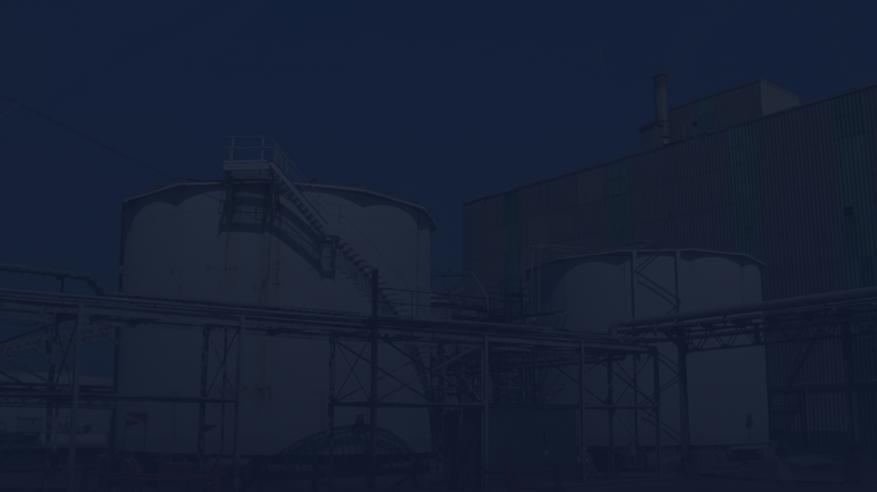
END OF PRESENTATION
Thank You!
The Korea Zinc Case

