Slide 1
Jenkins CI/CD Pipeline with Docker
Internship Project Presentation
GitHub • Jenkins • Node.js • Docker
01/10

Slide 2
Project Overview
Objective
Automate source checkout, application testing, and Docker image creation using Jenkins.
Application
A simple Node.js web application running on port 3000.
02/10

Slide 3
Technology Stack
GitHub — source code repository
Jenkins — pipeline automation
Node.js and npm — application runtime and scripts
Docker — container image and runtime
Linux / WSL — project environment
03/10

Slide 4
CI/CD Workflow
1. Push code to the tracked main branch on GitHub
2. Jenkins checks out the repository
3. Install dependencies with npm
4. Run the test script
5. Build a Docker image
04/10

Slide 5
Project Structure
Jenkins-Second-Project/
├── app.js
├── package.json
├── Dockerfile
├── .dockerignore
├── Jenkinsfile
├── README.md
└── test/app.test.js
05/10

Slide 6
Jenkins Pipeline Stages
Checkout
Jenkins retrieves the configured repository and branch.
Install & Test
Run npm install and npm test from the project directory.
Build Docker Image
Build an image using the project's Dockerfile.
06/10

Slide 7
Docker Integration
Image verified: nodejs-jenkins-cicd:6
Run the application container:
docker run -d -p 3000:3000 --name jenkins-app nodejs-jenkins-cicd:6
Check the app at http://localhost:3000
07/10

Slide 8
Challenges & Solutions
npm not found — installed Node.js and npm in the Jenkins environment.
Project files not found — ran npm commands from the project directory.
Docker permission denied — added jenkins to the docker group, restarted Jenkins, and checked access.
08/10

Slide 9
Results & Verification
Jenkins configured stages displayed green.
Docker image nodejs-jenkins-cicd:6 appeared in docker images.
Container started with port 3000 published.
Application checked through localhost:3000.
09/10

Slide 10
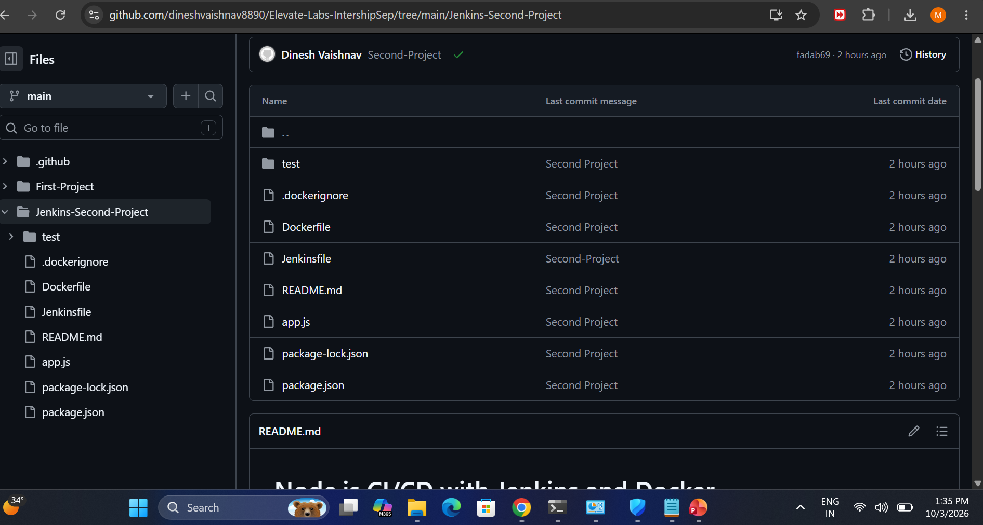

Slide 11
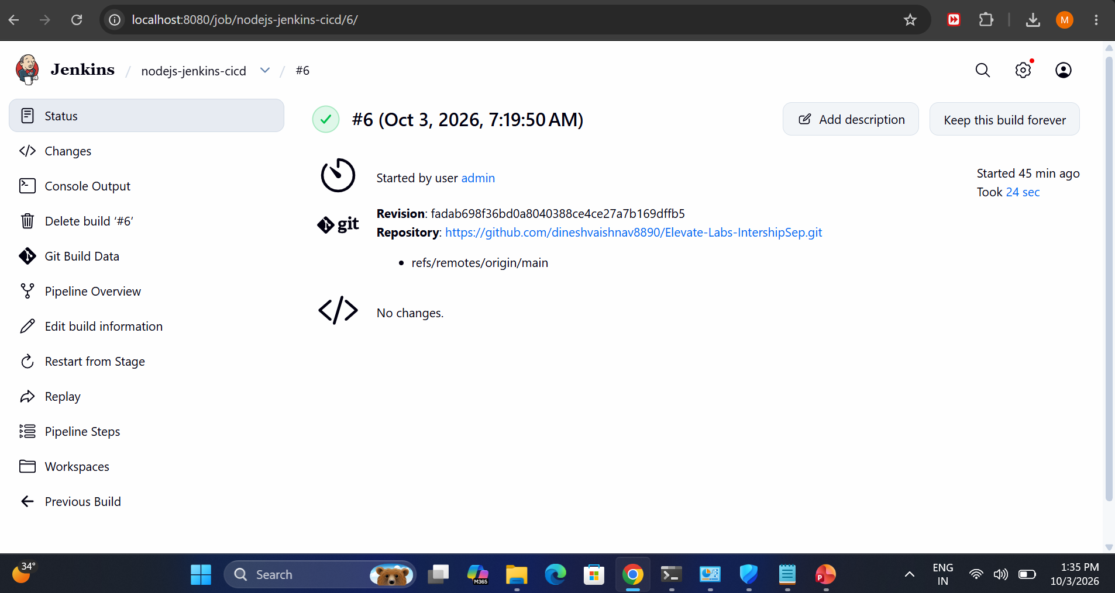

Slide 12
Conclusion
The project demonstrates a basic automated workflow from GitHub checkout to tests and Docker image creation.
Thank you
10/10

