Slide 1
DEVOPS INTERNSHIP • TASK 1
Automating Code
Deployment with CI/CD
CI / CD
Node.js | GitHub Actions | Docker | Docker Hub
Test → Build → Publish
NODE.JS DEMO APP | CI/CD WITH GITHUB ACTIONS
01

Slide 2
01 / INTRODUCTION
Project at a glance
A small Node.js app connected to an automated image-publishing workflow.
Application
Automation
Image registry
Lightweight HTTP server
Runs on port 3000
Returns a simple response
GitHub Actions workflow
Triggered by pushes to main
Tests before publishing
Docker builds the image
Docker Hub stores it
Tagged as latest
NODE.JS DEMO APP | CI/CD WITH GITHUB ACTIONS
02

Slide 3
02 / TECHNOLOGY
Tools used in this project
Each tool has a focused role in the pipeline.
Node.js
GitHub
GitHub Actions
Runs the sample HTTP app
Hosts the code repository
Automates workflow steps
NODE.JS DEMO APP | CI/CD WITH GITHUB ACTIONS
03

Slide 4
03 / PIPELINE FLOW
From code push to Docker Hub
A push to the main branch starts the workflow.
01 Push
02 Checkout
03 Test
Commit reaches main
Runner gets repository code
Node 20 • npm ci • npm test
Publishing happens only after tests succeed.
NODE.JS DEMO APP | CI/CD WITH GITHUB ACTIONS
04

Slide 5
04 / APP & TESTS
Validate before packaging
The test checks that the app responds with the expected HTTP result.
Application — app.js
Test — test.js
Uses Node.js HTTP module
Listens on port 3000
Response: Hello from DevOps CI/CD Project!
Starts test server on port 3001
Checks HTTP status 200
Checks expected response
Run with: npm test
NODE.JS DEMO APP | CI/CD WITH GITHUB ACTIONS
05

Slide 6
05 / DOCKER
Package the app consistently
The Dockerfile describes how to create and run the container image.
Dockerfile highlights
Local commands
FROM node:20
WORKDIR /app
Install production dependencies
Copy app files
Expose 3000; start app.js
Build: docker build -t nodejs-demo-app .
Run: docker run --rm -p 3000:3000 nodejs-demo-app
Open localhost:3000
NODE.JS DEMO APP | CI/CD WITH GITHUB ACTIONS
06

Slide 7
06 / GITHUB ACTIONS
Workflow configuration
The workflow is stored in .github/workflows/main.yml.
Trigger
CI steps
Publish steps
push event
branch: main
Checkout repository
Set up Node.js 20
npm ci
npm test
Log in to Docker Hub
Build image
Push latest tag
NODE.JS DEMO APP | CI/CD WITH GITHUB ACTIONS
07

Slide 8
07 / SECURITY
Protect registry credentials
GitHub repository secrets keep the token out of workflow source.
Required secrets
Security checklist
DOCKERHUB_USERNAME
Docker Hub account name
DOCKERHUB_TOKEN
Docker Hub access token
Use a token with push permissions
Store it in Actions secrets
Never commit credentials
Rotate exposed tokens
NODE.JS DEMO APP | CI/CD WITH GITHUB ACTIONS
08

Slide 9
08 / PUBLISHED IMAGE
Docker Hub image
The current workflow publishes the image to the Docker Hub namespace.
Image tag
Verify the result
dineshvaishnav/nodejs-demo-app:latest
Namespace / repository / tag
Open Docker Hub
Find nodejs-demo-app
Confirm latest tag exists
Review Actions run logs
Scope note: this workflow publishes an image; it does not deploy to a live production server.
NODE.JS DEMO APP | CI/CD WITH GITHUB ACTIONS
09

Slide 10
09 / OUTCOME
What this project demonstrates
Core steps of an automated CI/CD pipeline.
Continuous integration
Container build
Image publishing
Checkout code, install dependencies, and run tests on push.
Docker packages the app into a repeatable image.
Push the image to Docker Hub after tests pass.
NODE.JS DEMO APP | CI/CD WITH GITHUB ACTIONS
10

Slide 11
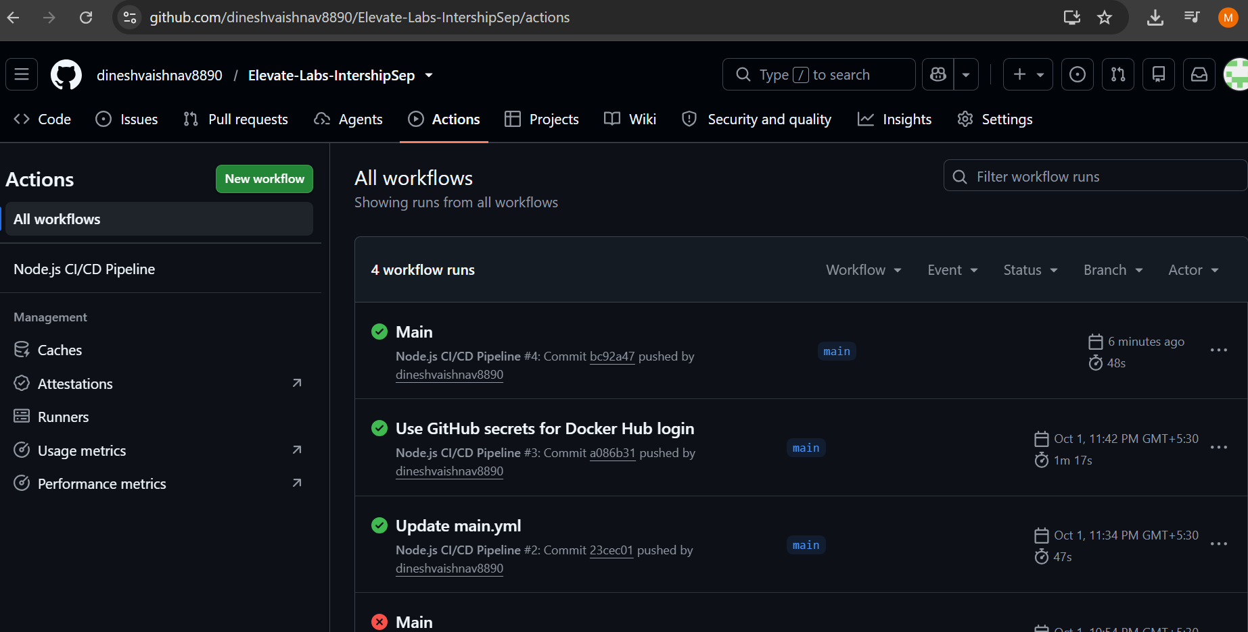
Github action complate Status

Slide 12
10 / NEXT STEPS
Ideas for future improvement
Possible extensions beyond the current task.
Pipeline improvements
Operations improvements
Add version or commit-SHA tags
Add security scanning
Expand automated tests
Add controlled deployment
Add health checks
Add logging and monitoring
Document rollback steps
Use environment approvals
Thank you
NODE.JS DEMO APP | CI/CD WITH GITHUB ACTIONS
11

