Slide 1
DEVOPS PROJECT PRESENTATION
CI/CD Pipeline with
Docker & GitHub Actions
Python Flask • Pytest • Docker Hub
Presented by: Dinesh Chand Vaishnav
Automating testing, image building, and publishing

Slide 2
Project Overview
A simple Flask app used to demonstrate an automated DevOps workflow.
01 Application
02 Continuous Integration
03 Image Publishing
A Python Flask endpoint returns a success message on port 5000.
GitHub Actions installs dependencies and runs Pytest after code changes.
Docker builds a container image and pushes it to Docker Hub after tests pass.
Goal: repeatable builds, automated tests, and a shareable container image.
2

Slide 3
Technology Stack
Tools used in the project and their roles.
Python + Flask
Pytest
Git + GitHub
Application runtime and web framework
Automated test execution
Source control and code hosting
GitHub Actions
Docker
Docker Hub
Workflow automation / CI-CD
Package the app and dependencies
Store and distribute the image
3

Slide 4
Application & Project Structure
The project is stored as a folder inside the parent GitHub repository.
Application response
Key files
GET /
CI/CD Pipeline Working Successfully 🚀
Local URL: http://localhost:5000
app.py — Flask application
requirements.txt — Flask and Pytest
test_app.py — automated tests
Dockerfile — image instructions
docker-compose.yml — local multi-container configuration
Note: GitHub Actions workflow lives in the parent repository's .github/workflows directory.
4

Slide 5
CI/CD Workflow
Pipeline stages run automatically when code is pushed to main.
1 Push code
2 Checkout
3 Install
4 Test
5 Build
6 Publish
Git push to main
→
Get repository source
→
Install requirements.txt
→
Run python -m pytest
→
Create Docker image
→
Push image to Docker Hub
Important: Docker build and push should run only after the tests succeed.
5

Slide 6
Docker Image Build & Run
Build locally, test the container, then publish to Docker Hub.
Build image
Run container
docker build -t cicd-docker-app:latest .
docker run -d -p 5000:5000 --name flask-app cicd-docker-app:latest
Verify app
Publish image
Open http://localhost:5000 in a browser.
docker push YOUR_USERNAME/cicd-docker-app:latest
Use your actual Docker Hub username and configure GitHub Secrets before enabling automated publishing.
6

Slide 7
Secure Configuration
Credentials are stored in GitHub Actions secrets—not in source code.
DOCKERHUB_USERNAME
DOCKERHUB_TOKEN
Your Docker Hub account username
A Docker Hub access token with appropriate permissions
Add both values under Repository Settings → Secrets and variables → Actions.
Never commit tokens, passwords, or .env credentials to GitHub.
Keep the Docker Hub repository name and workflow image tag consistent.
7

Slide 8
Testing & Validation
Confirm each stage before describing the pipeline as successful.
Run the application locally and verify the expected message.
Run tests with: python -m pytest -v
Check GitHub Actions for green success status.
Verify the latest image tag appears in Docker Hub.
Pull the published image and test it on a clean environment.
A successful GitHub Actions run and a published image are the evidence of completion.
8

Slide 9
Challenges & Troubleshooting
Common issues addressed while building the project.
Wrong working directory
Python environment
Docker build context
Set working-directory to ./cicd-docker-app for dependency installation and tests.
Use a virtual environment locally; install requirements in the CI runner.
Build with ./cicd-docker-app so Docker can find the correct Dockerfile and app files.
Additional checks: YAML indentation, repository secrets, test results, and image tag.
9

Slide 10
Learning Outcomes & Next Steps
Skills practiced and opportunities for improvement.
What I learned
Future enhancements
• Flask application basics
• Automated testing with Pytest
• Docker image build and run
• CI/CD with GitHub Actions
• Secure secrets management
• Publishing images to Docker Hub
• Add code linting and coverage
• Use versioned image tags
• Scan images for vulnerabilities
• Add health checks and monitoring
• Deploy to a cloud platform
Project repository: github.com/dineshvaishnav8890/Elevate-Labs-IntershipSep
10

Slide 11
Thank You!
Questions & Discussion
Dinesh Chand Vaishnav
CI/CD Pipeline with Docker, Flask, GitHub Actions & Docker Hub
11

Slide 12
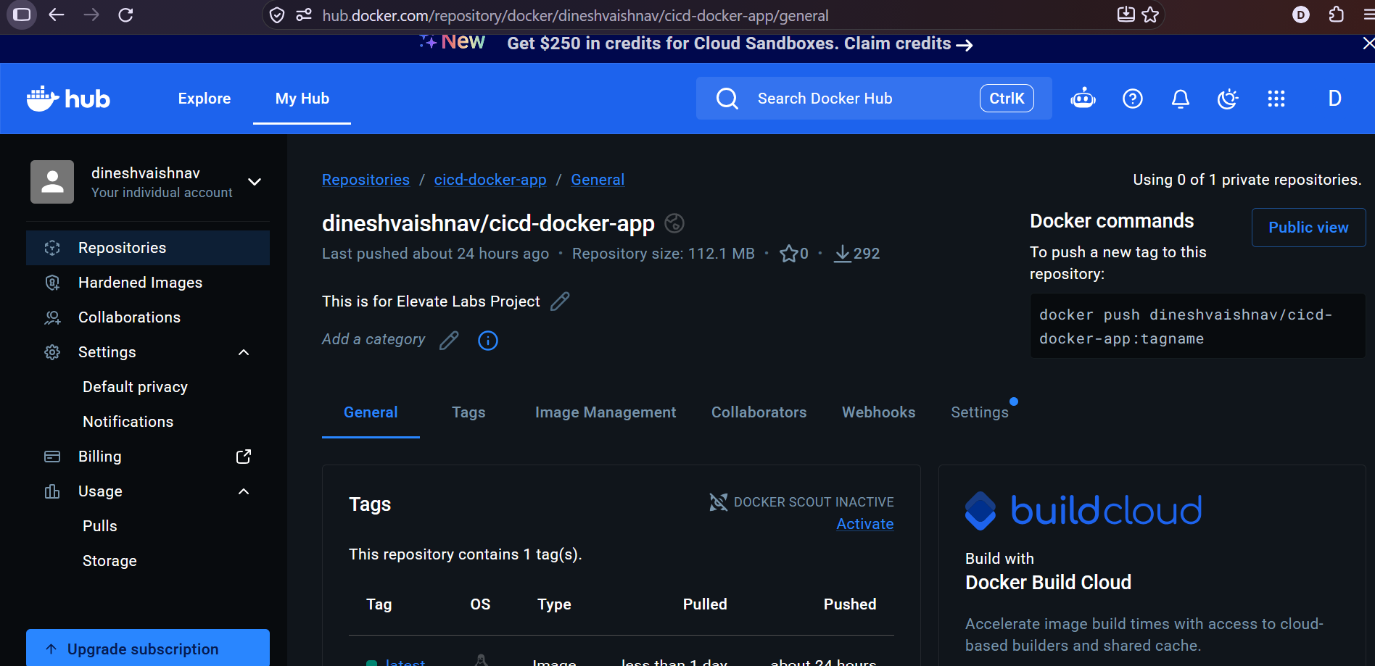
Docker Hub — Published Image
Repository: dineshvaishnav/cicd-docker-app • Tag: latest

Slide 13
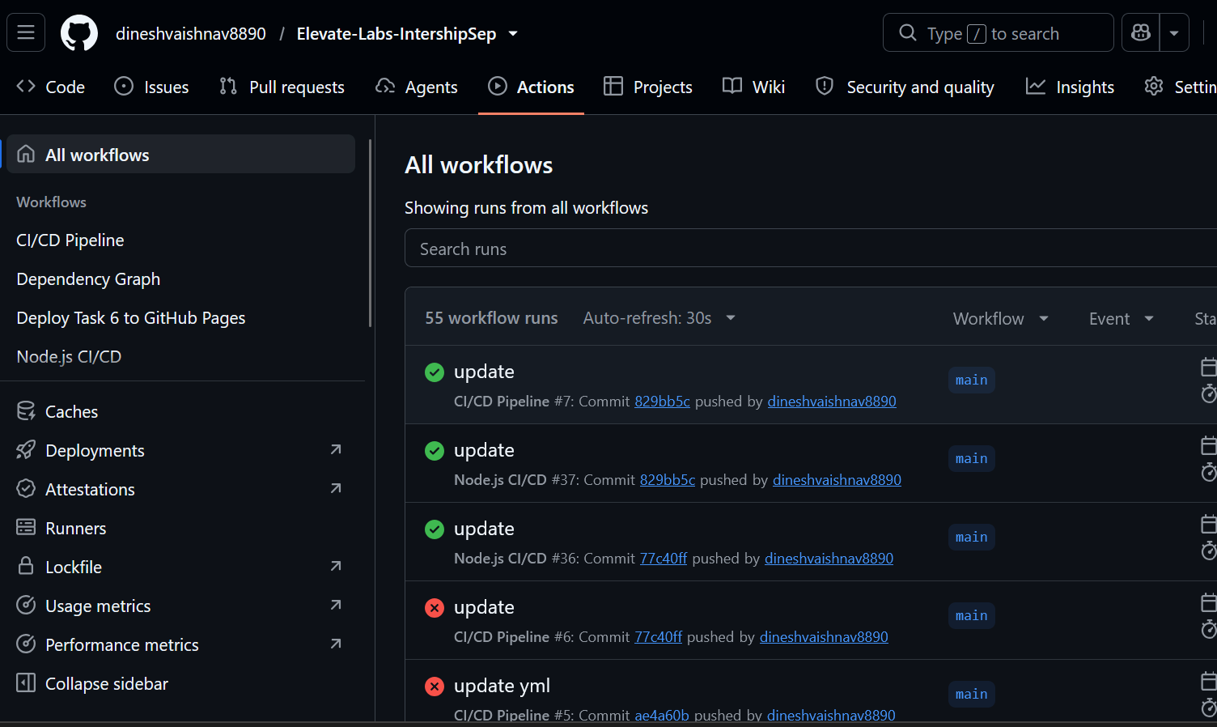
GitHub Actions — CI/CD Results
Green check marks show successful workflow runs; earlier failed runs are also visible.

Slide 14
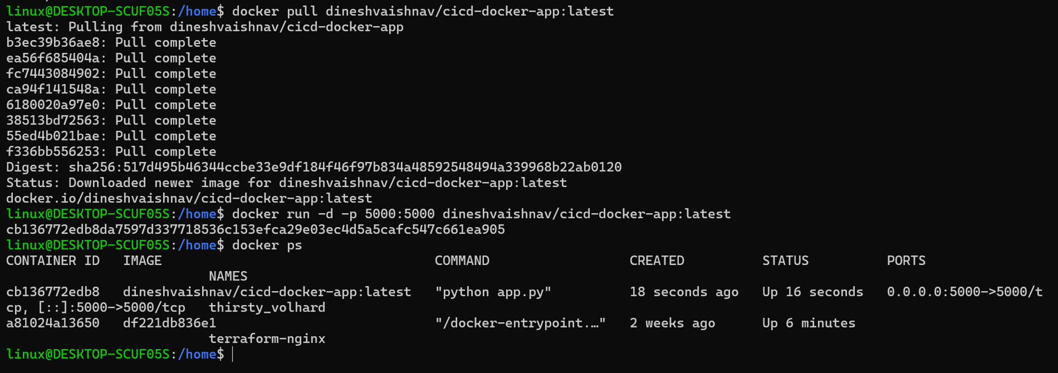

Slide 15
