Slide 1
TASK 4
Git Version Control
Git + GitHub • Branching • Pull Requests • Release Tagging
Elevate Labs DevOps Internship
dineshvaishnav8890/Elevate-Labs-InternshipSep
Elevate Labs • DevOps Internship • Task 4 | 1

Slide 2
Project Objective
What Task 4 demonstrates
Version Control
Collaboration
Release
Track changes, commits, branches, and release history with Git.
Use GitHub Pull Requests for controlled integration and review.
Use v1.0.0 to identify the documented release point.
• Feature-based development
• Branch comparison and merge readiness
• Clean repository using .gitignore
• Professional documentation and evidence
Elevate Labs • DevOps Internship • Task 4 | 2

Slide 3
Branching Strategy
Promotion flow from development to release
FEATURE
DEV
MAIN
v1.0.0
• FEATURE: implement the task
• DEV: integrate and validate
• MAIN: release-ready branch
• Tag: identify the release
Elevate Labs • DevOps Internship • Task 4 | 3

Slide 4
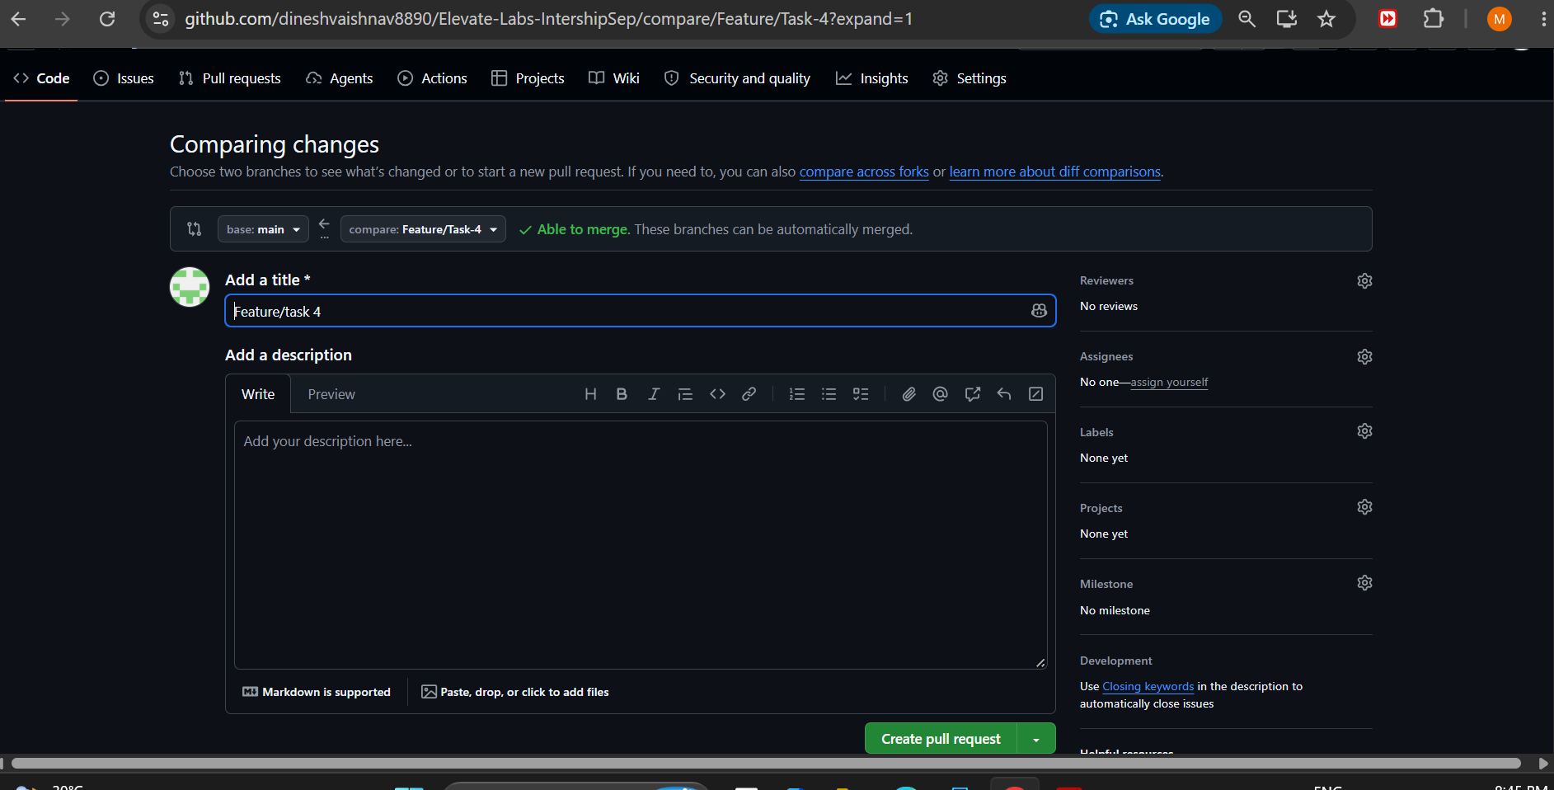
GitHub Branch Comparison
Evidence from the supplied screenshot
The comparison page confirms the branches can be merged automatically.
Elevate Labs • DevOps Internship • Task 4 | 4

Slide 5
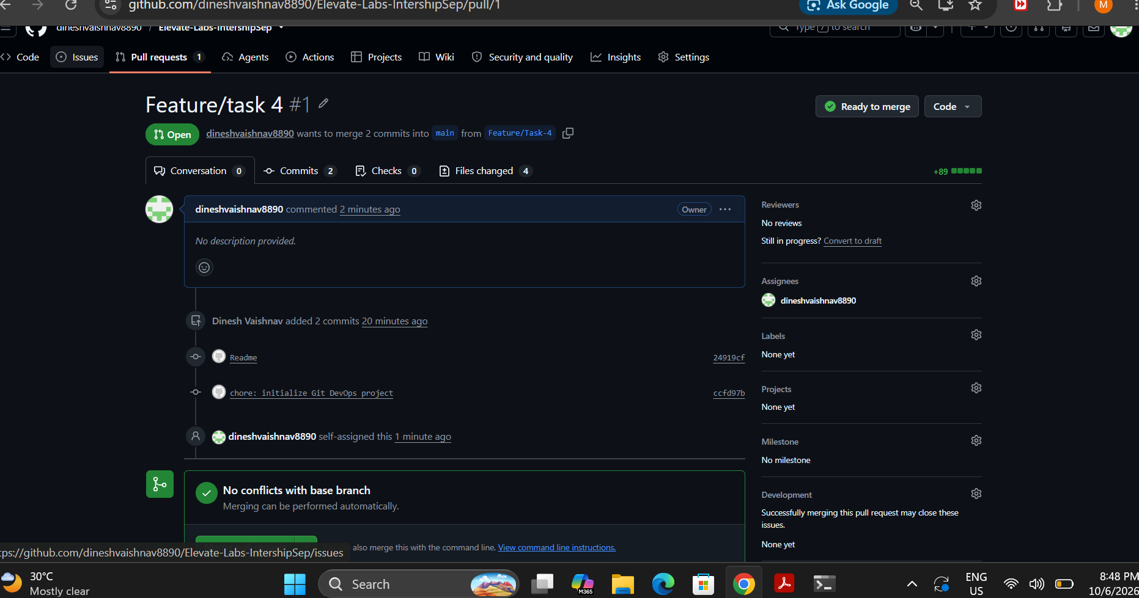
Pull Request Evidence
Feature work shown as Ready to merge
The Pull Request records commits, changed files, and merge readiness.
Elevate Labs • DevOps Internship • Task 4 | 5

Slide 6
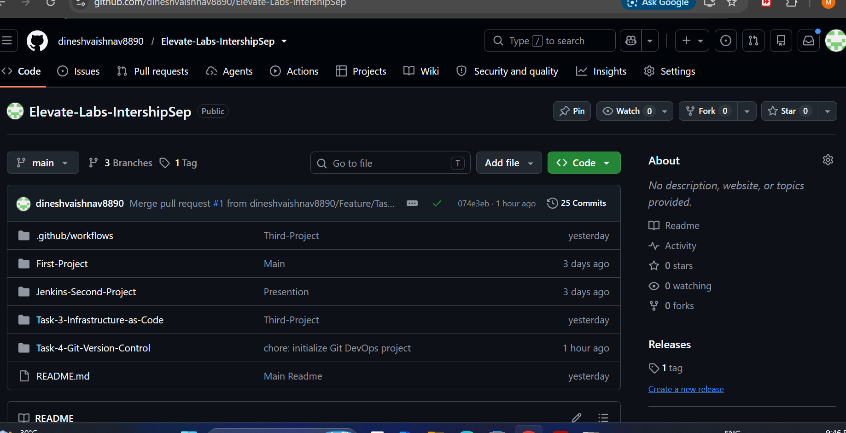
Repository Status
Task 4 visible in the main repository
Repository view shows Task-4-Git-Version-Control, 3 branches, and 1 tag.
Elevate Labs • DevOps Internship • Task 4 | 6

Slide 7
Project Structure
Clean and documented Task 4 layout
Task-4-Git-Version-Control/
├── app/
│ └── app.sh
├── screenshots/
├── .gitignore
├── README.md
└── VERSION
app/app.sh
Bash application used to verify the project artifact.
.gitignore
Keeps temporary and environment-specific files out of Git.
VERSION
Documents the release version: 1.0.0.
Elevate Labs • DevOps Internship • Task 4 | 7

Slide 8
Git Commands Practiced
Core commands used during Task 4
Inspect
Stage & Commit
git status\ngit branch\ngit log --oneline --graph --all
git add .\ngit commit -m "..."
Sync
Release
git pull origin main\ngit push origin feature
git tag -a v1.0.0 -m "..."\ngit push origin v1.0.0
Elevate Labs • DevOps Internship • Task 4 | 8

Slide 9
Learning Outcomes
Skills demonstrated
• Git repository and working-tree management
• Feature-based branching and controlled integration
• GitHub Pull Requests and branch comparison
• Commit history and release tagging
• .gitignore and repository hygiene
• Professional Markdown documentation
• Evidence-based project presentation
TASK 4 COMPLETE
Elevate Labs • DevOps Internship • Task 4 | 9

Slide 10
Thank You
Task 4 — Git Version Control
Elevate Labs DevOps Internship
FEATURE → DEV → MAIN → v1.0.0
Elevate Labs • DevOps Internship • Task 4 | 10

