Slide 1
Infrastructure as Code
Terraform + Docker + Nginx
DevOps Internship — Task 3
Provision, verify, inspect and destroy a local Docker container using Terraform.
Terraform
Docker
Nginx
Infrastructure as Code
Container runtime
Web server

Slide 2
Task Objective
What this project demonstrates
Infrastructure as Code
Docker Provisioning
Verification
Define infrastructure in a repeatable Terraform configuration instead of creating the container manually.
Use the Docker provider to manage an nginx:alpine image and a Docker container.
Expose port 80 through host port 8080 and verify the Nginx service.
• Lifecycle: init → validate → plan → apply → state → verify → destroy
• Deliverables: main.tf, execution evidence, README.md and presentation
• Environment documented in the README: WSL Ubuntu + Docker + Terraform
DEVOPS INTERNSHIP • TASK 3 • TERRAFORM + DOCKER
02

Slide 3
Technology Stack
Tools used in the implementation
Terraform
Docker
Nginx
WSL Ubuntu
Defines and manages infrastructure through configuration.
Runs the provisioned container locally.
Lightweight web server used to verify deployment.
Linux environment used for the project.
Terraform CLI
• Git/GitHub for version control and submission
• curl/browser for service verification
• Docker port mapping: localhost:8080 → container:80
terraform init
terraform validate
terraform plan
terraform apply
terraform state list
terraform destroy
DEVOPS INTERNSHIP • TASK 3 • TERRAFORM + DOCKER
03

Slide 4
Architecture
Terraform controls the local Docker infrastructure
main.tf
Terraform CLI
Docker Provider
nginx:alpine
terraform-nginx
localhost:8080
Desired configuration
→
Plan & apply
→
API integration
→
Image
→
Container
→
Verification
Port mapping
ports {
internal = 80
external = 8080
}
DEVOPS INTERNSHIP • TASK 3 • TERRAFORM + DOCKER
04

Slide 5
Terraform Configuration
The core resources defined in main.tf
main.tf
Provider
terraform {
required_providers {
docker = {
source = "kreuzwerker/docker"
version = "~> 3.0"
}
}
}
provider "docker" {}
resource "docker_image" "nginx" {
name = "nginx:alpine"
}
resource "docker_container" "nginx" {
name = "terraform-nginx"
image = docker_image.nginx.image_id
ports {
internal = 80
external = 8080
}
}
Installs the Docker provider plugin.
Image
Uses nginx:alpine as the container image.
Container
Creates terraform-nginx with port 8080 → 80.
DEVOPS INTERNSHIP • TASK 3 • TERRAFORM + DOCKER
05

Slide 6
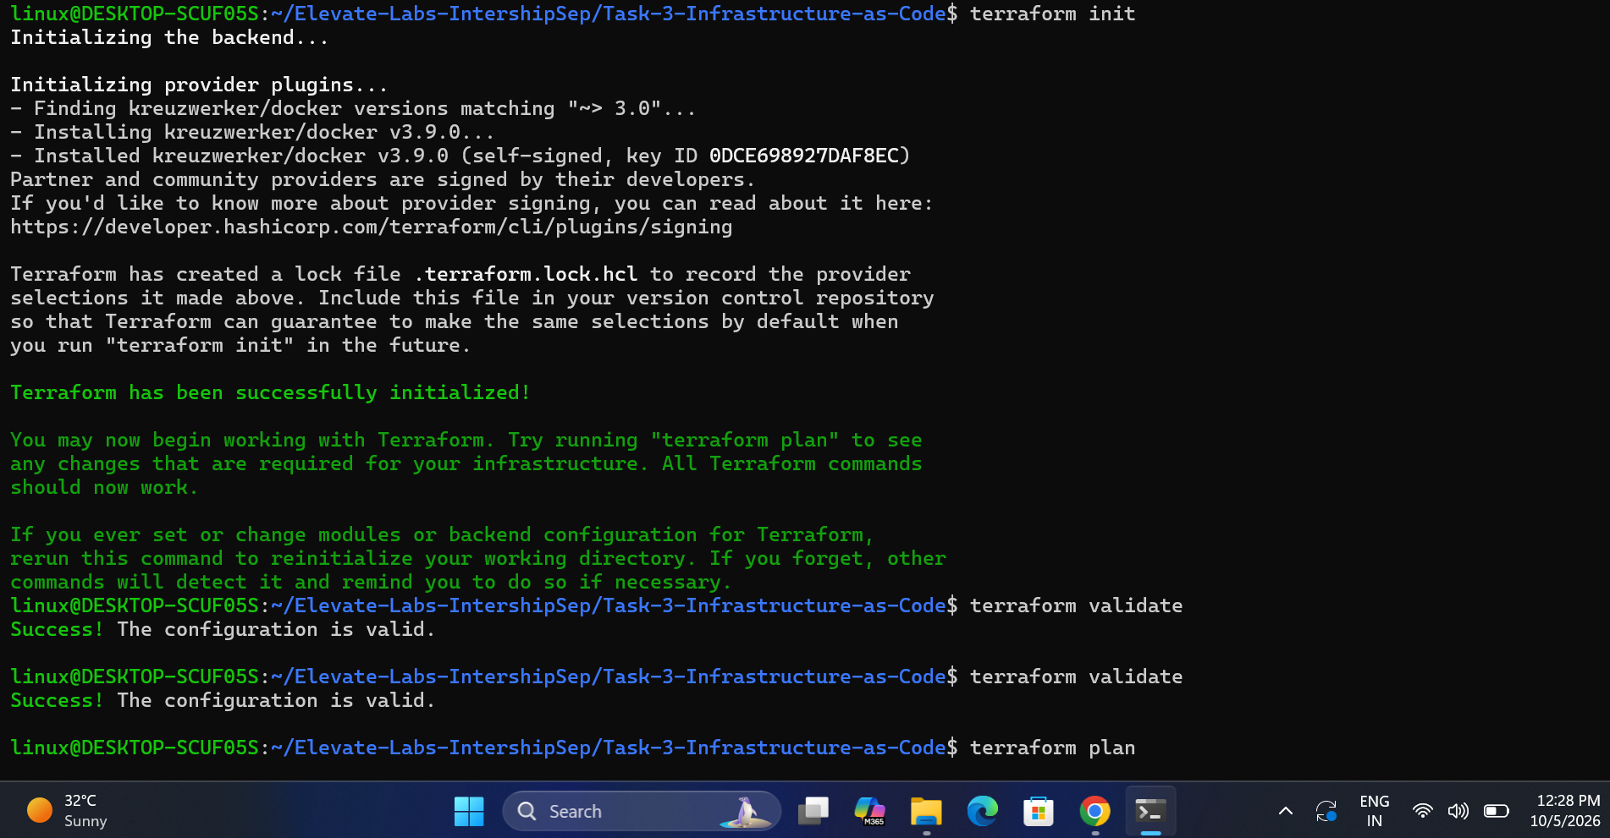
Initialize & Validate
Confirm Terraform is ready and the configuration is valid
• terraform init downloads and initializes the Docker provider.
• terraform validate checks the configuration syntax and structure.
• Both commands are prerequisites before planning infrastructure.
Screenshot 01 — Terraform init and validate
DEVOPS INTERNSHIP • TASK 3 • TERRAFORM + DOCKER
06

Slide 7
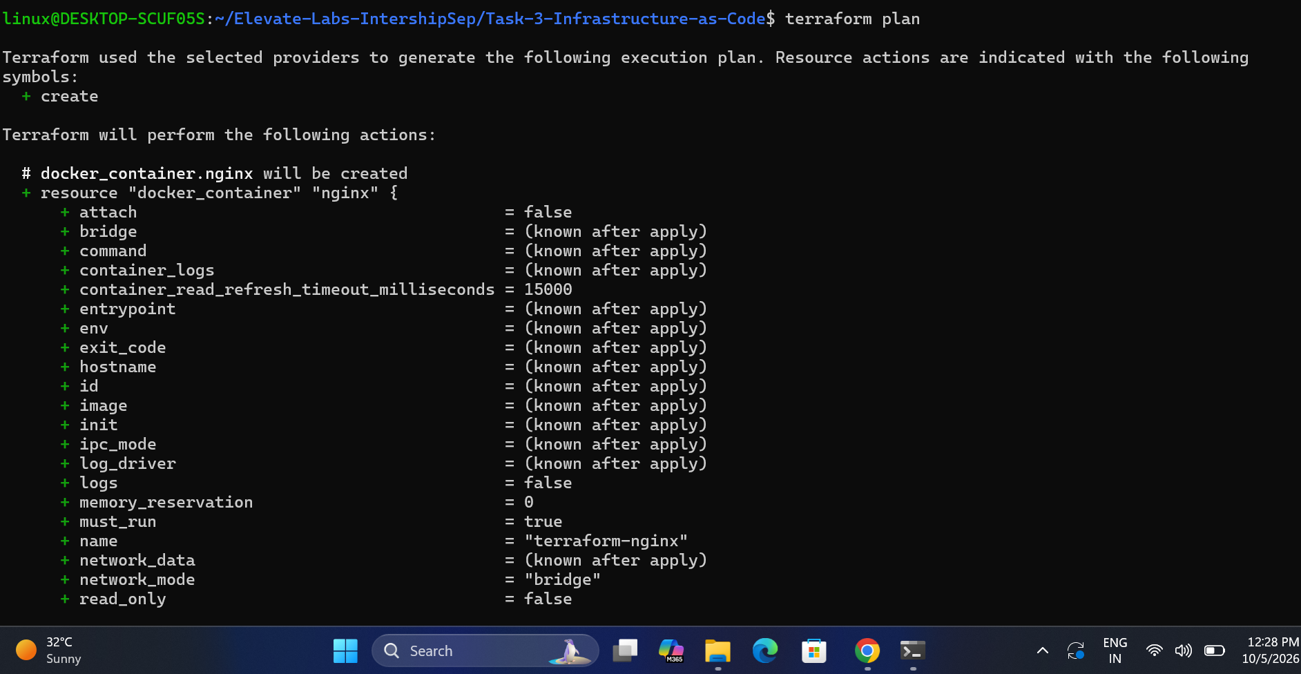
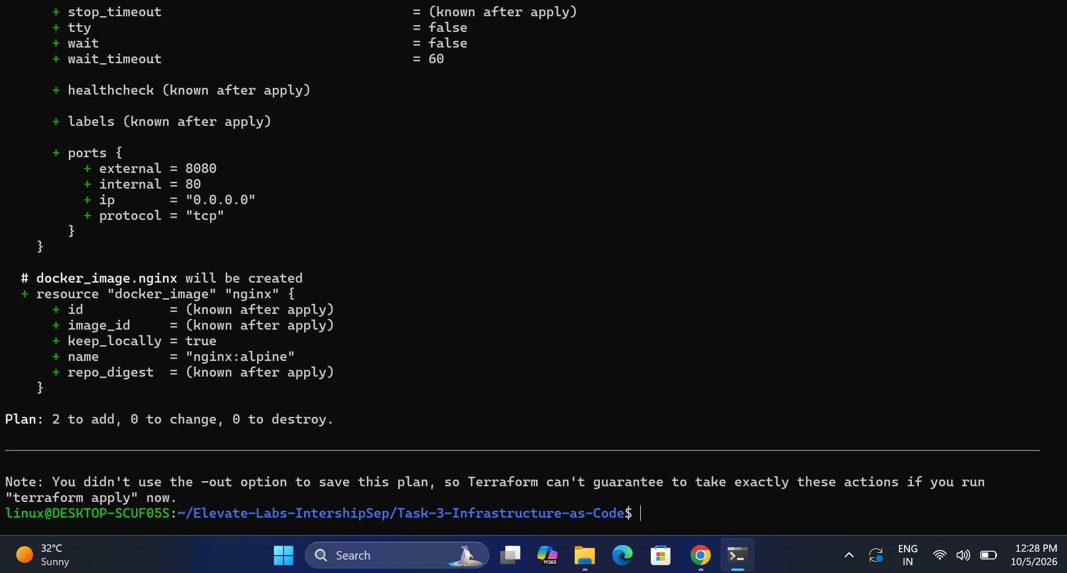
Terraform Plan
Preview changes before creating infrastructure
Screenshot 02 — Terraform plan
Screenshot 03 — Plan completion / summary
DEVOPS INTERNSHIP • TASK 3 • TERRAFORM + DOCKER
07

Slide 8
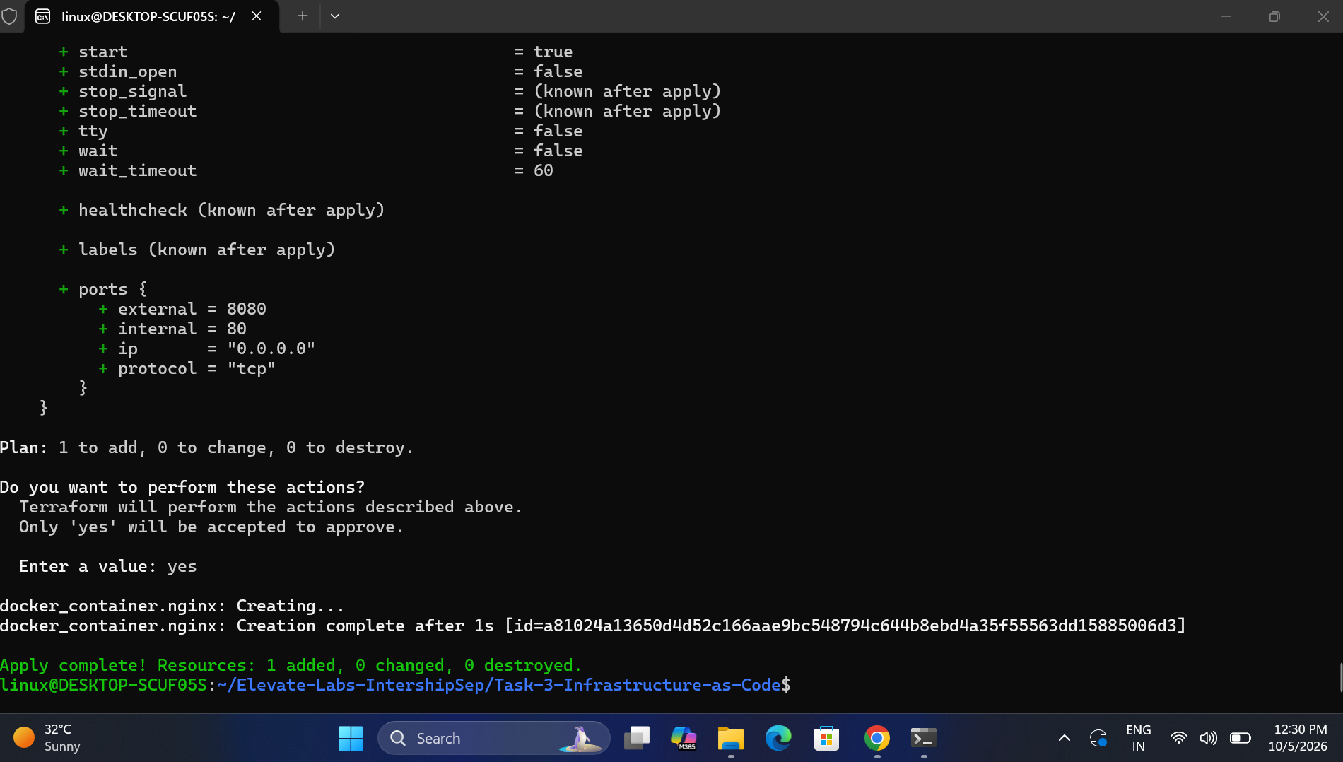
Provision the Infrastructure
Apply the approved plan and create the Docker resources
Apply
terraform apply executes the plan after confirmation.
Resources
Docker image + Docker container are managed by Terraform.
Result
The Nginx service becomes available through port 8080.
Screenshot 04 — Terraform apply
DEVOPS INTERNSHIP • TASK 3 • TERRAFORM + DOCKER
08

Slide 9
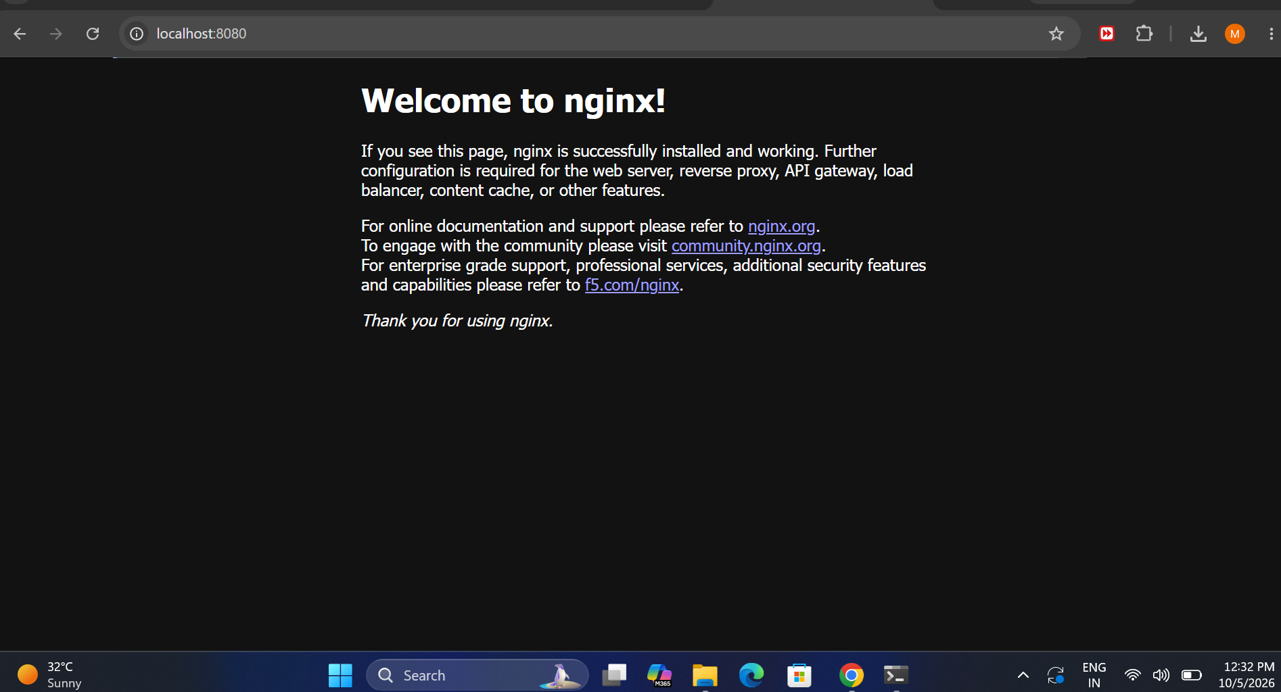
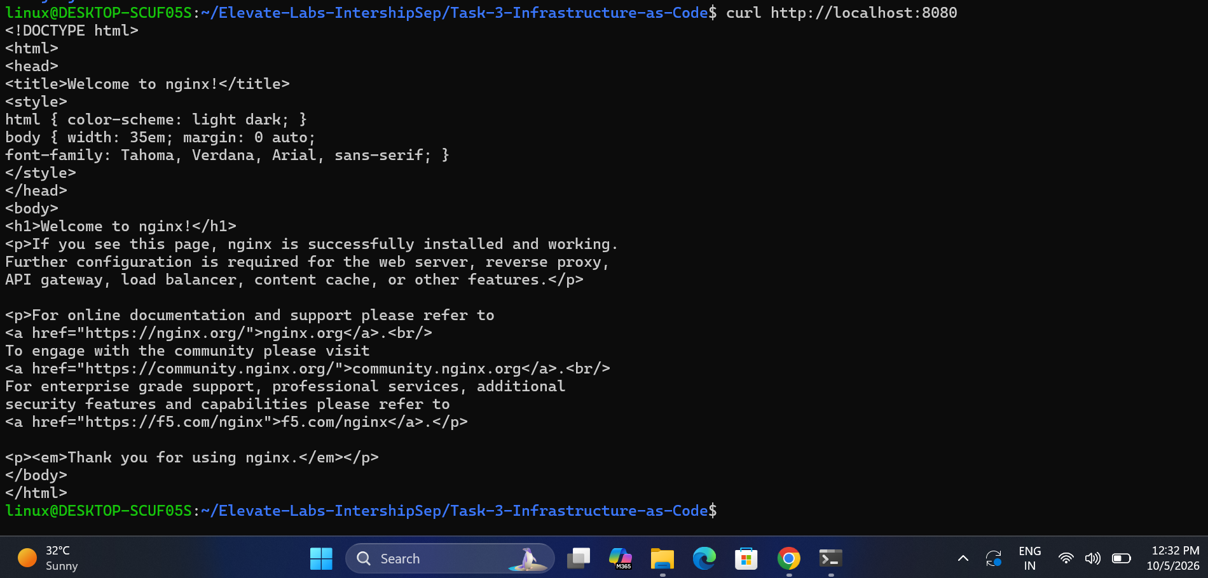
Verify the Nginx Application
Confirm the provisioned service is reachable
Screenshot 05 — Nginx curl test
Screenshot 06 — Nginx browser test
DEVOPS INTERNSHIP • TASK 3 • TERRAFORM + DOCKER
09

Slide 10
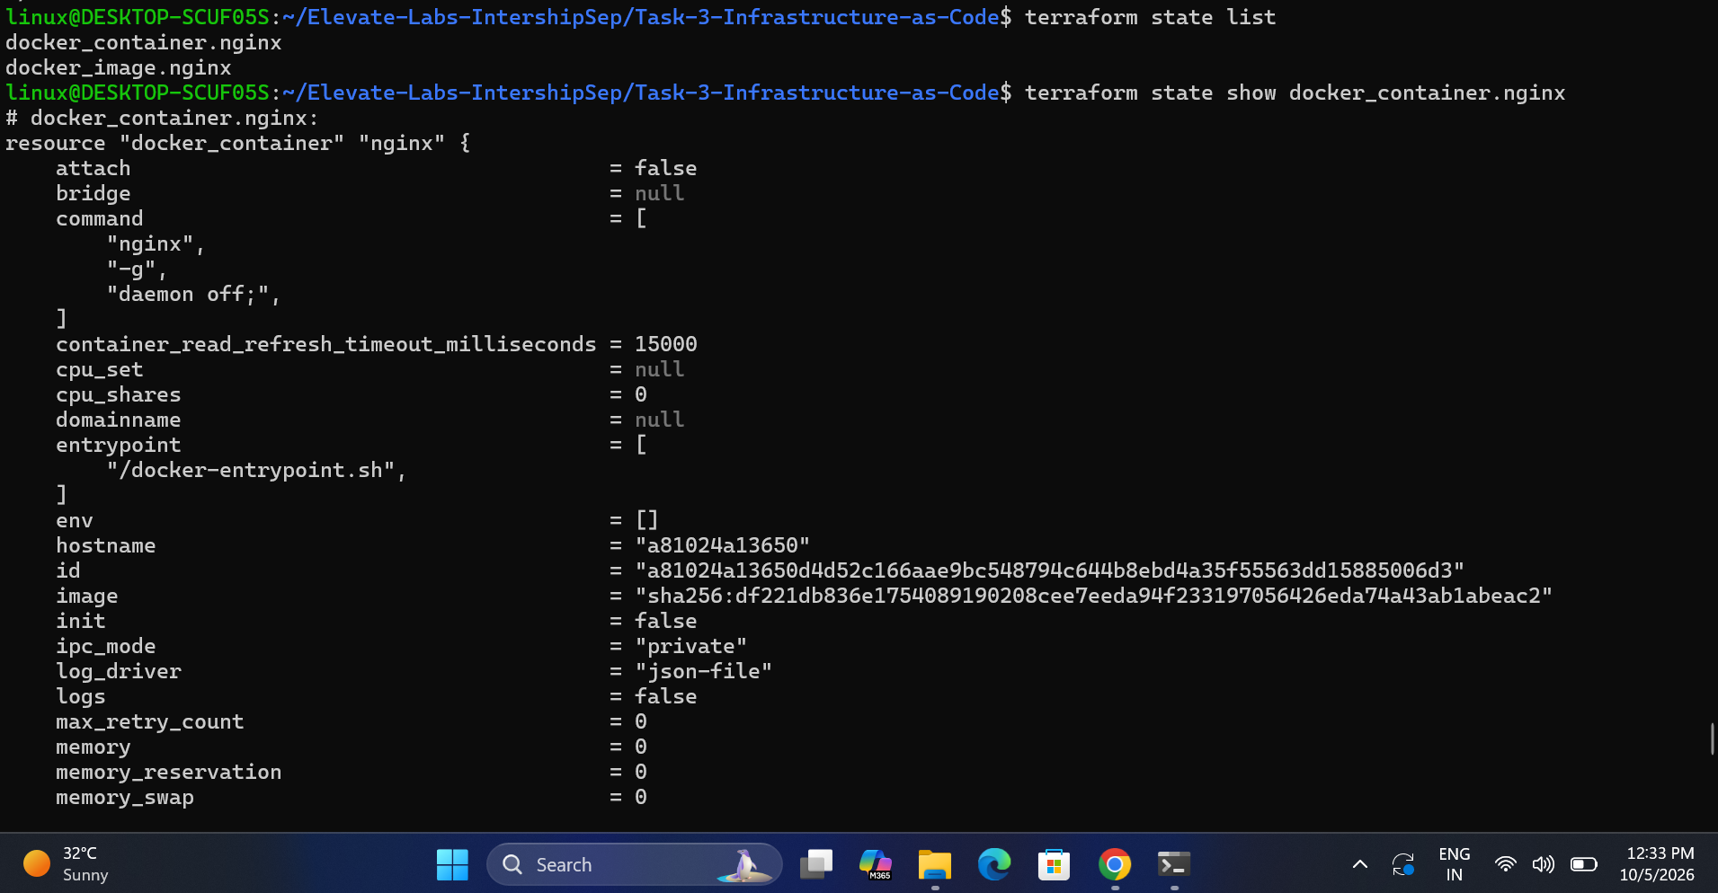
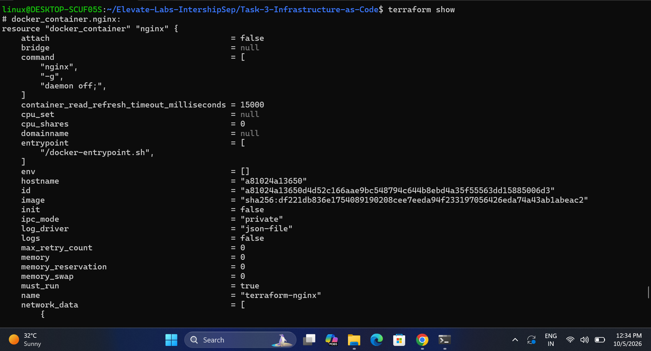
Terraform State Management
Inspect the infrastructure Terraform is tracking
Screenshot 07 — terraform state list / show
Screenshot 08 — terraform show
DEVOPS INTERNSHIP • TASK 3 • TERRAFORM + DOCKER
10

Slide 11
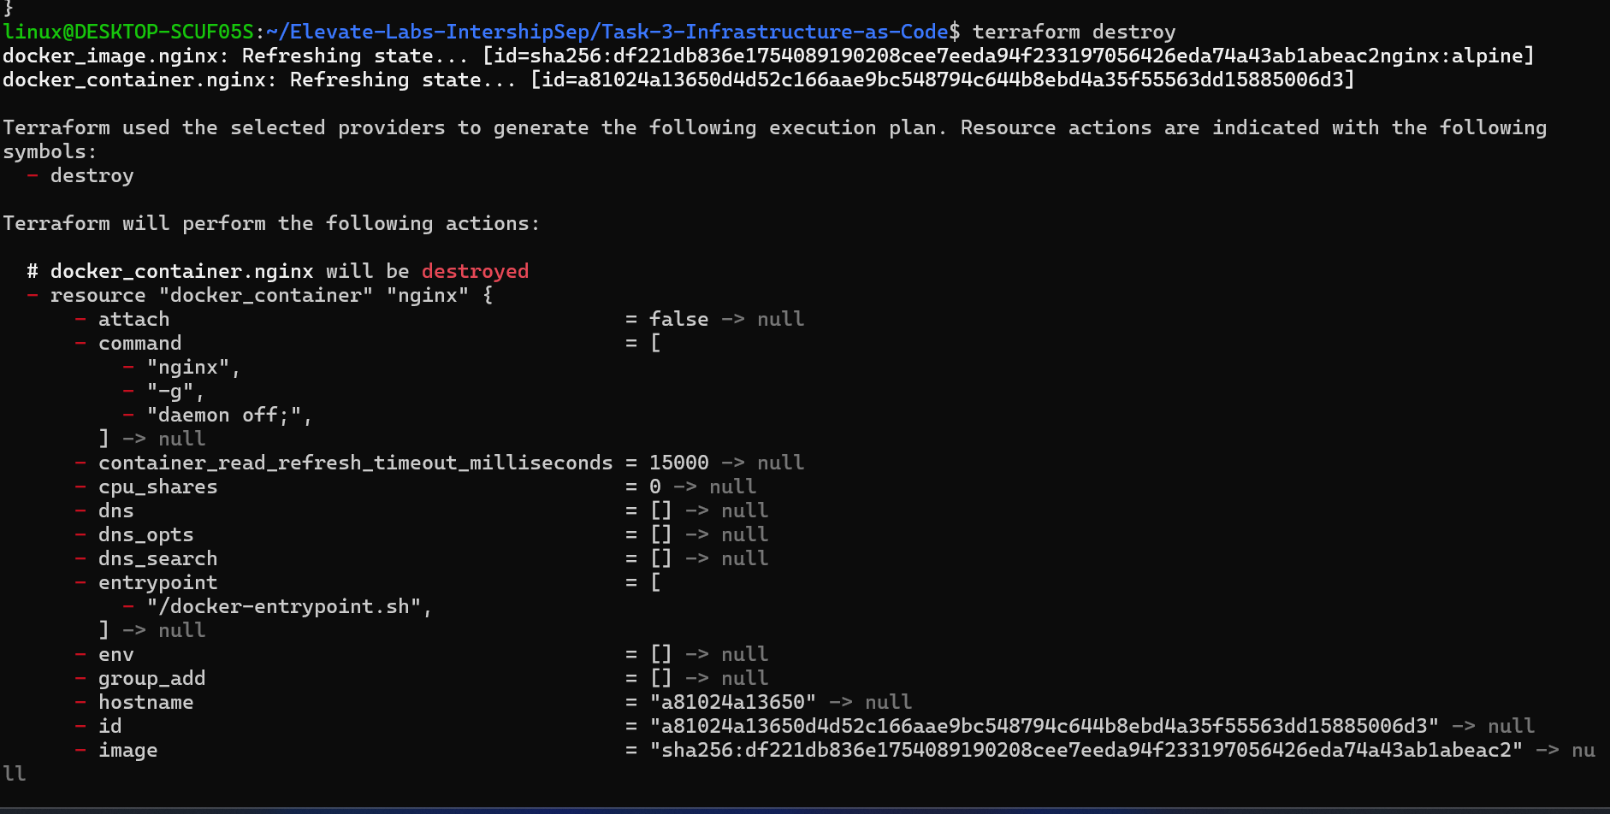
Destroy the Infrastructure
Remove the Terraform-managed resources when finished
• terraform destroy removes the managed image/container resources.
• The confirmation step prevents accidental destruction.
• After destruction, verify the Docker container is no longer running.
Screenshot 09 — Terraform destroy
DEVOPS INTERNSHIP • TASK 3 • TERRAFORM + DOCKER
11

Slide 12
Complete Project Workflow
End-to-end Infrastructure as Code lifecycle
1
Write main.tf
2
terraform init
3
terraform validate
4
terraform plan
5
terraform apply
6
Verify Nginx
7
terraform state
8
terraform destroy
DEVOPS INTERNSHIP • TASK 3 • TERRAFORM + DOCKER
12

Slide 13
Interview Questions
Core concepts demonstrated by the task
What is IaC?
Plan vs Apply
Infrastructure managed through machine-readable configuration.
plan previews changes; apply executes them.
What is state?
What are providers?
terraform.tfstate records managed resource information.
Plugins that connect Terraform to external platforms/APIs.
Resource dependency
Secret handling
The container depends on the Docker image reference.
Use sensitive variables, environment variables and secret stores.
DEVOPS INTERNSHIP • TASK 3 • TERRAFORM + DOCKER
13

Slide 14
Submission Checklist
Evidence and repository readiness
• main.tf included and documented
• README.md explains setup, commands, architecture and learning outcomes
• Execution screenshots included as evidence
• terraform init / validate / plan / apply completed
• Nginx verified on localhost:8080
• Terraform state inspected
• terraform destroy completed
• GitHub repository contains project files and screenshots
• Secrets and local state files are excluded where appropriate
Evidence
9 implementation screenshots embedded in this presentation.
Outcome
Local infrastructure provisioned, verified and cleaned up.
Ready
README + PPTX + code + evidence
DEVOPS INTERNSHIP • TASK 3 • TERRAFORM + DOCKER
14

Slide 15
Thank You
Terraform + Docker + Nginx
Infrastructure as Code — DevOps Internship Task 3

