Slide 1
DEVOPS INTERNSHIP | TASK 6
Host a Static Website
Using GitHub Pages
push → build → deploy
✓ Workflow successful
✓ Pages artifact published
HTML • CSS • GitHub Actions • Automated Deployment
Presented by Dinesh Vaishnav
Repository: Elevate-Labs-IntershipSep

Slide 2
1. Project Overview
Goal
Publish a static shopping homepage from a repository subfolder using GitHub Pages.
Website built with HTML5 and CSS3
Source code stored and versioned in GitHub
GitHub Actions automates deployment from the main branch
Screenshots provide evidence of the published page and workflow run
TASK 6 • GITHUB PAGES 02

Slide 3
2. Tools & Project Structure
HTML5
CSS3
GitHub
Pages + Actions
Page structure
Visual styling
Version control
Hosting and automation
Published folder
Task-6-github-pages/
├── index.html
├── style.css
└── imgea/
Important: use the exact lowercase filename index.html. GitHub Pages hosting is case-sensitive.
TASK 6 • GITHUB PAGES 03

Slide 4
3. Deployment Workflow
1
→
2
→
3
→
4
Commit & push
Checkout
Upload artifact
Deploy Pages
Update files on main
Actions gets repository
Publish Task-6 folder
Website becomes available
Workflow file: .github/workflows/deploy-task-6.yml
Artifact path: ./Task-6-github-pages
TASK 6 • GITHUB PAGES 04

Slide 5
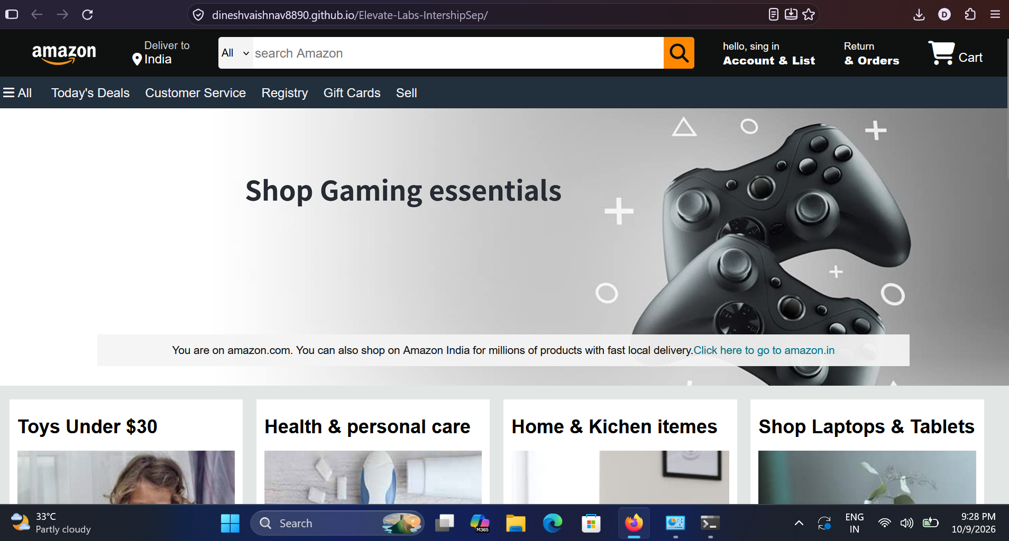
4. Website Preview
The deployed page shows a shopping homepage layout with a gaming hero banner and product-category cards.
Live URL: https://dineshvaishnav8890.github.io/Elevate-Labs-IntershipSep/
TASK 6 • GITHUB PAGES 05

Slide 6
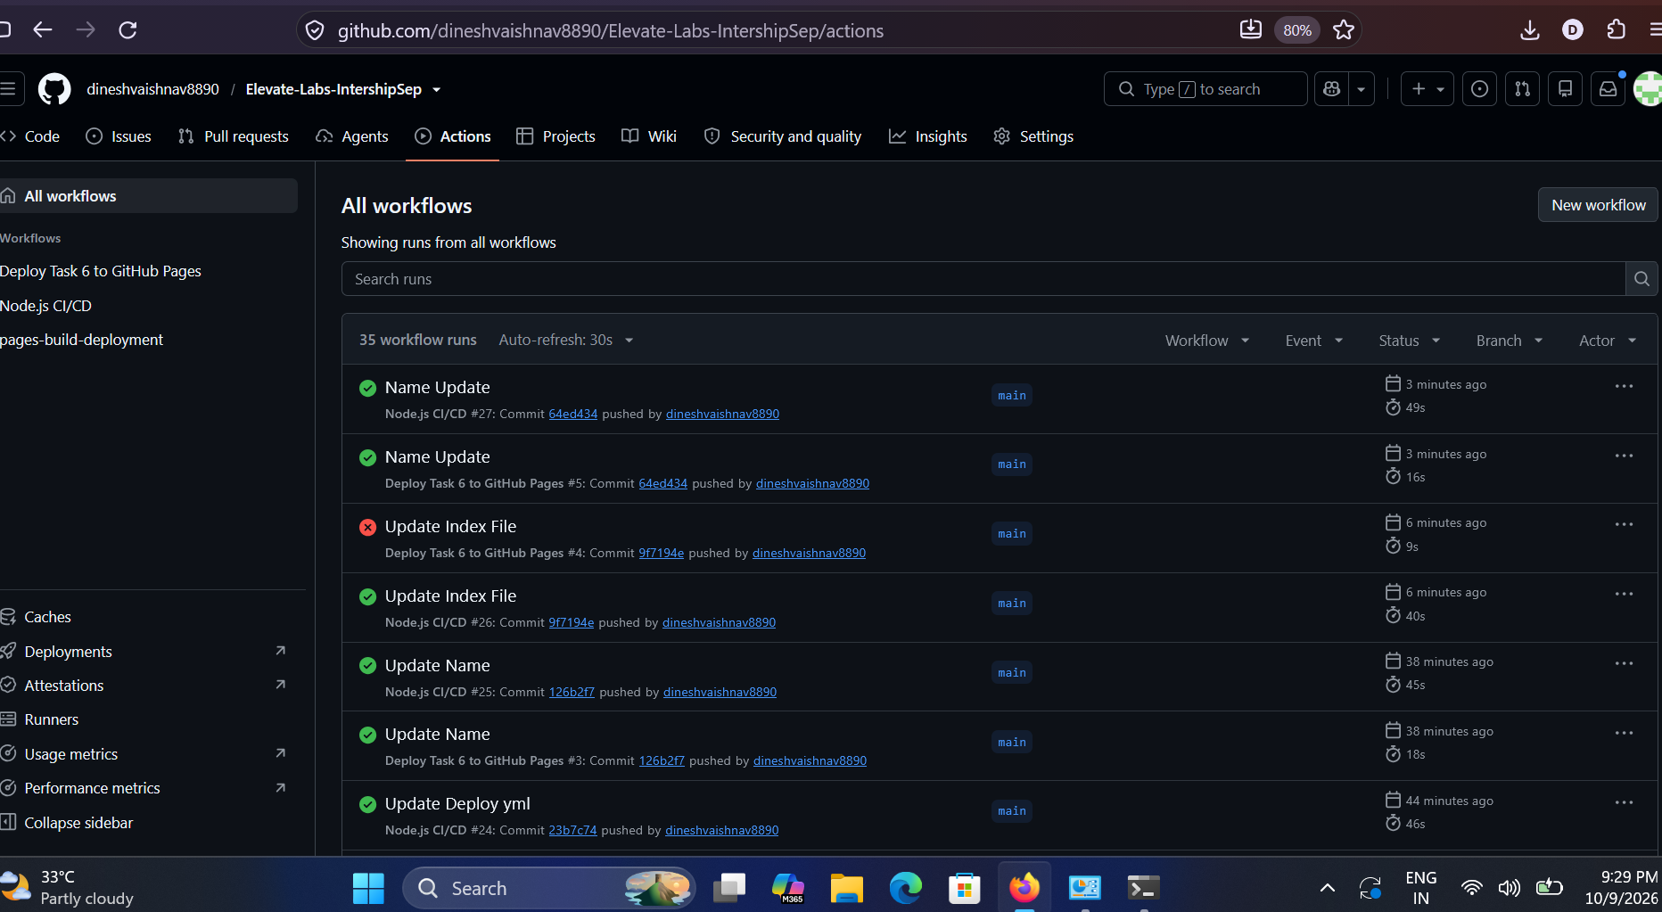
5. GitHub Actions Evidence
The latest Task 6 workflow run shows a successful green check. The workflow is triggered by repository updates.
Repository: https://github.com/dineshvaishnav8890/Elevate-Labs-IntershipSep
TASK 6 • GITHUB PAGES 06

Slide 7
6. Validation & Key Learnings
Use index.html in lowercase; filename case matters on GitHub Pages.
Confirm the workflow uploads the correct subfolder as the Pages artifact.
Check Settings → Pages and wait for the deployment job to finish.
Verify CSS and image paths use the correct names and capitalization.
A green workflow run and the live URL are separate checks.
Outcome: learned static hosting, Git-based workflow automation, and deployment troubleshooting.
TASK 6 • GITHUB PAGES 07

Slide 8
Thank You
Task 6 — Host a Static Website Using GitHub Pages
Dinesh Vaishnav
https://dineshvaishnav8890.github.io/Elevate-Labs-IntershipSep/
https://github.com/dineshvaishnav8890/Elevate-Labs-IntershipSep

