Slide 1
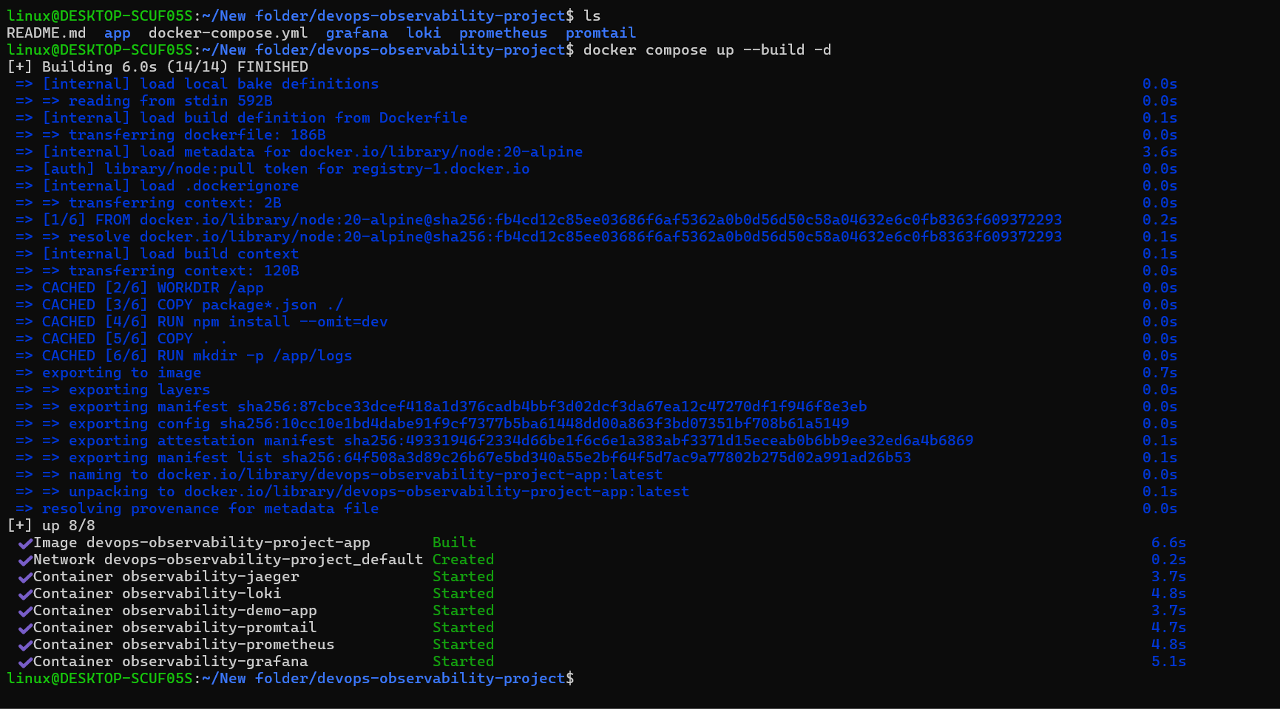
DEVOPS PROJECT • OBSERVABILITY
Complete
Observability System
Metrics • Logs • Distributed Tracing
Docker Compose | Prometheus | Grafana | Loki | Promtail | Jaeger
PROJECT WALKTHROUGH
COMPLETE OBSERVABILITY SYSTEM • DEVOPS PROJECT
1

Slide 2
01 | Project overview
A local, containerized observability lab
• Run a Node.js demo application with Docker Compose.
• Expose a health endpoint and Prometheus-compatible metrics.
• Explore time-series data in Prometheus and dashboards in Grafana.
• Use Loki + Promtail for log collection and Jaeger for traces.
• Learn how the three signals help troubleshoot application behavior.
COMPLETE OBSERVABILITY SYSTEM • DEVOPS PROJECT
2

Slide 3
02 | Architecture
One application, three observability signals
Prometheus
Metrics :9090
Node.js App
:3000
Grafana
Explore & Dashboards
Promtail → Loki
Logs :3100
Jaeger
Traces :16686
Note: Jaeger receives traces only when app instrumentation/export is configured.
COMPLETE OBSERVABILITY SYSTEM • DEVOPS PROJECT
3

Slide 4
03 | Bring the stack up
Build and start the containers
Observed in screenshot: image built, network created, and eight containers reported started.
COMPLETE OBSERVABILITY SYSTEM • DEVOPS PROJECT
4

Slide 5
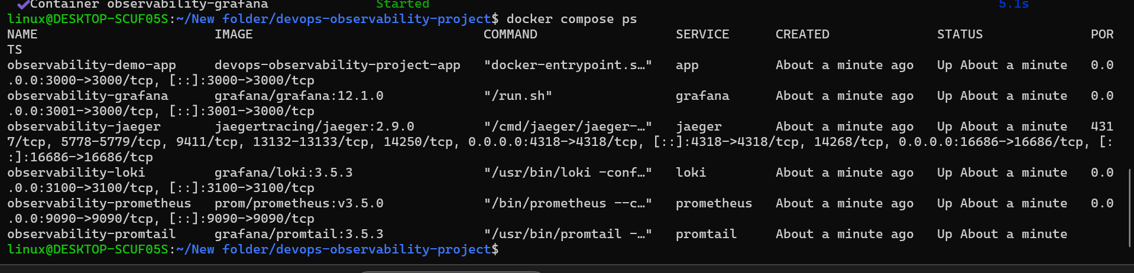
04 | Container status
Verify the services with Docker Compose
• Run: docker compose ps
• If something is unhealthy, inspect: docker compose logs <service>
COMPLETE OBSERVABILITY SYSTEM • DEVOPS PROJECT
5

Slide 6
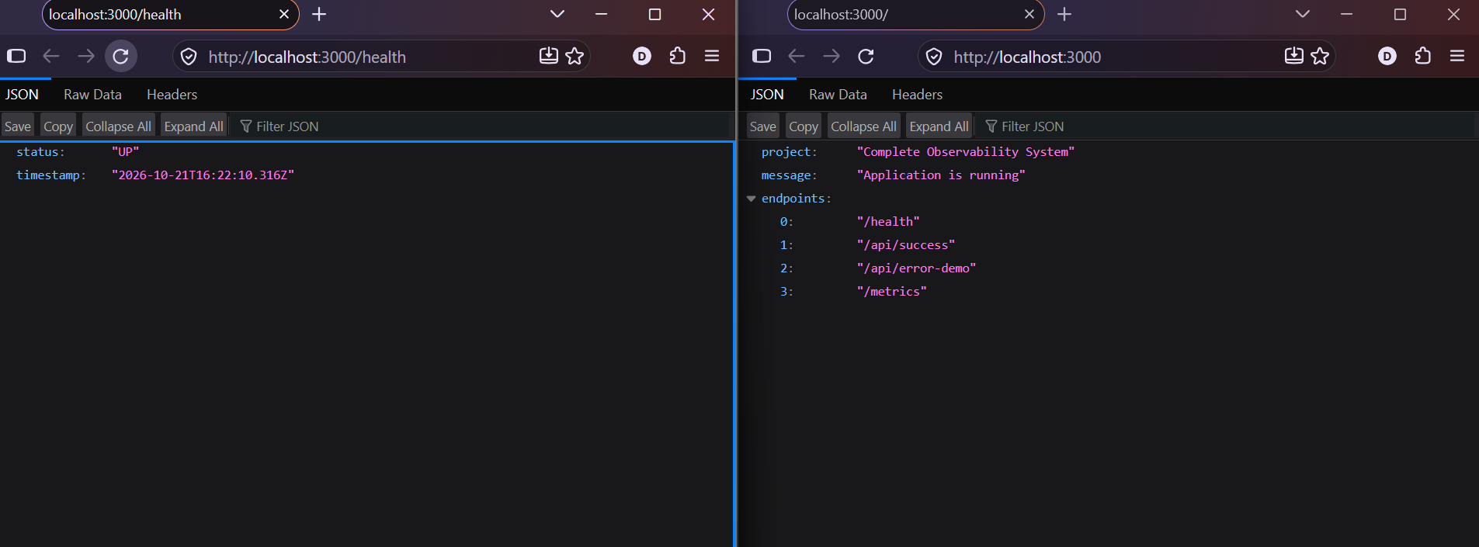
05 | Application endpoints
Health, route discovery, and demo traffic
Verified from screenshot: /health reports status up; / lists available endpoints.
COMPLETE OBSERVABILITY SYSTEM • DEVOPS PROJECT
6

Slide 7
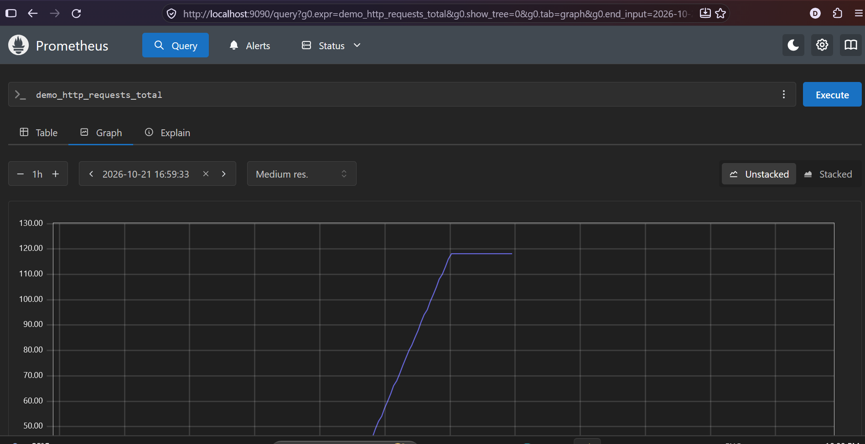
06 | Metrics with Prometheus
Query request counters and track change over time
Example query: demo_http_requests_total • Rate query: rate(demo_http_requests_total[5m])
COMPLETE OBSERVABILITY SYSTEM • DEVOPS PROJECT
7

Slide 8
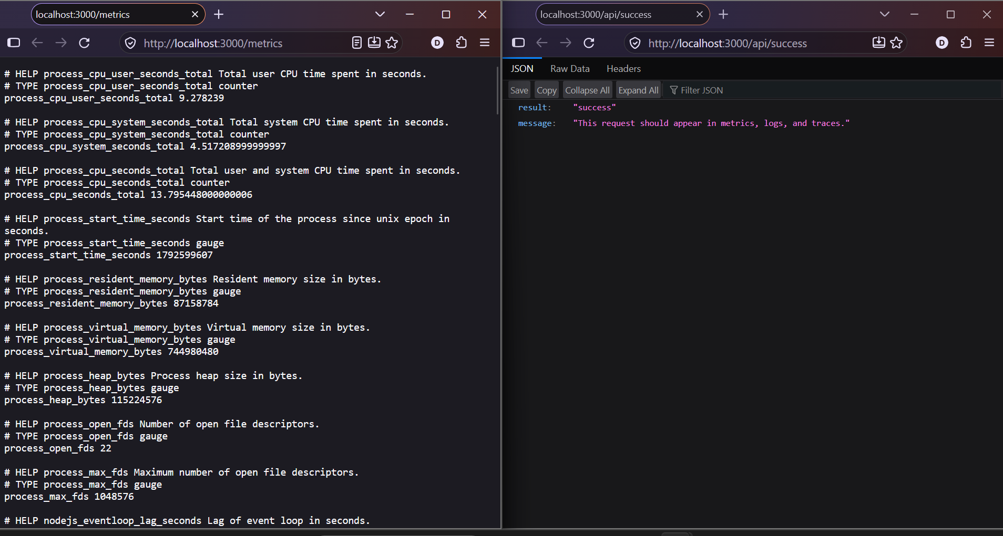
07 | Metrics endpoint & demo request
The app exposes process metrics and a success route
Generate requests, then check metrics, logs, and traces in their respective tools.
COMPLETE OBSERVABILITY SYSTEM • DEVOPS PROJECT
8

Slide 9
08 | Validation checklist
What to verify before calling the pipeline end-to-end
• Application: /health responds and /metrics contains app metrics.
• Prometheus: app target is UP and the request counter returns data.
• Grafana/Loki: a Loki data source is configured and logs are queryable.
• Jaeger: generate requests and confirm that spans appear for the demo service.
• Save dashboard screenshots and document expected behavior.
COMPLETE OBSERVABILITY SYSTEM • DEVOPS PROJECT
9

Slide 10
09 | Useful commands
Start, inspect, follow logs, and stop
docker compose up --build -d
docker compose ps
docker compose logs -f app
docker compose logs --tail=100
docker compose down
COMPLETE OBSERVABILITY SYSTEM • DEVOPS PROJECT
10

Slide 11
KEY TAKEAWAY
Observe the same application through
metrics, logs, and traces.
• Metrics reveal trends and service health.
• Logs explain events and errors.
• Traces help locate latency across operations.
Next: validate log shipping and trace export, then add dashboards and alerting.
COMPLETE OBSERVABILITY SYSTEM • DEVOPS PROJECT
11

