Slide 1
Deloitte Qupermarket Hackathon Challenge
Team Qustomers: Dinesh, Perminder, Yongjia, Amit, Kalai

Slide 2





Problem Statement
Goal: Optimize the energy consumption of Qupermarket in regard to its CO2.
3
1
Weather conditions affect how much electricity is generated by solar panels (sunny --> more electricity)
2
Supermarket can get its electricity from three ways:
From solar panels
Vehicle discharge
Plug
CO2 emissions increase in this order
‘m’ electric vehicles visit the supermarket on a given day. They also have additional batteries that can be used as storage to ‘discharge’ electricity

Slide 3
Approaches:
Quantum Inspired Approach (Simulated Annealing):
The QUBO function accepts the factors like power availability from sources and consumption elements and also the vehicle data for discharging and charging and optimize the vehicles to be discharged and charged.
Hybrid Approach (Quantum Inspired (Simulated Annealing) + Classical (Energy computation) ): **our approach
The consumption and energy availability is computed classically for each interval considering the mandatorily charging and route to optimization only if energy is not met by Solar power.
Classical Approach (Gurobi Optimization)

Slide 4
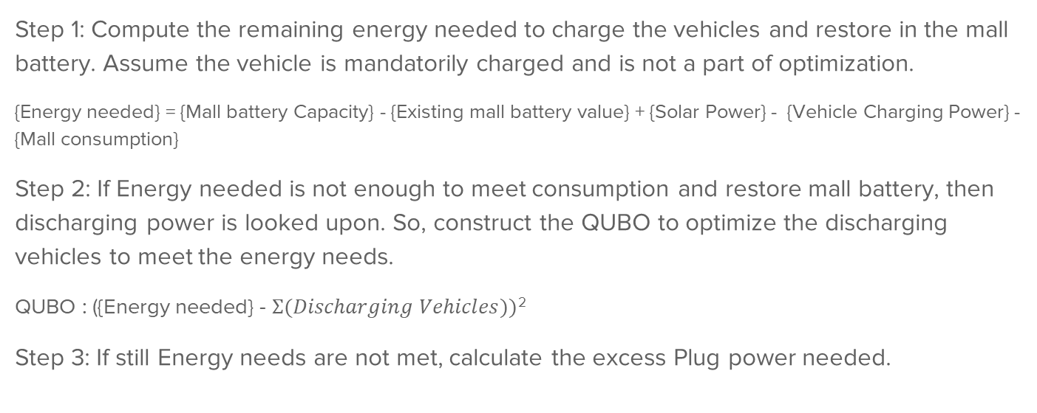
Approach 2 - Hybrid approach - QUBO Data:
Step 1: Compute the remaining energy needed to charge the vehicles and restore in the mall battery. Assume the vehicle is mandatorily charged and is not a part of optimization.
{Energy needed} = {Mall battery Capacity} - {Existing mall battery value} + {Solar Power} - {Vehicle Charging Power} - {Mall consumption}
Step 2: If Energy needed is not enough to meet consumption and restore mall battery, then discharging power is looked upon. So, construct the QUBO to optimize the discharging vehicles to meet the energy needs.
QUBO : ({Energy needed} - $Σ(Discharging Vehicles))$²
Step 3: If still Energy needs are not met, calculate the excess Plug power needed.

Slide 5
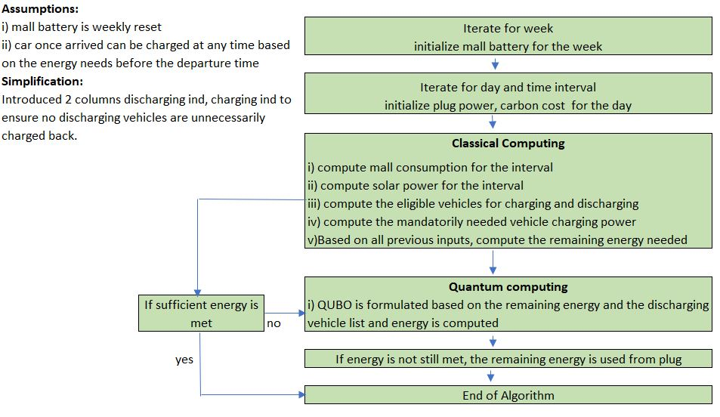
Solution approach

Slide 6
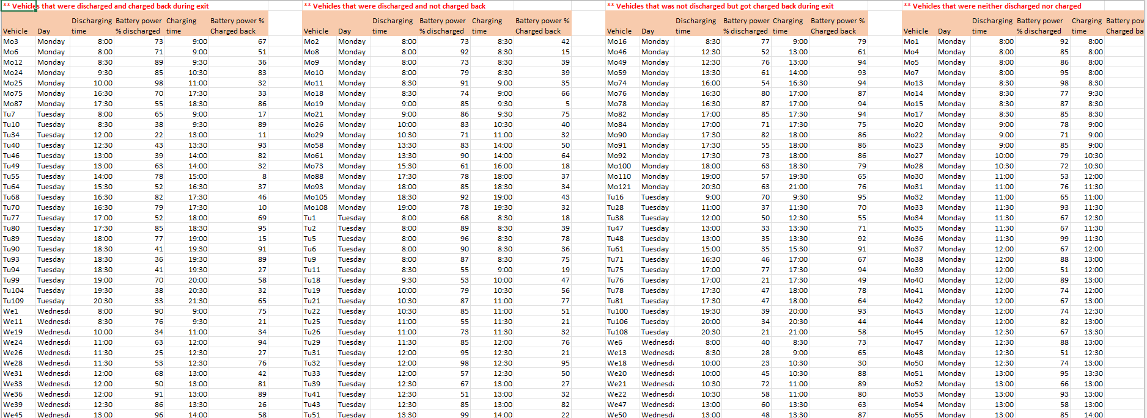
Vehicle Charging/Discharging schedules:

Slide 7
Analysis - Hybrid vs Quantum Approach
Carbon cost is noticed in high range, as few optimizations consider few vehicles and plug power is used | Carbon cost is noticed better compared to the former one as the discharging vehicles are properly optimised and only if energy is needed, plug power is sought.
Vehicles are not fully utilised to the extent | Only Discharging vehicles are put in optimization process, so vehicles are effectively discharged.
Since charging vehicles are also under optimization, there is a possibility of missing the vehicle to be charged thus may put the customer in a situation to wait for the technical assistance | Since charging vehicles are mandatorily charged based on the energy needed in a classical way, there is no possibility of any customer being missed, ensuring customers safe exit from mall.
Every interval, there is a call to the optimization engine to predict the discharging and charging vehicles. | Every interval, energy is classically computed and there is a optimization call only if energy shortage is there, else Algorithm effectively uses solar power and existing mall battery energy.

Slide 8
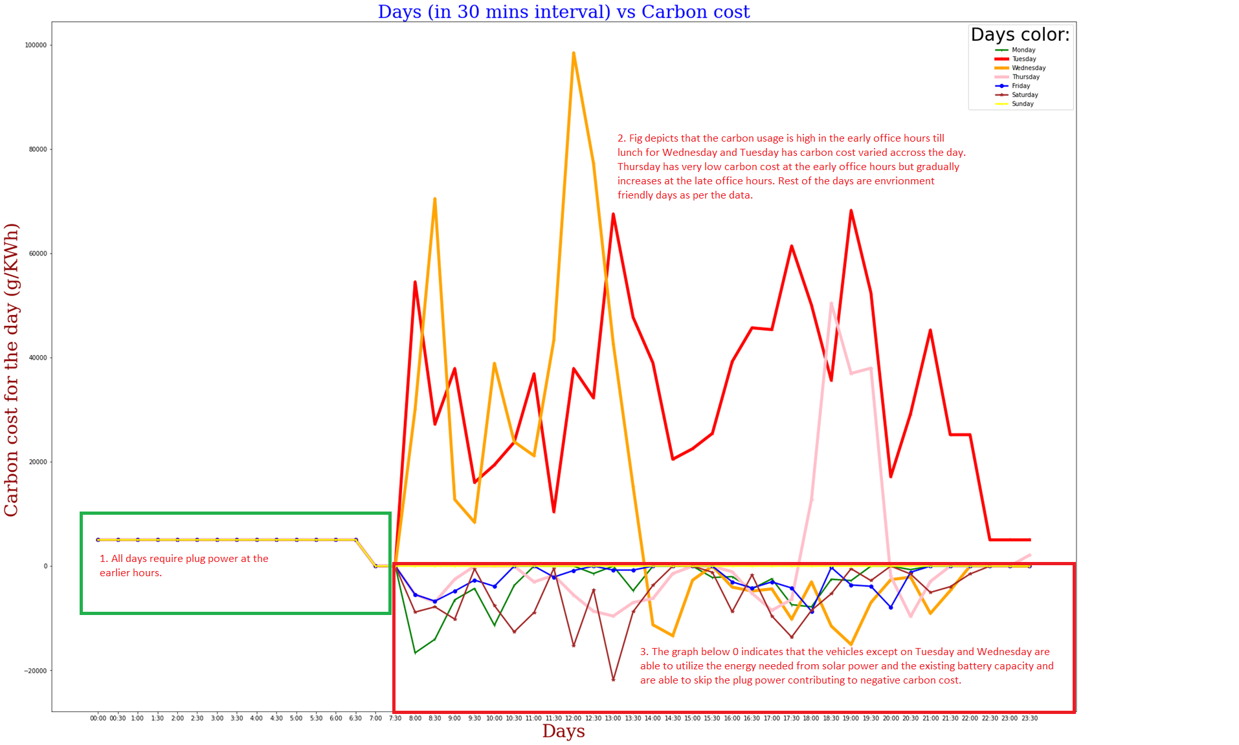
Carbon Cost Analysis (Hybrid Approach) - battery weekly reset

Slide 9
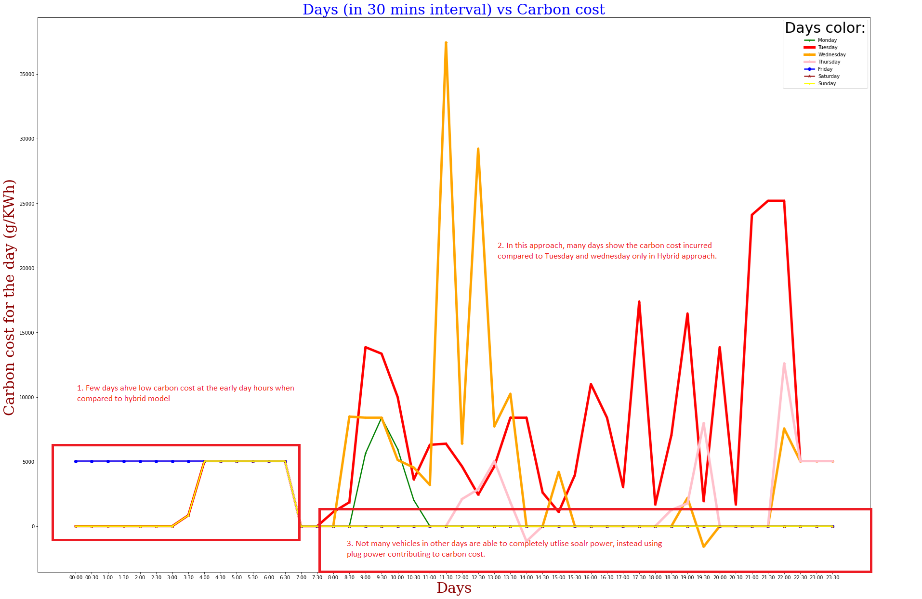
Carbon Cost Analysis (Quantum Approach) - battery weekly reset
Notes:
Do we use quantum approach and hybrid approach? -yongjia

Slide 10
Solutions
Requirements to implement our solution in real life
Dwave (Neal library for Simulated annealing sampler or Hardware API DwaveSampler)
Python
Scalability
Logical qubits: 2, Physical qubits: 11
Runtime increases linearly with datasets

