Slide 1
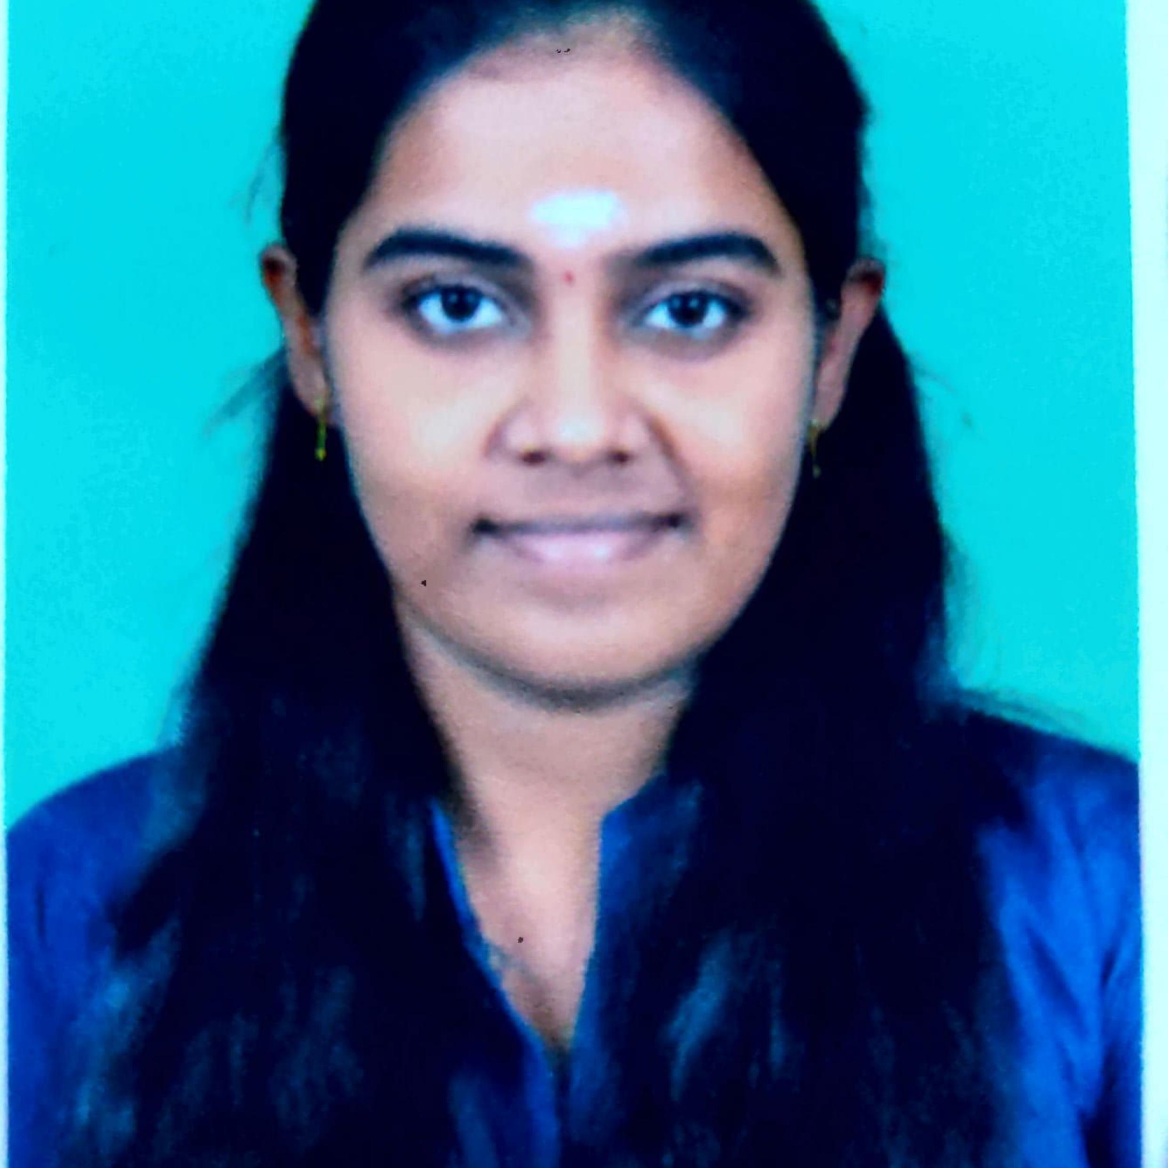



DINESHWARI V
Analyst/Software Engineer
BACHELOR OF TECHNOLOGY
Information Technology: 2016-2020
Skills Java
Spring Boot
Spring MVC
MERN Stack
NodeJS
MongoDB
Database
No SQL database – MongoDB
Web Technologies
HTML5
CSS3
Bootstrap
Javascript
Angular
AddOns
Github
Maven
Postman
Additional skills
Problem Solving
Quick Learner
Team management
Decision Maker
BANGALORE
DINESHWARI.V@CAPGEMINI.COM
9629272200
A4
Software Engineer who is Strong in design and integration with intuitive problem-solving skills.
Eager to work in a team of dedicated people and serve a key role in the enhancement and development of the project.
Passionate about implementing and launching new projects.
Ready to learn new technologies and implement them to further improve my knowledge.
Has working knowledge on Angular and Java Microservice Development using Spring framework on an intermediate level.
https://github.com/dineshwv/dineshwari_resume.git
https://github.com/dineshwv/Casestudy_video.git
Flight Booking System:
Completed end to end case study of Flight Booking System along with JWT authentication, Swagger and payment testing.Material-UI and ANGULAR used for user interface.
HTML CSS JAVASCRIPT for web developers at DEGREED
Completed this course with 97.5% and Designed responsive Restaurant website using HTML5 CSS3 ANGULAR.
https://www.linkedin.com/in/dineshwari-v-05318b173
Check out my work on GitHub & Video Profile

