Slide 1

BloomQuest
TMP-23-035
Personalized Learning System Based on Knowledge Graphs and Bloom’s Taxonomy.

Slide 2
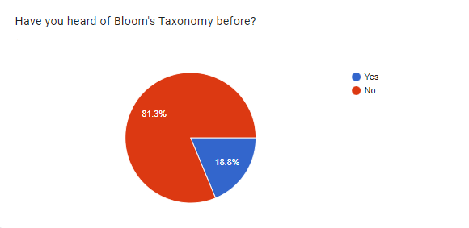
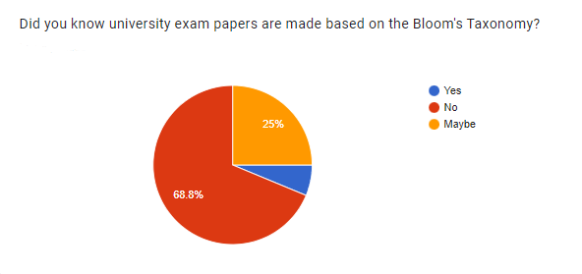
Research Problem
Lecturers rely on Bloom's Taxonomy framework to assess students' intellectual abilities and skills.
Many students are not aware of Bloom's Taxonomy and how it affects their learning experience.

Slide 3
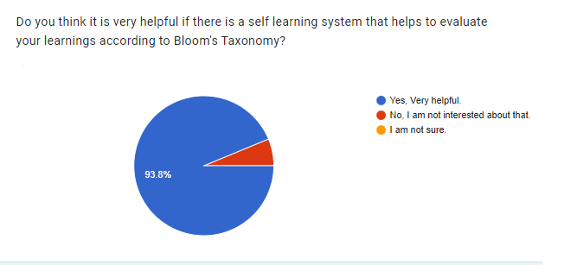
Research Problem Cont’d
Students missing important opportunities for growth and development in their academic pursuits.
Method for undergraduate students to
Identify and understand their cognitive level
Use the gained knowledge to do self studies effectively.

Slide 4
Research Objectives
Generate a comprehensive mind map for a given study material.
Generate a set of questions and answers from the study material and categorize them according to bloom’s taxonomy.
Track and forecast student performance in a specific subject.
Provide online extra study resources related to the upload study material.
Develop a personalized self-learning system to help undergraduate students.

Slide 5
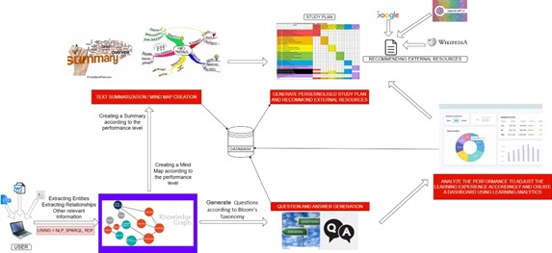
Overall System Diagram

Slide 6
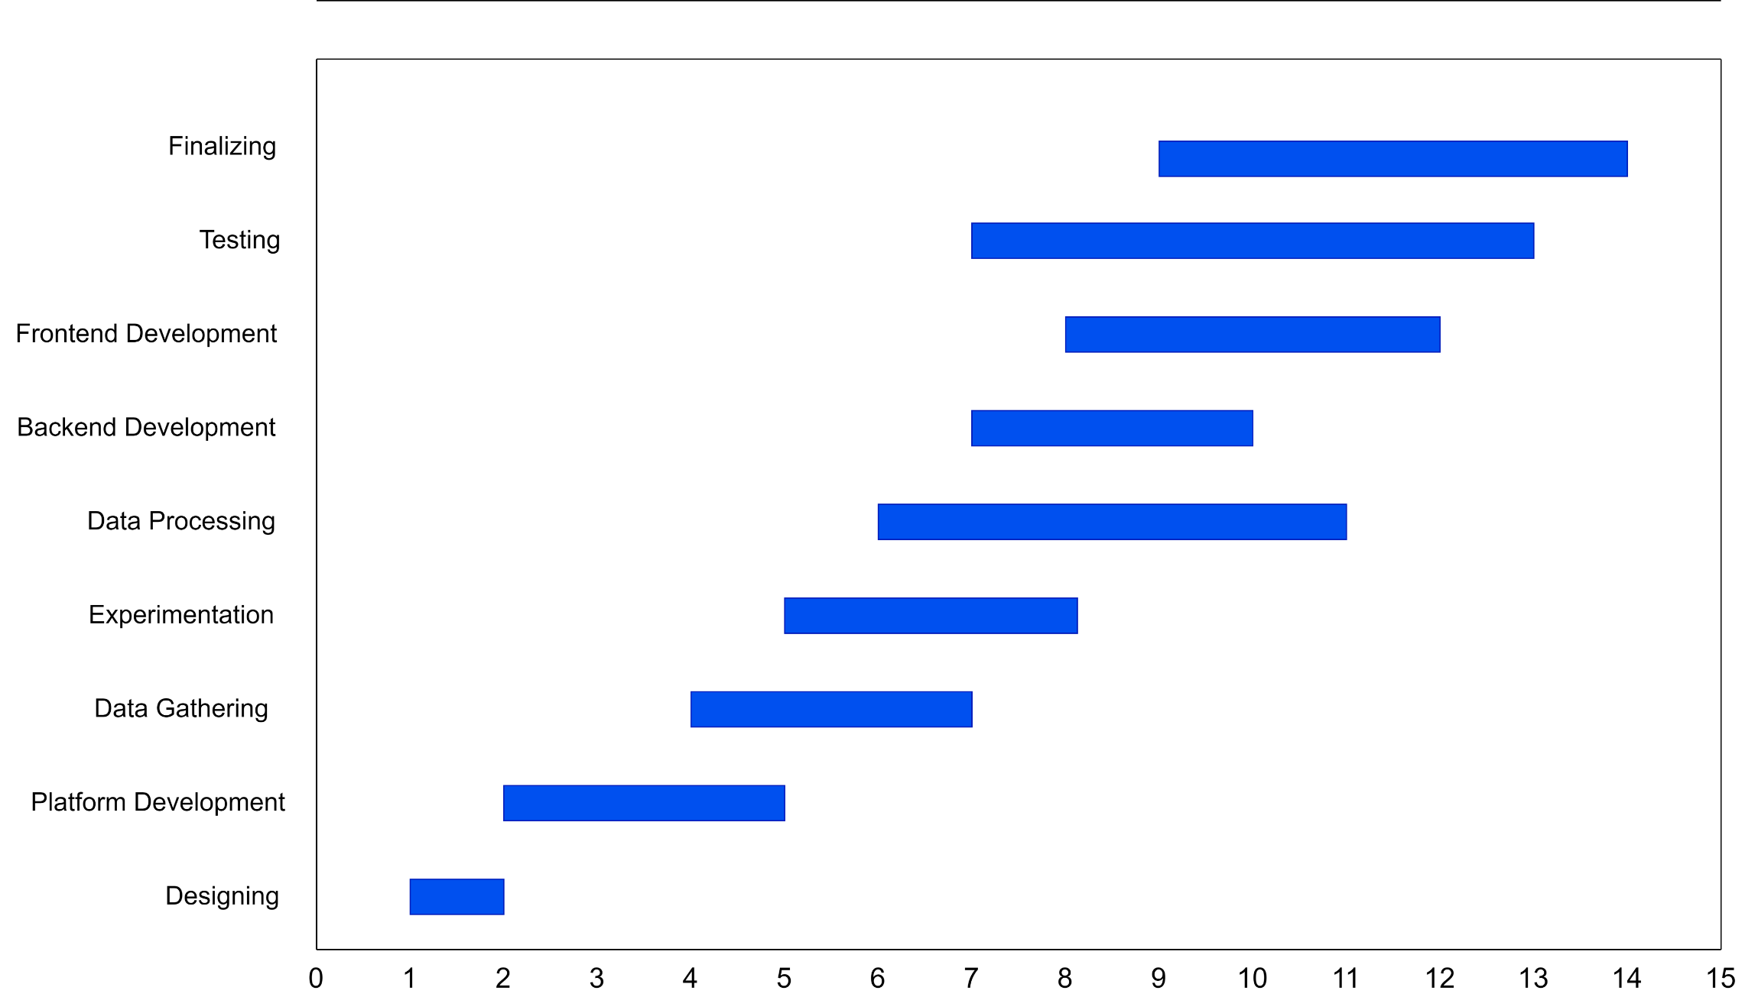
Gantt Chart

Slide 7

IT20133504 | Weerasekara n. n
Data Science
IT20133504 | Weerasekara N.N. | TMP-23-035

Slide 8
Background
What is a MIND MAP? - Mind mapping is a technique used for visually organizing information and concepts in a diagram or map. It's a widely-used method for note-taking, brainstorming, and idea organization.
It creates a visual representation of the relationships between ideas. This technique is useful for condensing large amounts of information into a clear and easy-to-understand format.
IT20133504 | Weerasekara N.N. | TMP-23-035

Slide 9
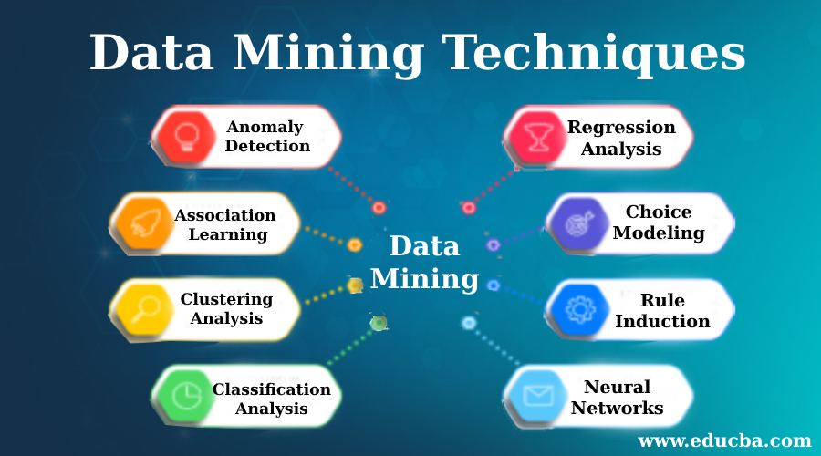
What do you think?
Paragraph
Mind Map
Data mining techniques are used to extract valuable information and insights from large datasets. These techniques can include machine learning algorithms, statistical analysis, clustering, association rule mining, and more. Some common techniques include association rule mining, which discovers relationships between variables, and clustering, which groups similar data points. Other techniques include classification, regression, decision trees, neural networks, text mining, time series analysis, anomaly detection, and ensemble methods. These techniques are applied in various fields such as finance, healthcare, marketing, and many more to gain insights and make data-driven decisions. By analyzing large datasets, data mining techniques can reveal patterns and trends that may be difficult to discern through manual analysis, leading to more efficient and effective decision making.
IT20133504 | Weerasekara N.N. | TMP-23-035

Slide 10
Background Cont’d
Nowadays many students are focusing on doing self studies but many of them don’t use mind maps because creating mind maps need extra mental efforts. Only few are creative enough to draw good mind maps and the rest don’t have that creativity[1].
If every student gets a chance to summarize their work using a mind map, they could improve their memory retention significantly.
There were some tools that built to generate mind maps in previous researches.
IT20133504 | Weerasekara N.N. | TMP-23-035

Slide 11
Research Gap
Existing automated systems for creating mind maps from text data rely on text mining algorithms[2] and machine learning approaches[3] that may not consider the domain-specific knowledge. As a result, the mind maps may be incomplete or may not accurately represent the text's intent.
This research attempts to design a knowledge-based system that uses domain-specific knowledge to generate more precise and significant mind maps from text input in order to get over this constraint.
In studies published in the Journal of the American Medical informatics association and Journal of Biomedical informatics found that their systems(Knowledge based) outperformed text mining algorithms in terms of accuracy.
IT20133504 | Weerasekara N.N. | TMP-23-035

Slide 12
Research Gap Cont’d
Comparison Criteria | Paper [1] | Paper [2] | Paper [3] | Proposed System
Use of knowledge-based concepts | ❌ | ❌ | ❌ | ✔
Evaluation metrics | ✔ | ❌ | ❌ | ✔
Scoring Algorithms | ✔ | ❌ | ❌ | ✔
Accuracy | ✔ | ❌ | ❌ | ✔
Speed | ❌ | ✔ | ✔ | ✔
User needs focus | ❌ | ❌ | ❌ | ✔
IT20133504 | Weerasekara N.N. | TMP-23-035

Slide 13
Research Question
"Can a knowledge-based system improve the accuracy and usefulness of mind maps generated from text data compared to existing text mining algorithms and Machine learning approaches?"
IT20133504 | Weerasekara N.N. | TMP-23-035

Slide 14
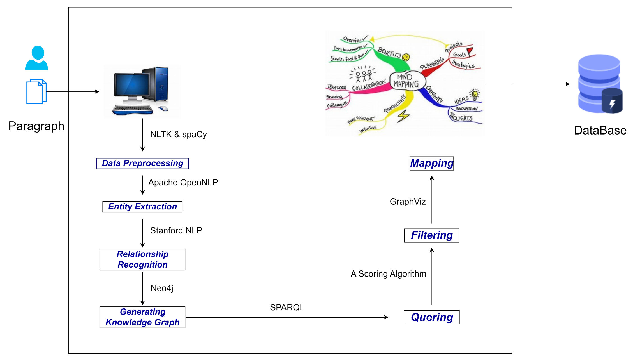
System Diagram
IT20133504 | Weerasekara N.N. | TMP-23-035

Slide 15
Technologies
Text Preprocessing : Clean the text data by removing stop words, punctuations, etc. (Python library : spaCY)
Entity Recognition : Identify the name entities. (e.g.- People, Places, etc.) (Stanford NLP)
Relationship Extraction : Identify the relationships between the entities. (Stanford NLP, Apache OpenNLP)
Graph Construction : Construct the graph. ( Entities as nodes, Relationships as Edges.) (Neo4j Tool)
Querying : Retrieve data from the Knowledge graph. (SPARQL)
Filtering : Include only the relevant entities and relationships. (A Scoring Algorithm)
Mapping : Map the entities and Visualize. (GraphViz Tool)
Frontend Development : User Interface (React js)
IT20133504 | Weerasekara N.N. | TMP-23-035

Slide 16
Main objective:
To develop a knowledge-based system for creating more accurate and meaningful mind maps from text data.
Sub objectives:
To design a mind map that supports self-study and helps students to better understand and retain key concepts in a particular subject.
To review existing literature on automated systems for creating mind maps from text data and identify the limitations of current approaches.
To conduct user studies to gather feedback on the usability and usefulness of the proposed system.
IT20133504 | Weerasekara N.N. | TMP-23-035

Slide 17
Functional Requirements:
Ability to extract and process text data from various file formats (e.g., PDF, Word).
Ability to identify key concepts and relationships within the inputted text data.
Ability to generate a visual mind map that represents the key concepts and relationships.
Ability to allow users to modify and edit the generated mind map.
Ability to export the generated mind map in various file formats (e.g., PNG, SVG).
Non-functional Requirements:
Accuracy: The system should accurately represent the key concepts and relationships.
Usability: The system should be user-friendly and easy to navigate.
Security: The system should ensure the confidentiality and integrity of the text data and generated mind maps.
IT20133504 | Weerasekara N.N. | TMP-23-035

Slide 18
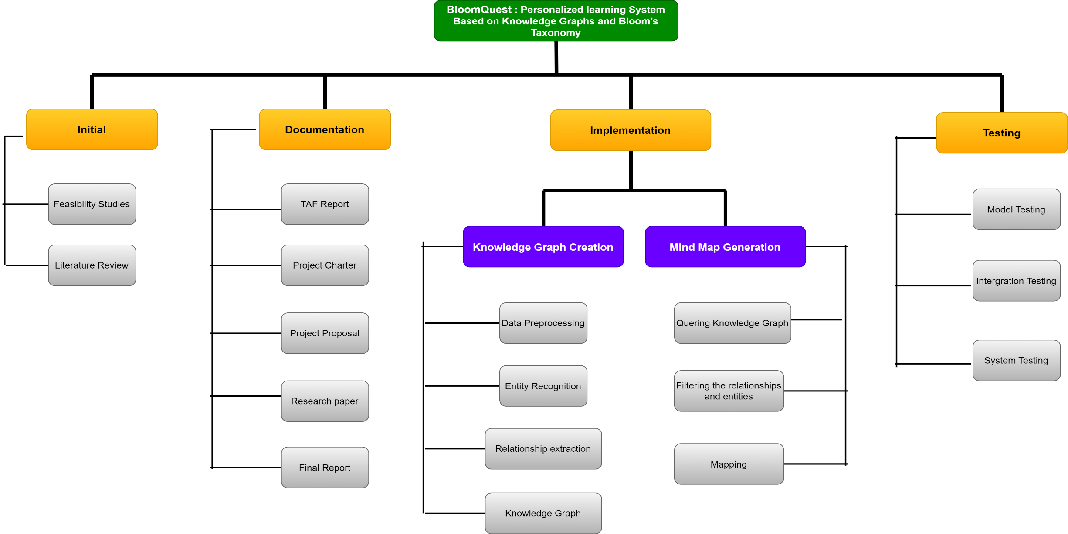
Work Breakdown Structure (WBS)
IT20133504 | Weerasekara N.N. | TMP-23-035

Slide 19
References
[1]M. Elhoseiny and A. Elgammal, "English2MindMap: an Automated System for MindMap Generation from English Text," Computer Science Department, Rutgers, The state university of New Jersey, Piscataway, NJ, USA, 2012.
[2] R. Kudelić, M. Konecki, and M. Maleković, "Mind Map Generator Software Model with Text Mining Algorithm," in Proceedings of the ITI 2011 33rd Int. Conf. on Information Technology Interfaces, Cavtat, Croatia, 2011
[3] M. F. Nurrokhim, L. S. Riza, and Rasim, "Generating mind map from an article using machine learning," J. Phys.: Conf. Ser., vol. 1280, p. 032023, 2019. DOI: 10.1088/1742-6596/1280/3/032023.
[4] A. Saelan and A. Purwarianti, "Generating Mind Map from Indonesian Text using Natural Language Processing Tools," Procedia Technology, vol. 11, pp. 1163-1169, 2013.
[5] D. Dessì, F. Osborne, D. Reforgiato Recupero, D. Buscaldi, and E. Motta, "Generating Knowledge Graphs by Employing Natural Language Processing and Machine Learning Techniques within the Scholarly Domain," Knowledge-Based Systems, vol. 154, pp. 1-14, 2018.
[6] A. Purwarianti, A. Saelan, I. Afif, F. Ferdian, and A. F. Wicaksono, "Natural Language Understanding Tools with Low Language Resource in Building Automatic Indonesian Mind Map Generator," in Proceedings of the International Conference on Advanced Computer Science and Information Systems (ICACSIS), Bali, Indonesia, 2013,
IT20133504 | Weerasekara N.N. | TMP-23-035

Slide 20

IT20126438 | Colambage K.G
Data Science
IT20126438 | Colambage K.G | TMP-23-035

Slide 21


Background
What is Generate a set of questions and answers using knowledge graph and categorize them according to bloom’s taxonomy?
Generating a set of questions and answers using a knowledge graph involves extracting information from a structured representation of knowledge and transforming it into a set of questions and answers. Bloom's taxonomy is a framework for categorizing educational goals and objectives into levels of cognitive complexity. Categorizing the questions and answers generated by the knowledge graph according to Bloom's taxonomy involves mapping them to the appropriate level of cognitive complexity, such as remembering, understanding, applying, analyzing, evaluating, or creating. This can help ensure that the questions and answers are appropriate for the level of learning intended and can guide the design of instructional materials and assessments
• Why do we say that it’s useful ?
If you have enough knowledge about Bloom’ taxonomy level, you can handle how to face the questions by categorizing Bloom’ taxonomy level
IT20126438 | Colambage K.G | TMP-23-035

Slide 22
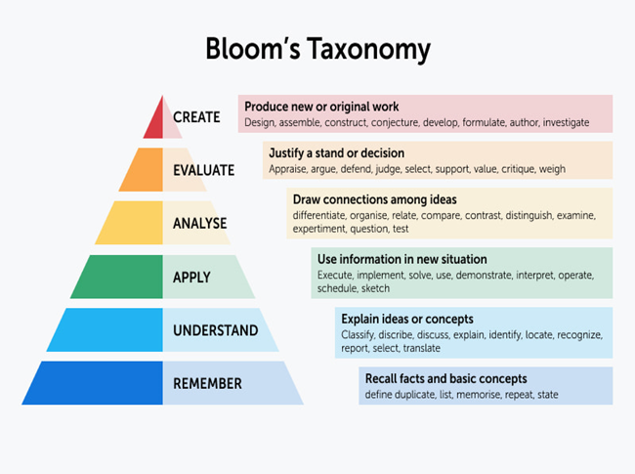

Background Cont’d
What is bloom’s taxonomy
Bloom's taxonomy is a framework a hierarchical model used for categorizing educational goals and objectives The taxonomy consists of six levels, which are listed below in order from lower to higher order thinking skills EX: remembering, understanding, applying, analyzing, evaluating, and creating.
Blooms taxonomy framework is used to assess university students
• What is the Reason for selecting this system ?
I have done a survey by getting details from the academic staff of the SLIIT campus, that the students those who are in the campus are not aware and not have enough knowledge about this system
IT20126438 | Colambage K.G | TMP-23-035

Slide 23
Research Gap
A system that generates, exam questions using natural language processing and ontology engineering. There is a potential research gap in comparing the effectiveness of generating exam questions with ontology engineering and natural language processing to generating self-study questions using a knowledge graph and Bloom's Taxonomy.
This research that generates, multiple-choice questions based on lecture notes here is a potential research gap in comparing the effectiveness of generating self-study questions with a knowledge graph and Bloom's Taxonomy to generating multiple-choice questions based on lecture notes. Use NLG
Another way of research that generates, quiz questions using a cognitive map here is a potential research gap in comparing the effectiveness of generating self-study questions with a knowledge graph and Bloom's Taxonomy to generating quiz questions using a cognitive map.
At a glance of research that generates, adaptive test questions based on a student's learning progress There is a potential research gap in comparing the effectiveness of generating self-study questions with a knowledge graph and Bloom's Taxonomy to generating adaptive test questions based on a student's learning progress.
If a question contain mostly keyword associated Analyzing level then can categories is Analyzing level..
IT20126438 | Colambage K.G | TMP-23-035​

Slide 24
Research Gap Cont’d
Feature​ | Paper [1]​ | Paper [2]​ ​ | Paper [3]​ ​ | Paper [4]​ ​ | Proposed Research Project​
Each question categorize bloom’s taxonomy level | ❌ ​ ​ | ​❌ ​ | ❌​ ​ | ❌​ ​ | ✔​ ​
Self-study help system. | ❌​ ​ | ❌​ ​ | ❌​ ​ | ✔​ ​ | ✔​ ​
Question and Answer Generation | ❌​ | ❌​ | ❌​ | ❌​ | ✔​ ​
​Automated using knowledge graph and using (NLP) | ❌​ | ❌​ | ✔​ | ❌​ | ✔​
Using the Knowledge graph | ❌​ | ❌​ | ✔ | ❌​ | ✔​
IT20126438 | Colambage K.G | TMP-23-035​

Slide 25
Research Questions
“How does categorizing Bloom’s taxonomy level questions understand by the students?”
“What factors, such as the size and complexity of the knowledge graph or the level of Bloom's Taxonomy used, influence the quality and usefulness of the generated questions and answers?”
“How does categorizing the generated questions and answers according to Bloom's Taxonomy impact the effectiveness of the self-study tool?”
"How effective is the use of a knowledge graph in generating sets of questions and answers to support self-study for students?”
IT20126438 | Colambage K.G | TMP-23-035​

Slide 26
Main objectives
The main objective of a project is the overarching goal that the project aims to achieve. It represents the desired outcome or end result of the project. The main objective provides a clear direction and focus for the project team and stakeholders to work towards.
When generating questions and answers using a knowledge graph and categorizing them according to Bloom's Taxonomy, here are some examples of how the main objective can be addressed
IT20126438 | Colambage K.G | TMP-23-035​

Slide 27
Specific and sub objectives
To develop a knowledge graph that includes relevant concepts and relationships for a given topic[1].
To use the knowledge graph to generate a set of self-study questions and answers.
Develop an algorithm to generate questions and answers from the knowledge graph
To categorize the self-study questions and answers according to Bloom's Taxonomy.
To generate a set of questions and answers that cover different levels of Bloom's Taxonomy.
Categorize the questions and answers according to the identified Bloom's Taxonomy levels.
IT20126438 | Colambage K.G | TMP-23-035​

Slide 28
Functional Requirements
•Input knowledge graph: Your component must accept an input knowledge graph that contains structured data that can be used to generate questions and answers.
•Question generation algorithm: Your component must have a question generation algorithm that can automatically generate questions based on the input knowledge graph.
•Answer generation algorithm: Your component must have an answer generation algorithm that can automatically generate answers based on the input knowledge graph.
•Bloom's taxonomy categorization: Your component must be able to categorize the generated questions according to the levels of Bloom's taxonomy.
•User interface: Your component should have a user interface to allow users to input the knowledge graph and interact with the generated questions and answers.
•Scalability: Your component should be able to handle large knowledge graphs and generate a large number of questions and answers in a reasonable amount of time.
IT20126438 | Colambage K.G | TMP-23-035​

Slide 29
Non-functional Requirements
Performance: Your component should be able to generate questions and answers quickly and efficiently, even with large amounts of data.
Scalability: The component should be designed to handle increasing amounts of data and user traffic over time.
Usability: The user interface should be intuitive and easy to use for both technical and non-technical users.
Security: The component should be designed to prevent unauthorized access and protect sensitive data.
IT20126438 | Colambage K.G | TMP-23-035​

Slide 30
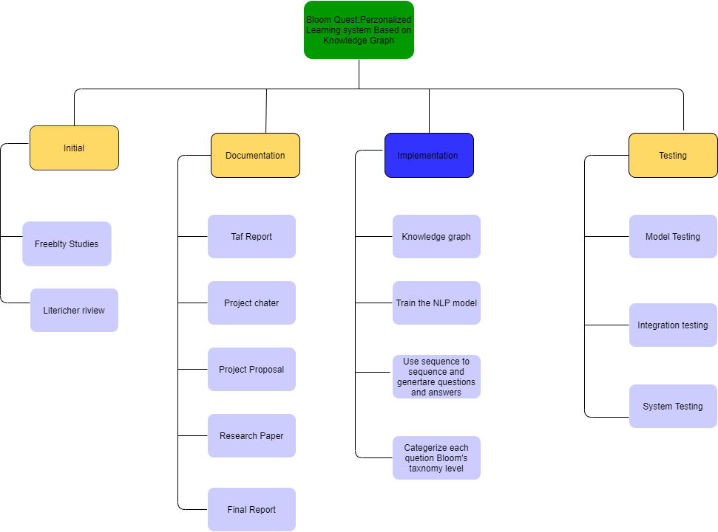
Work Breakdown Structure (WBS)

Slide 31
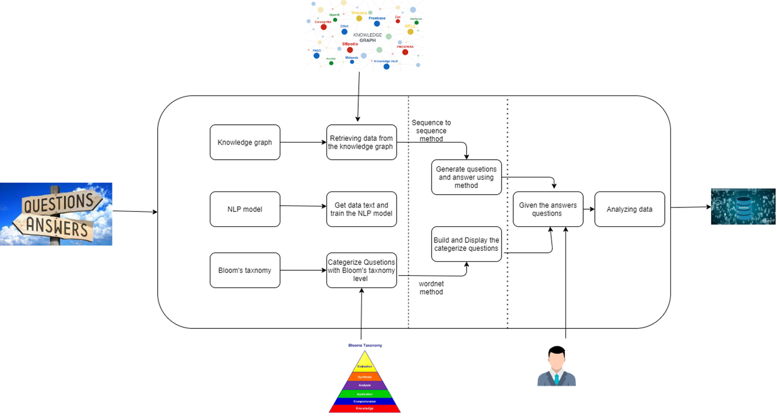
System Diagram
IT20126438 | Colambage K.G | TMP-23-035​

Slide 32
Technologies, techniques & algorithms
Programming languages:​
Python for data analysis and machine learning.​
JavaScript for building the front-end of the application.​
Frameworks and algorithms:​
Frontend : Neo4j
ReactJS for building user interfaces.​
Python
NLTK python package
(SPARQL)
NLP
.​An algorithm would be created utilizing basics of
Tokenization algorithm
Sequence to sequence
Wordnet
that is capable of extracting data from multi sources and performing an effective classification
Time series analysis or machine learning models for forecasting future performance.​
IT20126438 | Colambage K.G | TMP-23-035​

Slide 33
Other Required Resources
Analyzed student
Knowledge graph
Bloom's Taxonomy
Machine learning algorithms
Online resources
IT20126438 | Colambage K.G | TMP-23-035​

Slide 34
References
1] L. Einhardt, T. A. Tavares, and C. Cechinel, “Moodle analytics dashboard: A learning analytics tool to visualize users interactions in moodle,” 2016, doi: 10.1109/LACLO.2016.7751805.
[2] F. Gutiérrez, K. Seipp, X. Ochoa, K. Chiluiza, T. De Laet, and K. Verbert, “LADA: A learning analytics dashboard for academic advising,” 2020. doi: 10.1016/j.chb.2018.12.004.
[3] L. A. Costa, L. Do Nascimento Salvador, M. V. Das Santos E Souza, and R. J. Rocha Amorim, “Monitoring students performance in e-learning based on learning analytics and learning educational objectives,” 2019, doi: 10.1109/ICALT.2019.00067.
[4] U. K. Mothukuri et al., “Improvisation of learning experience using learning analytics in eLearning,” 2017, doi: 10.1109/ELELTECH.2017.8074995.
[5] D. Distante, M. Villa, N. Sansone, and S. Faralli, “MILA: A SCORM-compliant interactive learning analytics tool for moodle,” 2020, doi: 10.1109/ICALT49669.2020.00056.
6] M. Adraoui, A. Retbi, M. K. Idrissi, and S. Bennani, “Social learning analytics to describe the learners’ interaction in online discussion forum in Moodle,” 2017, doi: 10.1109/ITHET.2017.806781
[7] B. Yi et al., “Learning analytics-based evaluation mode for blended learning and its applications,” 2017, doi: 10.1109/ISET.2017.42.
[8] E. Hussein, S. Daoud, H. Alrabaiah, and R. Badawi, “Exploring undergraduate students’ attitudes towards emergency online learning during COVID-19: A case from the UAE,” Child. Youth Serv. Rev., vol. 119, 2
IT20126438 | Colambage K.G | TMP-23-035​

Slide 35

IT20123468 | SENAWEERA T.I.S
Software Engineering
IT20123468 | Senaweera T.I.S. | TMP-23-035

Slide 36
Background
University students are perplexed why their exam results are poor even though they performed well.
Blooms taxonomy framework is used to assess university students.
No method to find out which level student is performing better, and which is not.
Need of a personalized and effective approach to track status of each Bloom’s level for student in a specific subject.
Forecast how they will perform in a specific subject.
IT20123468 | Senaweera T.I.S. | TMP-23-035

Slide 37
Research Gap
Most studies predict student’s academic performance for the convenience of university decision-makers or higher education (HE) providers [1][2][3].
Fewer studies on identifying level of student based on bloom’s taxonomy [4].
Uses only historical information of an individual student to forecast/predict his/her own performance [5].
No studies were found,
Predicting performance,
Identifying level of student based on bloom’s taxonomy,
Forecast performance using platform-based and Bloom's levels-based metrics,
for the convenience of a student.
IT20123468 | Senaweera T.I.S. | TMP-23-035

Slide 38
Research Gap Cont’d
Feature | Paper [1] | Paper [2] | Paper [3] | Paper [4] | Proposed Research Project
Use platform engagement metrics. | ✔ | ✔ | ✔ | ❌ | ✔
Identify bloom’s level. | ❌ | ❌ | ❌ | ✔ | ✔
Forecast student performance. | ❌ | ❌ | ❌ | ❌ | ✔
Visualization of performance. | ❌ | ❌ | ❌ | ❌ | ✔
Focused on student. | ❌ | ❌ | ❌ | ❌ | ✔
IT20123468 | Senaweera T.I.S. | TMP-23-035

Slide 39
Research Question
Current educational system fails to provide students with personalized learning experiences.
Need to develop functionality that can track a student's performance status for each level of Bloom's taxonomy.
The proposed system aims to address this gap by allowing students to,
Track their progress.
Forecast the performance using a statistical index.
Use of visualization techniques to present the data in a clear and understandable format to students.
IT20123468 | Senaweera T.I.S. | TMP-23-035

Slide 40
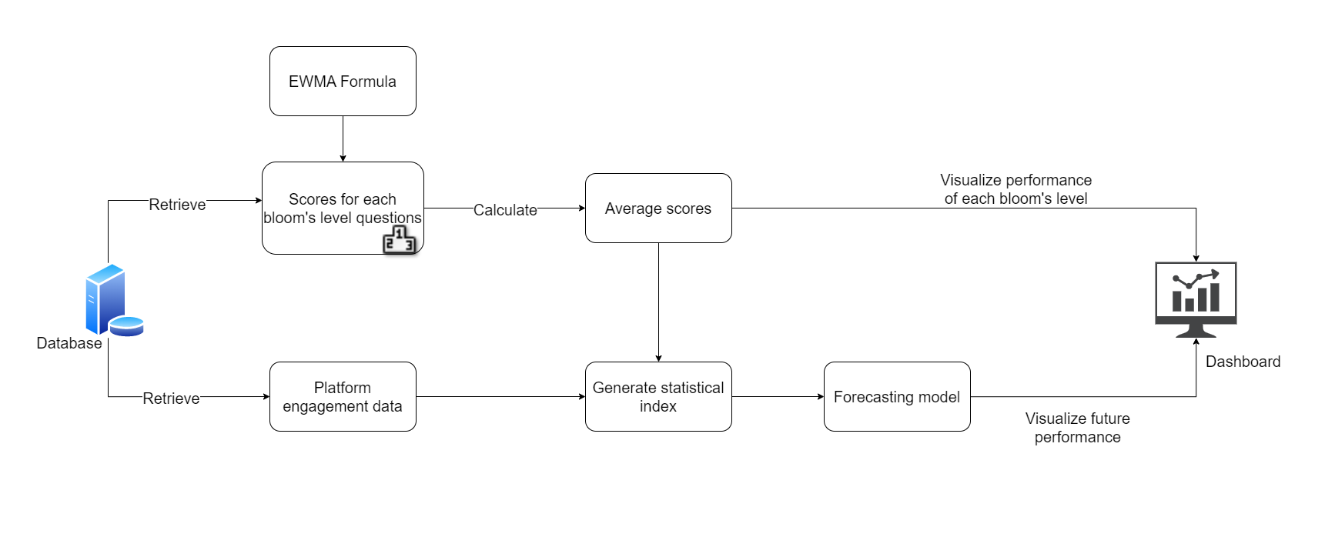
System Diagram
IT20123468 | Senaweera T.I.S. | TMP-23-035

Slide 41
Specific Objective
Track and forecast student performance in a specific subject by combining,
platform-based metrics.
Bloom's levels-based metrics.
Provide insights to students, allowing them to identify areas of strength and weakness and take steps to improve student learning outcomes through chart visualizations.
Ultimately, the goal is to improve student learning outcomes and enhance the educational experience.
IT20123468 | Senaweera T.I.S. | TMP-23-035

Slide 42
Sub Objectives
Track student scores for each level of Bloom's taxonomy through scores obtained.
Calculate the status of each Bloom's level for a student using Exponentially Weighted Moving Average (EWMA) formula.
Collect platform-based metrics data such as,
The number of visits to the specific subject.
Total time spent on a single Q and A.
Duration of interactions using the system.
Date of visit.
Reference to extra study materials.
IT20123468 | Senaweera T.I.S. | TMP-23-035

Slide 43
Sub Objectives Cont’d
Develop a statistical index for each student on a scale of 0 to 100 based on both platform-based and Bloom's levels-based metrics.
Forecast future changes in the performance index, which can be updated over time as more data is collected.
Presenting the data in a visual format using progress bar and gauge chart visualizations.
IT20123468 | Senaweera T.I.S. | TMP-23-035

Slide 44
Functional Requirements
Retrieving relevant data for analyzing.
Bloom's level calculation using Q & A scores and EWMA formula.
Develop a statistical index calculation method.
Performance forecasting.
Visualization of performance in dashboard.
IT20123468 | Senaweera T.I.S. | TMP-23-035

Slide 45
Non-functional Requirements
User Experience: Designed in a way that is visually appealing and engaging, while also being easy to interpret.
Usability: Easy to use and navigate, with a clear and intuitive interface that allows users to access the information they need quickly and easily.
Performance Standards: Meet specific performance standards for response time, throughput, and other metrics to ensure that it is delivering reliable and consistent results.
IT20123468 | Senaweera T.I.S. | TMP-23-035

Slide 46
Technologies, techniques & algorithms
Programming languages:
Python for data analysis and machine learning.
JavaScript for building the front-end of the application.
Frameworks and libraries:
ReactJS for building user interfaces.
Recharts or Victory for data visualization.
NumPy, Pandas, and Scikit-learn for data processing and machine learning.
Exponentially weighted moving average (EWMA) formula for calculating the Bloom's level scores.
Time series analysis or machine learning models for forecasting future performance.
IT20123468 | Senaweera T.I.S. | TMP-23-035

Slide 47
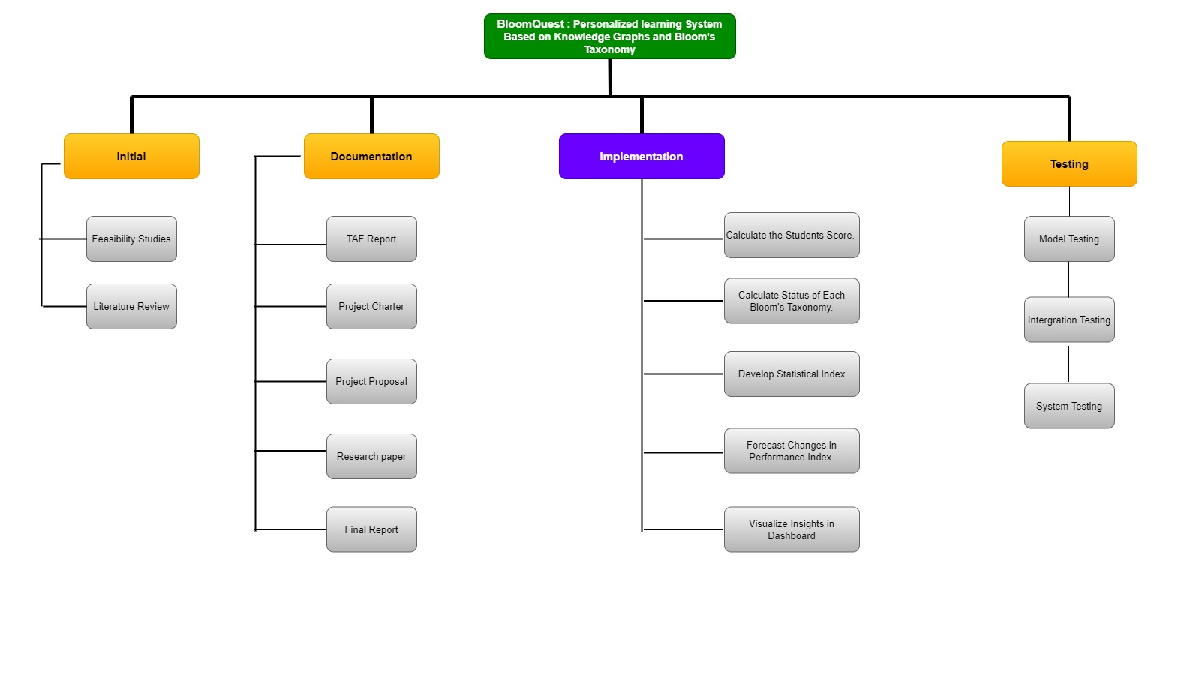
Work Breakdown Structure
IT20123468 | Senaweera T.I.S. | TMP-23-035

Slide 48
References
[1] S. Gaftandzhieva et al., “Exploring Online Activities to Predict the Final Grade of Student,” Mathematics, vol. 10, no. 20, Oct. 2022, doi: 10.3390/math10203758.
[2] A. S. Aljaloud et al., “A Deep Learning Model to Predict Student Learning Outcomes in LMS Using CNN and LSTM,” IEEE Access, vol. 10, pp. 85255–85265, 2022, doi: 10.1109/ACCESS.2022.3196784.
[3] K. Fahd, S. J. Miah, and K. Ahmed, “Predicting student performance in a blended learning environment using learning management system interaction data,” Applied Computing and Informatics, 2021, doi: 10.1108/ACI-06-2021-0150.
[4] G. N. R. Prasad, “Evaluating student performance based on bloom’s taxonomy levels,” in Journal of Physics: Conference Series, IOP Publishing Ltd, Mar. 2021. doi: 10.1088/1742-6596/1797/1/012063.
[5] N. Thai-Nghe, T. Horváth, and L. Schmidt-Thieme, “Personalized forecasting student performance,” in Proceedings of the 2011 11th IEEE International Conference on Advanced Learning Technologies, ICALT 2011, 2011, pp. 412–414. doi: 10.1109/ICALT.2011.130.
IT20123468 | Senaweera T.I.S. | TMP-23-035

Slide 49

IT20133368 | Wijayasena w.d.n.d.t
Data Science
IT20133368 | Wijayasena W.D.N.D.T. | TMP-23-035

Slide 50
Background
Nowadays many students move on to do self-studding to achieve more grades.
While doing self-studying , people may have difficulty understanding a passage or wish to learn more about the topics covered by it
The focal point is developing an online resource recommendation system for students who are doing self-studying to recommend more relevant online resources such as documents and videos regarding for passage given by student.
The resource will be ranked according to
how they match the different topics covered within the passage
the reading level of the passage.
IT20133368 | Wijayasena W.D.N.D.T. | TMP-23-035

Slide 51
Research Question
Students often struggle to find the right resources for self-study and may be discouraged by materials that are either too difficult or not relevant to their needs.
Many current recommendation systems have limitations in processing longer queries, which can result in inaccurate or incomplete search results.
This can be particularly challenging for students seeking resources on complex topics that require longer queries to accurately describe their information needs.
There is a need for a more personalized and effective resource recommending system that can address these challenges and support students in their learning.
IT20133368 | Wijayasena W.D.N.D.T. | TMP-23-035

Slide 52
Research Gap
Many students use other resource recommendation systems to search for extra resources.
These search engines have limitations when giving proper result for long queries.
Students have to use short queries when they search.
Using this system users able to input long paragraph to search resources.
Users are able to select what type of resources he/she need. (Documents , Videos).
Resources are recommended according to two ranking levels.
IT20133368 | Wijayasena W.D.N.D.T. | TMP-23-035

Slide 53
Research Gap Cont’d
 | Paper [1] | Paper [2] | Paper [3] | Paper [4] | Proposed System
Use of user-submitted paragraphs to generate recommendation. | ❌ | ❌ | ❌ | ✔ | ✔
Recommendation of resource types such documents and videos. | ❌ | ✔ | ✔ | ✔ | ✔
Measure the relevance based on topics instead of common IR models. | ❌ | ✔ | ❌ | ❌ | ✔
Consideration of reading level of user-submitted paragraph. | ❌ | ❌ | ✔ | ❌ | ✔
Combination of relevance and reading difficulty ranking. | ❌ | ❌ | ✔ | ❌ | ✔
User Can select what type of resources he/she wants. | ❌ | ❌ | ❌ | ❌ | ✔
IT20133368 | Wijayasena W.D.N.D.T. | TMP-23-035

Slide 54
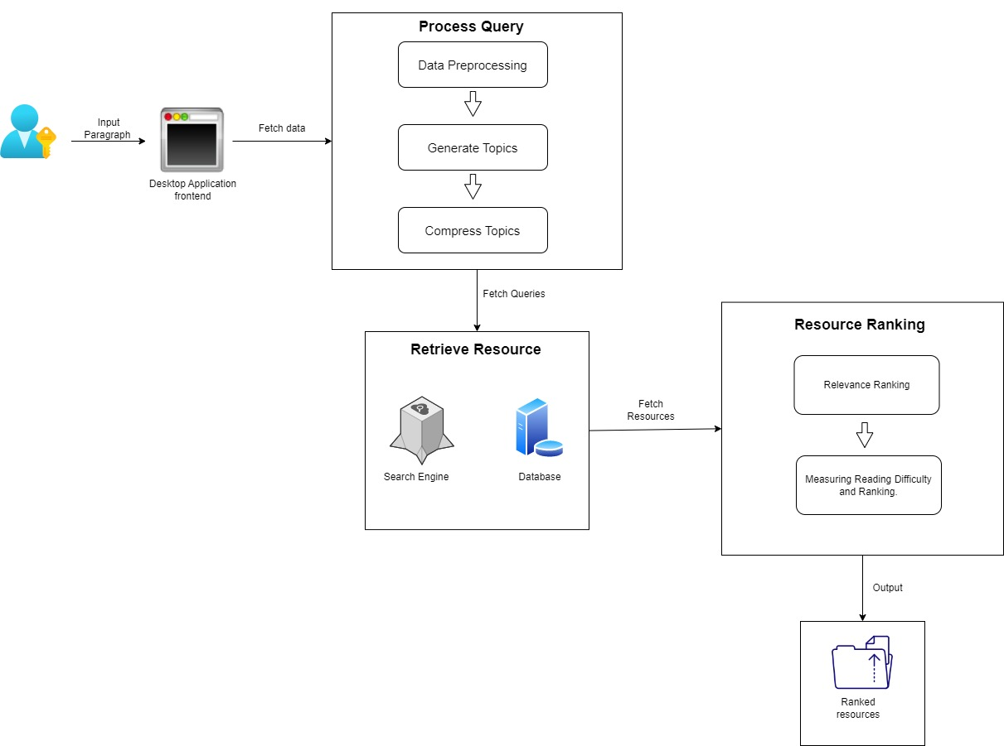
System Diagram
IT20133368 | Wijayasena W.D.N.D.T. | TMP-23-035

Slide 55
Main Objective:
Develop an online resource recommending system that can analyze a student's submitted paragraph and recommend educational materials that are tailored to their reading level and the specific concepts they need clarification on.
Sub Objectives:
Identify the topic related to the query using topic modeling algorithms.
Retrieve resources using google API.
Ranked the resources based on relevance ranking and reading difficulty.
Suggest related online resources.
IT20133368 | Wijayasena W.D.N.D.T. | TMP-23-035

Slide 56
Functional Requirements
Generate topics from the given paragraph using Topic modeling algorithms.
Retrieve resources using search engine.
Apply relevance ranking to retrieved resources.
Rank resources based on reading difficulty of the given paragraph.
IT20133368 | Wijayasena W.D.N.D.T. | TMP-23-035

Slide 57
Non-Functional Requirements
Performance: The system should be able to process and rank recommended resources in a timely manner, to ensure a smooth user experience.
Scalability: The system should be designed to handle a potentially large number of users and queries.
Security: The system should incorporate appropriate measures to protect user data and prevent unauthorized access.
Usability: The interface should be designed to be intuitive and easy to use, to encourage student engagement.
Accessibility: The system should be designed to accommodate users with disabilities, such as visually impaired or hearing-impaired students.
Accuracy: The recommendation engine should be designed to provide high-quality, relevant resources to users, and minimize the inclusion of irrelevant or low-quality resources.
IT20133368 | Wijayasena W.D.N.D.T. | TMP-23-035

Slide 58
Technologies, techniques & algorithms
Backend:
Data Preprocessing: Natural Language Toolkit (NLTK) Library
Topic Modeling Algorithm : Python
Similarity Measures: Cosine Similarity – Python
Readability Measurements: Flesch Reading Ease
Goggle API
Frontend:
ReactJs
IT20133368 | Wijayasena W.D.N.D.T. | TMP-23-035

Slide 59
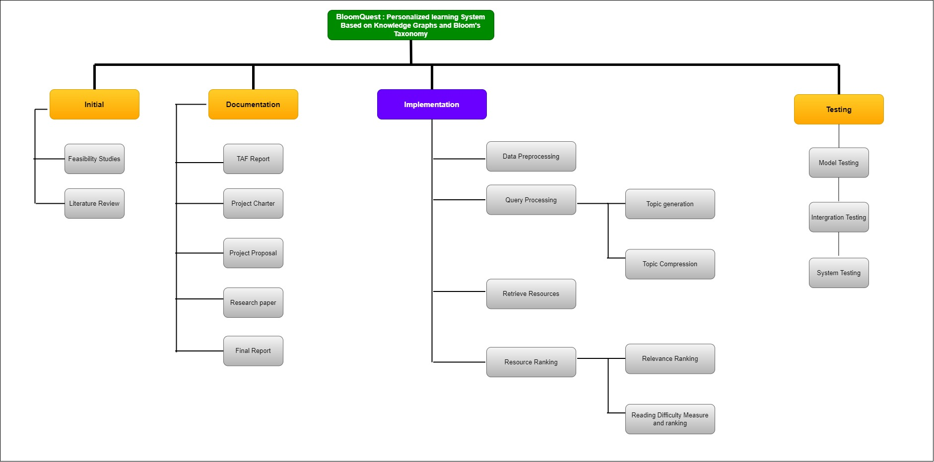
Work Breakdown Structure
IT20133368 | Wijayasena W.D.N.D.T. | TMP-23-035

Slide 60
References
[1] J. Xiao, M. Wang, B. Jiang, and J. Li, “A personalized recommendation system with combinational algorithm for online learning,” J Ambient Intell Humaniz Comput, vol. 9, no. 3, pp. 667–677, Jun. 2018, doi: 10.1007/s12652-017-0466-8.
[2] N. S. Milovančević and A. Gračanac, “Time and ontology for resource recommendation system,” Physica A: Statistical Mechanics and its Applications, vol. 525, pp. 752–760, Jul. 2019, doi: 10.1016/j.physa.2019.04.005.
[3] H. Qi, M. Cui, and M. Xiao, “A personalized resource recommendation system using data mining,” in Proceedings of the International Conference on E-Business and E-Government, ICEE 2010, 2010, pp. 5365–5368. doi: 10.1109/ICEE.2010.1342.
[4] T. B. Lalitha and P. S. Sreeja, “Personalised Self-Directed Learning Recommendation System,” in Procedia Computer Science, Elsevier B.V., 2020, pp. 583–592. doi: 10.1016/j.procs.2020.04.063.
[5] Aditya Anantharaman, Arpit Jadiya, Chandana Tulasi Sai Siri, Adikar Bharath NVS, and Biju Mohan, Performance Evaluation of Topic Modeling Algorithms for Text Classification. IEEE Xplore , 2019.
[6] L. Zahrotun, “Comparison Jaccard similarity, Cosine Similarity and Combined Both of the Data Clustering With Shared Nearest Neighbor Method,” Computer Engineering and Applications, vol. 5, no. 1, 2016.
IT20133368 | Wijayasena W.D.N.D.T. | TMP-23-035

Slide 61

Thank you
IT20133368 | Wijayasena W.D.N.D.T. | TMP-23-035

