Slide 1
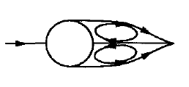
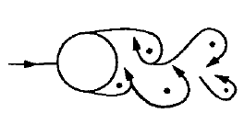
Introduction
Flow over a cylinder at different Reynolds numbers.
At 5 < Re < 40
At 40 < Re < 200
Cylinder
Stable vortices generate at 2 ends due to the flow separation[1]
Laminar vortex shedding[1]

Slide 2
Wake pattern generated in due to the vortex shedding. (Karman Vortex Street)

Slide 3
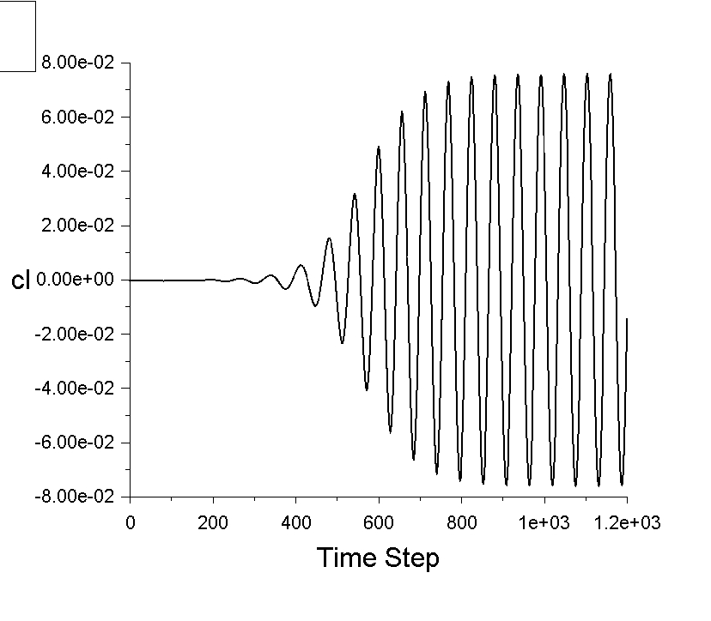
Generated lift forces due to the vortex shedding

Slide 4
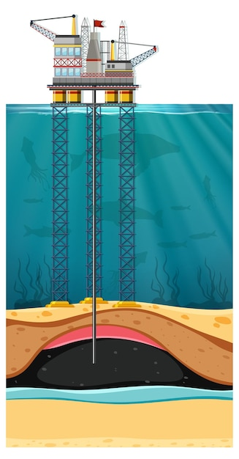
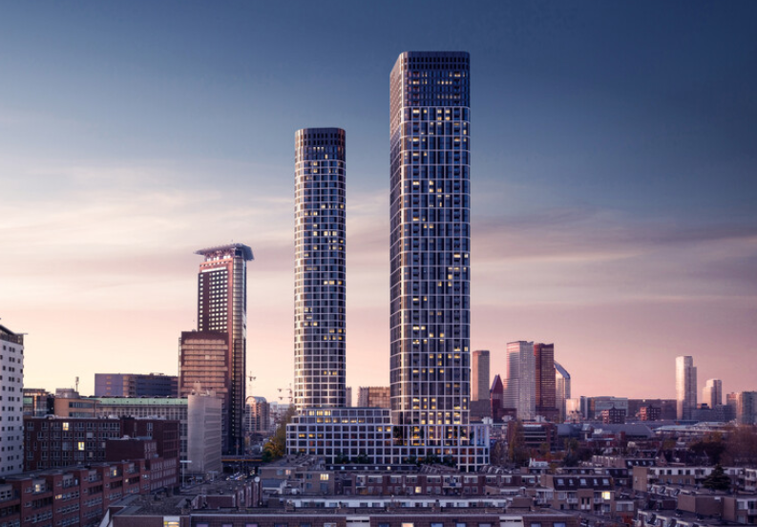
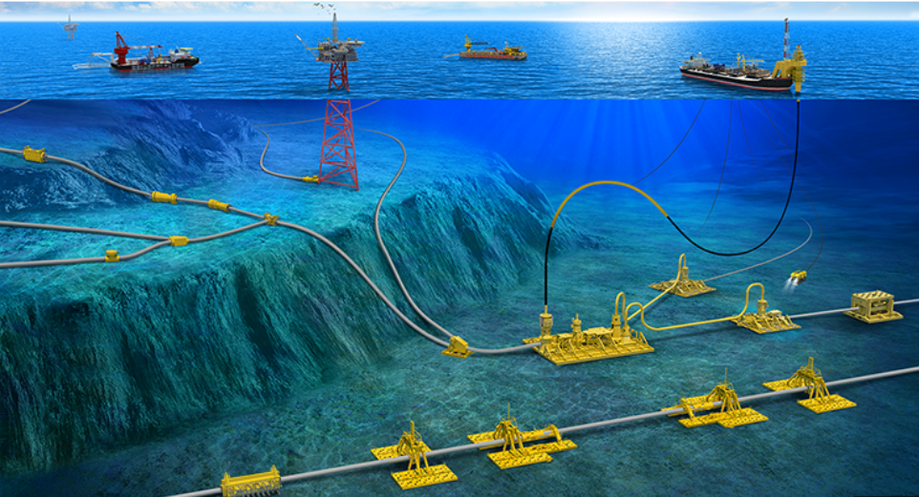
Off-shore pipelines/ structures are suspected to VIV
High rising buildings – Prone to flow induced vibrations

Slide 5
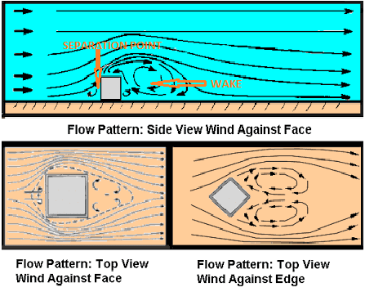

Slide 6
Objectives
Obtain a conceptual understanding of the phenomenon and review existing models of VIVACE converters.
Design a mathematical model to analyze the performance of a vortex-induced vibration converter.
Design a lab-scale prototype.
Validate the prototype.
Calculate design specifications for different application scales.

Slide 7
Timeline
Weeks | 1 | 2 | 3 | 4 | 5 | 6 | 7 | 8 | 9 | 10 | 11 | 12 | 13 | 14 | 15 | 16 | 17 | 18 | 19 | 20 | 21 | 22 | 23 | 24 | 25 | 26 | 27 | 28 | 29 | 30
Finalizing the project topic
Project proposal presentation submission
Literature review about vortex induced vibration and VIVACE converter models
Literature review about non linear vibrations
Literature review about power take-off systems
Understaning of existing mathematical models
Mid Video Presentation and viva
Develop a mathematical model for VIVACE
Design and simulation of the scaled-lab prototype
Demonstration
Lab prototype fabrication (without generator)
Lab. Testing I
Implementation of the generator
Study possible improvements to the system
Lab. Testing II
Final Evaluations

Slide 8
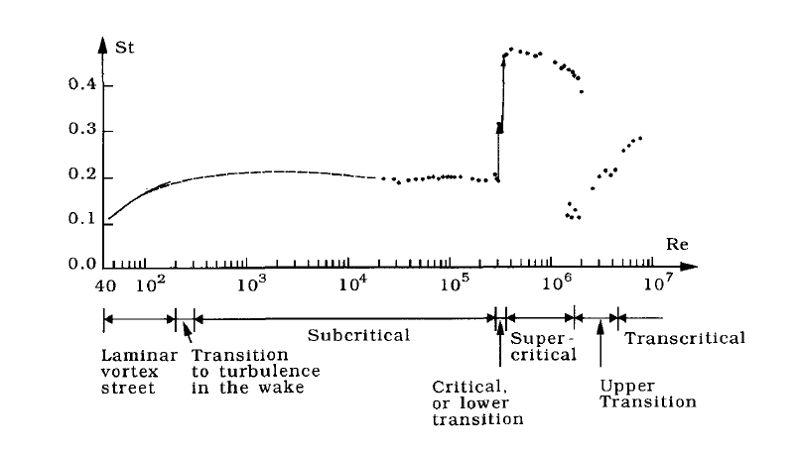
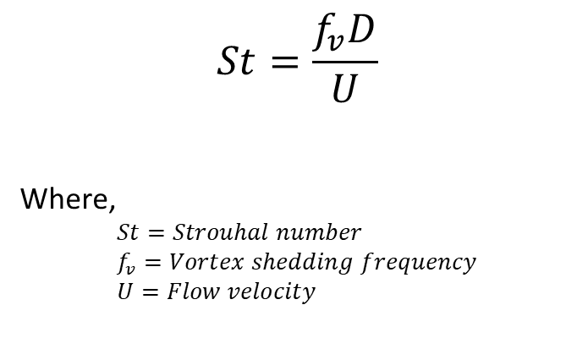
Strouhal Number
The vortex shedding frequency from a stationary cylinder depends on the Strouhal number (St).
$$St=\frac{f_{v}D}{U}$$
Where,
$$St=Strouhal number \\ f_{v}=Vortex shedding frequency \\ U=Flow velocity$$
Strouhal number variation with Re for smooth circular cylinder

Slide 9
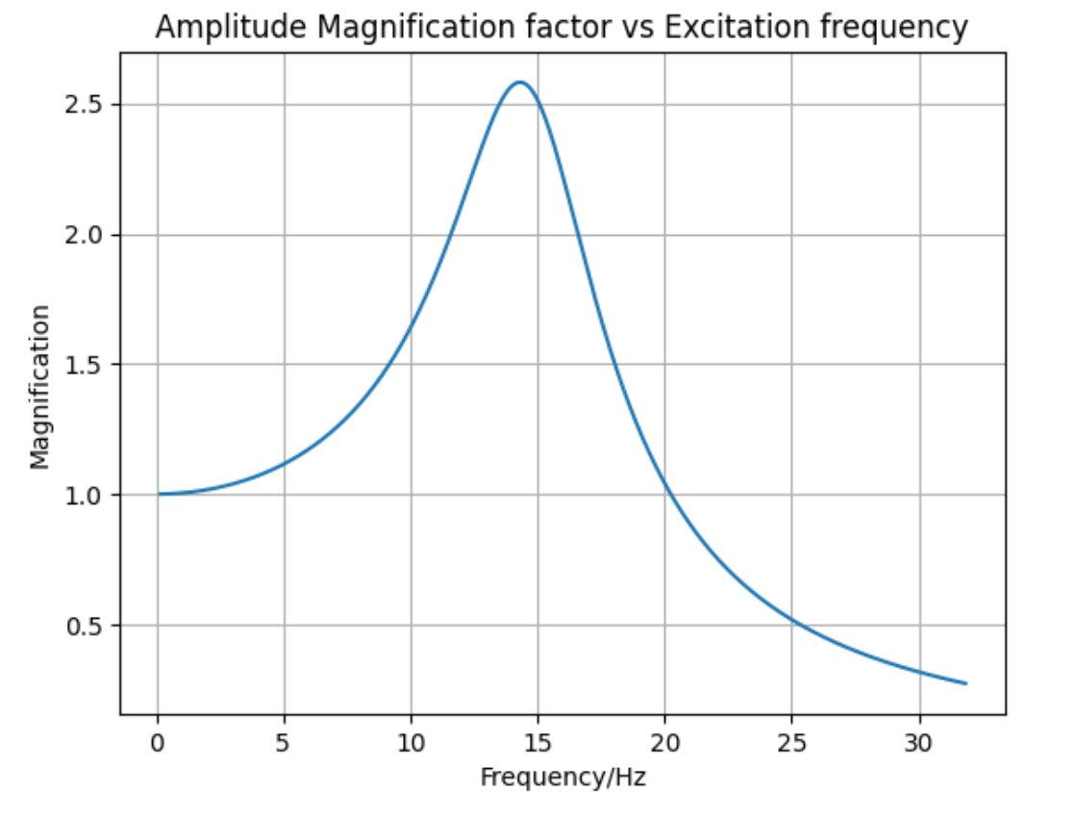
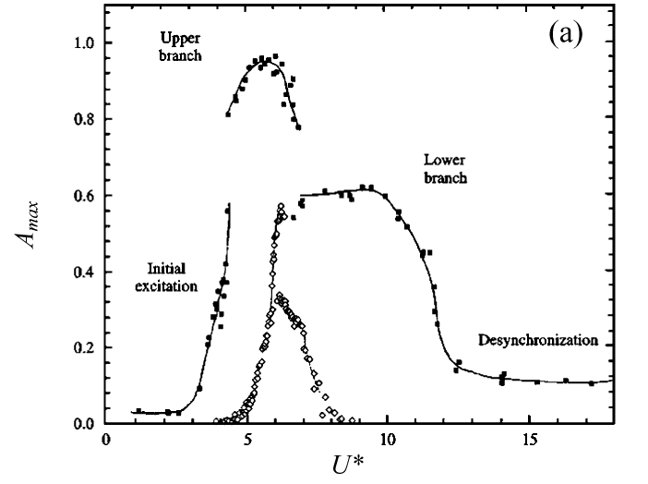

$U^{∗}=\frac{U}{f_{n,water}D}$
For linear vibration highest Magnification occurs at the resonance frequency
Amplitude vs Reduced velocity plotted for a smooth cylinder in water (black dots) - (Williamson & Roshko 1988)

Slide 10
$U^{∗}=\frac{U}{f_{n,water}D}$
For linear vibration highest Magnification occurs at the resonance frequency
Amplitude vs Reduced velocity plotted for a smooth cylinder in water (black dots) - (Williamson & Roshko 1988)

Slide 11
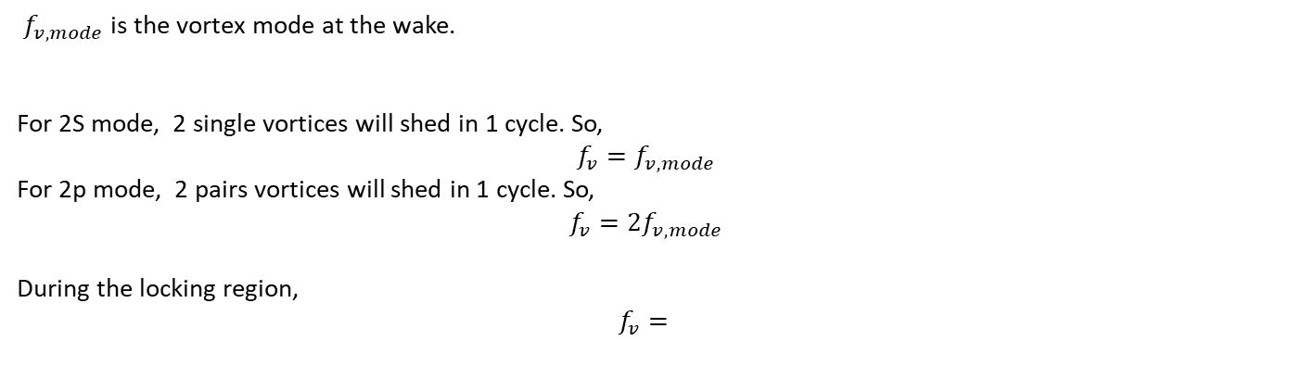
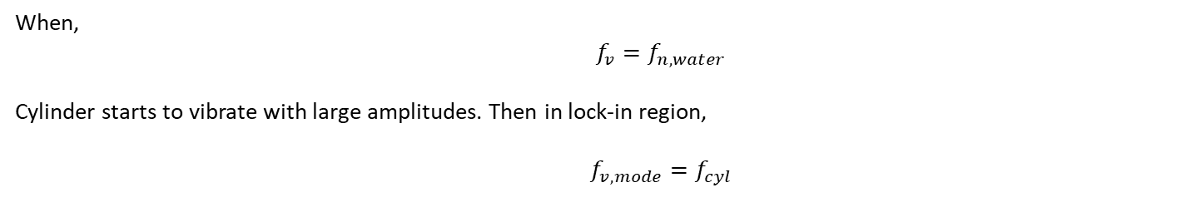
When,
$f_{v}=f_{n,water}$
Cylinder starts to vibrate with large amplitudes. Then in lock-in region,
$f_{v, mode}=f_{cyl}$
$f_{v, mode}$ is the vortex mode at the wake.
For 2S mode, 2 single vortices will shed in 1 cycle. So,
$$f_{v}=f_{v, mode}$$
For 2p mode, 2 pairs vortices will shed in 1 cycle. So,
$$f_{v}={2f}_{v, mode}$$
During the locking region,
$$f_{v}=$$

Slide 12
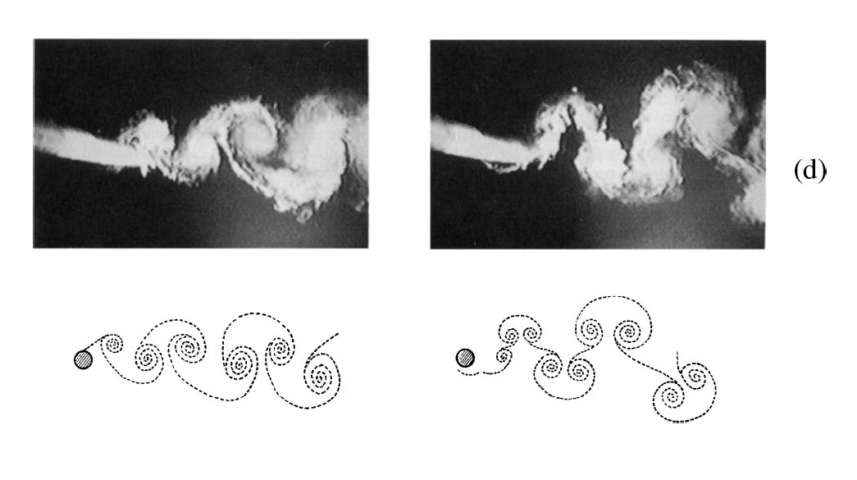
Vortex Modes in the Wake of a Cylinder
The vortex mode of the wake depends on the Reynolds number of the flow and the oscillatory behavior of the cylinder. These vortex modes can be categorized into four main types
2S (Two Single Vortices per Cycle)
2P (Two Pairs of Vortices per Cycle)
S+P (Single and Pair Vortices in a Cycle)
2T (Two Triplets of Vortices per Cycle)
2S mode
2P mode
Brika & Laneville’s smoke visualizations

Slide 13
Jump from 2S to 2P mode
Amplitude vs Reduced velocity plotted for a smooth cylinder in water (black dots) - (Williamson & Roshko 1988)

Slide 14
Recent Research Interests
Expanding the Lock-in Region
Experiments have been conducted to increase the optimum operating range by linking VIV with the galloping phenomenon at the edge of the synchronization region (at higher velocities)
New Power Take-Off (PTO) Systems
Efforts to develop more efficient PTO systems for maximizing power generation.
Effects of Combined Cylinder Arrays
Investigations into multiple-cylinder interactions for improved efficiency.

Slide 15
Identified Knowledge Gaps and Challenges
Scaling and real world implementation
Lack of long-term effect assessment
Auto parameter control

Slide 16
Project plan for 8th semester
Fabrication of the prototype
Test validate the mathematical model using the prototype
Use the prototype to scale the design

