Slide 1
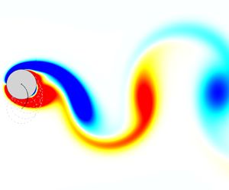
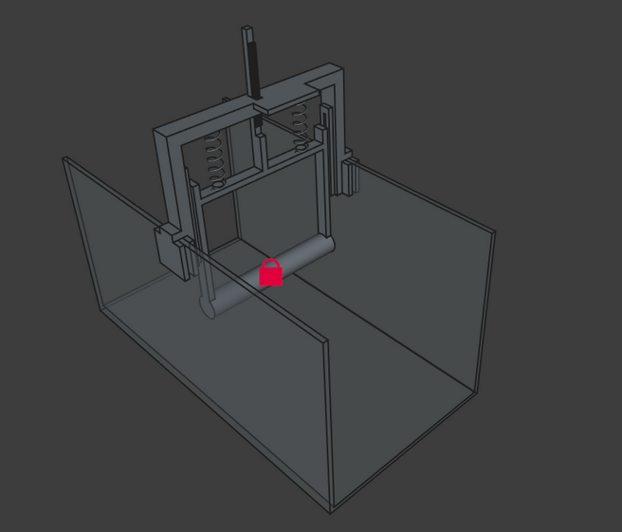
DESIGN AND REALIZATION OF VORTEX INDUCED VIBRATION CONVERTER

Slide 2
Main objectives of the project
Obtain a conceptual understanding of the phenomenon and review existing models.
Design a mathematical model to analyze the performance of a vortex-induced vibration converter.
Design a lab-scale prototype.
Fabricate the prototype
Validate the prototype.
Calculate design specifications for different application scales.

Slide 3
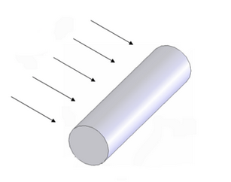
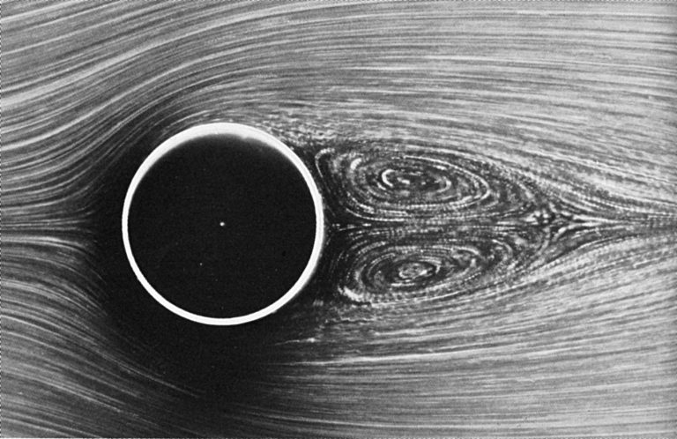
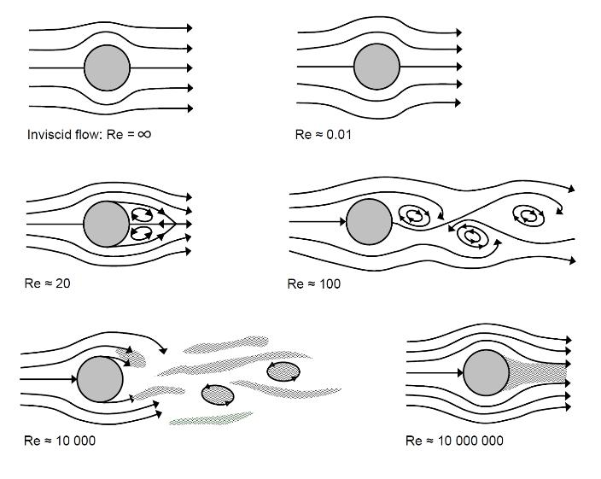
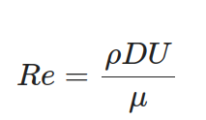
Theory behind the VIV
Flow can be categorized into different regions according to the Reynolds number
40 < Re < 200 – Laminar vortex street
200 < Re < 300 – Transition to turbulent wake
300 < Re < 3 x 10^{5 –} Subcritical region

Slide 4
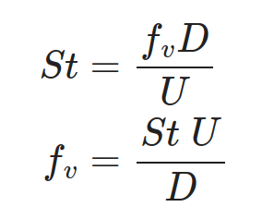
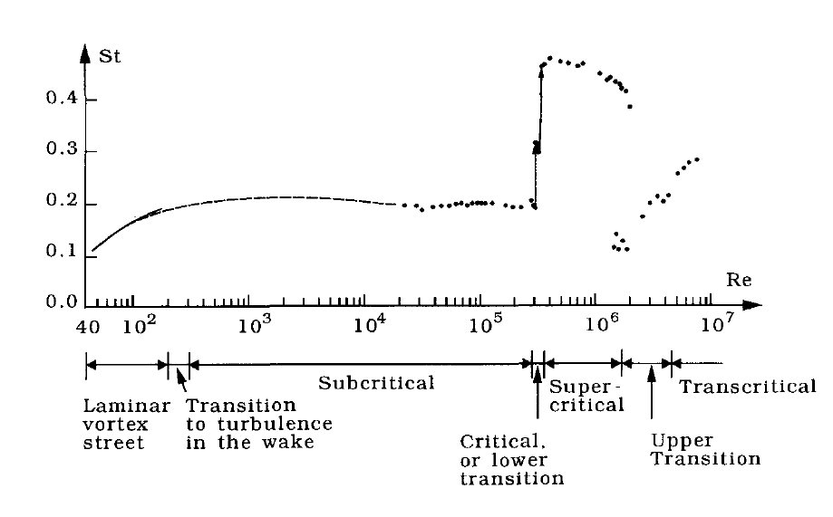
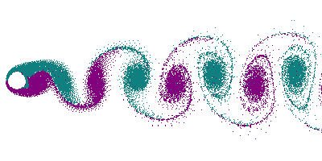
Vortex shedding
Vortex shedding frequency is determined by Strouhal number
St = 0.2
From Sumer and Fredsoe (2006)
Vortex shedding from stationary cylinder

Slide 5
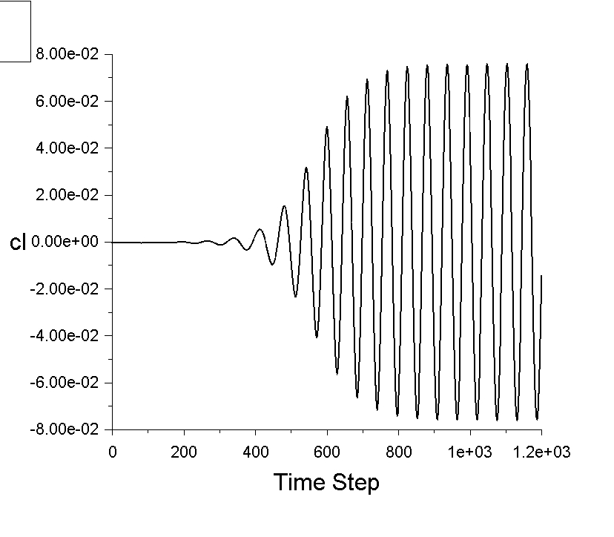
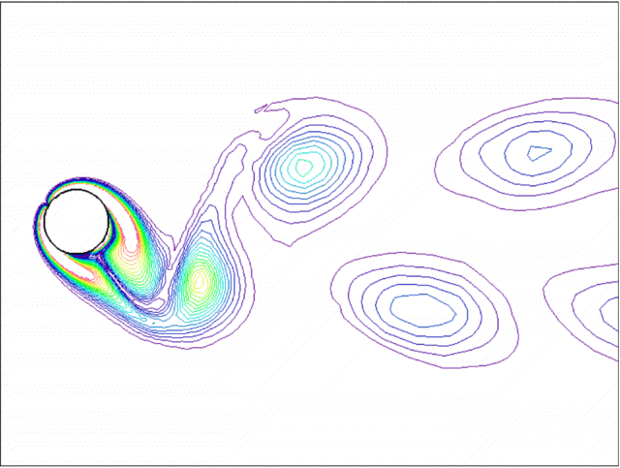
Vortex induced vibrations

Slide 6

What is Vortex induced vibration converter
Power take-off system

Slide 7
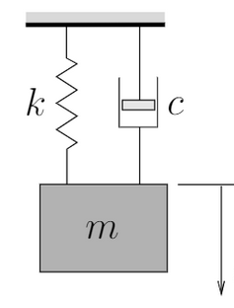

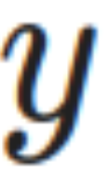
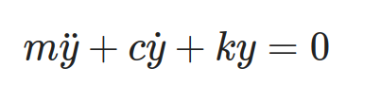

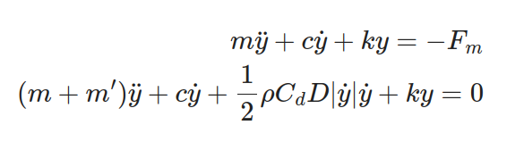
Development of the mathematical model
Free vibration of a mass within air
Free vibration of a mass within a fluid (water)
Hydrodynamical forces cannot be neglected due to high density of the fluid. This resistive force consist with drag force and inertia force. Collectively this is know as Morrison force.
Added mass,
Aerodynamical forces are neglected since the relative density of air is smaller.

Slide 8
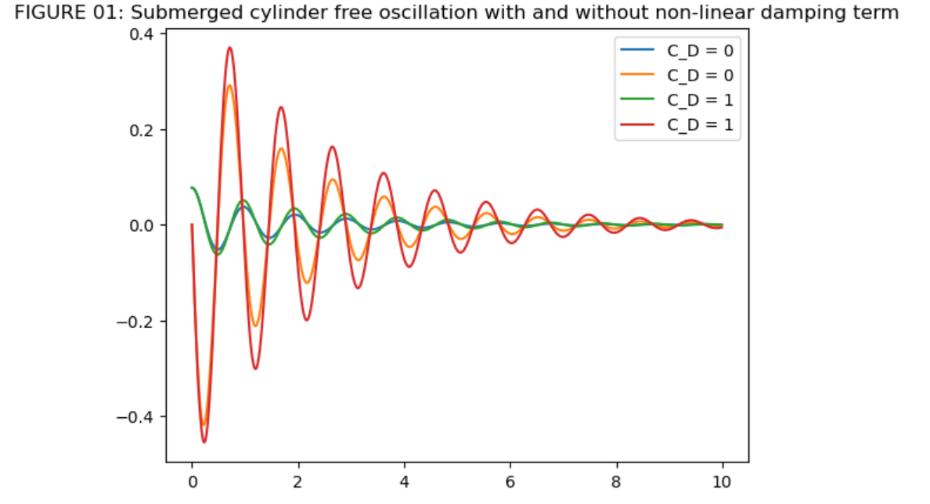
Free vibration simulation
Two System were simulated using Runga-Kutta method using same properties and initial conditions

Slide 9


Forced vibration (self excited)
Vortex shedding phenomenon generate a periodic lift force on the cylinder
Where lift coefficient,
For stationary smooth cylinder CL, rms = 0.3. For vibrating cylinder this force amplified by a factor of 3 – 4. (Bishop and Hassan 1964).

Slide 10
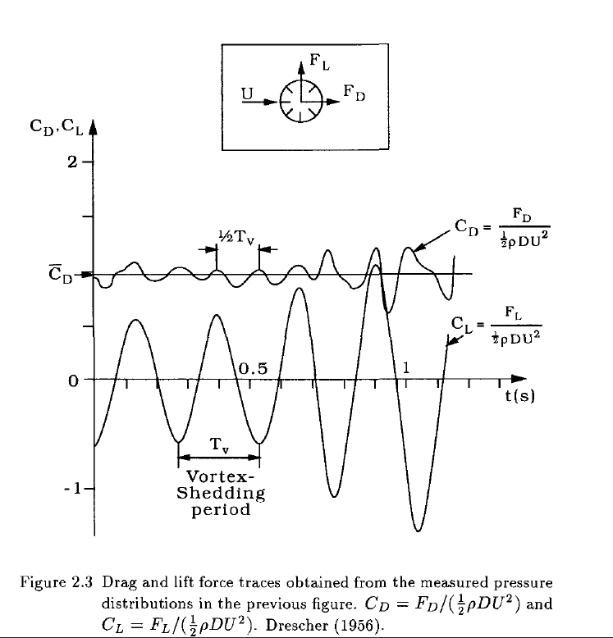

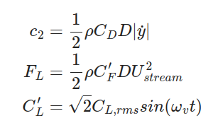
Forced vibration (self excited)
Then system becomes,
Where,
At the initial mode of vortex shedding (2S mode) vortex shedding Frequency is equal to the forcing frequency

Slide 11
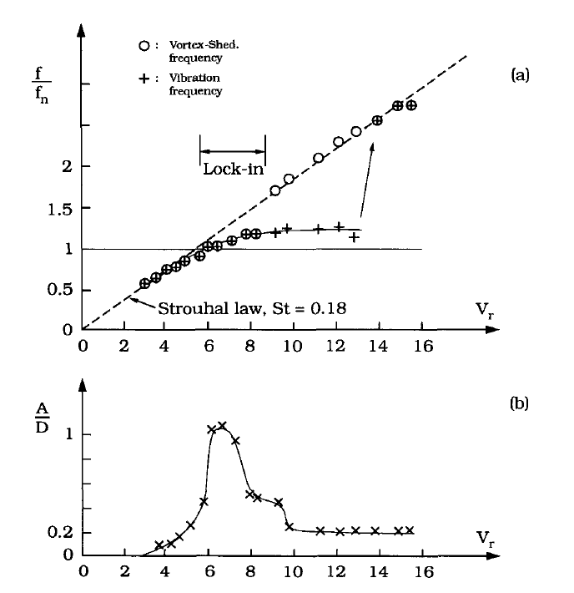
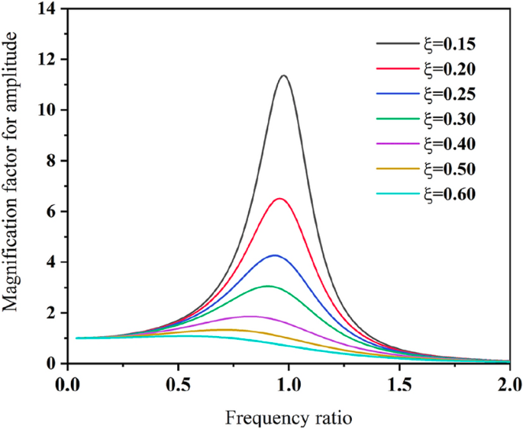

Non-linear behavior
Frequency response of a linear 1DOF system
Response of cylinder in a steady fluid flow
(Anand 1985 - from Sumer & Fredsoe)

Slide 12
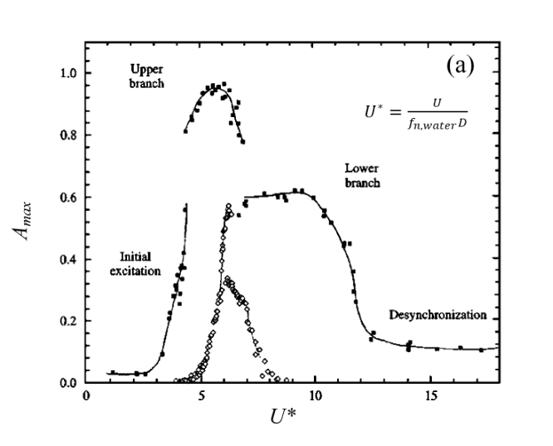
Non-linear behavior
For lightly damped systems upper branch is visible.
If the damping is high upper branch doesn’t appear. Response jump from initial excitation branch to lower branch
Amplitude vs Reduced velocity plotted for a smooth cylinder in water (black dots) - (Williamson & Roshko 1988)

Slide 13

Simulation of self-excited vibration
Assumptions
Flow is in subcritical region (300 < Re < 3.0 x 10⁵)
Hydrodynamic mass coefficient, Cm = 1
Drag coefficient CD = 1 (Schewe 1983)
Lift coefficient CL,RMS = 0.3 (Schewe 1983)
Lift amplification = 4
Keulegan-Carpenter (KC) number < 5

Slide 14
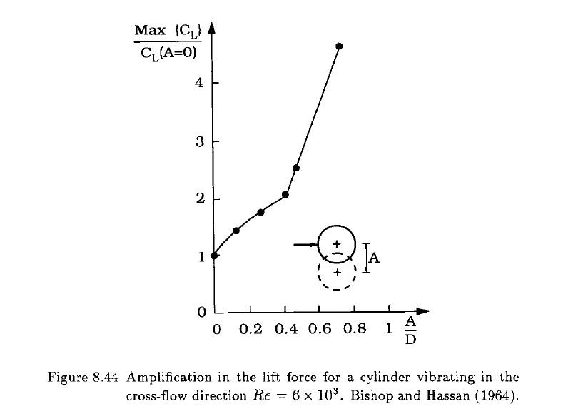
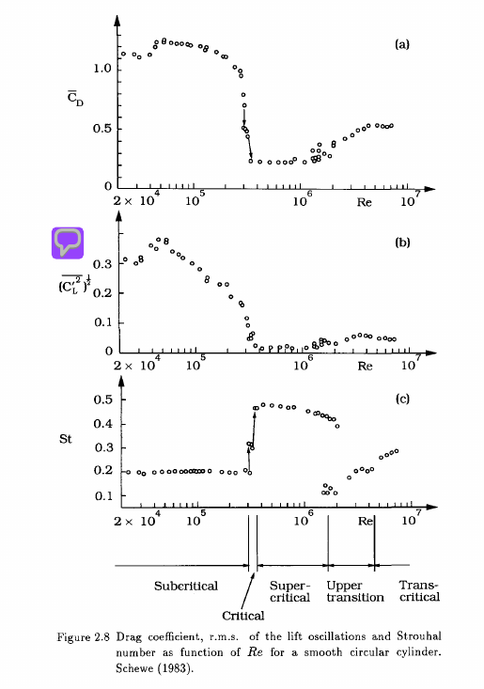
Simulation of self-excited vibration

Slide 15
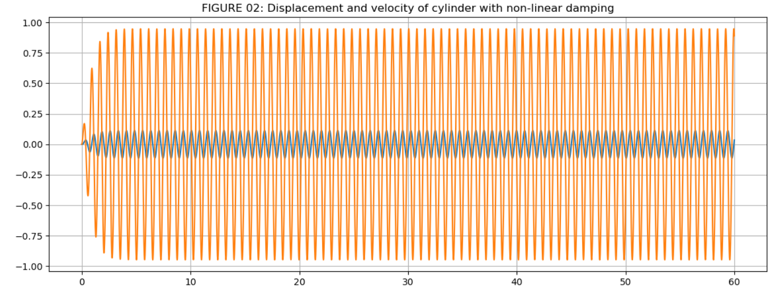

Simulation of self-excited vibration
Using the assumptions mentioned Self excited vibration of cylinder with 0.1 m diameter and specific density of 2. with no structural damping (c=0) was simulated.
Stream velocity was set to get the

Slide 16
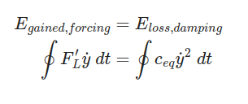
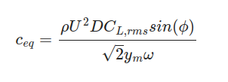
Equivalent damping term
To simulate the system as a linear system. Equivalent damping constant was obtained. Considering energy balance in steady state response. For the non-linear system steady state response is sinusoidal
At resonance phase
  per cycle,
Equivalent damping constant,
To calculate Ceq maximum amplitude is
Needed. This can be obtained by
Experiments or numerical methods

Slide 17


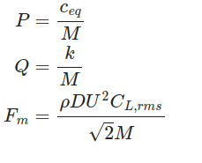
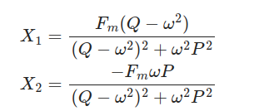
Simulation of linear system
With the linear damping term system reduces to
Then it can be solved into
Where,

Slide 18
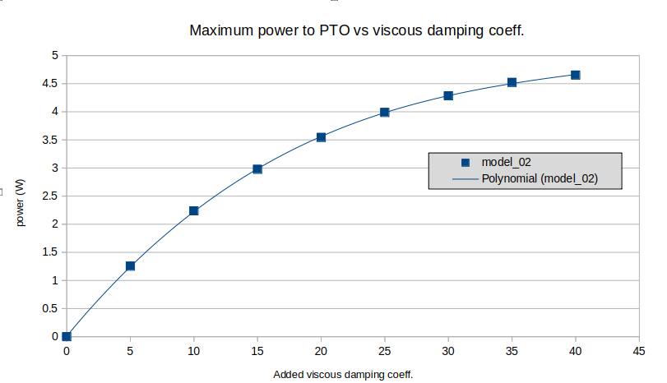
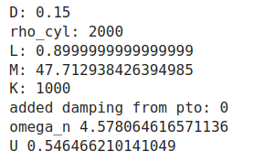

Output power calculation
Maximum power supplied to the PTO system was ploted with the structural damping using the simulation data.
= 10.98 W

Slide 19
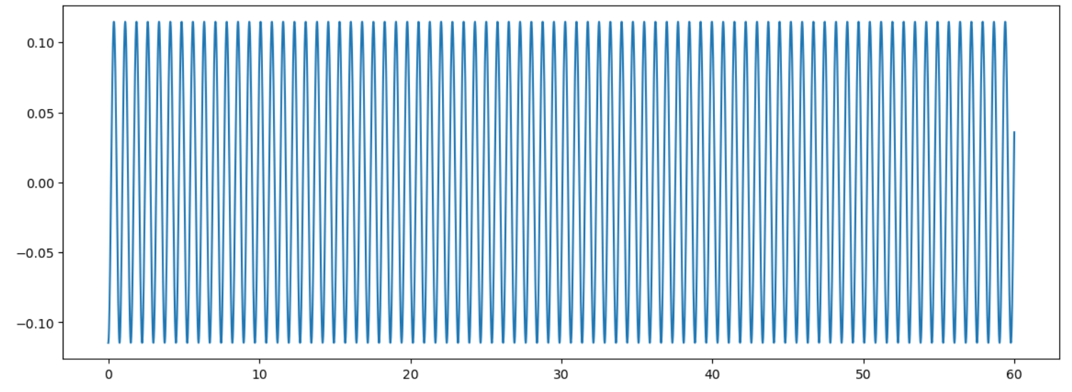
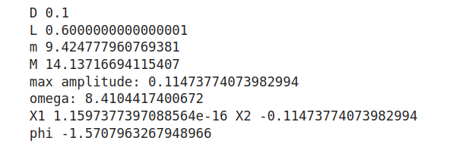
Simulation of linear system
Linear steady state response of the above system

Slide 20
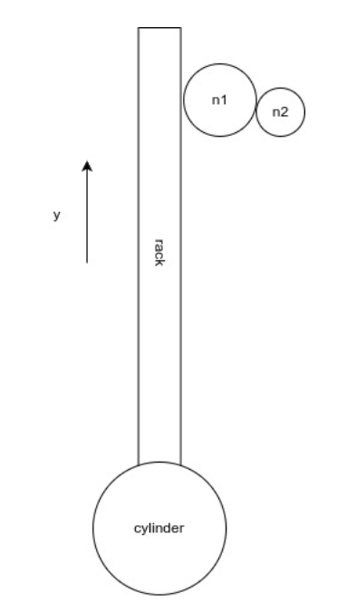


PTO DESIGN
Initially reck and pinion mechanism based PTO is planned. Pinion is connected to the separately excited DC generator via gear train.
Motor is mounted to 2nd gear, angular velocity of the gear can be written as
Terminal voltage of the generator at no load condition,

Slide 21
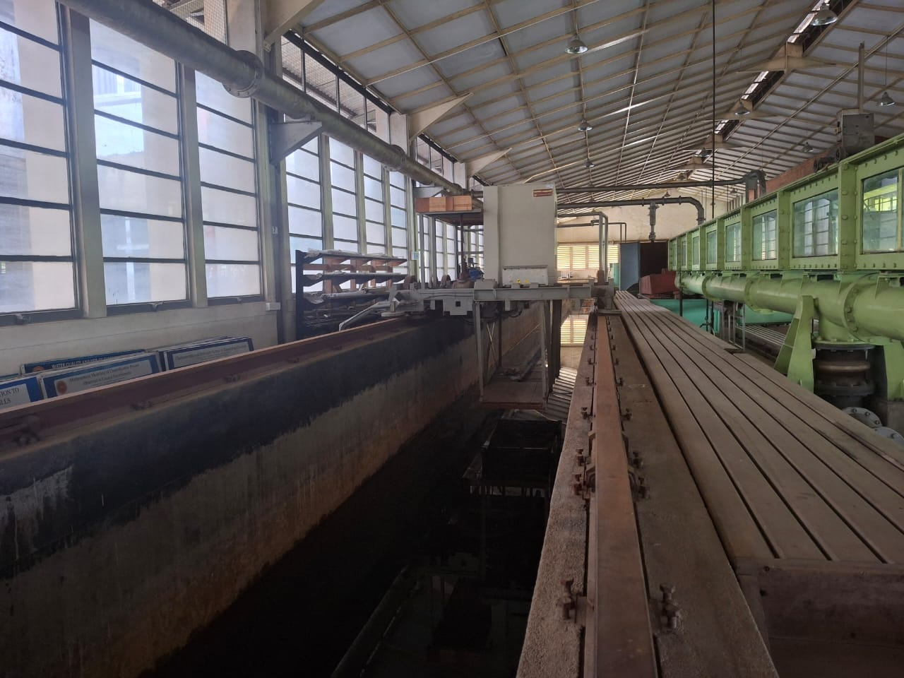
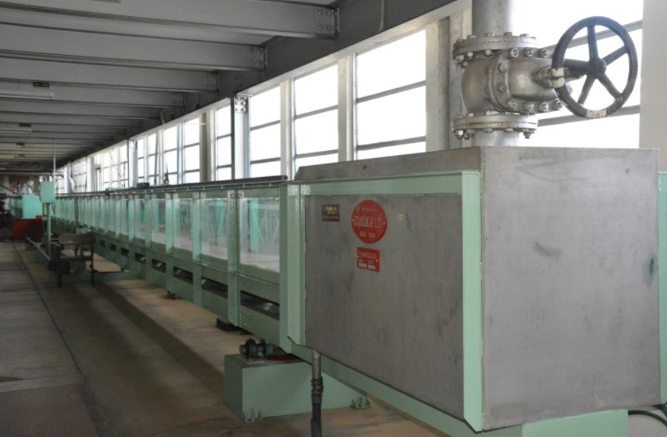
Prototype testing
Two suitable options identified.
Open-channel 3
Wave channel 2 with towing carriage

Slide 22
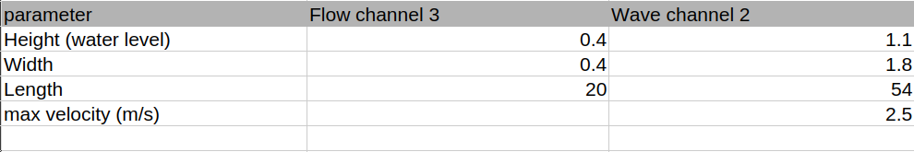
Prototype testing

Slide 23
Model 1
3D model was developed for the open channel parameters

