Slide 1


DESIGN AND REALIZATION OF VORTEX-INDUCED VIBRATION CONVERTER
LIYANAGE A.L.D.N. (E/19/218)
Supervised by Dr. Lalith N. Wickramarathna
Department of Mechanical Engineering
Faculty of Engineering
University of Peradeniya
ME420- Mechanical Engineering Individual Research Project
ES81
June, 2025

Slide 2
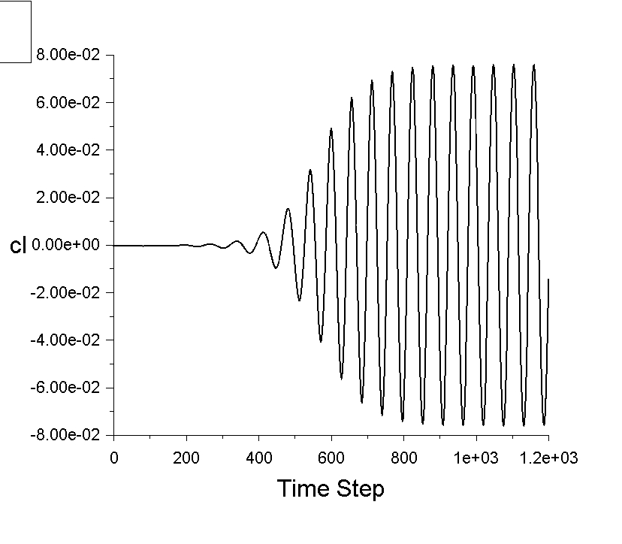
INTRODUCTION
When a fluid flows past a bluff body, such as a cylinder vortex shedding occurs and it generate oscillating transverse force component on the cylinder.
If the cylinder is free to oscillate/vibrate, vortex induced vibrations occurs.
Variation of the lift coefficient on the cylinder with time

Slide 3

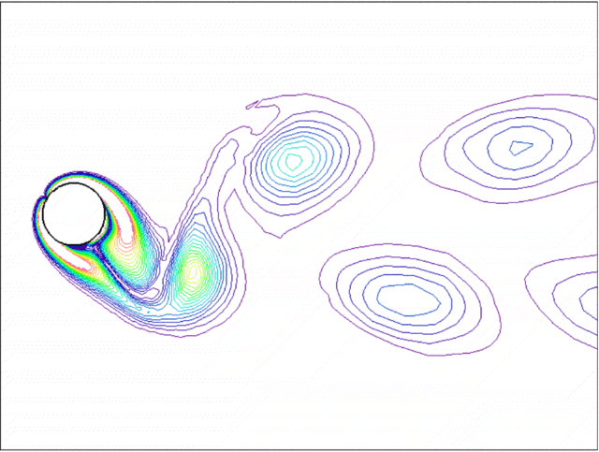
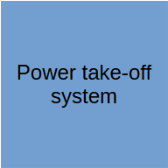

INTRODUCTION
What is vortex induced vibration converter?

Slide 4
OBJECTIVES
Obtain a conceptual understanding of the phenomenon and review existing models.
Design a mathematical model to analyze the performance of a vortex-induced vibration converter.
Design a lab-scale prototype.
Fabricate the prototype
Validate the prototype.
Calculate design specifications for different application scales.

Slide 5
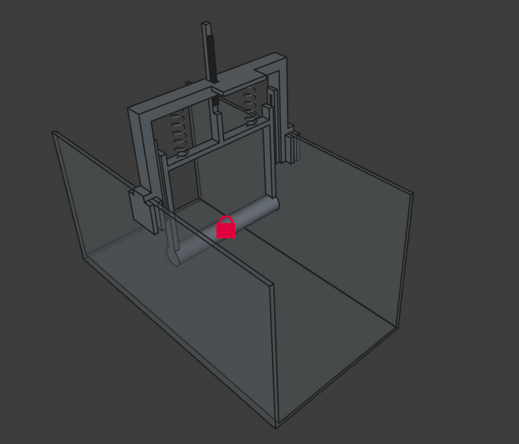
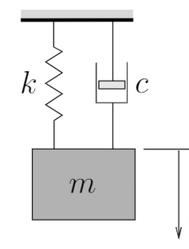

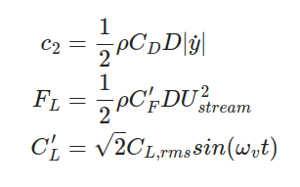
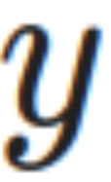
UPTO PREVIOUS EVALUATION
Literature survey about the existing models.
Mathematical model was developed to simulate the amplitude response of the device.
Basic 3D model was developed.
Variation of the lift coefficient on the cylinder with time

Slide 6
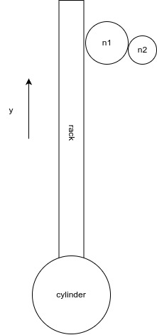
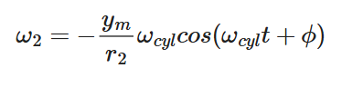
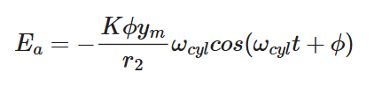
UPTO PREVIOUS EVALUATION
Basic PTO design with rack and pinion mechanism
if the motor is mounted to the n2 gear shaft, angular velocity of n2 shaft,
If separately excited DC generator is used, generated terminal voltage,

Slide 7
PROGRESS

Slide 8
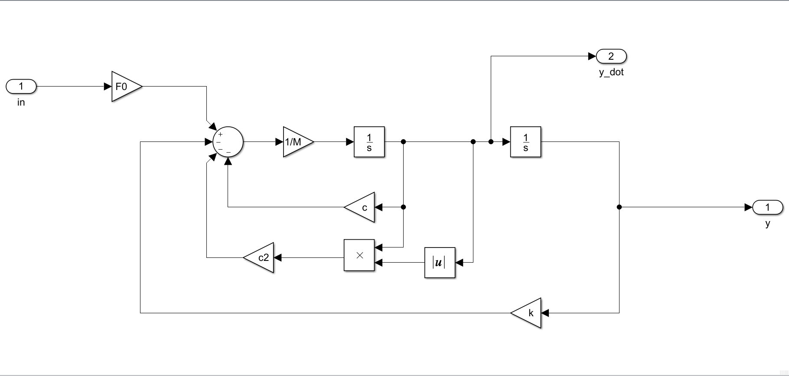

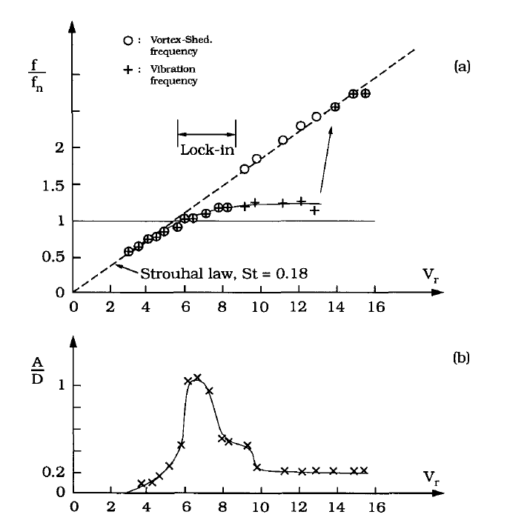
Mathematical model limitations
Inability to simulate the synchronization region.
Cannot simulate lift force magnification with cylinder motion
Simulink implementation
Response of cylinder in a steady fluid flow
(Anand 1985 - from Sumer & Fredsoe)
Variation of the lift coefficient on the cylinder with time

Slide 9
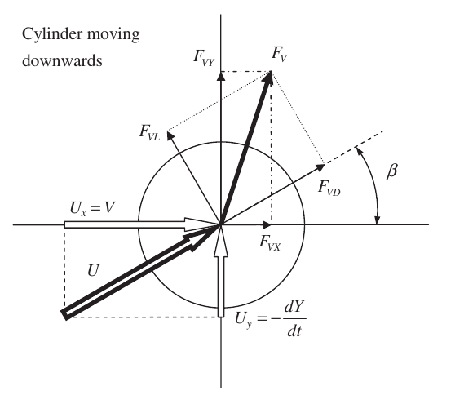
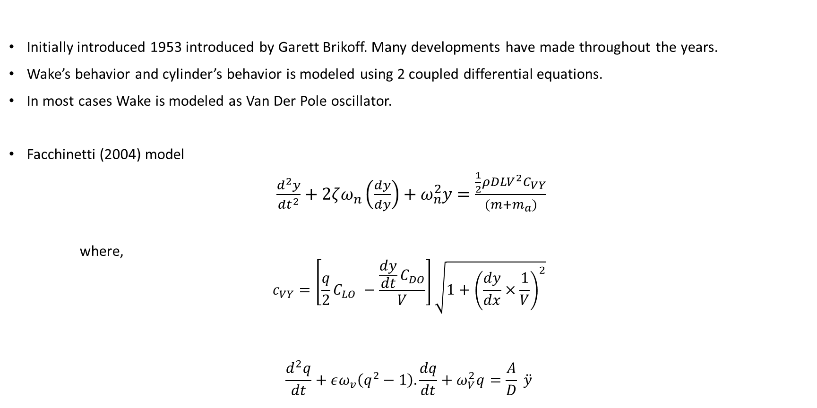
Wake-Oscillator model
Initially introduced 1953 introduced by Garett Brikoff. Many developments have made throughout the years.
Wake’s behavior and cylinder’s behavior is modeled using 2 coupled differential equations.
In most cases Wake is modeled as Van Der Pole oscillator.
Facchinetti (2004) model
$\frac{d^{2}y}{dt^{2}}+2ζω_{n}\left(\frac{dy}{dy}\right)+ω_{n}^{2}y=\frac{\frac{1}{2}ρDLV^{2}C_{VY}}{(m+m_{a})}$
where,
$$c_{VY}=\left[\frac{q}{2}C_{LO} −\frac{\frac{dy}{dt}C_{DO}}{V}\right]\sqrt{1+{\left(\frac{dy}{dx}×\frac{1}{V}\right)}^{2}}$$
$$\frac{d^{2}q}{dt}+εω_{v}\left(q^{2}−1\right).\frac{dq}{dt}+ω_{V}^{2}q=\frac{A}{D} \ddot{y}$$
From Ogink and Metrikine (2010)

Slide 10
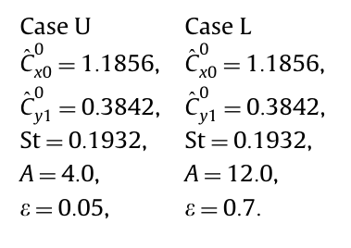
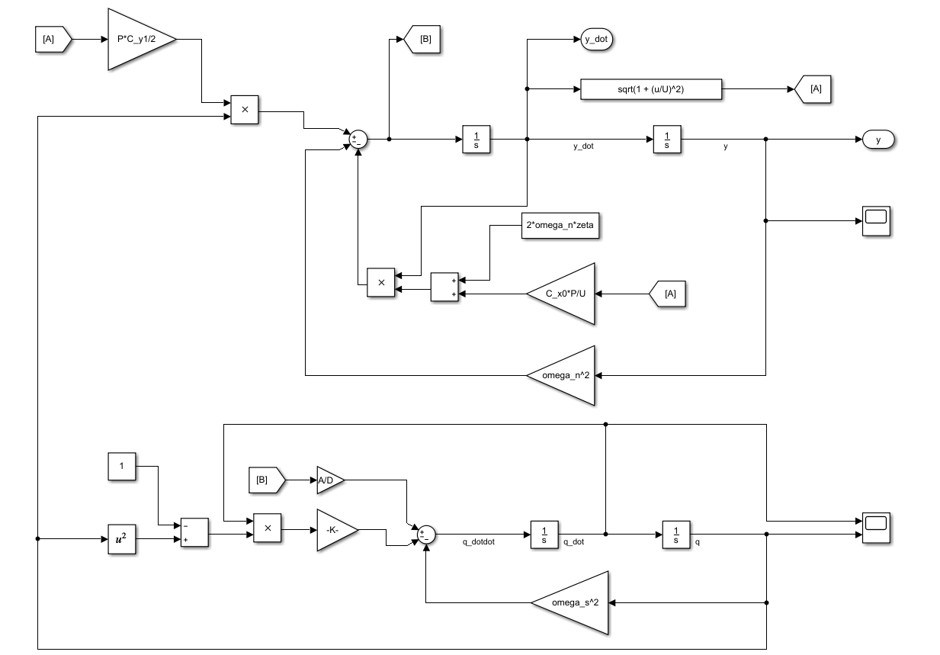
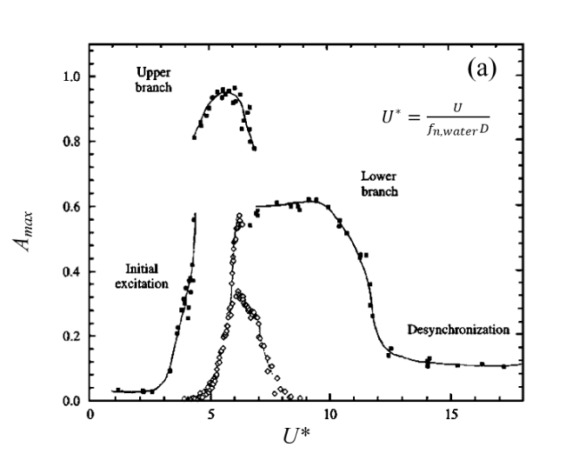

Wake-Oscillator model Implementation
Model parameters $(ε and A)$ , values proposed by Ogink and Metrikine (2010) were used
Upper branch
Lower branch
Amplitude vs Reduced velocity plotted for a smooth cylinder in water (black dots) - (Williamson & Roshko 1988)

Slide 11
Wake-Oscillator model response
Synchronization/lock- in region
Maximum amplitude and frequency variation with reduced velocity

Slide 12
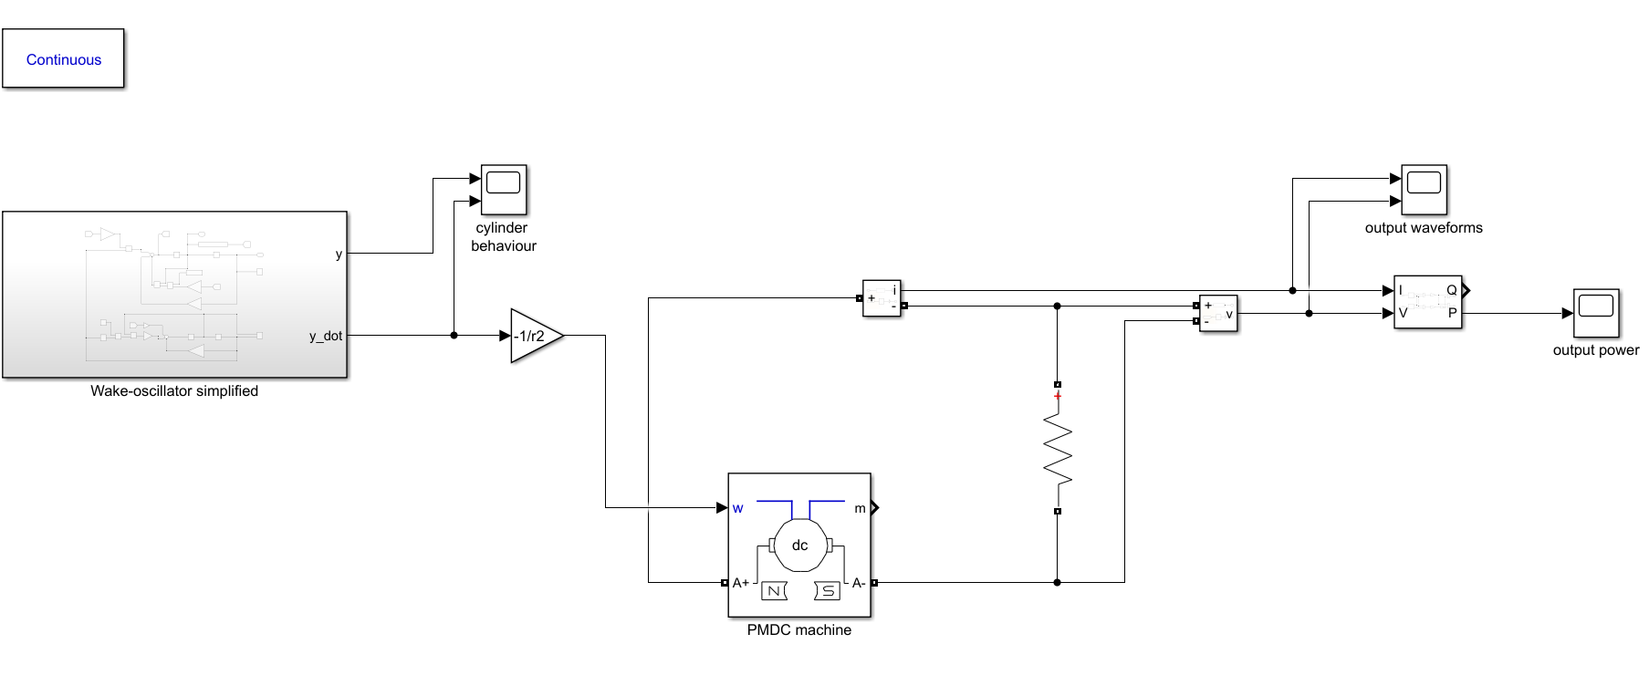


PTO System Implementation
Implementation in MATLAB
Damping induced by the DC generator on the oscillator,
$$c_{gen}=\frac{k^{2}}{r^{2}R_{T}}$$
RS755 12V DC motor has k=0.1, $R_{t}=100$ and $r=0.01$then,
$$c_{gen}=0.1$$
$$R_{t}$$

Slide 13
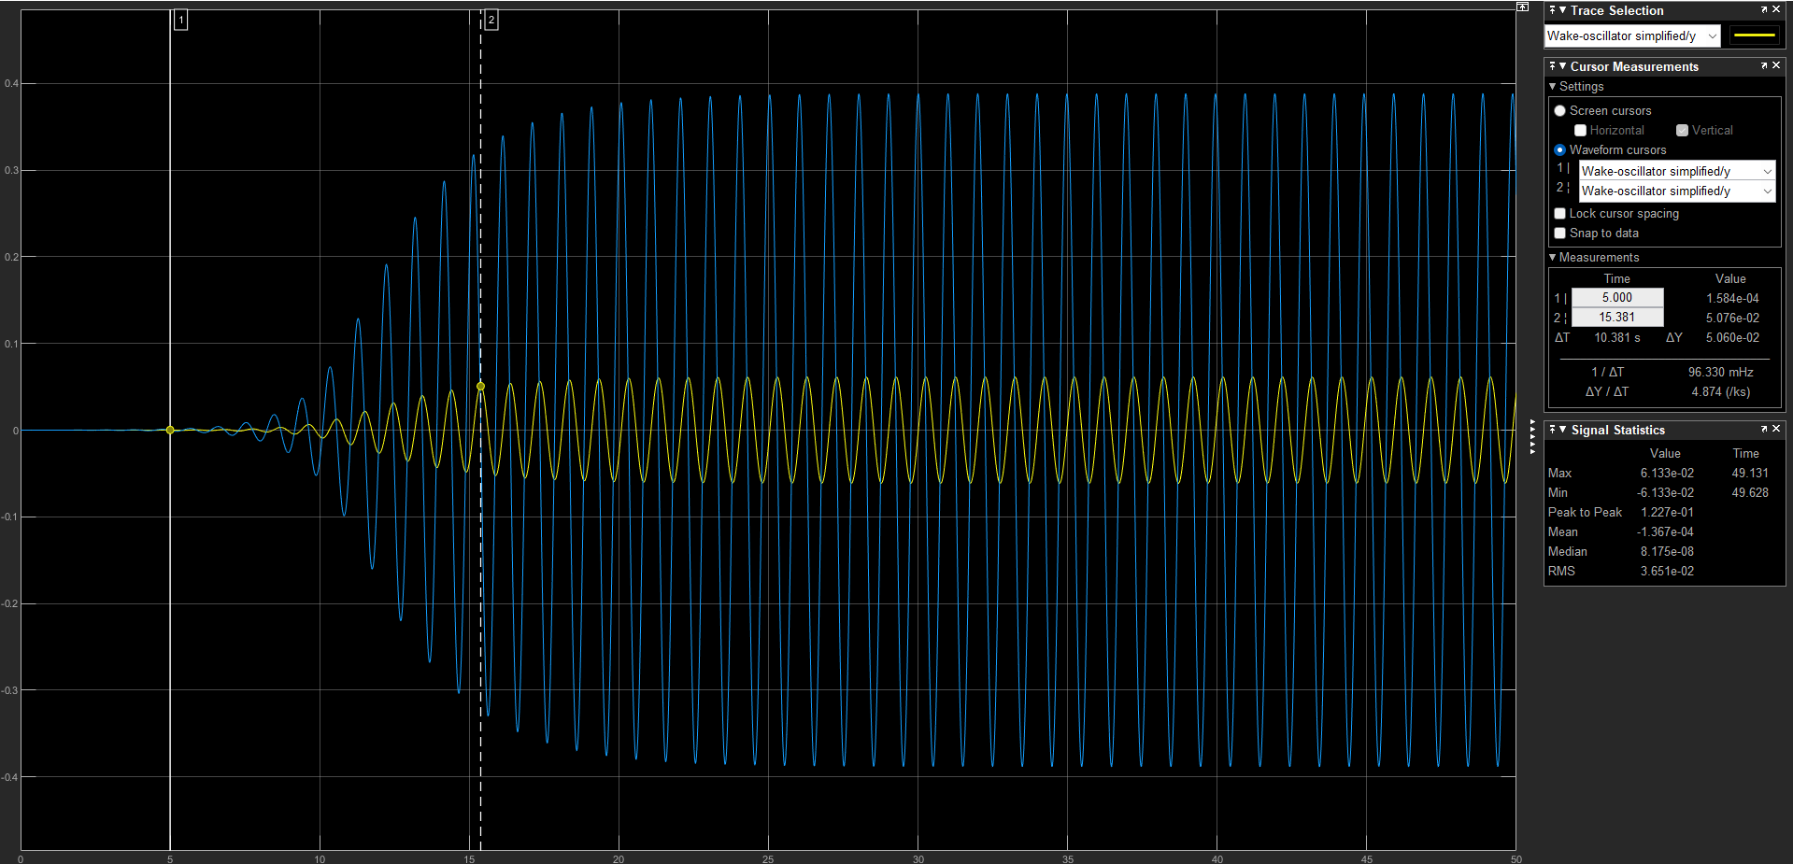
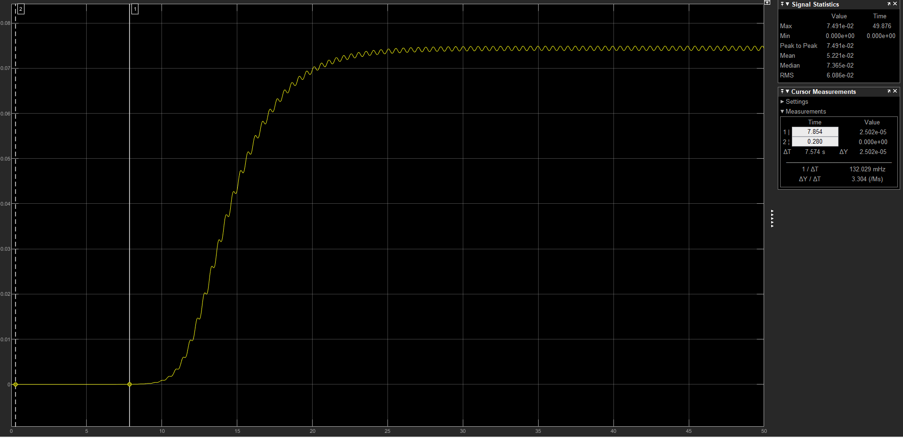
Power output
Cylinder motion
Power generation
According to the simulation with the RS775 motor 75 mW power can be generated at the resonance frequency.

Slide 14
Prototype Development

Slide 15
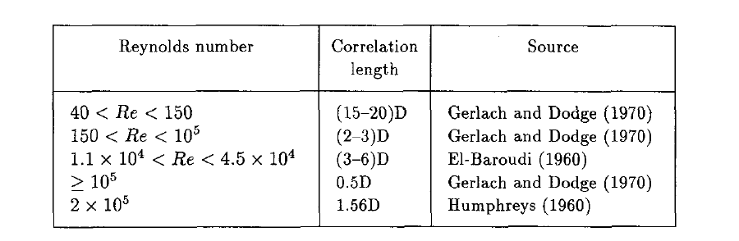
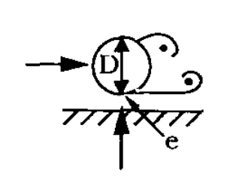

Constraints
According to the requirements and availability device can be tested in towing tank or in a Flume.
To observe vortex shedding $Re ∈(300, 3×{10}^{5})$.
Amplitude of the oscillation depends on the cylinder diameter. ( high D => high amplitudes).
Span-wise length of the cylinder should be according to the table below.
VIV amplitude get significantly effected if bottom gap ratio, $\frac{e}{D}<0.7$.
from Sumer and Fredsoe (2006)

Slide 16
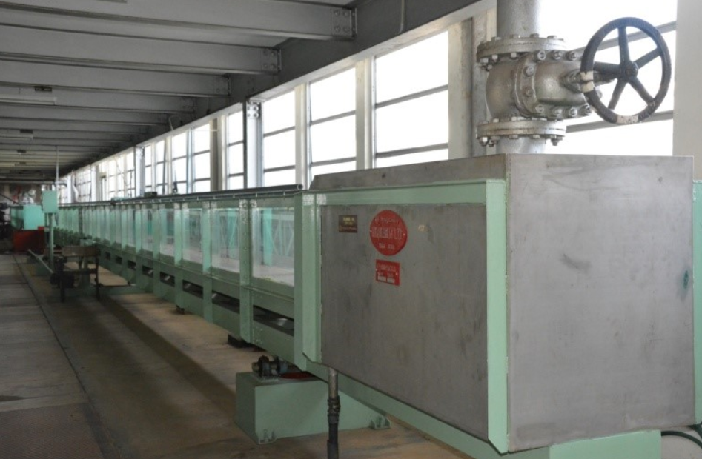
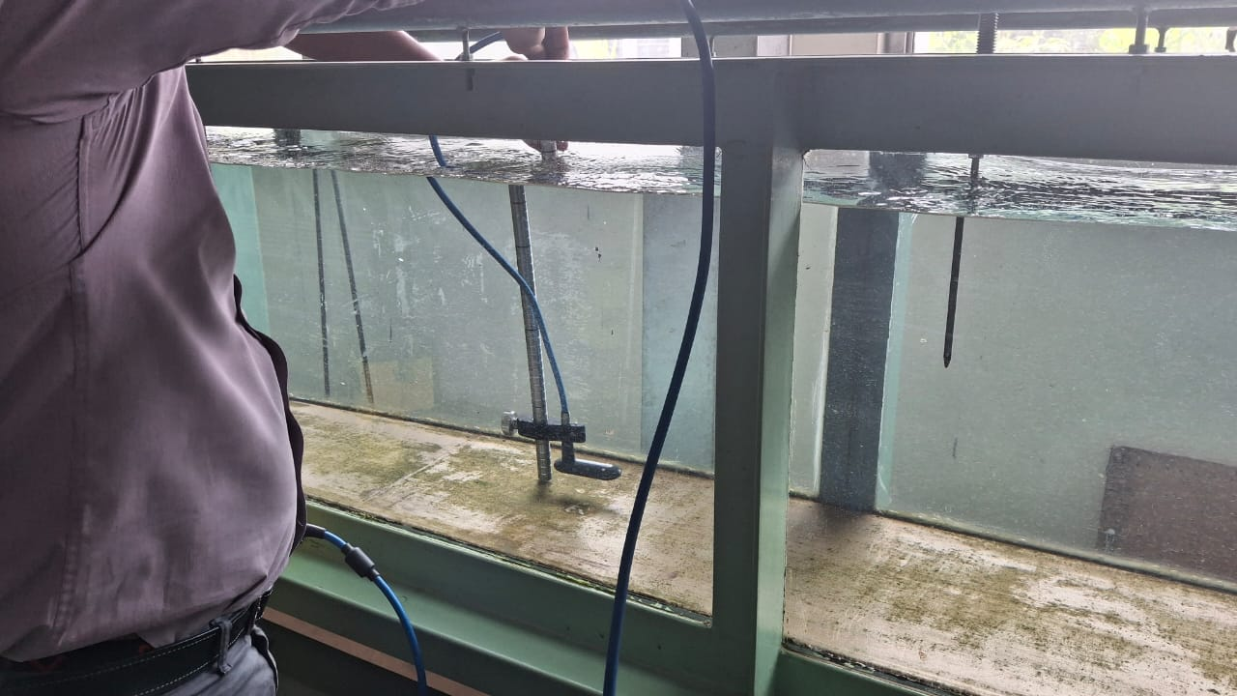
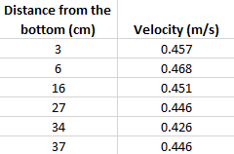
20m Flume check
Dimensions
Width = 400mm
Maximum water level = 380mm
Flume Velocity profile was tested using current meter. Maximum possible velocity (stable) is 0.47 m/s

Slide 17
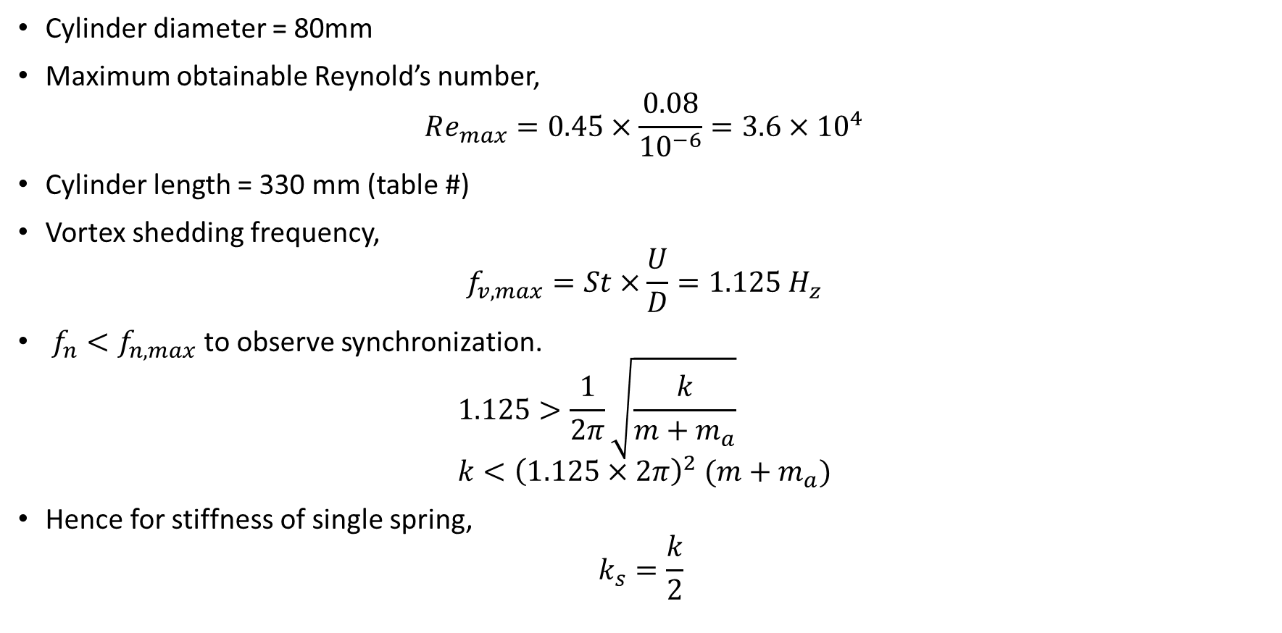
Prototype Scaling
Cylinder diameter = 80mm
Maximum obtainable Reynold’s number,
$$Re_{max}=0.45×\frac{0.08}{{10}^{−6}}=3.6×{10}^{4}$$
Cylinder length = 330 mm (table #)
Vortex shedding frequency,
$$f_{v,max}=St×\frac{U}{D}=1.125 H_{z}$$
$f_{n}<f_{n,max}$ to observe synchronization.
$$1.125>\frac{1}{2π}\sqrt{\frac{k}{m+m_{a}}} \\ k<{\left(1.125×2π\right)}^{2} (m+m_{a})$$
Hence for stiffness of single spring,
$$k_{s}=\frac{k}{2}$$

Slide 18
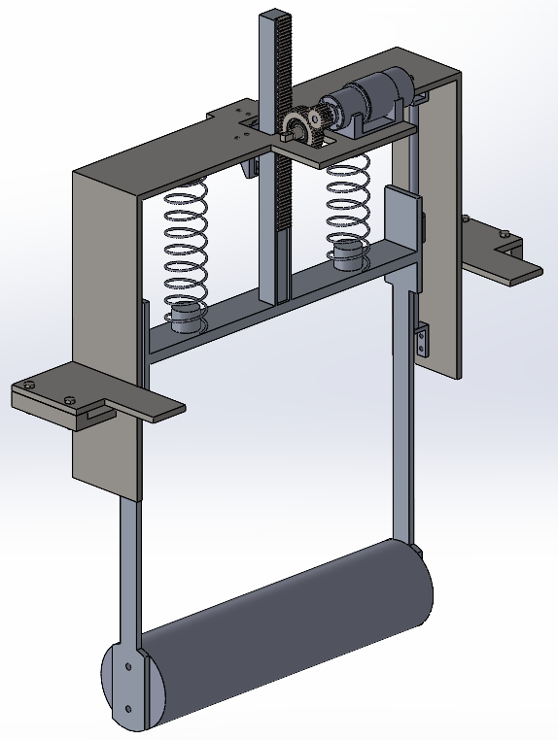
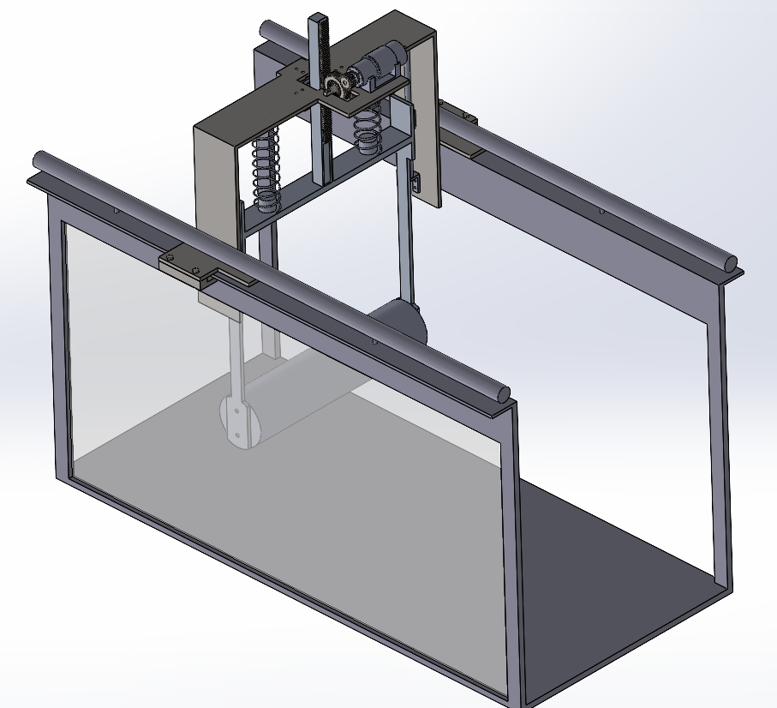
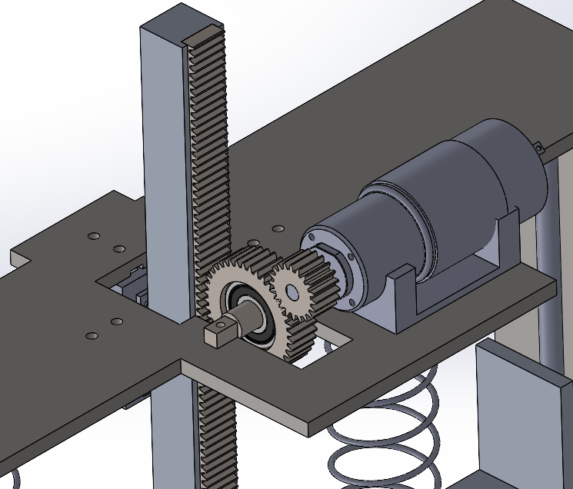
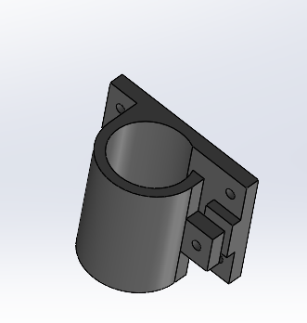
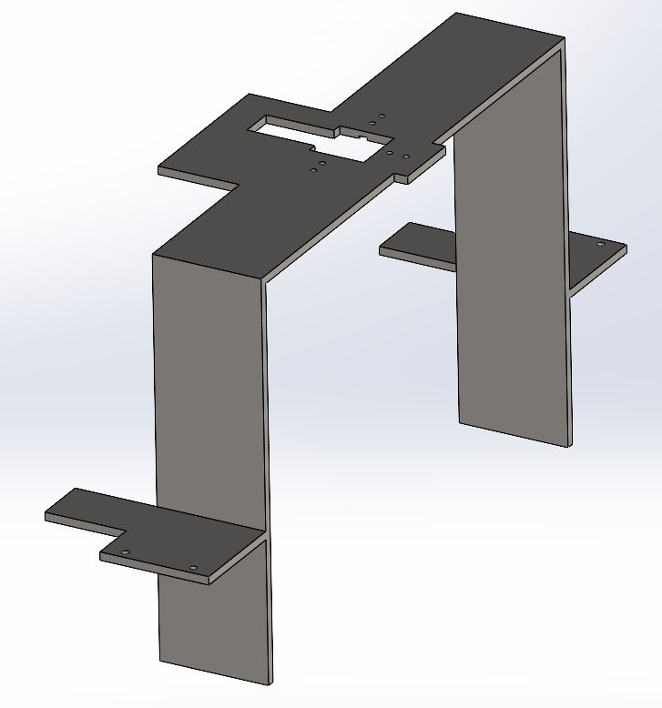
Prototype design
Prototype was developed in SolidWorks

Slide 19
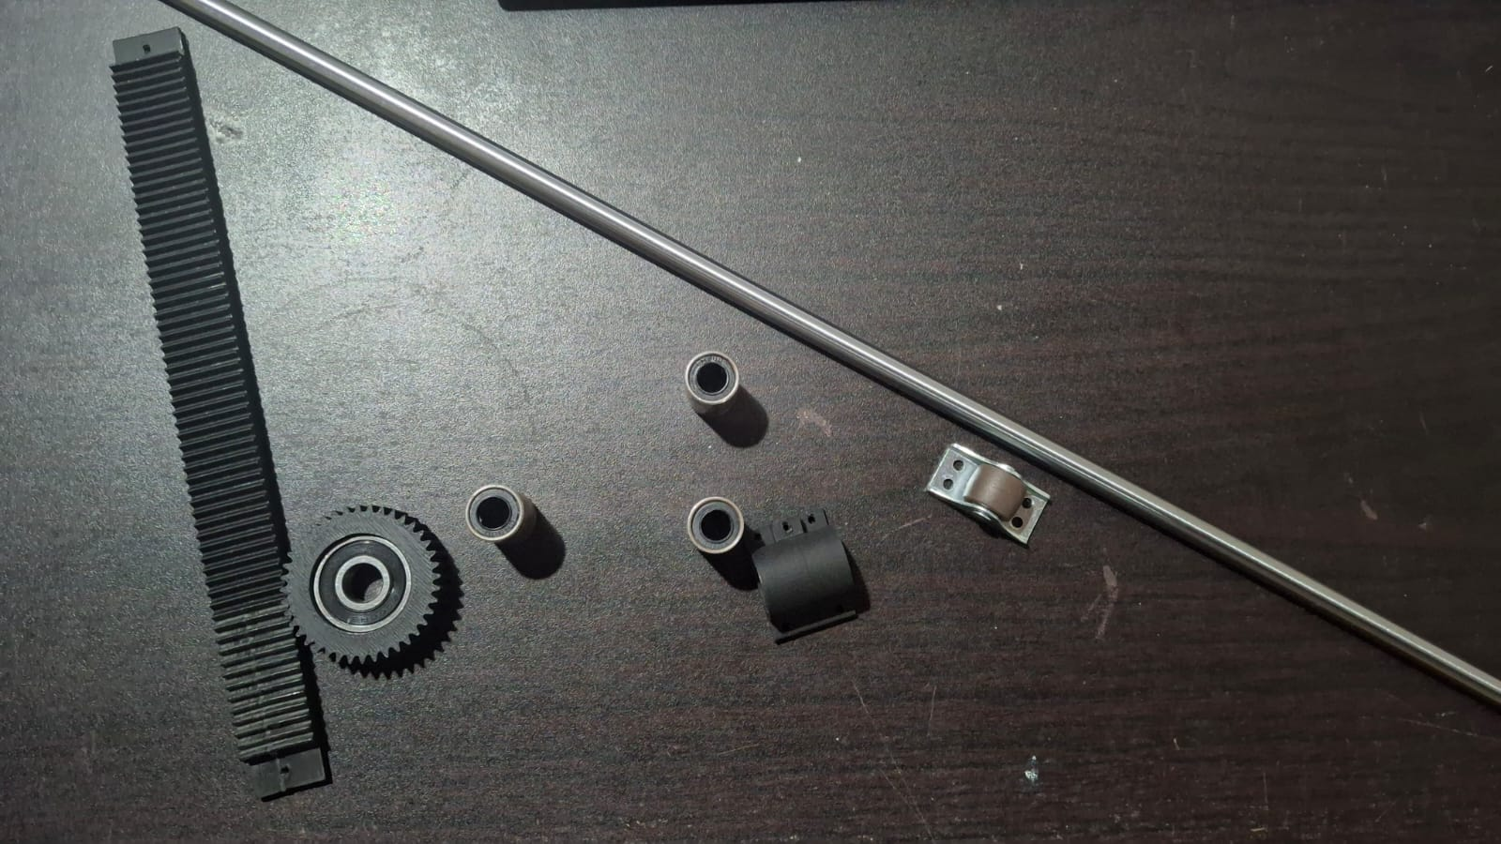
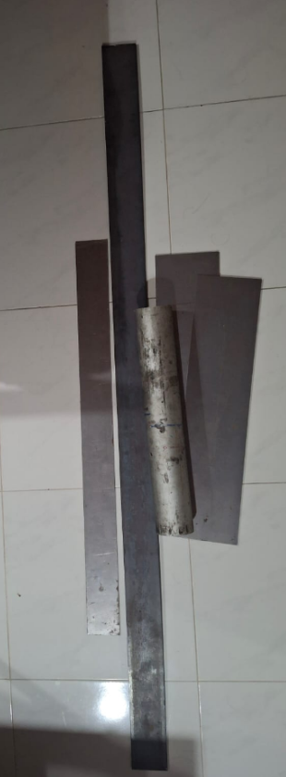
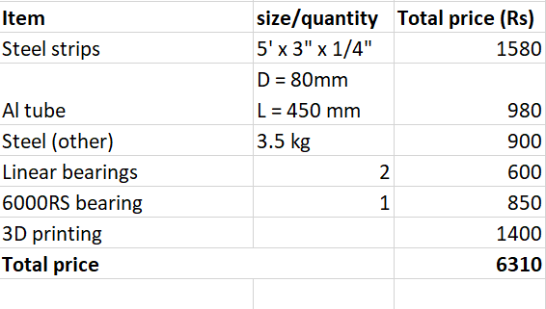
Ongoing Fabrication
Materials have selected and purchased.

Slide 20
References
Ogink, R.H.M. and Metrikine, A.V. (2010). A wake oscillator with frequency dependent coupling for the modeling of vortex-induced vibration. Journal of Sound and Vibration, 329(26), pp.5452–5473. doi: https://doi.org/10.1016/j.jsv.2010.07.008.
B. Mutlu Sumer and Jorgen Fredsoe (2006). Hydrodynamics Around Cylindrical Strucures. World Scientific.
Facchinetti, M.L., de Langre, E. and Biolley, F. (2004). Coupling of structure and wake oscillators in vortex-induced vibrations. Journal of Fluids and Structures, 19(2), pp.123–140. doi: https://doi.org/10.1016/j.jfluidstructs.2003.12.004.
Bernitsas, M.M., Raghavan, K., Ben-Simon, Y. and Garcia, E.M.H. (2008). VIVACE (Vortex Induced Vibration Aquatic Clean Energy): A New Concept in Generation of Clean and Renewable Energy From Fluid Flow. Journal of Offshore Mechanics and Arctic Engineering, 130(4). doi: https://doi.org/10.1115/1.2957913.

Slide 21
Thank you !

