Slide 1
PRE-DEFENSE 1 / 24 OCTOBER CHECKPOINT
Development of an Intelligent CRM Platform
with Automated Customer Interaction Analysis
Yeshimkul Beybit · Shaikenov Danial · Saken Akhmediyar
Software Engineering / SE-2426
Supervisor: Arailym Orazova
Astana IT University
First pre-defense
24 October 2026
SE-2426 / Astana IT University / 24 October 2026
01

Slide 2
PROBLEM AND TARGET USERS
The proposed problem needs user validation
Target users
Sales or support specialists, their manager and an organisation administrator.
Workflow hypothesis
Reading interaction histories and preparing CRM notes may take avoidable time.
Research question
Can source-linked automated analysis reduce review time while preserving factual accuracy?
Evidence status
No client agreement or user interviews supplied. Discovery is a checkpoint dependency.
SE-2426 / Astana IT University / 24 October 2026
02

Slide 3
AIM, SCOPE AND EXPECTED OUTCOMES
A bounded text-analysis workflow
Aim
Develop and evaluate a CRM workflow for analysing customer interaction text.
Mandatory scope
Customer records, ordered text turns, topics, source-linked summaries and human review.
Expected outcomes
A modular prototype, reproducible comparison and documented limitations.
Scope boundary
One organisation and English evaluation first. Voice transcription and automatic replies excluded.
SE-2426 / Astana IT University / 24 October 2026
03

Slide 4
TEAM AND INDIVIDUAL CONTRIBUTION
One project, three accountable owners
Student | Proposed ownership | Review contribution
Yeshimkul Beybit | Frontend, UX and visualisation | Analysis output usability
Shaikenov Danial | Backend, integrations and storage | Frontend integration
Saken Akhmediyar | AI/NLP, evaluation and QA | Backend acceptance
Each module includes tests and documentation. Changes are linked to YouTrack issues and reviewed in PRs.
SE-2426 / Astana IT University / 24 October 2026
04

Slide 5
RELEVANCE AND EVIDENCE PLAN
Discovery will test the business rationale
Recruit 3–5 prospective users
Ask about their last real interaction, note-taking process, errors and constraints.
Observe the current workflow
Record consent, participant role, anonymised examples and current tools.
Translate evidence into scope
Link each supported need to a requirement. Record counterexamples and rejected assumptions.
Current status: OPEN
An interview template is ready. No completed discussion is claimed.
SE-2426 / Astana IT University / 24 October 2026
05

Slide 6
CRITICAL LITERATURE REVIEW
Scientific evidence informs the evaluation
Datasets and evidence spans
DialogSum [L01] and QMSum [L02]: useful test material, with a domain mismatch.
Dialogue factuality
DialSummEval [L03], FacEval [L04], SummaC [L05] and DIASUMFACT [L06].
Evaluation and method selection
GPTCalls [L07, preprint], dialogue consistency [L08], FineSurE [L09] and distillation [L10].
Critical conclusion
Generic summary scores cannot establish factual reliability or business benefit.
SE-2426 / Astana IT University / 24 October 2026
06
Notes:
Sources: https://aclanthology.org/2021.findings-acl.449/
https://aclanthology.org/2021.naacl-main.472/
https://aclanthology.org/2022.naacl-main.418/
https://aclanthology.org/2022.emnlp-main.325/
https://aclanthology.org/2022.tacl-1.10/
https://aclanthology.org/2023.acl-long.377/
https://arxiv.org/abs/2306.07941
https://aclanthology.org/2024.naacl-long.338/
https://aclanthology.org/2024.acl-long.51/
https://aclanthology.org/2025.coling-main.302/

Slide 7
DESIGN IMPLICATIONS
Source references support human checking
Trace every extracted statement
Keep stable source-turn IDs and display the corresponding text.
Separate raw and reviewed output
Record approval, rejection and edits without replacing the original run.
Compare under fixed conditions
Use the same held-out records and pinned method/configuration versions.
Test a relevant alternative
Compare manual review, an extractive baseline and a selected pretrained candidate.
SE-2426 / Astana IT University / 24 October 2026
07
Notes:
Sources: https://aclanthology.org/2021.naacl-main.472/
https://aclanthology.org/2022.naacl-main.418/
https://aclanthology.org/2022.emnlp-main.325/
https://aclanthology.org/2023.acl-long.377/
https://aclanthology.org/2024.acl-long.51/

Slide 8
COMPARISON 1 OF 2
Existing systems already analyse interactions
Criterion | HubSpot | Salesforce ECI | Zoho Zia | Dynamics 365
Input | Recorded calls | Voice/video calls | Recorded calls | Call transcripts
Transcript review | Transcript + playback | Not verified¹ | Highlights | Transcript review
Summary | Review summary | Generative summary | One-line summary | Summary + insights
Topics / terms | Tracked terms | Insights, config unknown¹ | Keywords / phrases | Keywords / competitors
Official docs checked 19 Oct 2026 [S01–S06]. ¹ Narrow indexed excerpt only. No tenant testing.
SE-2426 / Astana IT University / 24 October 2026
08
Notes:
Sources: https://knowledge.hubspot.com/calling/review-call-recordings-and-transcripts
https://help.salesforce.com/s/articleView?id=sf.eci_call_summaries.htm&language=en_US
https://help.zoho.com/portal/en/kb/crm/zia-artificial-intelligence/communication/zia-for-calls/articles/zia-call-intelligence
https://learn.microsoft.com/en-us/dynamics365/sales/view-and-understand-call-summary
https://learn.microsoft.com/en-us/dynamics365/sales/configure-keywords-competitors-sales-app
https://learn.microsoft.com/en-us/dynamics365/sales/language-support-conversation-intelligence

Slide 9
COMPARISON 2 OF 2
Availability depends on product conditions
Criterion | HubSpot | Salesforce ECI | Zoho Zia | Dynamics 365
Next steps | Not verified | Included in summary | Action list unverified | Language-dependent
Human review | Comments / coaching | Summary sharing | Transcript inspection | Call summary review
Entitlement | Eligible Pro/Enterprise | Exact licence unchecked | Pro+; JP excluded | Licence / roles / setup
Languages | Verify target language | Not verified¹ | Local quality unproven | Feature-specific support
No claim of market uniqueness. A configured commercial CRM remains a relevant alternative.
SE-2426 / Astana IT University / 24 October 2026
09
Notes:
Sources: https://knowledge.hubspot.com/calling/review-call-recordings-and-transcripts
https://help.salesforce.com/s/articleView?id=sf.eci_call_summaries.htm&language=en_US
https://help.zoho.com/portal/en/kb/crm/zia-artificial-intelligence/communication/zia-for-calls/articles/zia-call-intelligence
https://learn.microsoft.com/en-us/dynamics365/sales/view-and-understand-call-summary
https://learn.microsoft.com/en-us/dynamics365/sales/configure-keywords-competitors-sales-app
https://learn.microsoft.com/en-us/dynamics365/sales/language-support-conversation-intelligence

Slide 10
TECHNOLOGY ALTERNATIVES
Five technology decisions remain reviewable
Decision | Alternatives considered | Proposed choice / reason
Frontend | Vue / React / Angular | Vue 3 + TypeScript; reported experience
Backend | FastAPI / NestJS / Django | FastAPI; Python analysis integration
Storage | PostgreSQL / MongoDB / SQLite | PostgreSQL; relational records + jobs
Communication | REST + polling / GraphQL / broker | HTTP JSON + durable jobs; limited scope
Analysis | Extractive / pretrained / hosted | Extractive baseline, evaluate pinned candidate
SE-2426 / Astana IT University / 24 October 2026
10
Notes:
Sources: https://vuejs.org/guide/introduction.html
https://react.dev/learn
https://angular.dev/overview
https://fastapi.tiangolo.com/features/
https://docs.nestjs.com/openapi/introduction
https://docs.djangoproject.com/en/5.2/intro/overview/
https://www.postgresql.org/docs/current/datatype-json.html
https://www.mongodb.com/docs/manual/core/transactions/
https://sqlite.org/whentouse.html
https://graphql.org/learn/
https://www.rabbitmq.com/tutorials/tutorial-one-python
https://scikit-learn.org/stable/modules/generated/sklearn.feature_extraction.text.TfidfVectorizer.html
https://huggingface.co/docs/transformers/main_classes/pipelines
https://www.rfc-editor.org/rfc/rfc9110.html

Slide 11
FUNCTIONAL REQUIREMENTS
Requirements have explicit acceptance criteria
FR-01–FR-04: access, records and input
Object permissions, customer records, interaction capture and search.
FR-05–FR-08: analysis and human review
Durable jobs, source-linked results, review decisions and failure recovery.
FR-09–FR-12: exports and evaluation
Accessible export and run comparison. Overview and extra adapters are lower priority.
Acceptance example
Opening a source reference highlights the exact turn without altering the original text.
SE-2426 / Astana IT University / 24 October 2026
11

Slide 12
NONFUNCTIONAL REQUIREMENTS
Quality targets require controlled measurement
Reliability and reproducibility
Record source hash, method/configuration versions and raw output. Use bounded retries.
Performance protocol
Measure p50/p95 under declared hardware, input size and concurrency.
Privacy and access
Keep real customer data outside Git. Verify role and object permissions in the backend.
Usability and portability
Keyboard operation, narrow-screen layout, clear error states and a documented local setup.
SE-2426 / Astana IT University / 24 October 2026
12

Slide 13
EDITABLE CONTEXT DIAGRAM
System context
Analyst / manager
Review and analyse
Validated text
Text input / import
Intelligent CRM
application
Administrator
Optional analysis
provider
Optional inference
Manage access
One organisation. Text-only MVP. All fixtures currently synthetic.
SE-2426 / Astana IT University / 24 October 2026
13

Slide 14
EDITABLE UML USE-CASE DIAGRAM
Use cases connect roles to actions
CRM platform
Manage records
Manage access
«actor»
Analyst
«actor»
Admin
«include»
Analyse text
Validate input
generalises
«include»
«actor»
Manager
Review / approve
Inspect source
SE-2426 / Astana IT University / 24 October 2026
14

Slide 15
EDITABLE DRAFT COMPONENT DIAGRAM
A modular API and worker share durable storage
HTTP JSON
FastAPI
Auth / records / jobs
Read / write
PostgreSQL
Records / jobs / runs
Vue web client
Analysis worker
Leases / bounded retries
Analysis adapter
Baseline / candidate
Versioned run
Proposed architecture. The current browser prototype has no backend or production authentication.
SE-2426 / Astana IT University / 24 October 2026
15

Slide 16
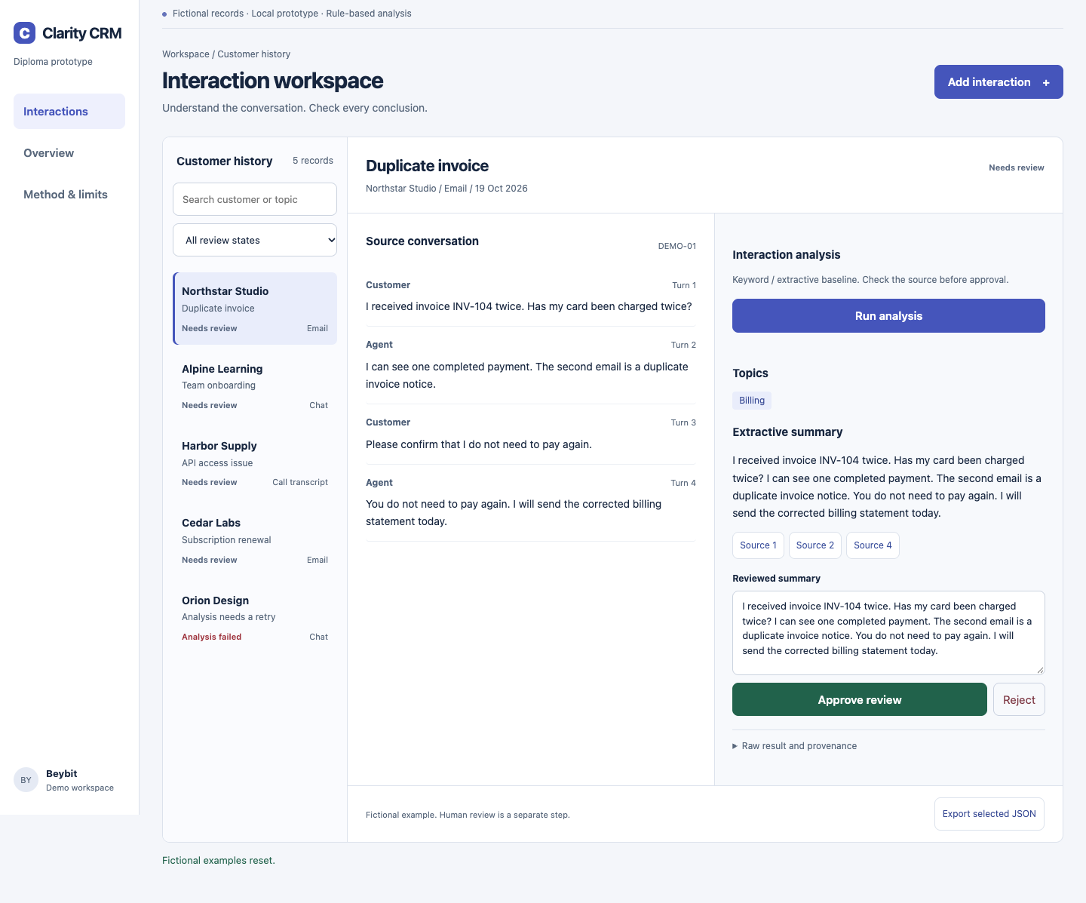
WORKING UX PROTOTYPE
The prototype demonstrates the review workflow
1 Select a record
2 Run baseline analysis
3 Inspect source turns
4 Edit and approve
5 Export the result
Synthetic fixtures. Local browser storage. Plain JavaScript UX prototype.
SE-2426 / Astana IT University / 24 October 2026
16

Slide 17
VERIFICATION AND EXPERIMENT PLAN
Evaluation compares quality and task completion
Comparison
B0 manual review, B1 extractive baseline, C1 pinned pretrained candidate.
Planned dataset
20 development + 100 held-out records, subject to lawful data availability.
Proposed quality targets
Topic macro-F1 ≥ 0.75, supported claims ≥ 0.95, key-fact coverage ≥ 0.80.
Proposed workflow target
Median review time improves ≥ 20% with no error increase. Report uncertainty and actual n.
SE-2426 / Astana IT University / 24 October 2026
17

Slide 18
MILESTONES TO 24 OCTOBER
Checkpoint plan and current tracker status
Date | Expected outcome | Lead
19 Oct | Candidate package and prototype | All three
20 Oct | Discovery / scope open; tracker created 23 Oct | Beybit + Danial
21–22 Oct | Source, requirements, UML and protocol review | All three
23 Oct | Supervisor review and rehearsal: still open | Beybit
24 Oct | Evidence audit, access and submission tag | Danial
SE-2426 / Astana IT University / 24 October 2026
18

Slide 19
RISKS AND MITIGATIONS
Risks can change scope or invalidate claims
No validated user need
Recruit users now. If evidence is missing, disclose it and limit the claim.
Factual mistakes or unsuitable data
Use source inspection, independent annotation and a held-out comparison.
Scope and integration delays
Keep a text-only MVP. Review the API contract and deliver one end-to-end slice.
Review and integration delays
Link tasks, changes, tests and review decisions in the project workflow.
SE-2426 / Astana IT University / 24 October 2026
19

Slide 20
CHECKPOINT READINESS
Prepared artefacts and remaining evidence
Prepared
Proposal, critical review, comparisons, requirements, diagrams, UX and evaluation plan.
Executable now
Extractive prototype and checks. YouTrack: CRM-1–CRM-14 assigned.
Still open
User discovery, supervisor feedback and team review.
Submission gate
Select the reviewed version, check access and create the final pre-defense-1 tag.
SE-2426 / Astana IT University / 24 October 2026
20

Slide 21
SOURCE REGISTER
Scientific references
L01 Chen et al. (2021). DialogSum. Findings of ACL.
L06 Zhu et al. (2023). Fine-Grained Factual Errors. ACL.
L02 Zhong et al. (2021). QMSum. NAACL.
L07 Malkiel et al. (2023). GPTCalls. arXiv preprint.
L03 Gao & Wan (2022). DialSummEval. NAACL.
L08 She et al. (2024). Dialogue consistency. NAACL.
L04 Wang et al. (2022). Faithfulness. EMNLP.
L09 Song et al. (2024). FineSurE. ACL.
L05 Laban et al. (2022). SummaC. TACL.
L10 Zhu et al. (2025). Factual dialogue distillation. COLING.
Full links in speaker notes and the report. Scientific evidence: 9 peer-reviewed papers + 1 preprint.
SE-2426 / Astana IT University / 24 October 2026
21
Notes:
Sources: https://aclanthology.org/2021.findings-acl.449/
https://aclanthology.org/2021.naacl-main.472/
https://aclanthology.org/2022.naacl-main.418/
https://aclanthology.org/2022.emnlp-main.325/
https://aclanthology.org/2022.tacl-1.10/
https://aclanthology.org/2023.acl-long.377/
https://arxiv.org/abs/2306.07941
https://aclanthology.org/2024.naacl-long.338/
https://aclanthology.org/2024.acl-long.51/
https://aclanthology.org/2025.coling-main.302/

