Slide 1
Deep Belief Nets for Topic Modeling

Slide 2
Topic Models
Topic models are algorithms for discovering the main themes that pervade a large and otherwise unstructured collection of documents. Topic models can organize the collection according to the discovered themes.
Topic modeling algorithms do not require any prior annotations or labeling of the documents—the topics emerge from the analysis of the original texts. Topic modeling enables us to organize and summarize electronic archives at a scale that would be impossible by human annotation.
Notes:
Topic models are algorithms for discovering the main themes that pervade a large and otherwise unstructured collection of documents. Topic models can organize the collection according to the discovered themes.

Slide 3
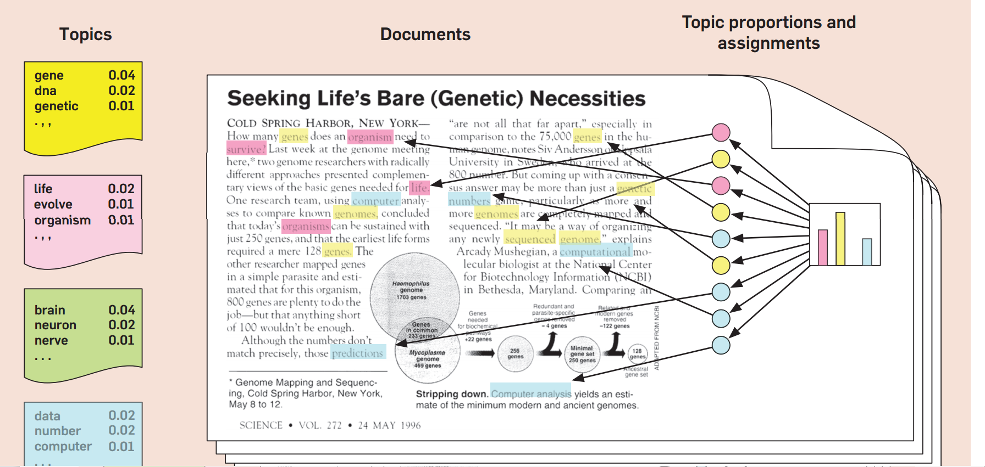
What is Latent Dirichlet Allocation
Source: https://www.cs.princeton.edu/~blei/papers/Blei2012.pdf
Notes:
Latent Dirichlet Allocation (LDA) is a common method of topic modeling. That is, if I have a document and want to figure out if it's a sports article or a mathematics paper, I can use LDA to build a system that looks at other sports articles or mathematics papers and automatically decides whether this unseen document's topic is sports or math. To LDA, a document is just a collection of topics where each topic has some particular probability of generating a particular word.
Figure 1. The intuitions behind latent Dirichlet allocation. We assume that some number of “topics,” which are distributions over words, exist for the whole collection (far left). Each document is assumed to be generated as follows. First choose a distribution over the topics (the histogram at right); then, for each word, choose a topic assignment (the colored coins) and choose the word from the corresponding topic. The topics and topic assignments in this figure are illustrative—they are not fit from real data.

Slide 4
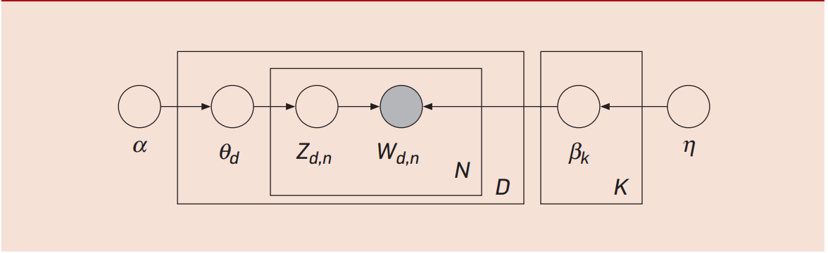
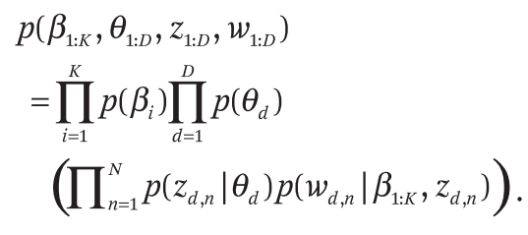

LDA Generative Model
$$p\left(h_{j}^{\left(1\right)}=1 | h^{\left(2\right)}\right)=sigm(b^{\left(1\right)}+W^{\left(2\right)T}h^{\left(2\right)})$$

Slide 5
What is Deep Belief Nets
A generative Model
Generate input instead of predicting label directly
Adjust weights to maximize probability of generating input
Maximizing p(x) not p(y|x)
Learn to write vs. Learn to read
Top two layers are Restricted Boltzmann Machines (RBM)
Other layers are Sigmoid Belief Net (SBN)

Slide 6
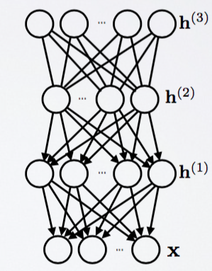
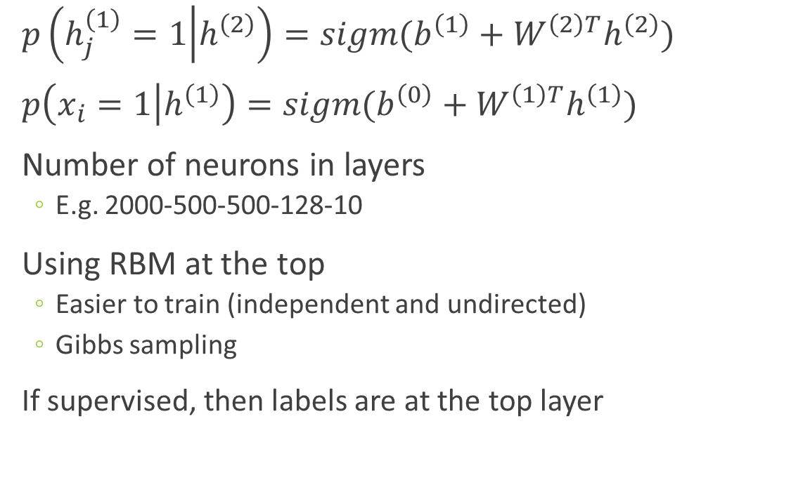
What is Deep Belief Nets
$p\left(h_{j}^{\left(1\right)}=1 | h^{\left(2\right)}\right)=sigm(b^{\left(1\right)}+W^{\left(2\right)T}h^{\left(2\right)})$
$p\left(x_{i}=1 | h^{\left(1\right)}\right)=sigm(b^{\left(0\right)}+W^{\left(1\right)T}h^{\left(1\right)})$
Number of neurons in layers
E.g. 2000-500-500-128-10
Using RBM at the top
Easier to train (independent and undirected)
Gibbs sampling
If supervised, then labels are at the top layer
RBM
SBM
Source: http://info.usherbrooke.ca/hlarochelle/neural_networks/content.html

Slide 7
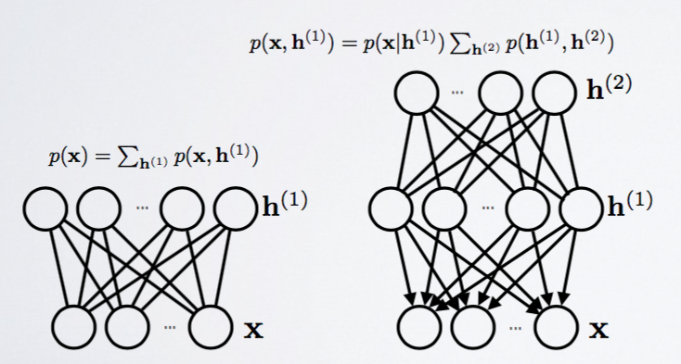
Training DBN
Step 1: Train one layer at a time using RBM
Step 2: Use weights to initialize the stack
Step 3: Train only upper layer (RBM)
Step 4: Stack up another layer and repeat
Notice that lower level is only a pass-through
Source: http://info.usherbrooke.ca/hlarochelle/neural_networks/content.html

Slide 8
Gibbs Chain in RBM
Step 1: Use training data (visible units) to find hidden units
Step 2: Use hidden units to reconstruct data
Step 3: Update hidden units using reconstructed visible units
Step 4: Keep repeating until converge
j
j
i
i
t = 0 t = 1
data
reconstruction
Source: http://www.cs.toronto.edu/~hinton/

Slide 9
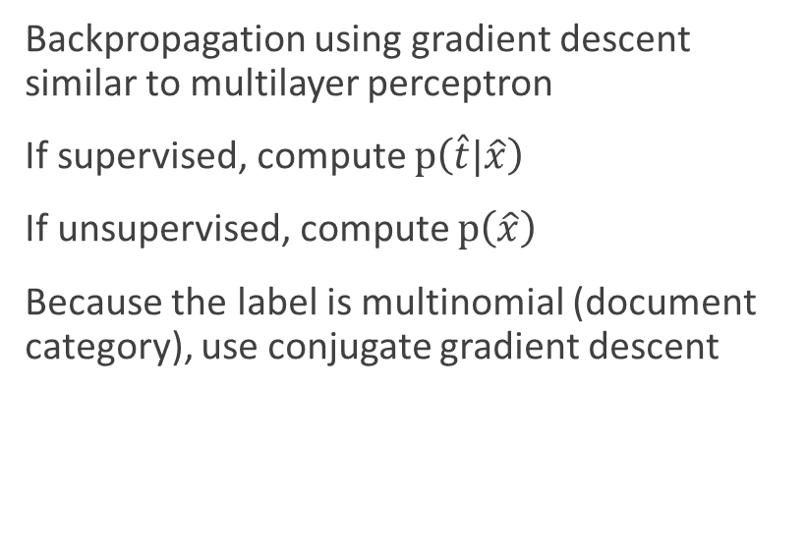
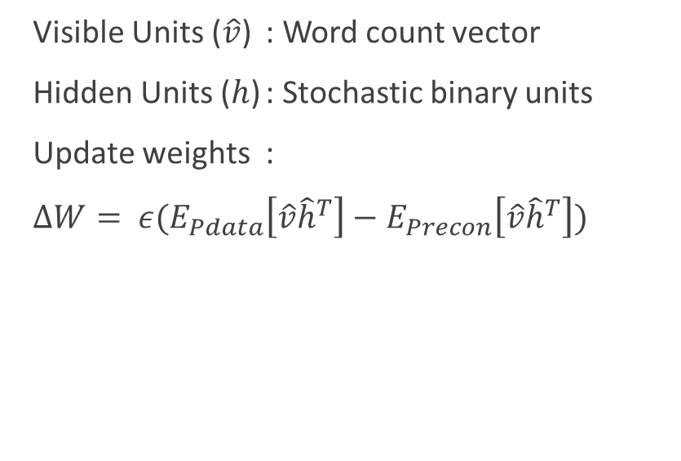
DBN for Topic Modeling
Pre-Training
Fine-Tuning
Visible Units ($\hat{v}$) : Word count vector
Hidden Units ($h$) : Stochastic binary units
Update weights :
$∆W= ε(E_{Pdata}\left[\hat{v}{\hat{h}}^{T}\right]−E_{Precon}\left[\hat{v}{\hat{h}}^{T}\right])$
Backpropagation using gradient descent similar to multilayer perceptron
If supervised, compute $p\left(\hat{t}|\hat{x}\right)$
If unsupervised, compute $p\left(\hat{x}\right)$
Because the label is multinomial (document category), use conjugate gradient descent

Slide 10
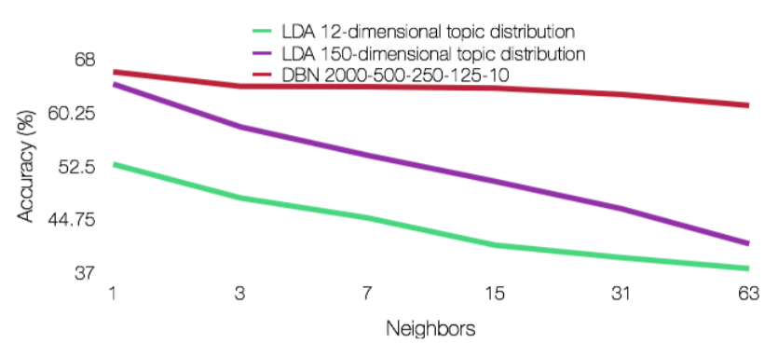
Empirical Tests (Wikipedia Corpus)
Classify into 12 categories within Business newsgroup
Labelled data
Train/Test = 70/30
DBN outperforms LDA when measuring % accuracy

Slide 11
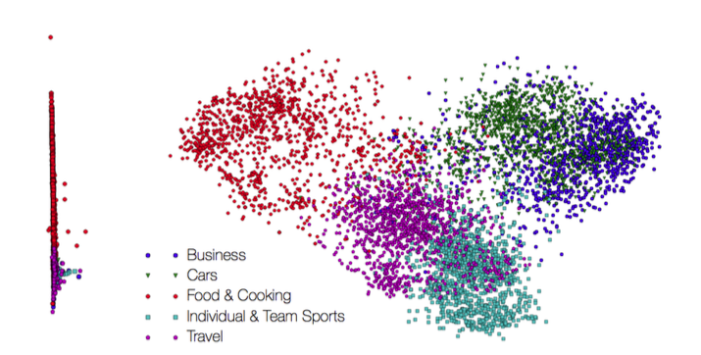
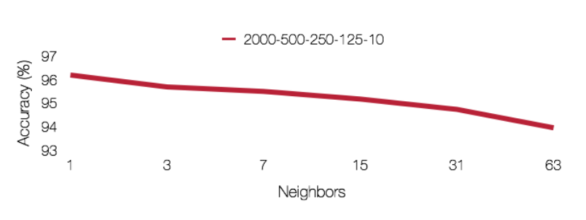
Empirical Tests (Issuu Corpus)
Classify into 5 categories based on Issuu’s LDA model
DBN can perform quite similar to LDA
PCA shows some degrees of separation between groups

Slide 12
DBN and Shakespeare
The experiment:
“Can DBN understand comedy, historical, and tragedy plays?”
The dataset:
50/50 training/testing data (total of 752 scenes)
The code:
https://github.com/larsmaaloee/deep-belief-nets-for-topic-modeling
2000-500-500-128

Slide 13
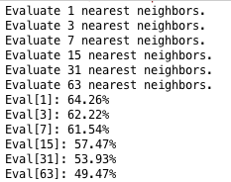
DBN and Shakespeare

Slide 14
Shakespeare Genre Classifying DBN vs RF

