Slide 1
Deep Belief Nets for Topic Modeling

Slide 2
What is Topic Modeling
A generative Model
Generate input instead of predicting label directly
Adjust weights to maximize probability of generating input
Maximizing p(x) not p(y|x)
Learn to write vs. Learn to read
Top two layers are Restricted Boltzmann Machines (RBM)
Other layers are Sigmoid Belief Net (SBN)

Slide 3
What is Latent Dirichlet Analysis (LDA)
A generative Model
Generate input instead of predicting label directly
Adjust weights to maximize probability of generating input
Maximizing p(x) not p(y|x)
Learn to write vs. Learn to read
Top two layers are Restricted Boltzmann Machines (RBM)
Other layers are Sigmoid Belief Net (SBN)

Slide 4
What is Deep Belief Nets
A generative Model
Generate input instead of predicting label directly
Adjust weights to maximize probability of generating input
Maximizing p(x) not p(y|x)
Learn to write vs. Learn to read
Top two layers are Restricted Boltzmann Machines (RBM)
Other layers are Sigmoid Belief Net (SBN)

Slide 5
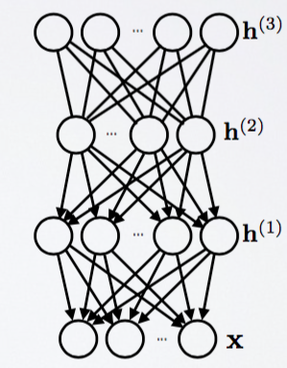
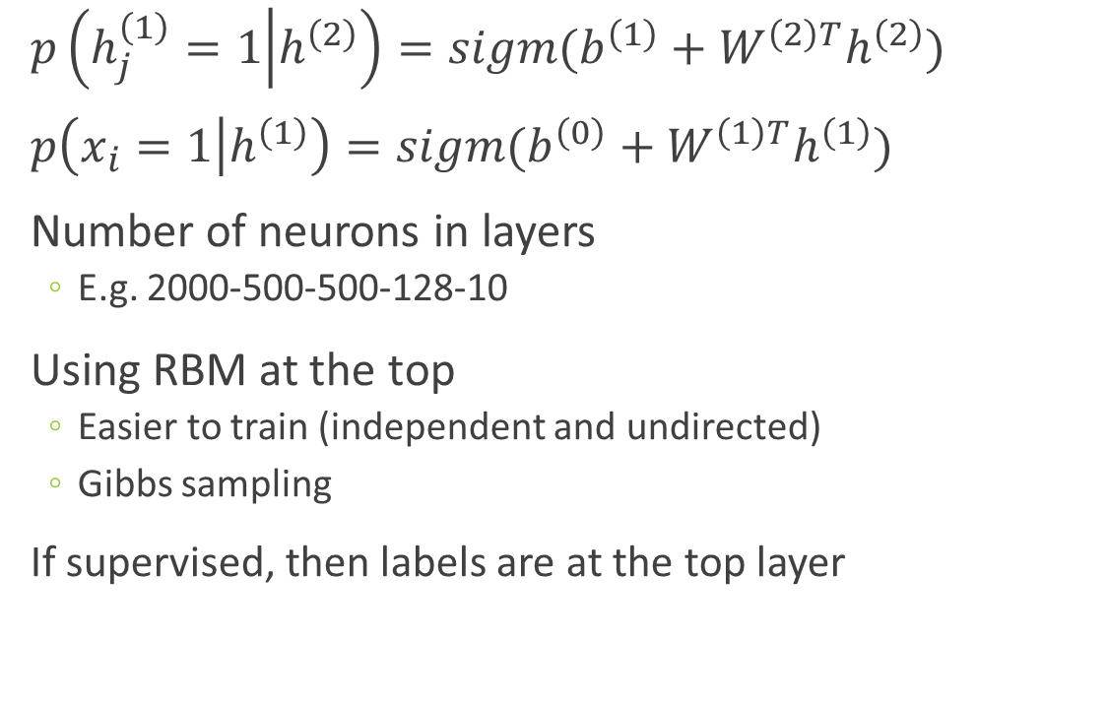
What is Deep Belief Nets
$p\left(h_{j}^{\left(1\right)}=1 | h^{\left(2\right)}\right)=sigm(b^{\left(1\right)}+W^{\left(2\right)T}h^{\left(2\right)})$
$p\left(x_{i}=1 | h^{\left(1\right)}\right)=sigm(b^{\left(0\right)}+W^{\left(1\right)T}h^{\left(1\right)})$
Number of neurons in layers
E.g. 2000-500-500-128-10
Using RBM at the top
Easier to train (independent and undirected)
Gibbs sampling
If supervised, then labels are at the top layer
RBM
SBM
Source: http://info.usherbrooke.ca/hlarochelle/neural_networks/content.html

Slide 6
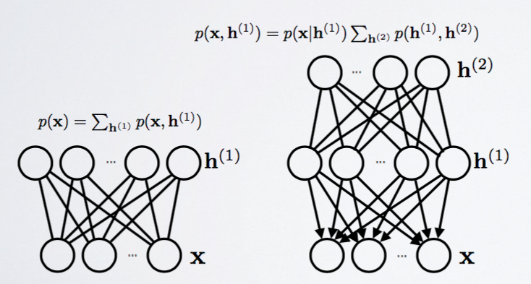
Training DBN
Step 1: Train one layer at a time using RBM
Step 2: Use weights to initialize the stack
Step 3: Train only upper layer (RBM)
Step 4: Stack up another layer and repeat
Notice that lower level is only a pass-through
Source: http://info.usherbrooke.ca/hlarochelle/neural_networks/content.html

Slide 7
Gibbs Chain in RBM
Step 1: Use training data (visible units) to find hidden units
Step 2: Use hidden units to reconstruct data
Step 3: Update hidden units using reconstructed visible units
Step 4: Keep repeating until converge
j
j
i
i
t = 0 t = 1
data
reconstruction
Source: http://www.cs.toronto.edu/~hinton/

Slide 8
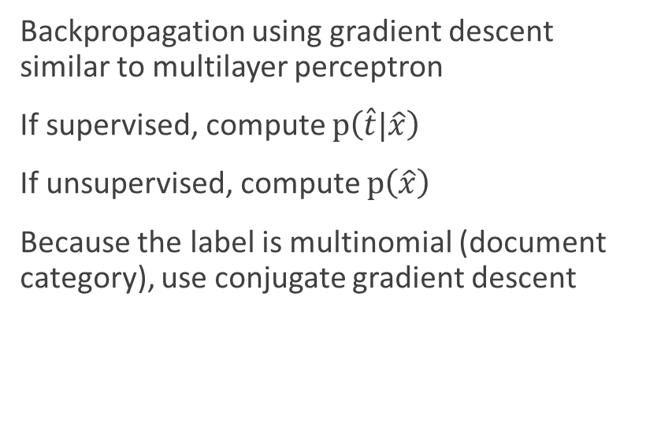
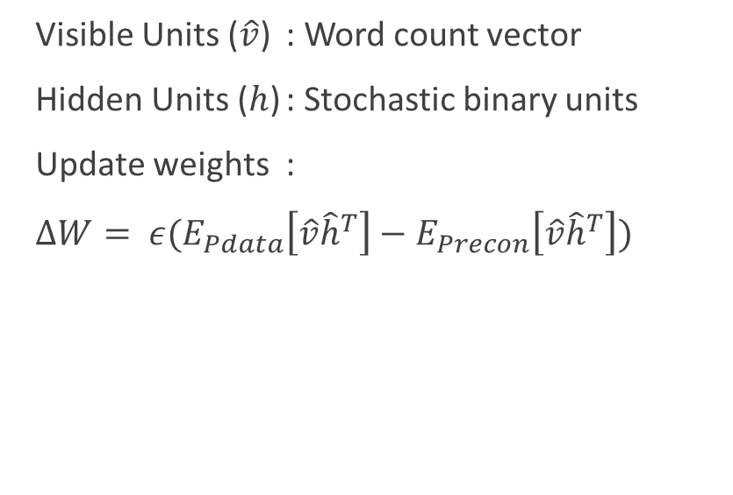
DBN for Topic Modeling
Pre-Training
Fine-Tuning
Visible Units ($\hat{v}$) : Word count vector
Hidden Units ($h$) : Stochastic binary units
Update weights :
$∆W= ε(E_{Pdata}\left[\hat{v}{\hat{h}}^{T}\right]−E_{Precon}\left[\hat{v}{\hat{h}}^{T}\right])$
Backpropagation using gradient descent similar to multilayer perceptron
If supervised, compute $p\left(\hat{t}|\hat{x}\right)$
If unsupervised, compute $p\left(\hat{x}\right)$
Because the label is multinomial (document category), use conjugate gradient descent

Slide 9
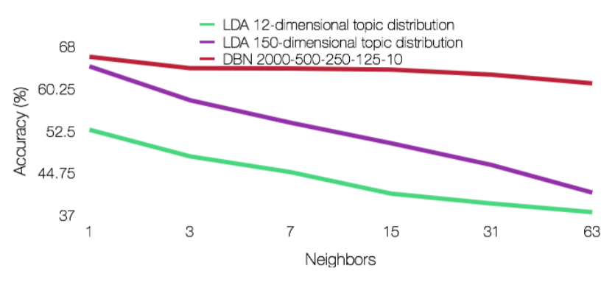
Empirical Tests (Wikipedia Corpus)
Classify into 12 categories within Business newsgroup
Labelled data
Train/Test = 70/30
DBN outperforms LDA when measuring % accuracy

Slide 10
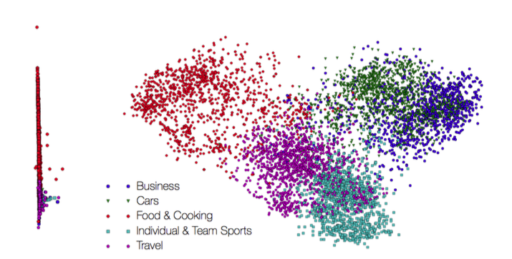
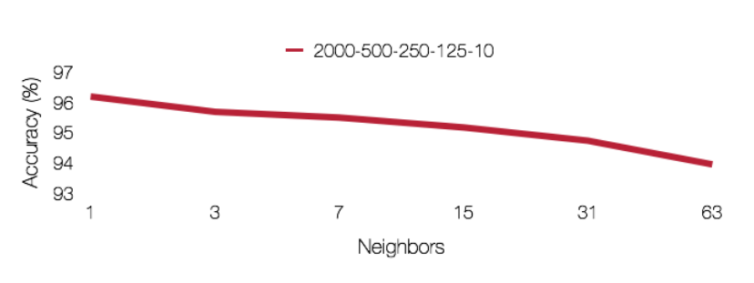
Empirical Tests (Issuu Corpus)
Classify into 5 categories based on Issuu’s LDA model
DBN can perform quite similar to LDA
PCA shows some degrees of separation between groups

Slide 11
DBN and Shakespeare
The experiment:
“Can DBN understand comedy, historical, and tragedy plays?”
The dataset:
50/50 training/testing data (total of 752 scenes)
The code:
https://github.com/larsmaaloee/deep-belief-nets-for-topic-modeling
2000-500-500-128

Slide 12
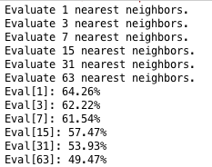
DBN and Shakespeare

Slide 13
What about Random Forest?

Slide 14
Shakespeare Genre Classifying DBN vs RF

