Slide 1
Deep Belief Nets for Topic Modeling

Slide 2
Topic Models
Topic models are algorithms for discovering the main themes that pervade a large and otherwise unstructured collection of documents. Topic models can organize the collection according to the discovered themes.
Topic modeling algorithms do not require any prior annotations or labeling of the documents—the topics emerge from the analysis of the original texts. Topic modeling enables us to organize and summarize electronic archives at a scale that would be impossible by human annotation.
Notes:
Hello, I am Dingchao, and my teammate Pipat and I today we are going to talk about Deep Belief Nets algorithm in the background of topic models.
First of all, what is topic models? Suppose you have a huge number of documents like decades of newspapers and you would to know what’s going on, but you can’t read them all, this is where Topic Modelling come to help. Topic Models are algorithms for discovering main topics out of an unstructured collection of documents, and the algorithm do not require any prior annotations or labelling.

Slide 3
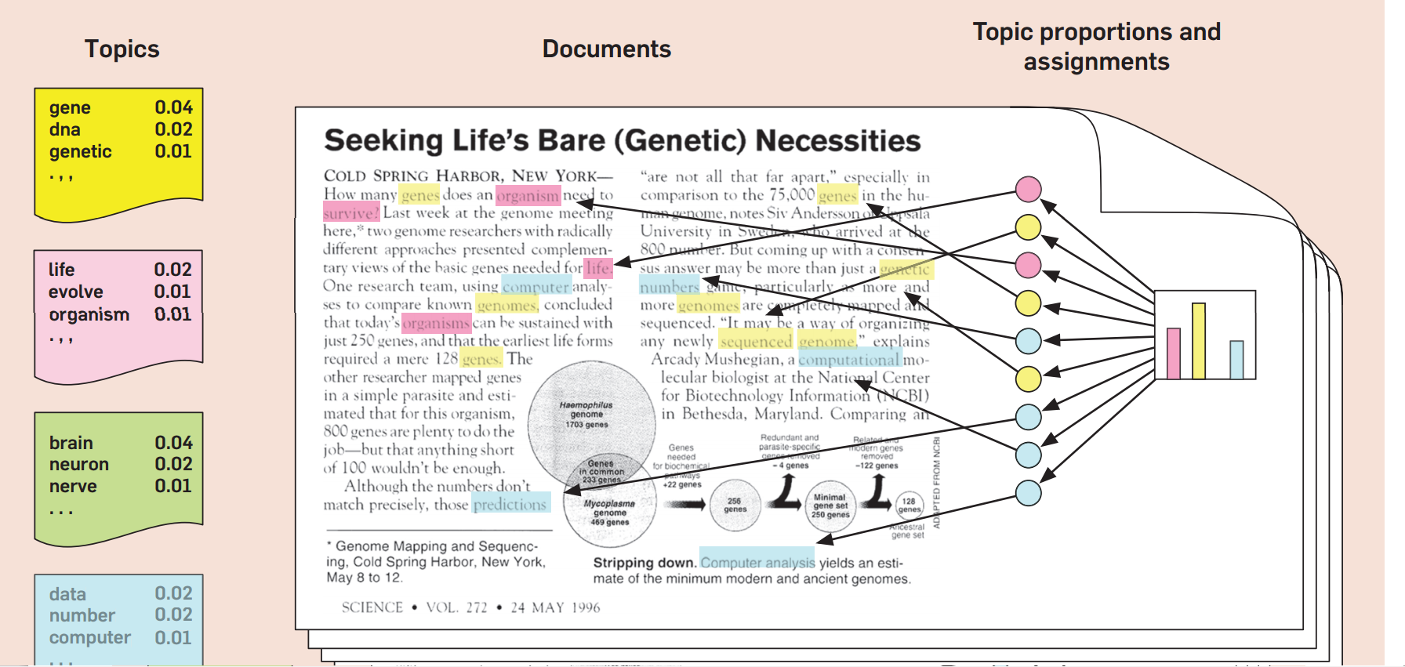
What is Latent Dirichlet Allocation
Source: https://www.cs.princeton.edu/~blei/papers/Blei2012.pdf
Notes:
Latent Dirichlet Allocation LDA discussed in the paper is a common method of topic modeling. The intuitions behind LDA is that a document is just a collection of topics where each topic has some particular probability of generating a particular word. We formally define a topic to be a distribution over a fixed vocabulary. For example, the genetics topic has words about genetics with high probability and the evolutionary biology topic has words about evolutionary biology with high probability. We assume that these topics are specified before any data has been generated.a Now for each a Technically, the model assumes that the topics are generated first, before the documents. document in the collection, we generate the words in a two-stage process. ˲ Randomly choose a distribution over topics. ˲ For each word in the document a. Randomly choose a topic from the distribution over topics in step #1. b. Randomly choose a word from the corresponding distribution over the vocabulary.

Slide 4
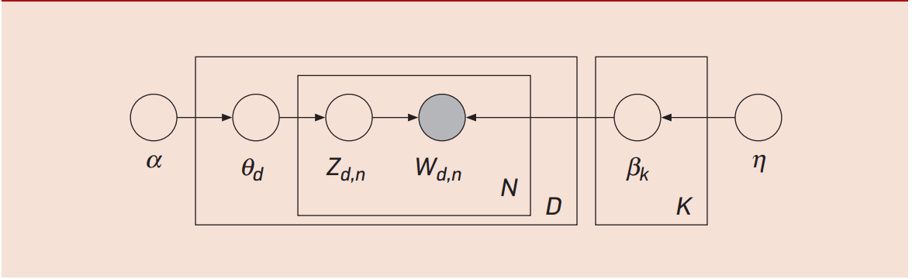

LDA Generative Model
Notes:
We can describe LDA more formally with the following notation. The topics are b1:K, where each bk is a distribution over the vocabulary (the distributions over words at left in Figure 1). The topic proportions for the dth document are q d, where q d,k is the topic proportion for topic k in document d (the cartoon histogram in Figure 1). The topic assignments for the dth document are zd, where zd,n is the topic assignment for the nth word in document d (the colored coin in Figure 1). Finally, the observed words for document d are wd, where wd,n is the nth word in document d, which is an element from the fixed vocabulary,
α is the parameter of the Dirichlet prior on the per-document topic distributions

Slide 5
What is Deep Belief Nets
A generative Model
Generate input instead of predicting label directly
Adjust weights to maximize probability of generating input
Maximizing p(x) not p(y|x)
Learn to write vs. Learn to read
Top two layers are Restricted Boltzmann Machines (RBM)
Other layers are Sigmoid Belief Net (SBN)

Slide 6
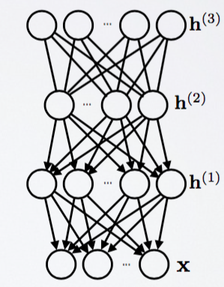
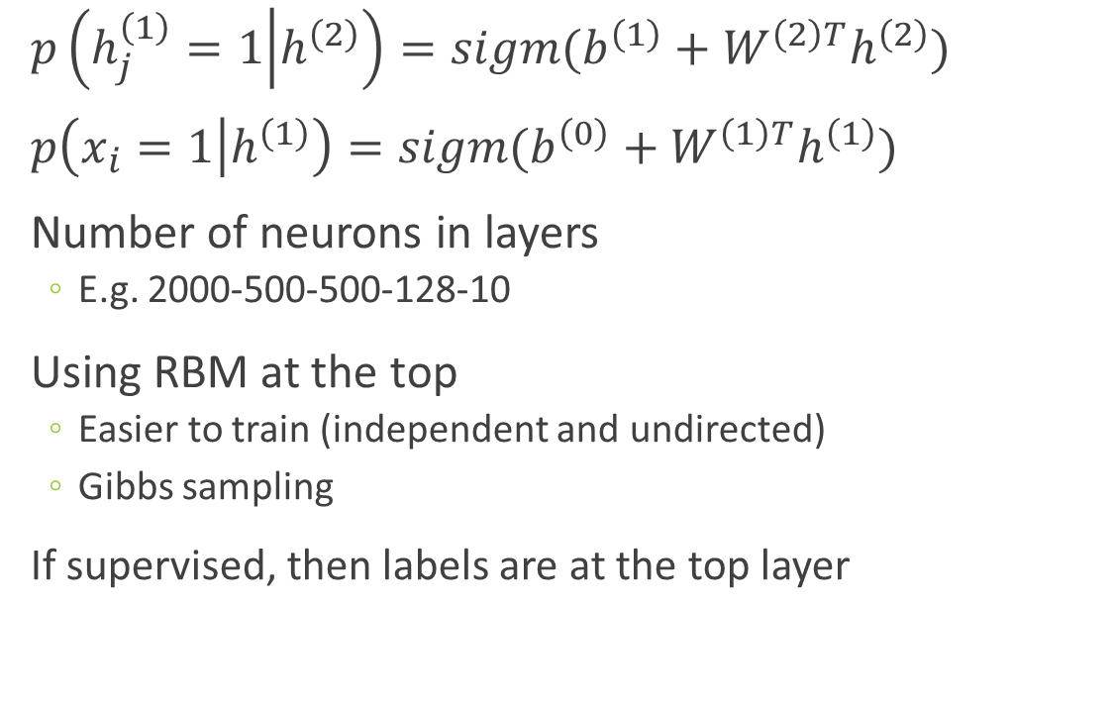
What is Deep Belief Nets
$p\left(h_{j}^{\left(1\right)}=1 | h^{\left(2\right)}\right)=sigm(b^{\left(1\right)}+W^{\left(2\right)T}h^{\left(2\right)})$
$p\left(x_{i}=1 | h^{\left(1\right)}\right)=sigm(b^{\left(0\right)}+W^{\left(1\right)T}h^{\left(1\right)})$
Number of neurons in layers
E.g. 2000-500-500-128-10
Using RBM at the top
Easier to train (independent and undirected)
Gibbs sampling
If supervised, then labels are at the top layer
RBM
SBM
Source: http://info.usherbrooke.ca/hlarochelle/neural_networks/content.html

Slide 7
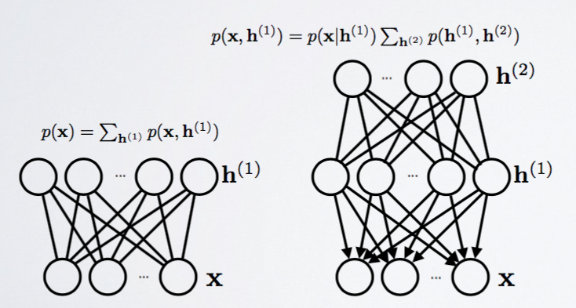
Training DBN
Step 1: Train one layer at a time using RBM
Step 2: Use weights to initialize the stack
Step 3: Train only upper layer (RBM)
Step 4: Stack up another layer and repeat
Notice that lower level is only a pass-through
Source: http://info.usherbrooke.ca/hlarochelle/neural_networks/content.html

Slide 8
Gibbs Chain in RBM
Step 1: Use training data (visible units) to find hidden units
Step 2: Use hidden units to reconstruct data
Step 3: Update hidden units using reconstructed visible units
Step 4: Keep repeating until converge
j
j
i
i
t = 0 t = 1
data
reconstruction
Source: http://www.cs.toronto.edu/~hinton/

Slide 9
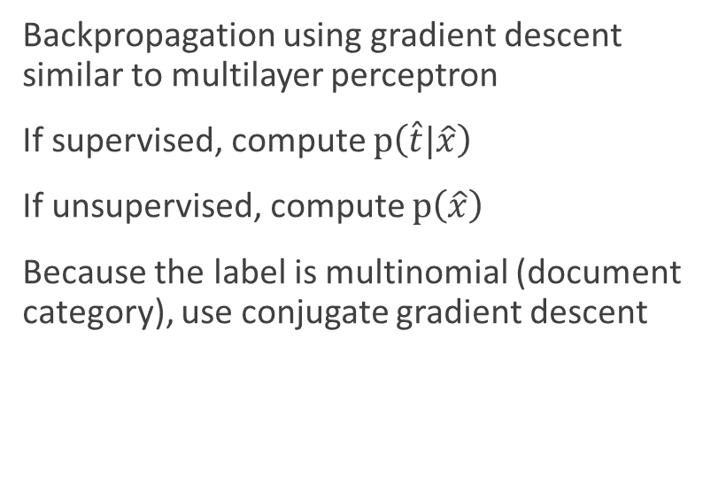
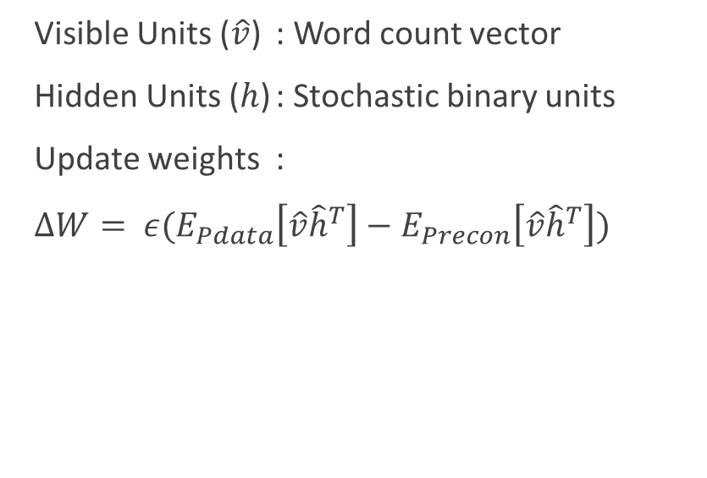
DBN for Topic Modeling
Pre-Training
Fine-Tuning
Visible Units ($\hat{v}$) : Word count vector
Hidden Units ($h$) : Stochastic binary units
Update weights :
$∆W= ε(E_{Pdata}\left[\hat{v}{\hat{h}}^{T}\right]−E_{Precon}\left[\hat{v}{\hat{h}}^{T}\right])$
Backpropagation using gradient descent similar to multilayer perceptron
If supervised, compute $p\left(\hat{t}|\hat{x}\right)$
If unsupervised, compute $p\left(\hat{x}\right)$
Because the label is multinomial (document category), use conjugate gradient descent

Slide 10
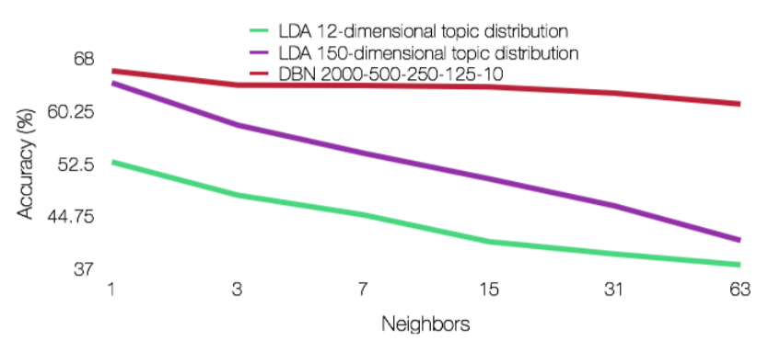
Empirical Tests (Wikipedia Corpus)
Classify into 12 categories within Business newsgroup
Labelled data
Train/Test = 70/30
DBN outperforms LDA when measuring % accuracy

Slide 11
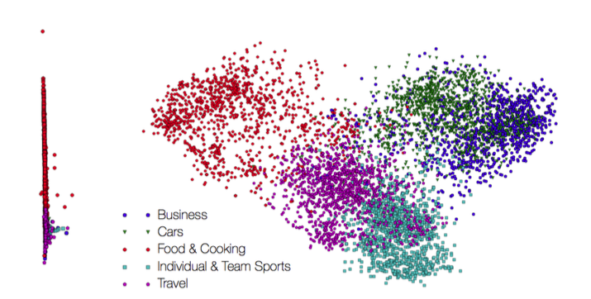
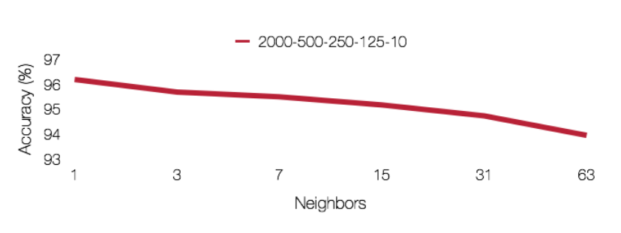
Empirical Tests (Issuu Corpus)
Classify into 5 categories based on Issuu’s LDA model
DBN can perform quite similar to LDA
PCA shows some degrees of separation between groups

Slide 12
DBN and Shakespeare
The experiment:
“Can DBN understand comedy, historical, and tragedy plays?”
The dataset:
50/50 training/testing data (total of 752 scenes)
The code:
https://github.com/larsmaaloee/deep-belief-nets-for-topic-modeling
2000-500-500-128

Slide 13
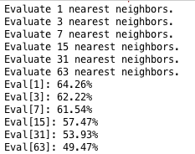
DBN and Shakespeare

Slide 14
Shakespeare Genre Classifying DBN vs RF

