Slide 1
Bird SDM summary
New-record species pool: 578 Matched species ready for modeling: 196 Successfully modeled species: 1 Unmatched species: 382

Slide 2
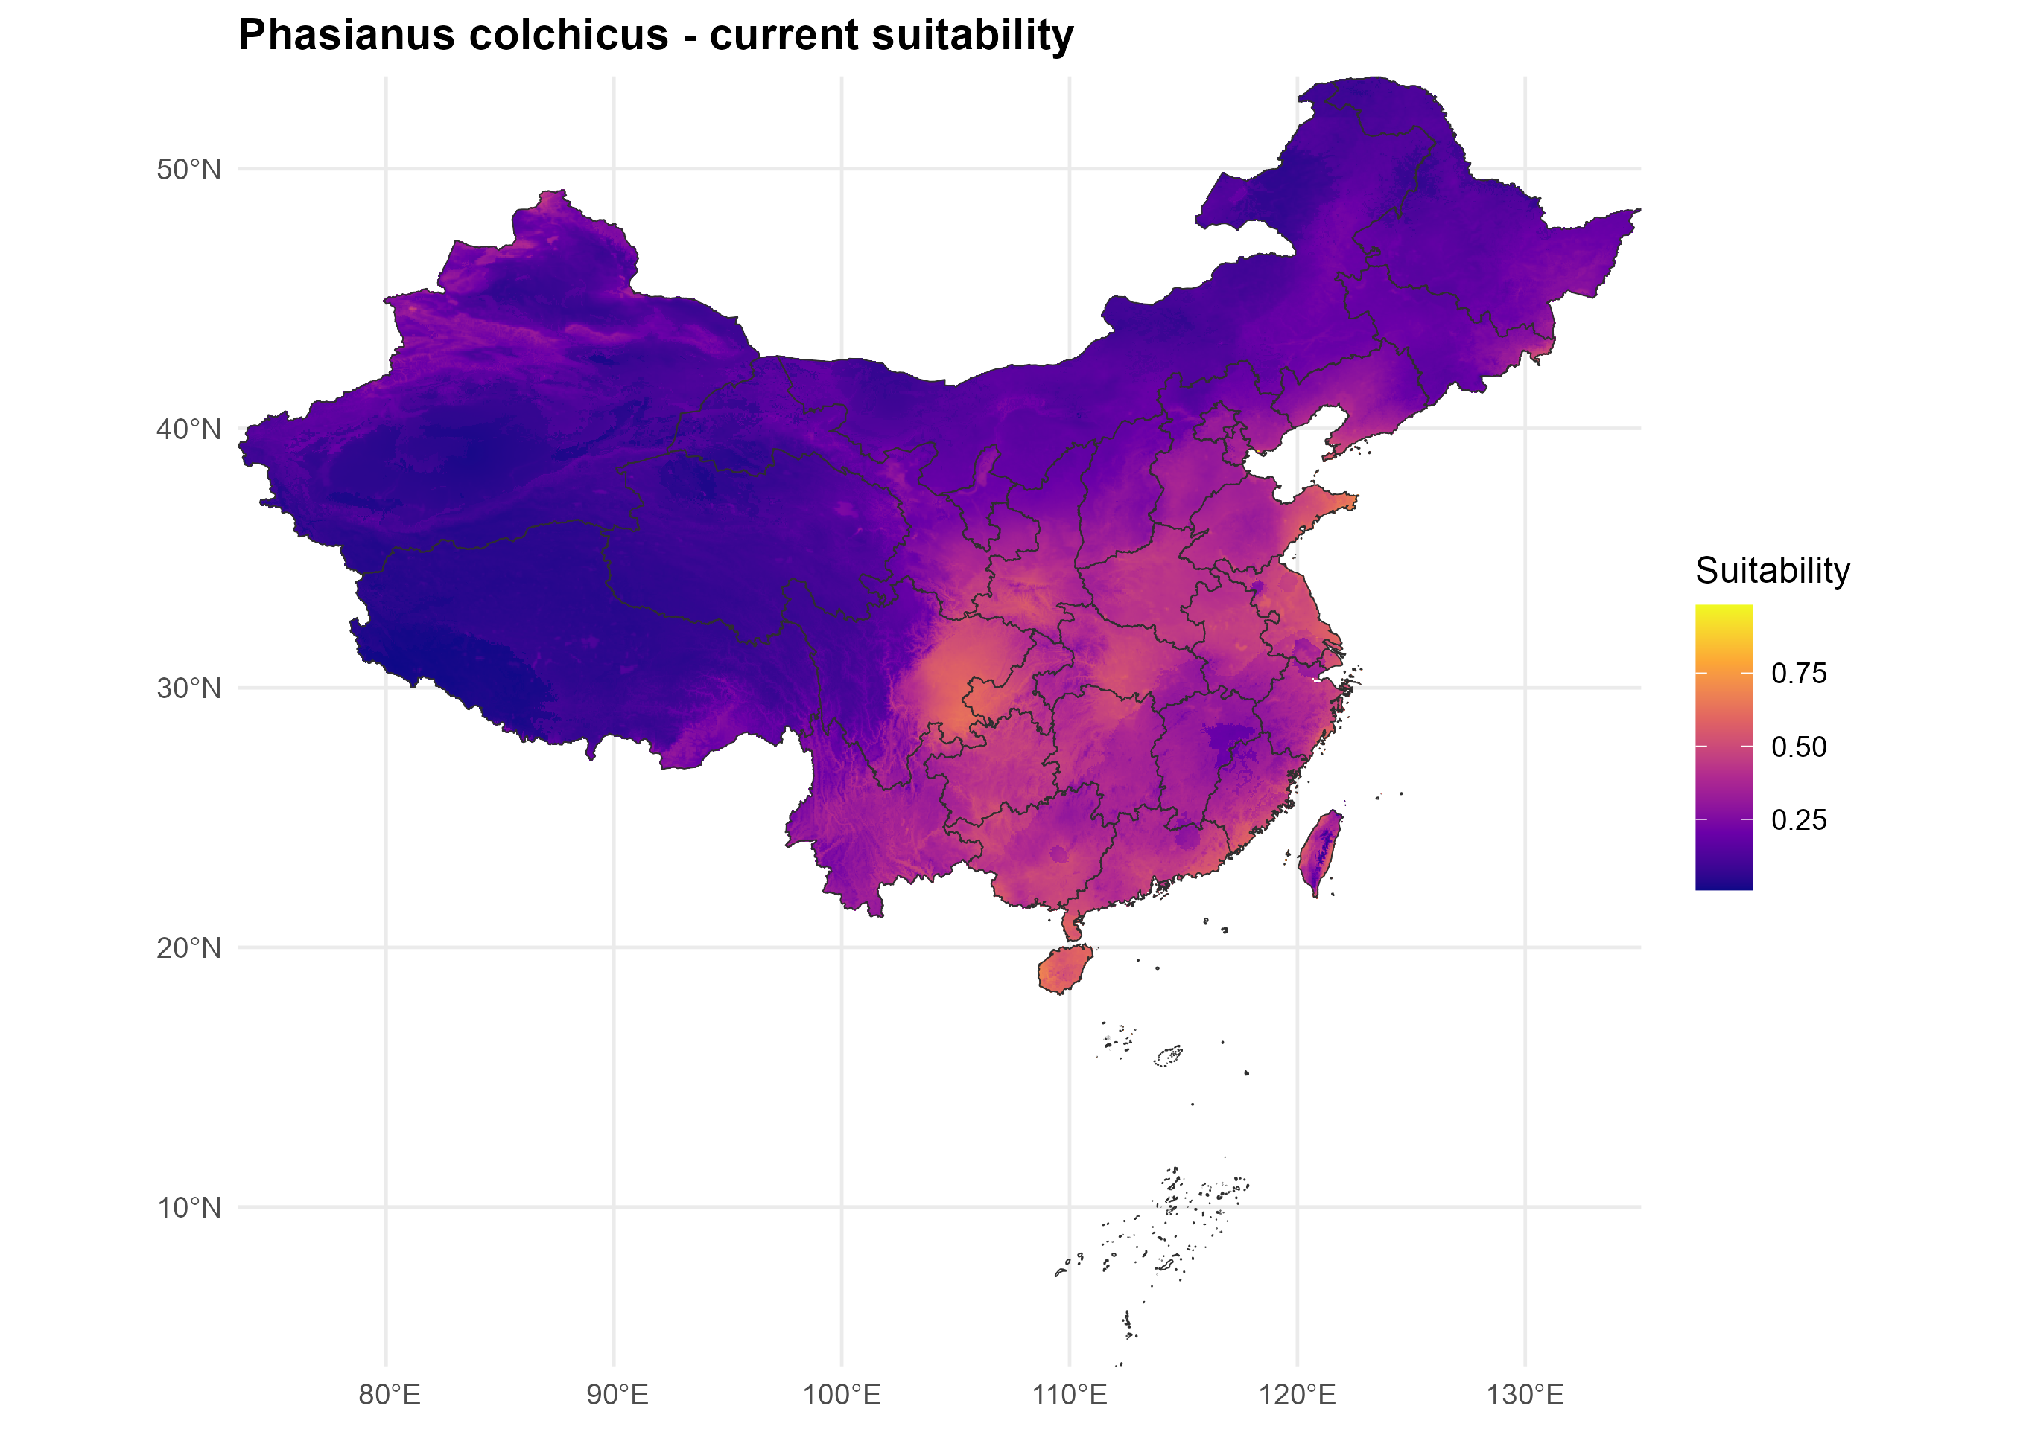
phasianus_colchicus_current_probability.png

Slide 3
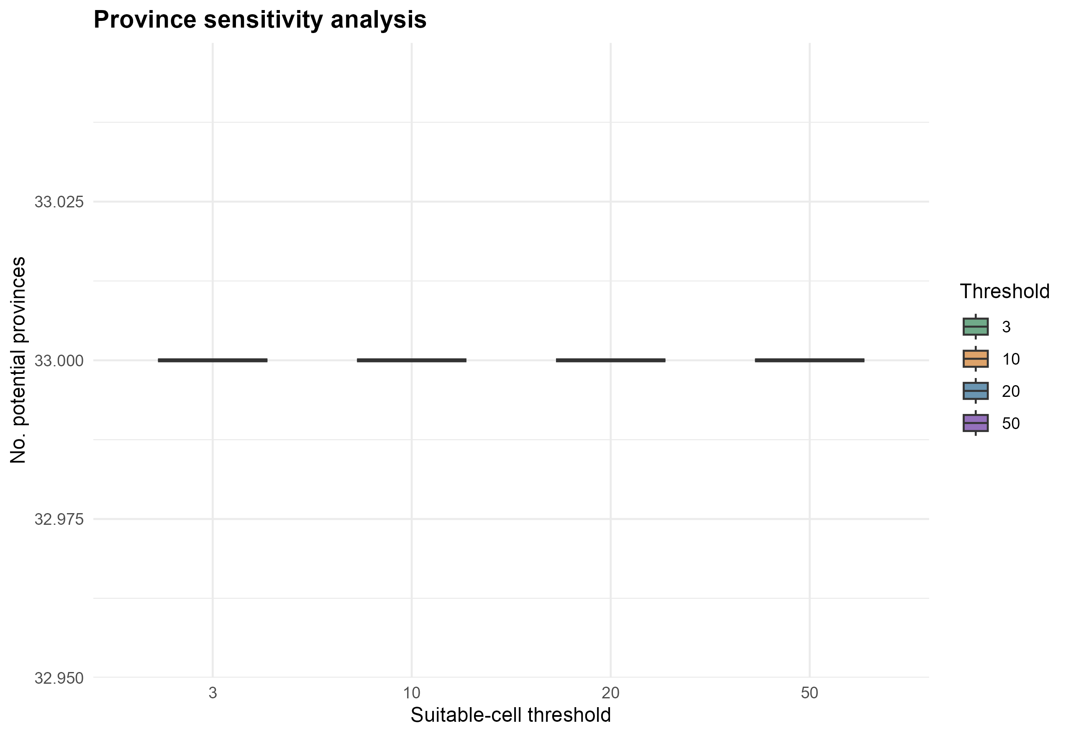
fig_sensitivity_thresholds.png

Slide 4
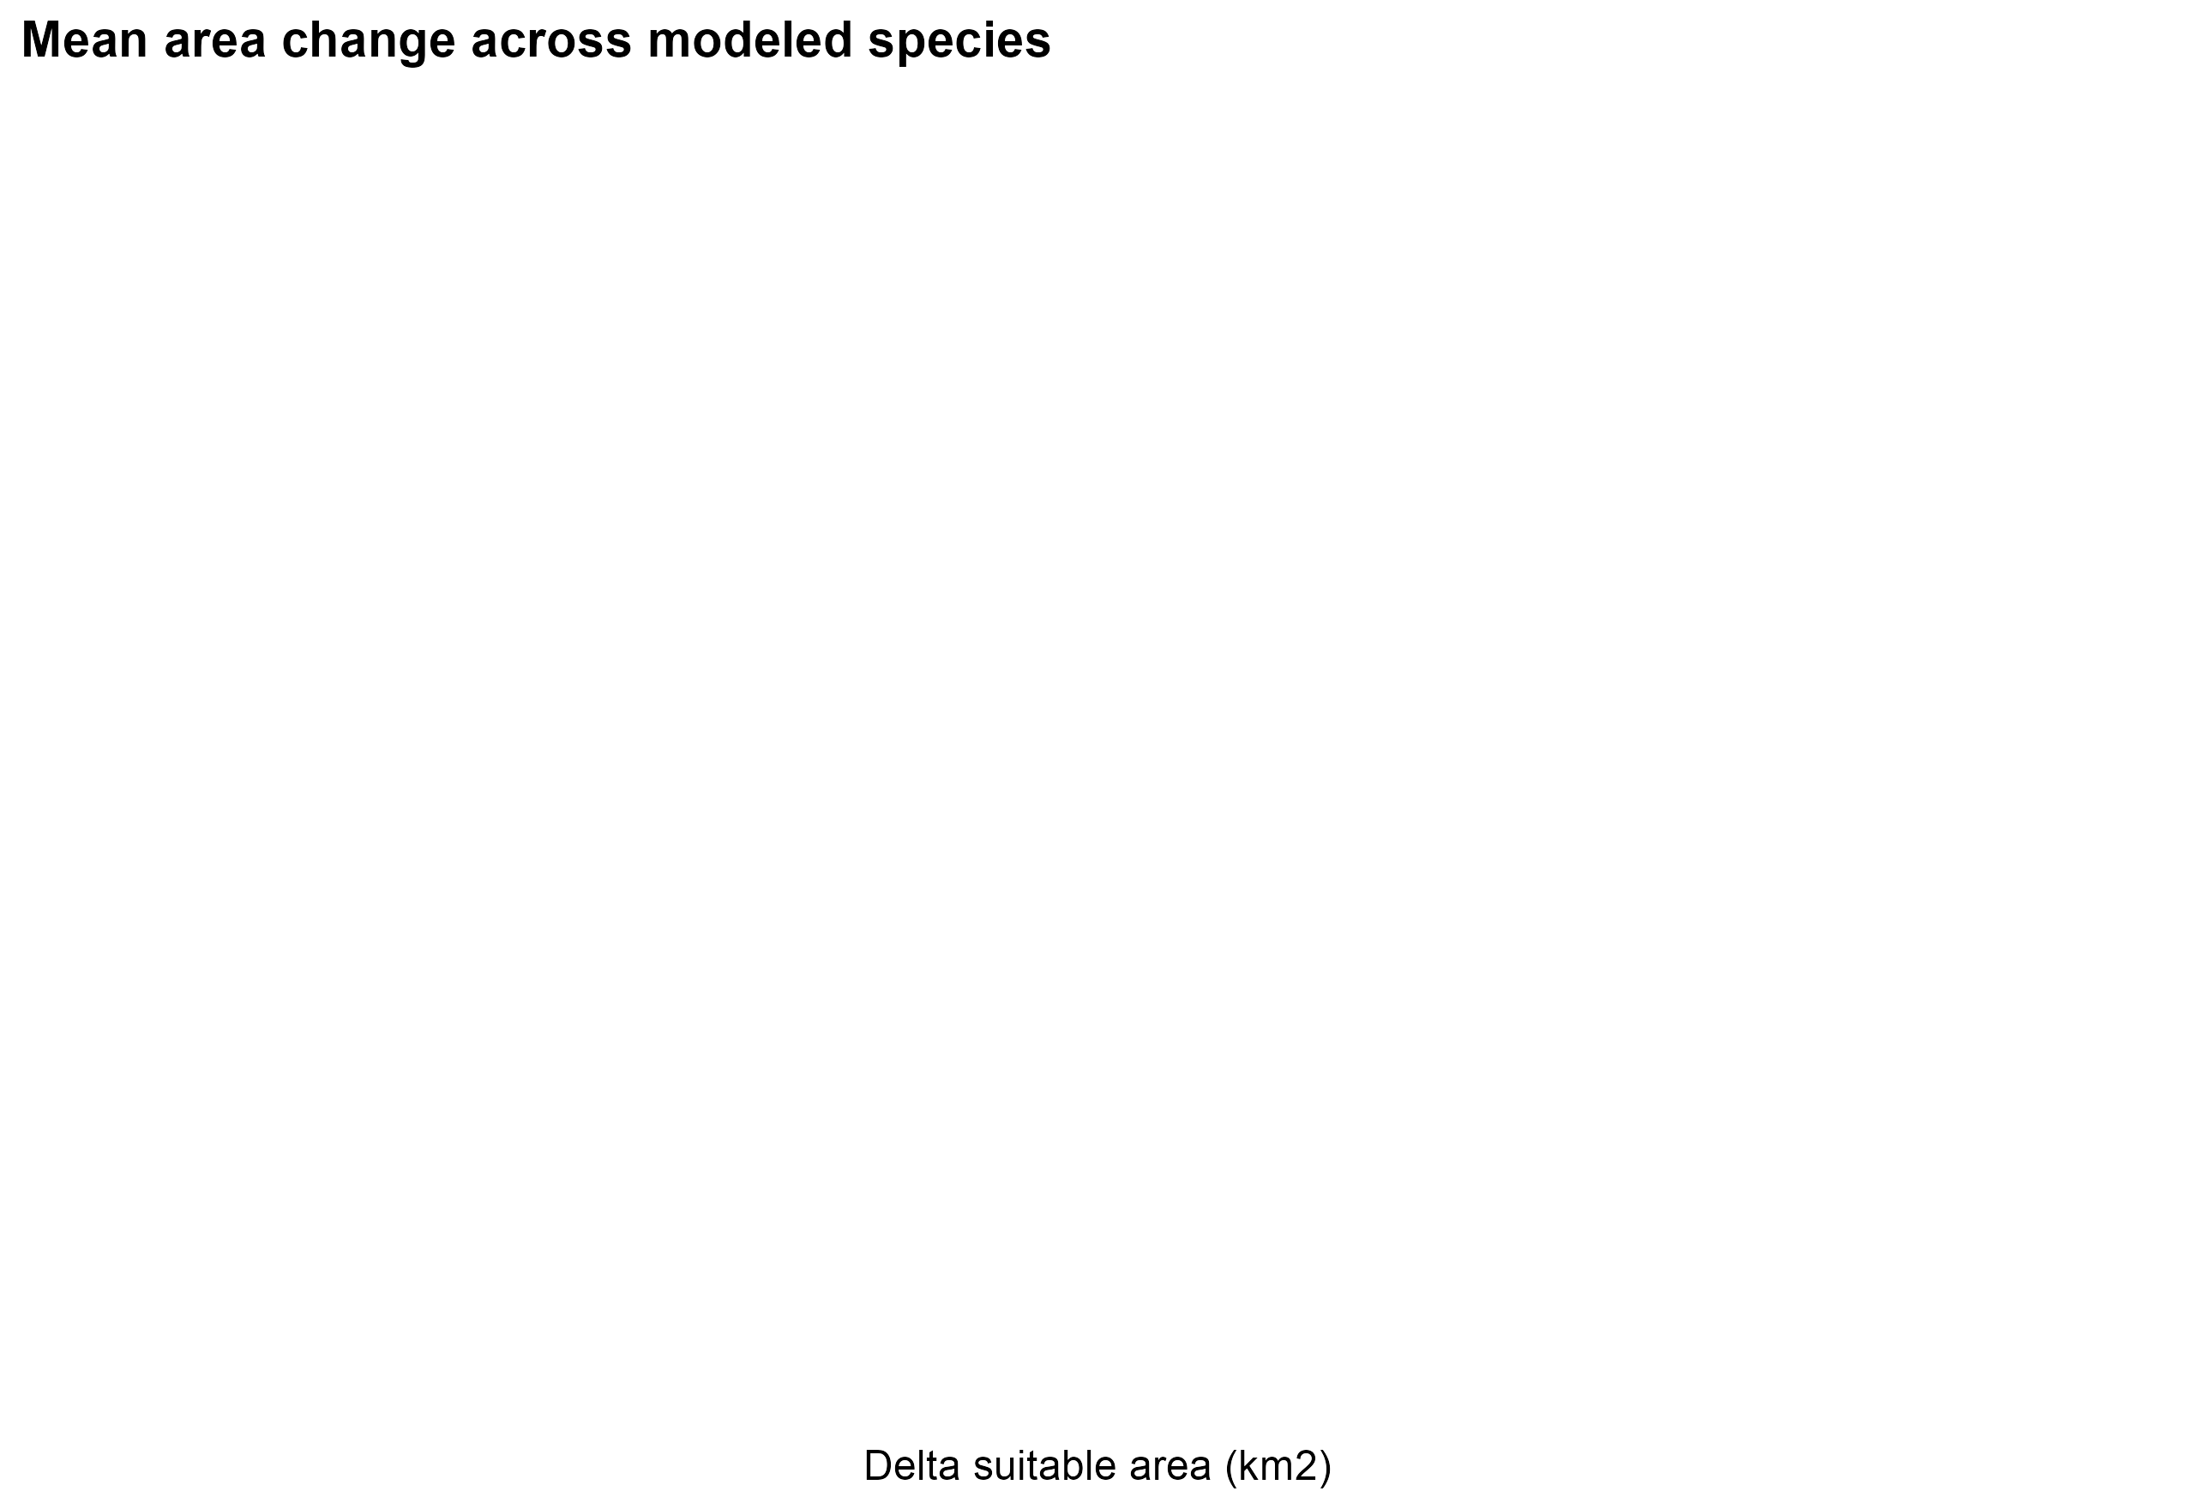
fig_area_change_summary.png

