Slide 1


AOC 2026
Singapore
Disentangling climate signals from survey effort
in new bird distribution records across China
Birds or birders? A discrete-time hazard model of first records, 2002–2024
Chenchen Ding¹, Zhengwang Zhang², Zhigang Jiang³, Zhiheng Wang¹
¹ Peking University ² Beijing Normal University ³ Institute of Zoology, Chinese Academy of Sciences
3rd Asian Ornithological Conference · National University of Singapore · 14–17 November 2026
Notes:
[about 30 s]
Good morning, everyone. I'm Chenchen Ding, from Peking University. Today I'd like to ask a simple question about new bird records. When a species turns up in a new province, is that the bird moving, or is it us looking harder? Our answer is: both, in roughly equal measure, and I'll show you how a single model can tell the two apart.

Slide 2
Background
Research gaps
Questions
Approach
Results
Synthesis
Background
A new record is the last link in a chain of three events
New distribution record: the first documented occurrence of a species
in a province where it had not been recorded before
1
The bird is there
2
Someone looks
3
The find is published
The species occupies the
A birder or a survey
The detection is written
New
province; warming can
detects it; effort grew
up and dated in a
record
move ranges
fast after 2000
paper or report
Ecological process
Observation process
Documentation
Only this link is ecological
These two leave the same trace in the data
Imperfect detection and uneven sampling can create apparent range changes where none occurred
In China, provincial new bird records have been read as evidence of poleward shifts
Tingley & Beissinger 2009; Hughes et al. 2021; Xing et al. 2024; Chen et al. 2025
Ding, Zhang, Jiang & Wang · AOC 2026, Singapore
02
Notes:
[about 40 s]
A new distribution record is the first documented occurrence of a species in a province where it had not been recorded before. But a record is not an observation of movement. It is the last link in a chain of three events: the bird is there, someone looks and finds it, and the find is published. Only the first link is ecological. The other two leave exactly the same trace in the data, so imperfect detection and uneven sampling can create apparent range changes where none occurred.
If asked: Is this specific to China? No; the chain applies to any dated compilation of first records.

Slide 3
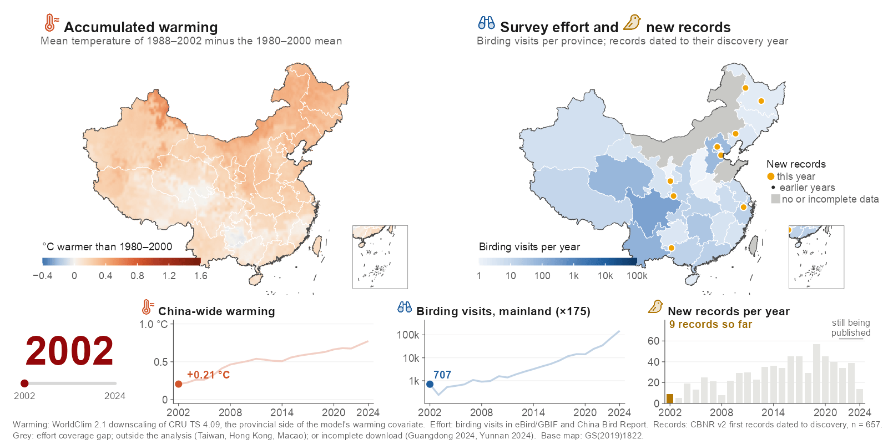
Background
Research gaps
Questions
Approach
Results
Synthesis
Background
After 2002, warming, birding and new records all rose together
Ding, Zhang, Jiang & Wang · AOC 2026, Singapore
03
Notes:
[about 50 s]
This is why the question is hard in China. On the left, accumulated warming: the fifteen-year mean temperature relative to 1980 to 2000. The country turns red, from about 0.2 degrees in 2002 to almost 0.8 by 2024, most strongly across the north and northwest. On the right, survey effort: birding visits per province, which rose about 175-fold over the same years and spread from the east coast inland. The amber dots are new records, appearing in the year they were discovered: 657 of them. Everything rises together, so a trend in new records cannot, on its own, tell us which process is behind it.
If asked: Why are Yunnan and Guangdong grey in 2024? Their visit counts in the source download fall by more than 90% from 2023 while record counts do not, so the map shows them as incomplete; national totals and the model input are unchanged.
If asked: Is this the warming variable in the model? It is the provincial side; the model uses the difference from the same quantity over each species' range.

Slide 4
Background
Research gaps
Questions
Approach
Results
Synthesis
Research gaps
Analyses of new records have not separated ecology from observation
How source papers explain their records
1
Confounded drivers
CBNR v2, n = 1,029 provincial first records
Warming and observation grew together; a model
GAP
with only one of them credits it with both
Range shift
61.1%
Survey effort, alone or
with range shift
7.3%
2
Unmodelled observation
Not stated
GAP
Survey pulses, and which species could be
31.0%
recorded where, are rarely in the model
Other (e.g. taxonomy)
0.6%
3
No benchmark, no support check
GAP
Warming lacks a null benchmark; projections
Birding visits rose about 175-fold, 2002–04 to 2022–24,
are rarely checked against the fitted data
yet effort is rarely given as the reason
Needed: one model that treats each record as the product of ecology and observation
Ding, Zhang, Jiang & Wang · AOC 2026, Singapore
04
Notes:
[about 55 s]
Here is the gap. When the original papers explain their own records, sixty-one percent say range shift, and only seven percent mention survey effort, although birding visits rose about 175-fold. Three things have not been separated. Warming and observation grew together, so a model with only one of them gives it the credit for both. Survey pulses, such as campaigns, festivals and new reserves, and the set of species that could have been recorded where, are rarely part of the model. And a warming effect needs a benchmark: what shared regional climate would produce anyway. Projections, finally, are rarely checked against the range of data the model was fitted to.
If asked: Where do these percentages come from? From CBNR's 'inferred discovery reason' field, which records the reason given in each source paper; 31% of papers give none.

Slide 5
Background
Research gaps
Questions
Approach
Results
Synthesis
Questions
Four questions, each with a testable expectation
Q1
Does warming raise the rate of new records once observation is modelled?
H1
Yes, beyond the benchmark that shared regional climate alone produces
Q2
How large is the observation process itself?
H2
Province-year survey pulses are the largest source of variation
Q3
Do warming and survey effort interact?
H3
Negatively: where effort is high, species favoured by warming are already recorded
Q4
Are the returns on warming and on effort stable through time?
H4
Returns on effort decline as gaps are filled; returns on warming do not
Ding, Zhang, Jiang & Wang · AOC 2026, Singapore
05
Notes:
[about 50 s]
So we asked four questions. One: does warming raise the rate of new records once observation is modelled, beyond what shared regional climate alone would produce? Two: how large is the observation process itself? We expected province-year survey pulses to be the largest source of variation. Three: do warming and effort interact? We expected a negative interaction, because where effort has long been high, the species that warming favours are already on the list. Four: are the returns stable? We expected the return on effort to decline as the stock of gaps is drawn down, but not the return on warming, which keeps adding new candidates.
If asked: Were these hypotheses pre-specified? H2 to H4 are among the four predictions written down before the robustness analyses; H1 is tested against permutation nulls.

Slide 6
Background
Research gaps
Questions
Approach
Results
Synthesis
Approach
From records to a hazard model, in four steps
1
Records
CBNR v2
Dated to discovery
Current release, v1.1
1,029 provincial first records
657 records in 2002–2024
1,076 records · 588 species
2
Risk set
Species × province × year
Reachable provinces only
Exit after first record
175,901 cells, 2002–2024
≥ 50 suitable SDM cells
each pair counted once
3
Covariates
Warming
Survey effort
Variability
Completeness
vs species range, 15 yr
birding visits
annual anomaly
offset, recent years
4
Analysis
Hazard GLMM
Robustness
Through time
Projections
cloglog link
nulls · 12 specs
time-varying returns
support checked
Outputs: contributions · interaction · observation process · returns through time · futures
Ding, Zhang, Jiang & Wang · AOC 2026, Singapore
06
Notes:
[about 50 s]
The framework has four steps. Records come from CBNR, our compilation of provincial first records from the literature: 1,029 in the published version, each dated to its discovery, 657 of them between 2002 and 2024. We then build a risk set of every species, province and year in which a first record could have happened: 175,901 cells. Each cell carries accumulated warming, survey effort, annual climate variability, and an offset for how complete recent reporting is. Finally, a discrete-time hazard model, tested with permutation nulls, twelve alternative specifications, time-varying effects, and scenario projections that report their own data support.
If asked: Why does the model use v2 and not v1.1? v2 is the citable Zenodo release; v1.1 adds 47 records and is not yet on Zenodo.

Slide 7
Background
Research gaps
Questions
Approach
Results
Synthesis
Approach
A discrete-time hazard model asks: is this the year of the first record?
The risk set
first record ~ warming × effort + variability
Each pair is at risk every year until its first record
+ offset(log completeness)
2002
03
04
05
06
07
08
09
…
24
+ (1 | species) + (1 | province) + (1 | province × year)
Species A × Yunnan
0
0
0
0
1
Binomial, cloglog link: exp(β) is a hazard ratio per SD
Species B × Sichuan
0
0
1
Accumulated warming
Province minus species-range anomaly, 15-yr; 1 SD = 0.18 °C
Species C × Beijing
0
0
0
0
0
0
0
0
…
0
Species D × Hainan
0
0
0
0
0
0
0
1
Survey effort
Provincial birding visits; 1 SD = 7.7-fold more visits
at risk, no record
first record
left the risk set
Province × year effect
175,901 cells · 649 first records
Survey campaigns, birding festivals, new reserves
392 species · 31 provinces · 2002–2024
Dated to discovery
Offset corrects the latest, incompletely published years
Ding, Zhang, Jiang & Wang · AOC 2026, Singapore
07
Notes:
[about 60 s]
For every species, in every province it could reach, in every year, we ask: is this the year of its first record? Each pair stays in the risk set until its first record and then leaves it; pairs that are never recorded stay to the end. The model is a binomial mixed model with a complementary log-log link, the discrete-time form of a proportional-hazards model, so exp of beta is a hazard ratio. Warming is measured relative to each species' own range over fifteen years; one standard deviation is 0.18 degrees. Effort is provincial birding visits; one standard deviation is a 7.7-fold difference. A province-by-year random effect absorbs survey campaigns, and an offset corrects the latest years, which are still being published.
If asked: How is 'could reach' defined? Provinces with at least 50 suitable cells in the species' distribution model; results are the same at 100 and 200.

Slide 8
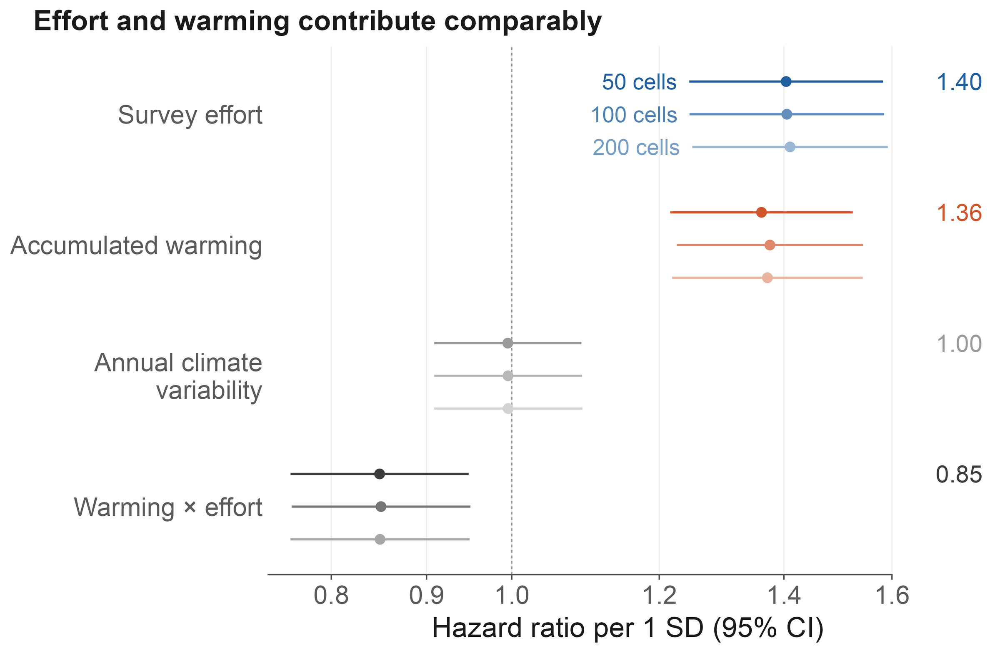
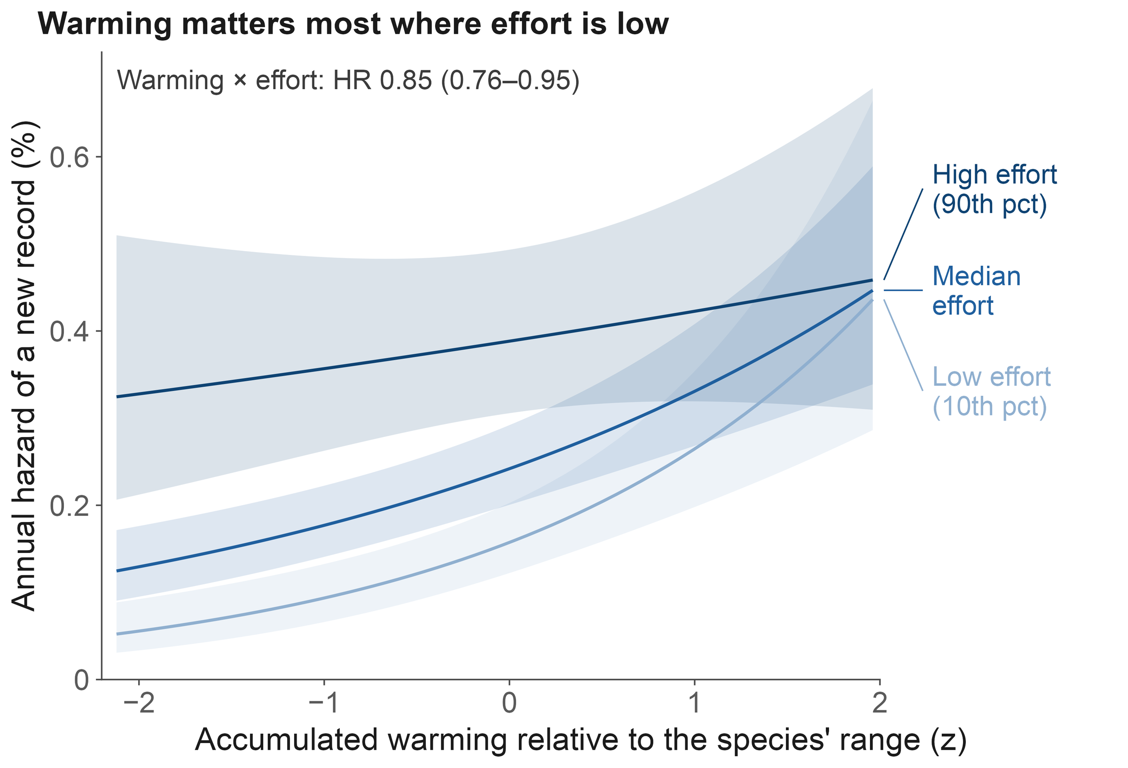
Background
Research gaps
Questions
Approach
Results
Synthesis
Finding 1
Warming and survey effort contribute comparably, and they interact
Fig. 1a Hazard ratio per SD, three SDM thresholds
Fig. 1b Effect of warming at three effort levels
Accumulated warming
Survey effort
Warming × effort
Annual variability
1.36
1.40
0.85
1.00
HR per SD (1.22–1.52)
HR per SD (1.25–1.58)
steepest where few look
no effect (0.91–1.09)
Ding, Zhang, Jiang & Wang · AOC 2026, Singapore
08
Notes:
[about 40 s]
First finding. Warming and survey effort contribute about equally: a hazard ratio of 1.36 per standard deviation for warming, and 1.40 for effort. And they interact negatively. On the right you can see what that means: where few people are looking, the warming curve is steep; where many people are looking, it flattens out. Annual climate variability has no effect at all. So the answer to question one is yes, and to question three, the interaction is negative, as we expected.
If asked: How big is the warming effect, really? A permutation null puts the baseline at 1.16, so the species-specific increment is about ×1.18 per SD.
If asked: What does 1 SD of warming mean? 0.18 °C of species-referenced accumulated warming.

Slide 9
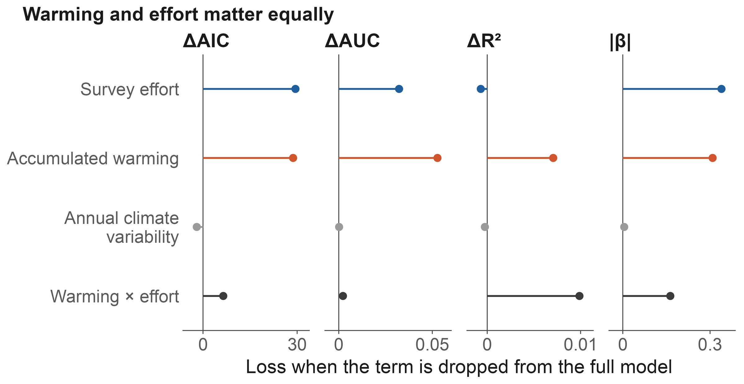
Background
Research gaps
Questions
Approach
Results
Synthesis
Finding 1
The balance holds across four criteria and twelve specifications
Cost of dropping a term
ΔAIC: warming 28.7, effort 29.5
ΔAUC: warming 0.053, effort 0.032
Conditional R² and |β| agree
Twelve specifications
SDM thresholds 50, 100, 200
4 effort proxies × 3 missing-data rules
Effort 1.25–1.52; warming 1.35–1.37
Fig. 1c Four criteria of importance
Design-preserving nulls
Warming null 1.16: increment ×1.18
Warming and effort carry comparable weight
Shuffled effort timing: 0.98
under all four criteria
Province bootstrap: lower bounds > 1
Ding, Zhang, Jiang & Wang · AOC 2026, Singapore
09
Notes:
[about 30 s] [optional: can be cut]
This balance is not fragile. Drop either term and the model loses about the same, around 29 AIC units each. Across twelve specifications, with different distribution-model thresholds, effort proxies and missing-data rules, the numbers stay put. And against design-preserving nulls, both effects stand: the warming increment over its null is about 1.18, and effort collapses to 0.98 if we break its timing.

Slide 10
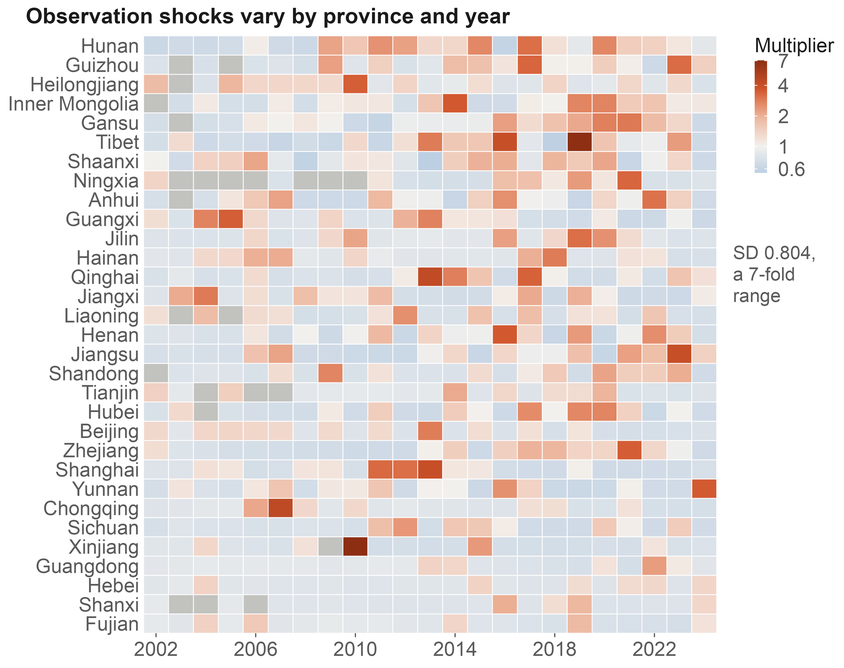
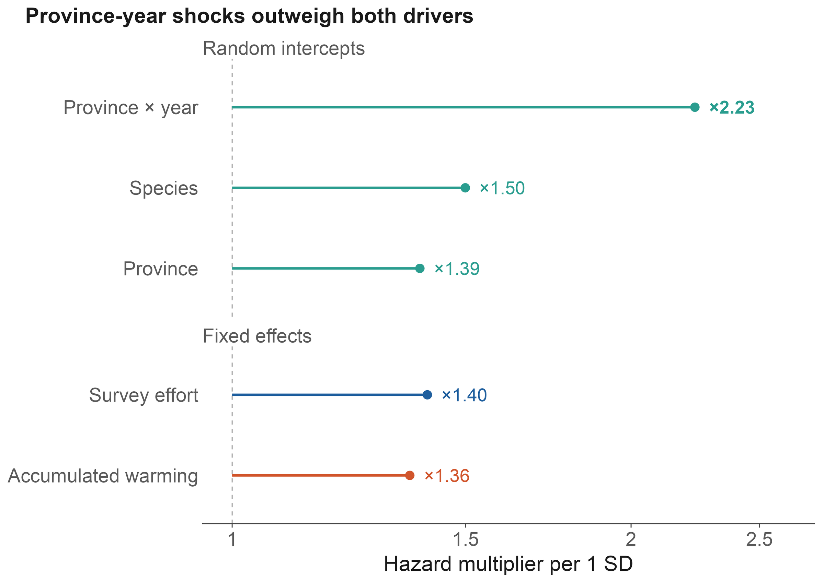
Background
Research gaps
Questions
Approach
Results
Synthesis
Finding 2
Survey pulses are the largest source of variation in the hazard
Fig. 5c Province × year multipliers
Fig. 4d Hazard multiplier per SD, all terms
Province × year
Species
Province
Conditional AUC
×2.23
×1.50
×1.39
0.72 → 0.85
per SD: survey pulses
intrinsic detectability
regional baseline
adding province × year
Ding, Zhang, Jiang & Wang · AOC 2026, Singapore
10
Notes:
[about 35 s]
Second finding. The biggest single component is not a driver at all. It is the province-by-year effect: one standard deviation multiplies the hazard by 2.23, more than warming or effort. This is where a provincial bird survey, a big birding event or a new reserve shows up. Adding this layer lifts conditional AUC from 0.72 to 0.85, and leaves the fixed effects unchanged. Treat it as noise, and survey history reads as range change.
If asked: Could the province-by-year effect absorb climate anomalies too? Partly; that protects the fixed effects at some cost in climatic signal, and we say so in the paper.

Slide 11
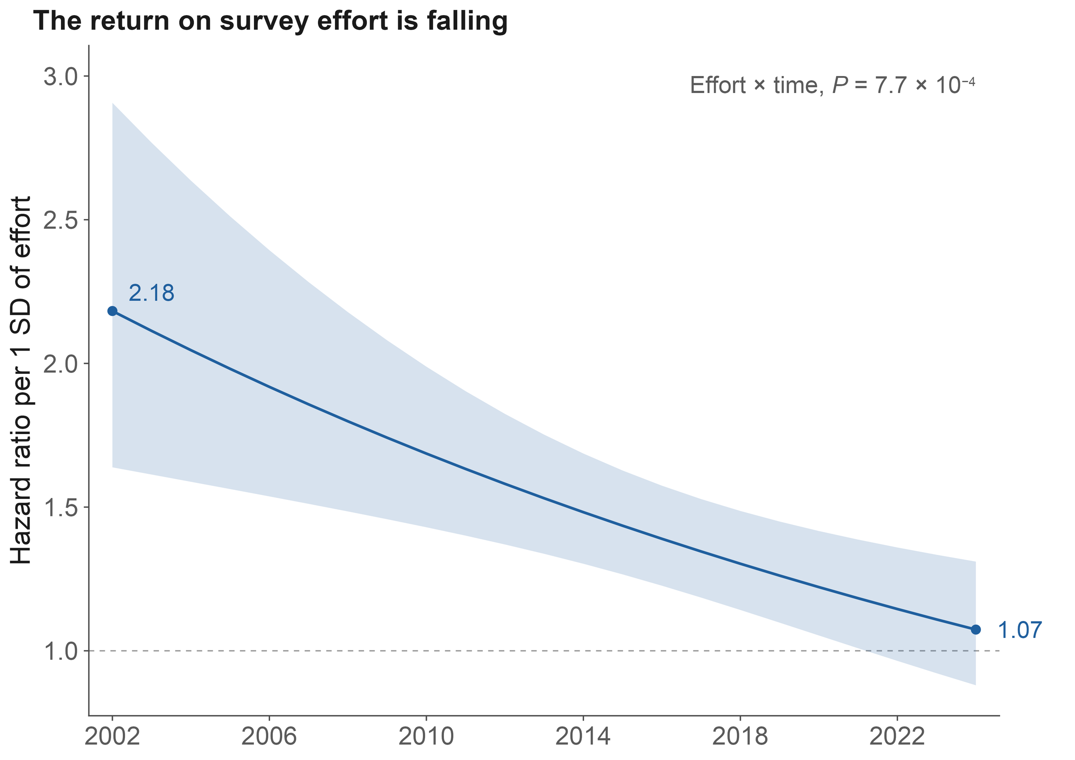
Background
Research gaps
Questions
Approach
Results
Synthesis
Finding 3
The return on effort is falling; the return on warming is not
Return on effort
2.18 → 1.07
HR per SD, 2002 → 2024; P = 0.00077
Return on warming
P = 0.82
warming × time: no trend; HR 1.37
A stock and a flow
Effort mines a finite stock
of undocumented occurrences;
warming keeps adding
new candidates
Fig. 5d Effort hazard ratio by year
Ding, Zhang, Jiang & Wang · AOC 2026, Singapore
11
Notes:
[about 40 s]
Third finding. Effort is saturating. Its hazard ratio fell from 2.2 in 2002 to about 1.1 in 2024, and after 2022 it is no longer different from one. The easy gaps have been filled. Warming shows no such trend. One way to read this is a stock and a flow: effort mines a finite stock of undocumented occurrences, while warming keeps adding new candidates. We haven't tested the two trends against each other, so I'd call it consistent, not proven.

Slide 12
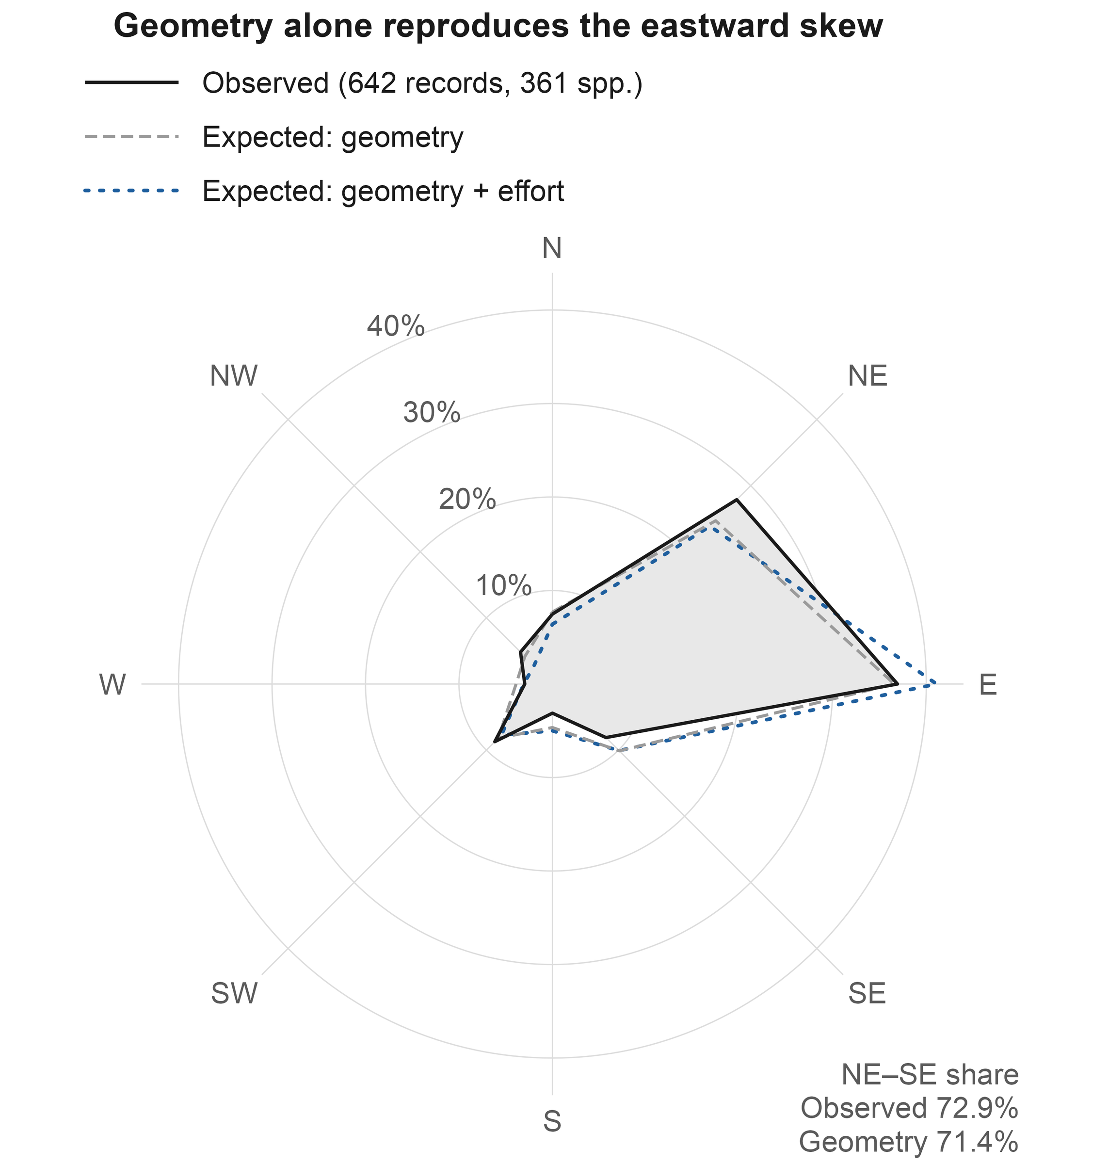
Background
Research gaps
Questions
Approach
Results
Synthesis
Finding 4
The eastward bias is geometry; net of it, records lean slightly north
Raw bearings, 642 records
East 36.9%, north-east 27.9%
China lies east of most ranges
Null 1: geometry only
East: 235 expected, 237 observed
No sector departs from the null
Null 2: geometry + birders
Northern sectors: 40.2% vs 33.0%
χ² = 25.8, P = 0.001
A modest poleward lean
Fig. 6a Observed vs null sectors
Ding, Zhang, Jiang & Wang · AOC 2026, Singapore
12
Notes:
[about 40 s] [optional: can be cut]
Fourth: direction. Measured from each species' range centre, new records look strongly biased to the east. But most of these species have ranges centred west or south of China, so almost any record inside China lands to the east. If we place each record at random among its species' possible provinces, geography alone reproduces the eastward pattern. Only when we also weight provinces by where birders go does a signal remain, and it points north: a modest poleward lean, visible only with the right null.

Slide 13
Background
Research gaps
Questions
Approach
Results
Synthesis
Application
Records inside reserves track observation, not reserve performance
Share inside the 1,028 mapped reserves
Few reserves carry the signal
New records
26.2%
172 events in 68 reserves
The top two hold 27.3% of them
Birding effort (checklists)
10.8%
Without them: OR 1.16
Land area
10.4%
Odds ratio against 200 matched controls
Only after birding boomed
Controls from the same province and year, weighted by checklists; 95% CI
2002–2012: OR 0.97
Matched on place and year
1.71 (1.39–2.11)
2013–2023: OR 2.05
24% more species per visit inside
+ elevation, longitude, climate
1.57 (1.26–1.96)
Without the 2 largest reserves
1.16 (0.92–1.47)
2002–2012 only
0.97 (0.62–1.50)
2013–2023 only
2.05 (1.61–2.59)
Record counts should not
index reserve performance
0.5
1
2
3
Ding, Zhang, Jiang & Wang · AOC 2026, Singapore
13
Notes:
[about 55 s] [optional: can be cut]
A first use. Nature reserves look like hot spots for new records: twenty-six percent of records fall inside reserves that cover ten percent of the land, a two-and-a-half-fold enrichment. Birding effort is not concentrated there, and matching each record to two hundred control locations that birders visited in the same province and year reduces the enrichment to an odds ratio of 1.7, or 1.6 with environmental covariates. But that residual rests on two reserves; without them it is 1.16. It appears only after birding boomed in 2013, and checklists inside reserves record a quarter more species per visit, an observation bias we cannot condition out. So record counts should not be used to judge how well reserves work.

Slide 14
Background
Research gaps
Questions
Approach
Results
Synthesis
Futures
Future record counts follow survey effort, not the emission scenario
Expected new records per year, China
SSP2-4.5
SSP5-8.5
Two climate × two effort scenarios
SSP2-4.5 or SSP5-8.5
Effort frozen, or still growing
61.9
60
57.4
What changes the count?
40
Climate scenario: barely anything
Growing effort: more than double
26.8
26.5
23.2
23.1
23.6
23.7
20
Most of that rise lies
0
outside the fitted data
2030
2030
2050
2050
(faded bars: 2% in support)
frozen effort
growing effort
frozen effort
growing effort
51–55% in support
34–37% in support
40–44% in support
2% in support
Ding, Zhang, Jiang & Wang · AOC 2026, Singapore
14
Notes:
[about 35 s]
What about the future? We crossed two climate scenarios with two effort scenarios. Switching from SSP2-4.5 to SSP5-8.5 changes the expected national count from 23.2 to 23.1 records a year: essentially nothing. If effort keeps growing, the count more than doubles by 2050. What we will record depends on how we look, more than on how the climate changes. But most of that increase lies outside the data we fitted.
If asked: Is 57 to 62 records a year a forecast? No. At 2050 only 2 percent of cells are inside the fitted support; the credible statement is about 23 to 27 records a year in 2030, under any scenario.

Slide 15
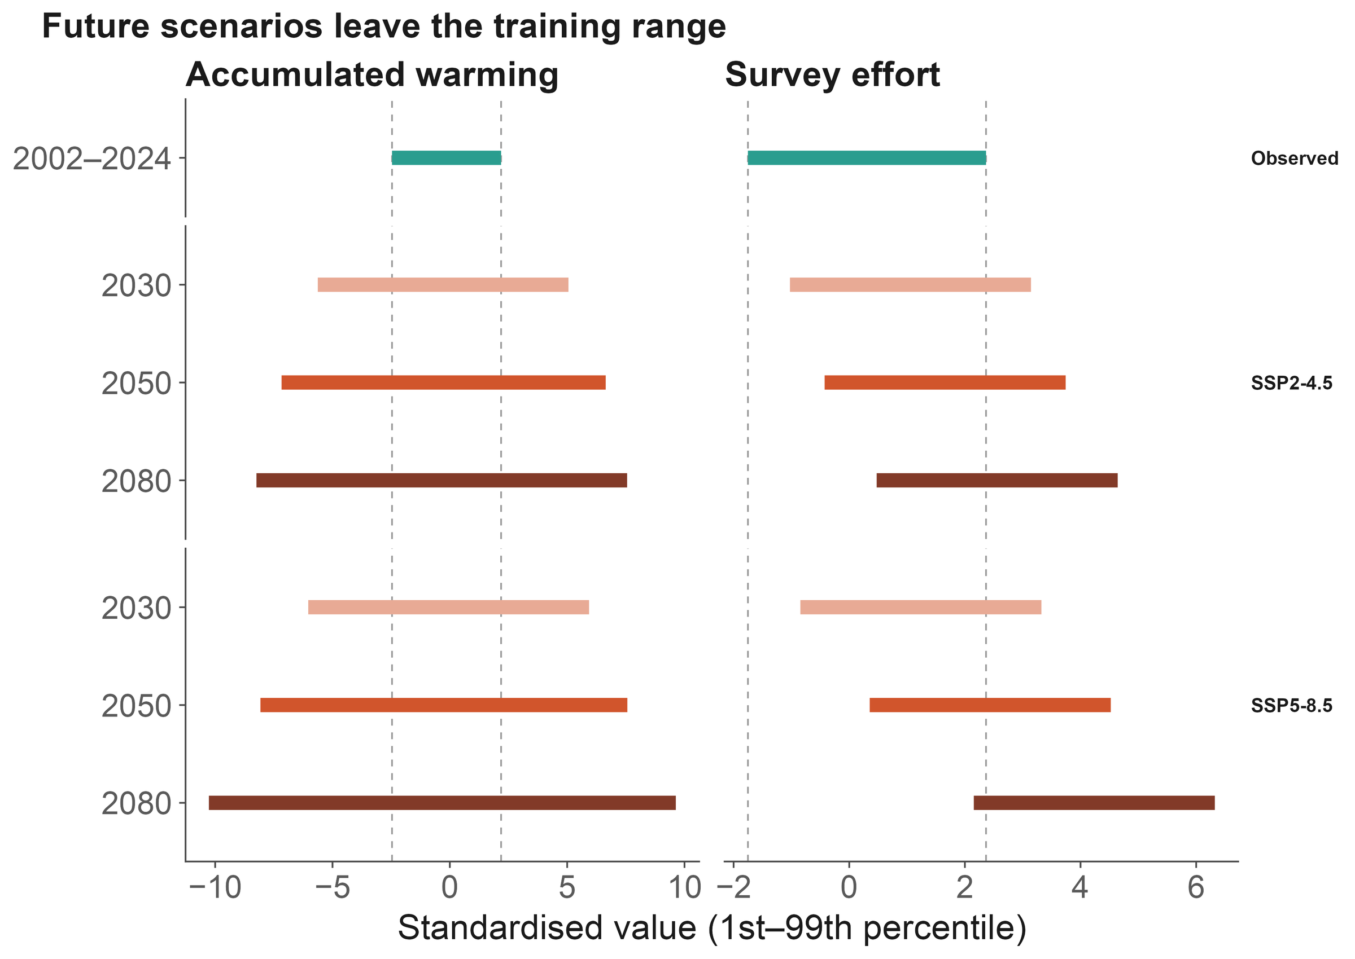
Background
Research gaps
Questions
Approach
Results
Synthesis
Futures
Data support, not ambition, sets the forecast horizon
Support shrinks fast
Cells inside the fitted range:
2030: 48% → 2050: 10%
2080: 2% (SSP2-4.5)
Machine learning does not help
Agree inside the range (ρ = 0.54)
Diverge outside it
2030: usable
End of century:
Fig. 7b Hazard model vs machine learning
illustration, not forecast
Ding, Zhang, Jiang & Wang · AOC 2026, Singapore
15
Notes:
[about 30 s] [optional: can be cut]
So our rule is simple: report where the model breaks. Under SSP2-4.5, the share of species-province combinations inside the fitted range drops from 48 percent in 2030, to 10 percent in 2050, and 2 percent by 2080. Machine learning does not rescue it: inside the range the two model families agree, outside it they diverge. So 2030 is usable; end-of-century maps are illustrations, not forecasts.

Slide 16
Background
Research gaps
Questions
Approach
Results
Synthesis
Limits
Four limits travel with these conclusions
Events are published records, not detections
We explain how records are documented, not range expansion itself.
Coordinates are precise to about 1 km at best
Reserve-overlap tests therefore use 0–5 km buffers as a sensitivity check.
Reserve polygons cover about a third of listed reserves
1,028 mapped reserves: no gap analysis, no 30×30 claims.
Projections leave the fitted support after 2030
Late-century maps are illustrations; the effort coefficient used is an upper bound.
Ding, Zhang, Jiang & Wang · AOC 2026, Singapore
16
Notes:
[about 25 s] [optional: can be cut]
Four limits travel with these results. Our events are published records, not detections, so we explain how records get documented, not how ranges expand. Coordinates are precise to about a kilometre at best. Our reserve map covers about a third of listed reserves. And projections leave the data after 2030, so late-century maps are illustrations.

Slide 17
Background
Research gaps
Questions
Approach
Results
Synthesis
Summary
Warming and survey effort leave signals of similar size
New records carry a climate signal mixed with an observation signal
01
02
03
04
Climate signal
Where few look
Observation process
Futures
Warming 1.36 vs
Warming × effort 0.85:
Province × year ×2.23;
Emission scenario barely
effort 1.40 per SD:
under-surveyed regions
returns on effort
matters; most change
comparable, separable
hide the signal
2.18 → 1.07
is extrapolation
Implications
Send survey effort to climatically exposed, under-surveyed regions
Read counts of new records as observation-weighted evidence, not as range shifts
Report where a model leaves its data support before mapping the future
Birds or birders? Both. Model how we look, and new records tell us how ranges change
Ding, Zhang, Jiang & Wang · AOC 2026, Singapore
17
Notes:
[about 50 s]
To sum up, four points. One: new records carry a climate signal; warming and survey effort contribute comparably, 1.36 against 1.40 per standard deviation, and one model can separate them. Two: warming matters most where few people are looking. Three: the observation process is the largest single component, and the return on effort is falling. Four: future record counts depend on how we look, and most projected change is extrapolation. For monitoring, send effort to climatically exposed, under-surveyed regions; that is where new records carry the most climate information. Birds or birders? Both. Model how we look, and the records tell us how ranges change.

Slide 18

Co-authors
Chenchen Ding
Institute of Ecology, College of Urban and Environmental Sciences, Peking University
Zhengwang Zhang
School of Life Sciences, Beijing Normal University
Zhigang Jiang
Institute of Zoology, Chinese Academy of Sciences
Zhiheng Wang
Thank you
Institute of Ecology, College of Urban and Environmental Sciences, Peking University
Questions welcome
Open data and code
CBNR v2 (CC BY 4.0) · doi.org/10.5281/zenodo.20809949
chenchen.ding@pku.edu.cn
github.com/dingchenchen6/bird-newrecord-discovery-dated
Climate: WorldClim 2.1 / CRU TS 4.09 · Ranges: BirdLife International
CBNR data
Effort: eBird/GBIF and China Bird Report · Base map: GS(2019)1822
We thank birdwatchers across China, and every author
whose records made CBNR possible.
Notes:
[about 25 s]
Everything is open: the CBNR data on Zenodo, and all of the analysis code on GitHub, where every number in this talk traces back to a table. My thanks to my co-authors, to birdwatchers across China, and to every author whose records made this possible. Thank you. I'm happy to take your questions.

Slide 19
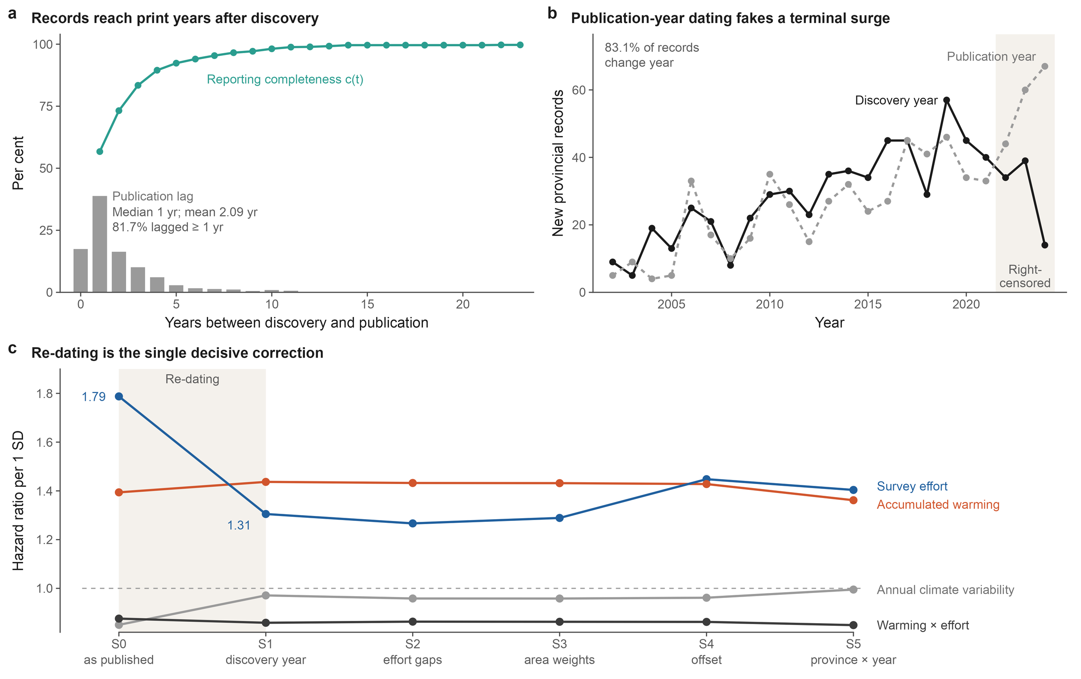
Background
Research gaps
Questions
Approach
Results
Synthesis
Backup
Dating to publication inflates effort and creates a phantom climate effect
Fig. 2 Discovery vs publication dating
Ding, Zhang, Jiang & Wang · AOC 2026, Singapore
19
Notes:
[about 25 s]
If asked about dating. Dated to publication year, as most compilations do, the effort hazard ratio is 1.79 instead of 1.31, inflated by 37 percent, and an annual climate-variability effect appears at 0.85 with P below 0.001. Dated to discovery it vanishes, and warming barely moves. Publication lags discovery by about two years.

Slide 20
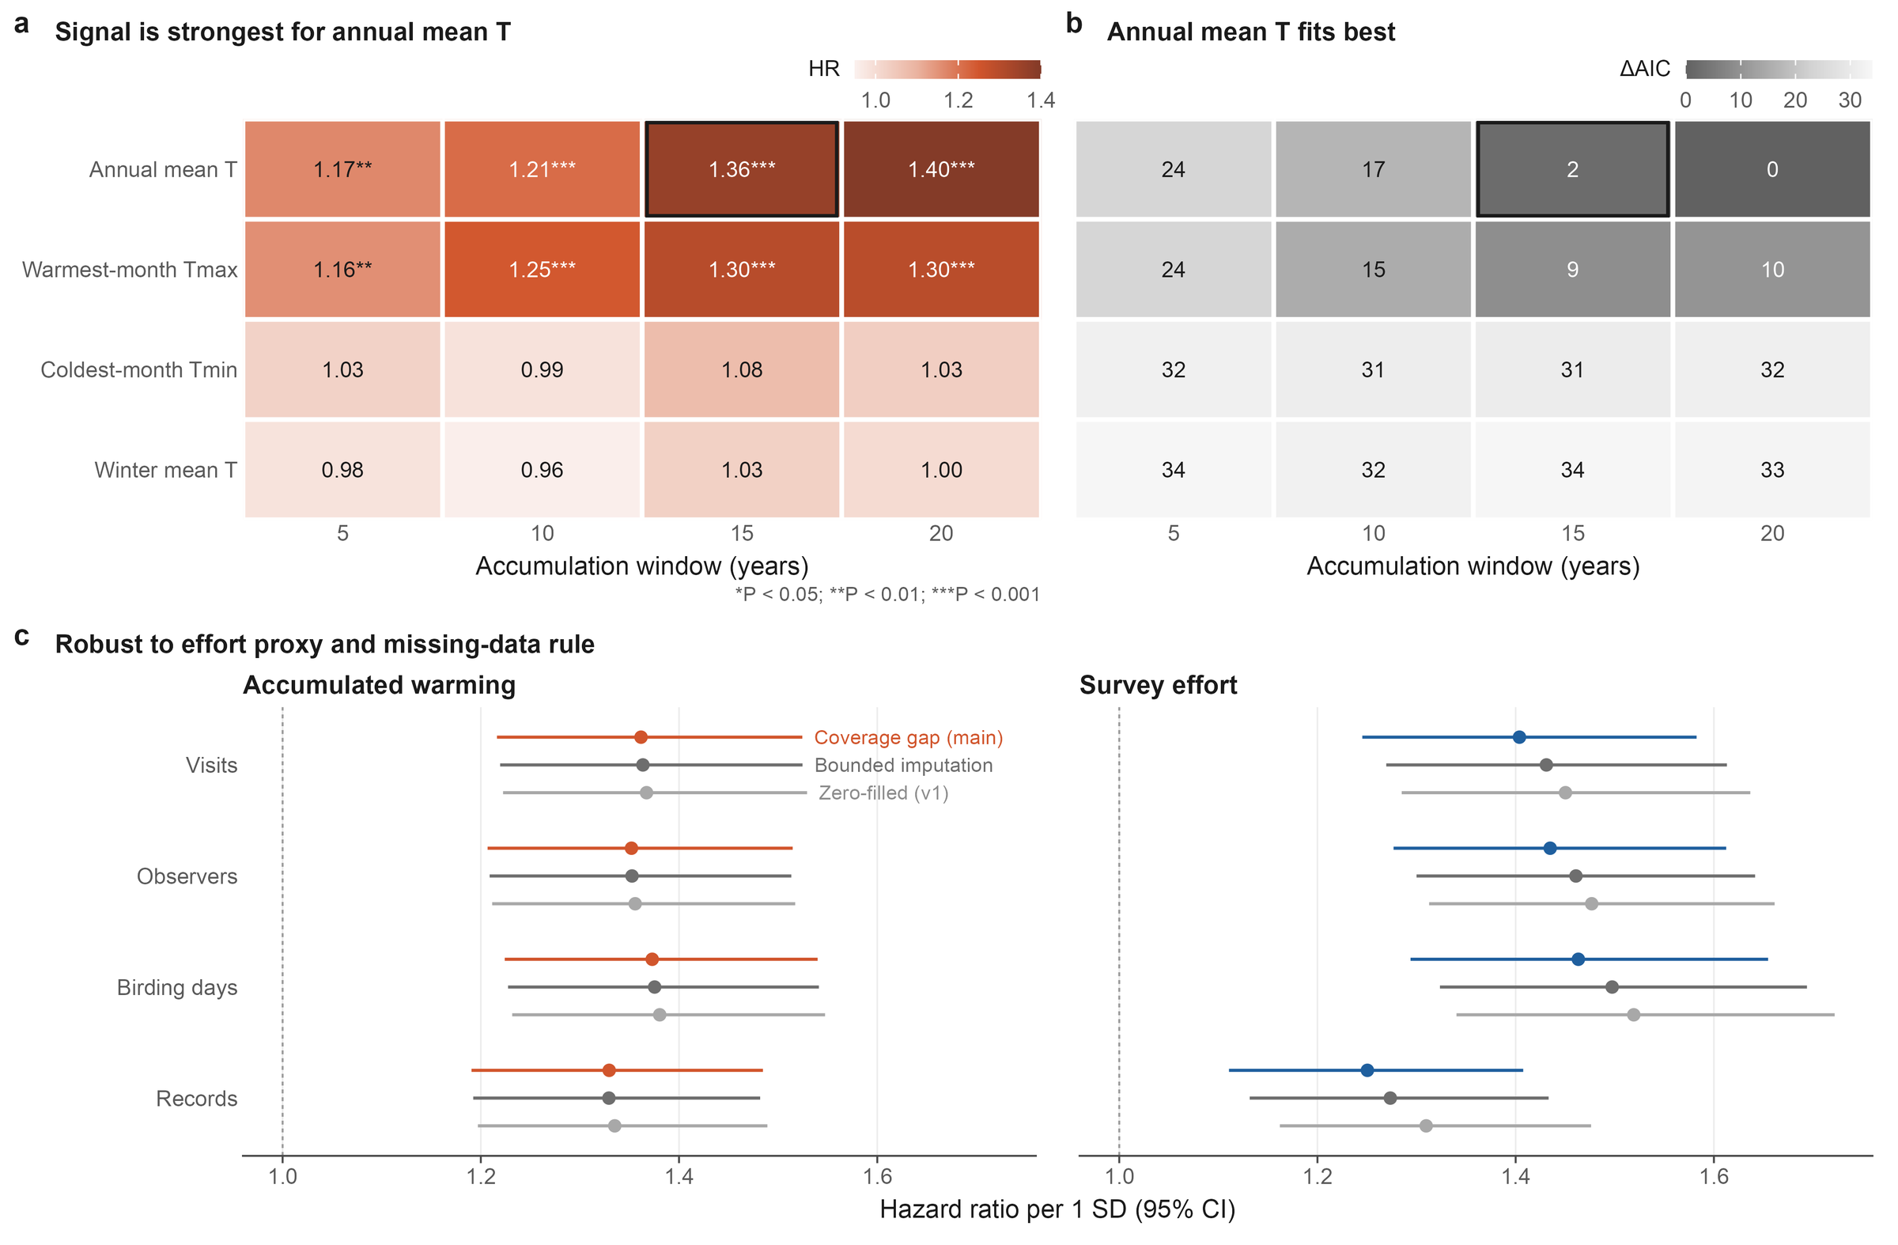
Background
Research gaps
Questions
Approach
Results
Synthesis
Backup
Specification robustness: climate indicator, window and effort proxy
Fig. 3 Specification grid
Ding, Zhang, Jiang & Wang · AOC 2026, Singapore
20
Notes:
[about 15 s]
If asked about specifications: the signal is strongest for annual mean temperature over 15 to 20 years, and the coefficients are stable across effort proxies and missing-data rules.

Slide 21
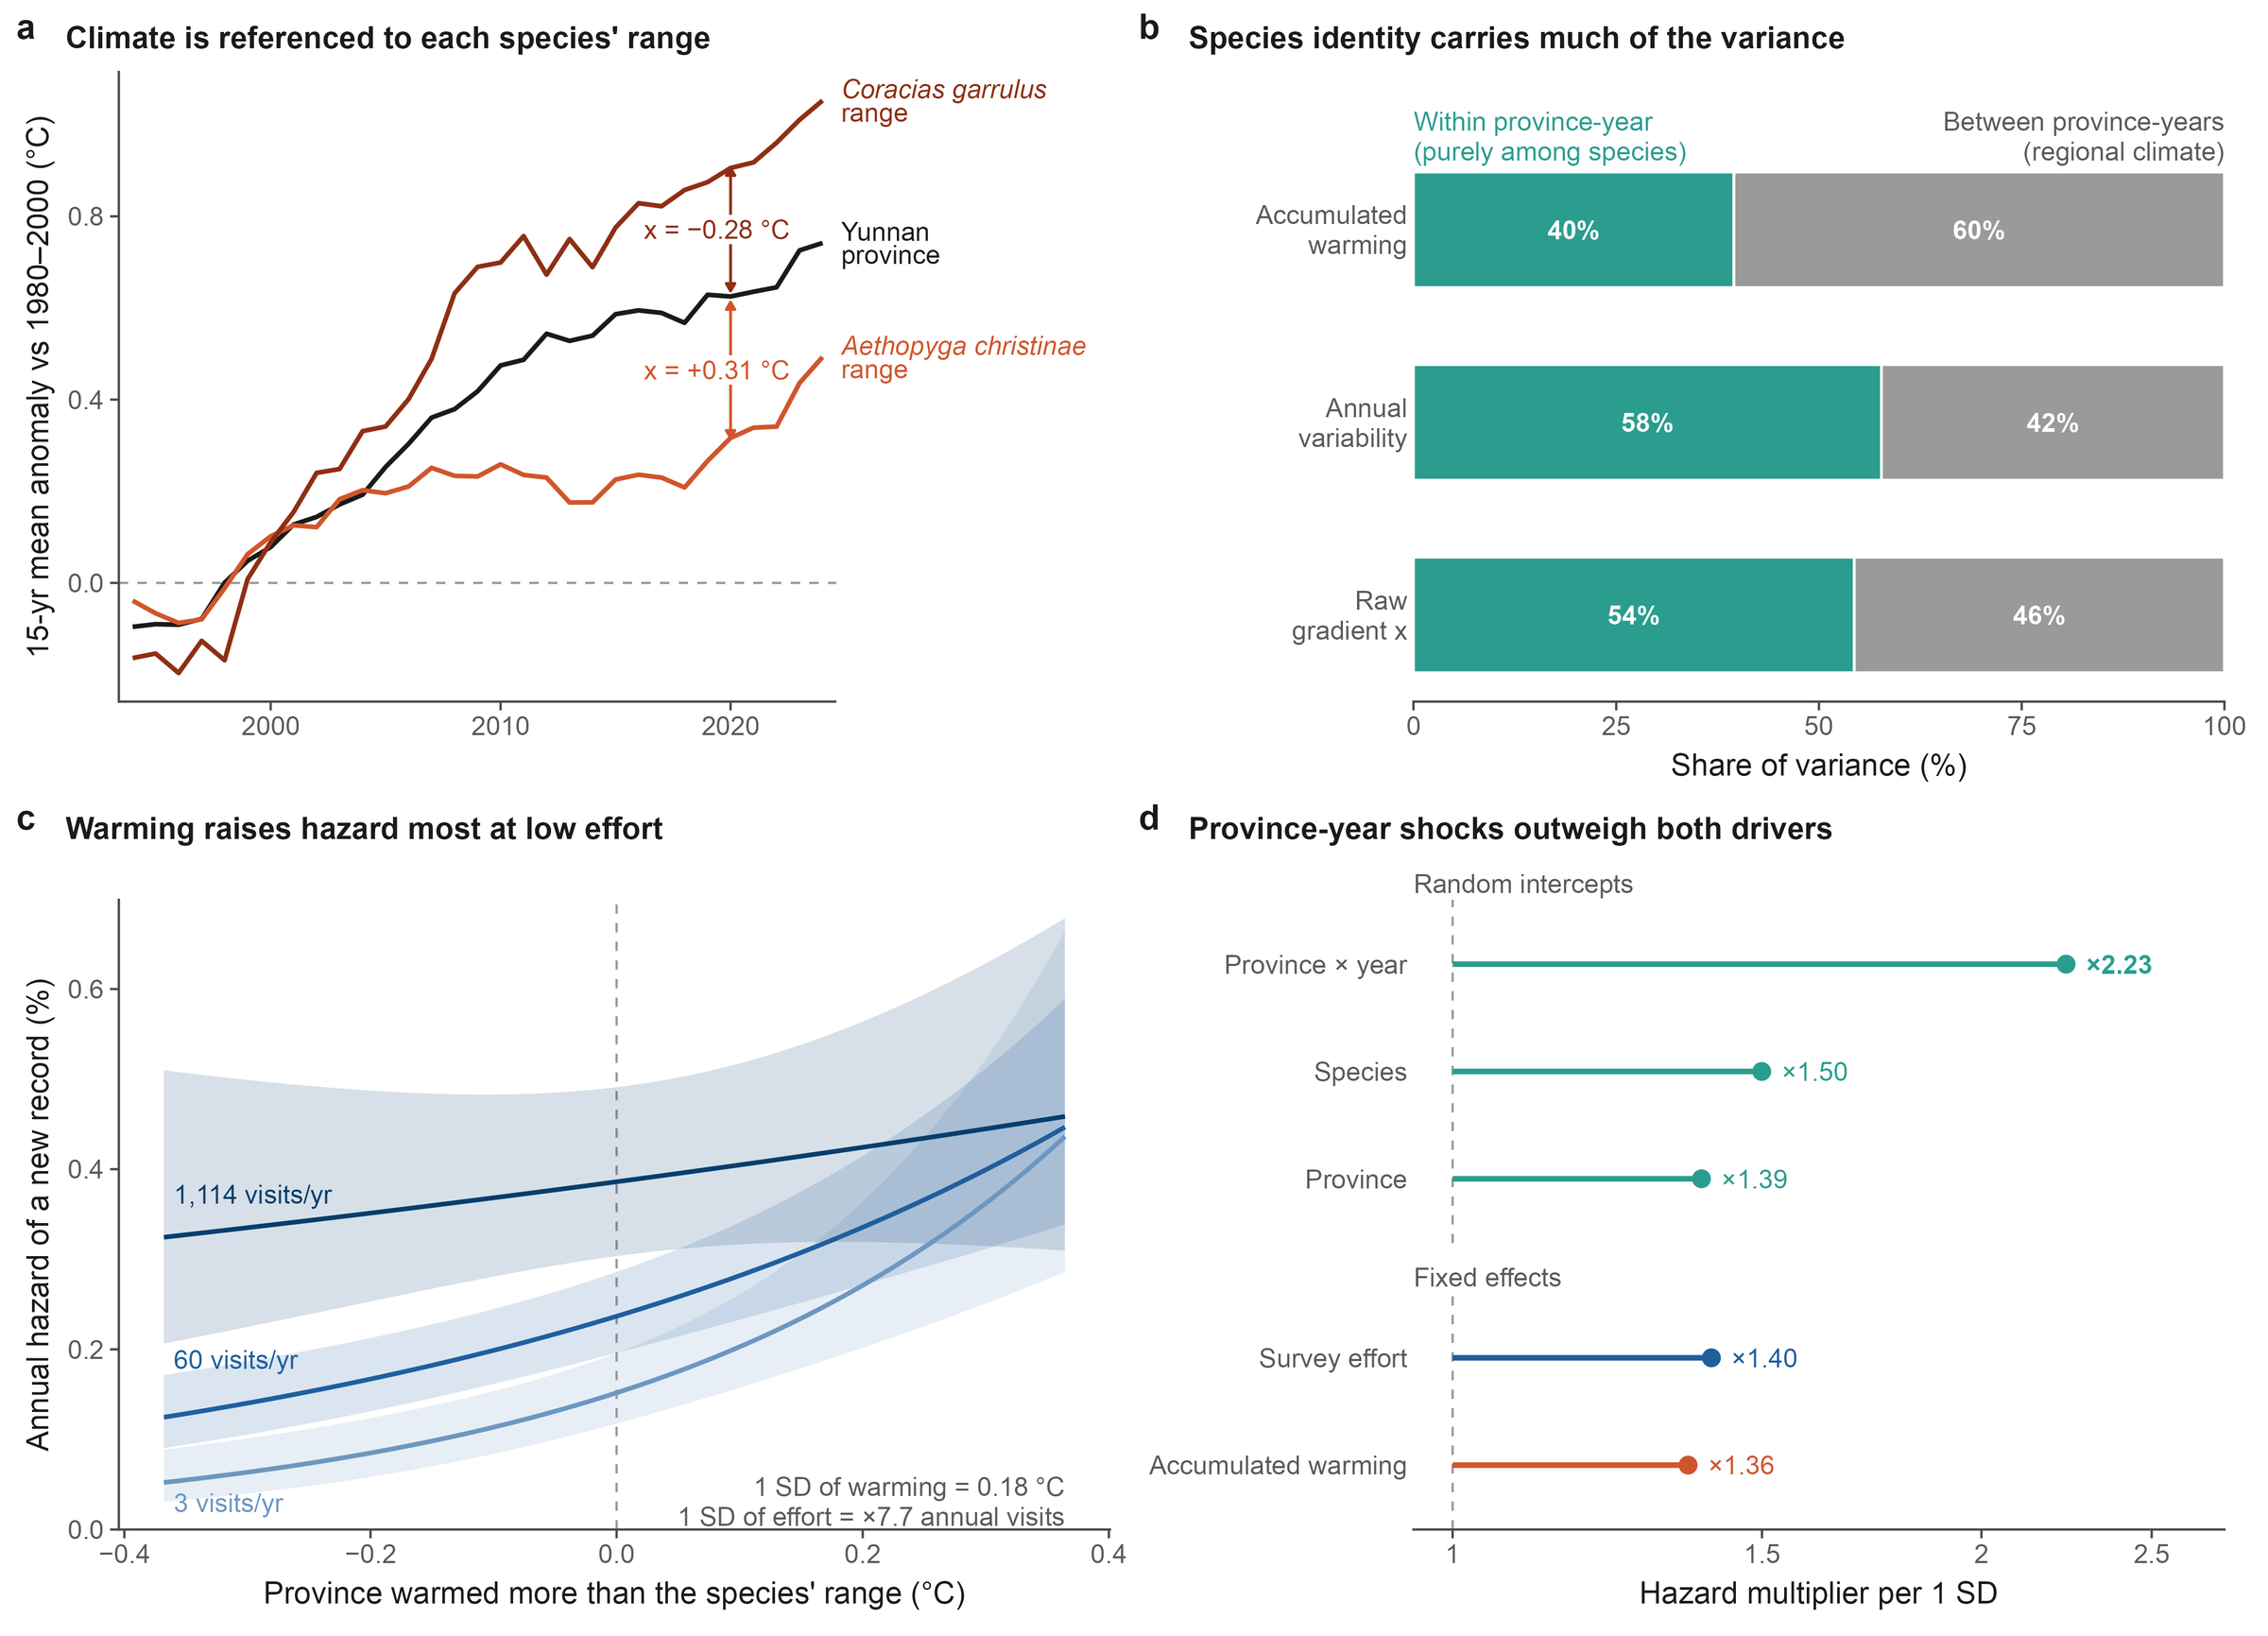
Background
Research gaps
Questions
Approach
Results
Synthesis
Backup
Model anatomy: climate referenced to each species' range
Fig. 4 Model anatomy
Ding, Zhang, Jiang & Wang · AOC 2026, Singapore
21
Notes:
[about 15 s]
If asked how warming is measured: the same province in the same year can warm more or less than a given species' range; that species-specific difference is the climate covariate.

Slide 22
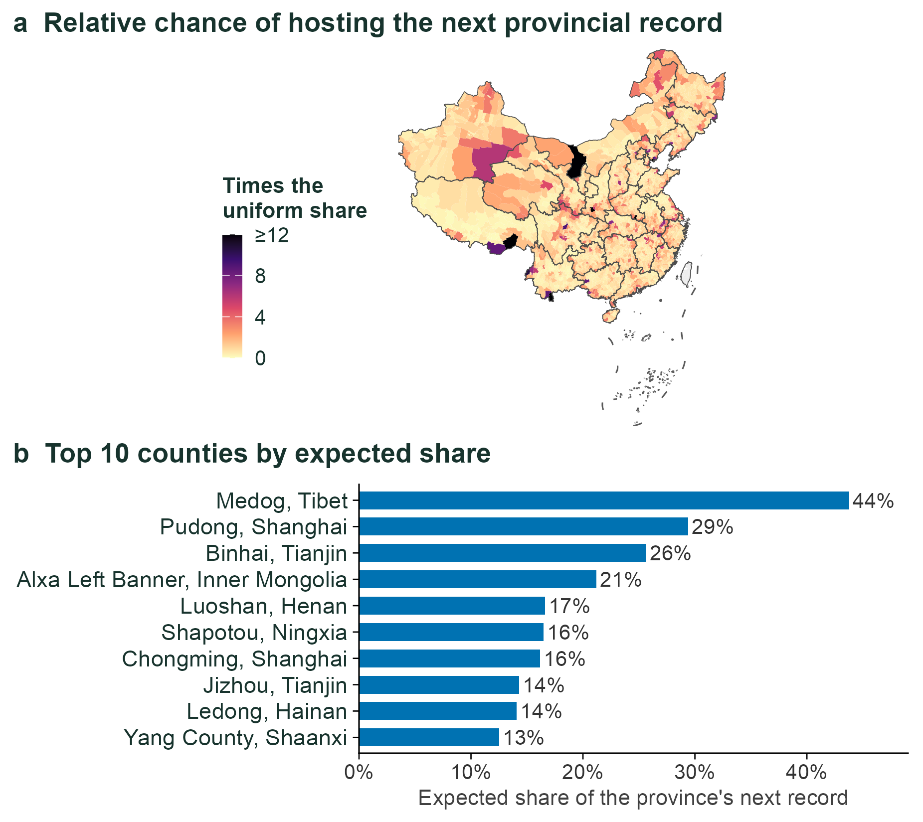
Background
Research gaps
Questions
Approach
Results
Synthesis
Backup
County-level surfaces: where to look first
Repository module County-level expected records, 2024
Ding, Zhang, Jiang & Wang · AOC 2026, Singapore
22
Notes:
[about 20 s]
If asked about finer scales: we split the problem into whether a province gets a new record and, if so, which county. Tested on 2019 to 2024, the top-ranked county was right 16 percent of the time, against about 1 percent by chance.

