Slide 1


AOC 2026
Singapore
Disentangling climate signals from survey effort
in new bird distribution records across China
Birds or birders? A discrete-time hazard model of first records, 2002–2024
Chenchen Ding¹, Zhengwang Zhang², Zhigang Jiang³, Zhiheng Wang¹
¹ Peking University ² Beijing Normal University ³ Institute of Zoology, Chinese Academy of Sciences
3rd Asian Ornithological Conference · National University of Singapore · 14–17 November 2026
Notes:
[about 30 s]
Good morning, everyone. I'm Chenchen Ding, from Peking University. Today I'd like to ask a simple question about new bird records. When a species turns up in a new province, is that the bird moving, or is it us looking harder? Our answer is: both, in roughly equal measure, and I'll show you how a single model can tell the two apart.

Slide 2
Background
Research gaps
Questions
Approach
Results
Synthesis
Background
Knowing where species occur underpins ecology, yet that knowledge is incomplete
Distribution data are the foundation
Biases accumulate at four stages
Biogeography, macroecology and conservation
all start from where species occur
Field survey
1
Whittaker et al. 2005; Jetz et al. 2012; Pimm et al. 2014
uneven expertise, funding and access
The Wallacean shortfall
2
Detection
Where species occur is incompletely known,
detectability, effort and survey method
and unevenly so across taxa, regions and time
Lomolino 2004; Hortal et al. 2015
3
Documentation
local journals, other languages, old taxonomy
Range maps can mislead
Outdated records stay; validated populations
4
Data sharing
in poorly surveyed places are missed
slow, partial entry into GBIF, IUCN, BirdLife
Herkt et al. 2017; Hughes et al. 2021
Boakes et al. 2010; Meyer et al. 2015; Oliver et al. 2021
Biases in how we look can be mistaken for patterns in nature
Ding, Zhang, Jiang & Wang · AOC 2026, Singapore
02
Notes:
[about 45 s]
Let me start with a basic fact. Almost everything we do in biogeography and conservation starts from knowing where species occur. And that knowledge is incomplete, and unevenly so. That's the Wallacean shortfall. Even range maps can mislead: they keep old records and miss real populations in places few people visit. The bias builds up step by step: who goes into the field, what they detect, whether it gets written up, and whether it ever reaches global databases. At each step, a gap in looking can be mistaken for a gap in nature.

Slide 3
Background
Research gaps
Questions
Approach
Results
Synthesis
Background
China is a key region for bird distributions, but its new records are scattered
Zoogeographic realms
Biodiversity hotspots
Migratory crossroads
Bird species
2
4
Flyways
1,505
Palearctic and Oriental meet
global hotspots within China
several major flyways cross it
about 14% of the world's birds
Zhang 2011; Mittermeier et al. 2011; Zheng 2023
Monitoring has expanded fast
But the evidence is scattered
National networks such as Sino BON
Chinese-language papers and local reports
Citizen science and camera traps
Mixed taxonomy, few coordinates
Sound recording and DNA identification
Largely absent from global databases
Feng et al. 2019; Huang et al. 2021; Mi et al. 2021
Xing et al. 2024; Chen et al. 2025
Gap: no standardized, open dataset of provincial new bird records in China
So we built one: CBNR, the China Bird New Record dataset
Ding, Zhang, Jiang & Wang · AOC 2026, Singapore
03
Notes:
[about 35 s]
China is a good place to study this. Two zoogeographic realms meet here, there are four biodiversity hotspots, several flyways, and about fifteen hundred bird species, some fourteen percent of the world's birds. Monitoring has grown fast, with national networks, citizen science, camera traps and sound recorders. But most new records are still scattered in Chinese-language papers and local reports, and many never reach global databases. There was no standardized dataset of them. So we built one: CBNR.

Slide 4
Background
Research gaps
Questions
Approach
Results
Synthesis
Background
A new record is the last link in a chain of three events
Provincial new record: the first verified occurrence of a known species
in a province where it was not reported before
1
The bird is there
2
Someone looks
3
The find is published
Climate, land use or
More surveys, better
The detection is written
New
vagrancy can move
access and new methods
up and dated in a
record
a species in
find what was missed
paper or report
Ecological process
Observation process
Documentation
Only this link is ecological
These two leave the same trace in the data
Two opposite errors: reading every record as a range shift, or dismissing all as sampling noise
Chen et al. 2011; Pecl et al. 2017; Lawlor et al. 2024; Lahoz-Monfort & Magrath 2021; Sanczuk et al. 2026
Ding, Zhang, Jiang & Wang · AOC 2026, Singapore
04
Notes:
[about 45 s]
So what is a new record? It's the first verified occurrence of a species in a province where it wasn't known before. But a record is not a direct observation of movement. It's the last link in a chain: the bird is there, someone looks and finds it, and the find is published. Only the first link is ecology. The other two leave exactly the same trace in the data. So there are two opposite mistakes we can make: read every record as a range shift, or dismiss them all as sampling noise.
If asked: Is this specific to China? No; the chain applies to any dated compilation of first records.

Slide 5
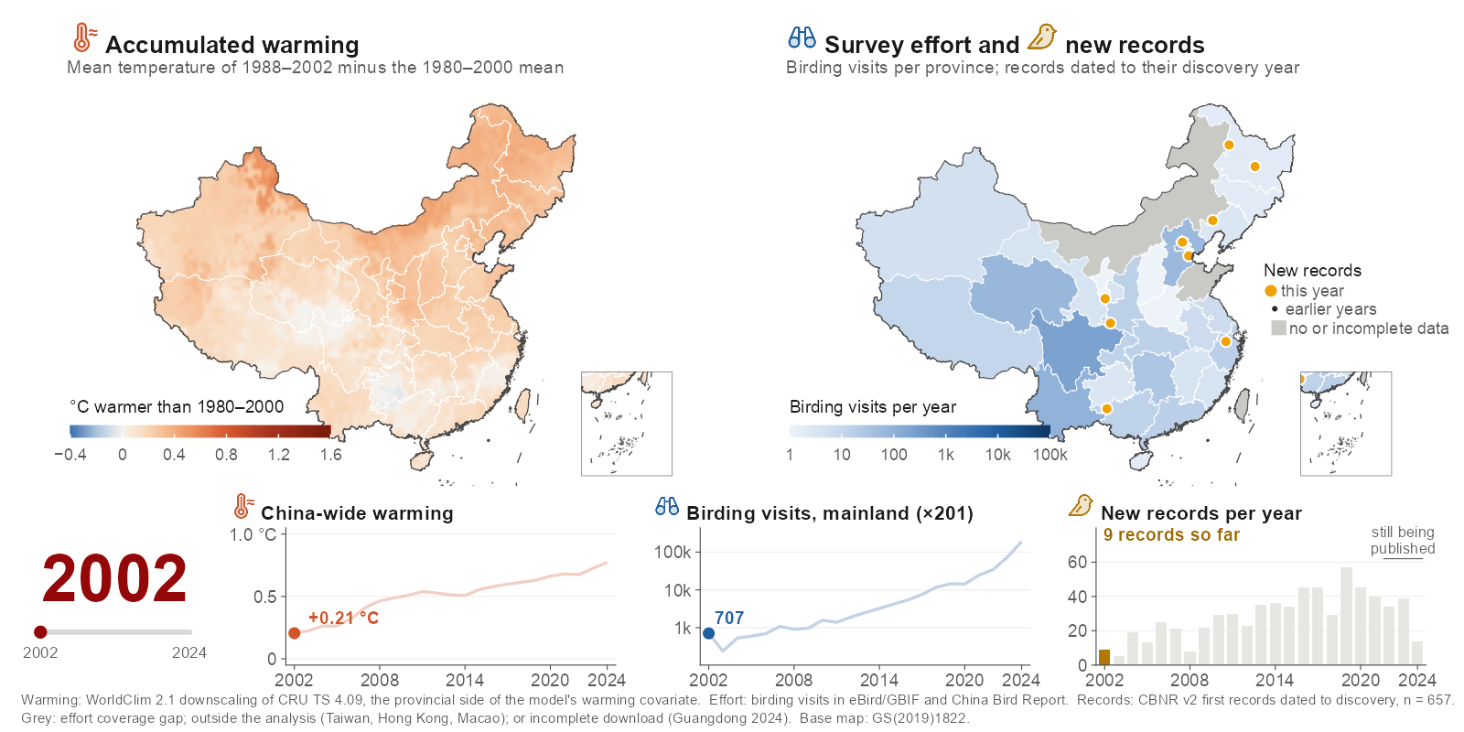
Background
Research gaps
Questions
Approach
Results
Synthesis
Background
After 2002, warming, birding and new records all rose together
Ding, Zhang, Jiang & Wang · AOC 2026, Singapore
05
Notes:
[about 35 s]
This is why the question is hard in China. On the left, warming: the country turns red, from about 0.2 degrees in 2002 to almost 0.8 by 2024. On the right, survey effort: birding visits rose about 200-fold and spread inland. The amber dots are new records, appearing in the year they were found. Everything rises together, so a trend in new records can't tell us, on its own, which process is behind it.
If asked: Why is Guangdong grey in 2024? Its China Bird Report records cover only 14 days of that year, so we treat that province-year as missing; eBird checklists for 2024, absent from the first download, were added for every province.
If asked: Is this the warming variable in the model? It is the provincial side; the model uses the difference from the same quantity over each species' range.

Slide 6
Background
Research gaps
Questions
Approach
Results
Synthesis
Research gaps
Analyses of new records have not separated ecology from observation
How source papers explain their records
1
Confounded drivers
CBNR v2, n = 1,029 provincial first records
Warming and observation grew together; a model
GAP
with only one of them credits it with both
Range shift
61.1%
Survey effort, alone or
with range shift
7.3%
2
Unmodelled observation
Not stated
GAP
Survey pulses, and which species could be
31.0%
recorded where, are rarely in the model
Other (e.g. taxonomy)
0.6%
3
No benchmark, no support check
GAP
Warming lacks a null benchmark; projections
Birding visits rose about 200-fold, 2002–04 to 2022–24,
are rarely checked against the fitted data
yet effort is rarely given as the reason
Needed: one model that treats each record as the product of ecology and observation
Ding, Zhang, Jiang & Wang · AOC 2026, Singapore
06
Notes:
[about 30 s]
Here's the gap. When the original papers explain their records, sixty-one percent say range shift, and only seven percent mention survey effort, even though birding grew about 200-fold. Three things haven't been separated: warming and observation grew together; survey pulses are rarely in the model; and warming effects are rarely tested against a benchmark, or projections against the data they came from.
If asked: Where do these percentages come from? From CBNR's 'inferred discovery reason' field, which records the reason given in each source paper; 31% of papers give none.

Slide 7
Background
Research gaps
Questions
Approach
Results
Synthesis
Questions
Four questions, each with a testable expectation
Q1
Does warming raise the rate of new records once observation is modelled?
H1
Yes, beyond the benchmark that shared regional climate alone produces
Q2
How large is the observation process itself?
H2
Province-year survey pulses are the largest source of variation
Q3
Do warming and survey effort interact?
H3
Negatively: where effort is high, species favoured by warming are already recorded
Q4
Are the returns on warming and on effort stable through time?
H4
Returns on effort decline as gaps are filled; returns on warming do not
Ding, Zhang, Jiang & Wang · AOC 2026, Singapore
07
Notes:
[about 50 s]
So we asked four questions. One: does warming raise the rate of new records once observation is modelled, beyond what shared regional climate alone would produce? Two: how large is the observation process itself? We expected province-year survey pulses to be the largest source of variation. Three: do warming and effort interact? We expected a negative interaction, because where effort has long been high, the species that warming favours are already on the list. Four: are the returns stable? We expected the return on effort to decline as the stock of gaps is drawn down, but not the return on warming, which keeps adding new candidates.
If asked: Were these hypotheses pre-specified? H2 to H4 are among the four predictions written down before the robustness analyses; H1 is tested against permutation nulls.

Slide 8
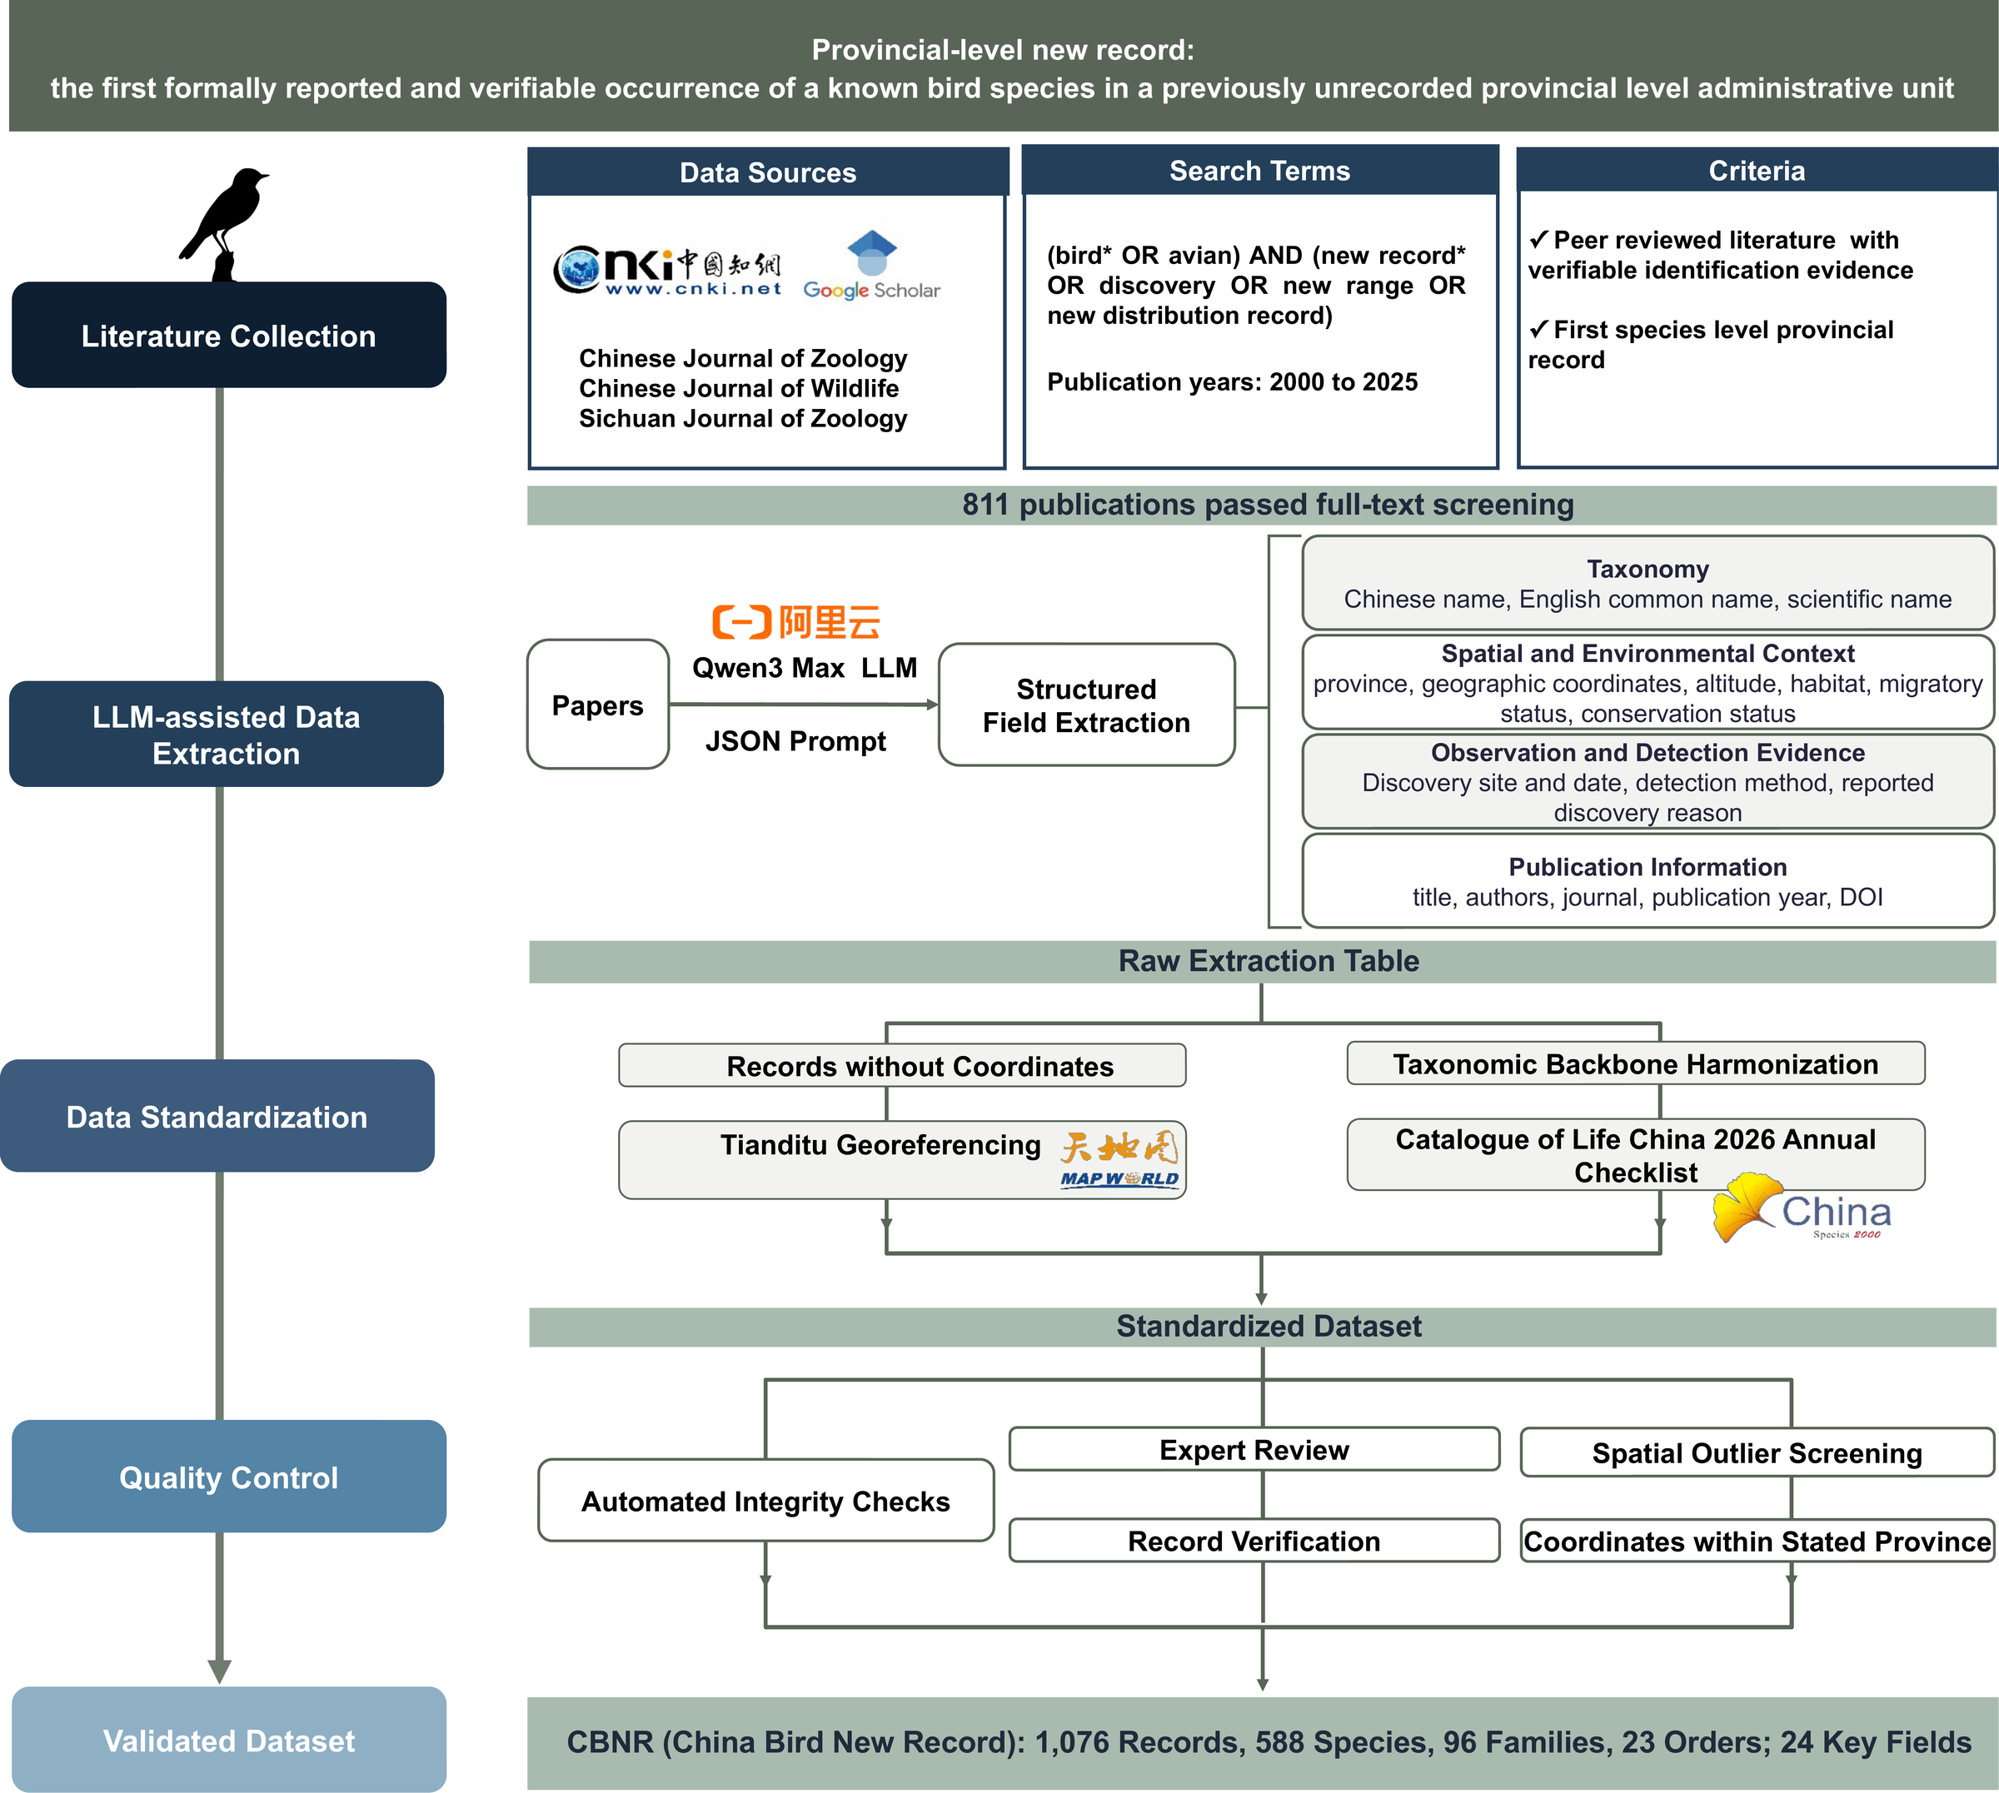
Background
Research gaps
Questions
Approach
Results
Synthesis
Data
CBNR turns 25 years of scattered literature into one auditable dataset
1
Literature
CNKI, Google Scholar and specialist journals, 2000–2025
2
LLM-assisted extraction
Qwen3-Max with a fixed JSON schema
3
Standardization
Tianditu coordinates; Catalogue of Life China 2026
4
Quality control
Integrity checks, expert review, spatial outliers
5
Release
1,076 records · 588 species · 23 orders
797 papers · 33 provinces · 24 key fields
Every curation step logged
CBNR Fig. 1 Technical workflow
Ding, Zhang, Jiang & Wang · AOC 2026, Singapore
08
Notes:
[about 35 s]
Here's how we built it. We searched Chinese and English literature from 2000 to 2025. A large language model pulled each record into a fixed set of fields, and then every record was standardized and checked by hand: coordinates, taxonomy against the 2026 Chinese catalogue, duplicates, and spatial outliers. The result is 1,076 validated records of 588 species, from 797 papers, and every step is logged so anyone can audit it.
If asked: How reliable is the language-model step? Every extracted record was checked by hand against the source paper; the model only speeds up the reading.

Slide 9
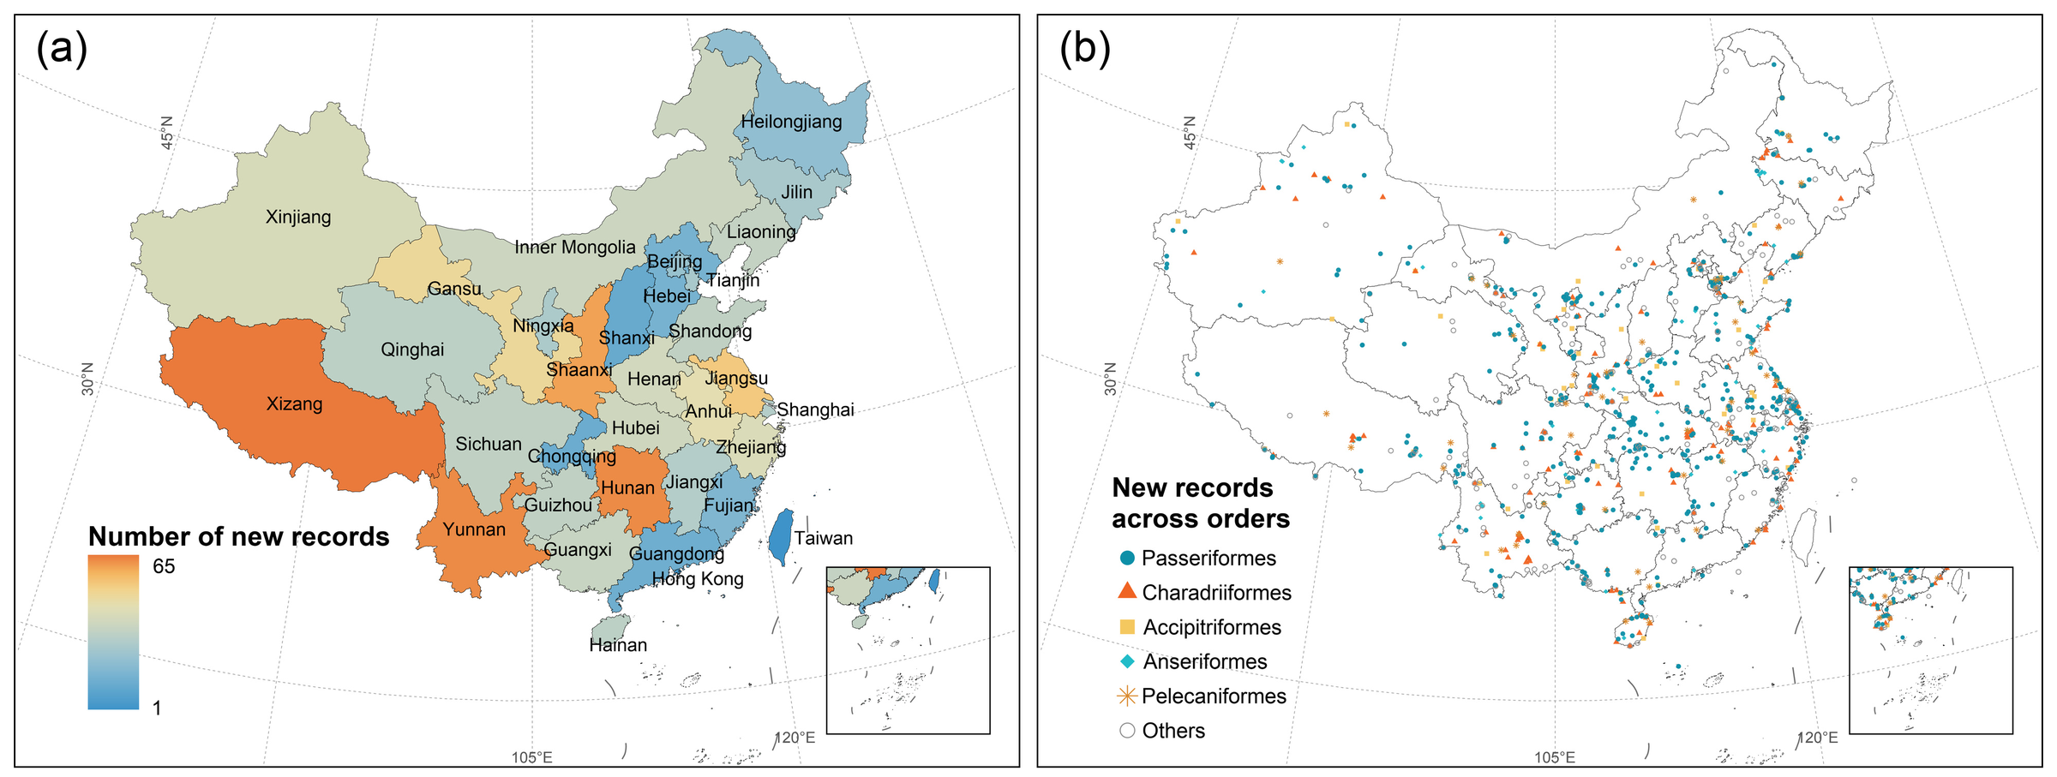
Background
Research gaps
Questions
Approach
Results
Synthesis
Data
New records come from every province, most from the south-west and centre
CBNR Fig. 2a, b Records per province; localities by order
Xizang
Hunan · Yunnan
Passeriformes
Field photographs
65
63 · 63
48.4%
79%
most records of any province
the next highest
521 records, 318 species
the commonest evidence
Ding, Zhang, Jiang & Wang · AOC 2026, Singapore
09
Notes:
[about 30 s]
Where are they? New records come from almost every province. The most are in Xizang, with 65, then Hunan and Yunnan, with 63 each. On the right, each dot is a locality: clusters along the south-western mountains, the edge of the Tibetan Plateau, the big river basins and the coast. Almost half are songbirds, and most are documented with field photographs.

Slide 10
Background
Research gaps
Questions
Approach
Results
Synthesis
Data
Records rose after 2010, led by songbirds and shorebirds
New records per publication year
Records by order
100
95
92
Passeriformes
521
75
Charadriiformes
166
Anseriformes
73
50
Accipitriformes
66
Pelecaniformes
44
25
Gruiformes
35
Columbiformes
20
0
Coraciiformes
19
2000
2005
2010
2015
2020
2025
Coverage of each order's Chinese species: 32–66%
Records rose after 2010 and are concentrated in songbirds and shorebirds
Ding, Zhang, Jiang & Wang · AOC 2026, Singapore
10
Notes:
[about 30 s] [optional: can be cut]
Over time, records rise after about 2010, with the most in the last two years. By order, songbirds lead with 521 records, then shorebirds with 166. The full Sankey diagram linking order, province and year is in the backup slides. Remember this timing: it tracks how hard people looked, which is exactly what the model has to account for.

Slide 11
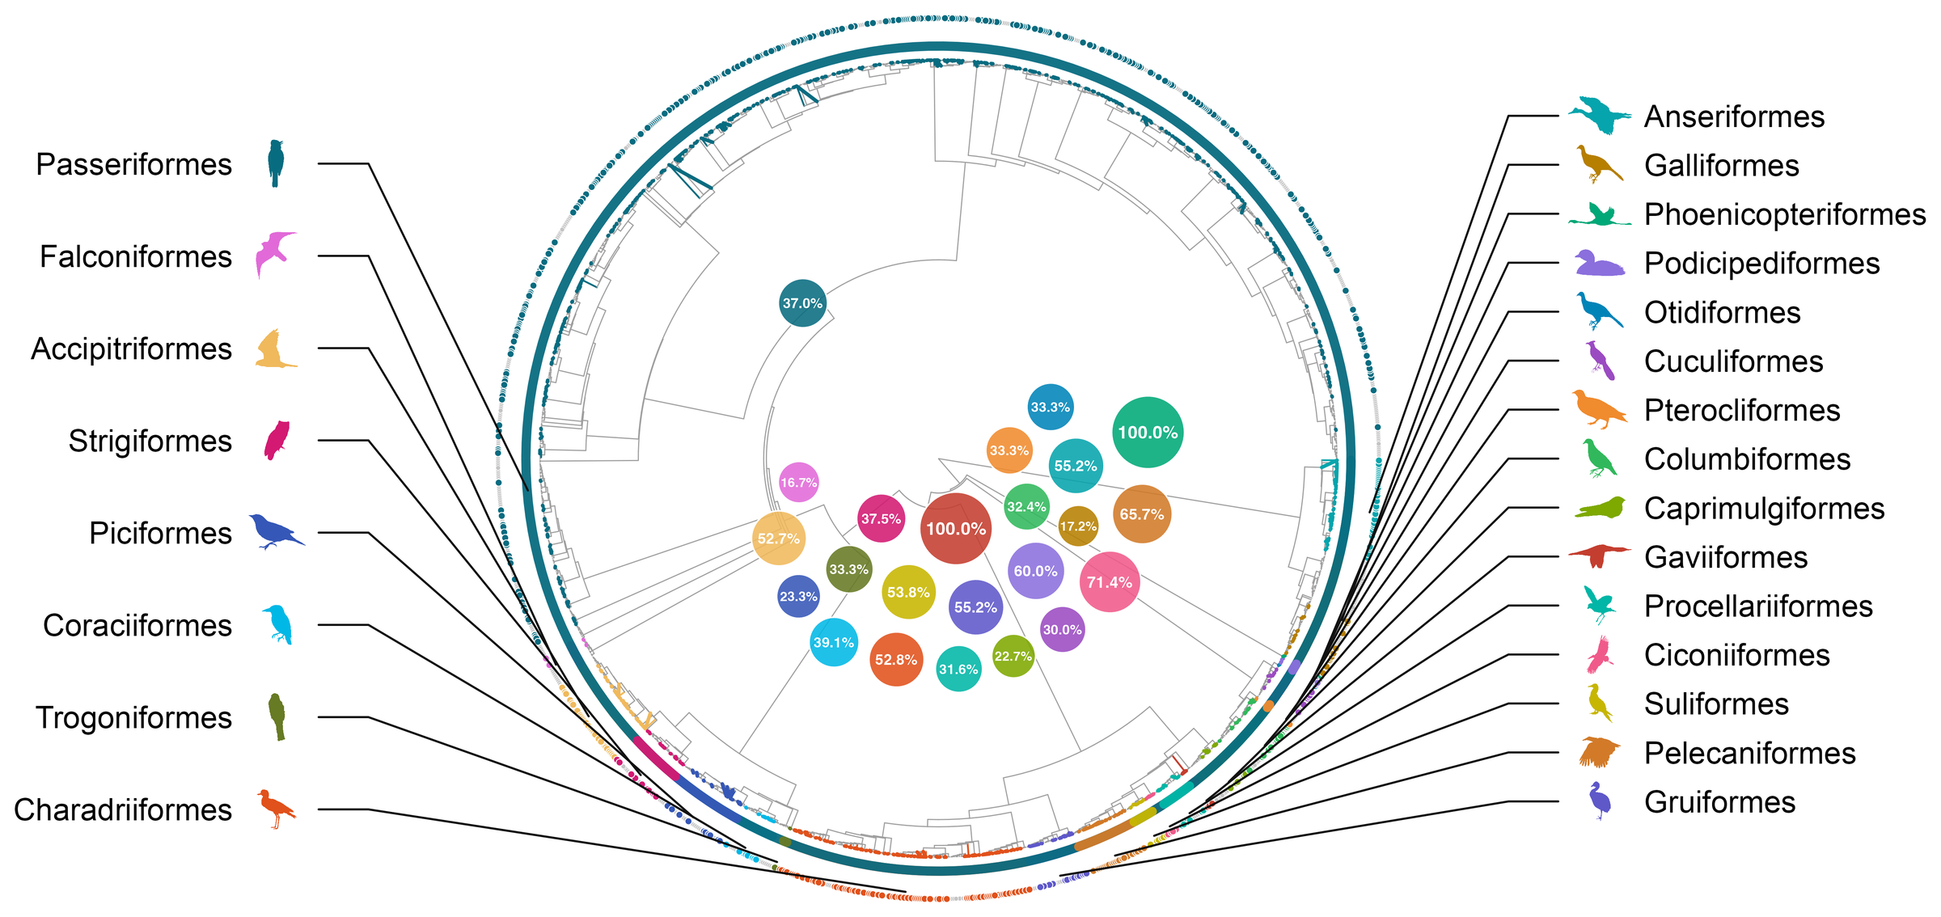
Background
Research gaps
Questions
Approach
Results
Synthesis
Data
Wetland and soaring orders are best covered; phylogenetic signal is weak
CBNR Fig. 3 New records on the bird phylogeny; bubbles: share of each order's species with a record
Fritz–Purvis D = 0.80: weak phylogenetic structure; no clustering (P = 0.87)
Ding, Zhang, Jiang & Wang · AOC 2026, Singapore
11
Notes:
[about 30 s] [optional: can be cut]
On the bird tree, coverage is uneven. Wetland, seabird and soaring orders have the highest share of species with a new record: all the loons, and about seventy percent of storks. Songbirds have the most records but only about a third of their species. Overall the phylogenetic signal is weak, so order-level patterns reflect both ecology and how we look, not just which lineages are moving.

Slide 12
Background
Research gaps
Questions
Approach
Results
Synthesis
Approach
From records to a hazard model, in four steps
1
Records
CBNR v2
Dated to discovery
Current release, v1.1
1,029 provincial first records
657 records in 2002–2024
1,076 records · 588 species
2
Risk set
Species × province × year
Reachable provinces only
Exit after first record
175,640 cells, 2002–2024
≥ 50 suitable SDM cells
each pair counted once
3
Covariates
Warming
Survey effort
Variability
Completeness
vs species range, 15 yr
birding visits
annual anomaly
offset, recent years
4
Analysis
Hazard GLMM
Robustness
Through time
Projections
cloglog link
nulls · 12 specs
time-varying returns
support checked
Outputs: contributions · interaction · observation process · returns through time · futures
Ding, Zhang, Jiang & Wang · AOC 2026, Singapore
12
Notes:
[about 45 s]
From CBNR to a model takes four steps. We take the records dated to their year of discovery: 657 between 2002 and 2024. We build a risk set of every species, province and year in which a first record could have happened, 175,640 cells. Each cell gets accumulated warming, survey effort, annual climate variability, and an offset for how complete recent reporting is. Then we fit a discrete-time hazard model and test it hard: permutation nulls, twelve alternative specifications, effects that change through time, and projections that report their own data support.
If asked: Why does the model use v2 and not v1.1? v2 is the citable Zenodo release; v1.1 adds 47 records and is not yet on Zenodo.

Slide 13
Background
Research gaps
Questions
Approach
Results
Synthesis
Approach
A discrete-time hazard model asks: is this the year of the first record?
The risk set
first record ~ warming × effort + variability
Each pair is at risk every year until its first record
+ offset(log completeness)
2002
03
04
05
06
07
08
09
…
24
+ (1 | species) + (1 | province) + (1 | province × year)
Species A × Yunnan
0
0
0
0
1
Binomial, cloglog link: exp(β) is a hazard ratio per SD
Species B × Sichuan
0
0
1
Accumulated warming
Province minus species-range anomaly, 15-yr; 1 SD = 0.18 °C
Species C × Beijing
0
0
0
0
0
0
0
0
…
0
Species D × Hainan
0
0
0
0
0
0
0
1
Survey effort
Provincial birding visits; 1 SD = 7.9-fold more visits
at risk, no record
first record
left the risk set
Province × year effect
175,640 cells · 649 first records
Survey campaigns, birding festivals, new reserves
392 species · 31 provinces · 2002–2024
Dated to discovery
Offset corrects the latest, incompletely published years
Ding, Zhang, Jiang & Wang · AOC 2026, Singapore
13
Notes:
[about 40 s]
The question the model asks is simple: for each species, in each province it could reach, in each year, is this the year of its first record? Each pair stays at risk until it's recorded, then leaves. It's a binomial mixed model with a cloglog link, so the coefficients are hazard ratios. Warming is measured against each species' own range; one standard deviation is 0.18 degrees. Effort is birding visits; one standard deviation is about eight-fold. A province-by-year effect absorbs survey campaigns.
If asked: How is 'could reach' defined? Provinces with at least 50 suitable cells in the species' distribution model; results are the same at 100 and 200.

Slide 14
Background
Research gaps
Questions
Approach
Results
Synthesis
Finding 1
Warming and survey effort contribute comparably, and they interact
Hazard ratio per SD (95% CI)
Annual hazard of a first record (%)
1.36
High effort (90th pct)
Warming
0.6
Median effort
Low effort (10th pct)
1.43
Survey effort
0.4
0.99
Annual variability
0.2
0.84
Warming × effort
Warming × effort: HR 0.84 (0.75–0.94)
warming null 1.16
0.0
0.8
1.0
1.2
1.4
1.6
-2
-1
0
+1
+2
Accumulated warming relative to the species' range (SD)
Thick: main analysis (≥ 50 suitable SDM cells); thin: 100 and 200 cells; log scale
Accumulated warming
Survey effort
Warming × effort
Annual variability
1.36
1.43
0.84
0.99
HR per SD (1.22–1.53)
HR per SD (1.27–1.61)
steepest where few look
no effect (0.91–1.09)
Ding, Zhang, Jiang & Wang · AOC 2026, Singapore
14
Notes:
[about 45 s]
First finding. Warming and survey effort contribute about equally: a hazard ratio of 1.36 per standard deviation for warming, and 1.43 for effort, and the estimates do not move across distribution-model thresholds. And they interact negatively. On the right you can see what that means: where few people are looking, the warming curve is steep; where many people are looking, it flattens out. Annual climate variability has no effect at all. So the answer to question one is yes, and to question three, the interaction is negative, as we expected.
If asked: How big is the warming effect, really? A permutation null puts the baseline at 1.16, so the species-specific increment is about ×1.18 per SD.
If asked: What does 1 SD of warming mean? 0.18 °C of species-referenced accumulated warming.

Slide 15
Background
Research gaps
Questions
Approach
Results
Synthesis
Finding 1
The balance holds on average across criteria and twelve specifications
Loss in fit when the term is dropped
Cost of dropping a term
ΔAIC
ΔAUC
ΔR²
|β|
ΔAIC: effort 33.4, warming 29.9
ΔAUC: warming 0.053, effort 0.033
|β|: effort 0.36, warming 0.31
Warming
29.9
0.053
0.0086
0.31
Survey effort
33.4
0.033
0.0006
0.36
Twelve specifications
SDM thresholds 50, 100, 200
Annual variability
-2.0
0.000
-0.0003
0.01
4 effort proxies × 3 missing-data rules
Effort 1.25–1.55; warming 1.33–1.39
Warming × effort
7.8
0.002
0.0115
0.18
Design-preserving nulls
Each column scaled to its own maximum; |β|: absolute standardised coefficient
Warming null 1.16: increment ×1.18
Shuffled effort timing: 0.98
Warming and effort rank equally on average
Province bootstrap: lower bounds > 1
across the four criteria
Ding, Zhang, Jiang & Wang · AOC 2026, Singapore
15
Notes:
[about 35 s] [optional: can be cut]
This balance is not fragile. Drop either term and the model loses about thirty AIC units. Warming costs more discrimination, effort carries the larger coefficient, and conditional R-squared favours warming; on average the two rank equally. Across twelve specifications, with different distribution-model thresholds, effort proxies and missing-data rules, the numbers stay put. And against design-preserving nulls, both effects stand: the warming increment over its null is about 1.18, and effort collapses to 0.98 if we break its timing.

Slide 16
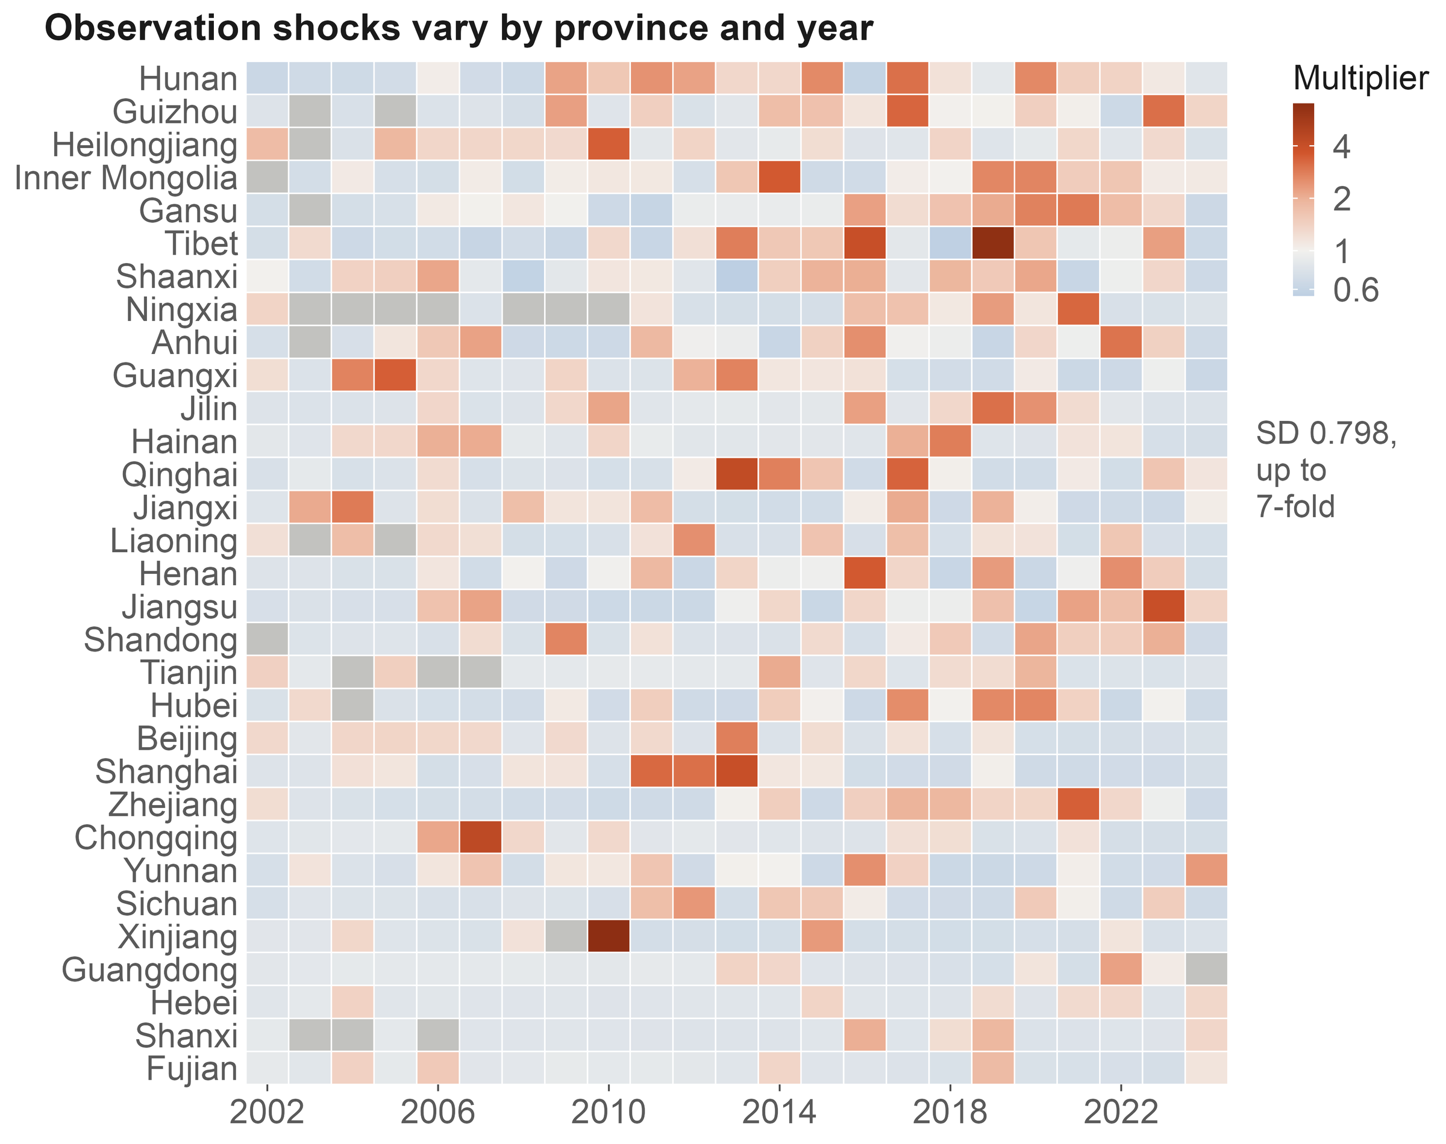
Background
Research gaps
Questions
Approach
Results
Synthesis
Finding 2
Survey pulses are the largest source of variation in the hazard
Hazard multiplier per SD
Random intercepts
Province × year
×2.22
Species
×1.50
Province
×1.39
Fixed effects
Survey effort
×1.43
Warming
×1.36
1.0
1.5
2.0
Conditional AUC
0.72 → 0.85
Fig. 5c Province × year multipliers
after adding the province × year layer
Ding, Zhang, Jiang & Wang · AOC 2026, Singapore
16
Notes:
[about 40 s]
Second finding. The biggest single component is not a driver at all. It is the province-by-year effect: one standard deviation multiplies the hazard by 2.22, more than warming or effort, and more than species or province. This is where a provincial bird survey, a big birding event or a new reserve shows up. Adding this layer lifts conditional AUC from 0.72 to 0.85, and leaves the fixed effects unchanged. Treat it as noise, and survey history reads as range change.
If asked: Could the province-by-year effect absorb climate anomalies too? Partly; that protects the fixed effects at some cost in climatic signal, and we say so in the paper.

Slide 17
Background
Research gaps
Questions
Approach
Results
Synthesis
Finding 3
The return on effort is falling; the return on warming is not
Return on survey effort: HR per SD (95% CI)
Return on effort
3.0
2.14 → 1.13
CI includes 1 from 2023
HR per SD, 2002 → 2024; P = 0.0021
2.14
Return on warming
2.0
P = 1.00
warming × time: no trend; HR 1.37
1.5
A stock and a flow
1.13
Effort mines a finite stock
1.0
of undocumented occurrences;
warming keeps adding
new candidates
2002
2006
2010
2014
2018
2022
Ding, Zhang, Jiang & Wang · AOC 2026, Singapore
17
Notes:
[about 40 s]
Third finding. Effort is saturating. Its hazard ratio fell from 2.1 in 2002 to about 1.1 in 2024, and from 2023 it is no longer different from one. The easy gaps have been filled. Warming shows no such trend. One way to read this is a stock and a flow: effort mines a finite stock of undocumented occurrences, while warming keeps adding new candidates. We haven't tested the two trends against each other, so I'd call it consistent, not proven.

Slide 18
Background
Research gaps
Questions
Approach
Results
Synthesis
Traits
Partial migrants and wide-ranging species gain more records; drivers act in every group
Which species gain records? Odds ratio (95% CI)
Both drivers, by migratory group: HR per SD
Partial migrant
Accumulated warming
Full migrant
Resident (218)
1.36
Global range size
Partial migrant (156)
1.51
Long-distance (175)
1.51
Hand-wing index
Survey effort
Body mass
Resident (218)
1.29
Clutch size
Partial migrant (156)
1.34
Diet breadth
Long-distance (175)
1.33
Habitat breadth
1.0
1.2
1.4
1.6
1.8
0.5
1
2
4
Three lines per trait: taxonomic nesting, phylogenetic eigenvectors, phyloglm
1,298 species; reference: resident; continuous traits per SD; log scale
Events per group in brackets; groups fitted separately
Migratory strategy shifts the baseline (ΔAIC 6.2) but moderates neither driver (all LR P ≥ 0.26)
Ding, Zhang, Jiang & Wang · AOC 2026, Singapore
18
Notes:
[about 35 s]
Which species get new records? Two traits matter. Partial migrants are about twice as likely as residents to gain one, and wide-ranging species are more likely too. Body size, wing shape, clutch size and diet breadth don't matter. On the right, we fitted the model separately for residents, partial migrants and long-distance migrants. Warming and effort raise the hazard in all three, by similar amounts. So migration changes the baseline, but not how the two drivers work.
If asked: Isn't warming weaker for long-distance migrants, who are often vagrants? We expected so, but their point estimate is the highest of the three, though indistinguishable from the others.
If asked: There is a hint that the warming × effort interaction is confined to long-distance migrants (0.75), but the test for a group difference is not significant (P = 0.26).

Slide 19
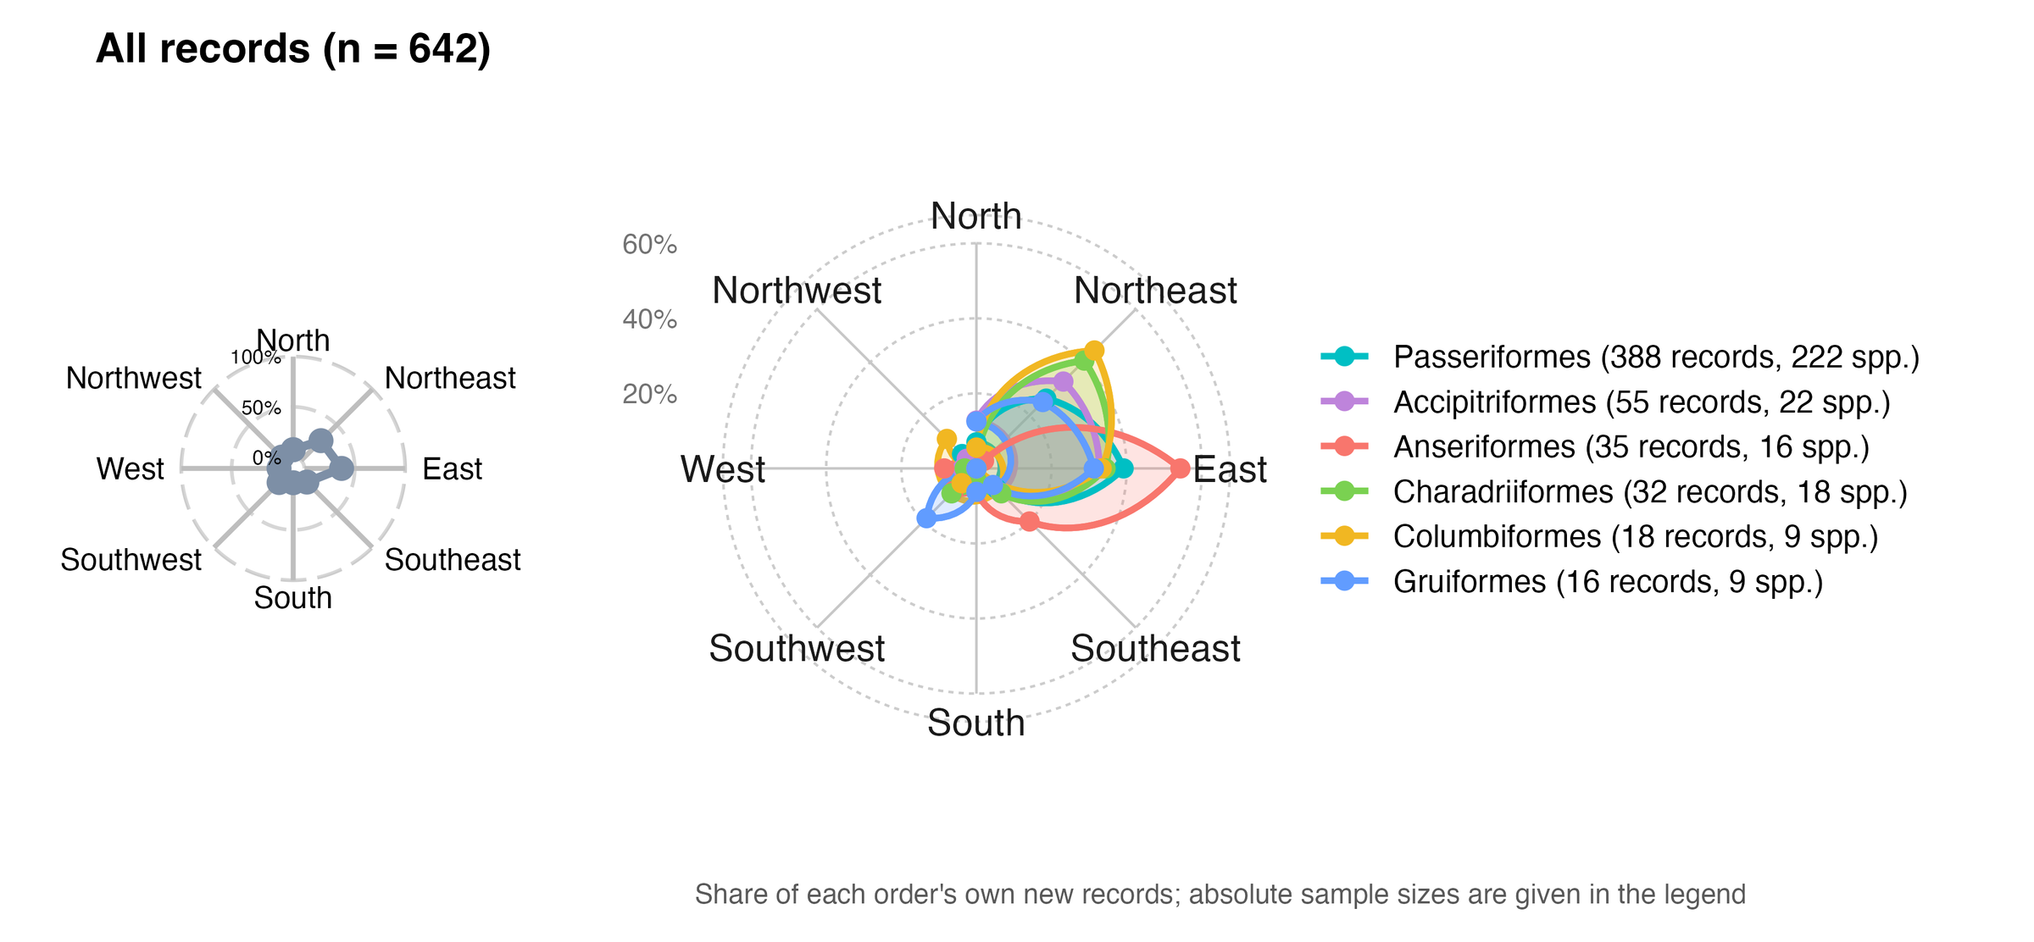
Background
Research gaps
Questions
Approach
Results
Synthesis
Finding 4
Seen from range centres, new records point east and north-east
Records
642
361 species, 20 orders
East
36.9%
237 of 642 records
North-east
27.9%
Bearings from range centroids: all records (left), six largest orders (right)
Most new records lie east or north-east of the species' range centre
179 of 642 records
Ding, Zhang, Jiang & Wang · AOC 2026, Singapore
19
Notes:
[about 35 s] [optional: can be cut]
Fourth: direction. For each record we take the bearing from the species' range centre to the new location. Of 642 records, 37 percent lie to the east and 28 percent to the north-east. The six largest orders share the lean: songbirds, raptors, ducks, shorebirds, pigeons, rails and cranes. Taken at face value, this looks like an eastward expansion. The next question is whether geography alone could produce it.

Slide 20
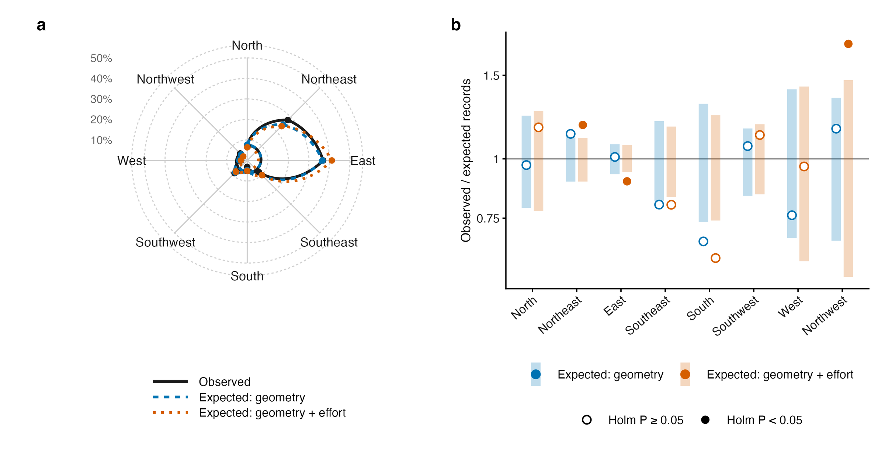
Background
Research gaps
Questions
Approach
Results
Synthesis
Finding 4
The eastward bias is geometry; net of it, records lean slightly north
Null 1: geometry only
East: 235 expected, 237 observed
No sector departs from the null
Null 2: geometry + birders
Northern sectors: 40.2% vs 32.8%
χ² = 26.8, P = 0.001
NE, NW above; E below (Holm)
Fig. 6 Observed vs expected sectors under two nulls
Null 1: each record placed at random among its species' reachable provinces
Net of geometry and effort:
Null 2: the same provinces, weighted by birding effort
a modest poleward lean
Ding, Zhang, Jiang & Wang · AOC 2026, Singapore
20
Notes:
[about 45 s] [optional: can be cut]
But most of these species have ranges centred west or south of China, so almost any record inside China lands to the east. If we place each record at random among its species' possible provinces, geography alone reproduces the eastward pattern: 235 records expected in the east, 237 observed. Only when we also weight provinces by where birders go does a signal remain, and it points north: 40 percent of records in the northern sectors against 33 percent expected. A modest poleward lean, visible only with the right null.

Slide 21
Background
Research gaps
Questions
Approach
Results
Synthesis
Application
Records inside reserves track observation, not reserve performance
Share inside the 1,028 mapped reserves
Few reserves carry the signal
New records
26.2%
172 events in 68 reserves
The top two hold 27.3% of them
Birding effort (checklists)
10.8%
Without them: OR 1.16
Land area
10.4%
Odds ratio against 200 matched controls
Only after birding boomed
Controls from the same province and year, weighted by checklists; 95% CI
2002–2012: OR 0.97
Matched on place and year
1.71 (1.39–2.11)
2013–2023: OR 2.05
24% more species per visit inside
+ elevation, longitude, climate
1.57 (1.26–1.96)
Without the 2 largest reserves
1.16 (0.92–1.47)
2002–2012 only
0.97 (0.62–1.50)
2013–2023 only
2.05 (1.61–2.59)
Record counts should not
index reserve performance
0.5
1
2
3
Ding, Zhang, Jiang & Wang · AOC 2026, Singapore
21
Notes:
[about 55 s] [optional: can be cut]
A first use. Nature reserves look like hot spots for new records: twenty-six percent of records fall inside reserves that cover ten percent of the land, a two-and-a-half-fold enrichment. Birding effort is not concentrated there, and matching each record to two hundred control locations that birders visited in the same province and year reduces the enrichment to an odds ratio of 1.7, or 1.6 with environmental covariates. But that residual rests on two reserves; without them it is 1.16. It appears only after birding boomed in 2013, and checklists inside reserves record a quarter more species per visit, an observation bias we cannot condition out. So record counts should not be used to judge how well reserves work.

Slide 22
Background
Research gaps
Questions
Approach
Results
Synthesis
Futures
Future record counts follow survey effort, not the emission scenario
Expected new records per year, China
SSP2-4.5
SSP5-8.5
Two climate × two effort scenarios
SSP2-4.5 or SSP5-8.5
100
Effort frozen, or still growing
89.0
80
79.3
What changes the count?
60
Climate scenario: barely anything
Growing effort: roughly triple
40
30.9
30.5
26.8
26.9
26.1
25.9
20
Most of that rise lies
0
outside the fitted data
2030
2030
2050
2050
(faded bars: none in support)
frozen effort
growing effort
frozen effort
growing effort
50–53% in support
30–33% in support
38–43% in support
0% in support
Ding, Zhang, Jiang & Wang · AOC 2026, Singapore
22
Notes:
[about 35 s]
What about the future? We crossed two climate scenarios with two effort scenarios. Switching from SSP2-4.5 to SSP5-8.5 changes the expected national count from 26.1 to 25.9 records a year: essentially nothing. If effort keeps growing, the count roughly triples by 2050. What we will record depends on how we look, more than on how the climate changes. But most of that increase lies outside the data we fitted.
If asked: Is 79 to 89 records a year a forecast? No. At 2050 no cell is inside the fitted support; the credible statement is about 26 to 31 records a year in 2030, under any scenario.

Slide 23
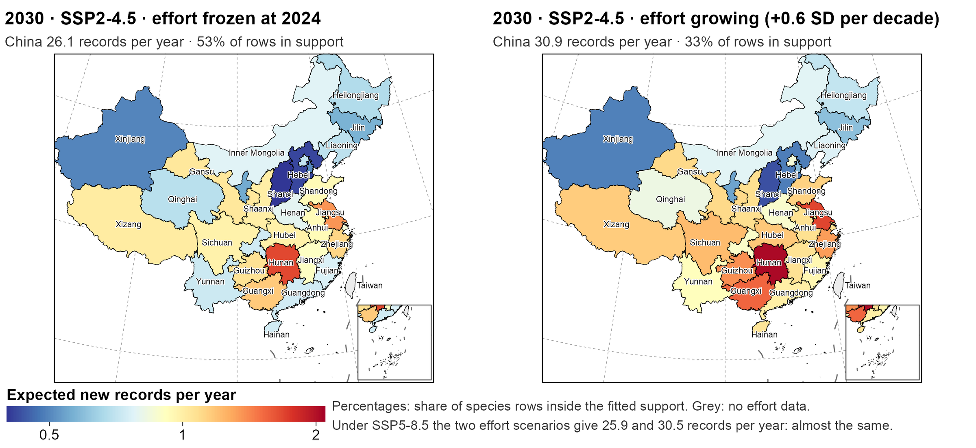
Background
Research gaps
Questions
Approach
Results
Synthesis
Futures
Records spread across central and southern China; growing effort leaves the data
Hunan, the top
1.7 → 2.1
per year: frozen → growing
Provinces off-data
8 → 16
< 50% of rows in support
Top five provinces
2030 · SSP2-4.5 · expected new records per province; CBNR map standard, GS(2019)1822
25%
Growing effort adds records in the south and east, beyond the data
of the national total
Ding, Zhang, Jiang & Wang · AOC 2026, Singapore
23
Notes:
[about 45 s] [optional: can be cut]
Where would these records come from? This is 2030 under the middle emission scenario. With effort frozen, the expected records are spread thinly: the top province, Hunan, expects about 1.7 a year, and the top five provinces together hold a quarter of the national total. Let effort keep growing and Hunan rises to about 2, but the number of provinces where most species fall outside the fitted data doubles, from eight to sixteen, mostly in the south and east. The map tells you where to look, and also where not to trust the numbers.

Slide 24
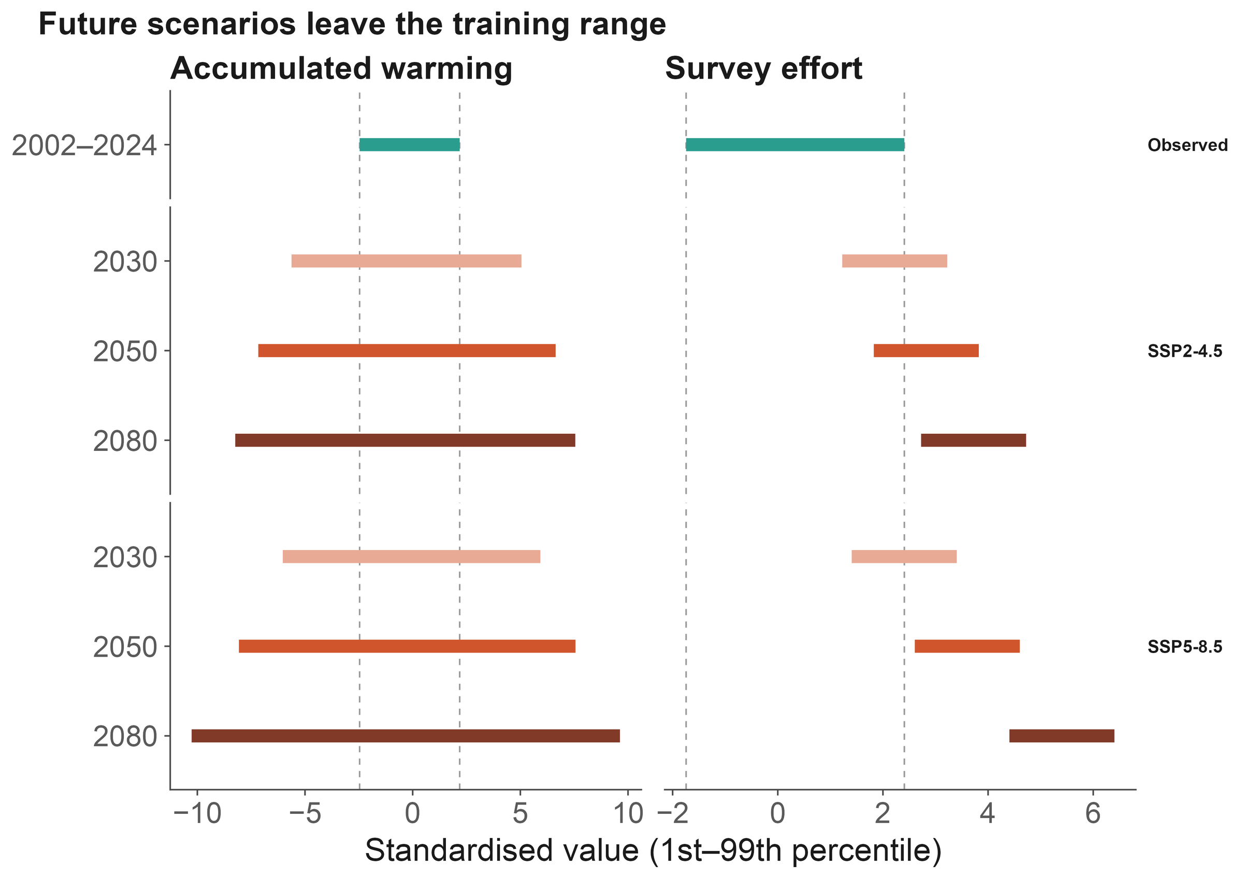
Background
Research gaps
Questions
Approach
Results
Synthesis
Futures
Data support, not ambition, sets the forecast horizon
Support shrinks fast
Cells inside the fitted range:
2030: 46% → 2050: 6%
2080: none (SSP2-4.5)
Machine learning does not help
Agree inside the range (ρ = 0.56)
Diverge outside it
2030: usable
End of century:
Fig. 7b Hazard model vs machine learning
illustration, not forecast
Ding, Zhang, Jiang & Wang · AOC 2026, Singapore
24
Notes:
[about 35 s] [optional: can be cut]
So our rule is simple: report where the model breaks. Under SSP2-4.5, the share of species-province combinations inside the fitted range drops from 46 percent in 2030 to 6 percent in 2050, and to none by 2080, mostly because effort outgrows its observed range. Machine learning does not rescue it: inside the range the two model families agree, outside it they diverge. So 2030 is usable; end-of-century maps are illustrations, not forecasts.

Slide 25
Background
Research gaps
Questions
Approach
Results
Synthesis
Limits
Four limits travel with these conclusions
Events are published records, not detections
We explain how records are documented, not range expansion itself.
Coordinates are precise to about 1 km at best
Reserve-overlap tests therefore use 0–5 km buffers as a sensitivity check.
Reserve polygons cover about a third of listed reserves
1,028 mapped reserves: no gap analysis, no 30×30 claims.
Projections leave the fitted support after 2030
Late-century maps are illustrations; the effort coefficient used is an upper bound.
Ding, Zhang, Jiang & Wang · AOC 2026, Singapore
25
Notes:
[about 25 s] [optional: can be cut]
Four limits travel with these results. Our events are published records, not detections, so we explain how records get documented, not how ranges expand. Coordinates are precise to about a kilometre at best. Our reserve map covers about a third of listed reserves. And projections leave the data after 2030, so late-century maps are illustrations.

Slide 26
Background
Research gaps
Questions
Approach
Results
Synthesis
Summary
Warming and survey effort leave signals of similar size
New records carry a climate signal mixed with an observation signal
01
02
03
04
Climate signal
Where few look
Observation process
Futures
Warming 1.36 vs
Warming × effort 0.84:
Province × year ×2.22;
Emission scenario barely
effort 1.43 per SD:
under-surveyed regions
returns on effort
matters; most change
comparable, separable
hide the signal
2.14 → 1.13
is extrapolation
Implications
Send survey effort to climatically exposed, under-surveyed regions
Read counts of new records as observation-weighted evidence, not as range shifts
Report where a model leaves its data support before mapping the future
Birds or birders? Both. Model how we look, and new records tell us how ranges change
Ding, Zhang, Jiang & Wang · AOC 2026, Singapore
26
Notes:
[about 50 s]
To sum up, four points. One: new records carry a climate signal; warming and survey effort contribute comparably, 1.36 against 1.40 per standard deviation, and one model can separate them. Two: warming matters most where few people are looking. Three: the observation process is the largest single component, and the return on effort is falling. Four: future record counts depend on how we look, and most projected change is extrapolation. For monitoring, send effort to climatically exposed, under-surveyed regions; that is where new records carry the most climate information. Birds or birders? Both. Model how we look, and the records tell us how ranges change.

Slide 27

Co-authors
Chenchen Ding
Institute of Ecology, College of Urban and Environmental Sciences, Peking University
Zhengwang Zhang
School of Life Sciences, Beijing Normal University
Zhigang Jiang
Institute of Zoology, Chinese Academy of Sciences
Zhiheng Wang
Thank you
Institute of Ecology, College of Urban and Environmental Sciences, Peking University
Questions welcome
Open data and code
CBNR v2 (CC BY 4.0) · doi.org/10.5281/zenodo.20809949
chenchen.ding@pku.edu.cn
github.com/dingchenchen6/bird-newrecord-discovery-dated
Climate: WorldClim 2.1 / CRU TS 4.09 · Ranges: BirdLife International
CBNR data
Effort: eBird/GBIF and China Bird Report · Base map: GS(2019)1822
We thank birdwatchers across China, and every author
whose records made CBNR possible.
Notes:
[about 25 s]
Everything is open: the CBNR data on Zenodo, and all of the analysis code on GitHub, where every number in this talk traces back to a table. My thanks to my co-authors, to birdwatchers across China, and to every author whose records made this possible. Thank you. I'm happy to take your questions.

Slide 28
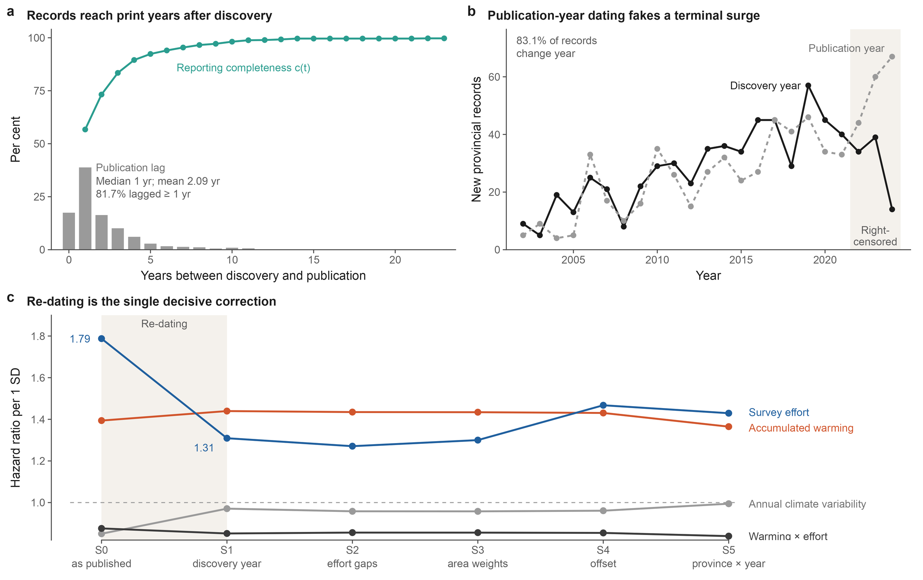
Background
Research gaps
Questions
Approach
Results
Synthesis
Backup
Dating to publication inflates effort and creates a phantom climate effect
Fig. 2 Discovery vs publication dating
Ding, Zhang, Jiang & Wang · AOC 2026, Singapore
28
Notes:
[about 25 s]
If asked about dating. Dated to publication year, as most compilations do, the effort hazard ratio is 1.79 instead of 1.31, inflated by 37 percent, and an annual climate-variability effect appears at 0.85 with P below 0.001. Dated to discovery it vanishes, and warming barely moves. Publication lags discovery by about two years.

Slide 29
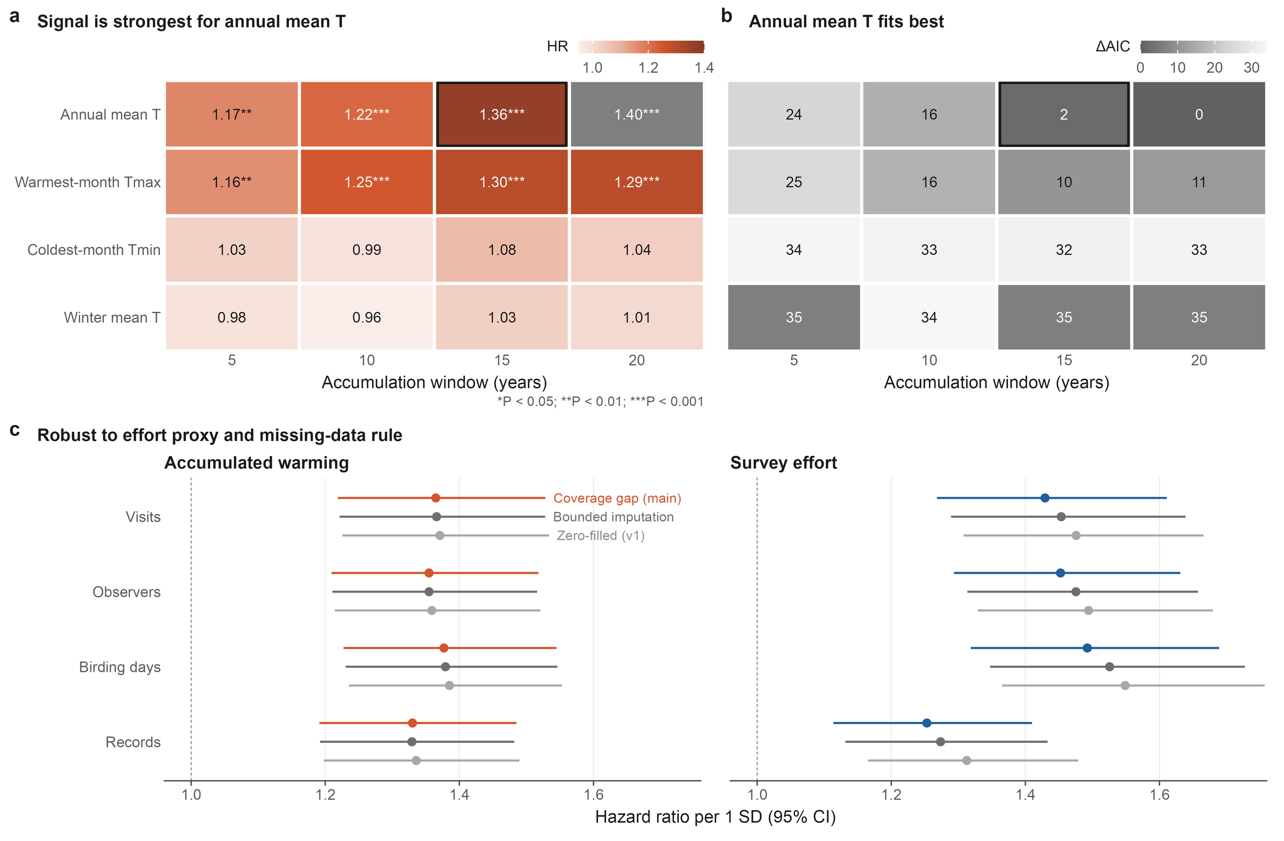
Background
Research gaps
Questions
Approach
Results
Synthesis
Backup
Specification robustness: climate indicator, window and effort proxy
Fig. 3 Specification grid
Ding, Zhang, Jiang & Wang · AOC 2026, Singapore
29
Notes:
[about 15 s]
If asked about specifications: the signal is strongest for annual mean temperature over 15 to 20 years, and the coefficients are stable across effort proxies and missing-data rules.

Slide 30
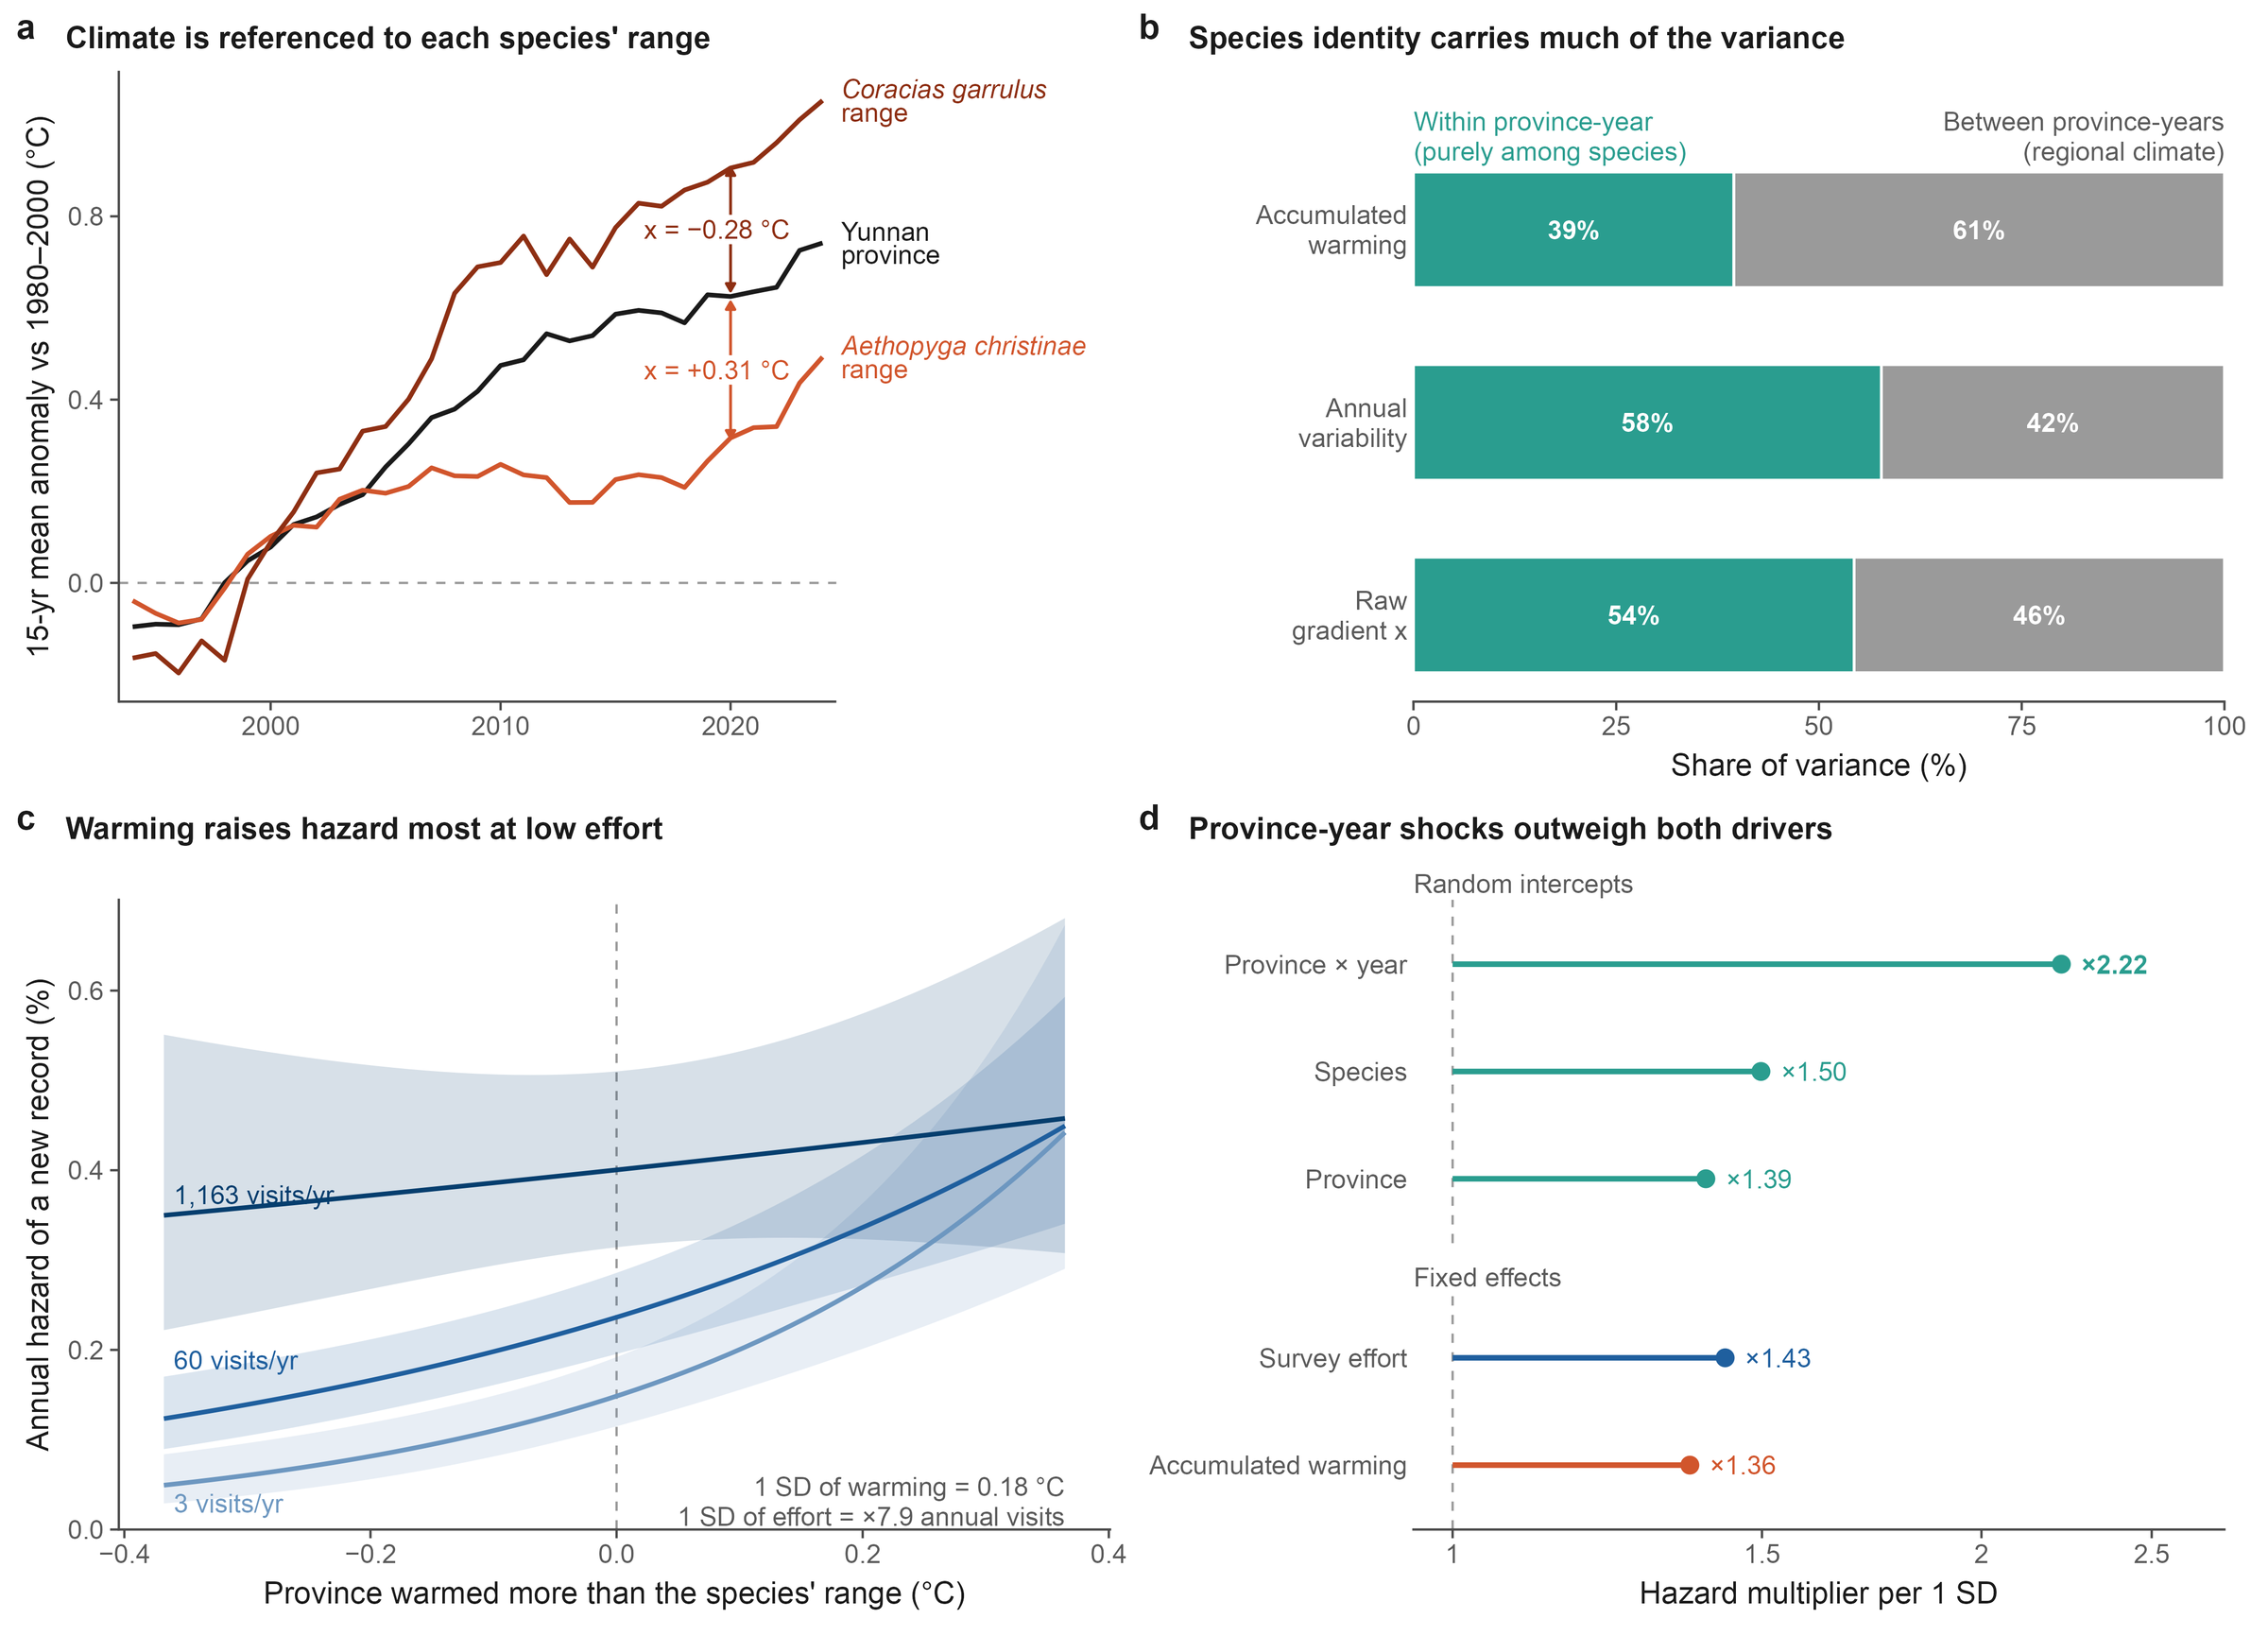
Background
Research gaps
Questions
Approach
Results
Synthesis
Backup
Model anatomy: climate referenced to each species' range
Fig. 4 Model anatomy
Ding, Zhang, Jiang & Wang · AOC 2026, Singapore
30
Notes:
[about 15 s]
If asked how warming is measured: the same province in the same year can warm more or less than a given species' range; that species-specific difference is the climate covariate.

Slide 31
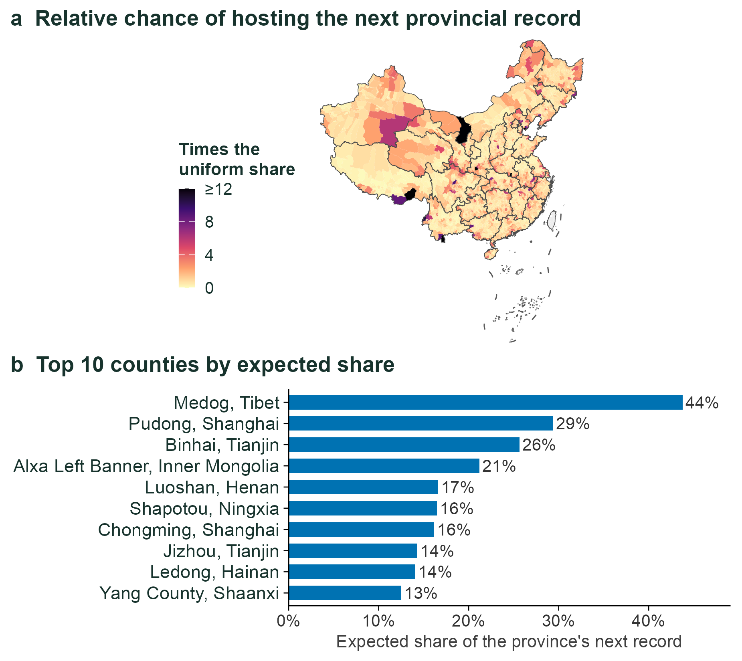
Background
Research gaps
Questions
Approach
Results
Synthesis
Backup
County-level surfaces: where to look first
Repository module County-level expected records, 2024
Ding, Zhang, Jiang & Wang · AOC 2026, Singapore
31
Notes:
[about 20 s]
If asked about finer scales: we split the problem into whether a province gets a new record and, if so, which county. Tested on 2019 to 2024, the top-ranked county was right 16 percent of the time, against about 1 percent by chance.

Slide 32
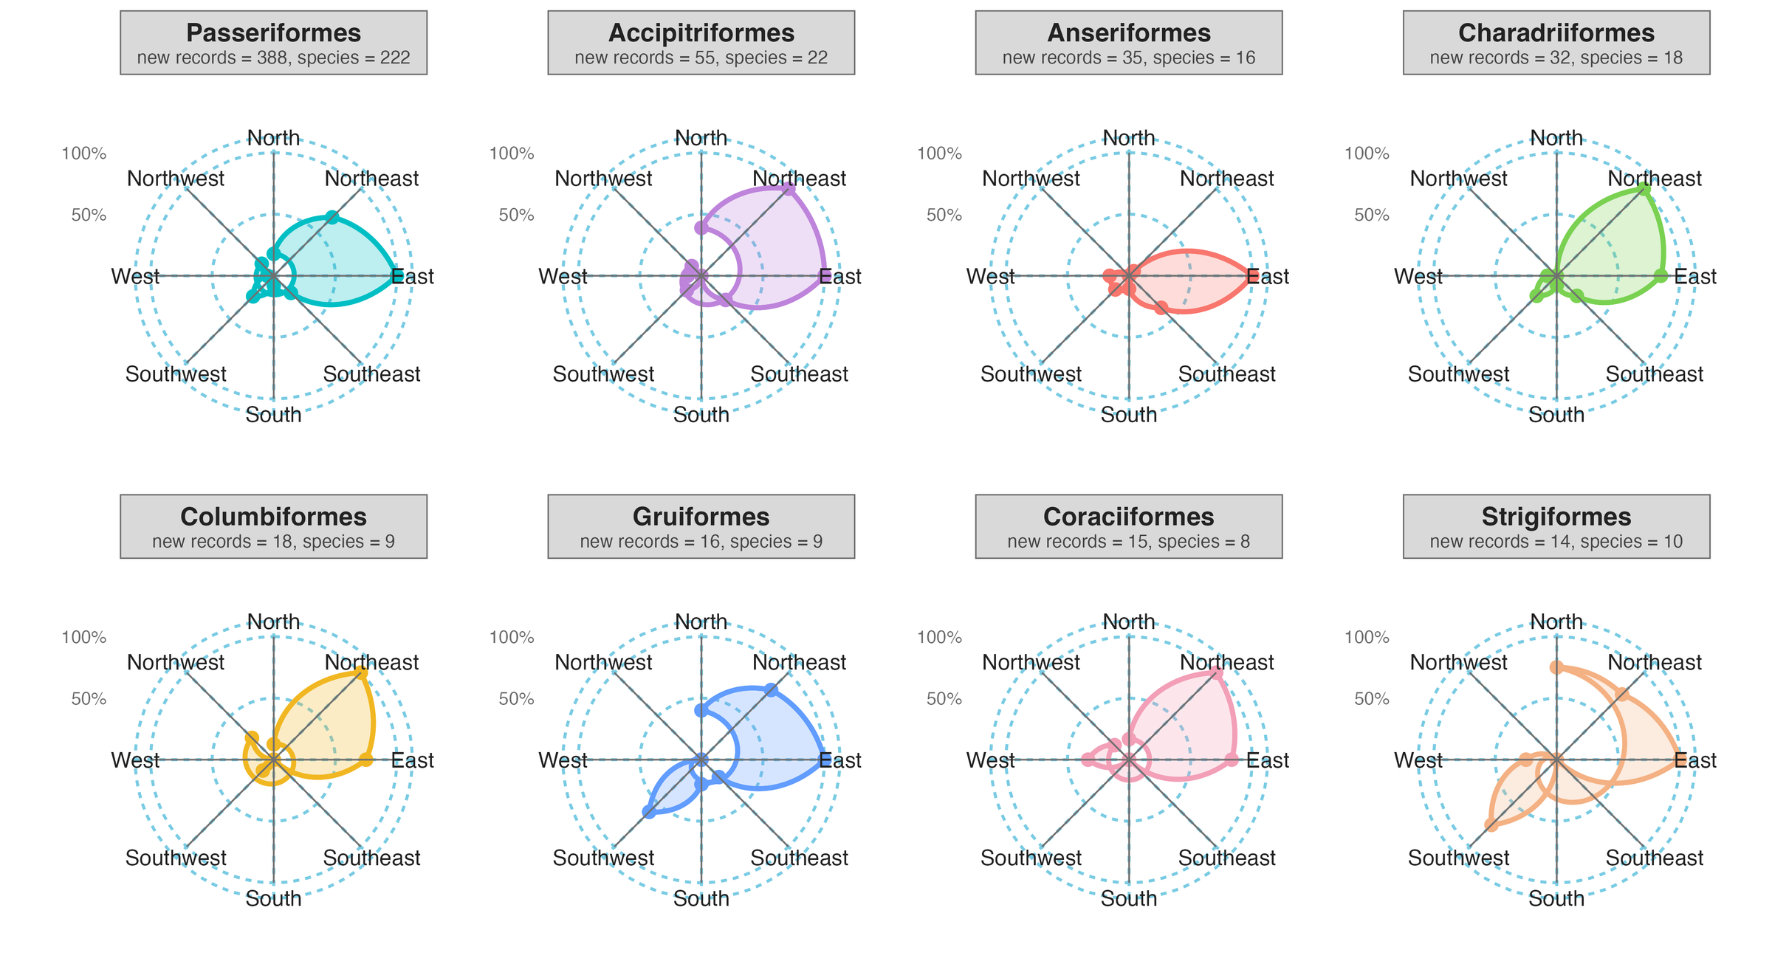
Background
Research gaps
Questions
Approach
Results
Synthesis
Backup
Direction by order: wind roses of the eight orders with most records
Share of each order's own records by compass sector
Ding, Zhang, Jiang & Wang · AOC 2026, Singapore
32
Notes:
[about 20 s]
If asked about taxonomic differences: the eastward and north-eastward lean is shared by the larger orders; ducks and geese lean most strongly east, and the small orders are noisy. Read these against the geometric null, not at face value.

Slide 33
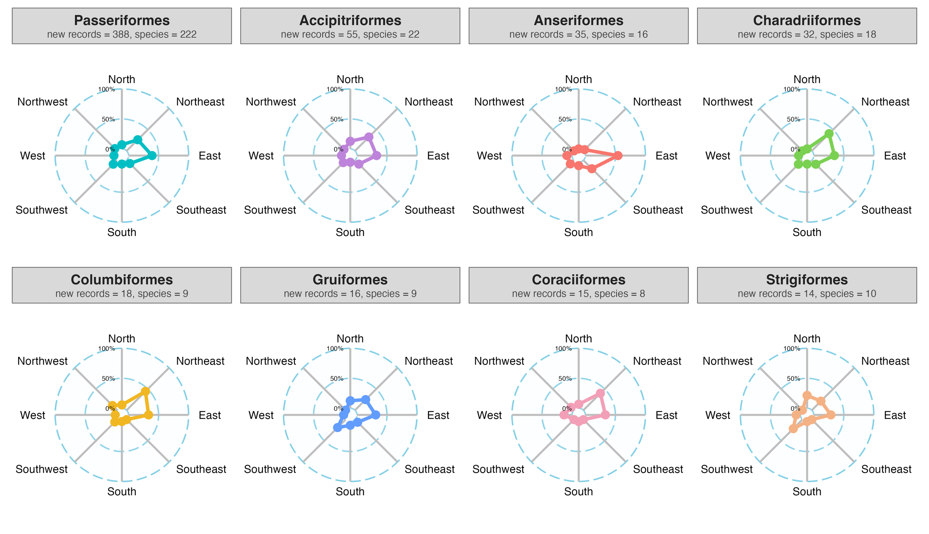
Background
Research gaps
Questions
Approach
Results
Synthesis
Backup
Direction by order: radar profiles of the eight orders with most records
Radar profiles: share of each order's records by sector
Ding, Zhang, Jiang & Wang · AOC 2026, Singapore
33
Notes:
[about 5 s]
The same information as radar profiles, scaled from 0 to 100 percent within each order.

Slide 34
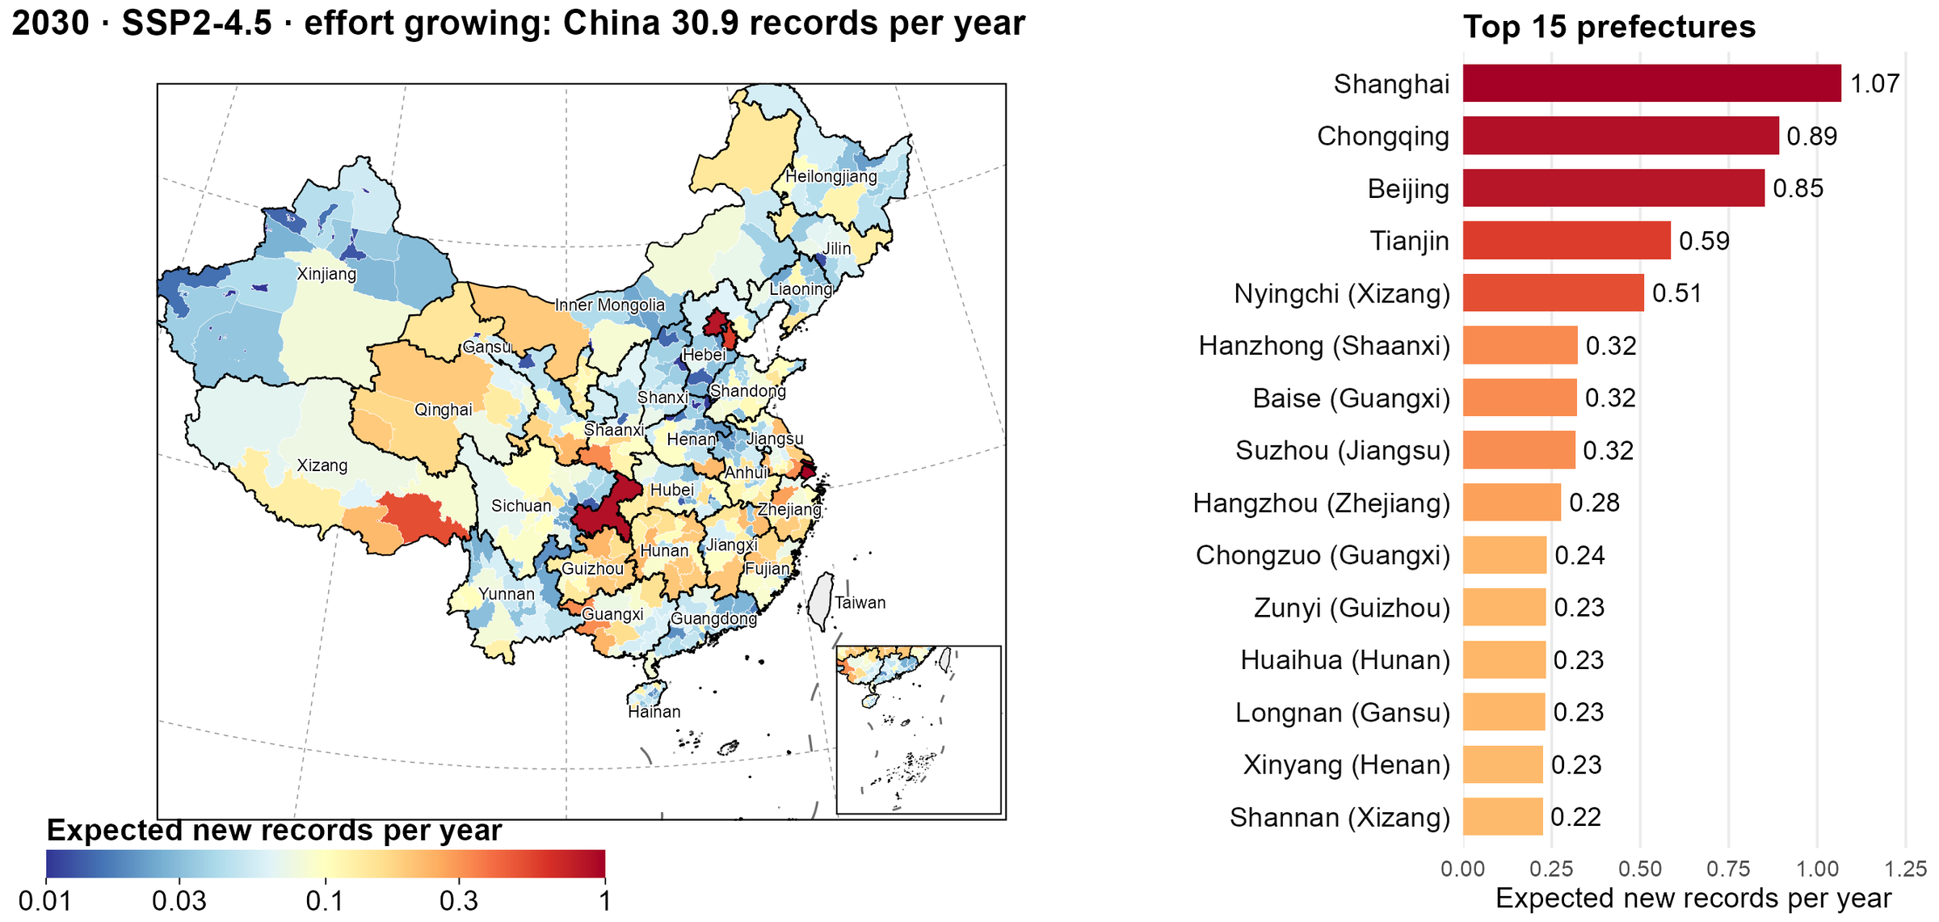
Background
Research gaps
Questions
Approach
Results
Synthesis
Backup
Prefecture view of the 2030 futures: where to look first
2030 · SSP2-4.5 · growing effort; prefecture shares held at 2024
Ding, Zhang, Jiang & Wang · AOC 2026, Singapore
34
Notes:
[about 20 s]
If asked about finer scales: the provincial expectation is split among prefectures by the 2024 allocation model, holding the shares fixed. Municipalities top the list because they are single units; among prefectures, Nyingchi in Xizang and Hanzhong in Shaanxi rank highest.

Slide 35
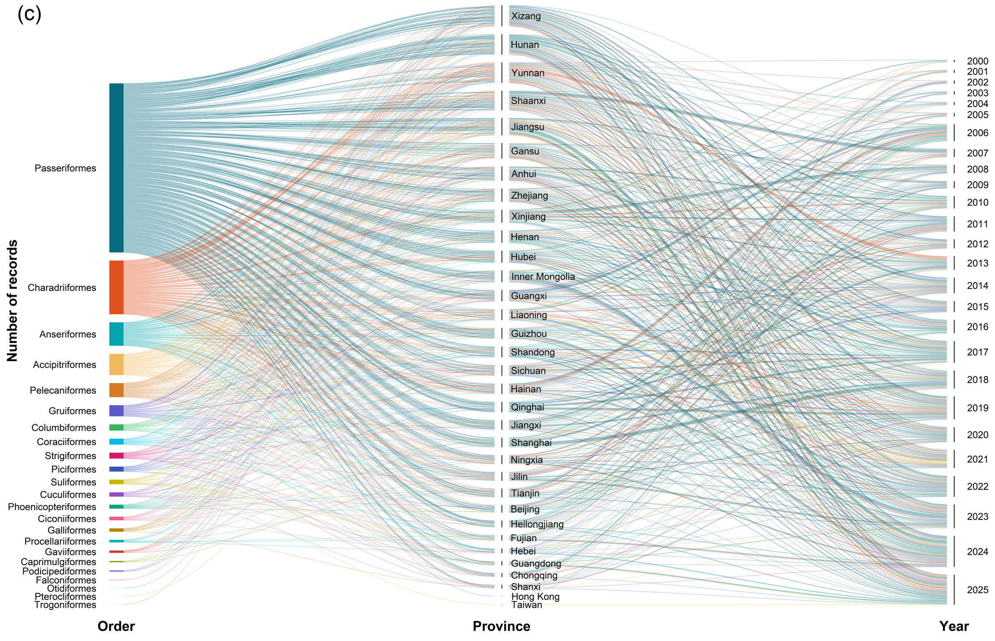
Background
Research gaps
Questions
Approach
Results
Synthesis
Backup
CBNR Fig. 2c: records linked by order, province and publication year
CBNR Fig. 2c Ribbon width proportional to the number of records
Ding, Zhang, Jiang & Wang · AOC 2026, Singapore
35
Notes:
[about 15 s]
If asked about the full picture: each ribbon is a set of records, from order, to the province of the record, to the year it was published.

Slide 36
Background
Research gaps
Questions
Approach
Results
Synthesis
Backup
Key references
Boakes, E. H. et al. (2010) PLoS Biol. 8, e1000385
Meyer, C. et al. (2015) Nat. Commun. 6, 8221
Chen, I.-C. et al. (2011) Science 333, 1024–1026
Mi, X. et al. (2021) Natl. Sci. Rev. 8, nwab032
Chen, S. et al. (2025) Avian Res. 16, 100310
Mittermeier, R. A. et al. (2011) Biodiversity Hotspots, 3–22
Feng, X. et al. (2019) Bull. Chin. Acad. Sci. 34, 1389–1398
Oliver, R. Y. et al. (2021) PLoS Biol. 19, e3001336
Herkt, K. M. B. et al. (2017) Glob. Ecol. Biogeogr. 26, 930–941
Pecl, G. T. et al. (2017) Science 355, eaai9214
Hortal, J. et al. (2015) Annu. Rev. Ecol. Evol. Syst. 46, 523–549
Pimm, S. L. et al. (2014) Science 344, 1246752
Huang, G. et al. (2021) Natl. Sci. Rev. 8, nwab042
Sanczuk, P. et al. (2026) Nat. Clim. Change 16, 21–25
Hughes, A. C. et al. (2021) Ecography 44, 1259–1269
Whittaker, R. J. et al. (2005) Divers. Distrib. 11, 3–23
Jetz, W. et al. (2012) Nature 491, 444–448
Xing, X. et al. (2024) Front. Ecol. Evol. 12, 1415268
Lahoz-Monfort, J. J. & Magrath, M. J. (2021) BioScience 71, 1038–1062
Zhang, R. (2011) China Animal Geography. Science Press
Lawlor, J. A. et al. (2024) Nat. Rev. Earth Environ. 5, 351–368
Zheng, G. (2023) Checklist of the Birds of China, 4th edn
Lomolino, M. V. (2004) Frontiers of Biogeography, 293–296
Dataset: Ding et al., CBNR v2, Zenodo, doi.org/10.5281/zenodo.20809949
Ding, Zhang, Jiang & Wang · AOC 2026, Singapore
36
Notes:
[about 5 s]
Key references cited on the background slides.

