Slide 1
Warming and survey effort contribute comparably
to new bird distribution records in China
— once each record is dated to its discovery
1,029
175,901
649
provincial new records
species × province × year
first records modelled
CBNR dataset, 2000–2025
cells in the risk set
392 species · 31 provinces
Chenchen Ding
Institute of Ecology, College of Urban and Environmental Sciences, Peking University
International Institute for Applied Systems Analysis (IIASA)
Third Asian Ornithological Conference · National University of Singapore · 14–17 November 2026
Notes:
[about 35 s · 69 words]
Good morning, everyone. I'm Chenchen Ding, from Peking University. Today I'd like to ask a simple question about new bird records. When a species turns up in a new province, is that the bird moving, or is it us looking harder? Our answer is: both, in roughly equal measure. But that is only true once each record is dated to when it was found, not when it was published.

Slide 2
Introduction
A new record can mean the bird moved — or that someone finally looked
Question
Every record needs a bird and a birder
In China, both grew fast after 2000
Range maps are built from records.
The climate warmed quickly.
A record = where birds are × where people look.
Birdwatching grew from a niche into a mass pastime.
In the raw data, the two cannot be told apart.
A model with only one of them gives it
Data
the credit for both.
Findings
Our question
Are new records driven by real range change or by observation —
and can we measure both in one model?
Robust
How the original papers explain the 1,029 CBNR records
Uses
Range shift
61.1%
Survey effort (alone or with range shift)
7.3%
Wrap-up
Not stated
31.0%
Other (e.g. taxonomic revision)
0.6%
Source: CBNR v2, field ‘Inferred discovery reason’
Birds or birders? · AOC 2026, Singapore
02 / 20
Notes:
[about 50 s · 106 words]
Every record needs two things: a bird, and a birder. So a map of records always mixes where the birds are with where people are looking. In China, both of these changed fast after 2000. The climate warmed, and birdwatching grew from a small hobby into a mass pastime. A model that includes only one of them will give that one the credit for both. Now look at the bottom of the slide. When the original papers explain their own records, sixty-one percent say "range shift", and only seven percent mention survey effort. So our question is simple: can we measure both processes, in one model?
If asked — Where do these percentages come from? From the 'inferred discovery reason' field in CBNR, which records the reason given or implied in each source paper.

Slide 3
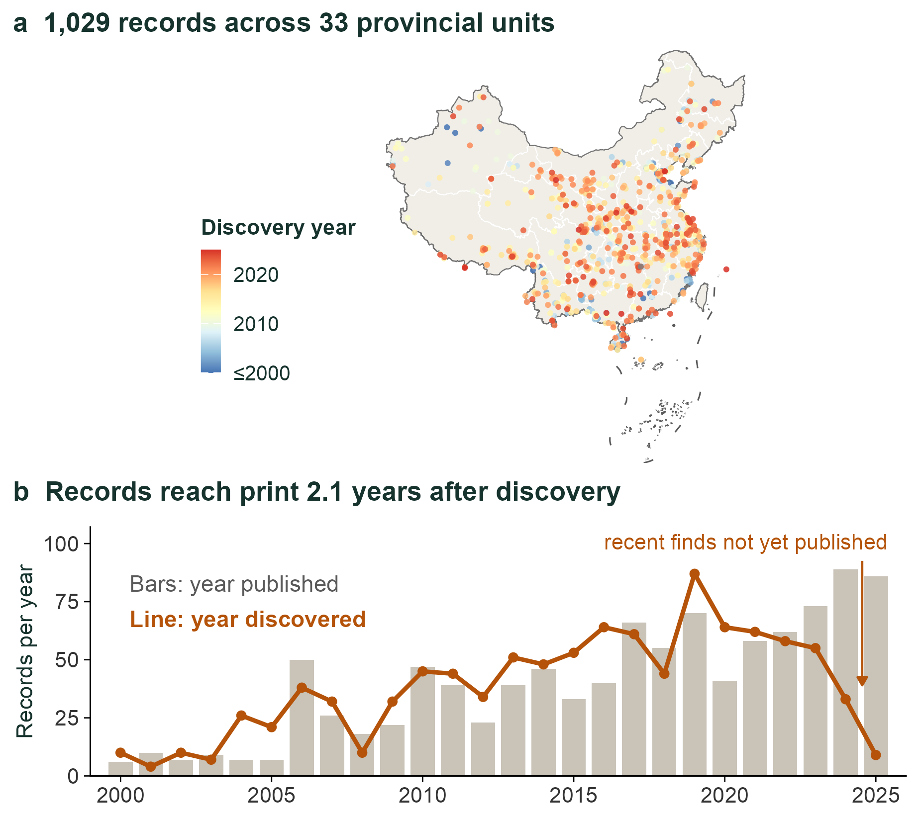

CBNR v2 · Zenodo 20809949
CBNR: an open dataset of provincial new bird records in China, 2000–2025
What is in it
Question
1,029 records · 568 species · 23 orders
33 provincial units · 2000–2025
Mined from peer-reviewed papers by an
Data
LLM-assisted pipeline; every record
then checked by hand
Findings
Why it matters for this talk
Discovery date and publication year
Georeferenced; three taxonomies linked
Robust
Detection method, discovery reason, status
Open data · CC BY 4.0
Uses
Zenodo, v2 (June 2026)
doi.org/10.5281/
zenodo.20809949
Wrap-up
Scan to download →
Birds or birders? · AOC 2026, Singapore
03 / 20
Notes:
[about 55 s · 112 words]
Our data come from CBNR, the China Bird New Record dataset, which our team released this year. It compiles provincial new records of birds from the peer-reviewed literature, 2000 to 2025: 1,029 records of 568 species, across 33 provinces. We pulled them out of the papers with a large-language-model pipeline, and then checked every single record by hand. Two things make it useful today. First, it keeps both the discovery date and the publication year. As panel b shows, a record reaches print about two years after it's found. Please keep that in mind. Second, it's open: CC BY licence, on Zenodo. If you'd like to use it, just scan the code.
If asked — Is CBNR complete? It covers peer-reviewed provincial new records; grey literature and unpublished sightings are not included.
If asked — How accurate is the LLM extraction? The model only drafts; every record was checked by hand, and the audit trail is part of the release.

Slide 4
Methods
One hazard model, four parts that cannot be dropped
For every species, in every province it could reach, in every year: is this the year of its first record?
Question
first record ~ warming × effort + climate variability + offset(log completeness)
+ (1 | species) + (1 | province) + (1 | province × year)
binomial, cloglog link
Data
cloglog = discrete-time proportional hazards, so exp(β) is a hazard ratio (HR)
Complete risk set
Dated to discovery
Findings
Only provinces the species could reach
Publication lags discovery by 2.09 years
Leaves the risk set after its first record
83% of events move to another year
Denominator = real opportunities
An offset corrects recent incompleteness
Robust
Species-referenced warming
Province × year effect
Province anomaly − range anomaly
The scale at which surveys happen
Uses
15-year moving window
Bird races, survey campaigns, new reserves
1 SD = 0.179 °C
The observation process, modelled
Wrap-up
Hazard ratio (HR): how many times one SD of a driver multiplies the yearly chance of a first record
Birds or birders? · AOC 2026, Singapore
04 / 20
Notes:
[about 45 s · 92 words]
We turned the question into a survival-style model. For every species, in every province it could plausibly reach, in every year, we ask: is this the year of its first record? Four parts matter. A complete risk set, so the denominator is real opportunities. Discovery dating, with an offset for records that are not yet published. Warming measured relative to each species' own range, because warming is fairly even across China, so only the difference tells us something about a species. And a province-by-year random effect, which is where survey campaigns live.
If asked — Why cloglog? It is the discrete-time form of a proportional-hazards model, so exp(beta) is a hazard ratio that does not depend on the time step. A logit coefficient would.
If asked — How is 'could reach' defined? Provinces with at least 50 suitable cells in the species' distribution model; results are the same at 100 and 200.

Slide 5
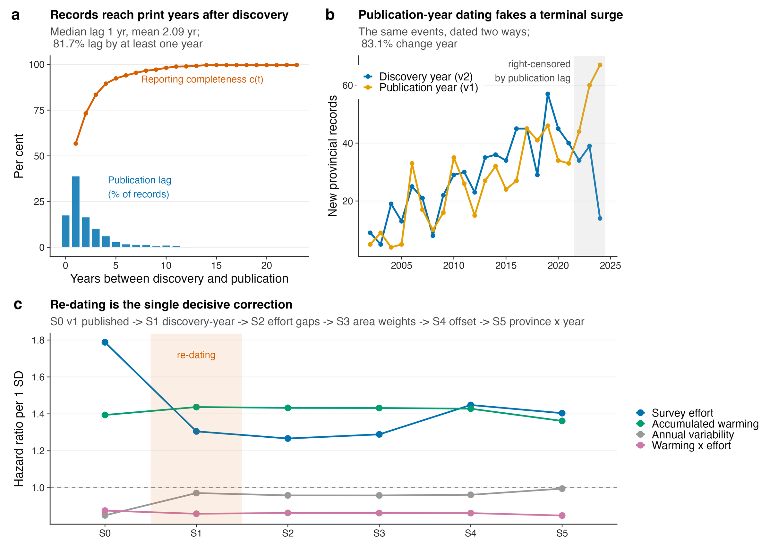
Figure 2 · Table 1
Finding 1 · Change the dating, and the conclusion changes
Publication year → discovery year
Question
Effort HR 1.79 → 1.31 (inflated by 37%)
Climate variability 0.85 → 0.97 (gone)
Accumulated warming 1.39 → 1.44 (stable)
Data
The 0.85 had P = 0.00018 — a phantom
Findings
Why it happens
The lag is right-skewed (mean 2.1 years)
and grew along with birding databases,
Robust
so publication year = a year of more effort
Uses
So what?
Dating is a modelling decision,
not bookkeeping
Wrap-up
Birds or birders? · AOC 2026, Singapore
05 / 20
Notes:
[about 40 s · 88 words]
First finding: the date you attach to a record changes the answer. If we date records by publication year, as most studies do, the effort effect is inflated by thirty-seven percent, and a climate-variability effect appears, with P below 0.001. That effect is not really there. Dated to discovery, it disappears, while the warming effect barely moves. Why? Because the publication lag grew over time together with the birding databases. So the publication year is, systematically, a year with more effort. Dating is a modelling decision, not bookkeeping.
If asked — Where do discovery dates come from? They are reported in the source papers; 1,028 of the 1,029 records have a parseable discovery year.

Slide 6
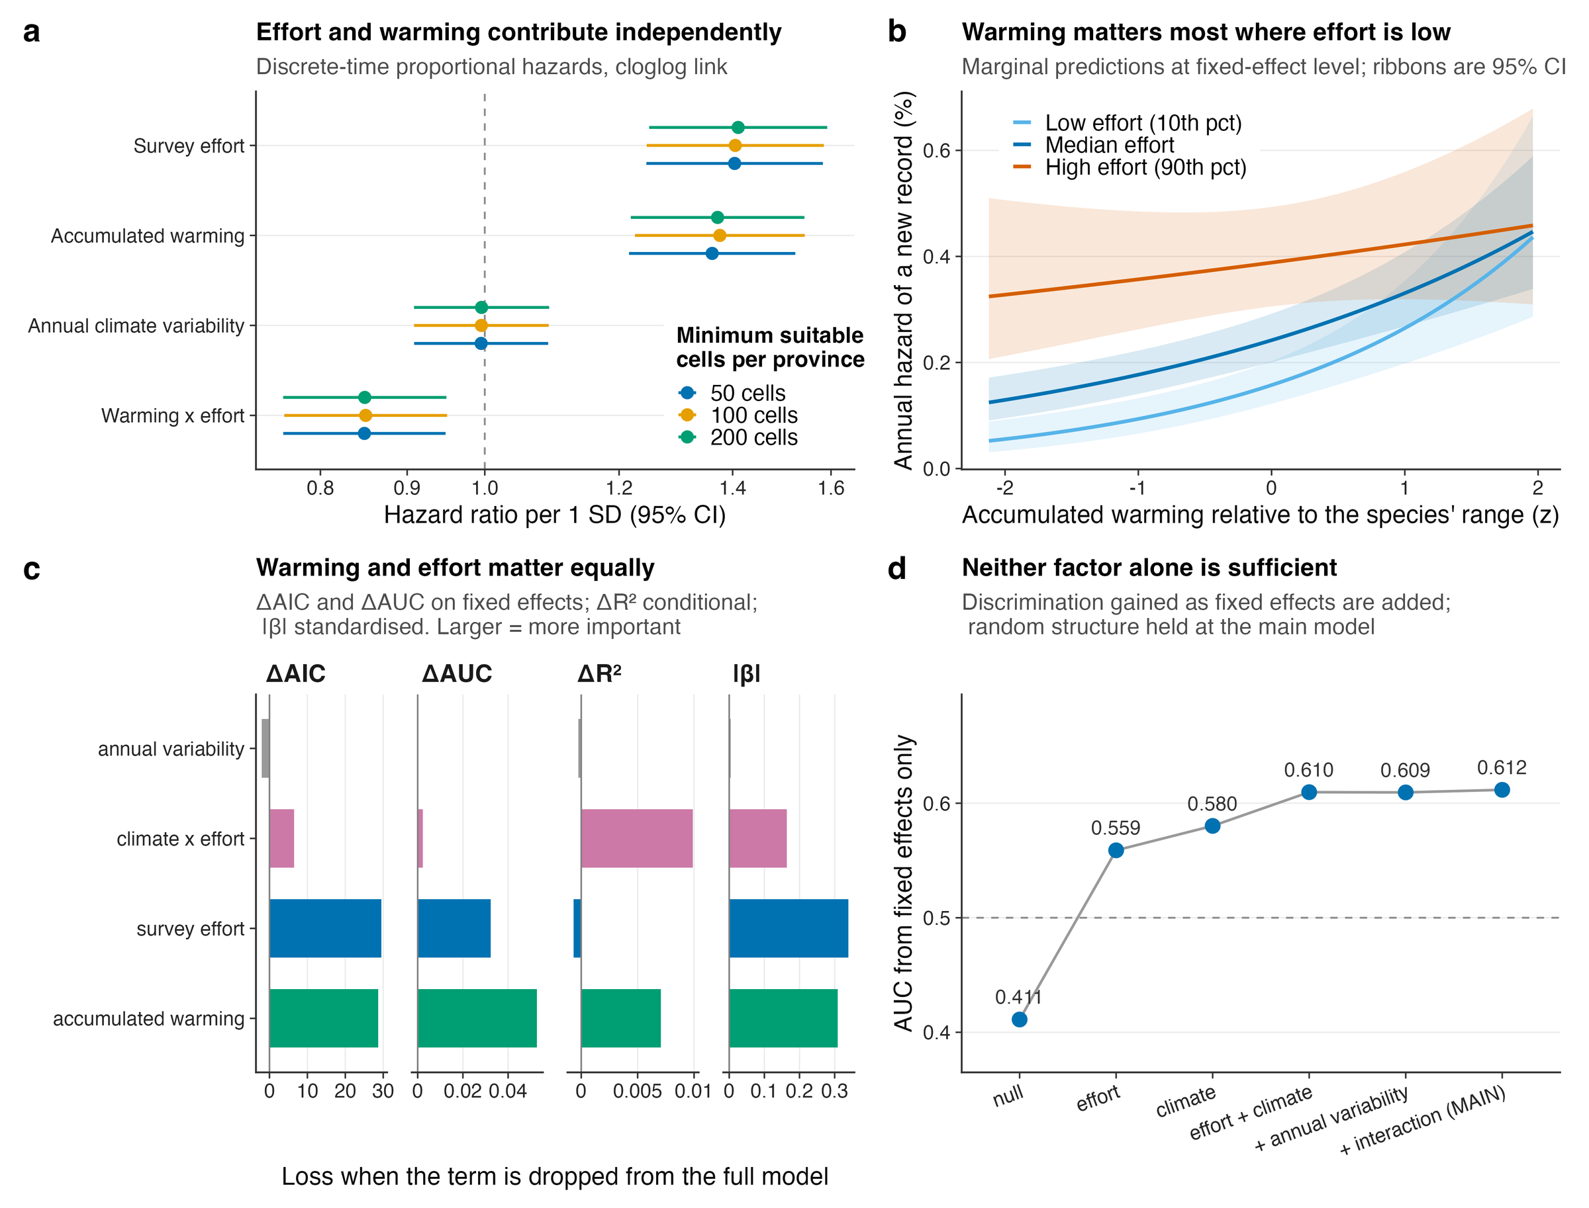
Figure 1 · Table 2
Finding 2 · Warming and effort matter equally — and interact
Main model (n = 175,901)
Question
Warming HR 1.36 (1.22–1.52)
Effort HR 1.40 (1.25–1.58)
Warming × effort HR 0.85 (0.76–0.95)
Data
Climate variability HR 1.00 (no effect)
Findings
Read each effect against the right null
Permutation null for warming = 1.16, not 1
→ species-specific increment ≈ ×1.18
Robust
Shuffle effort's timing: it falls to 0.98
→ its signal comes from real timing
Uses
Province-clustered bootstrap
Wrap-up
Warming 1.20–1.72 · effort 1.21–1.76
Both lower bounds above 1
Birds or birders? · AOC 2026, Singapore
06 / 20
Notes:
[about 40 s · 81 words]
Second: after correction, warming and effort contribute about equally. A hazard ratio of 1.36 per standard deviation for warming, and 1.40 for effort. They also interact negatively: warming matters most where survey effort is low. One honest caveat. For warming, the right null is not one. Our permutation null sits at 1.16, so the part we can attribute to species-specific warming is about 1.18. Effort is different: if we break its timing, it collapses to 0.98. So its signal is real.
If asked — So how big is the warming effect, really? Significant and robust, but the increment from species-specific warming is about 18 percent per SD, not 36.
If asked — What does 1 SD of warming mean? 0.179 degrees Celsius of species-referenced accumulated warming.

Slide 7
Figure 1c,d · Figure 3
The balance holds across four criteria and twelve specifications
Question
Cost of dropping each term
Discrimination ladder (Figure 1d)
ΔAIC: warming 28.7 · effort 29.5
Null 0.41 → effort only 0.56
ΔAUC: warming 0.053 · effort 0.032
→ warming only 0.58 → both 0.61
Δ conditional R² and |β| agree
Climate alone beats effort alone; both needed
Data
Twelve specifications, one answer
Survey effort
Accumulated warming
Findings
SDM thresholds (50 / 100 / 200 cells)
HR 1.40–1.41
HR 1.36–1.38
Robust
4 effort proxies × 3 missing-data rules
HR 1.25–1.52
HR 1.35–1.37
4 climate windows × 3 baselines
—
best window 18–20 yr
Uses
A weather-driven process predicts the opposite window pattern — we did not see it.
Wrap-up
Birds or birders? · AOC 2026, Singapore
07 / 20
Notes:
[about 25 s · 53 words] [optional: can be cut]
This balance is not fragile. Drop either term and the model loses about the same, around 29 AIC units each. On discrimination, climate alone does slightly better than effort alone, and you need both. And across twelve specifications, with different distribution-model thresholds, effort proxies, missing-data rules and climate windows, the numbers stay put.

Slide 8
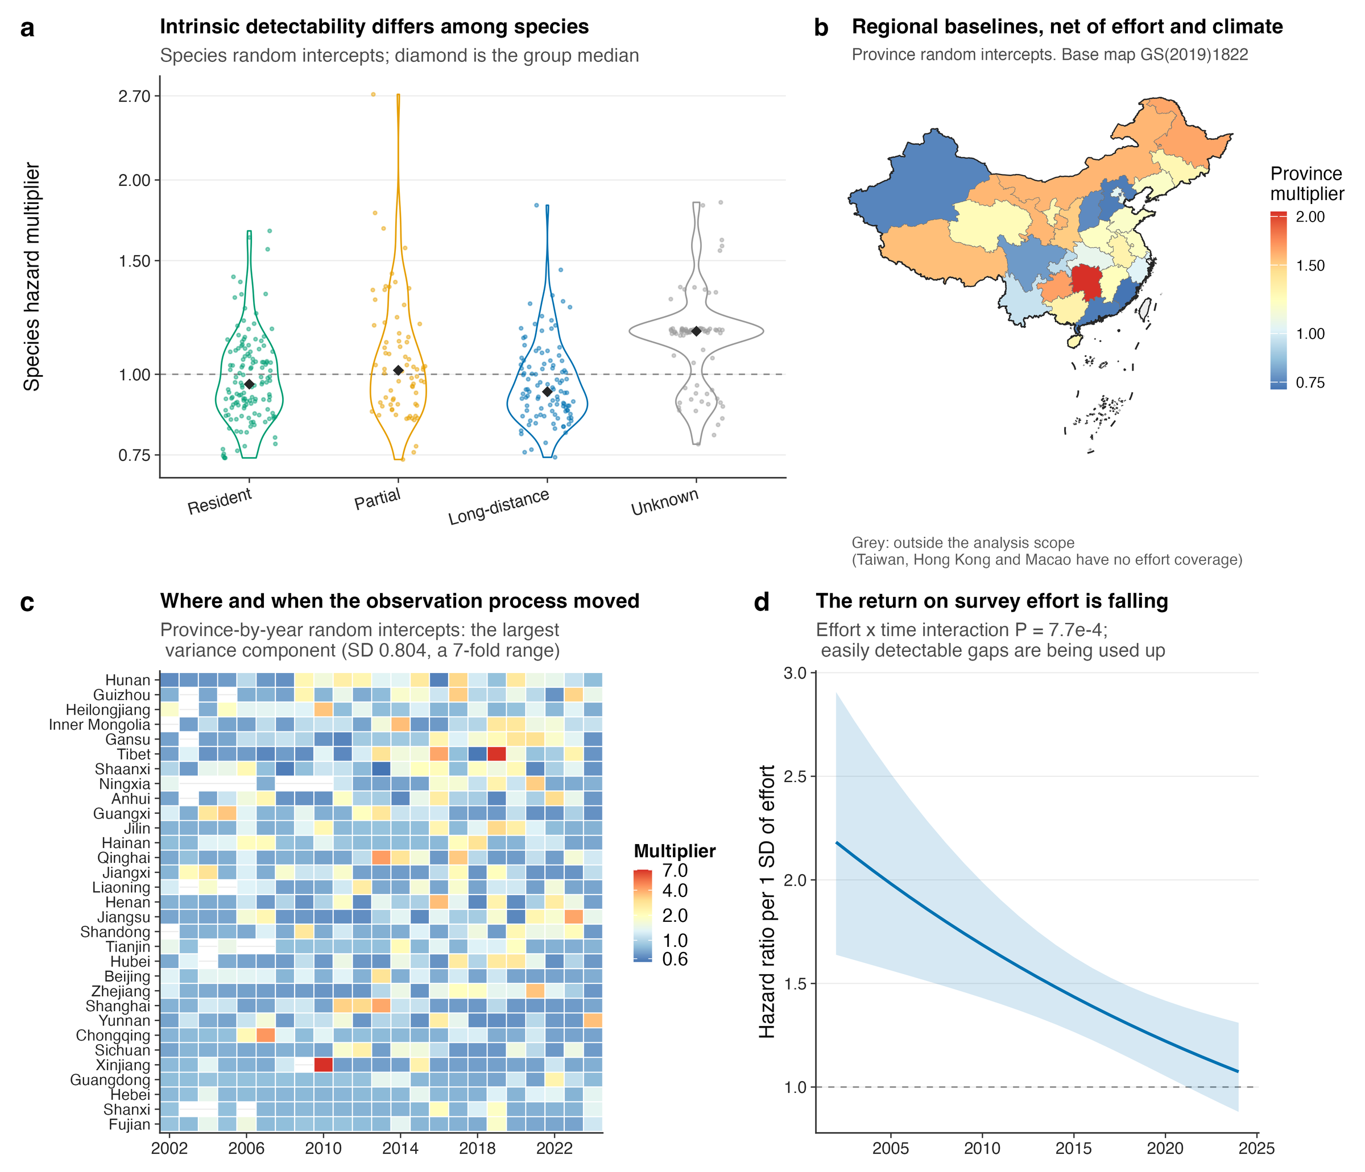
Figure 5 · Table 3
Finding 3 · Survey campaigns move the record more than either driver
Province × year effect
Question
× 2.23
per 1 SD
Data
Three layers
Species: ×1.50 (detectability)
Province: ×1.39 (regional baseline)
Findings
Province × year: ×2.23 (survey shocks)
Robust
Adding this layer
Conditional AUC 0.72 → 0.85
Conditional R² 0.27 → 0.41
Uses
Fixed effects unchanged
Wrap-up
Treat it as noise,
and survey history reads as range change
Birds or birders? · AOC 2026, Singapore
08 / 20
Notes:
[about 35 s · 78 words]
Third: the biggest single component is not a driver at all. It's the province-by-year effect. One standard deviation of it multiplies the hazard by 2.23, more than warming or effort. This is where a provincial bird survey, a big birding event, or a new reserve shows up. Adding this layer lifts conditional AUC from 0.72 to 0.85, but leaves the fixed effects unchanged. If you treat it as noise, you will read the survey history as range change.
If asked — Could the province-by-year effect also absorb climate anomalies? Yes, partly; that protects the fixed effects at some cost in climatic signal, and we say so in the paper.

Slide 9
Figure 5d · SI Notes S3–S4
Finding 4 · Effort is saturating; warming shows no such trend
Effort breaks proportional hazards (P = 0.00077): a finding, not a failure
Question
Returns on effort are falling
Warming shows no such trend
2002: HR 2.18 (1.63–2.90)
Warming × time: P = 0.82
2024: HR 1.07 (0.88–1.30)
Time-varying model: warming HR 1.37
Data
After 2022 the interval includes 1
Effort mines a finite stock of gaps;
The easy gaps have been filled
warming keeps adding new candidates
Findings
Consistent with a stock and a flow
The two time trends were not tested against each other: consistent, not proven
Robust
Same signal at province level
What it means for monitoring
Provinces well covered in 2002–2008
More effort in eastern hotspots adds little;
Uses
now yield fewer records per unit of effort
send it to under-surveyed,
IRR 0.71, P = 0.028
fast-warming regions
Wrap-up
Birds or birders? · AOC 2026, Singapore
09 / 20
Notes:
[about 45 s · 96 words]
Fourth: effort is saturating. The effect of effort fell from a hazard ratio of 2.2 in 2002 to about 1.1 in 2024, and after 2022 it is no longer different from one. The easy gaps have been filled. Warming shows no such trend. One way to read this is a stock and a flow: effort mines a finite stock of undiscovered records, while warming keeps adding new candidates. We haven't tested the two trends against each other, so I'd call it consistent, not proven. For monitoring, it means that more effort in eastern hotspots adds little.

Slide 10
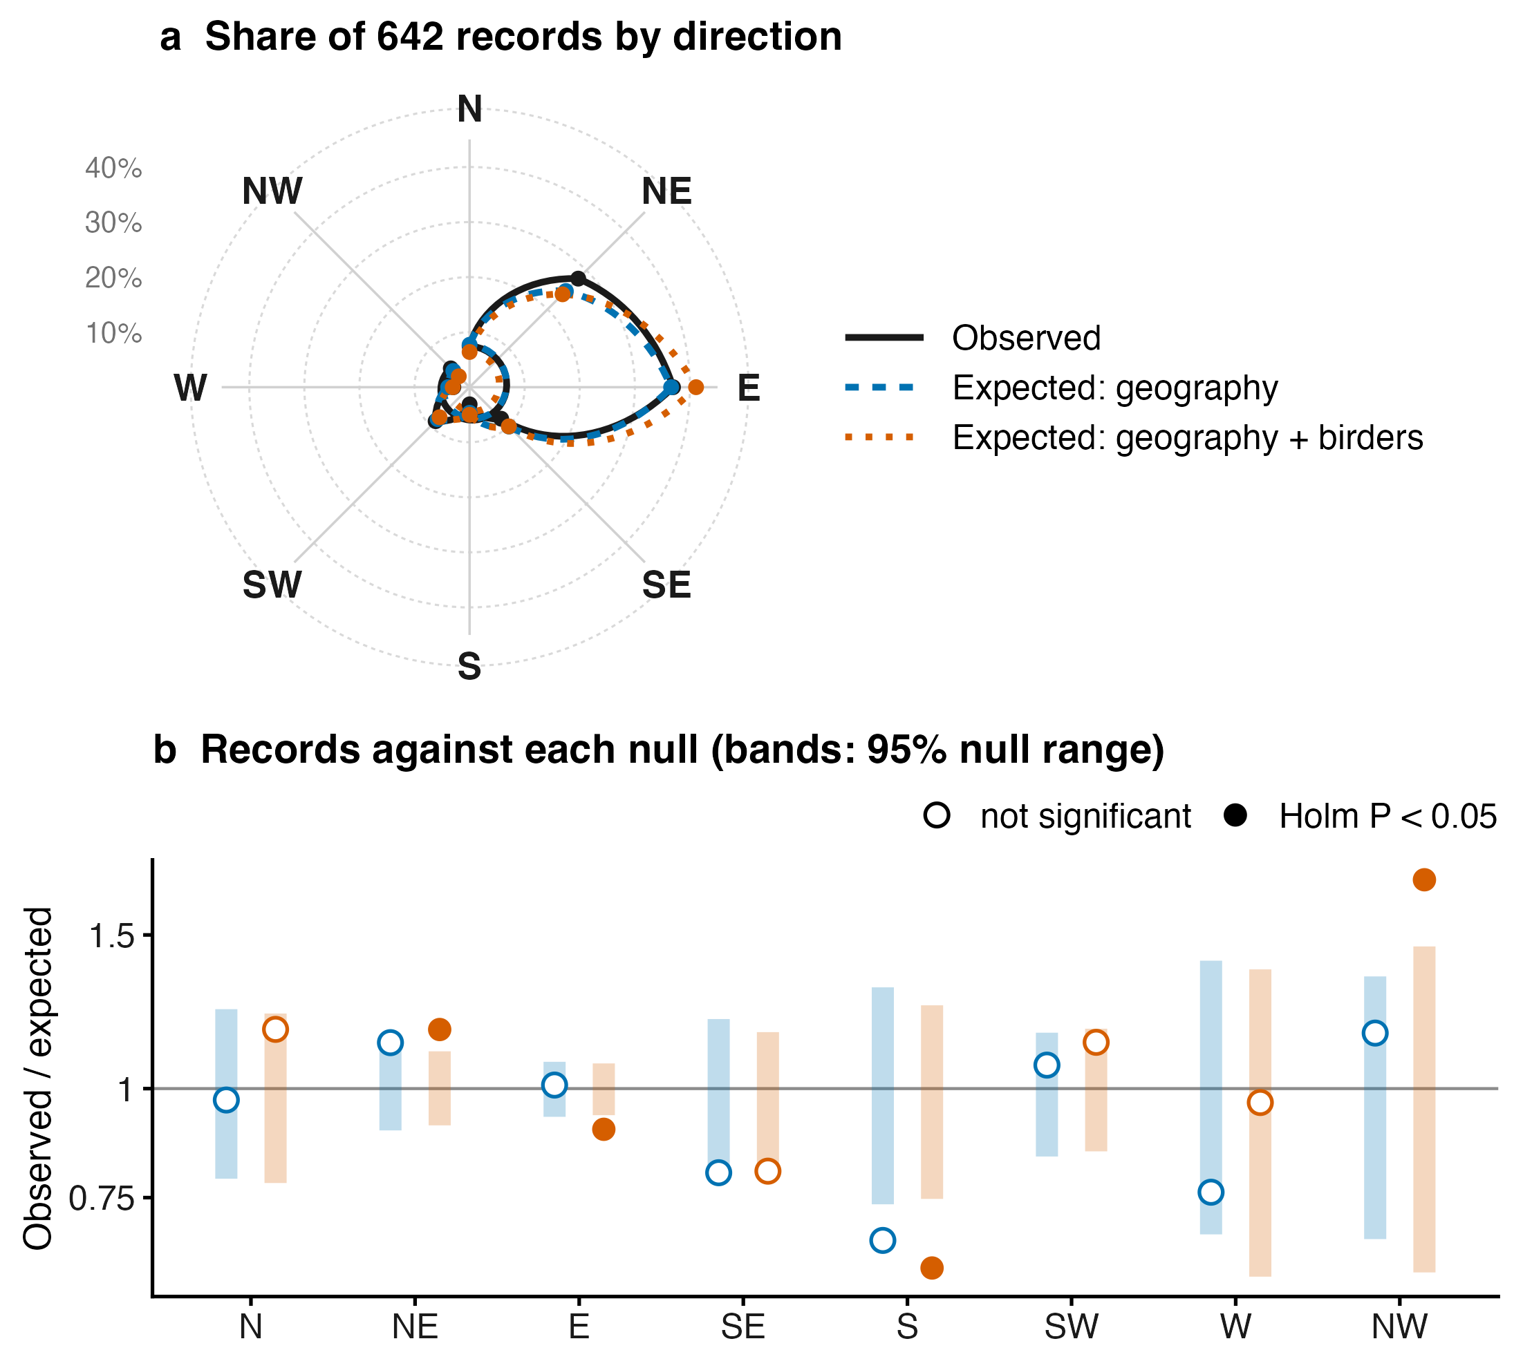
Figure 6 · SI Tables S9–S10
Finding 5 · The eastward bias is geography; records lean slightly north
Raw bearings (642 records)
Question
East 36.9% · north-east 27.9%
χ² = 580 against a uniform null,
but China lies east of most ranges
Data
Null 1 · geography only
Findings
Each record placed at random among
its species' possible provinces
East: 235 expected, 237 observed
Robust
Null 2 · geography + birders
More NE and NW, fewer E and S
Uses
Northern sectors: 40% vs 33% expected
χ² = 25.8, P = 0.001
Wrap-up
Direction mostly reflects geography;
net of it, records lean slightly north
Birds or birders? · AOC 2026, Singapore
10 / 20
Notes:
[about 50 s · 102 words]
Fifth: direction. Measured from each species' range centre, new records look strongly biased to the east and north-east. But most of these species have ranges centred west or south of China, so almost any record inside China lands to the east. If we scatter each record at random among its species' possible provinces, geography alone reproduces the eastward pattern. Only when we also weight provinces by where birders go does a signal remain, and it points north: more records than expected to the north-east and north-west, fewer to the east and south. A modest poleward lean, visible only with the right null.
If asked — Why global range centroids? That is what AVONET provides for every species. Any reference point needs a geometric null; ours places records at province level, and a finer, grid-level null is a next step.

Slide 11
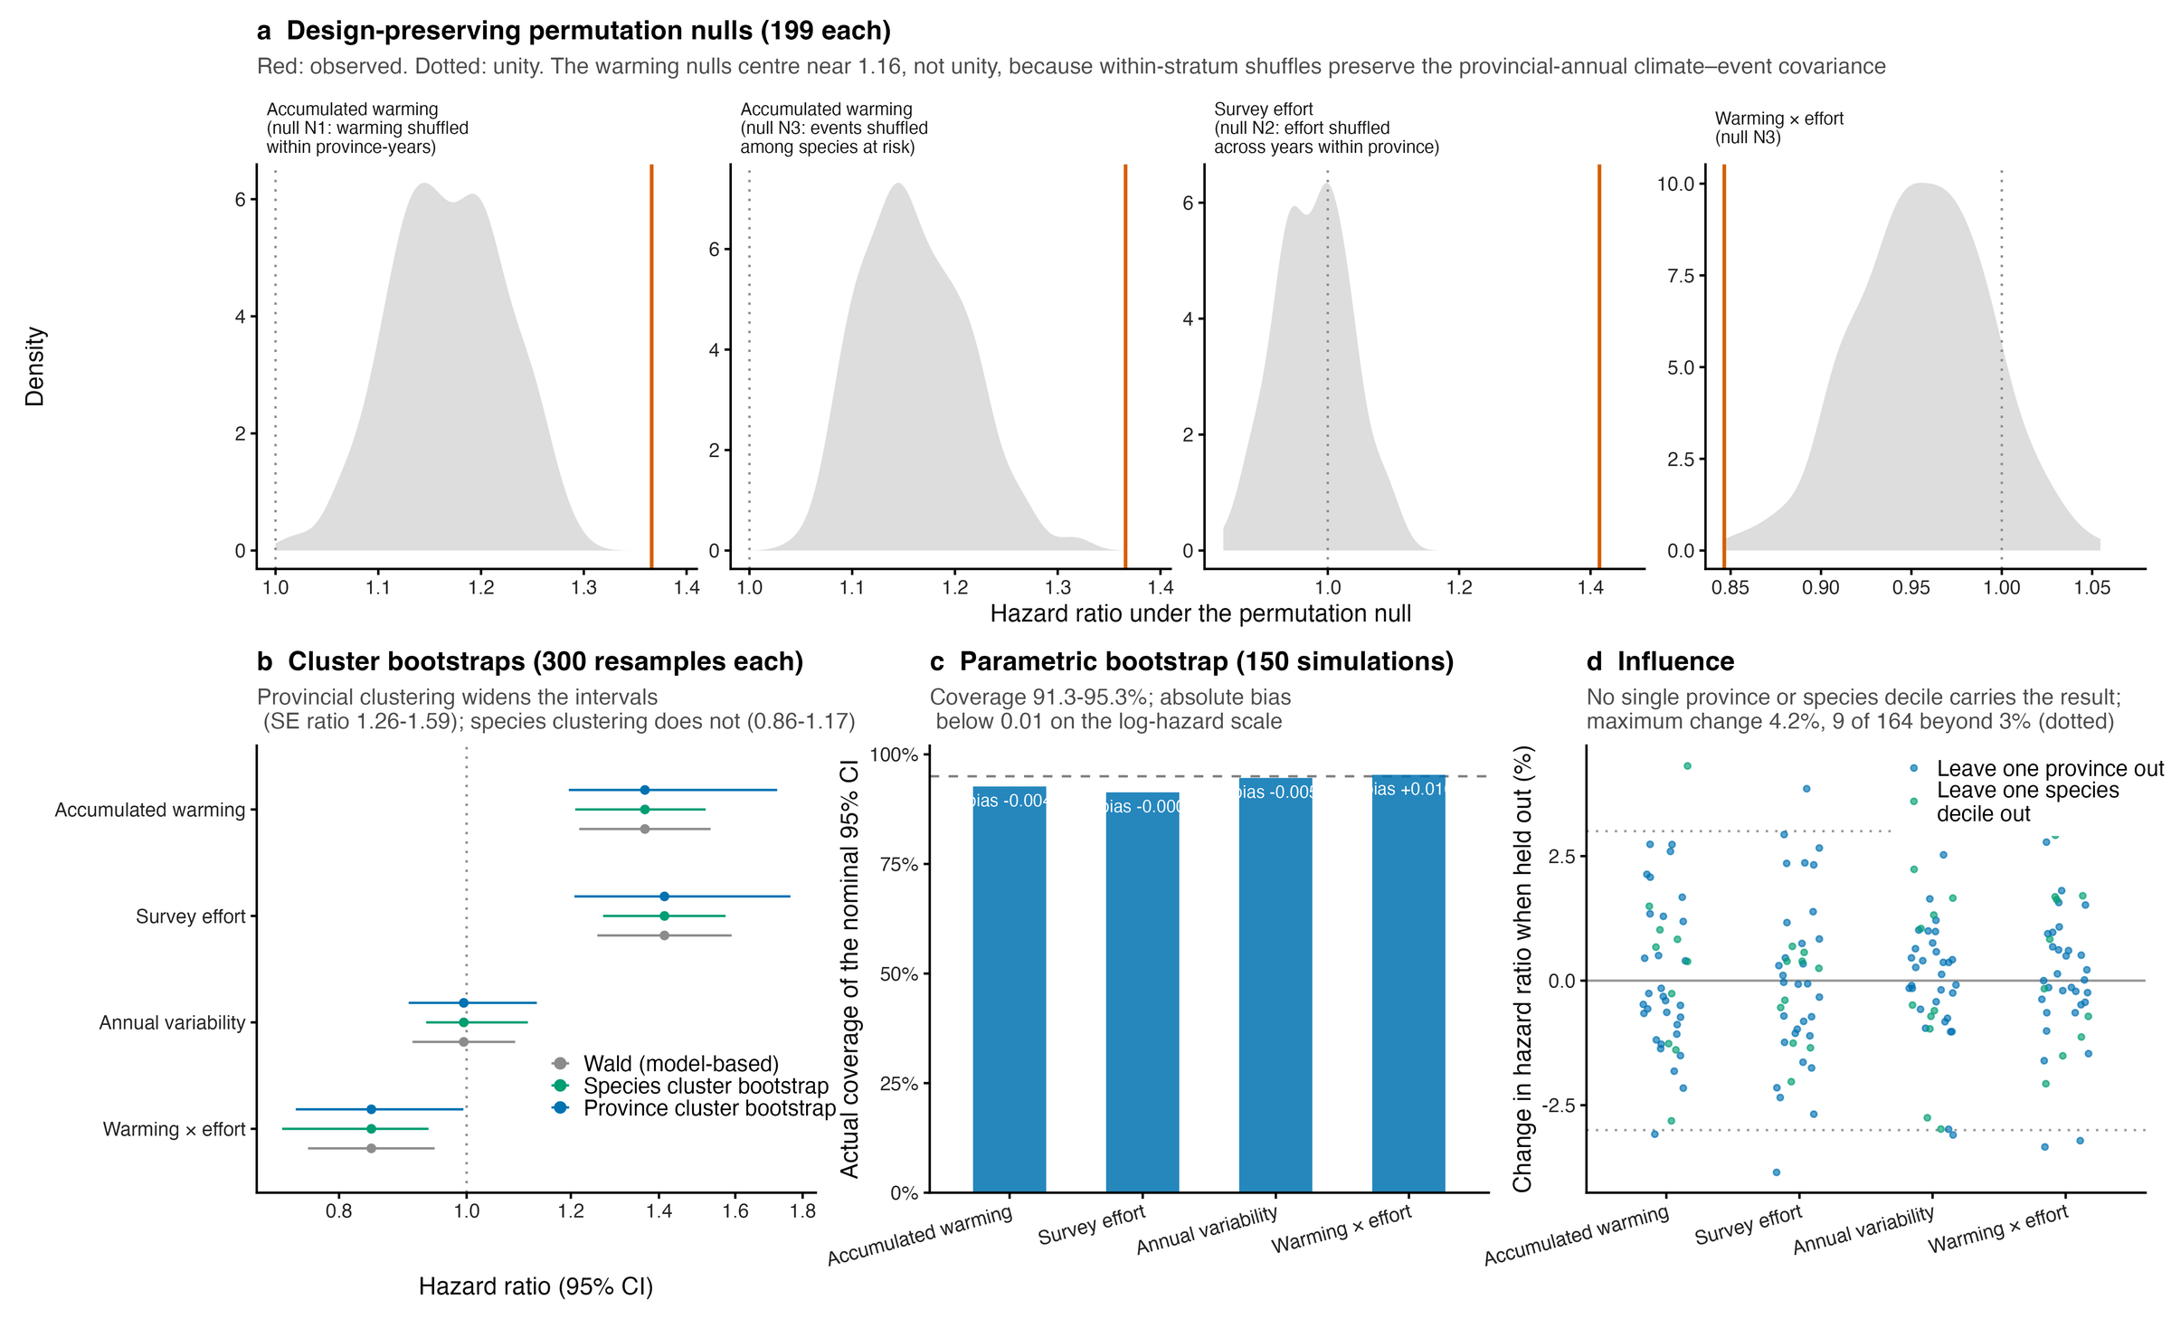
SI Fig. S11 · Table 2
The results survive null models and resampling
Design-preserving nulls
Question
Each null breaks one link, keeps the rest
199 permutations per null
All four coefficients outside their nulls
Data
P = 0.005 (variability excepted)
Findings
Bootstraps and influence
Province-cluster bootstrap: SE ×1.26–1.59
Parametric bootstrap coverage 91–95%
Leave one out: largest change 4.2%
Robust
No single province or species
Uses
group drives the result
Diagnostics (DHARMa): uniformity P = 0.74 · dispersion P = 0.59 · zero-inflation P = 0.59 · Moran's I P = 0.86
Wrap-up
Birds or birders? · AOC 2026, Singapore
11 / 20
Notes:
[about 25 s · 51 words] [optional: can be cut]
We also tested all of this against design-preserving null models, which break one link at a time and keep everything else. All four coefficients sit outside their nulls. Bootstraps clustered by province widen the intervals but don't change the conclusions, and no single province, or group of species, drives the result.

Slide 12
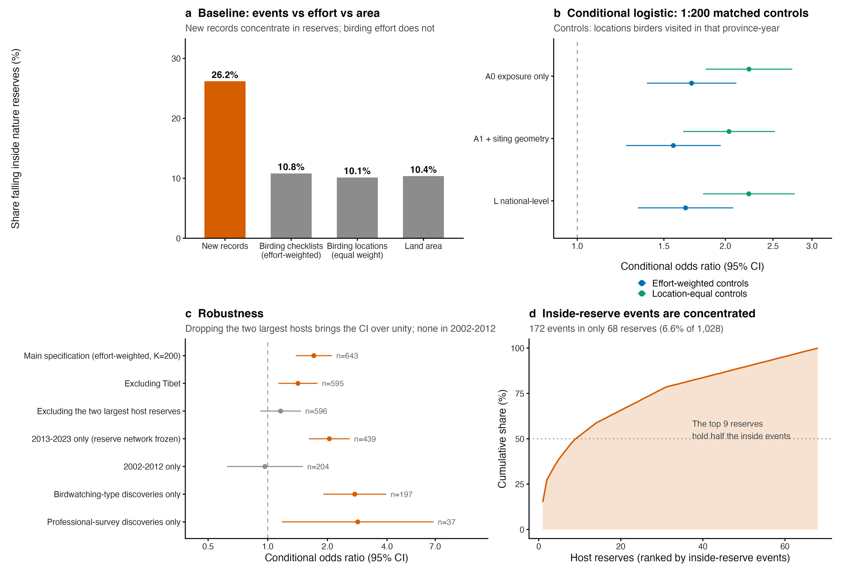
SI Figs S12–S14
Use 1 · Reserves look rich in new records because birders go there
An apparent 2.5-fold enrichment
Question
Records inside reserves: 26.2%
Birding effort inside reserves: 10.8%
Land area inside reserves: 10.4%
Data
Against where birders actually went
Findings
Matched same province and year: OR 1.57
Without the 2 largest reserves: 1.16
Before 2013: no effect (0.97)
Robust
Checklists inside list 24% more species
Uses
More records ≠ better protection
Record counts cannot measure
how well a reserve works
Wrap-up
Birds or birders? · AOC 2026, Singapore
12 / 20
Notes:
[about 40 s · 82 words]
Now, some uses. Nature reserves look like hot spots for new records: twenty-six percent of records fall inside reserves that cover only ten percent of the land. But birders go there too. When we compare each record with places birders actually visited, in the same province and year, the effect shrinks. It disappears if we drop the two largest host reserves, or look at the years before 2013. So, more records inside a reserve is not evidence that the reserve is working.
If asked — Which reserves? 1,028 mapped, mostly national, nature reserves established before 2012; about a third of all listed reserves, so we make no gap-analysis or 30-by-30 claims.

Slide 13
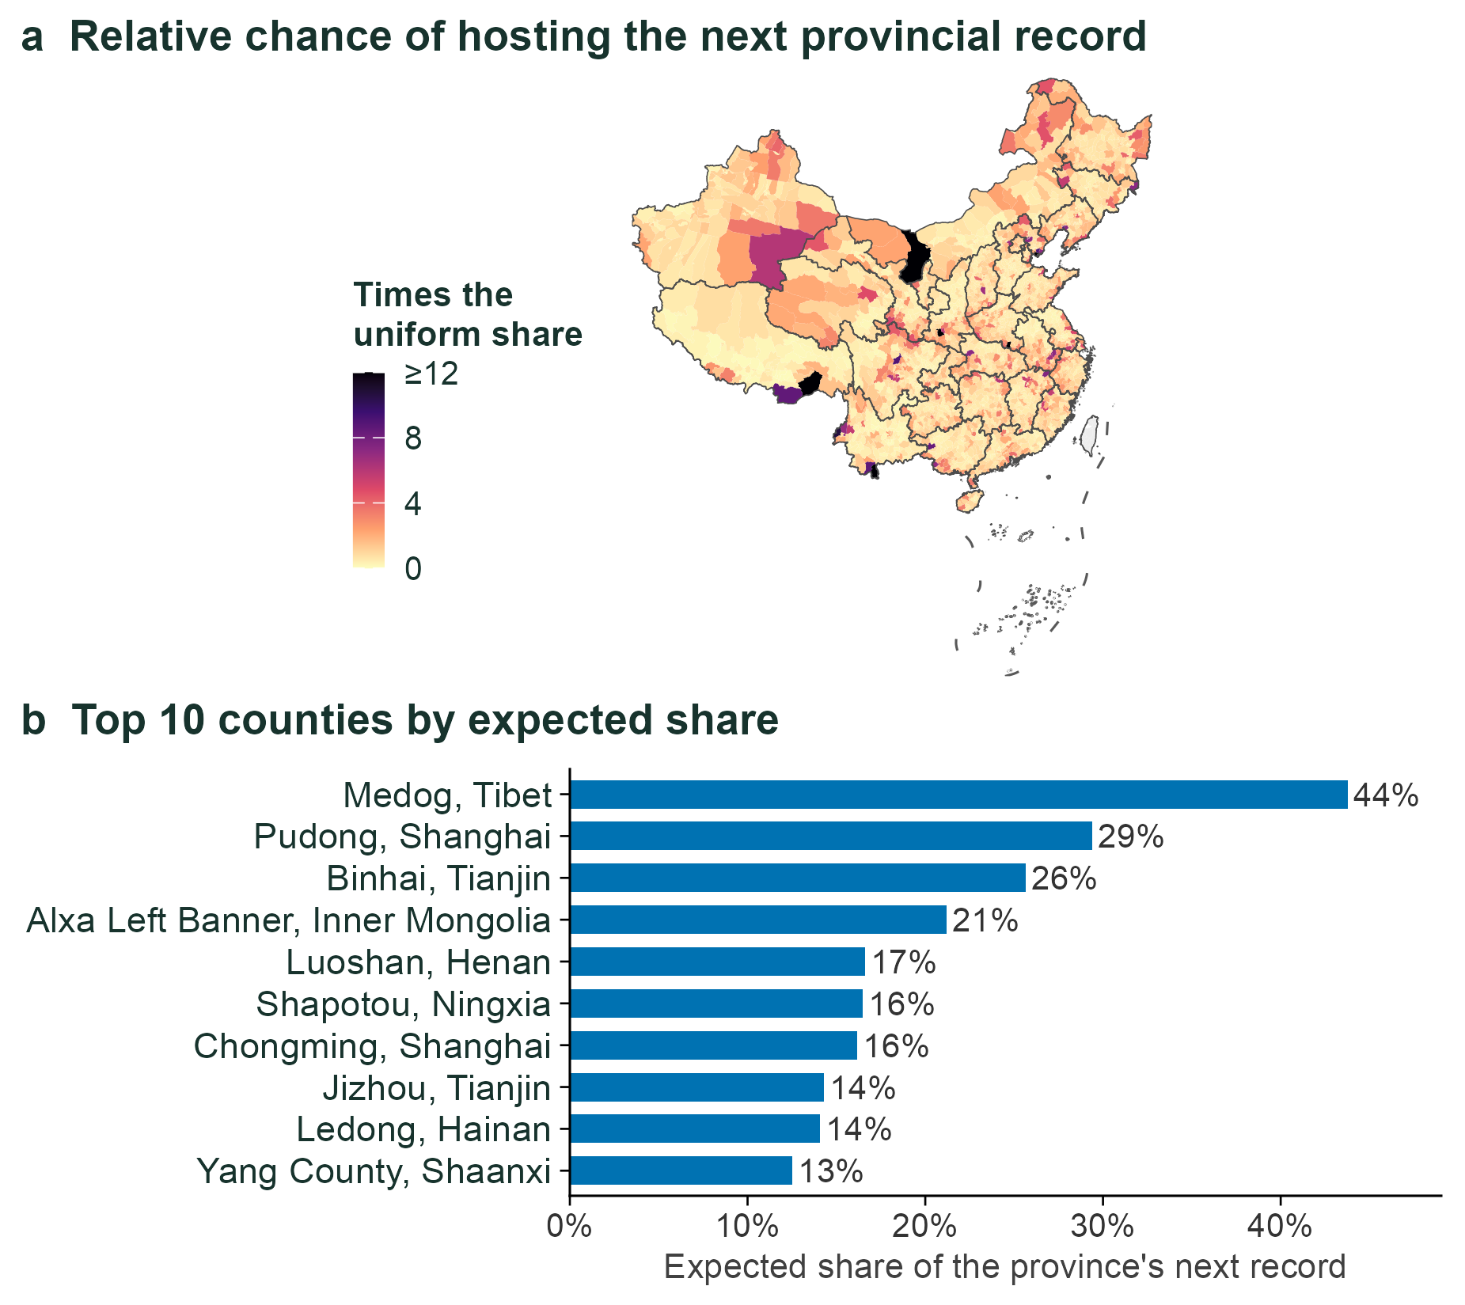
Repository module
Use 2 · Predictions can be pushed down to the county
Two steps
Question
1 Will the province get a new record?
2 If so, which county? (conditional logit)
Data
Out-of-sample skill, 2019–2024
Findings
Top-ranked county right 16.1% of the time
(random: about 1%)
True county in the top 10%: 45.4%
Robust
Leave one province out: 27 of 29 beat random
Uses
Birders will know these names
Medog · Pudong (Nanhui) · Chongming
Wrap-up
Luoshan (Dongzhai) · Yang County
— the model was never told
Birds or birders? · AOC 2026, Singapore
13 / 20
Notes:
[about 35 s · 77 words]
Second, we can push the predictions down to counties. We split the problem in two: will a province get a new record, and if it does, which county? Tested on 2019 to 2024, the top-ranked county was right sixteen percent of the time, against about one percent by chance. And look at the list: Medog; Pudong, which includes Nanhui; Chongming; Luoshan, home of Dongzhai; Yang County. Birders in China know these names. The model was never told.
If asked — Why do Shanghai and Tianjin districts rank so high? Those provinces have only 16 districts, so each one's share is naturally larger.
If asked — Is this in the paper? It is an extension module in our open repository, beyond the journal manuscript.

Slide 14
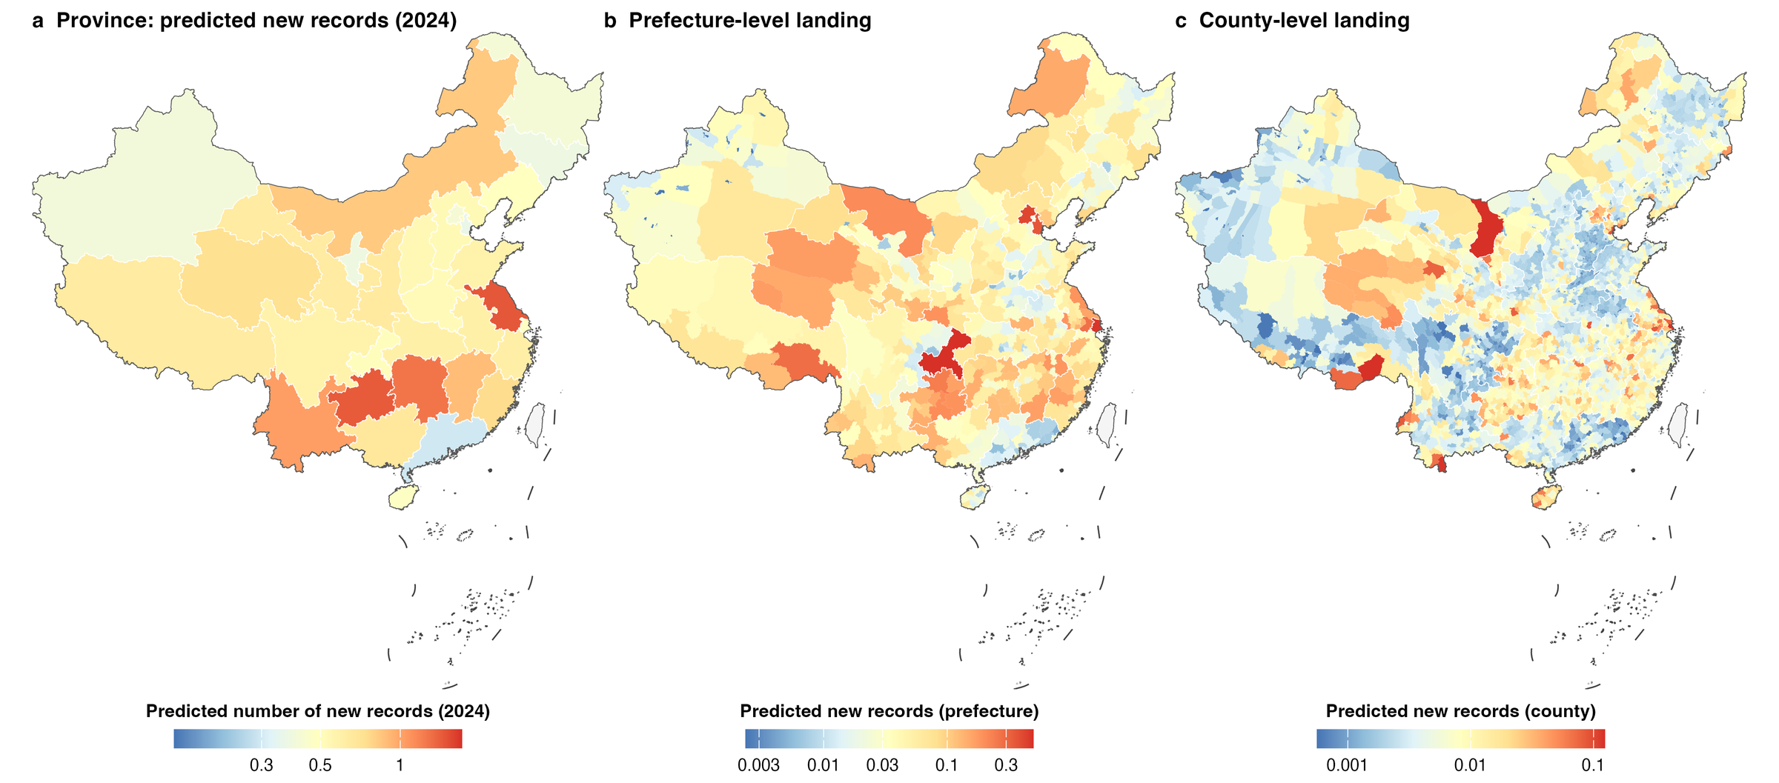
Repository module
Province, prefecture and county maps from one consistent model (2024)
Question
Data
Findings
Robust
Uses
Wrap-up
One model, three scales
Change the model family: maps barely move
Expected records (province) × share (unit)
Random forest / XGBoost: ρ = 0.62–0.90
371 prefectures · 2,835 counties · log colour
Differences sit in the low-effort west
Birds or birders? · AOC 2026, Singapore
14 / 20
Notes:
[about 20 s · 46 words] [optional: can be cut]
Here is the same model at three scales: province, prefecture and county, for 2024. We also refitted it with random forests and with XGBoost. The maps barely change, with rank correlations between 0.62 and 0.90. Where to look first is robust to the choice of model.

Slide 15
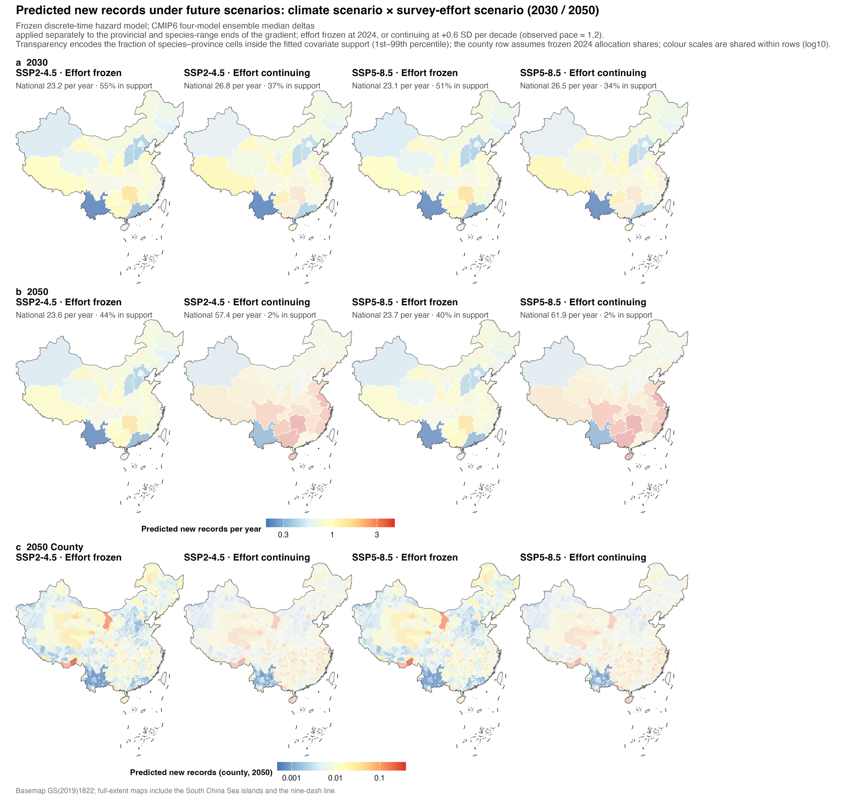
Repository module
Futures: two climate × two effort scenarios (2030 and 2050)
Scenario grid
Question
Climate: SSP2-4.5 or SSP5-8.5
Effort: frozen at 2024, or +0.6 SD a decade
Horizons: 2030 and 2050
Data
Findings
What drives future record counts?
Switch climate: 23.2 → 23.1 per year
Switch effort: 23.6 → 57–62 per year
Robust
What we record will depend on how we look,
more than on how the climate changes
Uses
But read the transparency
Wrap-up
Effort growing, 2050: only 2% in support
Most of the rise lies outside the data
Birds or birders? · AOC 2026, Singapore
15 / 20
Notes:
[about 40 s · 83 words]
What about the future? We crossed two climate scenarios with two effort scenarios, and the result is striking. Switching from SSP2-4.5 to SSP5-8.5 changes the expected national count from 23.2 to 23.1 records a year. Essentially nothing. Switching effort from frozen to continuing growth more than doubles it. What we will record depends on how we look, more than on how the climate changes. But notice the transparency on the maps: by 2050, most of that increase lies outside the data we fitted.
If asked — Is 57 to 62 records a year a forecast? No. At 2050 only 2 percent of cells are inside the fitted support. The credible statement is about 23 to 27 records a year in 2030, under any scenario.

Slide 16
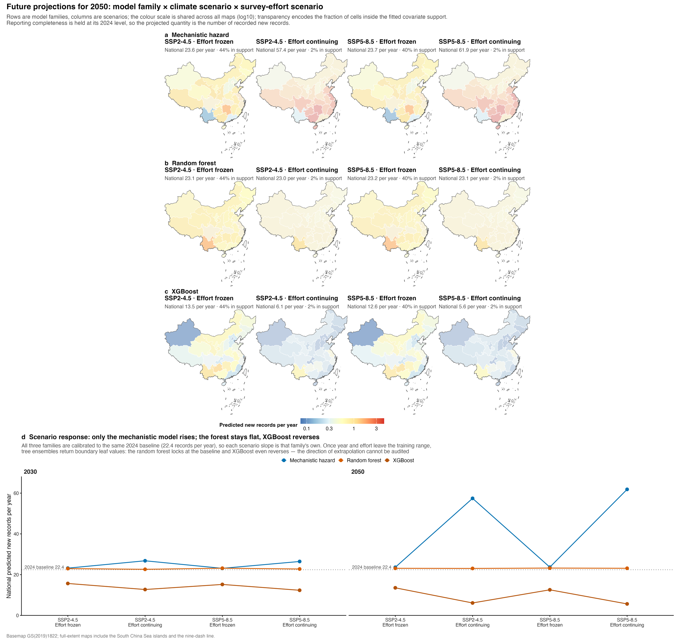
Repository module
Same futures, three model families: who responds, who flat-lines
Same scenarios, three model families
Question
All calibrated to 22.4 records a year in 2024
After that, each family's slope is its own
Data
Findings
2050, effort growing: they diverge
Hazard model: 23.6 → 57.4 per year
Random forest: 23.1 → 23.0 (flat)
XGBoost: 13.5 → 6.1 (reversed)
Robust
Yet all agree on where (ρ = 0.62–0.90)
Uses
Not a contest between models
Wrap-up
Outside the data, trees return edge values;
nobody can check the direction
Birds or birders? · AOC 2026, Singapore
16 / 20
Notes:
[about 35 s · 72 words] [optional: can be cut]
A warning about machine learning. We ran the same futures with three model families, all calibrated to the same 2024 baseline. Under continuing effort in 2050, our hazard model rises to 57 records a year, the random forest stays flat, and XGBoost actually goes down. They all agree on where records will appear. But outside the data, tree models simply return their edge values, and nobody can check which direction is right.
If asked — So do you trust the hazard model's 57? No, and I don't claim it: support there is 2 percent.

Slide 17
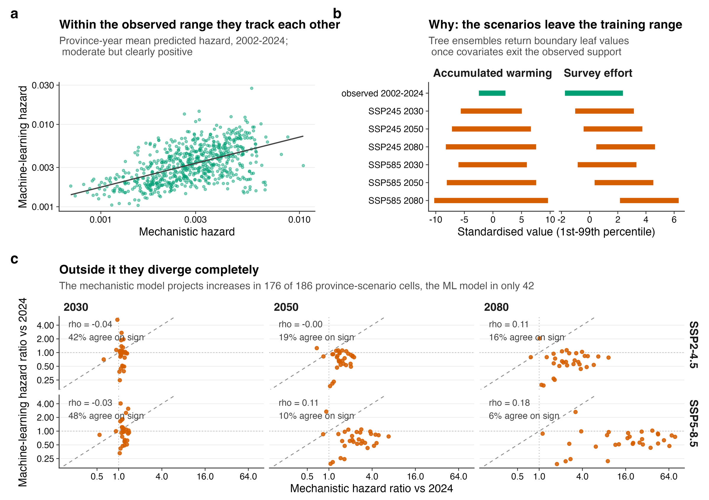
Figure 7 · SI Figs S6–S8, S10
Use 3 · Data support, not ambition, sets the forecast horizon
Data support shrinks fast (SSP2-4.5)
Question
Species–province cells inside the fitted range:
2030: 47.8% → 2050: 10.4% → 2080: 2.1%
Masked HR 0.79–2.94; unmasked up to 78
Data
Findings
Machine learning does not rescue it
Agree inside the range (ρ = 0.54),
diverge outside it
Random forest saturates at 6.7% by 2.9 SD
Robust
Uses
Report where a model breaks
2030: usable
End of century: illustration, not forecast
Wrap-up
Birds or birders? · AOC 2026, Singapore
17 / 20
Notes:
[about 25 s · 47 words] [optional: can be cut]
So our rule is simple: report where the model breaks. Under SSP2-4.5, the share of species-province combinations inside the fitted range drops from 48 percent in 2030, to 10 percent in 2050, and 2 percent by 2080. So 2030 is usable. End-of-century maps are illustrations, not forecasts.

Slide 18
Discussion
Four limits that travel with the conclusions
Question
Events are published records, not detections
We explain how records are documented, not range expansion itself; single cases need occupancy models.
Data
Coordinates are precise to about 1 km at best
Findings
Reserve-overlap tests therefore use 0–5 km buffers as a sensitivity check.
Robust
Reserve polygons cover about a third of listed reserves
1,028 mapped, mostly national, set up before 2012: no gap analysis, no 30×30 claims.
Uses
Direction and reserve tests are only as good as their nulls
Wrap-up
Direction uses province-level geometric nulls; no null removes observer bias inside reserves.
Birds or birders? · AOC 2026, Singapore
18 / 20
Notes:
[about 35 s · 71 words]
Four limits travel with these results. Our events are published records, not detections, so we explain how records get documented, not how ranges expand. Coordinates are precise to about one kilometre at best. Our reserve map covers about a third of listed reserves. And direction and reserve tests are only as good as their nulls: our direction null works at province level, and no null can remove observer bias inside reserves.

Slide 19
Conclusions
Four take-home messages
1 Dating is a modelling decision
2 Two processes, comparable and separable
Question
Publication dating inflates effort by 37%
Warming 1.36 · effort 1.40
and creates a phantom effect
increment over null ×1.18
Data
3 Model the observation process
4 Keep applications inside the evidence
Province × year ×2.23 is the largest part;
Records ≠ reserve success; counties work;
Findings
effort saturates; warming shows no such trend
the future depends on effort
Robust
Birds or birders? Not either–or.
Both matter about equally — but the climate signal becomes interpretable
Uses
only once we model how we look.
Next steps
Wrap-up
Reptiles and amphibians · test the direction mechanism across taxa · occupancy models for single cases
Monitoring priority = climate exposure × (1 − current coverage), mapped to counties
Birds or birders? · AOC 2026, Singapore
19 / 20
Notes:
[about 35 s · 70 words]
Four messages to take home. One: dating is a modelling decision, so use the discovery year. Two: warming and survey effort contribute comparably, and we can separate them. Three: model the observation process explicitly; survey shocks are the largest component. Four: keep applications inside the evidence. So, back to our question: birds or birders? It's not either-or. But the climate signal only becomes interpretable once we model how we look.

Slide 20
Data availability
Open data, open code — and thank you
Question
Open data and code
Other data
CBNR (CC BY 4.0)
Ranges: BirdLife International
doi.org/10.5281/zenodo.20809949
Climate: CRU TS 4.09 · WorldClim 2.1 · CMIP6
Code: github.com/dingchenchen6/
Effort: 2.86 million GBIF / eBird records
Data
bird-newrecord-discovery-dated
Reserves: 1,028 national nature-reserve maps
Every number traces back to a results table
Base map: approval no. GS(2019)1822
Findings
Acknowledgements
Birdwatchers across China, and every author whose records made CBNR possible.
Robust
Uses
Thank you — questions welcome
CBNR data
scan to download
chenchen.ding@pku.edu.cn
Wrap-up
Birds or birders? · AOC 2026, Singapore
20 / 20
Notes:
[about 25 s · 50 words]
Everything is open: the CBNR data on Zenodo, and all of the analysis code on GitHub, where every number in this talk traces back to a table. My thanks to birdwatchers across China, and to every author whose records made this possible. Thank you. I'm happy to take your questions.

