Slide 1


AOC 2026
Singapore
Disentangling climate signals from survey effort
in new bird distribution records across China
Birds or birders? A discrete-time hazard model of first records, 2002–2024
Chenchen Ding¹, Zhengwang Zhang², Zhigang Jiang³, Zhiheng Wang¹
¹ Peking University ² Beijing Normal University ³ Institute of Zoology, Chinese Academy of Sciences
3rd Asian Ornithological Conference · National University of Singapore · 14–17 November 2026
Notes:
[about 30 s]
Good morning, everyone. I'm Chenchen Ding, from Peking University. Today I'd like to ask a simple question about new bird records. When a species turns up in a new province, is that the bird moving, or is it us looking harder? Our answer is: both, in roughly equal measure, and I'll show you how a single model can tell the two apart.

Slide 2
Background
Research gaps
Questions
Approach
Results
Synthesis
Background
Global change is moving species, but we see it only through incomplete records
1
Global change threatens about one million species;
Biases accumulate at four stages
Species are moving poleward and upslope,
16.9 km per decade on land
Field survey
1
IPBES 2019; Chen et al. 2011; Pecl et al. 2017
uneven expertise, funding and access
2
Tracking these moves needs distribution data;
2
Detection
Those data are incomplete, and unevenly so
detectability, effort and survey method
across taxa, regions and time
Lomolino 2004; Hortal et al. 2015; Herkt et al. 2017
3
Documentation
local journals, other languages, old taxonomy
3
New distribution records are where a move first shows;
But a record shows that a bird was found,
4
Data sharing
not why it was there
slow, partial entry into GBIF, IUCN, BirdLife
Hughes et al. 2021; Lawlor et al. 2024
Boakes et al. 2010; Meyer et al. 2015; Oliver et al. 2021
Biases in how we look can be mistaken for patterns in nature
Ding, Zhang, Jiang & Wang · AOC 2026, Singapore
02
Notes:
[about 40 s]
Let me start with the big picture. Global change threatens about a million species, and one clear response is that species move: on land, poleward by about seventeen kilometres a decade. To see those moves we need distribution data, and those data are patchy. New records are where a move first shows up. The catch: a record tells us a bird was found, not why it was there. So a gap in looking can pass for a pattern in nature.
If asked: Where is the 16.9 km figure from? Chen et al. 2011 in Science: the median poleward shift across terrestrial taxa, with 11 m per decade upslope.

Slide 3
Background
Research gaps
Questions
Approach
Results
Synthesis
Background
China is a key region for bird distributions, but its new records are scattered
Zoogeographic realms
Biodiversity hotspots
Migratory crossroads
Bird species
2
4
Flyways
1,505
Palearctic and Oriental meet
global hotspots within China
several major flyways cross it
about 14% of the world's birds
Zhang 2011; Mittermeier et al. 2011; Zheng 2023
Monitoring has expanded fast
But the evidence is scattered
National networks such as Sino BON
Chinese-language papers and local reports
Citizen science and camera traps
Mixed taxonomy, few coordinates
Sound recording and DNA identification
Largely absent from global databases
Feng et al. 2019; Huang et al. 2021; Mi et al. 2021
Xing et al. 2024; Chen et al. 2025
Gap: no standardized, open dataset of provincial new bird records in China
So we built one: CBNR, the China Bird New Record dataset
Ding, Zhang, Jiang & Wang · AOC 2026, Singapore
03
Notes:
[about 25 s]
China is a good place to test this: two realms, four hotspots, several flyways, and about fifteen hundred bird species. Monitoring has grown fast, but most new records still sit in Chinese-language papers that never reach global databases. There was no standard dataset. So we built one: CBNR.

Slide 4
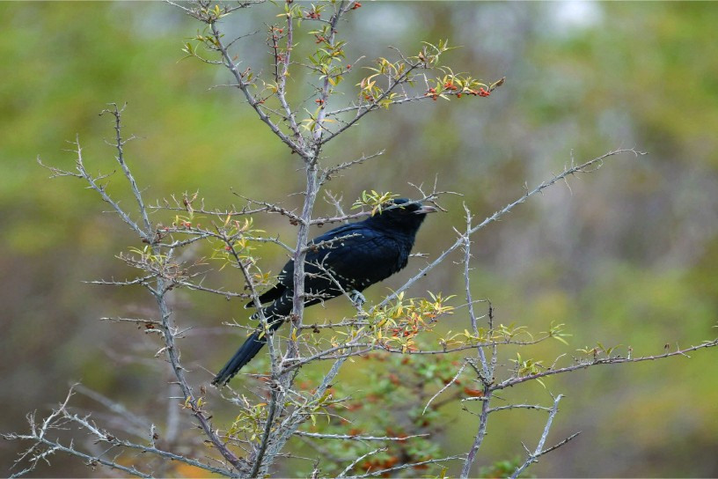
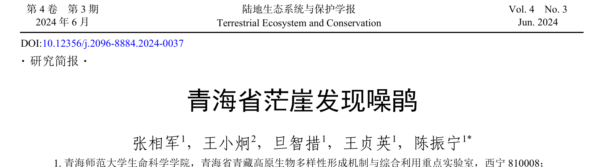
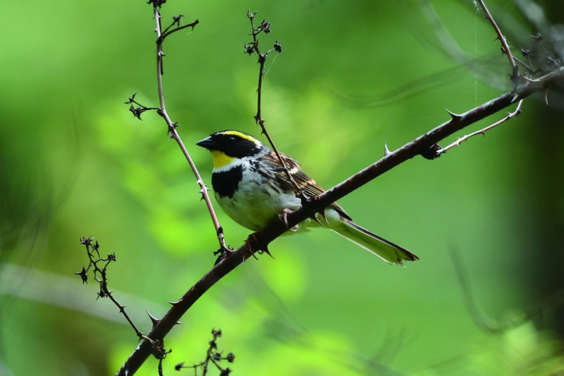
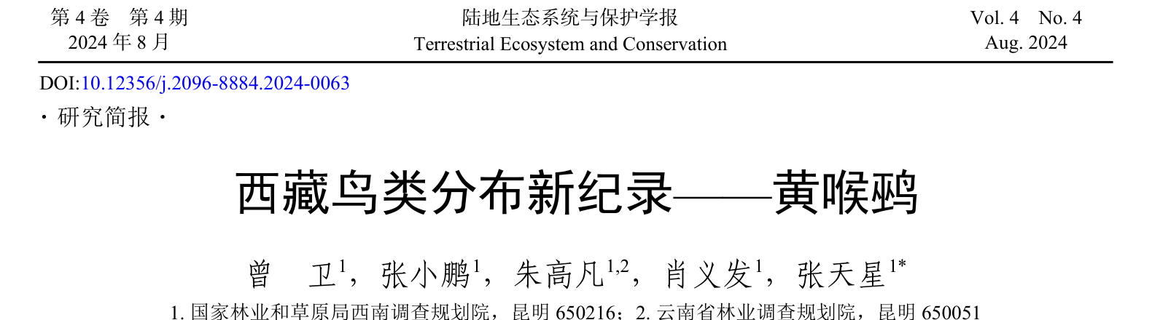
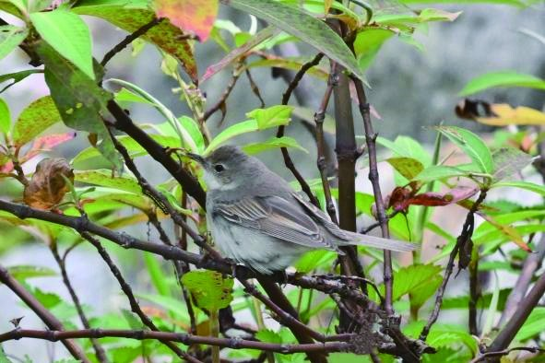
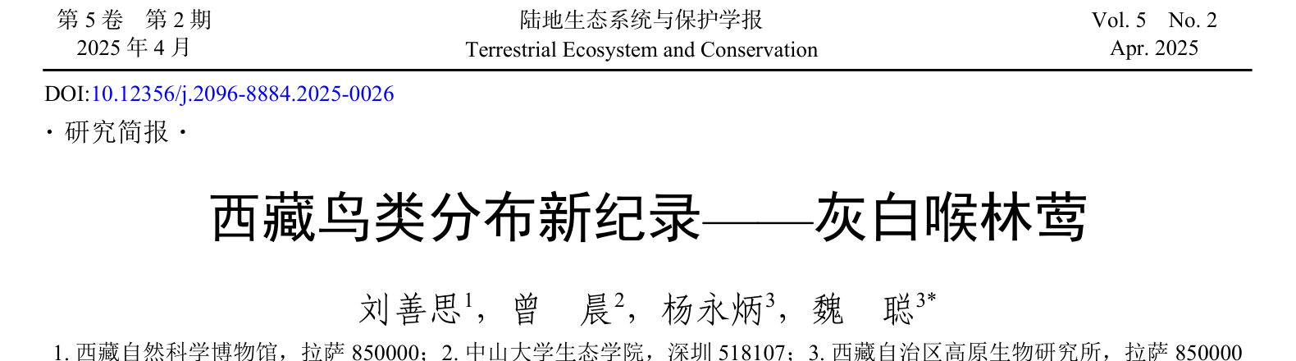
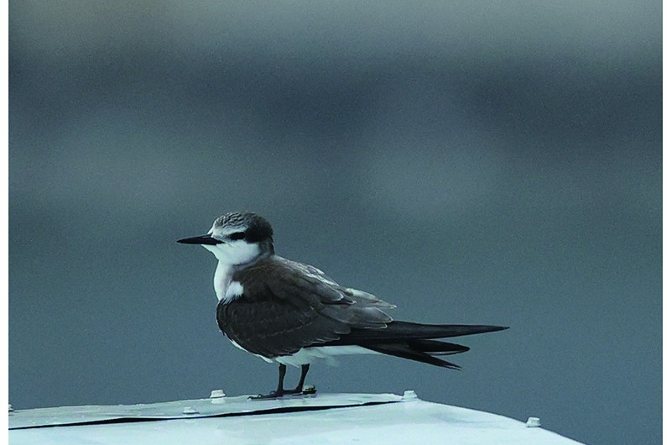
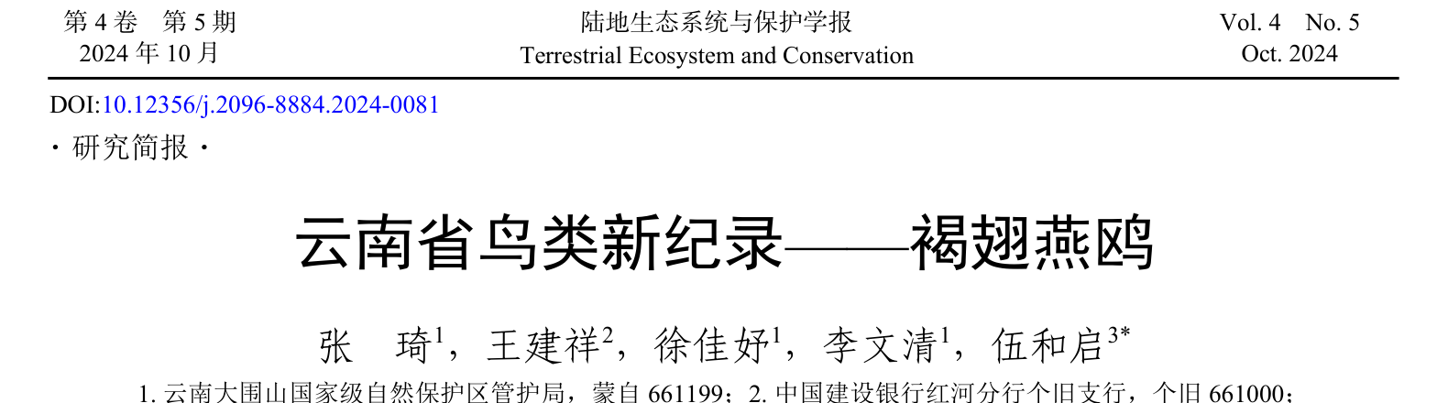
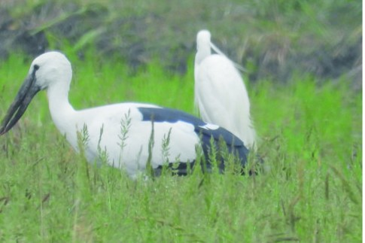
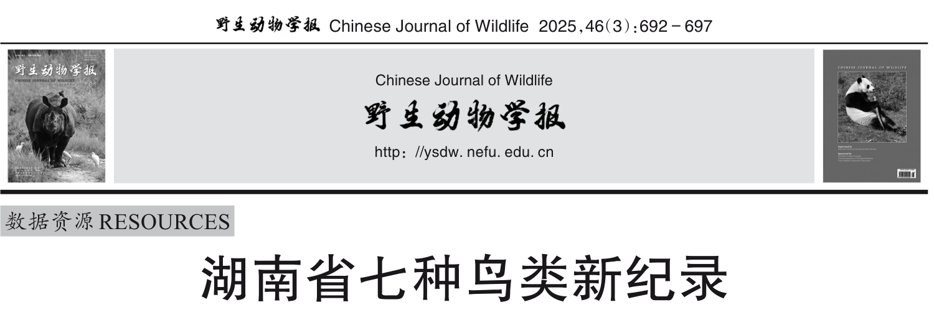
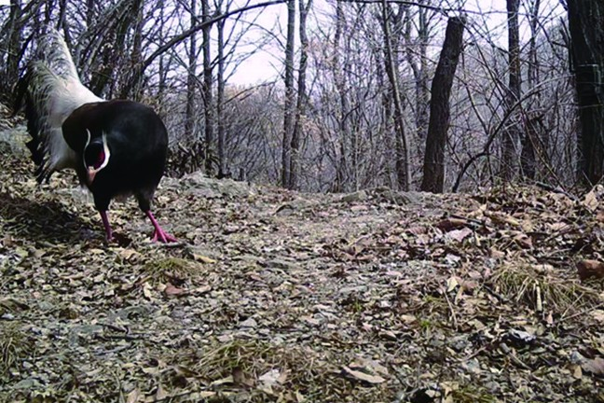
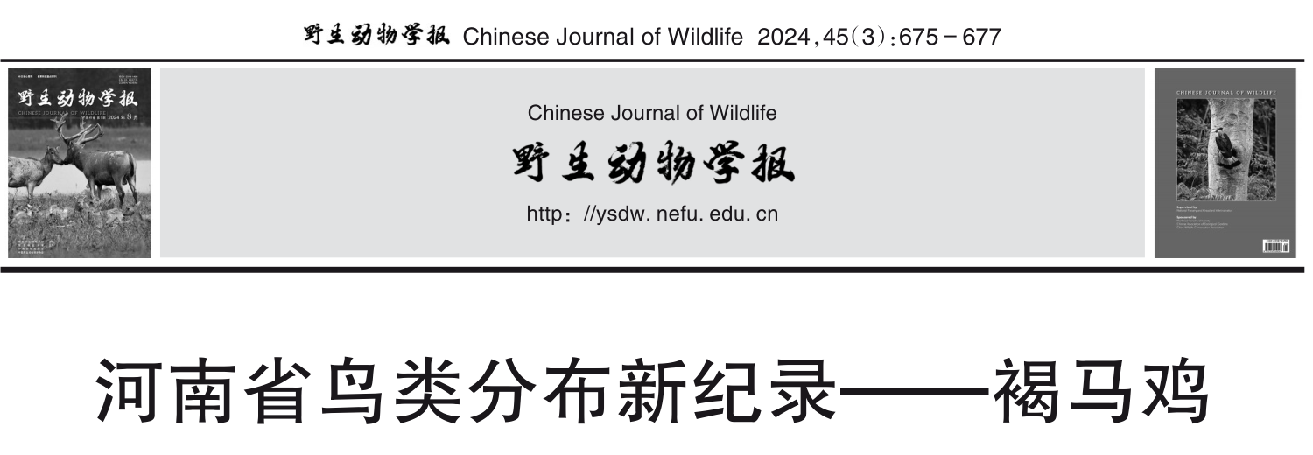
Background
Research gaps
Questions
Approach
Results
Synthesis
Background
Each new record is a short paper, backed by a photograph
Western Koel
Yellow-throated Bunting
Qinghai · found 2023, published 2024
Eudynamys scolopaceus
Xizang · found 2023, published 2024
Emberiza elegans
Common Whitethroat
Bridled Tern
Xizang · found 2024, published 2025
Curruca communis
Yunnan · found 2024 and published
Onychoprion anaethetus
Asian Openbill
Brown Eared-Pheasant
Hunan · found 2024, published 2025
Anastomus oscitans
Henan · found 2022, published 2024
Crossoptilon mantchuricum
Open-access sources: Terrestrial Ecosystem and Conservation 2024–2025; Chinese Journal of Wildlife 2024–2025
Ding, Zhang, Jiang & Wang · AOC 2026, Singapore
04
Notes:
[about 35 s]
This is what a new record looks like: a short paper, often in Chinese, with a photo as evidence. A koel on the Qinghai plateau, a bunting and a whitethroat in Xizang, a seabird far inland in Yunnan, an openbill in Hunan, and an eared-pheasant on a camera trap in Henan. Notice the dates: most were found a year or two before they were published. We date every record to when it was found.
If asked: Are these typical? They are recent, open-access examples; 79% of CBNR records rest on field photographs like these.

Slide 5
Background
Research gaps
Questions
Approach
Results
Synthesis
Background
A new record is the last link in a chain of three events
Provincial new record: the first verified occurrence of a known species
in a province where it was not reported before
1
The bird is there
2
Someone looks
3
The find is published
Climate, land use or
More surveys, better
The detection is written
New
vagrancy can move
access and new methods
up and dated in a
record
a species in
find what was missed
paper or report
Ecological process
Observation process
Documentation
Only this link is ecological
These two leave the same trace in the data
Two opposite errors: reading every record as a range shift, or dismissing all as sampling noise
Chen et al. 2011; Pecl et al. 2017; Lawlor et al. 2024; Lahoz-Monfort & Magrath 2021; Sanczuk et al. 2026
Ding, Zhang, Jiang & Wang · AOC 2026, Singapore
05
Notes:
[about 35 s]
So what is a new record? The first verified sighting of a species in a province where it wasn't known. But it's the last link in a chain: the bird is there, someone looks, and the find gets published. Only the first link is ecology; the other two leave exactly the same trace. So we can make two opposite mistakes: call every record a range shift, or dismiss them all as sampling noise.
If asked: Is this specific to China? No; the chain applies to any dated compilation of first records.

Slide 6
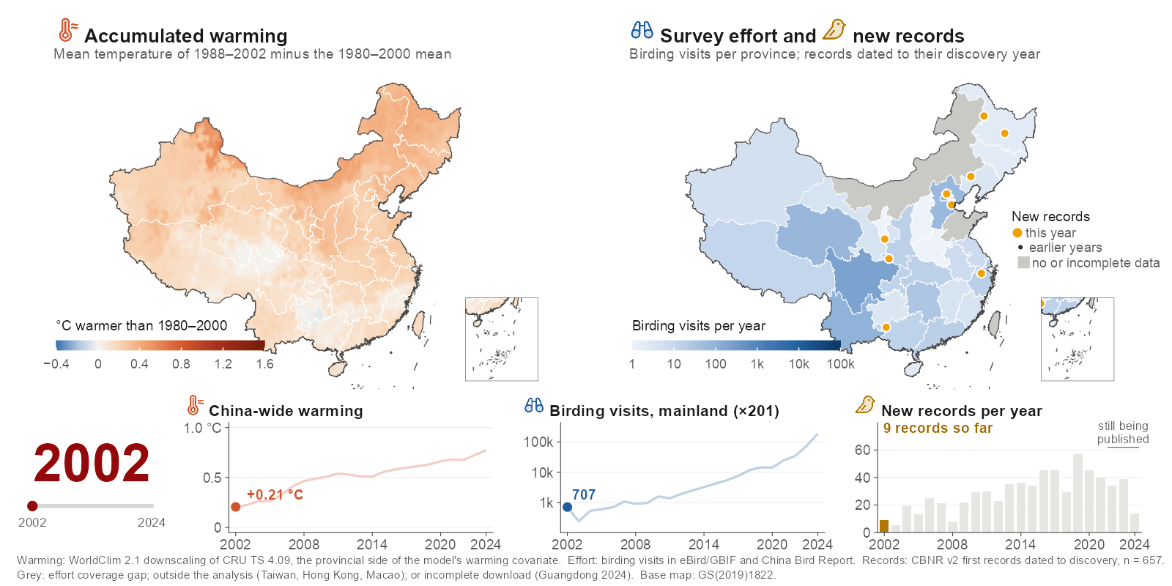
Background
Research gaps
Questions
Approach
Results
Synthesis
Background
After 2002, warming, birding and new records all rose together
Ding, Zhang, Jiang & Wang · AOC 2026, Singapore
06
Notes:
[about 35 s]
This is why the question is hard in China. On the left, warming: the country turns red, from about 0.2 degrees in 2002 to almost 0.8 by 2024. On the right, survey effort: birding visits rose about 200-fold and spread inland. The amber dots are new records, appearing in the year they were found. Everything rises together, so a trend in new records can't tell us, on its own, which process is behind it.
If asked: Why is Guangdong grey in 2024? Its China Bird Report records cover only 14 days of that year, so we treat that province-year as missing; eBird checklists for 2024, absent from the first download, were added for every province.
If asked: Is this the warming variable in the model? It is the provincial side; the model uses the difference from the same quantity over each species' range.

Slide 7
Background
Research gaps
Questions
Approach
Results
Synthesis
Research gaps
Analyses of new records have not separated ecology from observation
How source papers explain their records
1
Drivers studied apart
CBNR v2, n = 1,029 provincial first records
Range shifts or sampling bias, usually one at a time
GAP
Warming and effort are rarely modelled together;
Range shift
their interaction is almost never tested
61.1%
Survey effort, alone or
with range shift
Heterogeneity unexplored
7.3%
2
Responses differ among species, places and years
Not stated
GAP
Do traits such as migration modulate both drivers?
31.0%
Do records lean poleward, net of geometry?
Other (e.g. taxonomy)
0.6%
3
Scattered data, mismatched scales
Records are local, scattered and dated to publication
GAP
No national, discovery-dated dataset links
Birding visits rose about 200-fold, 2002–04 to 2022–24,
each record to annual climate and effort
yet effort is rarely given as the reason
Quantifying both drivers, their interaction and its heterogeneity nationally fills this gap
Boakes et al. 2010; Pacifici et al. 2017; Lahoz-Monfort & Magrath 2021; Xing et al. 2024
Ding, Zhang, Jiang & Wang · AOC 2026, Singapore
07
Notes:
[about 35 s]
So where's the gap? The original papers credit sixty-one percent of records to range shifts and only seven percent to survey effort, although birding grew about 200-fold. Three things are missing. Warming and effort are studied apart, and their interaction is almost never tested. We don't know how the response varies, by traits like migration or by direction. And the data are scattered and dated to publication, not discovery.
If asked: Where do these percentages come from? From CBNR's 'inferred discovery reason' field, which records the reason given in each source paper; 31% of papers give none.

Slide 8
Background
Research gaps
Questions
Approach
Results
Synthesis
Questions
Three questions, each with a testable hypothesis
Q1
How do warming and survey effort jointly drive new records?
Low effort
High effort
H1
Hazard
Both raise the annual hazard of a first record, warming beyond its regional-climate null;
their effects are comparable and interact negatively: where effort is high,
the species that warming favours are already on the list
Warming
Q2
Do their effects change through time and across space?
N
H2
Province-year survey pulses dominate the variation; the return on effort declines
Return
Warming
as gaps fill, the return on warming does not; net of geometry and effort,
Effort
records lean poleward
Year
Q3
Which species gain records, and do traits modulate the two drivers?
Migrants
?
H3
Mobile, wide-ranging species, such as partial migrants, gain more records;
Hazard
Residents
migratory strategy may change how strongly warming and effort act
(for example, a weaker warming effect in long-distance migrants)
Warming
Ding, Zhang, Jiang & Wang · AOC 2026, Singapore
08
Notes:
[about 40 s]
So, three questions. One: how do warming and effort work together? We expect both to raise the chance of a first record, warming beyond what shared regional climate gives, with a negative interaction: where people have looked hard for years, the species warming favours are already listed. Two: does this change over time and space? We expect the payoff from effort to shrink, not the payoff from warming, and records to lean poleward. Three: which species? We expect mobile species, like migrants, to gain more records.
If asked: Were these hypotheses pre-specified? The interaction, the survey pulses and the declining return on effort were written down before the robustness analyses; the warming effect is tested against permutation nulls; the trait and direction expectations follow the literature.

Slide 9
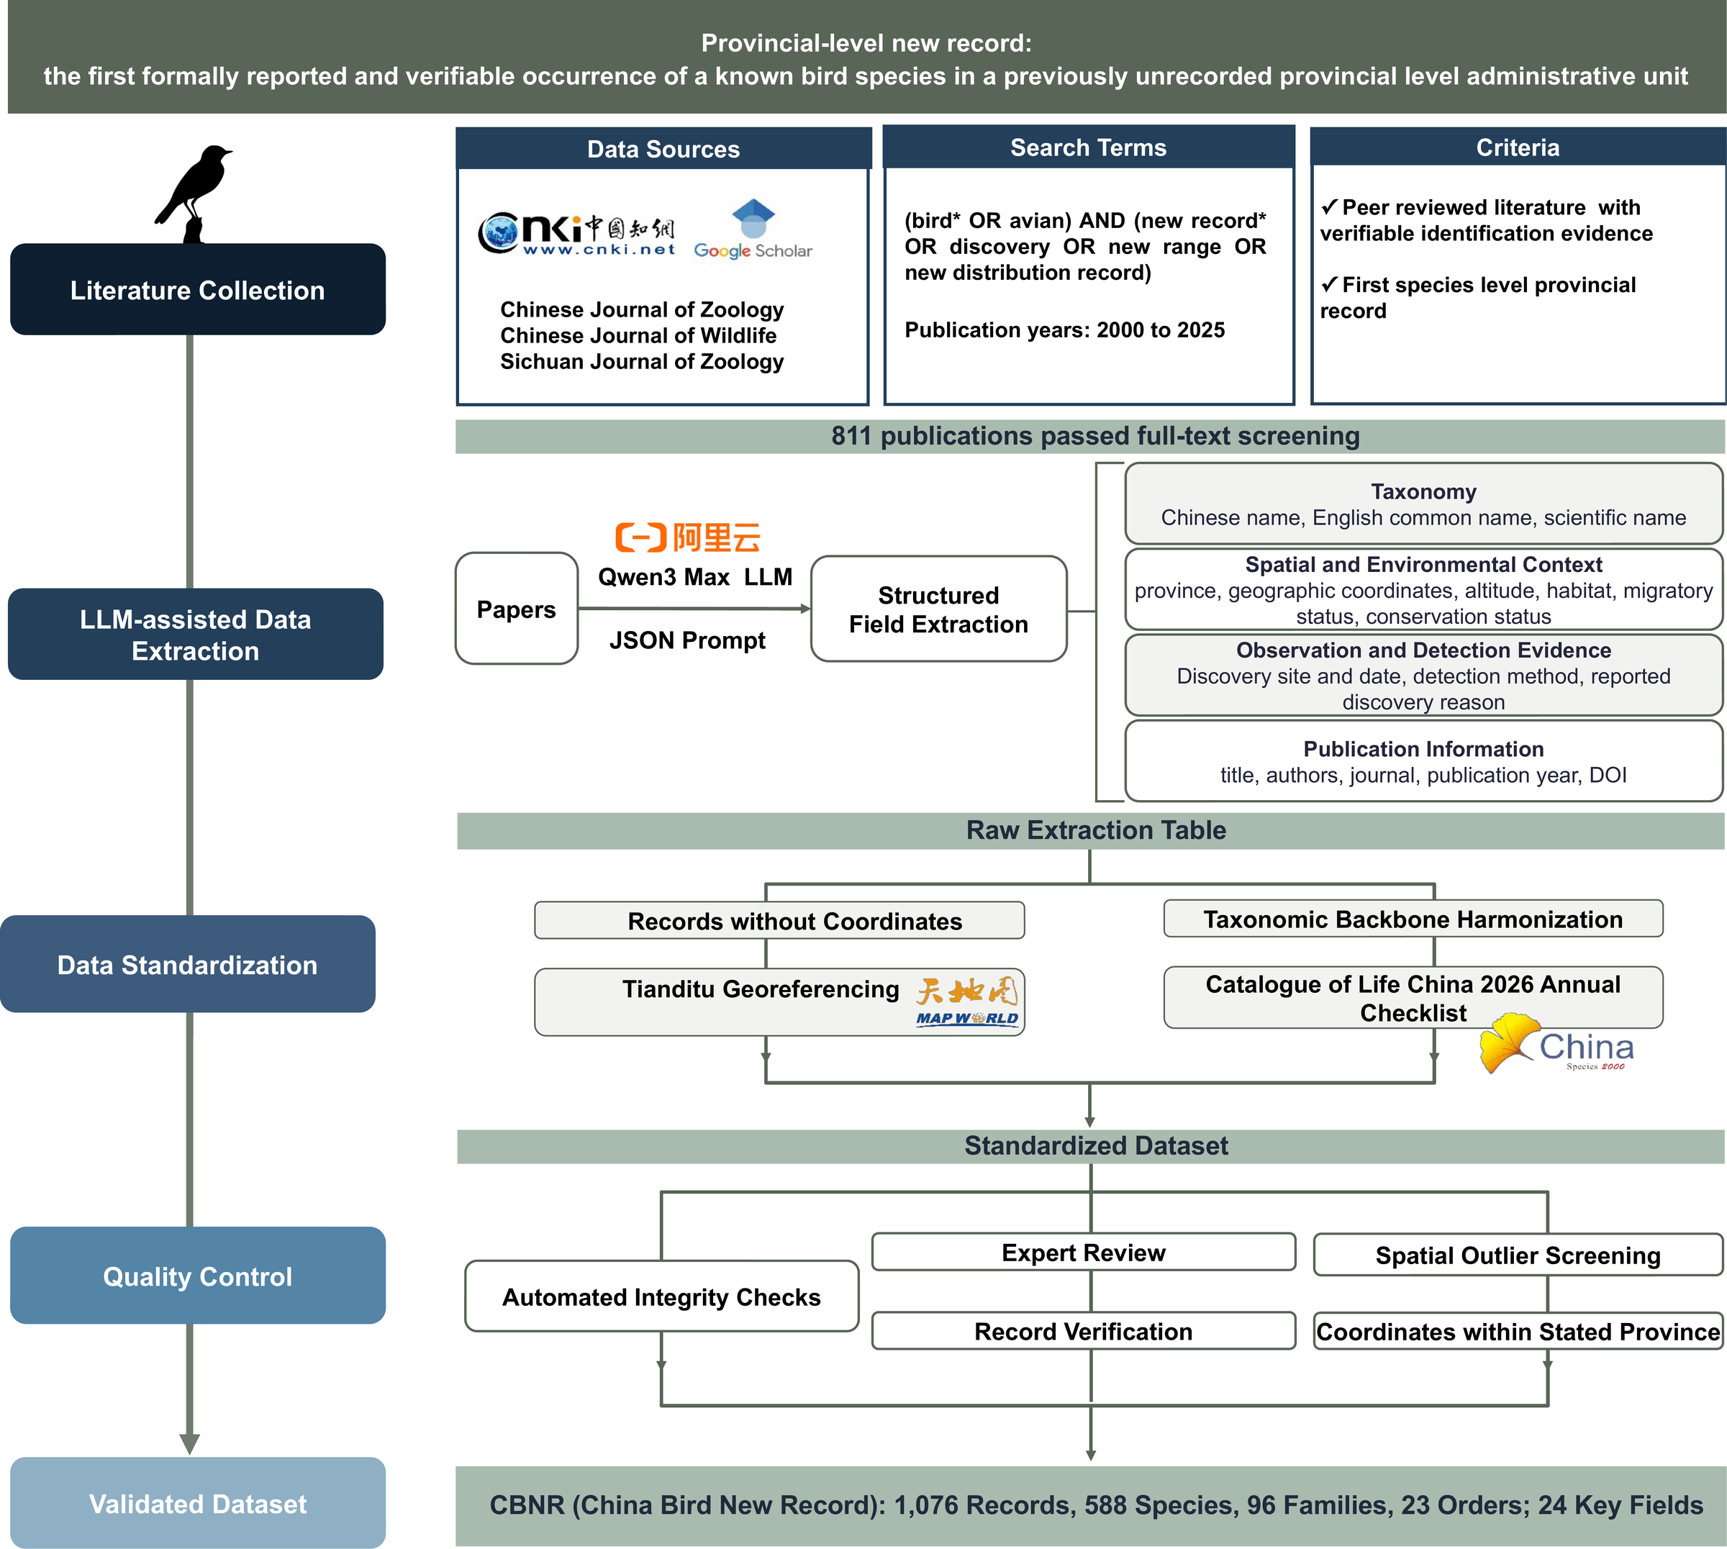
Background
Research gaps
Questions
Approach
Results
Synthesis
Data
CBNR turns 25 years of scattered literature into one auditable dataset
1
Literature
CNKI, Google Scholar and specialist journals, 2000–2025
2
LLM-assisted extraction
Qwen3-Max with a fixed JSON schema
3
Standardization
Tianditu coordinates; Catalogue of Life China 2026
4
Quality control
Integrity checks, expert review, spatial outliers
5
Release
1,076 records · 588 species · 23 orders
797 papers · 33 provinces · 24 key fields
Every curation step logged
CBNR Fig. 1 Technical workflow
Ding, Zhang, Jiang & Wang · AOC 2026, Singapore
09
Notes:
[about 35 s]
Here's how we built it. We searched Chinese and English literature from 2000 to 2025. A large language model pulled each record into a fixed set of fields, and then every record was standardized and checked by hand: coordinates, taxonomy against the 2026 Chinese catalogue, duplicates, and spatial outliers. The result is 1,076 validated records of 588 species, from 797 papers, and every step is logged so anyone can audit it.
If asked: How reliable is the language-model step? Every extracted record was checked by hand against the source paper; the model only speeds up the reading.

Slide 10
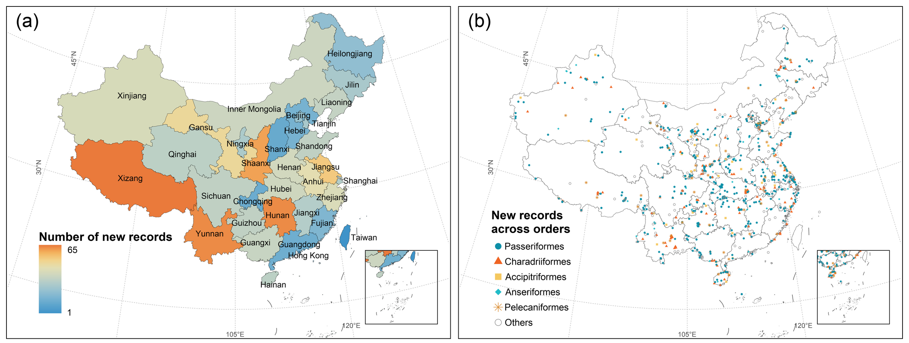
Background
Research gaps
Questions
Approach
Results
Synthesis
Data
New records come from every province, most from the south-west and centre
CBNR Fig. 2a, b Records per province; localities by order
Xizang
Hunan · Yunnan
Passeriformes
Field photographs
65
63 · 63
48.4%
79%
most records of any province
the next highest
521 records, 318 species
the commonest evidence
Ding, Zhang, Jiang & Wang · AOC 2026, Singapore
10
Notes:
[about 30 s]
Where are they? New records come from almost every province. The most are in Xizang, with 65, then Hunan and Yunnan, with 63 each. On the right, each dot is a locality: clusters along the south-western mountains, the edge of the Tibetan Plateau, the big river basins and the coast. Almost half are songbirds, and most are documented with field photographs.

Slide 11
Background
Research gaps
Questions
Approach
Results
Synthesis
Data
Records rose after 2010, led by songbirds and shorebirds
New records per publication year
Records by order
100
95
92
Passeriformes
521
75
Charadriiformes
166
Anseriformes
73
50
Accipitriformes
66
Pelecaniformes
44
25
Gruiformes
35
Columbiformes
20
0
Coraciiformes
19
2000
2005
2010
2015
2020
2025
Coverage of each order's Chinese species: 32–66%
Records rose after 2010 and are concentrated in songbirds and shorebirds
Ding, Zhang, Jiang & Wang · AOC 2026, Singapore
11
Notes:
[about 30 s] [optional: can be cut]
Over time, records rise after about 2010, with the most in the last two years. By order, songbirds lead with 521 records, then shorebirds with 166. The full Sankey diagram linking order, province and year is in the backup slides. Remember this timing: it tracks how hard people looked, which is exactly what the model has to account for.

Slide 12
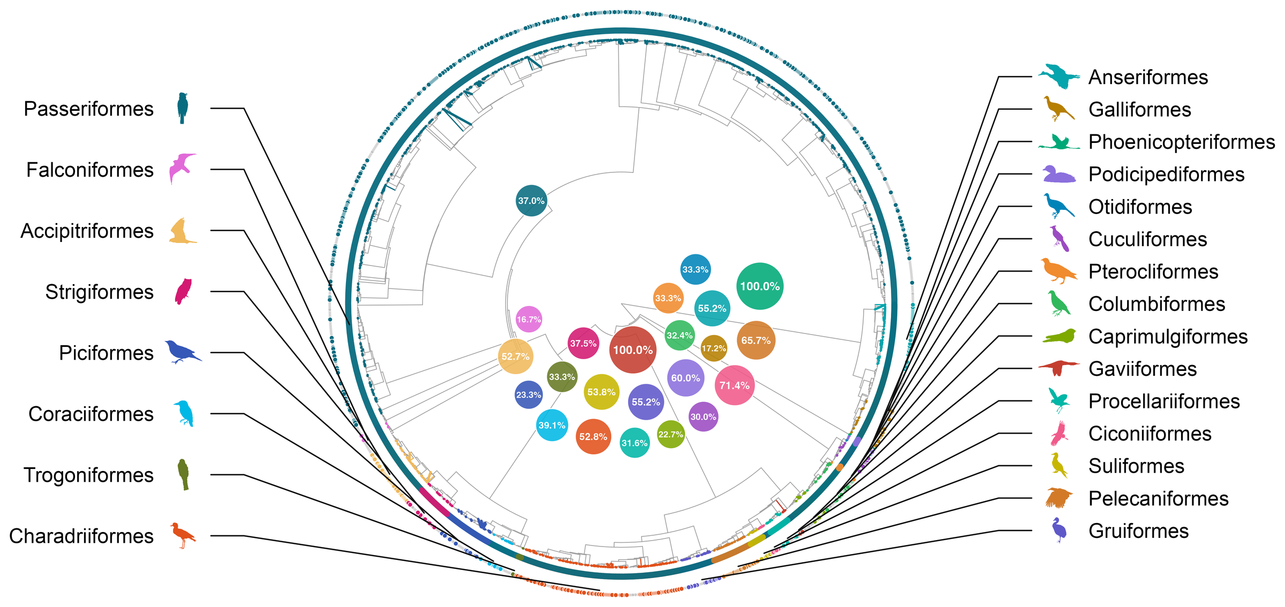
Background
Research gaps
Questions
Approach
Results
Synthesis
Data
Wetland and soaring orders are best covered; phylogenetic signal is weak
CBNR Fig. 3 New records on the bird phylogeny; bubbles: share of each order's species with a record
Fritz–Purvis D = 0.80: weak phylogenetic structure; no clustering (P = 0.87)
Ding, Zhang, Jiang & Wang · AOC 2026, Singapore
12
Notes:
[about 30 s] [optional: can be cut]
On the bird tree, coverage is uneven. Wetland, seabird and soaring orders have the highest share of species with a new record: all the loons, and about seventy percent of storks. Songbirds have the most records but only about a third of their species. Overall the phylogenetic signal is weak, so order-level patterns reflect both ecology and how we look, not just which lineages are moving.

Slide 13
Background
Research gaps
Questions
Approach
Results
Synthesis
Approach
From records to a hazard model, in four steps
1
Records
CBNR v2
Dated to discovery
Current release, v1.1
1,029 provincial first records
657 records in 2002–2024
1,076 records · 588 species
2
Risk set
Species × province × year
Reachable provinces only
Exit after first record
175,640 cells, 2002–2024
≥ 50 suitable SDM cells
each pair counted once
3
Covariates
Warming
Survey effort
Variability
Completeness
vs species range, 15 yr
birding visits
annual anomaly
offset, recent years
4
Analysis
Hazard GLMM
Robustness
Through time
Projections
cloglog link
nulls · 12 specs
time-varying returns
support checked
Outputs: contributions · interaction · observation process · returns through time · futures
Ding, Zhang, Jiang & Wang · AOC 2026, Singapore
13
Notes:
[about 45 s]
From CBNR to a model takes four steps. We take the records dated to their year of discovery: 657 between 2002 and 2024. We build a risk set of every species, province and year in which a first record could have happened, 175,640 cells. Each cell gets accumulated warming, survey effort, annual climate variability, and an offset for how complete recent reporting is. Then we fit a discrete-time hazard model and test it hard: permutation nulls, twelve alternative specifications, effects that change through time, and projections that report their own data support.
If asked: Why does the model use v2 and not v1.1? v2 is the citable Zenodo release; v1.1 adds 47 records and is not yet on Zenodo.

Slide 14
Background
Research gaps
Questions
Approach
Results
Synthesis
Approach
A discrete-time hazard model asks: is this the year of the first record?
The risk set
first record ~ warming × effort + variability
Each pair is at risk every year until its first record
+ offset(log completeness)
2002
03
04
05
06
07
08
09
…
24
+ (1 | species) + (1 | province) + (1 | province × year)
Species A × Yunnan
0
0
0
0
1
Binomial, cloglog link: exp(β) is a hazard ratio per SD
Species B × Sichuan
0
0
1
Accumulated warming
Province minus species-range anomaly, 15-yr; 1 SD = 0.18 °C
Species C × Beijing
0
0
0
0
0
0
0
0
…
0
Species D × Hainan
0
0
0
0
0
0
0
1
Survey effort
Provincial birding visits; 1 SD = 7.9-fold more visits
at risk, no record
first record
left the risk set
Province × year effect
175,640 cells · 649 first records
Survey campaigns, birding festivals, new reserves
392 species · 31 provinces · 2002–2024
Dated to discovery
Offset corrects the latest, incompletely published years
Ding, Zhang, Jiang & Wang · AOC 2026, Singapore
14
Notes:
[about 40 s]
The question the model asks is simple: for each species, in each province it could reach, in each year, is this the year of its first record? Each pair stays at risk until it's recorded, then leaves. It's a binomial mixed model with a cloglog link, so the coefficients are hazard ratios. Warming is measured against each species' own range; one standard deviation is 0.18 degrees. Effort is birding visits; one standard deviation is about eight-fold. A province-by-year effect absorbs survey campaigns.
If asked: How is 'could reach' defined? Provinces with at least 50 suitable cells in the species' distribution model; results are the same at 100 and 200.

Slide 15
Background
Research gaps
Questions
Approach
Results
Synthesis
Finding 1
Warming and survey effort contribute comparably, and they interact
Hazard ratio per SD (95% CI)
Annual hazard of a first record (%)
1.36
High effort (90th pct)
Warming
0.6
Median effort
Low effort (10th pct)
1.43
Survey effort
0.4
0.99
Annual variability
0.2
0.84
Warming × effort
Warming × effort: HR 0.84 (0.75–0.94)
warming null 1.16
0.0
0.8
1.0
1.2
1.4
1.6
-2
-1
0
+1
+2
Accumulated warming relative to the species' range (SD)
Thick: main analysis (≥ 50 suitable SDM cells); thin: 100 and 200 cells; log scale
Accumulated warming
Survey effort
Warming × effort
Annual variability
1.36
1.43
0.84
0.99
HR per SD (1.22–1.53)
HR per SD (1.27–1.61)
steepest where few look
no effect (0.91–1.09)
Ding, Zhang, Jiang & Wang · AOC 2026, Singapore
15
Notes:
[about 45 s]
First finding. Warming and survey effort contribute about equally: a hazard ratio of 1.36 per standard deviation for warming, and 1.43 for effort, and the estimates do not move across distribution-model thresholds. And they interact negatively. On the right you can see what that means: where few people are looking, the warming curve is steep; where many people are looking, it flattens out. Annual climate variability has no effect at all. So the answer to question one is yes, and to question three, the interaction is negative, as we expected.
If asked: How big is the warming effect, really? A permutation null puts the baseline at 1.16, so the species-specific increment is about ×1.18 per SD.
If asked: What does 1 SD of warming mean? 0.18 °C of species-referenced accumulated warming.

Slide 16
Background
Research gaps
Questions
Approach
Results
Synthesis
Finding 1
The balance holds on average across criteria and twelve specifications
Loss in fit when the term is dropped
Cost of dropping a term
ΔAIC
ΔAUC
ΔR²
|β|
ΔAIC: effort 33.4, warming 29.9
ΔAUC: warming 0.053, effort 0.033
|β|: effort 0.36, warming 0.31
Warming
29.9
0.053
0.0086
0.31
Survey effort
33.4
0.033
0.0006
0.36
Twelve specifications
SDM thresholds 50, 100, 200
Annual variability
-2.0
0.000
-0.0003
0.01
4 effort proxies × 3 missing-data rules
Effort 1.25–1.55; warming 1.33–1.39
Warming × effort
7.8
0.002
0.0115
0.18
Design-preserving nulls
Each column scaled to its own maximum; |β|: absolute standardised coefficient
Warming null 1.16: increment ×1.18
Shuffled effort timing: 0.98
Warming and effort rank equally on average
Province bootstrap: lower bounds > 1
across the four criteria
Ding, Zhang, Jiang & Wang · AOC 2026, Singapore
16
Notes:
[about 35 s] [optional: can be cut]
This balance is not fragile. Drop either term and the model loses about thirty AIC units. Warming costs more discrimination, effort carries the larger coefficient, and conditional R-squared favours warming; on average the two rank equally. Across twelve specifications, with different distribution-model thresholds, effort proxies and missing-data rules, the numbers stay put. And against design-preserving nulls, both effects stand: the warming increment over its null is about 1.18, and effort collapses to 0.98 if we break its timing.

Slide 17
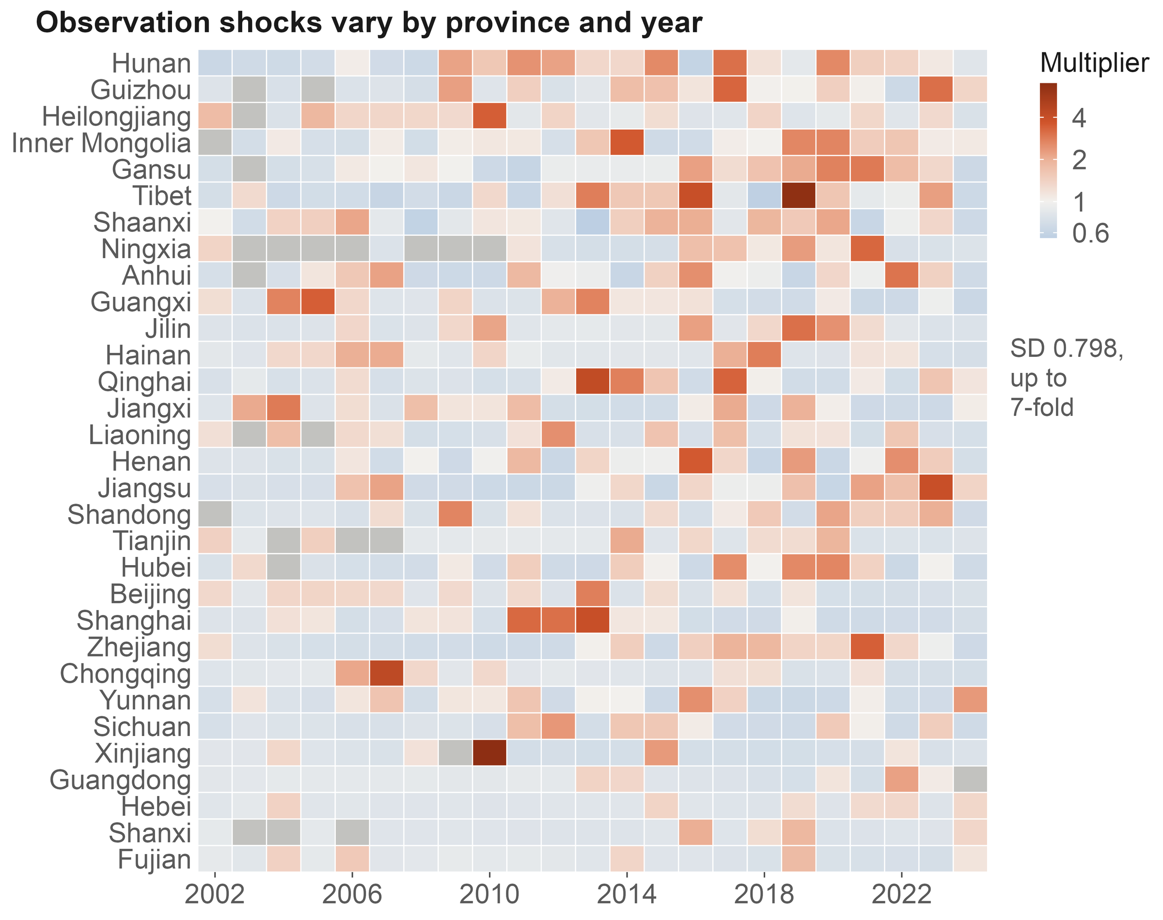
Background
Research gaps
Questions
Approach
Results
Synthesis
Finding 2
Survey pulses are the largest source of variation in the hazard
Hazard multiplier per SD
Random intercepts
Province × year
×2.22
Species
×1.50
Province
×1.39
Fixed effects
Survey effort
×1.43
Warming
×1.36
1.0
1.5
2.0
Conditional AUC
0.72 → 0.85
Fig. 5c Province × year multipliers
after adding the province × year layer
Ding, Zhang, Jiang & Wang · AOC 2026, Singapore
17
Notes:
[about 40 s]
Second finding. The biggest single component is not a driver at all. It is the province-by-year effect: one standard deviation multiplies the hazard by 2.22, more than warming or effort, and more than species or province. This is where a provincial bird survey, a big birding event or a new reserve shows up. Adding this layer lifts conditional AUC from 0.72 to 0.85, and leaves the fixed effects unchanged. Treat it as noise, and survey history reads as range change.
If asked: Could the province-by-year effect absorb climate anomalies too? Partly; that protects the fixed effects at some cost in climatic signal, and we say so in the paper.

Slide 18
Background
Research gaps
Questions
Approach
Results
Synthesis
Finding 3
The return on effort is falling; the return on warming is not
Return on survey effort: HR per SD (95% CI)
Return on effort
3.0
2.14 → 1.13
CI includes 1 from 2023
HR per SD, 2002 → 2024; P = 0.0021
2.14
Return on warming
2.0
P = 1.00
warming × time: no trend; HR 1.37
1.5
A stock and a flow
1.13
Effort mines a finite stock
1.0
of undocumented occurrences;
warming keeps adding
new candidates
2002
2006
2010
2014
2018
2022
Ding, Zhang, Jiang & Wang · AOC 2026, Singapore
18
Notes:
[about 40 s]
Third finding. Effort is saturating. Its hazard ratio fell from 2.1 in 2002 to about 1.1 in 2024, and from 2023 it is no longer different from one. The easy gaps have been filled. Warming shows no such trend. One way to read this is a stock and a flow: effort mines a finite stock of undocumented occurrences, while warming keeps adding new candidates. We haven't tested the two trends against each other, so I'd call it consistent, not proven.

Slide 19
Background
Research gaps
Questions
Approach
Results
Synthesis
Traits
Partial migrants and wide-ranging species gain more records; drivers act in every group
Which species gain records? Odds ratio (95% CI)
Both drivers, by migratory group: HR per SD
Partial migrant
Accumulated warming
Full migrant
Resident (218)
1.36
Global range size
Partial migrant (156)
1.51
Long-distance (175)
1.51
Hand-wing index
Survey effort
Body mass
Resident (218)
1.29
Clutch size
Partial migrant (156)
1.34
Diet breadth
Long-distance (175)
1.33
Habitat breadth
1.0
1.2
1.4
1.6
1.8
0.5
1
2
4
Three lines per trait: taxonomic nesting, phylogenetic eigenvectors, phyloglm
1,298 species; reference: resident; continuous traits per SD; log scale
Events per group in brackets; groups fitted separately
Migratory strategy shifts the baseline (ΔAIC 6.2) but moderates neither driver (all LR P ≥ 0.26)
Ding, Zhang, Jiang & Wang · AOC 2026, Singapore
19
Notes:
[about 35 s]
Which species get new records? Two traits matter. Partial migrants are about twice as likely as residents to gain one, and wide-ranging species are more likely too. Body size, wing shape, clutch size and diet breadth don't matter. On the right, we fitted the model separately for residents, partial migrants and long-distance migrants. Warming and effort raise the hazard in all three, by similar amounts. So migration changes the baseline, but not how the two drivers work.
If asked: Isn't warming weaker for long-distance migrants, who are often vagrants? We expected so, but their point estimate is the highest of the three, though indistinguishable from the others.
If asked: There is a hint that the warming × effort interaction is confined to long-distance migrants (0.75), but the test for a group difference is not significant (P = 0.26).

Slide 20
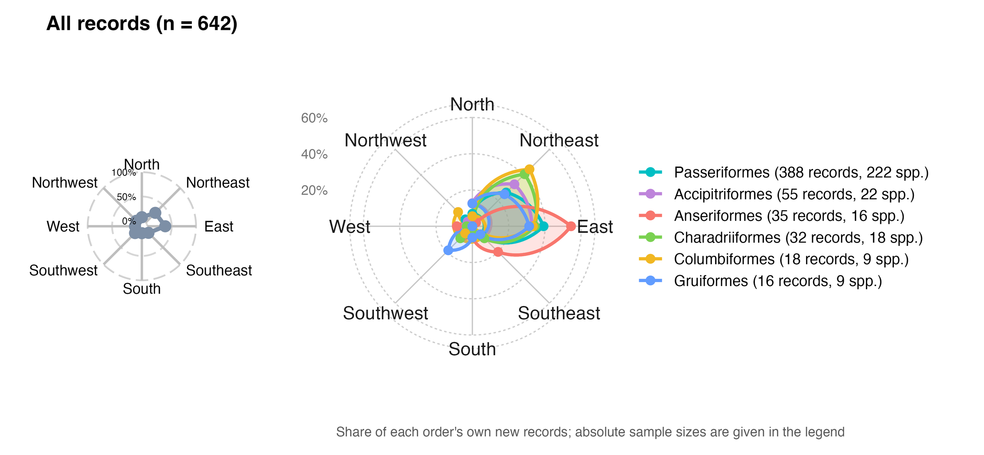
Background
Research gaps
Questions
Approach
Results
Synthesis
Finding 4
Seen from range centres, new records point east and north-east
Records
642
361 species, 20 orders
East
36.9%
237 of 642 records
North-east
27.9%
Bearings from range centroids: all records (left), six largest orders (right)
Most new records lie east or north-east of the species' range centre
179 of 642 records
Ding, Zhang, Jiang & Wang · AOC 2026, Singapore
20
Notes:
[about 35 s] [optional: can be cut]
Fourth: direction. For each record we take the bearing from the species' range centre to the new location. Of 642 records, 37 percent lie to the east and 28 percent to the north-east. The six largest orders share the lean: songbirds, raptors, ducks, shorebirds, pigeons, rails and cranes. Taken at face value, this looks like an eastward expansion. The next question is whether geography alone could produce it.

Slide 21
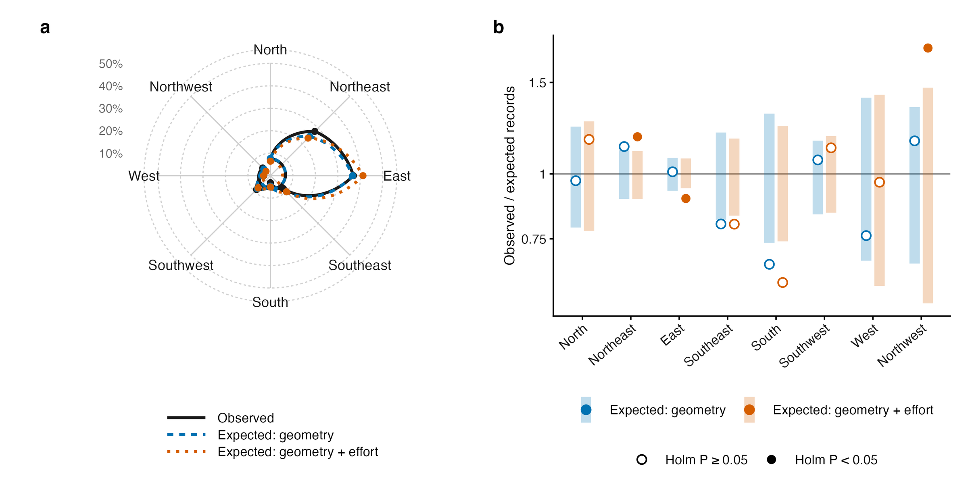
Background
Research gaps
Questions
Approach
Results
Synthesis
Finding 4
The eastward bias is geometry; net of it, records lean slightly north
Null 1: geometry only
East: 235 expected, 237 observed
No sector departs from the null
Null 2: geometry + birders
Northern sectors: 40.2% vs 32.8%
χ² = 26.8, P = 0.001
NE, NW above; E below (Holm)
Fig. 6 Observed vs expected sectors under two nulls
Null 1: each record placed at random among its species' reachable provinces
Net of geometry and effort:
Null 2: the same provinces, weighted by birding effort
a modest poleward lean
Ding, Zhang, Jiang & Wang · AOC 2026, Singapore
21
Notes:
[about 35 s]
Fourth, direction. Seen from range centres, records point east. But most of these species have ranges centred west or south of China, so almost any record here lands to the east. Placing records at random among each species' possible provinces gives 235 in the east; we saw 237. Only after adding where birders go does a signal remain, and it points north: 40 percent against 33 expected. A modest poleward lean.

Slide 22
Background
Research gaps
Questions
Approach
Results
Synthesis
Application
Records inside reserves track observation, not reserve performance
Share inside the 1,028 mapped reserves
Few reserves carry the signal
New records
26.2%
172 events in 68 reserves
The top two hold 27.3% of them
Birding effort (checklists)
10.8%
Without them: OR 1.16
Land area
10.4%
Odds ratio against 200 matched controls
Only after birding boomed
Controls from the same province and year, weighted by checklists; 95% CI
2002–2012: OR 0.97
Matched on place and year
1.71 (1.39–2.11)
2013–2023: OR 2.05
24% more species per visit inside
+ elevation, longitude, climate
1.57 (1.26–1.96)
Without the 2 largest reserves
1.16 (0.92–1.47)
2002–2012 only
0.97 (0.62–1.50)
2013–2023 only
2.05 (1.61–2.59)
Record counts should not
index reserve performance
0.5
1
2
3
Ding, Zhang, Jiang & Wang · AOC 2026, Singapore
22
Notes:
[about 55 s] [optional: can be cut]
A first use. Nature reserves look like hot spots for new records: twenty-six percent of records fall inside reserves that cover ten percent of the land, a two-and-a-half-fold enrichment. Birding effort is not concentrated there, and matching each record to two hundred control locations that birders visited in the same province and year reduces the enrichment to an odds ratio of 1.7, or 1.6 with environmental covariates. But that residual rests on two reserves; without them it is 1.16. It appears only after birding boomed in 2013, and checklists inside reserves record a quarter more species per visit, an observation bias we cannot condition out. So record counts should not be used to judge how well reserves work.

Slide 23
Background
Research gaps
Questions
Approach
Results
Synthesis
Limits
Four limits travel with these conclusions
Events are published records, not detections
We explain how records are documented, not range expansion itself.
Coordinates are precise to about 1 km at best
Reserve-overlap tests therefore use 0–5 km buffers as a sensitivity check.
Reserve polygons cover about a third of listed reserves
1,028 mapped reserves: no gap analysis, no 30×30 claims.
Projections leave the fitted support after 2030
Late-century maps are illustrations; the effort coefficient used is an upper bound.
Ding, Zhang, Jiang & Wang · AOC 2026, Singapore
23
Notes:
[about 25 s] [optional: can be cut]
Four limits travel with these results. Our events are published records, not detections, so we explain how records get documented, not how ranges expand. Coordinates are precise to about a kilometre at best. Our reserve map covers about a third of listed reserves. And projections leave the data after 2030, so late-century maps are illustrations.

Slide 24
Background
Research gaps
Questions
Approach
Results
Synthesis
Summary
Warming and survey effort leave signals of similar size
New records carry a climate signal mixed with an observation signal
01
02
03
04
Climate signal
Where few look
Observation process
Who and where
Warming 1.36 vs
Warming × effort 0.84:
Province × year ×2.22;
Partial migrants gain
effort 1.43 per SD:
under-surveyed regions
returns on effort
more records; net of
comparable, separable
hide the signal
2.14 → 1.13
geometry, a slight north lean
Implications
Send survey effort to climatically exposed, under-surveyed regions
Read counts of new records as observation-weighted evidence, not as range shifts
Test direction against geometric and effort nulls before calling it a shift
Birds or birders? Both. Model how we look, and new records tell us how ranges change
Ding, Zhang, Jiang & Wang · AOC 2026, Singapore
24
Notes:
[about 45 s]
To sum up. One: warming and survey effort contribute about equally, 1.36 against 1.43 per standard deviation, and one model can tell them apart. Two: warming shows most where few people look. Three: the observation process is the biggest piece, and the payoff from effort is falling. Four: partial migrants gain the most records, and net of geometry, records lean only slightly north. So send effort to under-surveyed regions that are warming fast. Birds or birders? Both. Model how we look, and the records tell us how ranges change.

Slide 25

Co-authors
Chenchen Ding
Institute of Ecology, College of Urban and Environmental Sciences, Peking University
Zhengwang Zhang
School of Life Sciences, Beijing Normal University
Zhigang Jiang
Institute of Zoology, Chinese Academy of Sciences
Zhiheng Wang
Thank you
Institute of Ecology, College of Urban and Environmental Sciences, Peking University
Questions welcome
Open data and code
CBNR v2 (CC BY 4.0) · doi.org/10.5281/zenodo.20809949
chenchen.ding@pku.edu.cn
github.com/dingchenchen6/bird-newrecord-discovery-dated
Climate: WorldClim 2.1 / CRU TS 4.09 · Ranges: BirdLife International
CBNR data
Effort: eBird/GBIF and China Bird Report · Base map: GS(2019)1822
We thank birdwatchers across China, and every author
whose records made CBNR possible.
Notes:
[about 25 s]
Everything is open: the CBNR data on Zenodo, and all of the analysis code on GitHub, where every number in this talk traces back to a table. My thanks to my co-authors, to birdwatchers across China, and to every author whose records made this possible. Thank you. I'm happy to take your questions.

Slide 26
Background
Research gaps
Questions
Approach
Results
Synthesis
Backup
Future record counts follow survey effort, not the emission scenario
Expected new records per year, China
SSP2-4.5
SSP5-8.5
Two climate × two effort scenarios
SSP2-4.5 or SSP5-8.5
100
Effort frozen, or still growing
89.0
80
79.3
What changes the count?
60
Climate scenario: barely anything
Growing effort: roughly triple
40
30.9
30.5
26.8
26.9
26.1
25.9
20
Most of that rise lies
0
outside the fitted data
2030
2030
2050
2050
(faded bars: none in support)
frozen effort
growing effort
frozen effort
growing effort
50–53% in support
30–33% in support
38–43% in support
0% in support
Ding, Zhang, Jiang & Wang · AOC 2026, Singapore
26
Notes:
[about 35 s]
If asked about the future. We crossed two climate scenarios with two effort scenarios. Switching from SSP2-4.5 to SSP5-8.5 changes the expected national count from 26.1 to 25.9 records a year: essentially nothing. If effort keeps growing, the count roughly triples by 2050. What we will record depends on how we look, more than on how the climate changes. But most of that increase lies outside the data we fitted.
If asked: Is 79 to 89 records a year a forecast? No. At 2050 no cell is inside the fitted support; the credible statement is about 26 to 31 records a year in 2030, under any scenario.

Slide 27
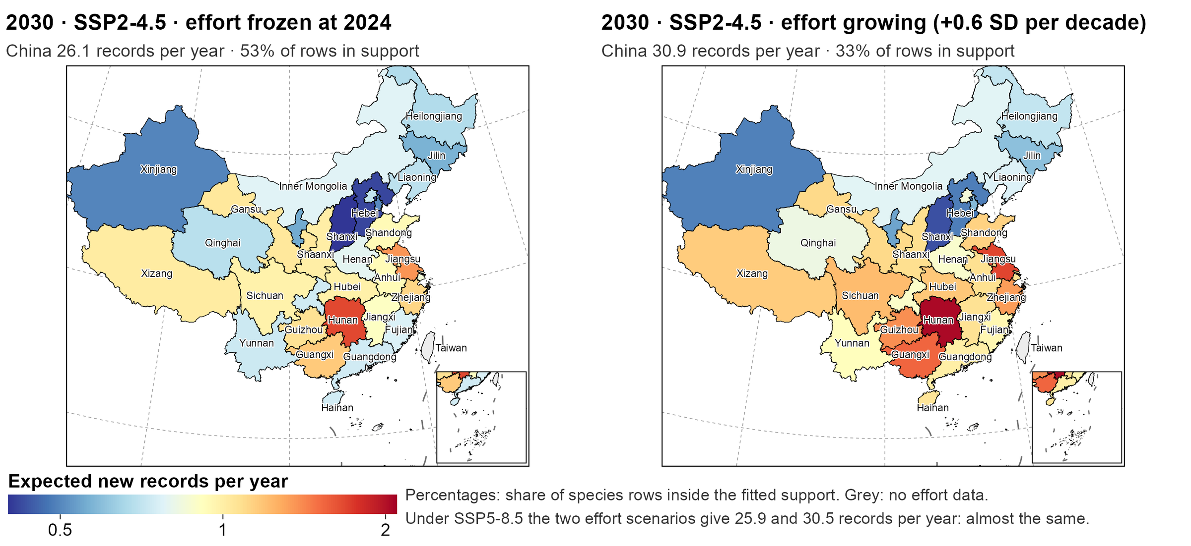
Background
Research gaps
Questions
Approach
Results
Synthesis
Backup
Records spread across central and southern China; growing effort leaves the data
Hunan, the top
1.7 → 2.1
per year: frozen → growing
Provinces off-data
8 → 16
< 50% of rows in support
Top five provinces
2030 · SSP2-4.5 · expected new records per province; CBNR map standard, GS(2019)1822
25%
Growing effort adds records in the south and east, beyond the data
of the national total
Ding, Zhang, Jiang & Wang · AOC 2026, Singapore
27
Notes:
[about 45 s]
Where would these records come from? This is 2030 under the middle emission scenario. With effort frozen, the expected records are spread thinly: the top province, Hunan, expects about 1.7 a year, and the top five provinces together hold a quarter of the national total. Let effort keep growing and Hunan rises to about 2, but the number of provinces where most species fall outside the fitted data doubles, from eight to sixteen, mostly in the south and east. The map tells you where to look, and also where not to trust the numbers.

Slide 28
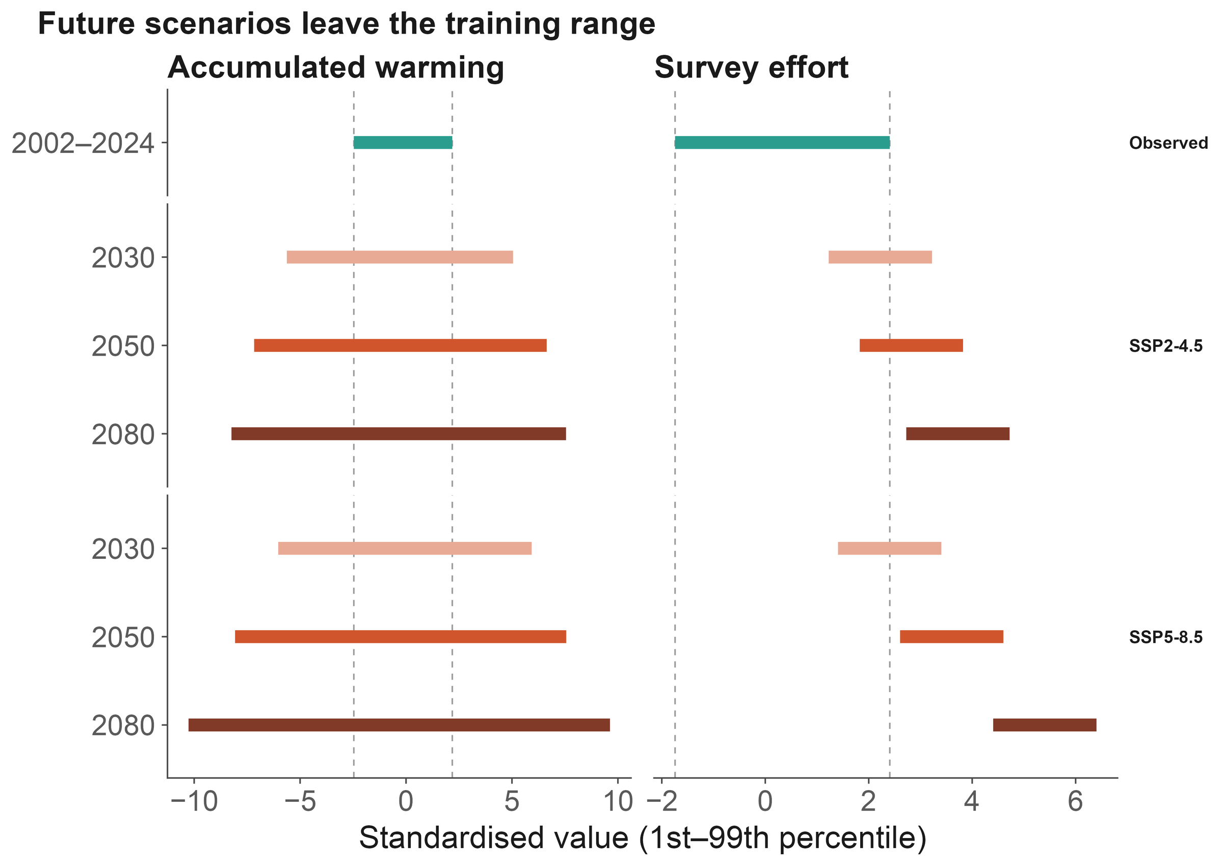
Background
Research gaps
Questions
Approach
Results
Synthesis
Backup
Data support, not ambition, sets the forecast horizon
Support shrinks fast
Cells inside the fitted range:
2030: 46% → 2050: 6%
2080: none (SSP2-4.5)
Machine learning does not help
Agree inside the range (ρ = 0.56)
Diverge outside it
2030: usable
End of century:
Fig. 7b Hazard model vs machine learning
illustration, not forecast
Ding, Zhang, Jiang & Wang · AOC 2026, Singapore
28
Notes:
[about 35 s]
So our rule is simple: report where the model breaks. Under SSP2-4.5, the share of species-province combinations inside the fitted range drops from 46 percent in 2030 to 6 percent in 2050, and to none by 2080, mostly because effort outgrows its observed range. Machine learning does not rescue it: inside the range the two model families agree, outside it they diverge. So 2030 is usable; end-of-century maps are illustrations, not forecasts.

Slide 29
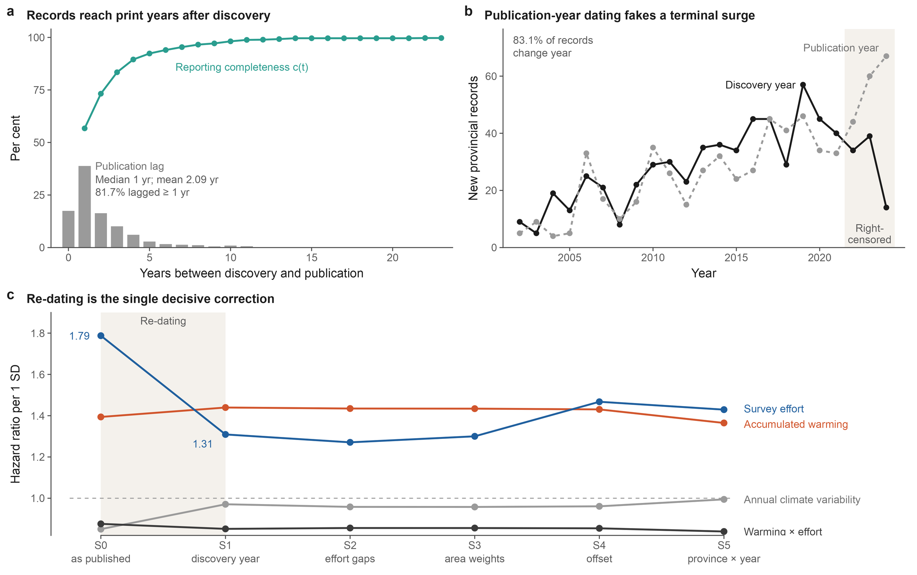
Background
Research gaps
Questions
Approach
Results
Synthesis
Backup
Dating to publication inflates effort and creates a phantom climate effect
Fig. 2 Discovery vs publication dating
Ding, Zhang, Jiang & Wang · AOC 2026, Singapore
29
Notes:
[about 25 s]
If asked about dating. Dated to publication year, as most compilations do, the effort hazard ratio is 1.79 instead of 1.31, inflated by 37 percent, and an annual climate-variability effect appears at 0.85 with P below 0.001. Dated to discovery it vanishes, and warming barely moves. Publication lags discovery by about two years.

Slide 30
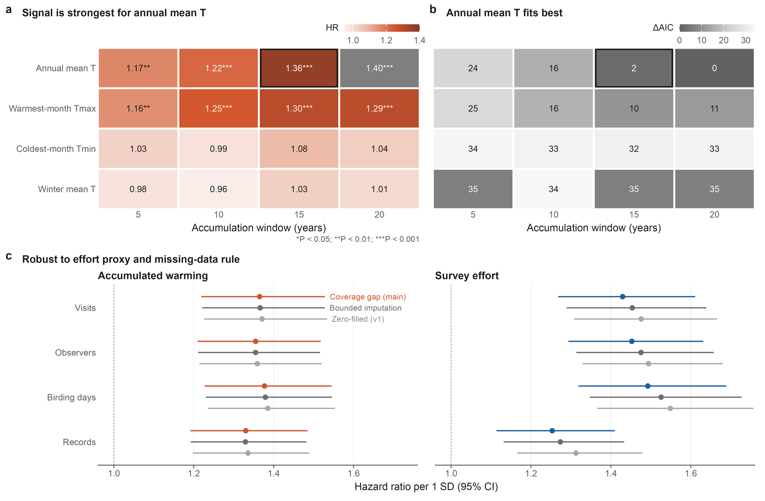
Background
Research gaps
Questions
Approach
Results
Synthesis
Backup
Specification robustness: climate indicator, window and effort proxy
Fig. 3 Specification grid
Ding, Zhang, Jiang & Wang · AOC 2026, Singapore
30
Notes:
[about 15 s]
If asked about specifications: the signal is strongest for annual mean temperature over 15 to 20 years, and the coefficients are stable across effort proxies and missing-data rules.

Slide 31
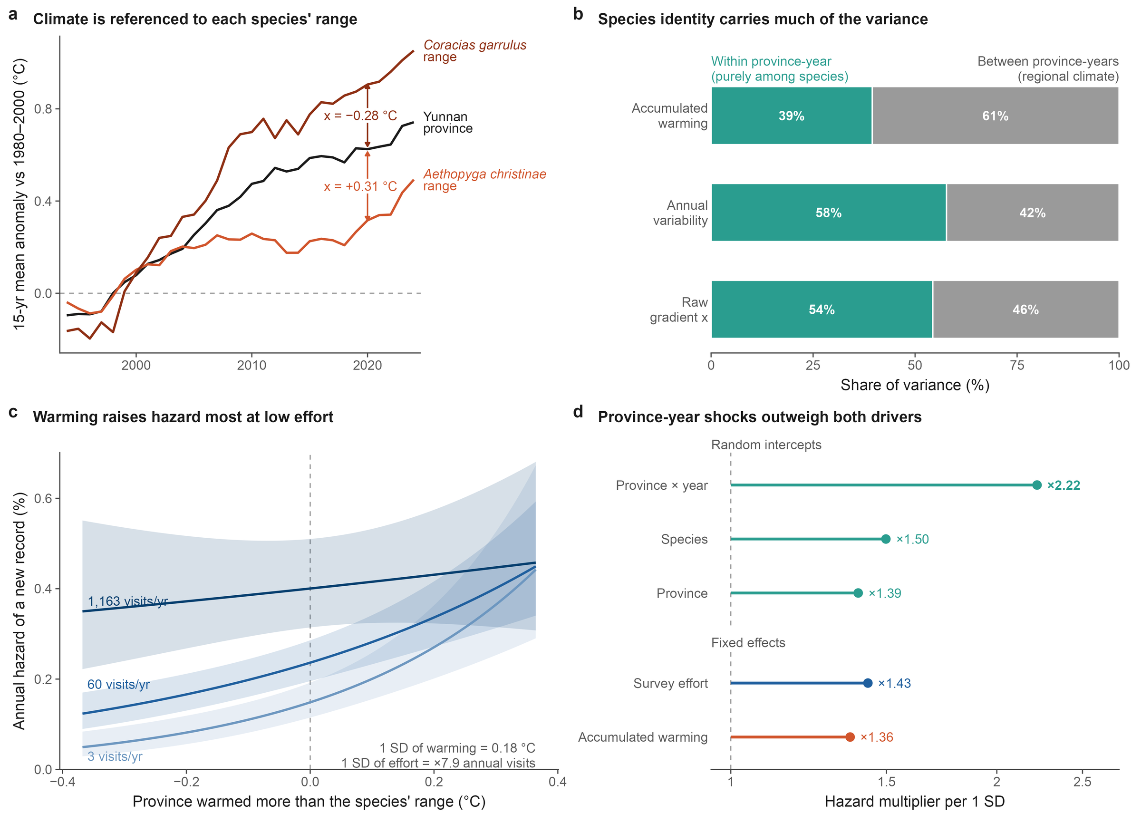
Background
Research gaps
Questions
Approach
Results
Synthesis
Backup
Model anatomy: climate referenced to each species' range
Fig. 4 Model anatomy
Ding, Zhang, Jiang & Wang · AOC 2026, Singapore
31
Notes:
[about 15 s]
If asked how warming is measured: the same province in the same year can warm more or less than a given species' range; that species-specific difference is the climate covariate.

Slide 32
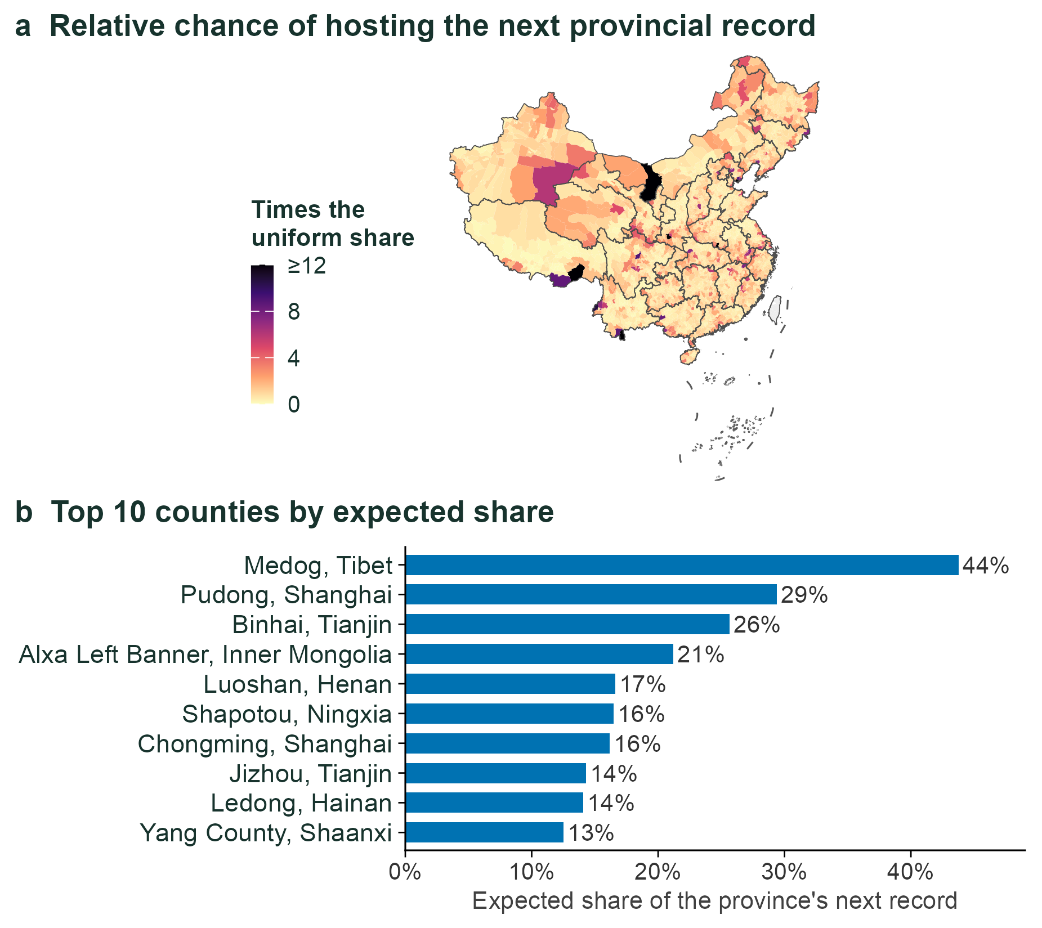
Background
Research gaps
Questions
Approach
Results
Synthesis
Backup
County-level surfaces: where to look first
Repository module County-level expected records, 2024
Ding, Zhang, Jiang & Wang · AOC 2026, Singapore
32
Notes:
[about 20 s]
If asked about finer scales: we split the problem into whether a province gets a new record and, if so, which county. Tested on 2019 to 2024, the top-ranked county was right 16 percent of the time, against about 1 percent by chance.

Slide 33
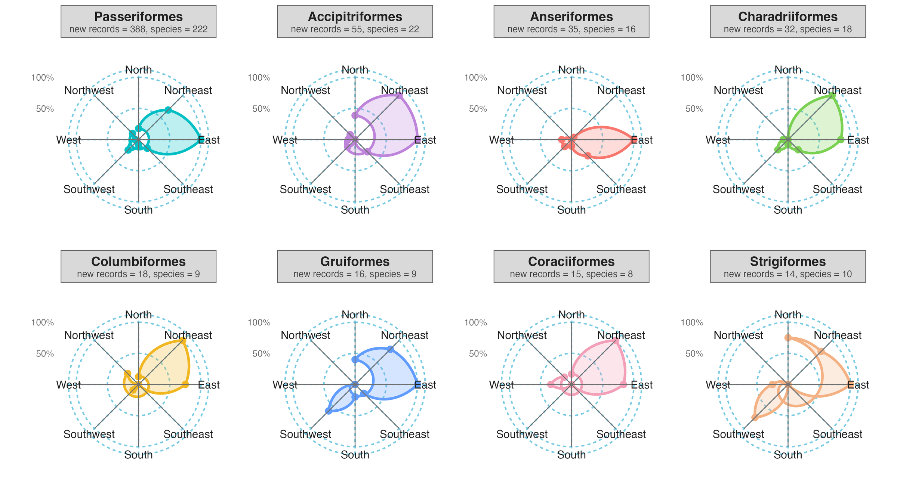
Background
Research gaps
Questions
Approach
Results
Synthesis
Backup
Direction by order: wind roses of the eight orders with most records
Share of each order's own records by compass sector
Ding, Zhang, Jiang & Wang · AOC 2026, Singapore
33
Notes:
[about 20 s]
If asked about taxonomic differences: the eastward and north-eastward lean is shared by the larger orders; ducks and geese lean most strongly east, and the small orders are noisy. Read these against the geometric null, not at face value.

Slide 34
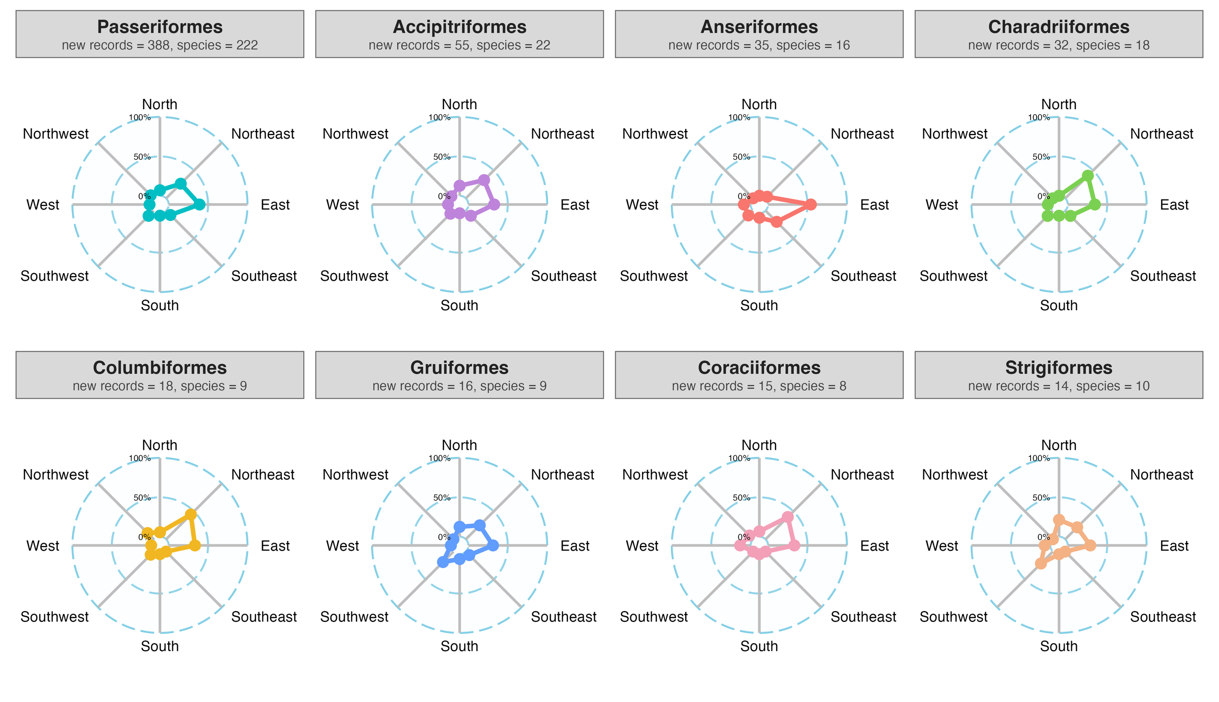
Background
Research gaps
Questions
Approach
Results
Synthesis
Backup
Direction by order: radar profiles of the eight orders with most records
Radar profiles: share of each order's records by sector
Ding, Zhang, Jiang & Wang · AOC 2026, Singapore
34
Notes:
[about 5 s]
The same information as radar profiles, scaled from 0 to 100 percent within each order.

Slide 35
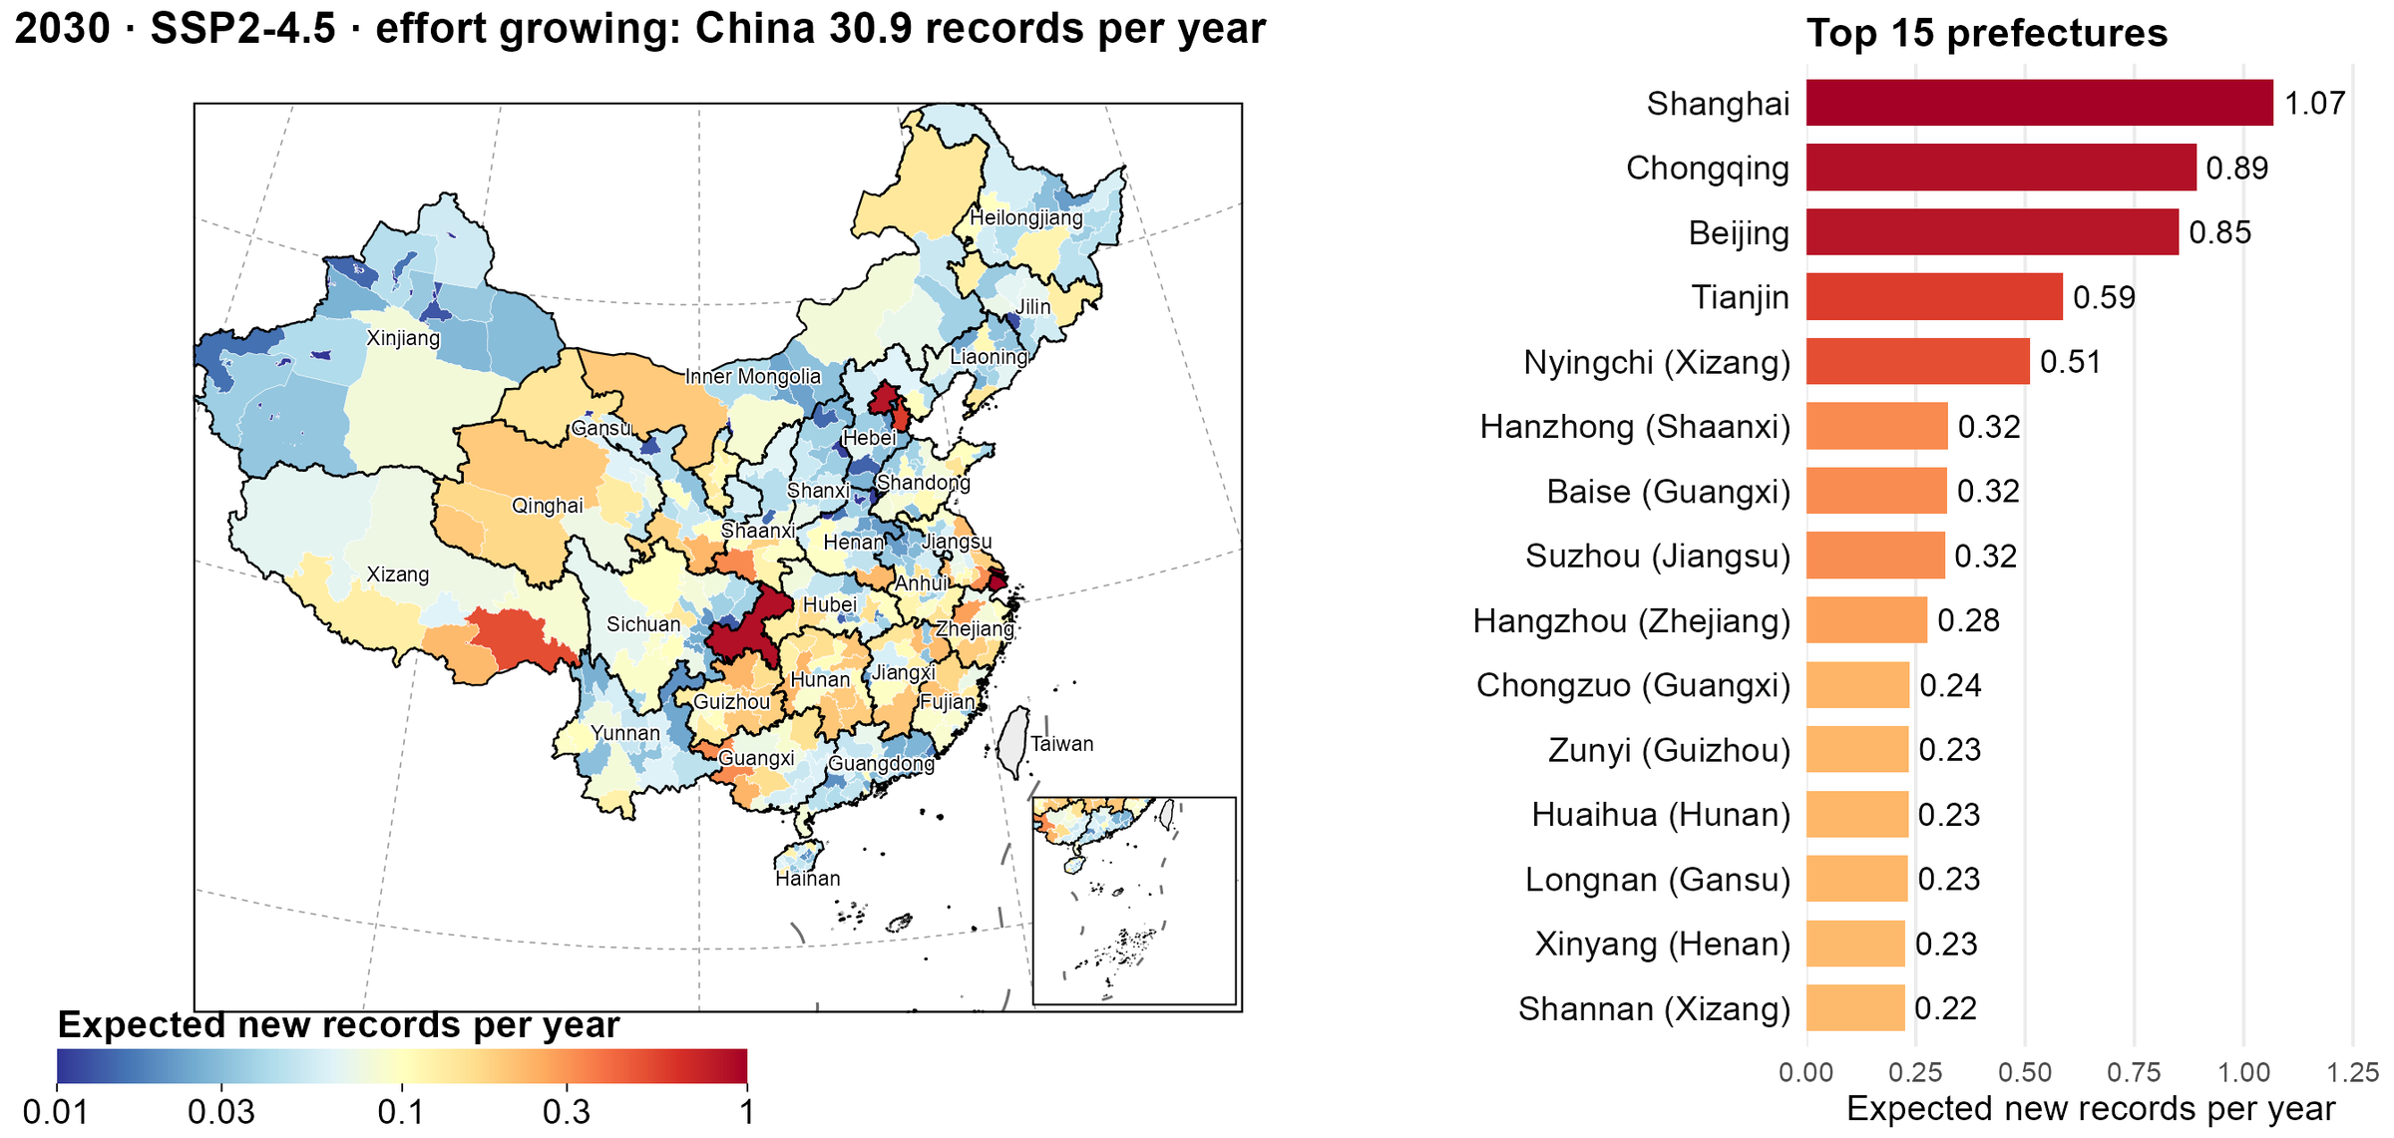
Background
Research gaps
Questions
Approach
Results
Synthesis
Backup
Prefecture view of the 2030 futures: where to look first
2030 · SSP2-4.5 · growing effort; prefecture shares held at 2024
Ding, Zhang, Jiang & Wang · AOC 2026, Singapore
35
Notes:
[about 20 s]
If asked about finer scales: the provincial expectation is split among prefectures by the 2024 allocation model, holding the shares fixed. Municipalities top the list because they are single units; among prefectures, Nyingchi in Xizang and Hanzhong in Shaanxi rank highest.

Slide 36
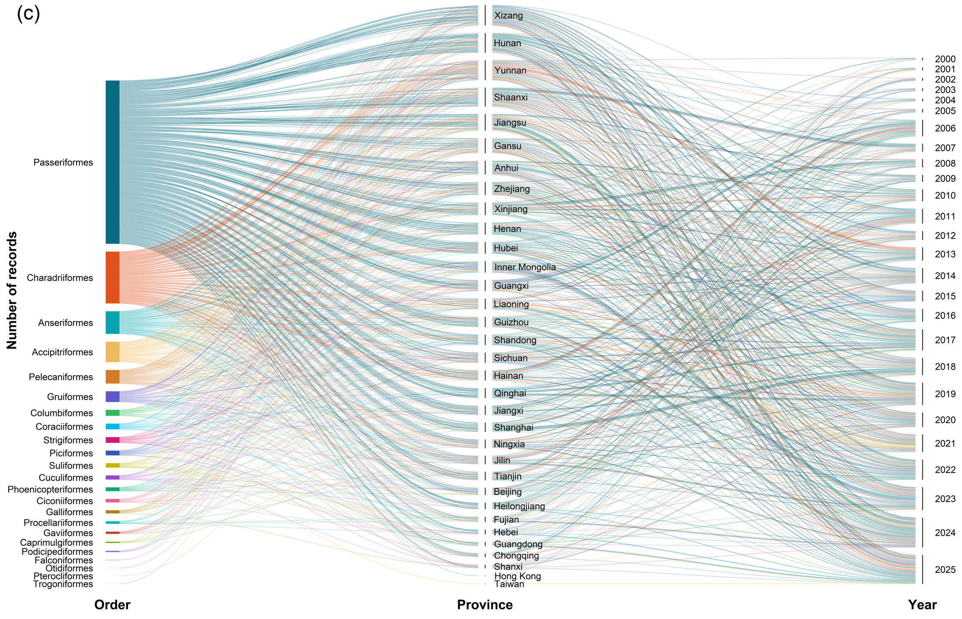
Background
Research gaps
Questions
Approach
Results
Synthesis
Backup
CBNR Fig. 2c: records linked by order, province and publication year
CBNR Fig. 2c Ribbon width proportional to the number of records
Ding, Zhang, Jiang & Wang · AOC 2026, Singapore
36
Notes:
[about 15 s]
If asked about the full picture: each ribbon is a set of records, from order, to the province of the record, to the year it was published.

Slide 37
Background
Research gaps
Questions
Approach
Results
Synthesis
Backup
Key references
Boakes, E. H. et al. (2010) PLoS Biol. 8, e1000385
Meyer, C. et al. (2015) Nat. Commun. 6, 8221
Chen, I.-C. et al. (2011) Science 333, 1024–1026
Mi, X. et al. (2021) Natl. Sci. Rev. 8, nwab032
Chen, S. et al. (2025) Avian Res. 16, 100310
Mittermeier, R. A. et al. (2011) Biodiversity Hotspots, 3–22
Feng, X. et al. (2019) Bull. Chin. Acad. Sci. 34, 1389–1398
Oliver, R. Y. et al. (2021) PLoS Biol. 19, e3001336
Herkt, K. M. B. et al. (2017) Glob. Ecol. Biogeogr. 26, 930–941
Pacifici, M. et al. (2017) Nat. Clim. Change 7, 205–208
Hortal, J. et al. (2015) Annu. Rev. Ecol. Evol. Syst. 46, 523–549
Pecl, G. T. et al. (2017) Science 355, eaai9214
Huang, G. et al. (2021) Natl. Sci. Rev. 8, nwab042
Pimm, S. L. et al. (2014) Science 344, 1246752
Hughes, A. C. et al. (2021) Ecography 44, 1259–1269
Sanczuk, P. et al. (2026) Nat. Clim. Change 16, 21–25
IPBES (2019) Global Assessment Report. IPBES Secretariat, Bonn
Whittaker, R. J. et al. (2005) Divers. Distrib. 11, 3–23
Jetz, W. et al. (2012) Nature 491, 444–448
Xing, X. et al. (2024) Front. Ecol. Evol. 12, 1415268
Lahoz-Monfort, J. J. & Magrath, M. J. (2021) BioScience 71, 1038–1062
Zhang, R. (2011) China Animal Geography. Science Press
Lawlor, J. A. et al. (2024) Nat. Rev. Earth Environ. 5, 351–368
Zheng, G. (2023) Checklist of the Birds of China, 4th edn
Lomolino, M. V. (2004) Frontiers of Biogeography, 293–296
Dataset: Ding et al., CBNR v2, Zenodo, doi.org/10.5281/zenodo.20809949
Ding, Zhang, Jiang & Wang · AOC 2026, Singapore
37
Notes:
[about 5 s]
Key references cited on the background slides.

Slide 38
Background
Research gaps
Questions
Approach
Results
Synthesis
Q&A
Likely questions, with short answers (1 of 2)
Q1
Is a single record a range shift, or just a vagrant?
We never call one record a shift. We model the yearly chance of a first record, and
warming and effort raise it in residents too, where vagrancy is rare.
Q2
Isn't effort partly a response to records, with birders chasing rarities?
Effort is all checklists per province-year, not trips for one species, and a
province × year term absorbs pulses. Still, we read it as an association.
Q3
How exactly do you measure warming?
Accumulated warming in the province relative to the species' own range, in SD;
strongest for annual mean temperature over 15–20 years (backups B2–B3).
Q4
Why a discrete-time hazard model, not counts or an SDM?
Each species–province pair is at risk every year until its first record; one model
handles exposure, yearly climate and effort, and species and province effects.
Q5
Why does dating to discovery matter so much?
Publication lags discovery by about two years. Dated to publication, the effort
effect inflates by about 37% and a phantom climate effect appears (backup B1).
Ding, Zhang, Jiang & Wang · AOC 2026, Singapore
38
Notes:
[about 5 s]
Short answers are on the slide; spoken answers follow, one per question.
If asked: Q1. Is a single record a range shift, or just a vagrant? Good question, and we're careful here. We never say any single record is a range shift; some are surely vagrants. What we model is the yearly chance that a species gets its first record in a province. And when we fit residents, partial migrants and long-distance migrants separately, warming and effort raise that chance in all three, including residents, where vagrancy isn't really the story.
If asked: Q2. Isn't effort partly a response to records, with birders chasing rarities? That's a fair worry. Our effort measure is all birding checklists in a province in a year, not trips for one species, so a single twitch barely moves it. On top of that, a province-by-year random effect soaks up local pulses. But I'd be honest: we can't rule out every feedback, so we read the effort effect as a strong association, not a causal estimate.
If asked: Q3. How exactly do you measure warming? We don't use raw provincial warming. For each species and province, we take the warming accumulated in that province and compare it with warming over the species' own range. So the same province can be 'warm' for one species and not for another. The signal is strongest for annual mean temperature over fifteen to twenty years, and the estimates are stable across effort proxies and missing-data rules.
If asked: Q4. Why a discrete-time hazard model, not counts or an SDM? Because a new record is an event that happens once. Each species-province pair is 'at risk' every year until it gets its first record, and then it drops out. That lets climate and effort change year by year, it accounts for how long each pair was exposed, and species and province differences go in as random effects. Counts or a distribution model would lose the timing, and timing is the whole point.
If asked: Q5. Why does dating to discovery matter so much? Because papers come out about two years after the bird was found, and effort keeps rising in between. If you date records to publication, as most compilations do, the effort effect is inflated by about a third, and a climate-variability effect shows up that simply isn't there when you use the discovery date. So the date you pick changes the answer.

Slide 39
Background
Research gaps
Questions
Approach
Results
Synthesis
Q&A
Likely questions, with short answers (2 of 2)
Q6
How reliable is CBNR, if a language model read the papers?
The model only speeds up reading: every record was checked by hand against its
paper, plus taxonomy, coordinate and outlier checks. 1,076 records, open on Zenodo.
Q7
What about land-use change and other drivers?
Not in this model. Stable differences sit in the province term, year-to-year
pulses in province × year. Land use is our next step.
Q8
Records point east. Isn't that a range expansion?
Geometry alone predicts it: 235 expected in the east, 237 observed. Net of geometry
and effort, northern sectors hold 40% of records against 33% expected.
Q9
What should monitoring programmes do with this?
Warming × effort is 0.84: the climate signal is steepest where few people look.
Send effort to under-surveyed regions that are warming fast.
Q10
Can you predict where the next records will appear?
Near term, yes: about 26–31 a year nationally in 2030, and the top-ranked county was
right 16% of the time vs about 1% by chance. Beyond 2050 it is extrapolation.
Ding, Zhang, Jiang & Wang · AOC 2026, Singapore
39
Notes:
[about 5 s]
Short answers are on the slide; spoken answers follow, one per question.
If asked: Q6. How reliable is CBNR, if a language model read the papers? The language model only speeds up the reading. Every single record was checked by hand against its source paper, and then we checked taxonomy against the 2026 Chinese catalogue, coordinates, duplicates and spatial outliers. Every step is logged, and the data are open on Zenodo, so anyone can audit it.
If asked: Q7. What about land-use change and other drivers? It's not in this model, and that's a real limit. Stable differences between provinces are absorbed by the province effect, and year-to-year shocks by the province-by-year effect, so land use can't masquerade as warming very easily. But testing land use directly, and how it interacts with climate, is exactly our next step.
If asked: Q8. Records point east. Isn't that a range expansion? It looks like one, but no. Most of these species have ranges centred west or south of China, so almost any record inside China lands to the east. Placing records at random among each species' possible provinces gives 235 in the east; we saw 237. Only after we add where birders go does a signal remain, and it points north: about 40 percent against 33. A modest poleward lean.
If asked: Q9. What should monitoring programmes do with this? The interaction is the practical part. Warming matters most where few people look, so that's where a new record tells you the most about climate. If I could move survey effort, I'd send it to under-surveyed regions that are warming fast, not to the places that are already well covered.
If asked: Q10. Can you predict where the next records will appear? In the near term, yes. For 2030 we expect about 26 to 31 new records a year nationally, whatever the emission scenario. At county level, when we tested on 2019 to 2024, our top-ranked county was right sixteen percent of the time, against about one percent by chance. But by 2050 the model is outside its data, so the late-century maps are illustrations, not forecasts.

