Slide 1
BIRDS OR BIRDERS?
Disentangling climate signals from survey effort in new bird
distribution records across China
1,076
175,640
649
provincial new records
species × province × year
first records modelled
588 species · CBNR v1.1
cells in the risk set
392 species · 31 provinces (v2)
Chenchen Ding¹, Zhengwang Zhang², Zhigang Jiang³, Zhiheng Wang¹
1 Institute of Ecology, College of Urban and Environmental Sciences, Peking University
2 School of Life Sciences, Beijing Normal University 3 Institute of Zoology, Chinese Academy of Sciences
Third Asian Ornithological Conference · National University of Singapore · 14–17 November 2026
Notes:
[about 30 s]
Good morning, everyone. I'm Chenchen Ding, from Peking University. Today I'd like to ask a simple question about new bird records. When a species turns up in a new province, is that the bird moving, or is it us looking harder? Our answer is: both, in roughly equal measure, and I'll show you how a single model can tell the two apart.

Slide 2
THE QUESTION
Introduction
A new record can mean the bird moved, or that someone finally looked
Every record needs a bird and a birder
In China, both grew fast after 2000
Range maps are built from records.
The climate warmed quickly.
A record = where birds are × where people look.
Birding visits rose about 200-fold (2002–2024).
In the raw data, the two cannot be told apart.
A model with only one of them gives it
the credit for both.
Our question
How much of the accumulation of new records reflects warming,
and how much reflects survey effort?
How the original papers explain the CBNR v2 records (n = 1,029)
Range shift
61.1%
Survey effort (alone or with range shift)
7.3%
Not stated
31.0%
Other (e.g. taxonomic revision)
0.6%
Birds or birders? · AOC 2026, Singapore
02 / 19
Notes:
[about 50 s]
Every record needs two things: a bird, and a birder. So a map of records always mixes where the birds are with where people are looking. In China, both changed fast after 2000. The climate warmed, and birding visits rose roughly a hundred-and-seventy-five-fold. A model with only one of them will give it the credit for both. At the bottom you can see how the original papers explain their own records: sixty-one percent say range shift, only seven percent mention survey effort. So our question is: how much of the accumulation of new records reflects warming, and how much reflects effort?
If asked: Where do these percentages come from? From CBNR's 'inferred discovery reason' field, which records the reason given or implied in each source paper.

Slide 3
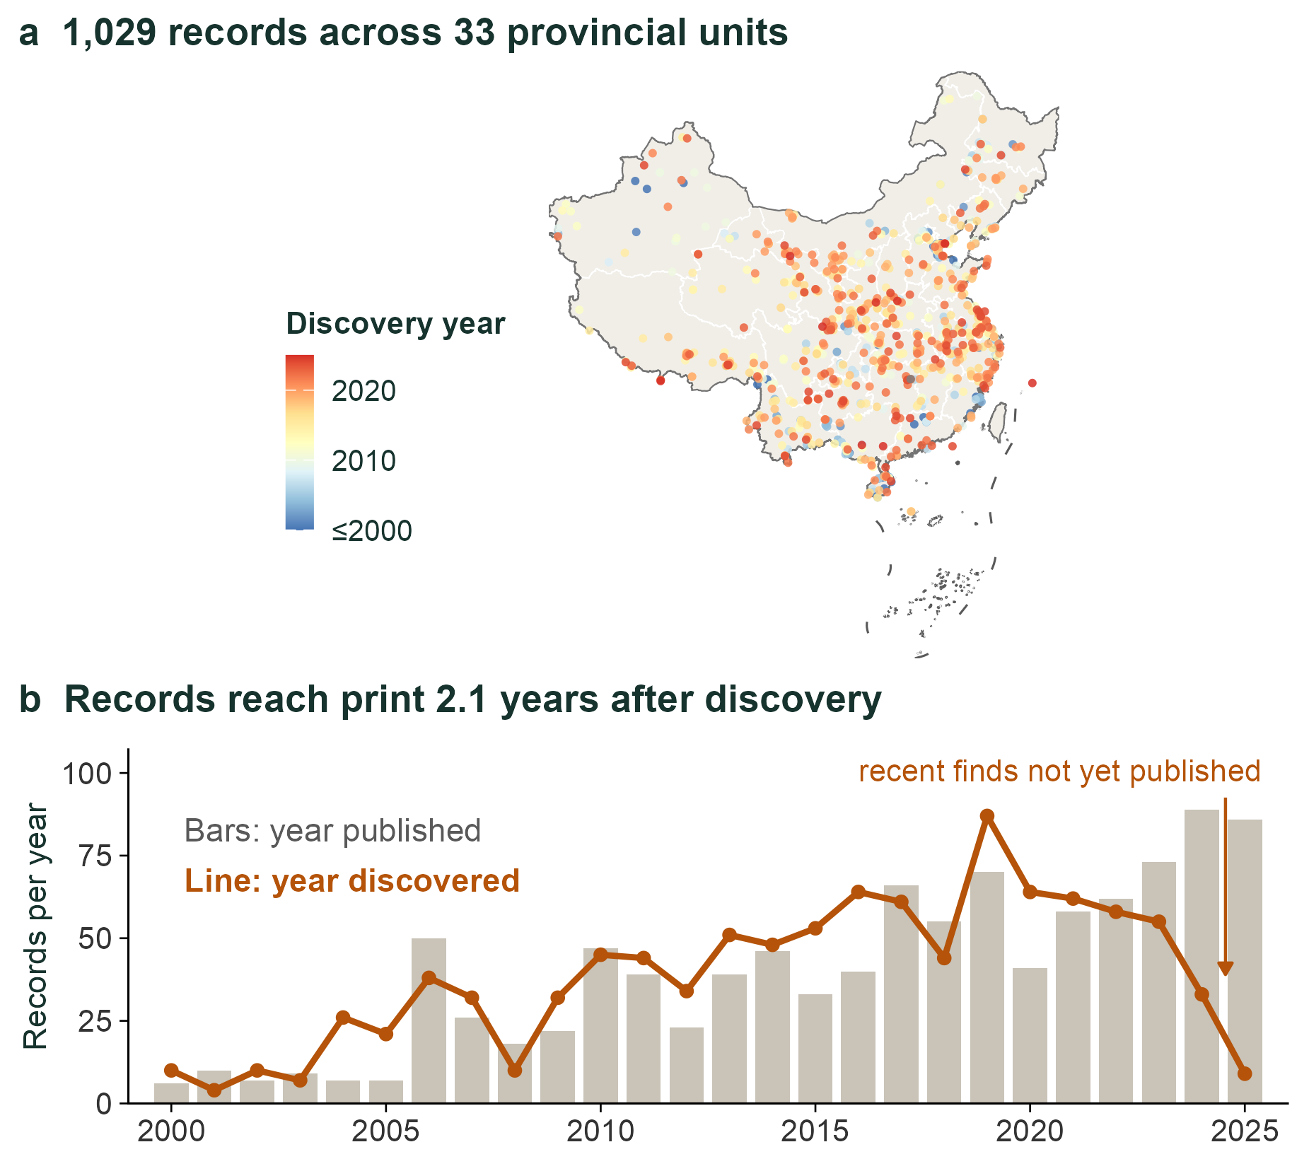

DATA
CBNR · Zenodo 20809949
CBNR: provincial new bird records in China, 2000–2025
CBNR, the dataset
v1.1: 1,076 records · 588 species
23 orders · 33 provincial units · 2000–2025
Mined from peer-reviewed papers, every
record then checked by hand
What the model uses
The published v2 release (1,029 records)
Records dated to their discovery year
649 first records in 2002–2024
Open data · CC BY 4.0
doi.org/10.5281/
zenodo.20809949
Birds or birders? · AOC 2026, Singapore
03 / 19
Notes:
[about 40 s]
Our data come from CBNR, the China Bird New Record dataset, which our team compiled from the peer-reviewed literature and checked record by record. The current version holds 1,076 records of 588 species, across 33 provincial units, from 2000 to 2025. The analysis I'll show uses the published v2 release of 1,029 records, which gives 649 first records in our modelling window. Each record is dated to the year it was discovered. The data are open, under a CC BY licence; scan the code to get them.
If asked: Why does the model use v2 and not v1.1? v2 is the citable Zenodo release; v1.1 adds 47 records and is not yet on Zenodo.
If asked: Is CBNR complete? It covers peer-reviewed provincial new records; grey literature and unpublished sightings are not included.

Slide 4
APPROACH
Methods
A discrete-time hazard model separates the two processes
For every species, in every province it could reach, in every year: is this the year of its first record?
first record ~ warming × effort + climate variability + offset(log completeness)
+ (1 | species) + (1 | province) + (1 | province × year)
binomial, cloglog link
Discrete-time hazard model: exp(β) is a hazard ratio (HR) per standard deviation
Complete risk set
Species-referenced warming
Only provinces the species could reach
Province anomaly − range anomaly
Leaves the risk set after its first record
15-year moving window
Denominator = real opportunities
1 SD = 0.18 °C
Survey effort
Province × year effect
Birding visits per province and year
The scale at which surveys happen
eBird and GBIF, 2.86 million records
Bird races, campaigns, new reserves
1 SD = 7.9-fold more visits
The observation process, modelled
Records are dated to their discovery year; an offset corrects the most recent years for unpublished records.
Birds or birders? · AOC 2026, Singapore
04 / 19
Notes:
[about 50 s]
We turned the question into a discrete-time hazard model. For every species, in every province it could plausibly reach, in every year, we ask: is this the year of its first record? Four parts matter. A complete risk set, so the denominator is real opportunities. Warming measured relative to each species' own range, because only the difference tells us something about that species. Survey effort, from millions of eBird and GBIF records. And a province-by-year random effect, which is where survey campaigns live. Records are dated to the year they were discovered, with an offset for the most recent years.
If asked: Why cloglog? It is the discrete-time form of a proportional-hazards model, so exp(beta) is a hazard ratio that does not depend on the time step.
If asked: How is 'could reach' defined? Provinces with at least 50 suitable cells in the species' distribution model; results are the same at 100 and 200.

Slide 5
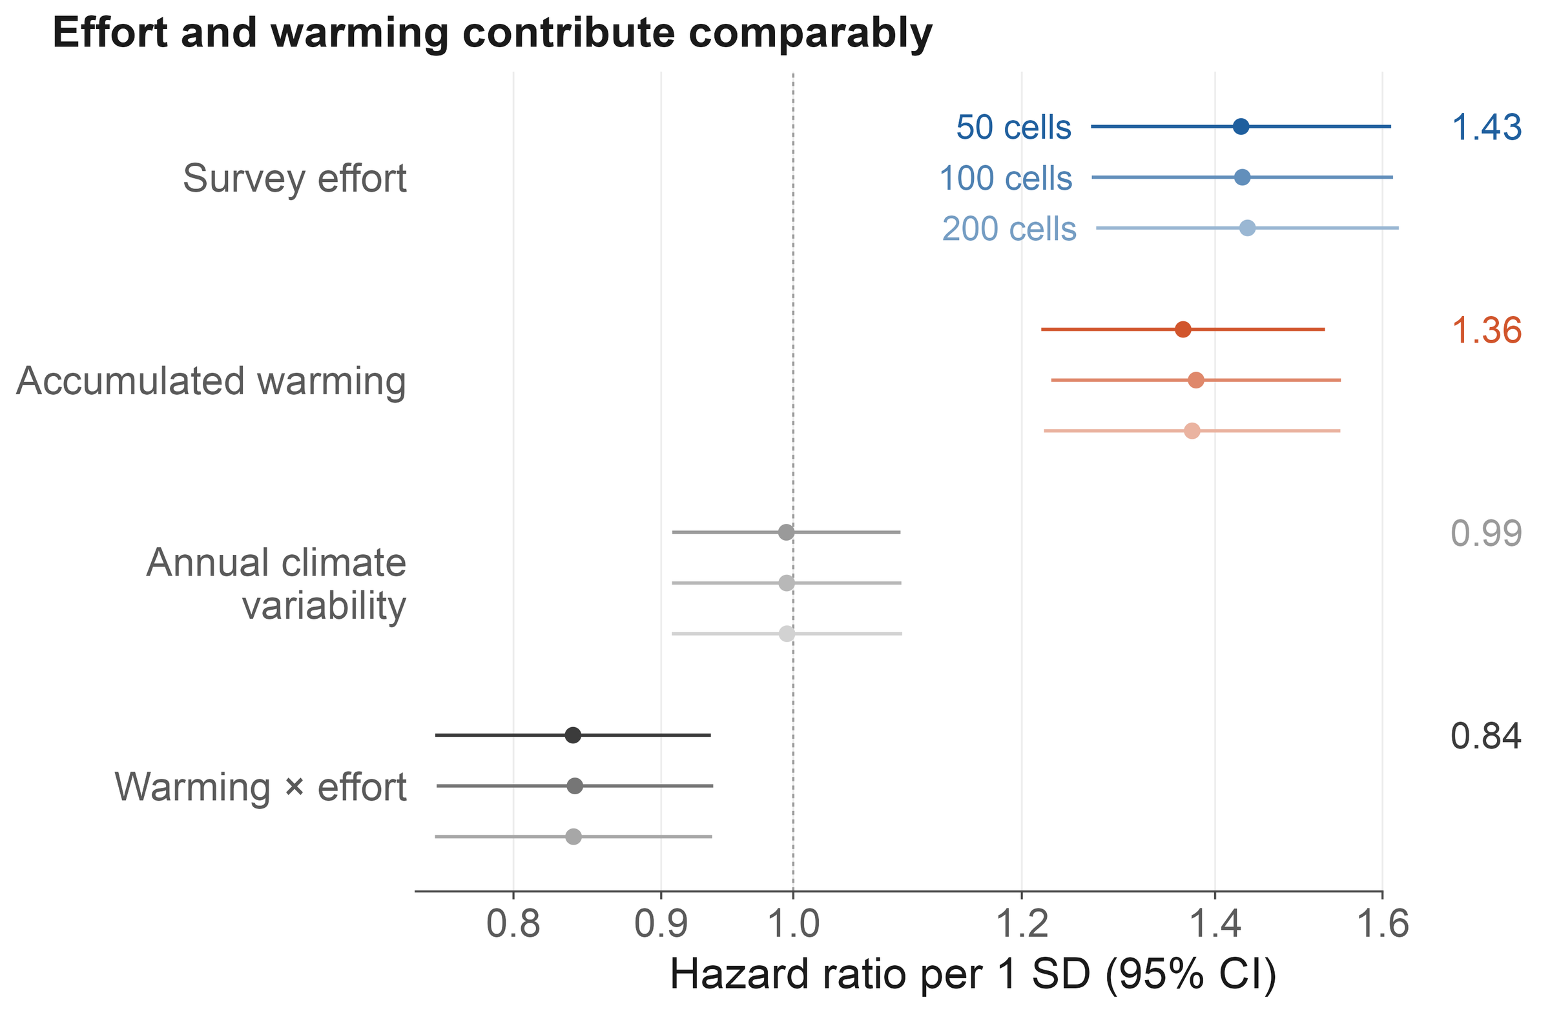
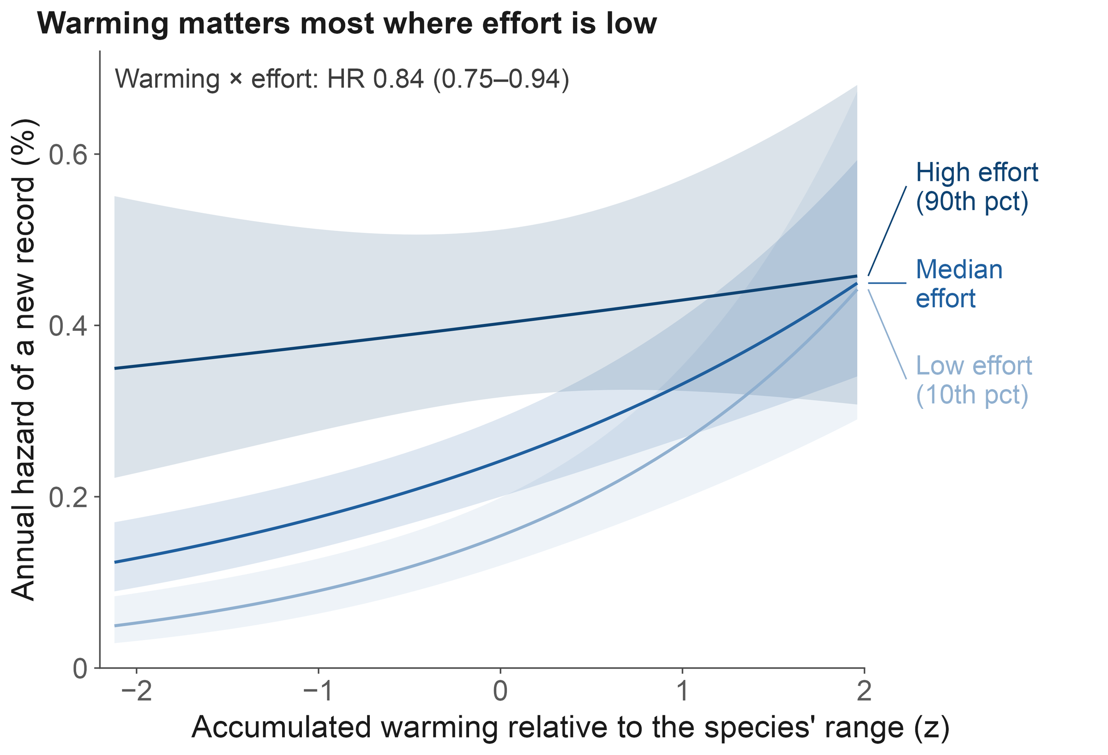
FINDING 1
Figure 1
Warming and survey effort contribute comparably and interact
1.36
1.43
0.84
0.99
Accumulated warming
Survey effort
Warming × effort
Annual variability
HR per SD (1.22–1.53)
HR per SD (1.27–1.61)
strongest where few look
no effect
Birds or birders? · AOC 2026, Singapore
05 / 19
Notes:
[about 30 s]
First finding. Warming and survey effort contribute about equally: a hazard ratio of 1.36 per standard deviation for warming, and 1.43 for effort. And they interact negatively. On the right you can see what that means: where few people are looking, the warming curve is steep; where many people are looking, it flattens out. Annual climate variability has no effect at all.
If asked: How big is the warming effect, really? A permutation null puts the baseline at 1.16, so the species-specific increment is about ×1.18 per SD.
If asked: What does 1 SD of warming mean? 0.18 °C of species-referenced accumulated warming.

Slide 6
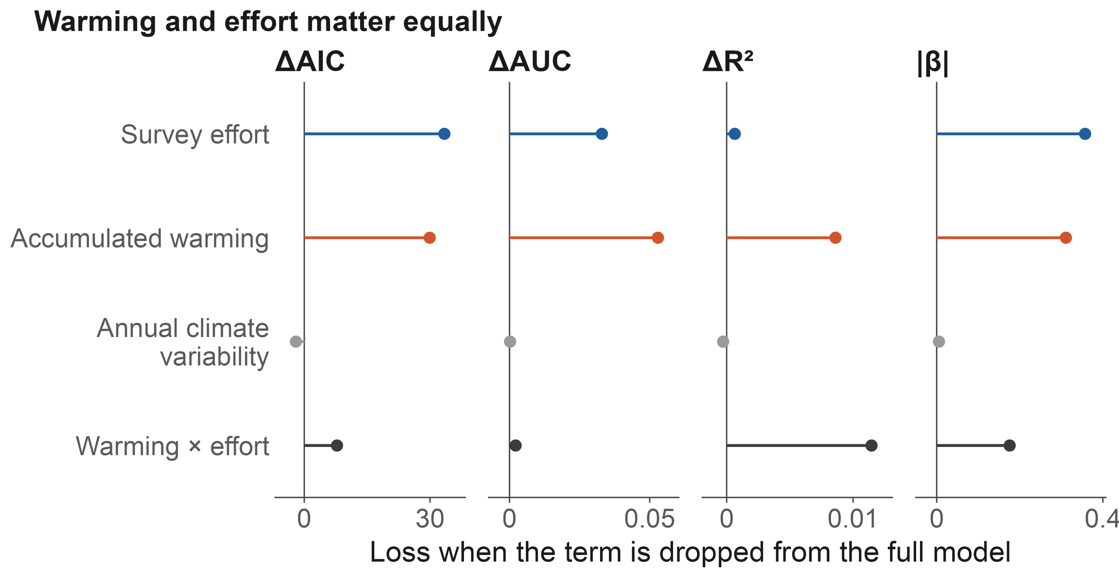
FINDING 1 · ROBUSTNESS
Figure 1c · Figure 3
The balance holds across four criteria and twelve specifications
Cost of dropping each term
Twelve specifications
Design-preserving nulls
ΔAIC: warming 29.9 · effort 33.4
SDM thresholds 50/100/200: stable
Warming null 1.16 → increment ×1.18
ΔAUC: warming 0.053 · effort 0.033
4 effort proxies × 3 missing-data rules
Shuffle effort timing: falls to 0.98
Conditional R² and |β| agree
Effort HR 1.25–1.55 · warming 1.33–1.39
Province bootstrap: both lower bounds > 1
Birds or birders? · AOC 2026, Singapore
06 / 19
Notes:
[about 30 s] [optional: can be cut]
This balance is not fragile. Drop either term and the model loses about the same, around 30 AIC units or more each. Across twelve specifications, with different distribution-model thresholds, effort proxies and missing-data rules, the numbers stay put. And against design-preserving nulls, both effects stand: the warming increment over its null is about 1.18, and effort collapses to 0.98 if we break its timing.

Slide 7
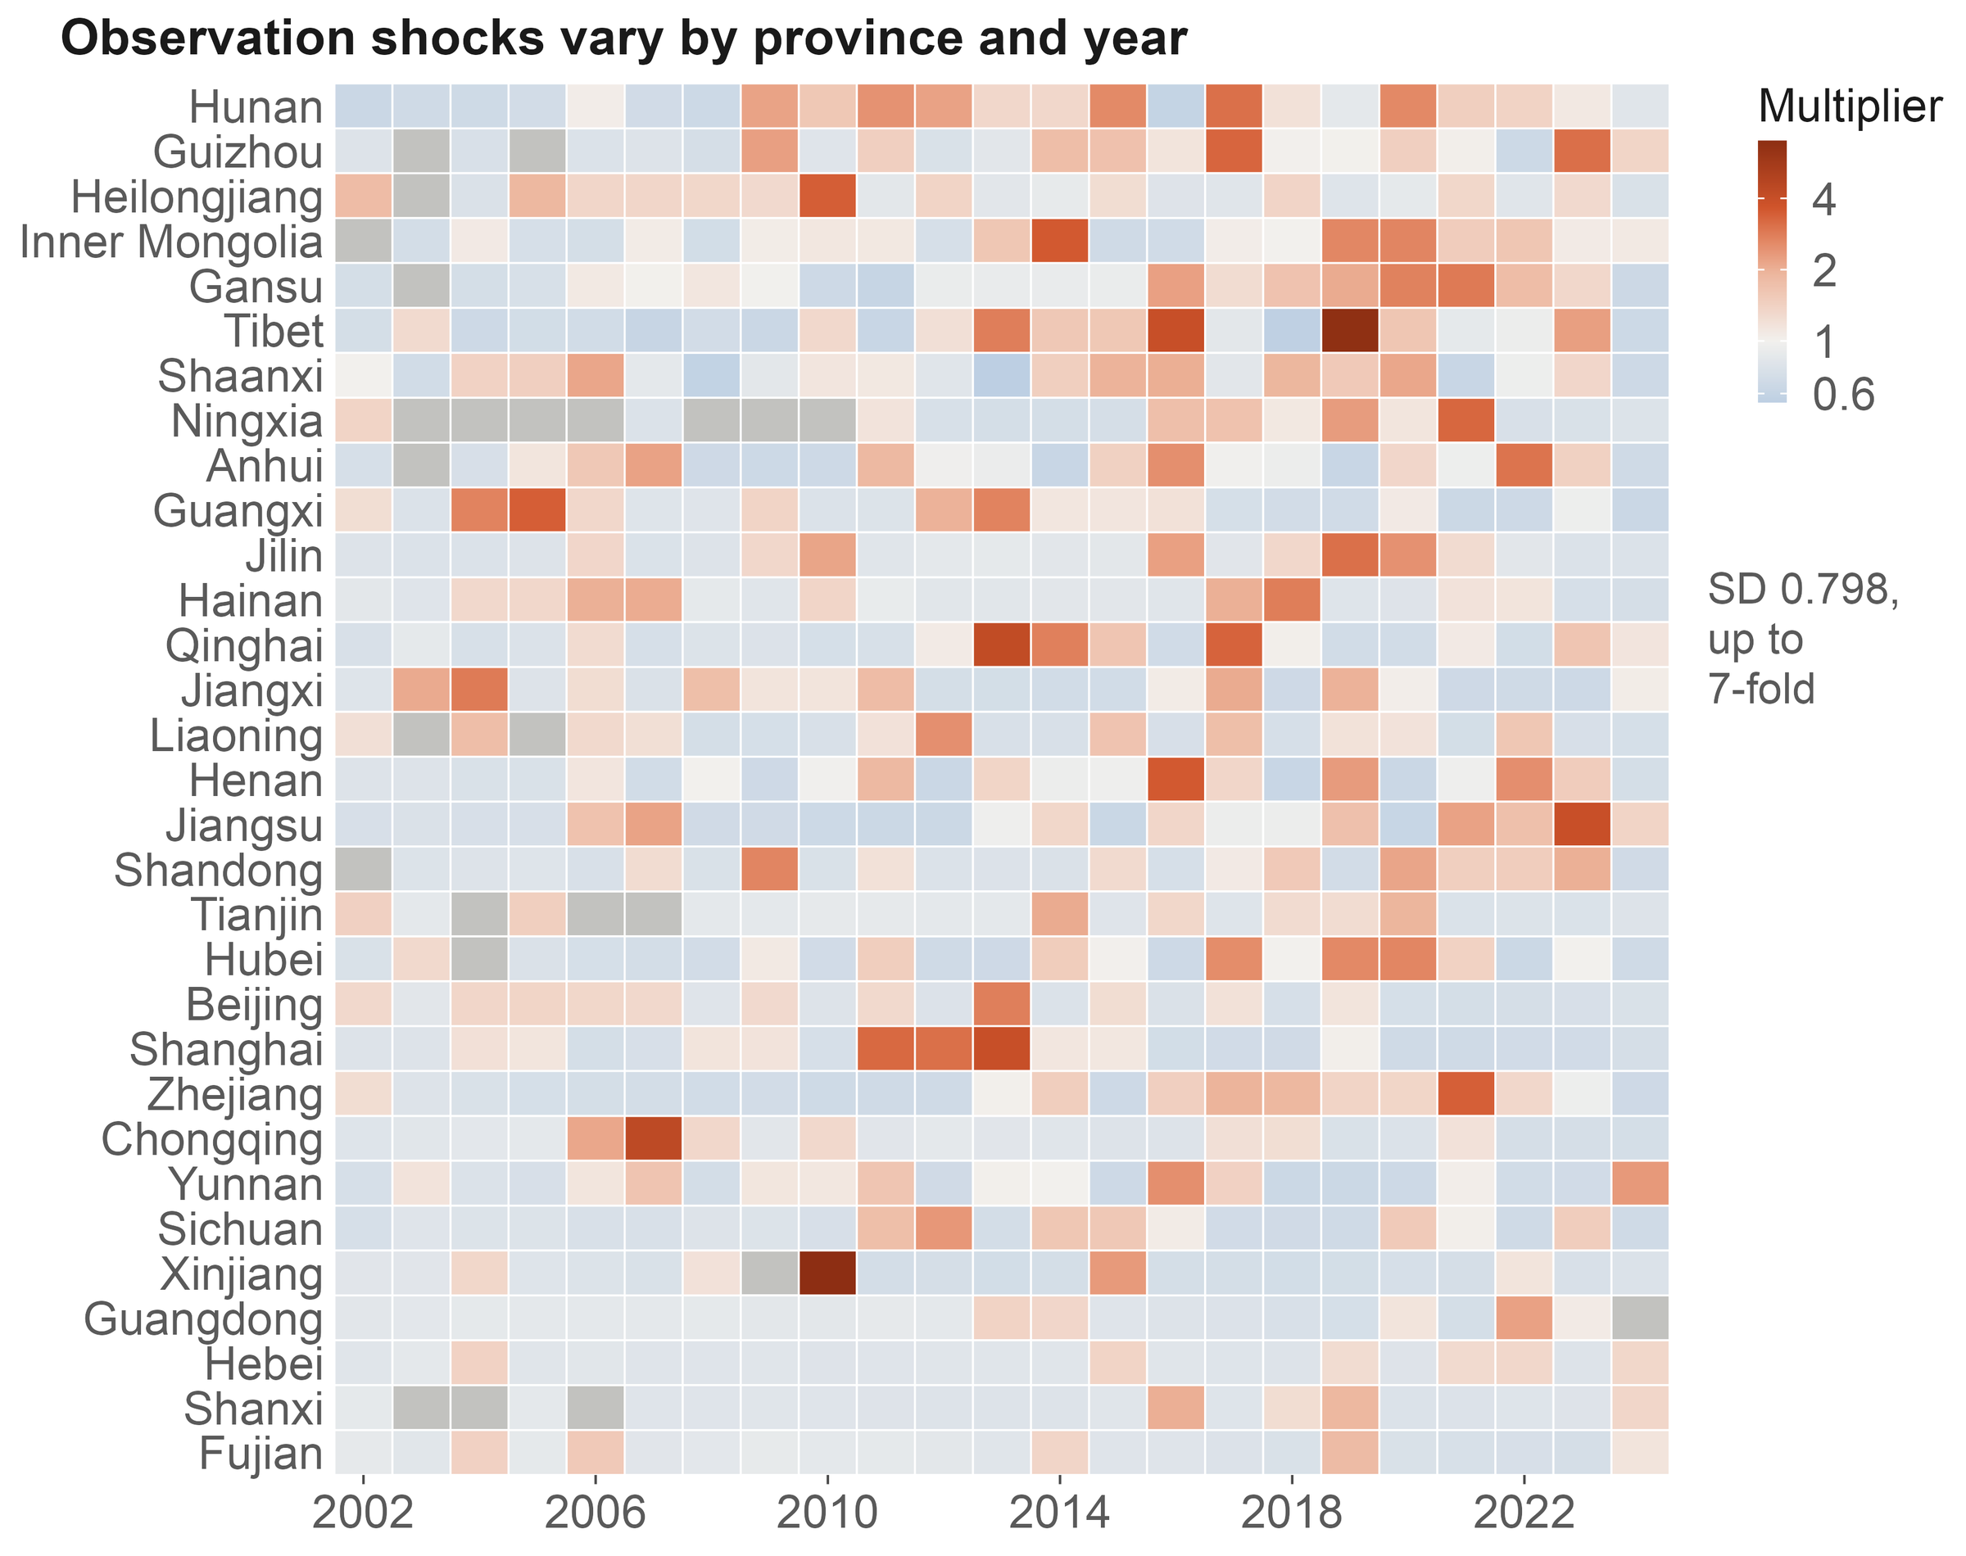
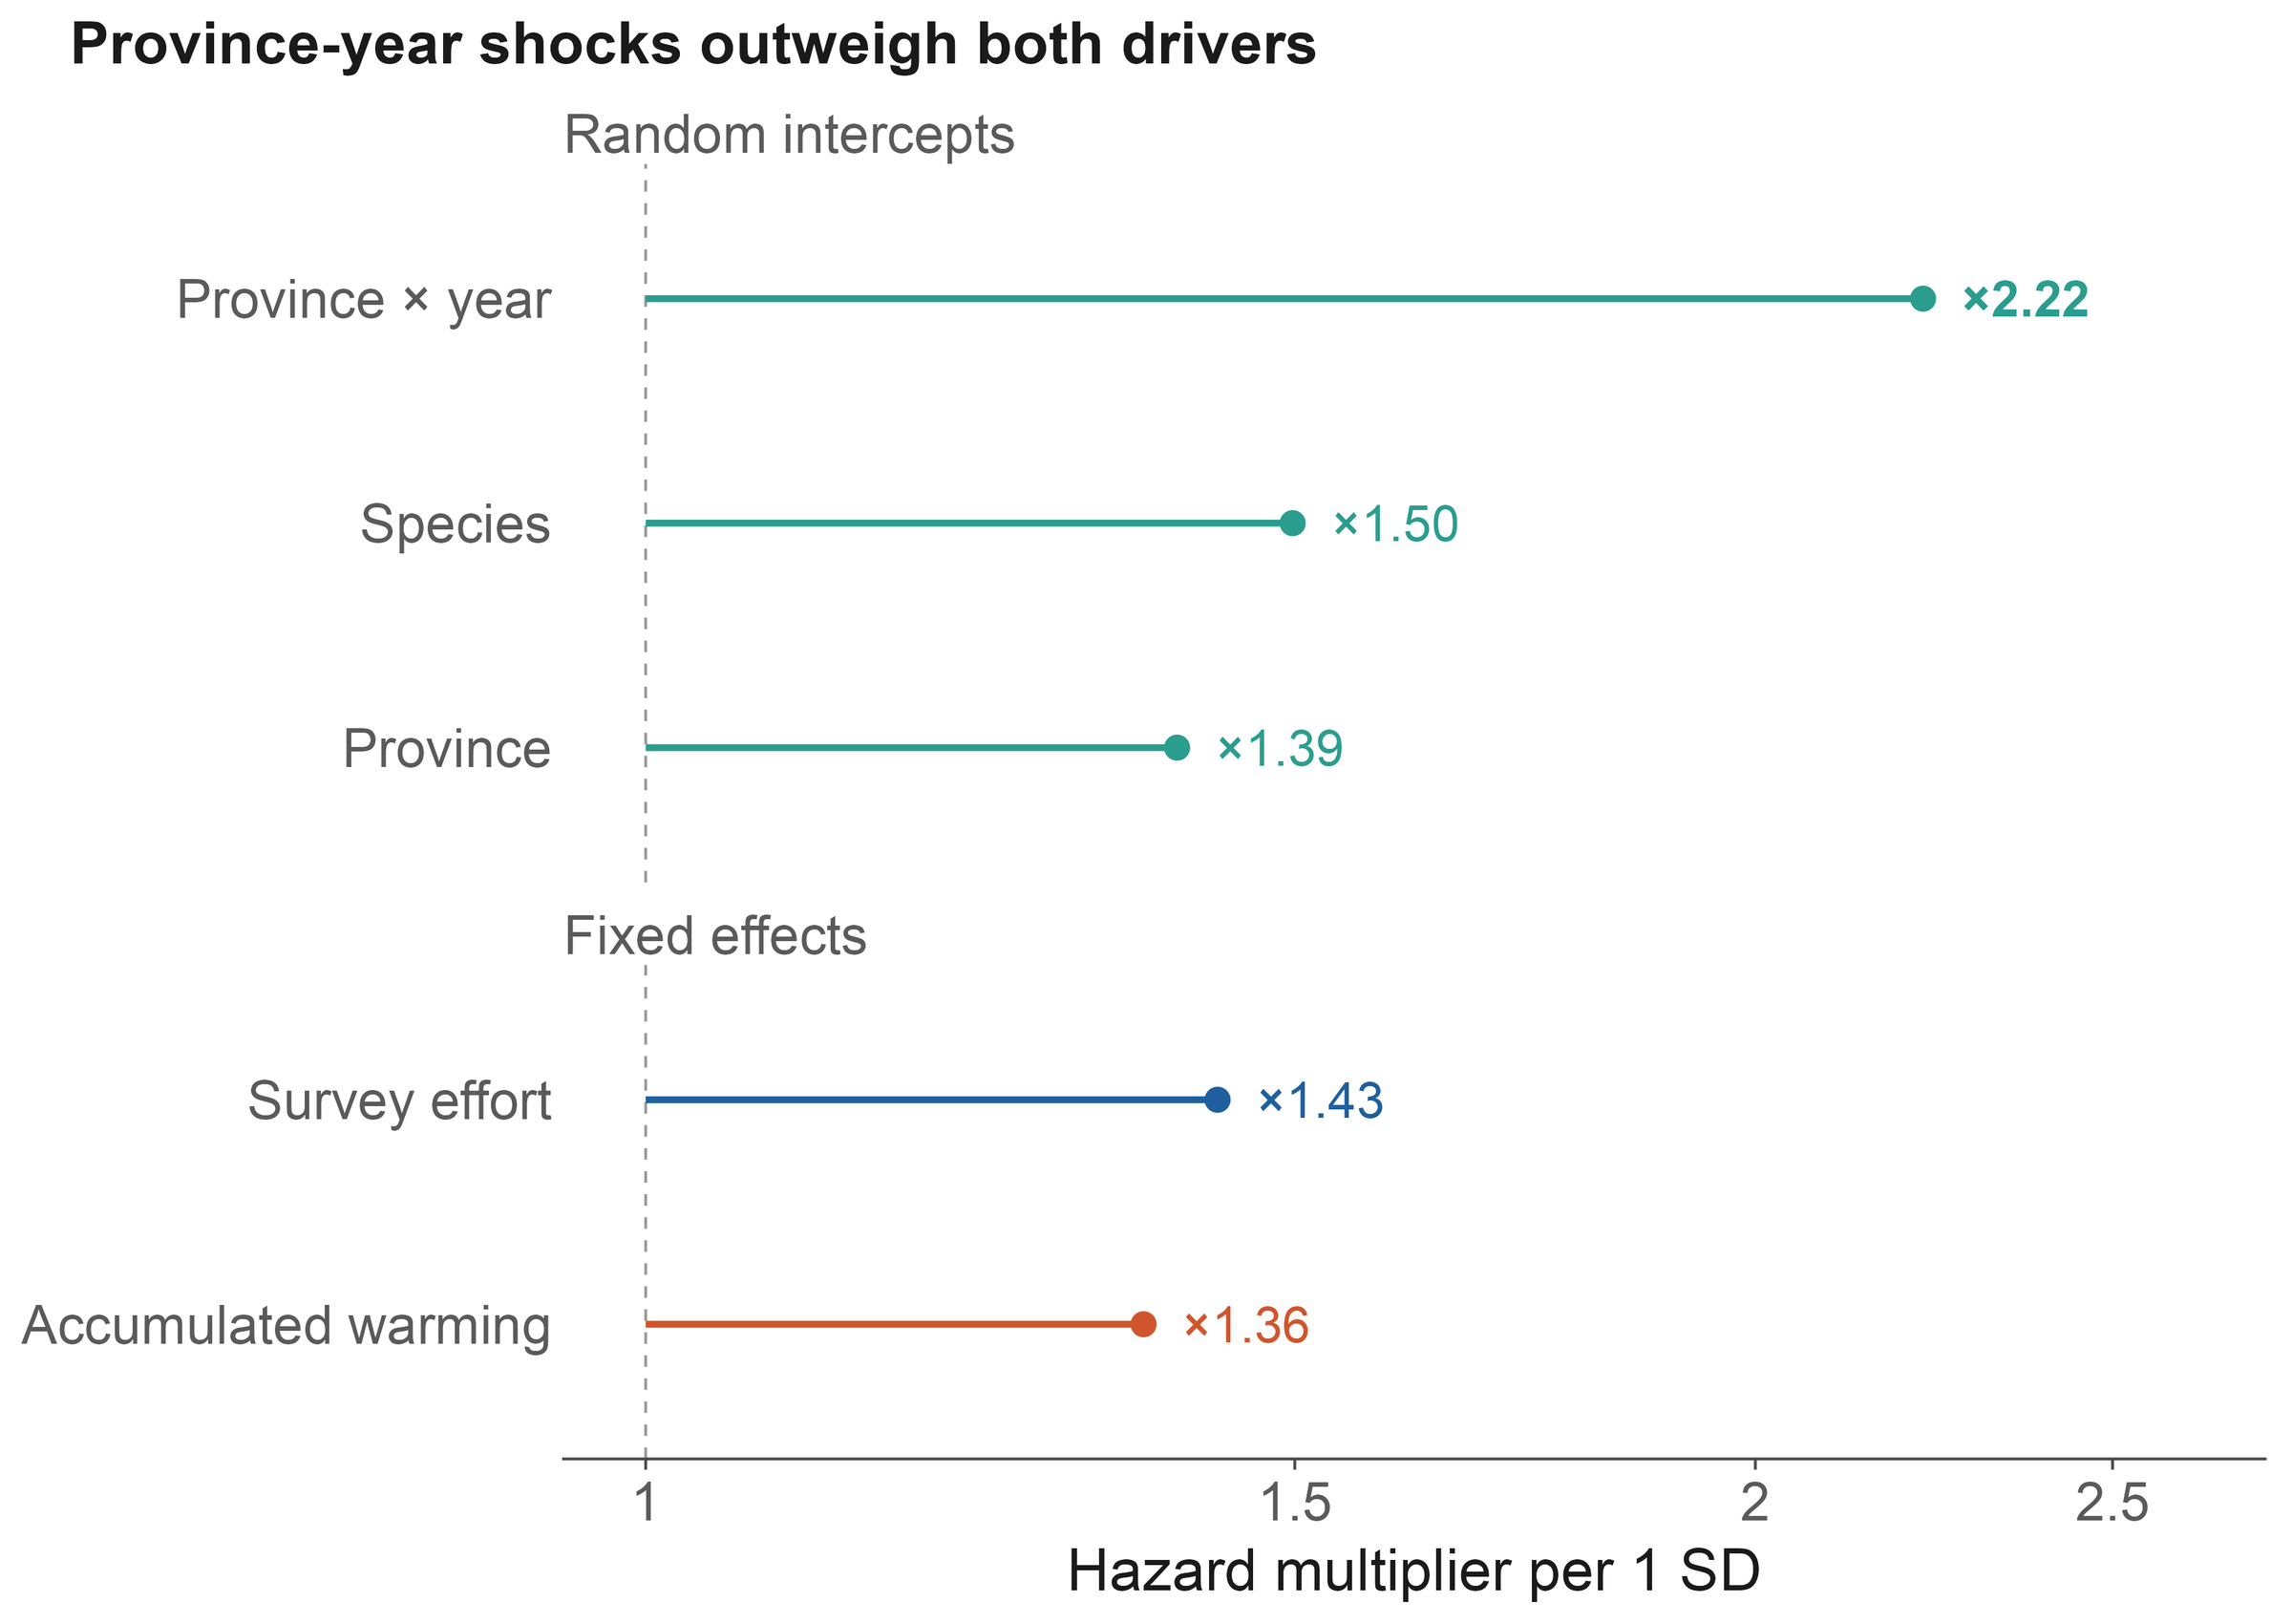
FINDING 2
Figure 5
Pulses of survey activity are the largest source of variation
×2.22
×1.50
×1.39
Province × year
Species
Province
per SD: survey campaigns
intrinsic detectability
regional baseline
Birds or birders? · AOC 2026, Singapore
07 / 19
Notes:
[about 35 s]
Second finding. The biggest single component is not a driver at all. It is the province-by-year effect: one standard deviation multiplies the hazard by 2.22, more than warming or effort. This is where a provincial bird survey, a big birding event or a new reserve shows up. Adding this layer lifts conditional AUC from 0.72 to 0.85, and leaves the fixed effects unchanged. Treat it as noise, and survey history reads as range change.
If asked: Could the province-by-year effect absorb climate anomalies too? Partly; that protects the fixed effects at some cost in climatic signal, and we say so in the paper.

Slide 8
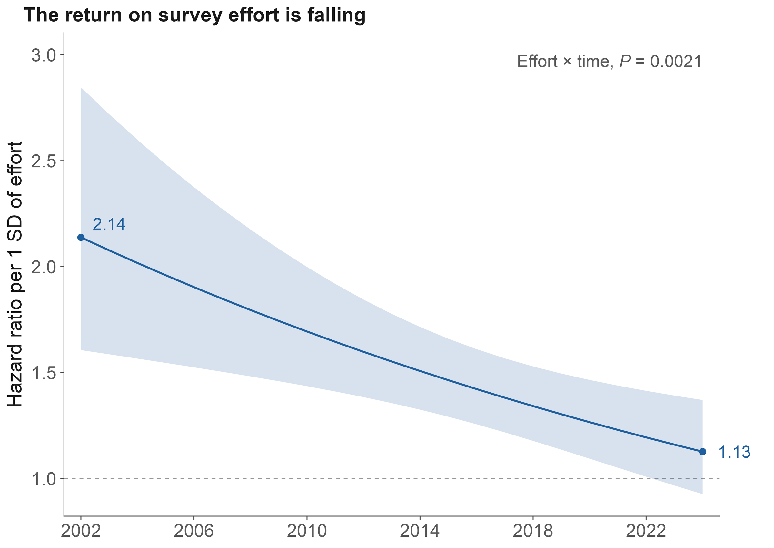
FINDING 3
Figure 5d · SI Notes S3–S4
The return on effort is falling; the effect of warming is not
Returns on effort are falling
2002: HR 2.14 (1.61–2.85)
2024: HR 1.13 (0.93–1.37)
Effort × time: P = 0.0021
Warming shows no such trend
Warming × time: P = 1.00
Time-varying model: warming HR 1.37
A stock and a flow
Effort mines a finite stock of gaps;
warming keeps adding new candidates
Birds or birders? · AOC 2026, Singapore
08 / 19
Notes:
[about 40 s]
Third finding. Effort is saturating. Its hazard ratio fell from 2.1 in 2002 to about 1.1 in 2024, and from 2023 it is no longer different from one. The easy gaps have been filled. Warming shows no such trend. One way to read this is a stock and a flow: effort mines a finite stock of undiscovered records, while warming keeps adding new candidates. We haven't tested the two trends against each other, so I'd call it consistent, not proven.

Slide 9
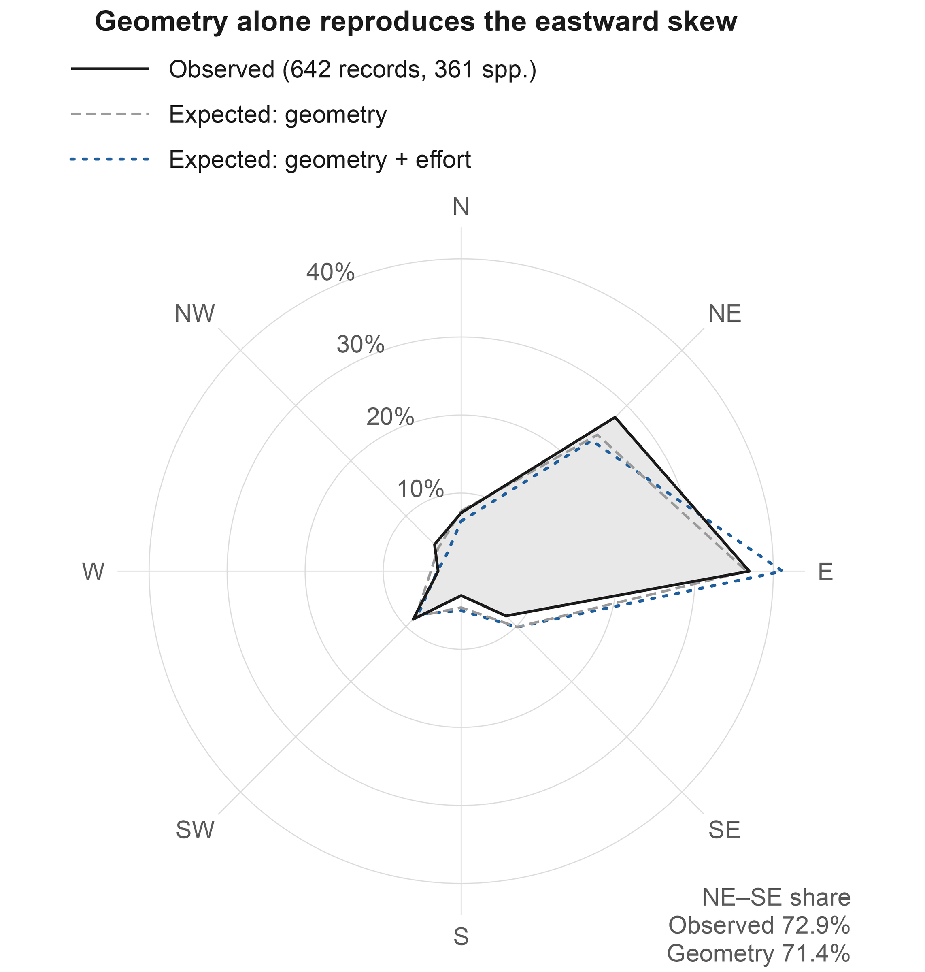
FINDING 4
Figure 6 · SI Tables S9–S10
The eastward bias is geometry; net of it, records lean slightly north
Raw bearings (642 records)
East 36.9% · north-east 27.9%
But China lies east of most ranges
Null 1 · geography only
East: 235 expected, 237 observed
No sector differs
Null 2 · geography + birders
Northern sectors: 40% vs 33% expected
χ² = 26.8, P = 0.001
Birds or birders? · AOC 2026, Singapore
09 / 19
Notes:
[about 40 s] [optional: can be cut]
Fourth: direction. Measured from each species' range centre, new records look strongly biased to the east. But most of these species have ranges centred west or south of China, so almost any record inside China lands to the east. If we place each record at random among its species' possible provinces, geography alone reproduces the eastward pattern. Only when we also weight provinces by where birders go does a signal remain, and it points north. A modest poleward lean, visible only with the right null.

Slide 10
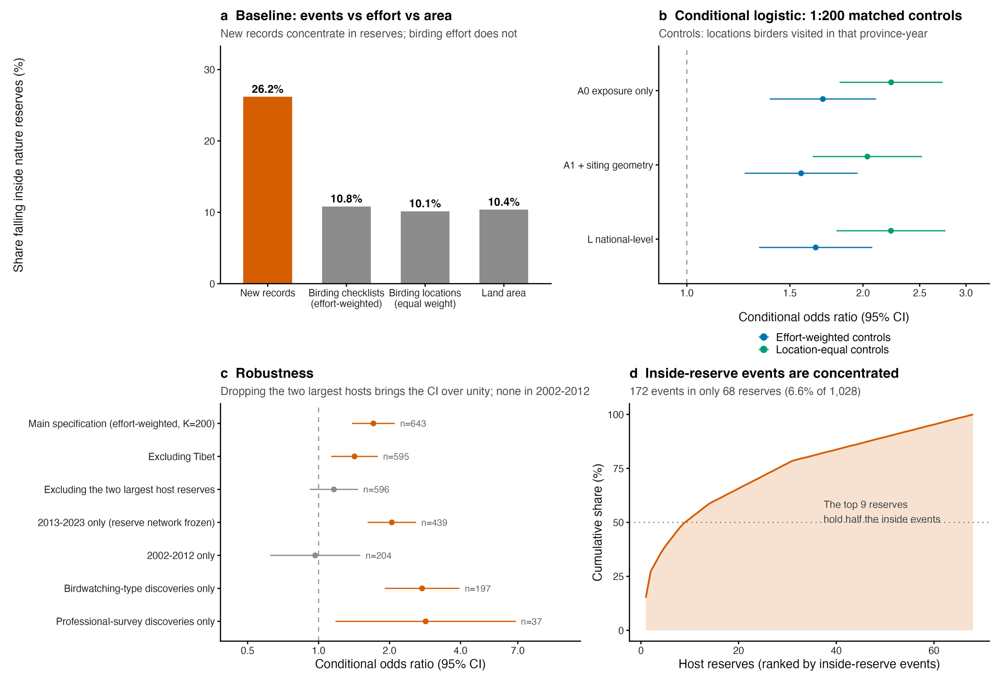
USE 1
SI Figs S12–S14
Reserves look rich in new records because birders go there
An apparent 2.5-fold enrichment
Records inside reserves: 26.2%
Birding effort inside: 10.8%
Land area inside: 10.4%
Against where birders actually went
Same province and year: OR 1.57
Without the 2 largest reserves: 1.16
Before 2013: no effect (0.97)
More records ≠ better protection
Record counts cannot measure
how well a reserve works
Birds or birders? · AOC 2026, Singapore
10 / 19
Notes:
[about 40 s]
Now, some uses. Nature reserves look like hot spots for new records: twenty-six percent of records fall inside reserves that cover only ten percent of the land. But birders go there too. When we compare each record with places birders actually visited, in the same province and year, the effect shrinks, and it disappears if we drop the two largest host reserves or look before 2013. More records inside a reserve is not evidence that the reserve is working.

Slide 11
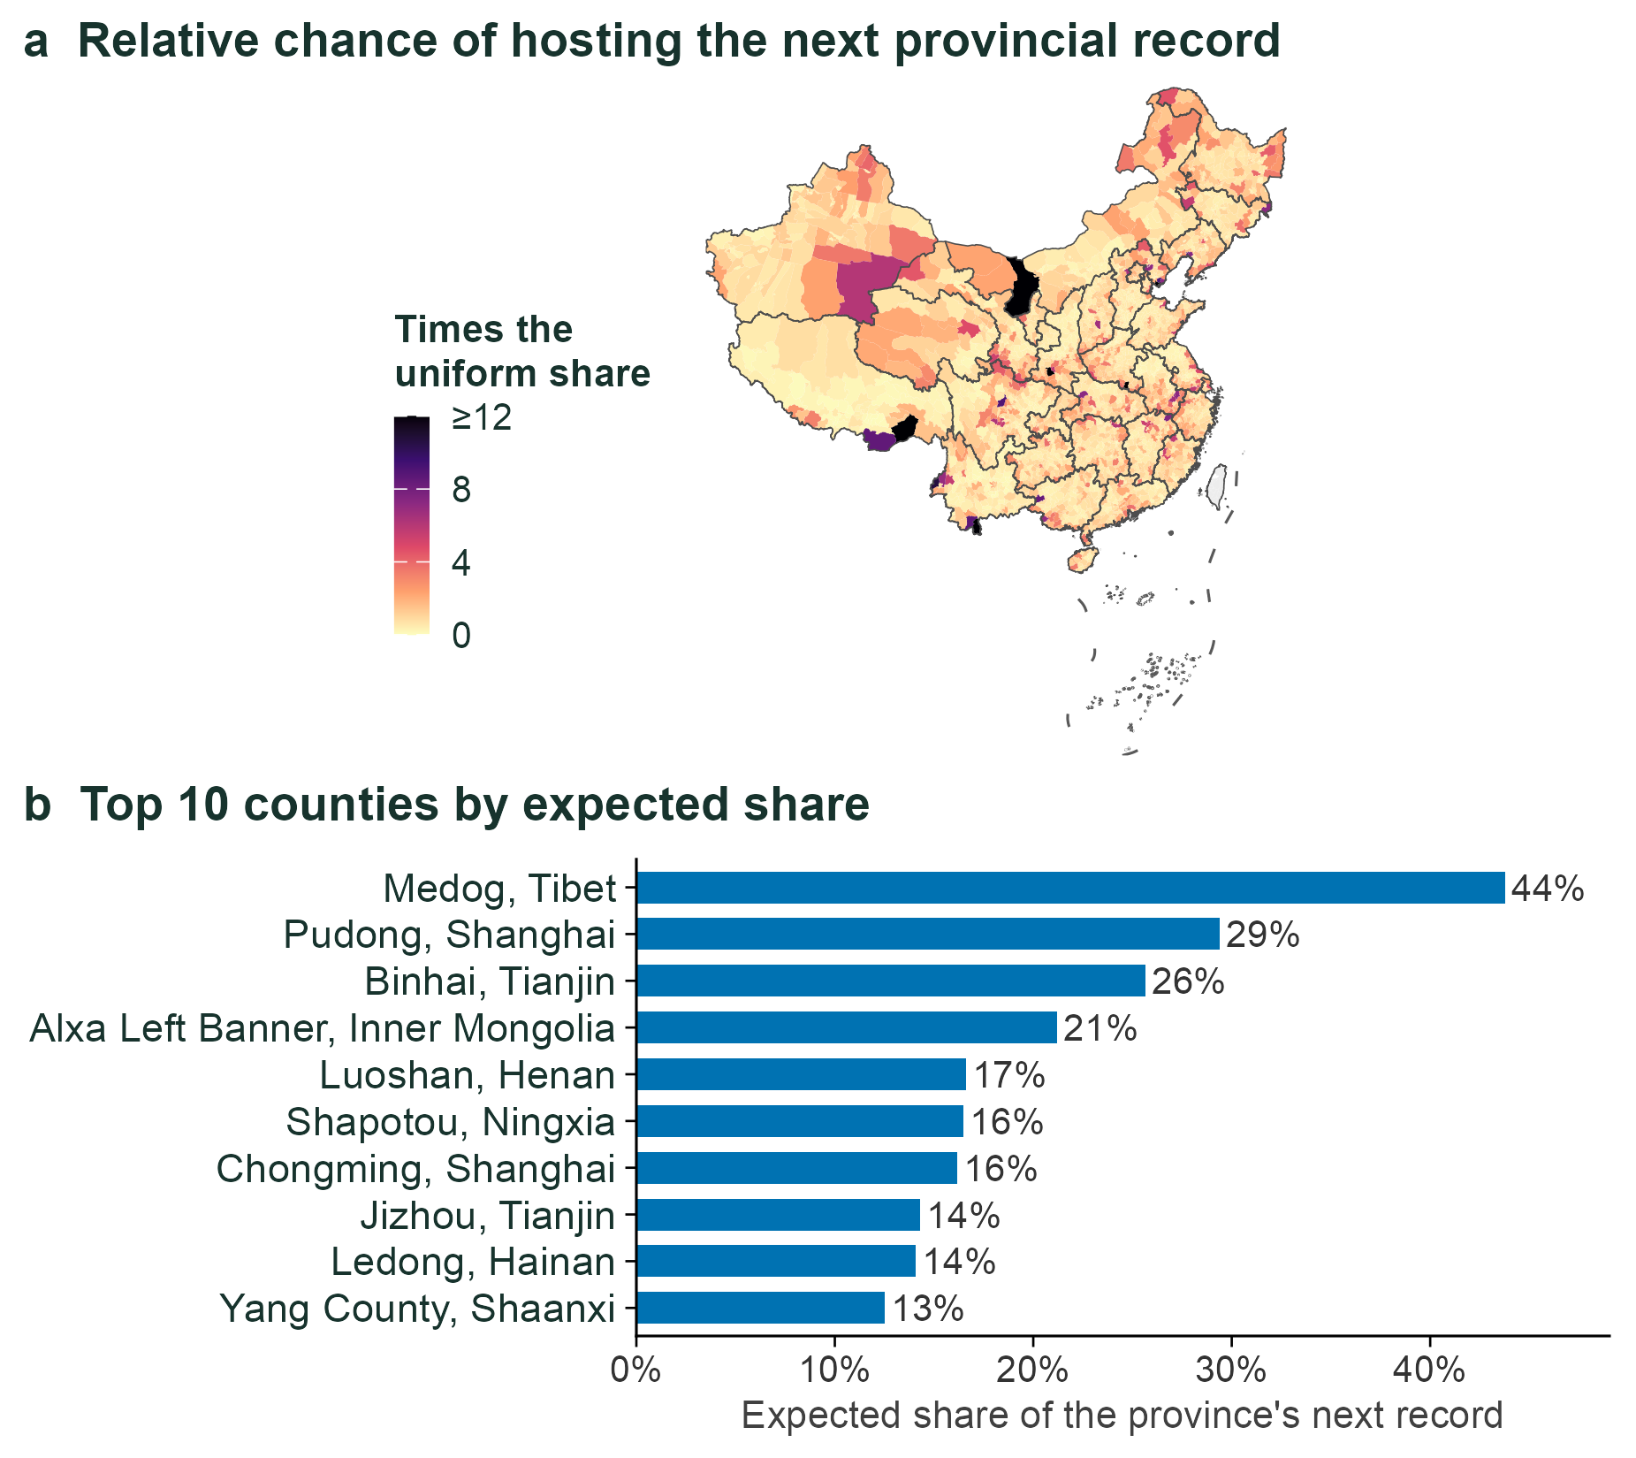
USE 2
Repository module
Predictions can be pushed down to the county
Two steps
1 Will the province get a new record?
2 If so, which county?
Out-of-sample skill, 2019–2024
Top county right 16.1% (random ≈ 1%)
True county in the top 10%: 45.4%
Leave one province out: 27 of 29
Birders will know these names
Medog · Pudong (Nanhui) · Chongming
Luoshan (Dongzhai) · Yang County
Birds or birders? · AOC 2026, Singapore
11 / 19
Notes:
[about 35 s]
Second, we can push the predictions down to counties. We split the problem in two: will a province get a new record, and if it does, which county? Tested on 2019 to 2024, the top-ranked county was right sixteen percent of the time, against about one percent by chance. And look at the names: Medog, Pudong with Nanhui, Chongming, Luoshan with Dongzhai, Yang County. Birders in China know them. The model was never told.

Slide 12
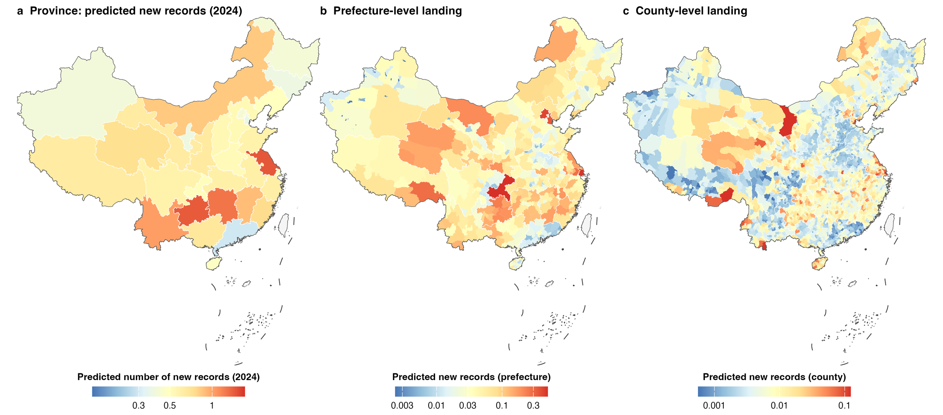
USE 2 · SCALES
Repository module
Province, prefecture and county maps from one consistent model
One model, three scales
Change the model family: maps barely move
Expected records (province) × share (unit)
Random forest / XGBoost: ρ = 0.59–0.89
371 prefectures · 2,835 counties
Differences sit in the low-effort west
Birds or birders? · AOC 2026, Singapore
12 / 19
Notes:
[about 20 s] [optional: can be cut]
Here is the same model at three scales: province, prefecture and county. We also refitted it with random forests and with XGBoost. The maps barely change, with rank correlations between 0.59 and 0.89. Where to look first is robust to the choice of model.

Slide 13
FUTURES
Repository module
Future record counts follow survey effort, not the emission scenario
New records per year, China
SSP2-4.5
SSP5-8.5
100
Two climate × two effort scenarios
Climate: SSP2-4.5 or SSP5-8.5
89.0
Effort: frozen, or +0.6 SD a decade
79.3
Horizons: 2030 and 2050
80
60
What changes the expected count?
Switch climate: barely anything
40
Keep effort growing: roughly triple
30.9
30.5
26.1
25.9
26.8
26.9
20
Most of that rise lies outside the data
0
Faded bars: no cell in support
2030
2030
2050
2050
frozen effort
growing effort
frozen effort
growing effort
50–53% in support
30–33% in support
38–43% in support
0% in support
Birds or birders? · AOC 2026, Singapore
13 / 19
Notes:
[about 35 s]
What about the future? We crossed two climate scenarios with two effort scenarios. Switching from SSP2-4.5 to SSP5-8.5 changes the expected national count from 26.1 to 25.9 records a year: essentially nothing. If effort keeps growing, the count roughly triples by 2050. What we will record depends on how we look, more than on how the climate changes. But most of that increase lies outside the data we fitted.
If asked: Is 79 to 89 records a year a forecast? No. At 2050 no cell is inside the fitted support; the credible statement is about 26 to 31 records a year in 2030, under any scenario.

Slide 14
FUTURES · MODELS
Repository module
Same futures, three model families: they diverge outside the data
New records per year in 2050 (SSP2-4.5)
Same scenarios, three model families
100
All agree on where records fall
ρ = 0.59–0.89 across units
80
Hazard model 26.8 → 79.3
They disagree on how many
60
Hazard model rises
Random forest stays flat
XGBoost falls
40
Random forest 24.5 → 23.9
20
Not a contest between models
XGBoost 14.6 → 7.4
Outside the data nobody can check
0
which direction is right
effort frozen
effort growing
Birds or birders? · AOC 2026, Singapore
14 / 19
Notes:
[about 35 s] [optional: can be cut]
A warning about machine learning. We ran the same futures with three model families, all calibrated to the same 2024 baseline. Under continuing effort in 2050, the hazard model rises to 79 records a year, the random forest stays flat, and XGBoost goes down. They all agree on where records will appear. But outside the data, tree models simply return their edge values, and nobody can check which direction is right.

Slide 15
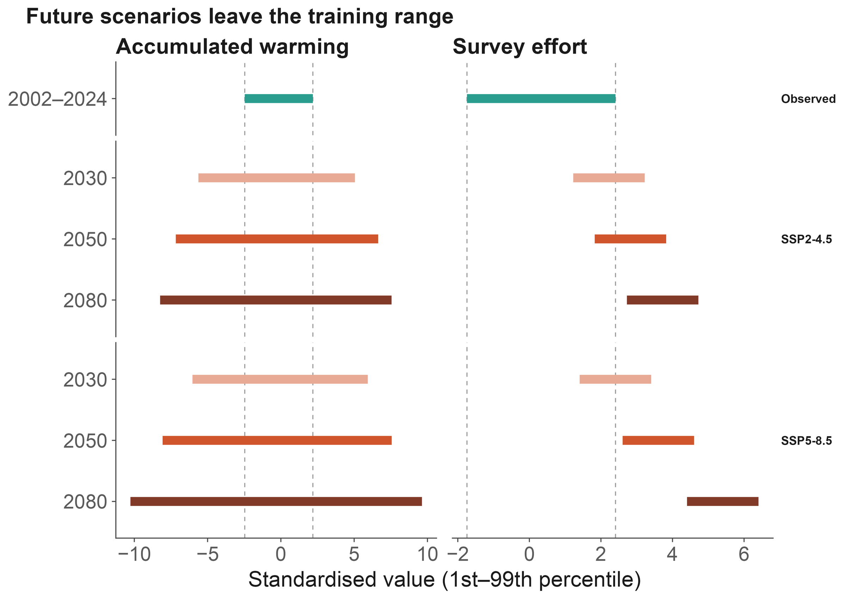
USE 3
Figure 7 · SI Figs S6–S8
Data support, not ambition, sets the forecast horizon
Support shrinks fast (SSP2-4.5)
Cells inside the fitted range:
2030: 46% → 2050: 6% → 2080: none
Machine learning does not rescue it
Agree inside the range (ρ = 0.56)
Diverge outside it
Report where a model breaks
2030: usable
End of century: illustration, not forecast
Birds or birders? · AOC 2026, Singapore
15 / 19
Notes:
[about 25 s]
So our rule is simple: report where the model breaks. Under SSP2-4.5, the share of species-province combinations inside the fitted range drops from 46 percent in 2030, to 6 percent in 2050, and to none by 2080, mostly because effort outgrows its observed range. So 2030 is usable. End-of-century maps are illustrations, not forecasts.

Slide 16
LIMITS
Discussion
Four limits that travel with the conclusions
Events are published records, not detections
We explain how records are documented, not range expansion itself.
Coordinates are precise to about 1 km at best
Reserve-overlap tests therefore use 0–5 km buffers as a sensitivity check.
Reserve polygons cover about a third of listed reserves
1,028 mapped reserves: no gap analysis, no 30×30 claims.
Projections leave the fitted support after 2030
Late-century maps are illustrations; the effort coefficient used is an upper bound.
Birds or birders? · AOC 2026, Singapore
16 / 19
Notes:
[about 25 s]
Four limits travel with these results. Our events are published records, not detections, so we explain how records get documented, not how ranges expand. Coordinates are precise to about a kilometre at best. Our reserve map covers about a third of listed reserves. And projections leave the data after 2030, so late-century maps are illustrations.

Slide 17
TAKE-HOME
Conclusions
Four take-home messages
1 New records carry a climate signal
2 Warming matters most where few look
Warming 1.36 vs effort 1.43 per SD
Warming × effort = 0.84
comparable, and separable in one model
under-surveyed regions hide the signal
3 Model the observation process
4 Futures depend on how we look
Province × year ×2.22 is the largest part;
Emission scenario barely matters;
returns on effort are falling
most projected change is extrapolation
Birds or birders? Both.
New records carry a climate signal,
but we can read it only once we model how we look.
Next
Reptiles and amphibians · monitoring priority = climate exposure × (1 − current coverage), mapped to counties
Birds or birders? · AOC 2026, Singapore
17 / 19
Notes:
[about 40 s]
Four messages to take home. One: new records carry a climate signal, and warming and survey effort contribute comparably. Two: warming matters most where few people are looking. Three: model the observation process; survey pulses are the largest component, and the return on effort is falling. Four: future record counts depend on how we look, and most projected change is extrapolation. So, birds or birders? Both. But we can read the climate signal only once we model how we look.

Slide 18
IMPLICATION
Discussion
Put effort where warming is fast and records are few
Where the climate signal is strongest
Where more effort adds little
Warming effect is largest at low effort
Returns on effort fell from 2.14 to 1.13
Low-effort provinces lie mostly in
Eastern hotspots are near saturation
the west and the interior
Province level: IRR 0.71, P = 0.028
Monitoring priority
Send effort to climatically exposed, under-surveyed regions:
that is where new records carry the most climate information
Birds or birders? · AOC 2026, Singapore
18 / 19
Notes:
[about 30 s]
What does this mean for monitoring? The warming effect is largest where effort is low, and the low-effort provinces lie mostly in the west and the interior. Meanwhile the return on effort in the eastern hotspots has nearly run out. So the monitoring priority is clear: send effort to climatically exposed, under-surveyed regions. That is where new records carry the most climate information.

Slide 19
THANK YOU
Data availability
Open data, open code, and thanks
Open data and code
Other data
CBNR (CC BY 4.0)
Ranges: BirdLife International
doi.org/10.5281/zenodo.20809949
Climate: CRU TS 4.09 · WorldClim 2.1 · CMIP6
github.com/dingchenchen6/
Effort: 2.86 million GBIF / eBird records
bird-newrecord-discovery-dated
Base map: approval no. GS(2019)1822
Acknowledgements
Birdwatchers across China, and every author whose records made CBNR possible.
Thank you. Questions welcome
CBNR data
chenchen.ding@pku.edu.cn
scan to download
Birds or birders? · AOC 2026, Singapore
19 / 19
Notes:
[about 25 s]
Everything is open: the CBNR data on Zenodo, and all of the analysis code on GitHub, where every number in this talk traces back to a table. My thanks to birdwatchers across China, and to every author whose records made this possible. Thank you. I'm happy to take your questions.

Slide 20
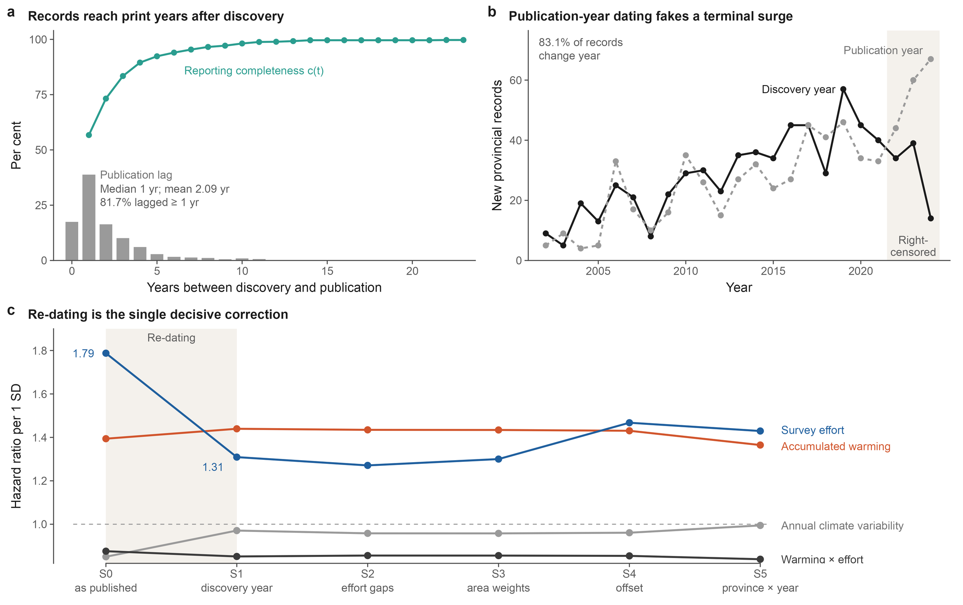
BACKUP
Figure 2 · Table 1
Dating records to publication inflates effort and creates a phantom climate effect
Birds or birders? · AOC 2026, Singapore
B1
Notes:
[about 30 s] [optional: can be cut]
If asked about dating. Dated to publication year, as most compilations do, the effort hazard ratio is 1.79 instead of 1.31, inflated by 37 percent, and an annual climate-variability effect appears at 0.85 with P below 0.001. Dated to discovery it vanishes, and warming barely moves. Publication lags discovery by about two years, and the lag grew with the birding databases.

Slide 21
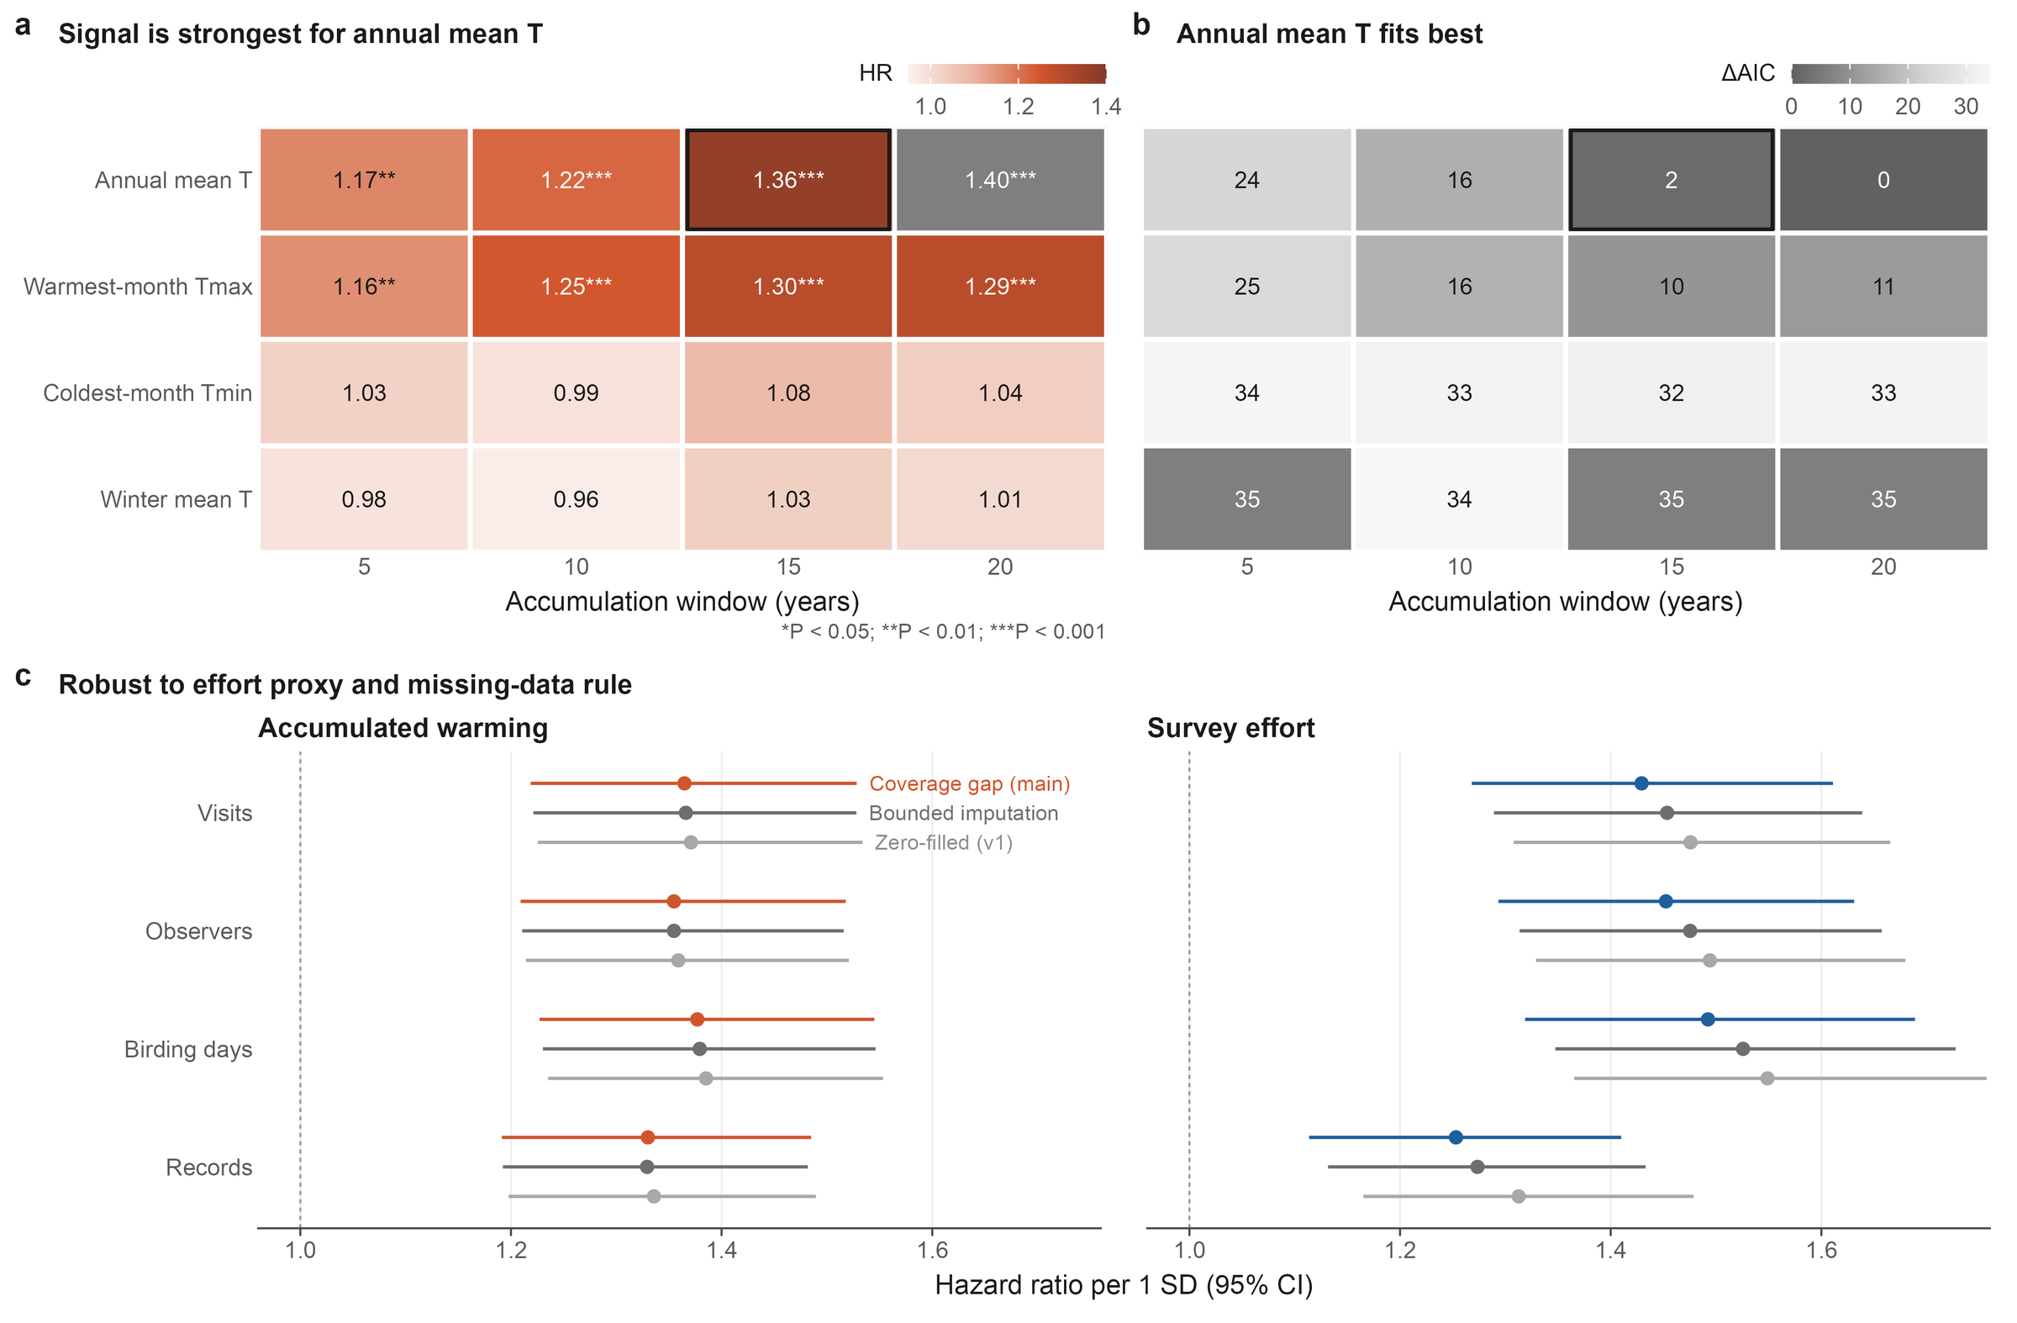
BACKUP
Figure 3
Specification robustness: climate indicator, window and effort proxy
Birds or birders? · AOC 2026, Singapore
B2
Notes:
[about 15 s] [optional: can be cut]
If asked about specifications: the signal is confined to annual mean temperature over 15 to 20 years, and the coefficients are stable across effort proxies and missing-data rules.

Slide 22
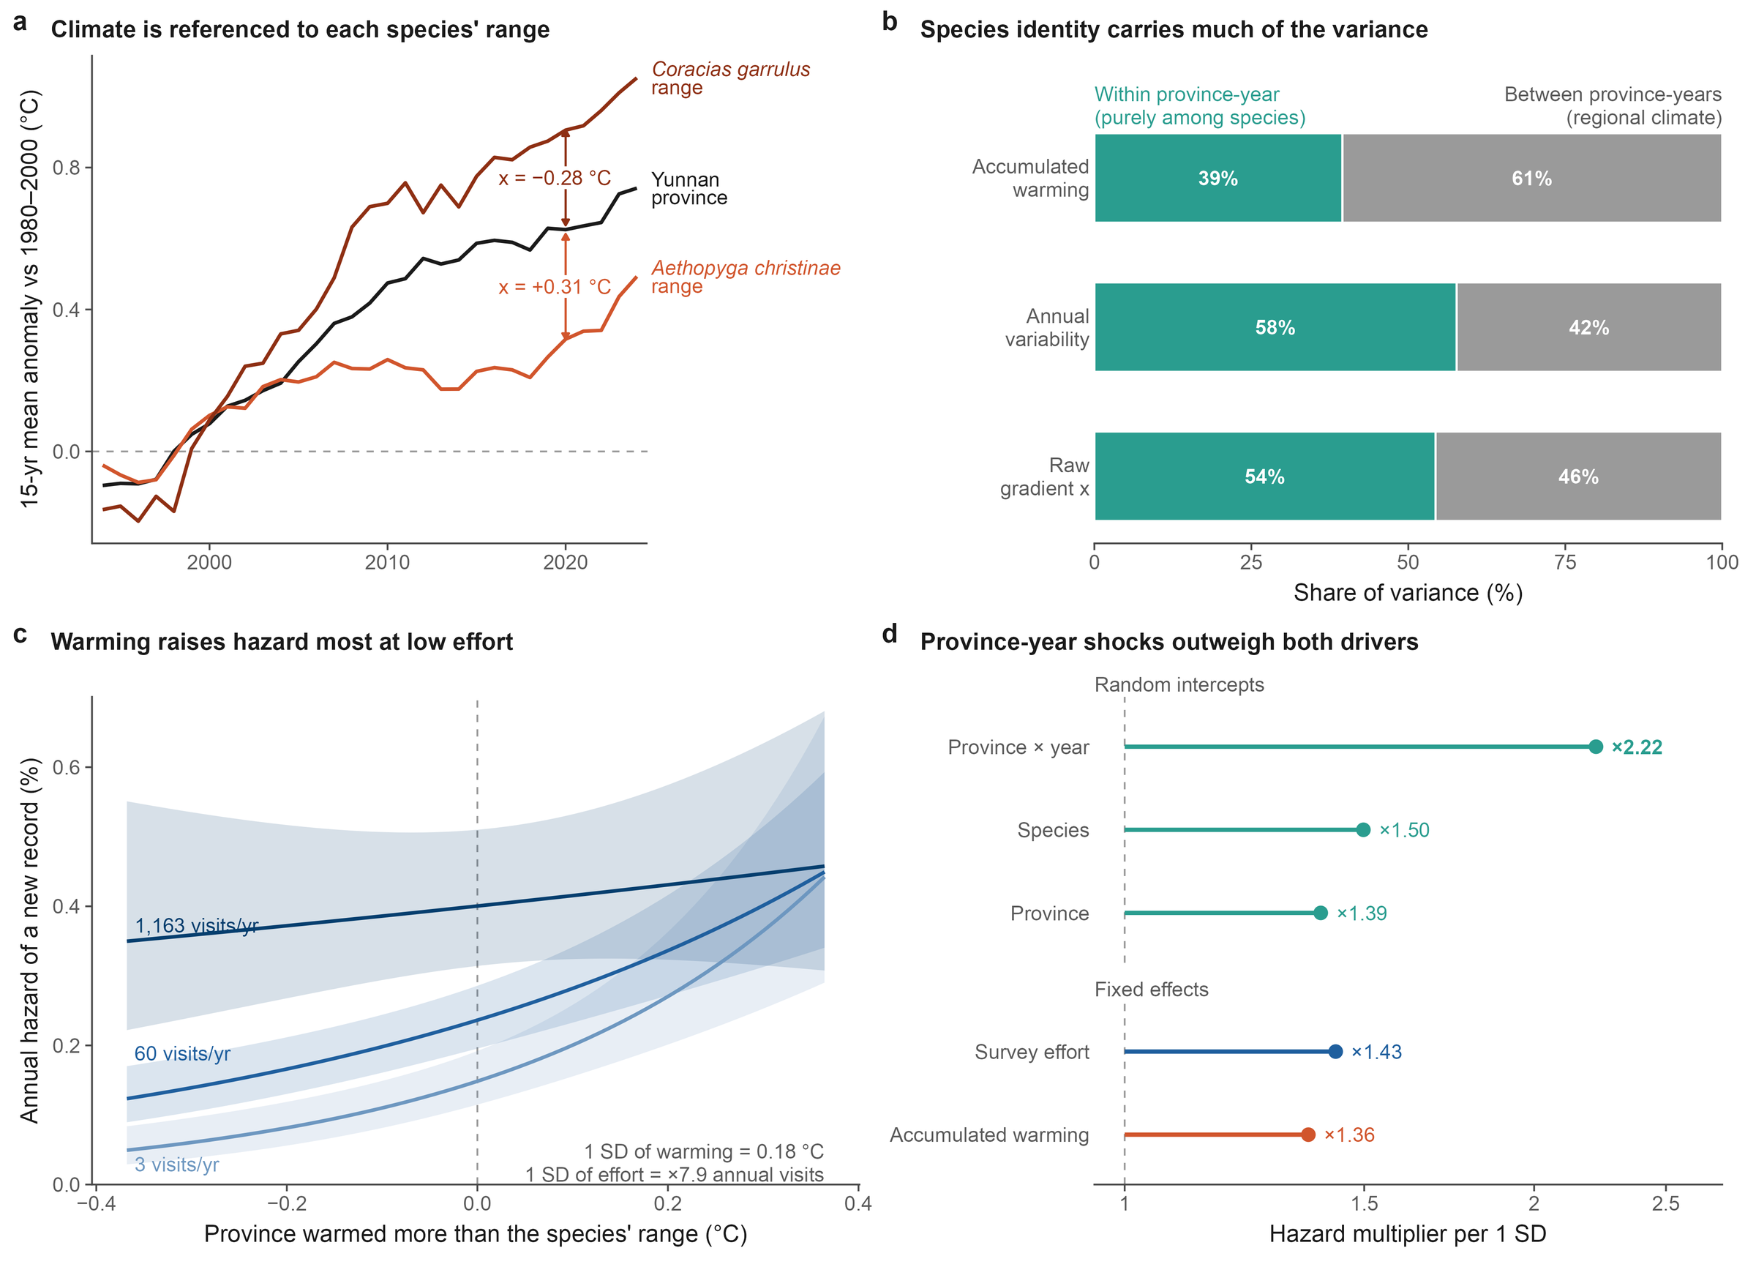
BACKUP
Figure 4
Model anatomy: climate referenced to each species' range
Birds or birders? · AOC 2026, Singapore
B3
Notes:
[about 15 s] [optional: can be cut]
If asked how warming is measured: the same province in the same year can warm more or less than a given species' range; that species-specific difference is the climate covariate.

