Slide 1
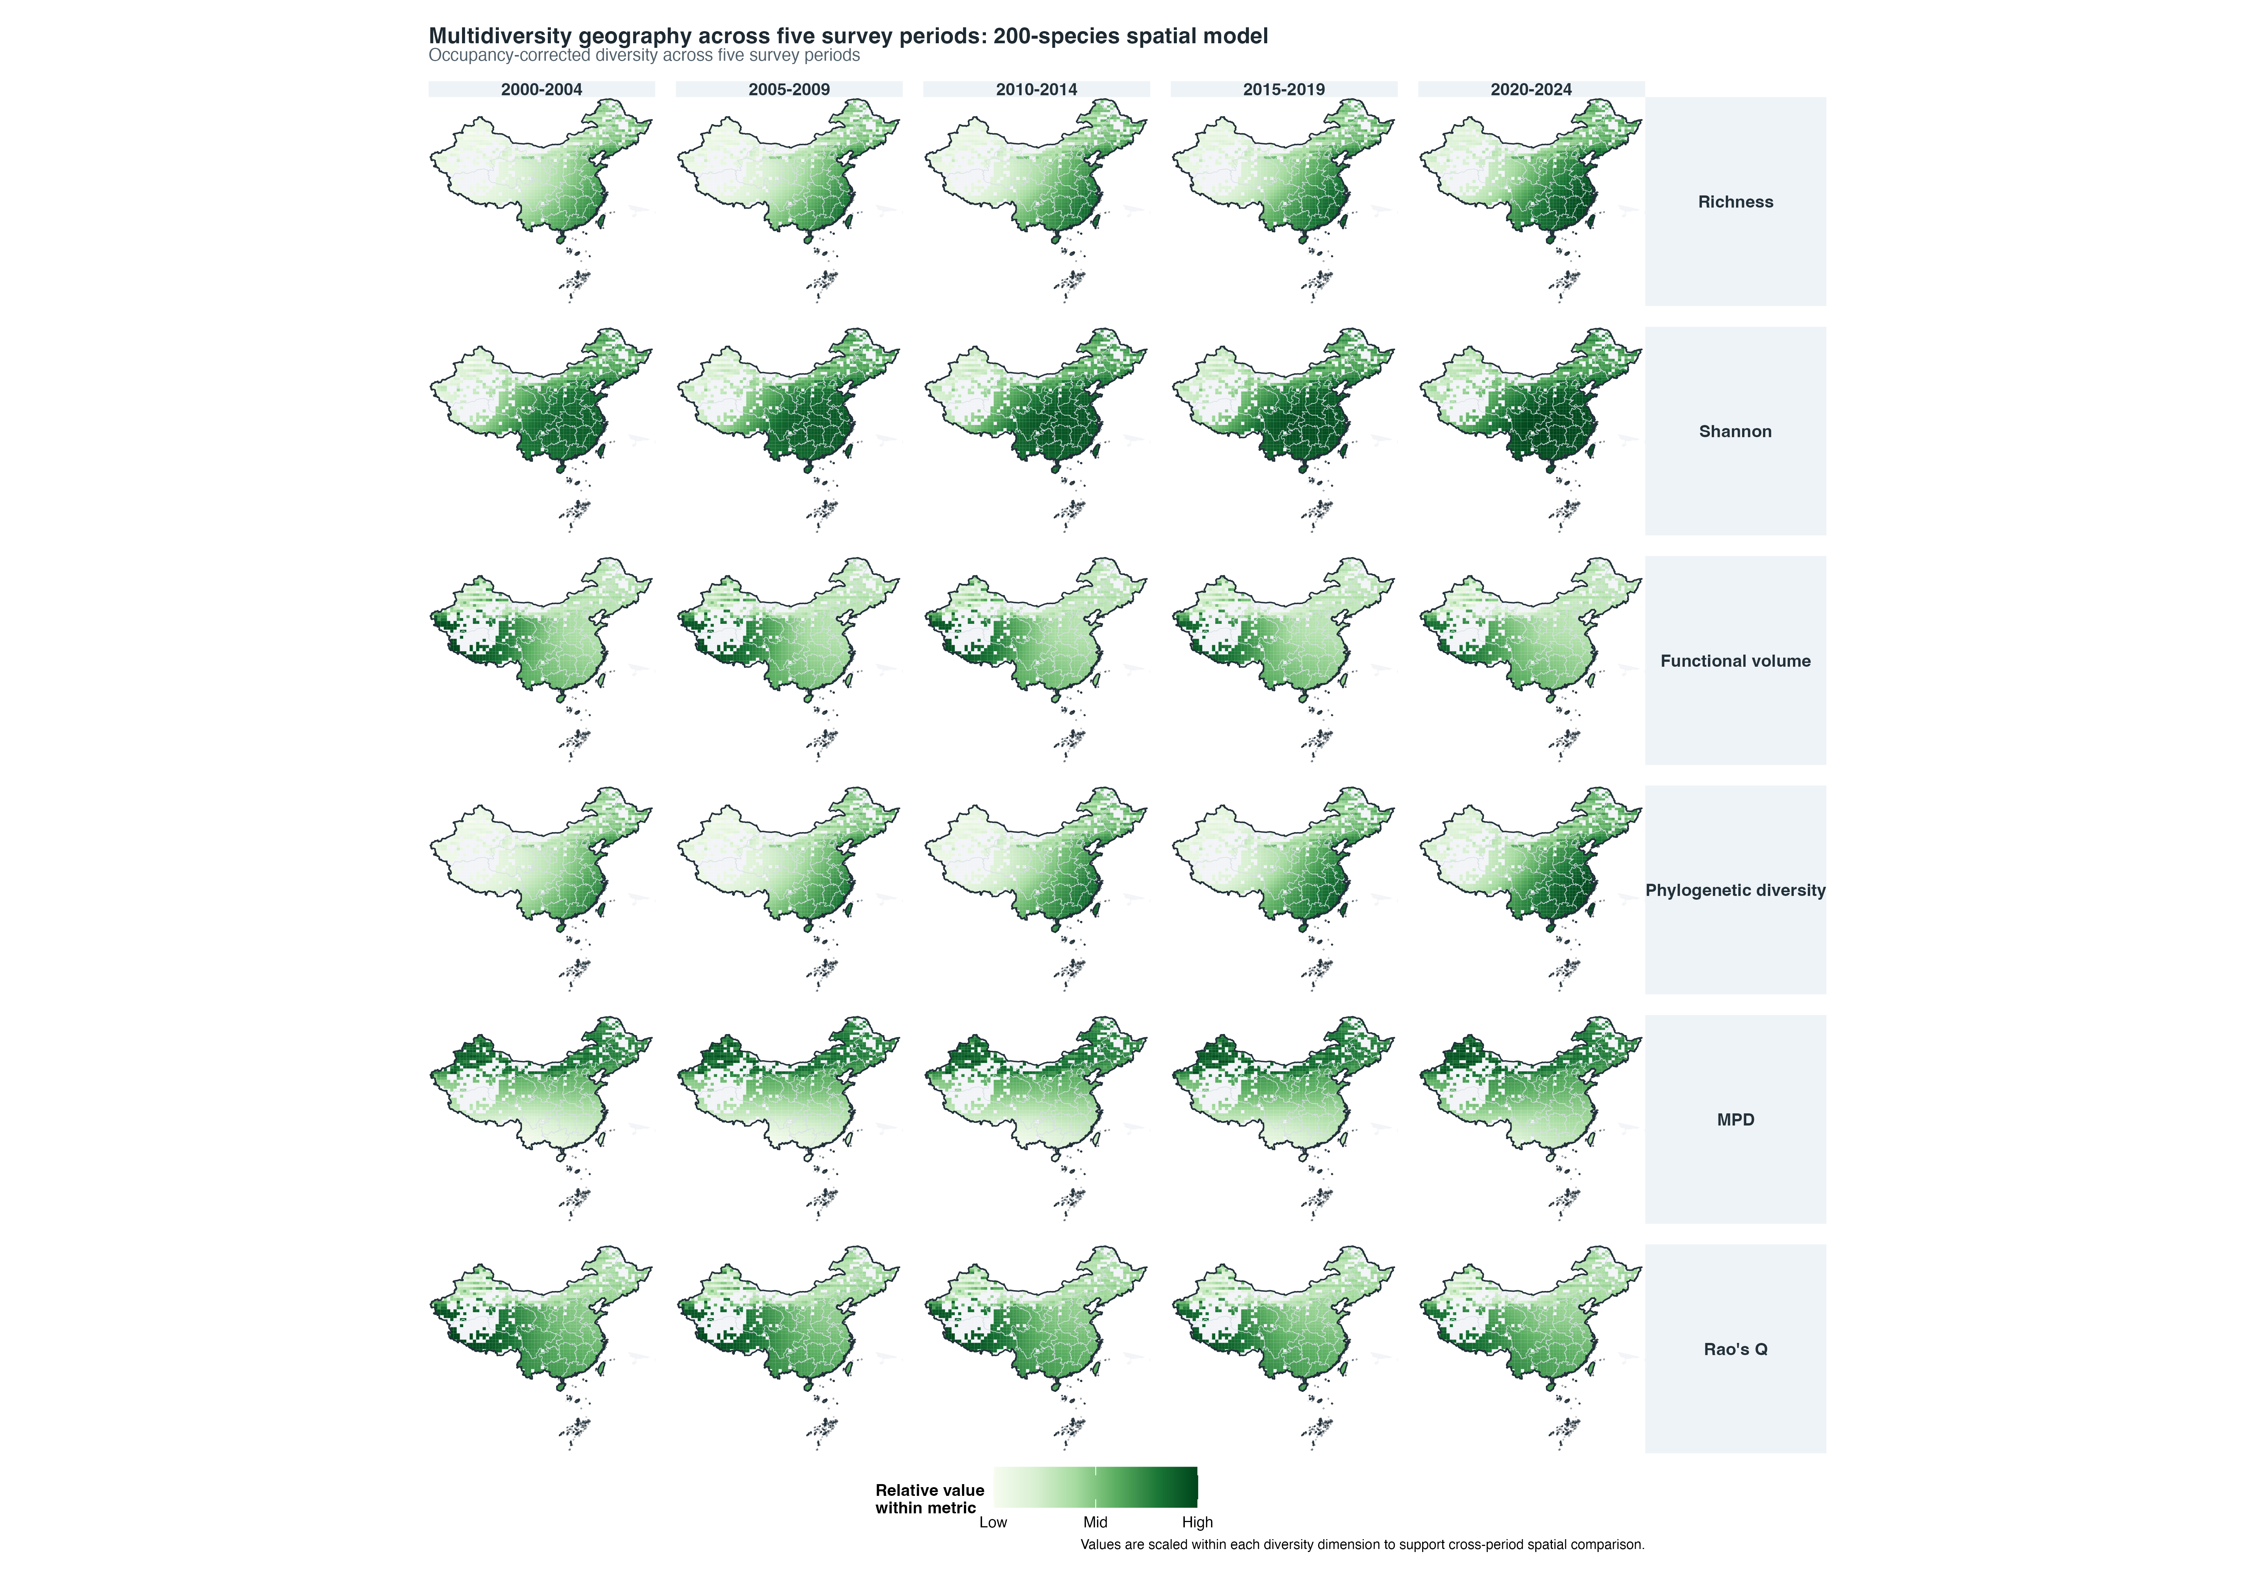
Fig01 multidiversity timeslices 200sp top journal

