Slide 1
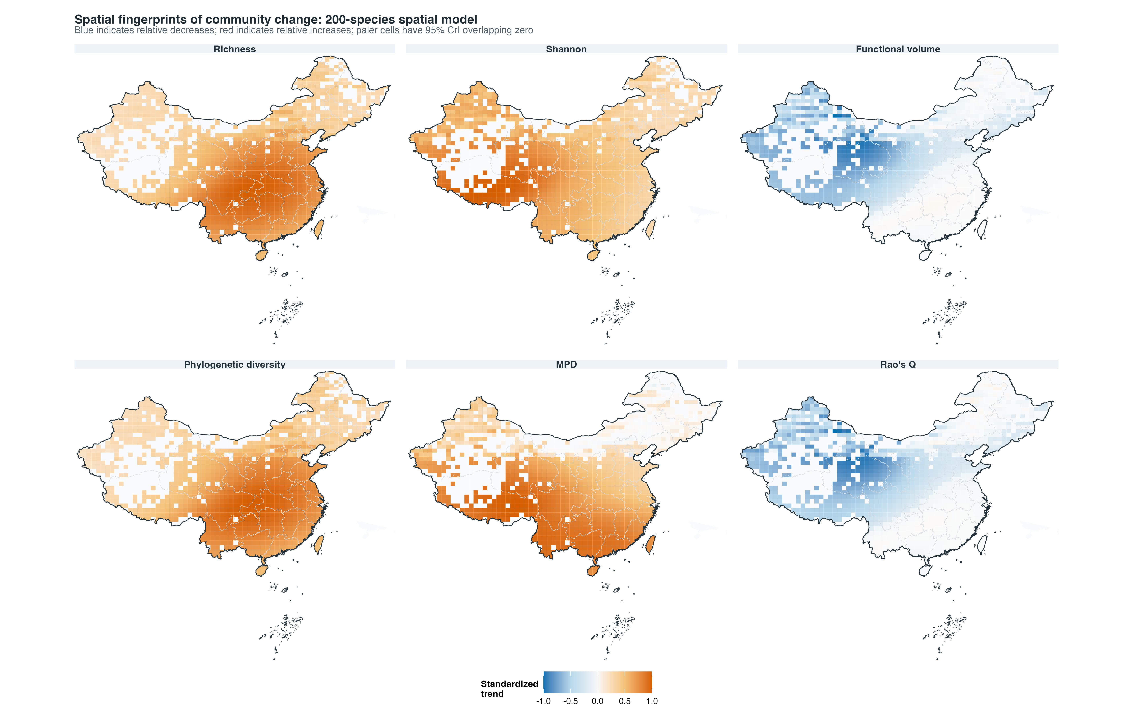
Fig02 community trends 200sp top journal

