Slide 1
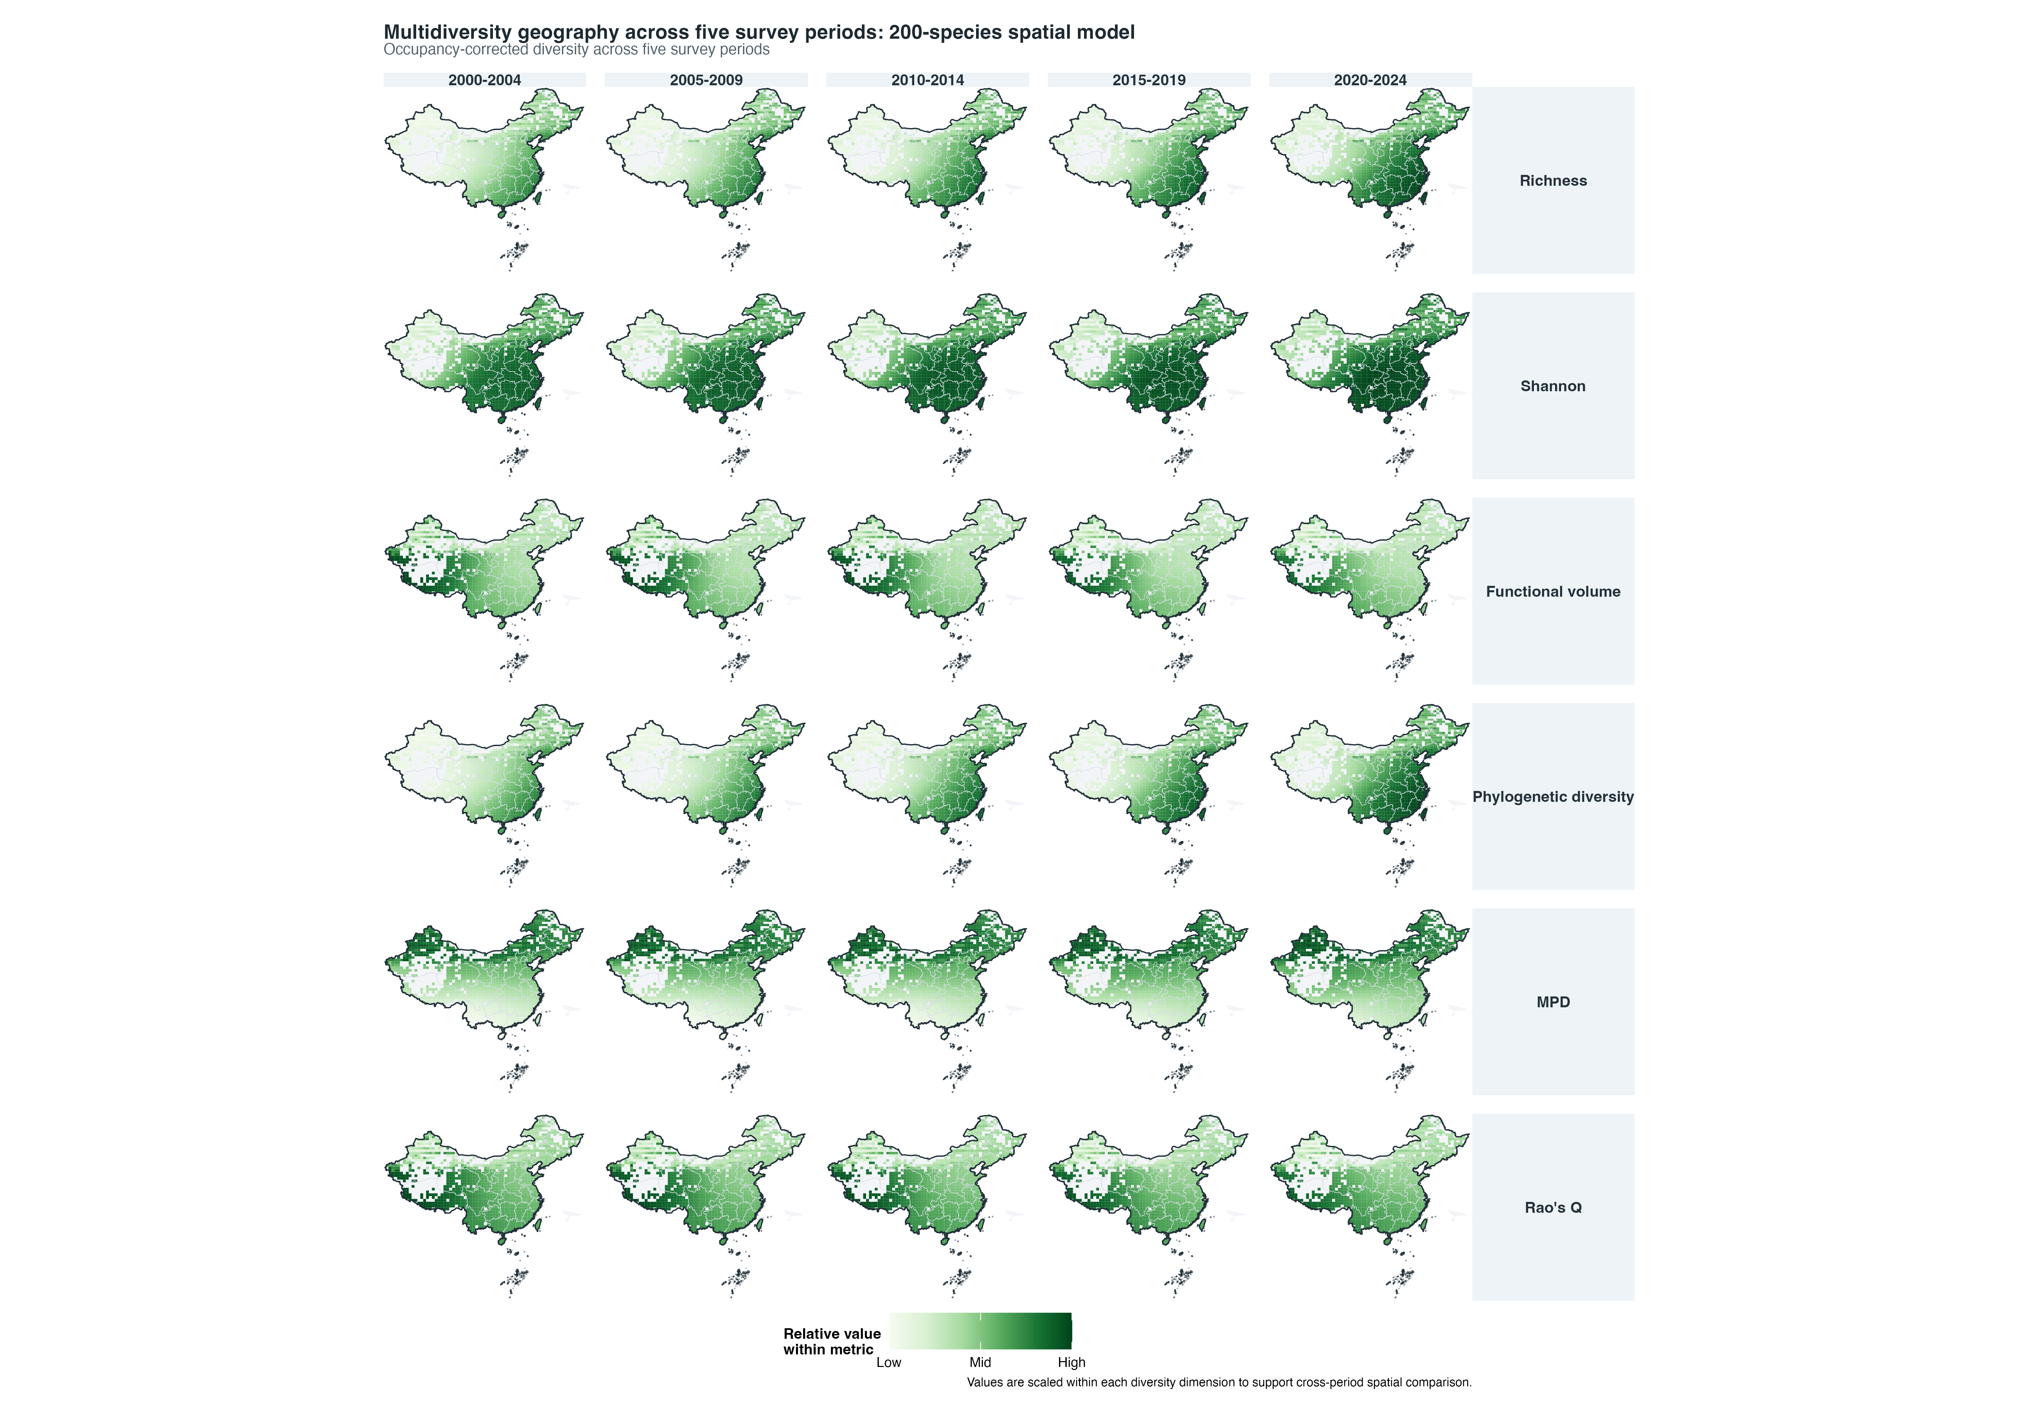
Fig01 multidiversity timeslices 200sp top journal

Slide 2
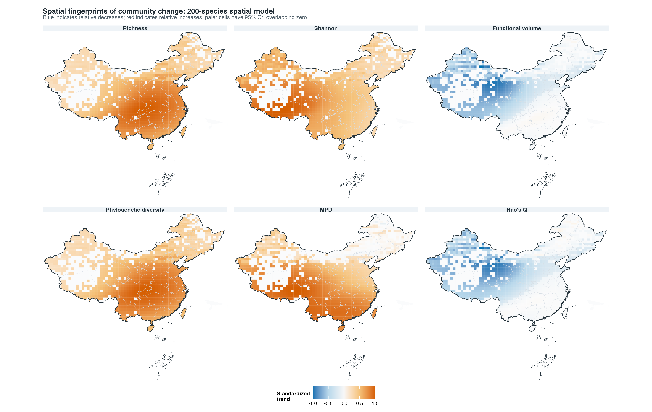
Fig02 community trends 200sp top journal

Slide 3
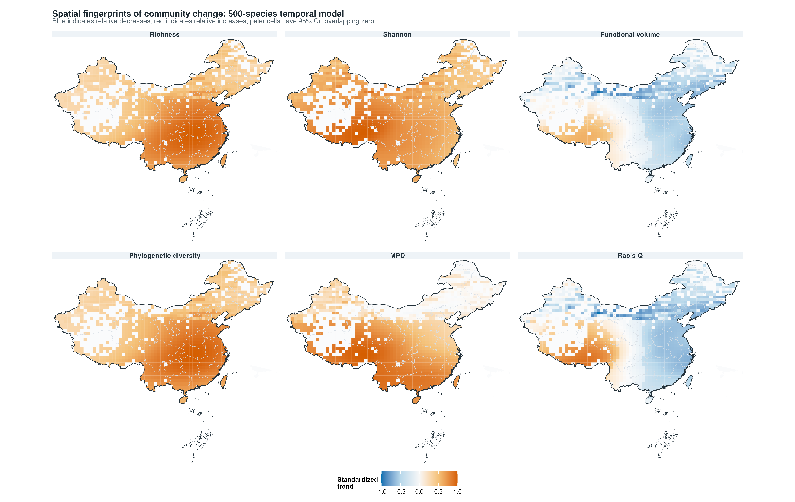
Fig02b community trends 500sp temporal top journal

Slide 4
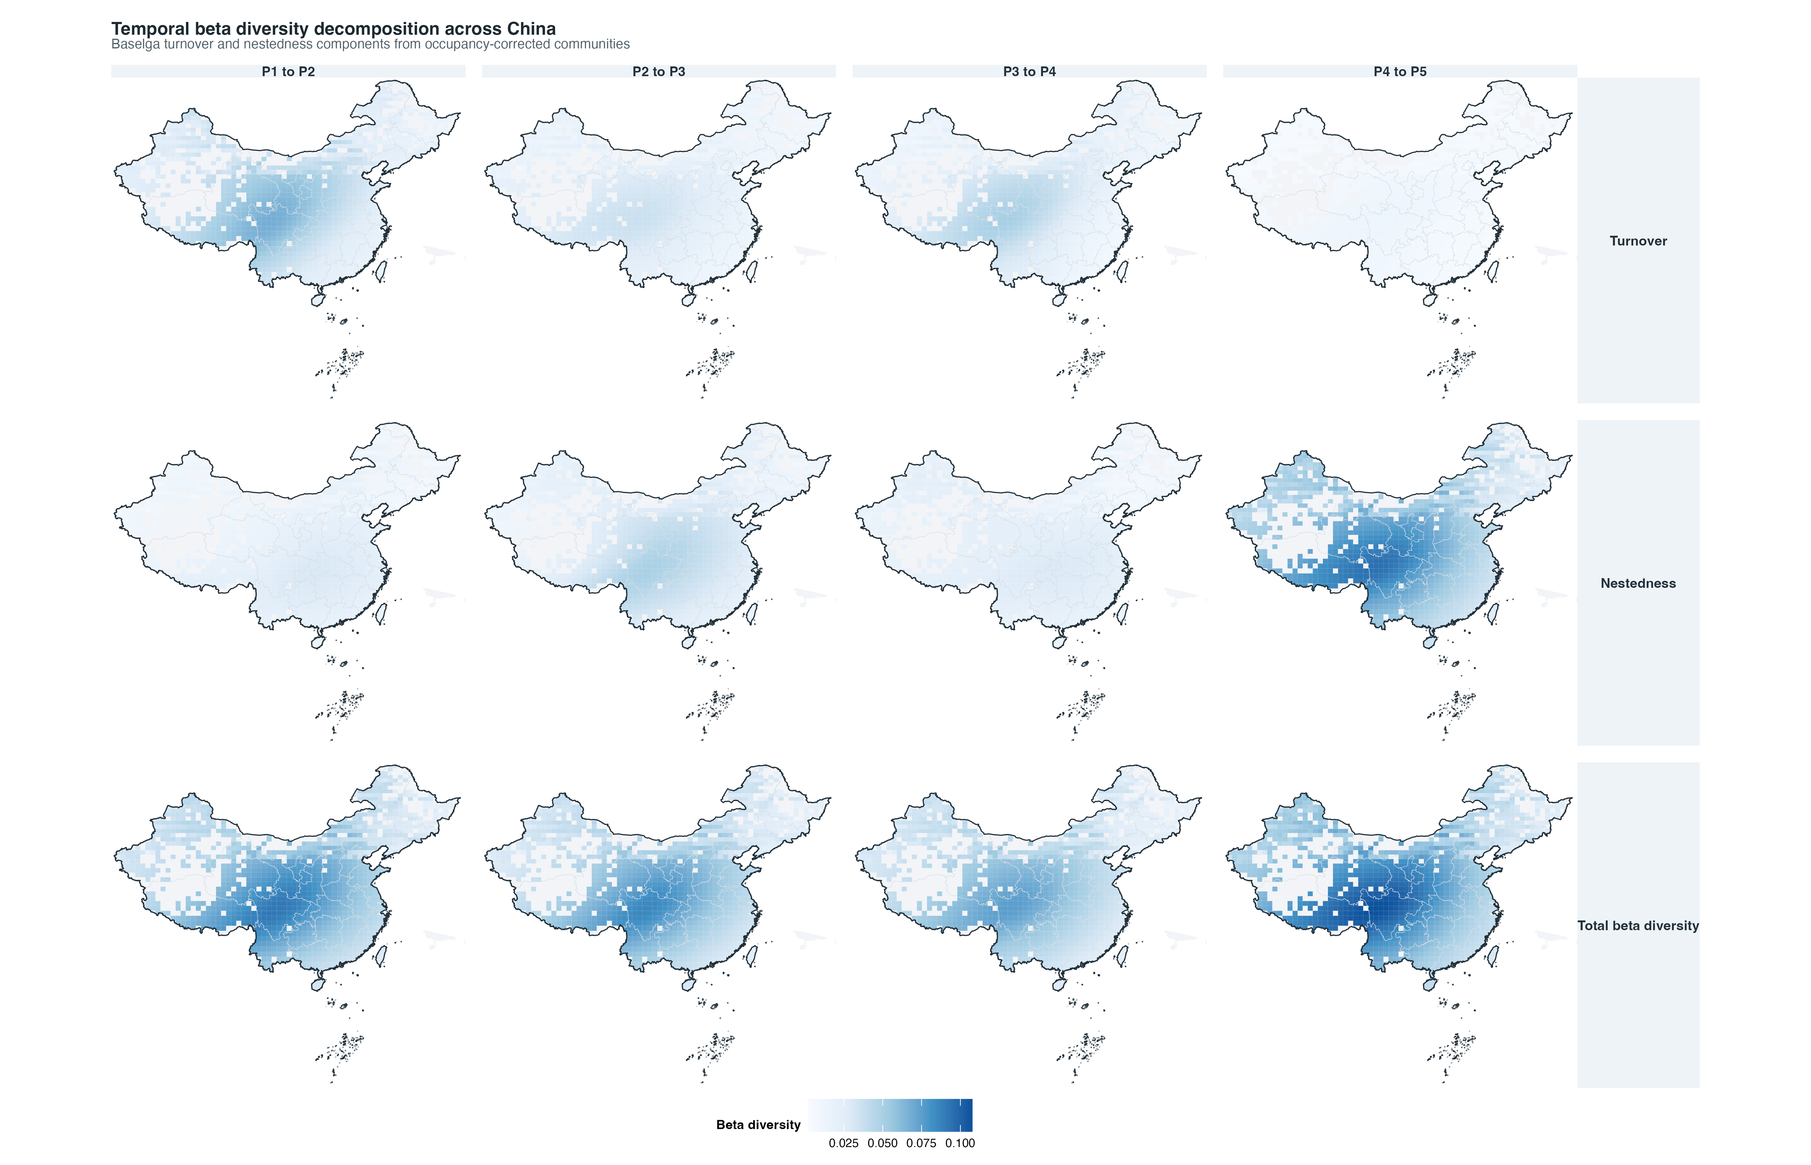
Fig03 temporal beta baselga 200sp top journal

Slide 5
Fig04 global multidiversity trajectories top journal editable
National multidiversity trajectories
Each dimension is indexed to 100 at 2000-2004 to compare rates of change across metrics
Occupancy-corrected richness
Mean phylogenetic distance
Phylogenetic diversity
130
104
130
103
120
120
102
110
101
110
100
100
99
100
Index (2000-2004 = 100)
Rao's Q
Shannon diversity
Functional volume
102
103
101
101
102
100
100
101
99
99
98
100
98
2000-2004
2005-2009
2010-2014
2015-2019
2020-2024
2000-2004
2005-2009
2010-2014
2015-2019
2020-2024
2000-2004
2005-2009
2010-2014
2015-2019
2020-2024
200 spatial species
500 temporal species

Slide 6
Fig05 species trend classes 500sp top journal editable
Species-level winners and losers
Trend classification and the strongest 500-species temporal shifts
Trend classes
Most shifted species in the 500-species extension
100%
2
15
1.0%
3.0%
Fulica atra
Pernis ptilorhynchus
62
Picoides canicapillus
31.0%
75%
227
Vanellus cinereus
45.4%
Chlidonias hybrida
Ardea intermedia
Himantopus himantopus
Species share
Corvus dauuricus
50%
Luscinia svecica
136
Sturnus vulgaris
68.0%
Lanius tigrinus
25%
258
51.6%
Coloeus dauuricus
Phylloscopus ogilviegranti
Seicercus valentini
Columba livia
0%
200 spatial species
500 temporal species
-0.05
0.00
0.05
0.10
Species occupancy trend
Declining
Stable
Increasing
Declining
Increasing

Slide 7
Fig06 naive vs corrected trends top journal editable
Direction flips: 37 / 1247

Slide 8
Fig07 global baselga turnover nestedness top journal editable
Homogenization is governed by turnover collapse
Global Baselga decomposition across consecutive five-year periods
200 spatial species
100%
75%
50%
25%
0%
Component share of total beta diversity
500 temporal species
100%
75%
50%
25%
0%
P1 to P2
P2 to P3
P3 to P4
P4 to P5
Nestedness
Turnover

Slide 9
Fig08 random forest driver importance top journal editable
Environmental drivers of community change
Random-forest importance from posterior draws of diversity trends
Top predictors
Predictor groups
Longitude
Mean temperature (baseline)
Spatial baseline
Extreme temperature change
Elevation (baseline)
Land use change
Latitude
Impervious surface change
Mean temperature change
Climate change
Natural land cover change
Human footprint change
Human pressure change
Forest cover change
0.00
0.05
0.10
0.15
0.0
0.1
0.2
0.3
Permutation importance
Grouped importance
Climate change
Human pressure change
Land-use change
Spatial baseline

Slide 10
Fig09 trait environment mechanisms 500sp top journal editable
Ecological mechanisms in the 500-species extension
Complete-case trait and environmental screens; interpret as association, not causal effect
Trait associations
Climate-gradient associations
Landcover cropland
n = 200
Elevation
n = 200
Diet specialization
Temperature annual range
n = 200
Precipitation of wettest month
n = 200
Temperature seasonality
n = 200
Hfi mean
n = 200
Habitat breadth
Mean temperature of coldest quarter
n = 200
Landcover built
n = 200
0.0
0.2
0.4
0.0
0.1
0.2
0.3
0.4
Spearman rho with species trend
Spearman rho with species trend

Slide 11
Fig10 driver coefficients 500sp top journal editable
Posterior driver coefficients across 500-species diversity responses
Temporal-change covariates fitted to occupancy-corrected trend estimates
Richness trend
Functional dispersion trend
Functional evenness trend
Mean temperature change
Thermal-extreme change
Forest-cover change
Delta impervious
Delta natural
Human footprint change
Mean temperature of coldest quarter
Elevation
Longitude
Latitude
-4
-2
0
2
4
-0.2
-0.1
0.0
0.1
-0.06
-0.04
-0.02
0.00
0.02
0.04
Functional richness trend
Inverse Simpson trend
Mean phylogenetic distance trend
Mean temperature change
Thermal-extreme change
Forest-cover change
Delta impervious
Delta natural
Human footprint change
Mean temperature of coldest quarter
Elevation
Longitude
Latitude
-0.1
0.0
0.1
0.2
-4
-2
0
2
-1.2
-0.8
-0.4
0.0
Phylogenetic diversity trend
Shannon trend
Mean temperature change
Thermal-extreme change
Forest-cover change
Delta impervious
Delta natural
Human footprint change
Mean temperature of coldest quarter
Elevation
Longitude
Latitude
-20000
-10000
0
10000
-0.010
-0.005
0.000
0.005
Posterior coefficient
CrI overlaps 0
CrI excludes 0

