Slide 1
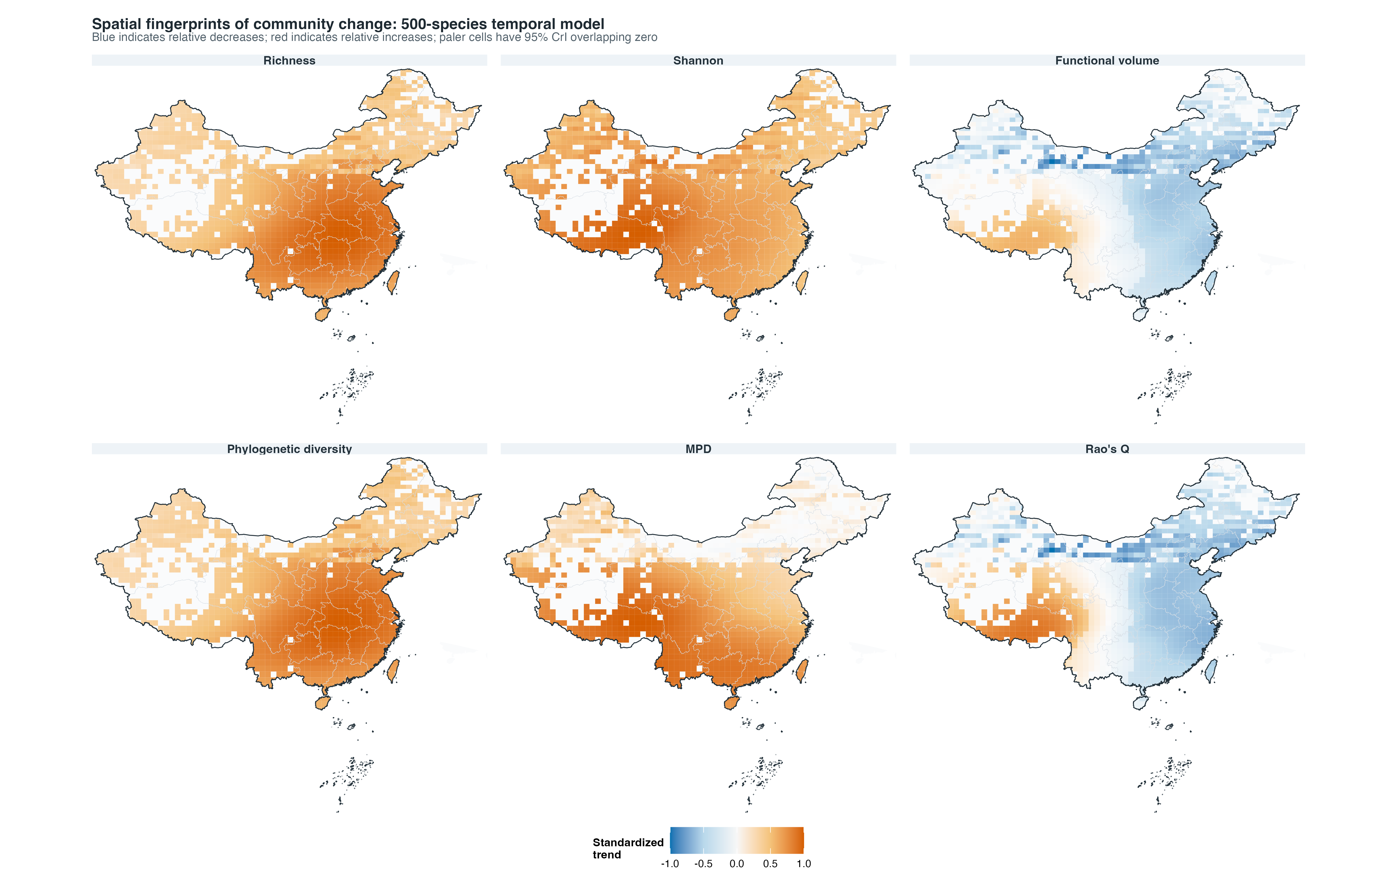
Fig02b community trends 500sp temporal top journal

