Slide 1
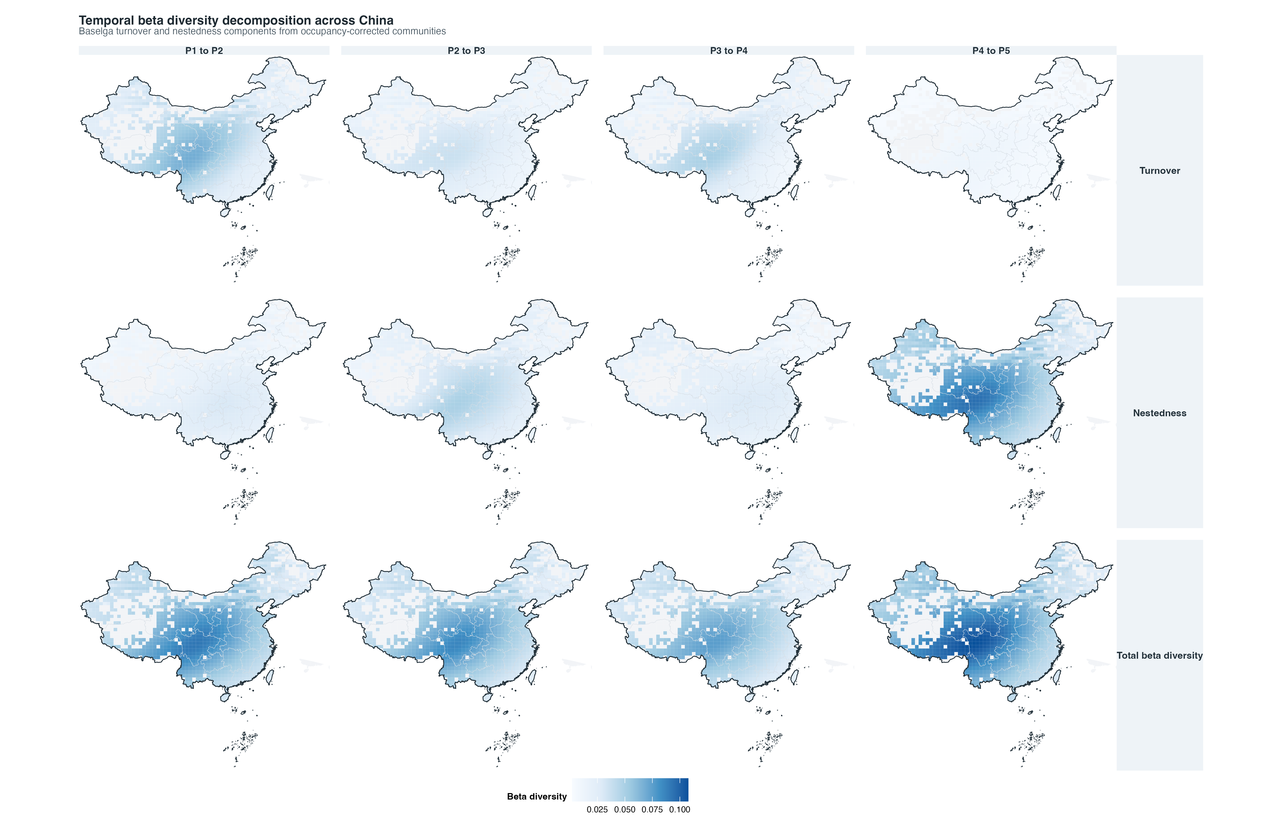
Fig03 temporal beta baselga 200sp top journal

