Slide 1

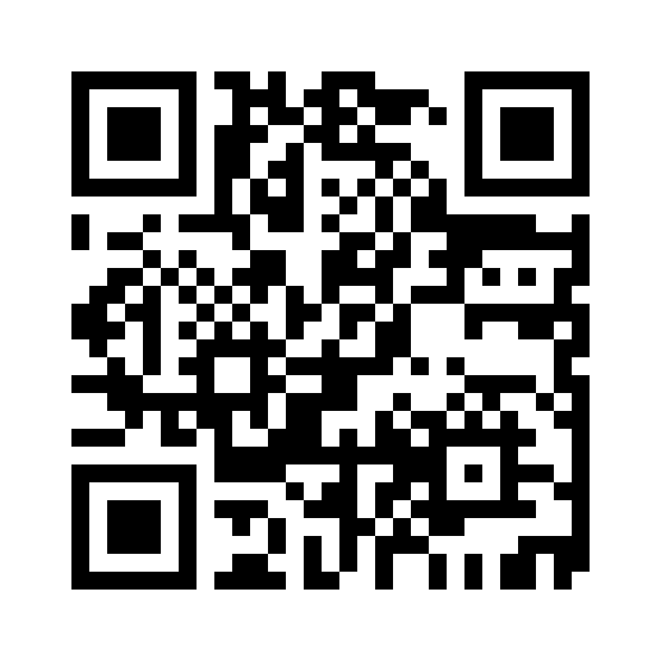
ClearGive
ClearGive Project Team
ClearGive — Giving, with proof.
Notes:
SPOKEN SCRIPT (≈15 s)
Good afternoon. We are presenting ClearGive, a prototype for milestone-based donations, where money is released under predefined rules and every key approval and payment can be checked.
EVIDENCE STATUS
Cover artwork is AI-generated conceptual illustration reused from the team’s draft deck; it is not a photograph of a real project.
SOURCES
ClearGive demo, https://cleargive.pages.dev/demo (accessed 17 Oct 2026).

Slide 2




01 · BACKGROUND / PROBLEM STATEMENT
Where does a donation go after it is given?
Three gaps between a donor’s contribution and the project outcome
32%
of Singapore non-donors cited fear of scams as a major reason (2023; +9 pts since 2021)
Transparency
Plan and approvals are hard to inspect
Fund control
SURVEY · REASON FOR NOT DONATING
One party controls the pooled balance
36%
chose “knowing how my money would be spent” as an encouragement to give (2025)
Outcome verification
Delivery is hard to confirm afterwards
SURVEY · WHAT WOULD ENCOURAGE GIVING
OUR QUESTION
How can donations be released under predefined conditions, with key decisions and payments independently verifiable?
Sources: National Volunteer & Philanthropy Centre (2024), base: non-donors; Charities Aid Foundation (2025, p. 20).
Notes:
SPOKEN SCRIPT (≈40 s)
Once a donation is made, three things are hard to see: the spending plan and its approvals, who controls the pooled money, and what was actually delivered. Surveys suggest this matters. In Singapore, 32 percent of non-donors cited fear of scams as a major reason for not giving. Globally, 36 percent said knowing how their money would be spent would encourage them to give. These are attitudes, not fraud rates. So our question is: how can donations be released under predefined conditions, with key decisions and payments independently verifiable?
EVIDENCE STATUS
External survey statistics. NVPC figure: base = non-donors, a reason for not donating; +9 percentage points vs 2021 as reported by NVPC. CAF figure: one of the three things most likely to encourage donations; CAF does not state the base for this item, so it is not presented as a share of all respondents. No claim is made that this is the largest pain point or that blockchain prevents fraud. Illustration: AI-generated conceptual artwork.
SOURCES
NVPC (2024). Giving in Singapore remains resilient: National Giving Study 2023. 12 June 2024. https://nvpc.org.sg/newsroom/national-giving-study-2023/
Charities Aid Foundation (2025). World Giving Report 2025, p. 20 (55,836 respondents, 101 countries and territories). https://cdn.prod.website-files.com/67d1838beb72321adb3f57fc/684fe35981883f8156643c23_b73e54c572856504aefb9b02749ab5a0_CAF%20World%20Giving%20Report%202025.pdf

Slide 3


02 · MARKET VALUE
Large donation flows, a narrow entry market
Three different measures — shown separately because they are not comparable
① Charitable donations to Singapore charities, S$ billion
① Charitable donations
S$3.68 bn
Singapore · FY2024 · received by charities
② Platform industry revenue
US$293.5 m
Global · 2024 · 13.1% CAGR forecast
③ ClearGive revenue
1% × volume
Real-world pricing unvalidated · e.g. S$100k → S$1k
Entry use case: school supplies and community equipment
Users
Payers
PROPOSED
Schools and community groups (organisers), reviewers, suppliers, donors
Donors: 1% fee (built in demo) · sponsors: admin fee (proposed)
Sources: Office of the Commissioner of Charities (2026, p. 15); Global Market Insights (2025). Revenue formula is illustrative, not a forecast.
Notes:
SPOKEN SCRIPT (≈35 s)
Next, the market. We keep three numbers apart. Singapore charities received 3.68 billion dollars in donations in financial year 2024. Separately, global non-profit crowdfunding platforms earned about 294 million US dollars in revenue. Our own revenue is not estimated: under our proposal it is one percent of whatever volume runs through ClearGive. None of this is our addressable market. We start narrow, with schools and community groups buying from known suppliers, funded by donors and corporate sponsors.
EVIDENCE STATUS
① and ② are external statistics with different units, regions and definitions; they are not plotted on one axis. ③ is a proposed pricing formula with an illustrative calculation only — no SAM, SOM, market share or demand validation has been measured. Payer roles are proposed.
SOURCES
Office of the Commissioner of Charities (2026). Annual Report 2024, p. 15, chart ‘Annual Donations by Financial Year’ (S$ m: FY2021 2,796.5; FY2022 3,386.7; FY2023 3,547.8; FY2024 3,680.0). Footnote 14: compiled from annual submissions for financial years ended in each year; covers tax-deductible and non-tax-deductible donations. https://www.charities.gov.sg/PublishingImages/Resource-and-Training/Publications/COC-Annual-Reports/Documents/Commissioner%20of%20Charities%20Annual%20Report%202024.pdf
Global Market Insights (2025). Non-profit Crowdfunding Platform Market Size, Forecasts 2034 (GMI13303, March 2025). Metric: revenue; 2024 value USD 293.5 m; CAGR 13.1% 2025–2034. https://www.gminsights.com/industry-analysis/non-profit-crowdfunding-platform-market

Slide 4

02 · COMPETITOR ANALYSIS
How donated funds are held, released and returned
 | Giving.sg | GoFundMe | The Giving Block | ClearGive (demo)
Fund custody | Weekly payout to charity, less fees | Organiser withdraws to bank | Nonprofit-owned account | Per-campaign escrow contract
Conditional release | No — paid regardless of target | Not verified | Not verified | Two approvals of the same evidence
Evidence review | Account approval at sign-up | Not verified | DAF onboarding checks only | Two assigned reviewers
Traceability | Acknowledgement; IPC tax receipts | Not verified | On-chain transaction ID | Events for gifts, approvals, payments
Refunds | Non-refundable | Giving Guarantee refunds | Non-refundable | Pro-rata claim of unspent funds
Our difference is the combination: review-linked release plus a rule-based refund route, for fixed-budget purchases.
Sources: Giving.sg (2025a; 2025b); GoFundMe (2026a; 2026b); The Giving Block (2021; n.d.).
Notes:
SPOKEN SCRIPT (≈35 s)
How do existing platforms compare? According to their own terms, Giving.sg pays charities weekly whether or not a target is met, and donations are non-refundable. GoFundMe pays the organiser and offers its Giving Guarantee. The Giving Block passes crypto gifts to the nonprofit with on-chain transaction IDs. Where we found no official statement, we write ‘not verified’ rather than ‘no’. ClearGive’s difference is the combination: release only after two reviewers approve the same evidence, and a rule-based route for unspent funds.
EVIDENCE STATUS
Competitor cells: documented mechanisms only, from official terms/help pages; ‘Not verified’ means no official source was found — not that the feature is absent. ClearGive column: demonstrated in the live demo, except pro-rata refunds, which are implemented and were verified by executing the demo’s compiled contract on a fresh local chain (two donors 600/400 → refunds 360/240) but are not shown in the guided walkthrough. Not an exhaustive competitor audit.
SOURCES
Giving.sg (2025). Specific Terms of Use for Registered Charities, Organisations and Groundups. Last updated Sept 2025. https://www.giving.sg/doc/policy/4/For%20Registered%20Charities,%20Organisations%20and%20Groundups
Giving.sg (2025). Specific Terms of Use for Donors and Volunteers. Sept 2025. https://www.giving.sg/doc/policy/2/For%20Donors%20&%20Volunteers
GoFundMe Help Centre: Bank transfer deadlines (updated 23 Sep 2026) https://support.gofundme.com/hc/en-us/articles/204119238 ; Receiving charity fundraiser payouts (16 Jul 2026) https://support.gofundme.com/hc/en-gb/articles/360056093332 ; Donor Protection: The GoFundMe Giving Guarantee (27 Jan 2026) https://support.gofundme.com/hc/en-us/articles/203604704 ; Unexpected refund from GoFundMe (17 Jun 2026) https://support.gofundme.com/hc/en-us/articles/360001980367
The Giving Block: How to Accept Bitcoin Donations https://thegivingblock.com/resources/accept-bitcoin-donations ; DAF Donations onboarding (4 Aug 2026) https://docs.thegivingblock.com/docs/daf-donations-nonprofit-onboarding-flow ; Refund policy FAQ https://faq.thegivingblock.com/faq/frequently-asked-questions/what-is-the-giving-blocks-donation-refund-policy ; Receipt/transaction FAQ https://faq.thegivingblock.com/faq/frequently-asked-questions/how-long-should-it-take-for-my-receipt-to-arrive-transaction-to-show-on-dashboard
ClearGive_Code.zip — pnpm test: 72 passed, 0 failed (17 Oct 2026); claim-to-test map in docs/SUBMISSION-VERIFICATION.md: tests/contracts.test.mjs — “factory rejects conflicted reviewers, suppliers, invalid deadlines and empty budgets”.

Slide 5


03 · WHY BLOCKCHAIN
Why a blockchain, and when it is not worth it
Capability | ClearGive application | Value | Trade-off
Shared record | All parties read one record of gifts, approvals, payments | Less reconciliation | Amounts publicly visible
Programmable escrow | Supplier, budget, deadlines fixed; no withdraw function | No single operator controls funds | Plans cannot be changed
Signed approvals | Two reviewer addresses approve one revision | Authority is attributable | Two addresses ≠ two people
Hash anchoring | Keccak-256 evidence fingerprint linked to approvals | Evidence changes are detectable | Cannot prove an invoice is real
OUR CONTRIBUTION
Fixed supplier payments, evidence-version approvals and claims on unspent funds, combined in one campaign escrow workflow
Worth it when
Simpler without it
Our demo shows less
Several parties must verify rules and payments without one trusted operator
If all trust one institution, a database plus escrow account is cheaper
One presenter’s local chain shows rule enforcement, not multi-party validation
Source: Wüst and Gervais (2018).
Notes:
SPOKEN SCRIPT (≈45 s)
So why a blockchain? A shared record lets every party see the same history. Programmable escrow fixes the supplier, budget and deadlines, so no single operator can redirect funds. Signed approvals make payment authority attributable, and hashing makes changes to evidence detectable. Each has a trade-off: public visibility, rigidity, possible collusion, and a hash cannot prove an invoice is real. If everyone trusts one institution, a database and escrow account is simpler and cheaper. Our contribution is not a new blockchain technology: it combines fixed supplier payments, evidence-version approvals and claims on unspent funds in one campaign escrow workflow. And our local demo proves those rules, not decentralised validation.
EVIDENCE STATUS
Contribution statement: a mechanism combination for a specific donation scenario, implemented in the demo contracts and verified by the code submission’s test suite (72/72 passed); no claim of inventing new blockchain technology. Design reasoning following the Wüst & Gervais decision framework. Contract properties (fixed terms, no withdraw/owner/upgrade function in the ABI, two approvals of the same revision, Keccak-256 evidence hash) are implemented and demonstrated in the local demo. Multi-party validation value applies only to a production deployment on a shared network — proposed, not demonstrated.
SOURCES
Wüst, K., & Gervais, A. (2018). Do you need a blockchain? 2018 Crypto Valley Conference on Blockchain Technology (CVCBT), IEEE, pp. 45–54. https://doi.org/10.1109/CVCBT.2018.00011
ClearGive demo, ‘How it works’ and ‘Rules & responsibilities’ (accessed 17 Oct 2026). ClearGive technical description (team document) ClearGive Technical Description (team document, 2026), §1, §5.

Slide 6




03 · BUSINESS MODEL & INCENTIVES
PROPOSED REAL-WORLD PRICING
S$100 for the cause, S$1 for the service
Positioning: accountability for planned community purchases
Reviewer incentives
PARTLY BUILT
S$100
Supplier
Reviewers earn donation-only credits; decisions stay accountable.
Donation → campaign escrow
Paid after target + 2 approvals
Open, verified entry PROPOSED
Anyone may apply; basic checks deter fake accounts
DONOR PAYS
S$101
Random pairs PROPOSED
FEE VAULT
Two independent reviewers per project; lowers, not removes, collusion
S$1
S$0.60 operations
S$0.40 reviewer credits
One reward per campaign BUILT
1% fee on top → fee vault
Split equally once both review; S$0.20 each per S$100 gift
Donation-only credits BUILT
From the 40% reserve; no cash-out or transfer; cannot fund own campaign
IN THE DEMO
Split runs on CGUSD demo tokens; fee kept on refunds. No real money; costs of gas, payments, storage and review not yet validated.
Accountable record PARTLY BUILT
Decisions on-chain (built); spot checks and appeals (proposed)
Source: ClearGive (2026). Credits built in demo; pairing, verification, appeals proposed; real-money pricing unvalidated.
Notes:
SPOKEN SCRIPT (≈45 s)
Our business model keeps the gift whole. A donor who gives 100 dollars pays 101. The full 100 goes into escrow and reaches the supplier only when the conditions are met. The extra dollar goes to a fee vault: 60 cents for operations and 40 cents for reviewer credits. Why would reviewers take part? They earn donation-only credits to support other charities. Each campaign pays one reward, split equally once both reviewers have reviewed, whether they approve or reject, so a 100-dollar gift gives each reviewer 20 cents. Credits cannot be cashed out. Random pairing, identity checks and appeals are still proposals, and real-world pricing is not yet validated.
EVIDENCE STATUS
BUILT and tested (CGUSD demo tokens): 1% fee added on top; separate fee vault; 60/40 operations/reviewer split; fee retained on refunds; one reviewer award per campaign, split equally after both assigned reviewers participate (rejections included), no extra award for revised invoices; credits are donation-only, cannot be withdrawn or transferred, cannot fund the reviewer’s own campaign; credit-funded refunds return as credits. The operations reserve has no payout function and pays no real server or gas costs. PROPOSED: real-money pricing, sponsor admin fee, reporting services, open reviewer application with identity checks, random assignment, reputation, spot checks and appeals. Random pairing would reduce but not eliminate collusion. Cost coverage, payment charges and taxes are unvalidated.
SOURCES
ClearGive (2026) demo, ‘Rules & responsibilities’ and ‘Demo controls → Prepared presentation scenarios’ (Newborn Essentials: earned reviewer credits donated onward), accessed 17 Oct 2026.
ClearGive_Code.zip — pnpm test: 72 passed, 0 failed (17 Oct 2026); claim-to-test map in docs/SUBMISSION-VERIFICATION.md: tests/fees.test.mjs — “both reviews award equal donation-only credits once, including rejection; credit refunds cannot cash out”; “a 1% fee is atomic, separately backed, correctly allocated and excluded from donation refunds”.

Slide 7





04 · TECHNICAL MODEL · ARCHITECTURE & DATA BOUNDARIES
DEMONSTRATED
One browser, one local chain, two kinds of storage
ClearGive website
ethers.js
Ganache local chain
SOLIDITY CONTRACTS
CGUSD · ERC-20 demo token
Served by Cloudflare
Turns clicks into contract calls
In-browser EVM · Chain ID 1337
Campaign factory
Campaign escrow (+ fee vault)
Application storage (off-chain)
On-chain records (local chain)
Full invoice evidence
Account profiles and registration records
Signed delivery statements
Supporting application information
Token balances and transfers
Campaign rules and deadlines
Evidence hashes and approvals
Payment and refund events
Keccak-256 evidence fingerprint
Reviewers judge evidence; they are not validators. Not deployed: public network, user wallets, bank link.
Notes:
SPOKEN SCRIPT (≈35 s)
Now the technical model. Everything in the demo runs in one browser. Cloudflare serves the site, ethers.js turns clicks into contract calls, and Ganache runs a local Ethereum-compatible chain, chain ID 1337. It hosts the CGUSD demo token, a campaign factory, and one escrow contract per campaign. Full invoices, profiles and delivery statements stay in application storage. The chain keeps balances, rules, approvals and events, plus a Keccak-256 fingerprint linking each approval to one evidence revision. Reviewers judge evidence; they are not blockchain validators.
EVIDENCE STATUS
DEMONSTRATED: website, ethers.js calls, browser Ganache chain (Chain ID 1337), DemoUSD contract (symbol CGUSD), ClearGiveFeeFactory, per-campaign ClearGiveFeeCampaign escrow, ClearGiveFeeVault, off-chain storage of evidence and signed statements, salted Keccak-256 evidence hashes (ethers keccak256 in app code). IMPLEMENTED · NOT DEMONSTRATED: the separate ‘XSGD platform’ page contains code for a Sepolia testnet deployment and an XSGD factory, but no shared contract is configured or deployed — so it is not drawn as a component. PROPOSED: user-owned wallets, bank interface, production evidence service. Discrepancy: the team’s earlier deck described the escrow as ‘virtual SGD token’ and ‘salted hash’ only; this slide uses the technical description’s component names, confirmed against the demo bundle.
SOURCES
ClearGive Technical Description (team document, 2026), §1 System Architecture, §5 Evidence Storage.
ClearGive demo, ‘How it works’ → ‘Your sandbox environment’ (Chain ID 1337, demo token 0x17e9…2352, factory 0xd800…9bF7), accessed 17 Oct 2026; app bundle app.js inspected for contract names.

Slide 8
04 · TECHNICAL MODEL · DEMO TOKEN & ESCROW
DEMONSTRATED
One donation, two transactions, one escrow
mint()
Setup
Balances in a recorded walkthrough (CGUSD)
1
Gives the new donor 200 CGUSD
2
approve()
Tx 1
Authorises 101 (100 + 1% fee); nothing moves
3
donate()
Tx 2
100 → escrow and 1 → fee vault, in one step
4
Receipt
Record
Tx hash, block number, decoded events
CGUSD is an internal ERC-20 demo token
“SGD” is a display unit only: no cash conversion or reserve. Not XSGD, not a regulated stablecoin.
Funds sit in the campaign contract, not in an organiser’s spendable account.
Notes:
SPOKEN SCRIPT (≈35 s)
Here is one donation on chain. Mint gives a new donor 200 CGUSD, an internal demo token: the interface says SGD, but no cash or reserve stands behind it. The donation then takes two transactions. Approve authorises the contract to take 101, and nothing moves. Donate moves 100 into escrow and 1 into the fee vault in one step. The receipt records the transaction hash, block number and events. The donor goes from 200 to 99, and escrow holds 100. Ganache provides development ETH for gas.
EVIDENCE STATUS
DEMONSTRATED in a recorded guided walkthrough (17 Oct 2026): mint 200 → approve → donate; wallet 200 → 99; escrow +100; fee vault +1; events FeeCharged (donation 100, fee 1, total 101), Donated and FeeAllocated (operations 0.60, reviewerCredits 0.40). Block numbers depend on the workspace history and will differ in a live run (block 28 in the recorded example). Discrepancy: Technical Description §2 shows Donor 200 → 100 (zero-fee version); the current demo adds the 1% fee, so the balance is 99. Demo-token mechanics only; no real-money fee collection.
SOURCES
ClearGive (2026) demo, guided walkthrough and donation receipt (recorded example).
ClearGive technical description (team document), §2.
ClearGive_Code.zip — pnpm test: 72 passed, 0 failed (17 Oct 2026); claim-to-test map in docs/SUBMISSION-VERIFICATION.md: tests/fees.test.mjs — “insufficient total balance or allowance rolls back the donation, fee and all counters”.

Slide 9




04 · TECHNICAL MODEL · CONDITIONAL RELEASE & REFUNDS
DEMONSTRATED
Rules are checked when someone calls the contract
Funding
Active
Evidence
2 approvals
release() tx
Gifts held in escrow
Target reached
Invoice hash, revision n
Both on the same revision
Fixed payee and amount, once
↺ After a rejection, new evidence resets approvals
Deadline missed → a donor’s first claimRefund() freezes the unspent balance; each eligible donor claims a share. Supplier funds already paid are not refunded.
Time moves nothing
Paid ≠ delivered
Hash ≠ truth
Local history
Deadlines enable refunds; a transaction executes them
A token transfer does not prove goods arrived
A match shows a file is unchanged, not genuine
The demo chain can be reset; no Etherscan record
Notes:
SPOKEN SCRIPT (≈40 s)
Release follows a short chain of checks. The target must be reached. The organiser submits invoice evidence as a hash, and both reviewers must approve that same revision. If a reviewer rejects it, the organiser can submit replacement evidence and approvals start again. Then a transaction calls release, paying the fixed supplier the fixed amount, once. If a deadline is missed, the first donor to claim freezes the unspent balance, and each eligible donor claims a share. Money already paid to a supplier is not refunded. Four cautions: time alone moves nothing, payment is not delivery, a matching hash is not proof of truth, and our local chain can be reset.
EVIDENCE STATUS
BUILT and tested: release needs full funding and two approvals of the current revision; evidence can be replaced only after a rejection, which resets approvals and makes stale signatures invalid; each milestone pays once to its fixed supplier; refunds cannot open before the applicable deadline; claimRefund() opens refunds itself if nobody has called openRefunds(); refunds block later releases; refunds cover unspent principal pro rata, excluding fees and completed supplier payments; duplicate and non-donor claims fail. A campaign can therefore have both supplier payments and refunds.
SOURCES
ClearGive technical description (team document), §3–4.
ClearGive_Code.zip — pnpm test: 72 passed, 0 failed (17 Oct 2026); claim-to-test map in docs/SUBMISSION-VERIFICATION.md: tests/contracts.test.mjs — “current 1% supplier payment requires full funding and two distinct approvals; organiser receives nothing”; “rejection resets both approvals and stale evidence signatures cannot approve revised evidence”; “duplicate approvals and duplicate milestone payments revert”; “partial spending refunds only the remainder, proportionally; no double claims or later releases”.

Slide 10
05 · WORKFLOW & MILESTONES
Who does what, from plan to delivery
1
2
3
4
5
6
7
Create project
Donate
Hold in escrow
Submit evidence
Review
Pay supplier
Close out
Organiser
Donor
Contract
Organiser
Reviewers ×2
Contract
Supplier · Donor
Sets milestones and 2 reviewers
S$100 + S$1 fee
Locked until rules are met
Invoice: 10 kits × S$10
Approve the same revision
Anyone may trigger release
Delivery signed; unspent refundable
On-chain
On-chain
On-chain
Hash on-chain
On-chain
On-chain
Off- / on-chain
What a milestone fixes
Collaboration rule
Budget
Supplier
Organiser, both reviewers and supplier must be different addresses, or creation fails.
S$100 (fixed)
Learning Supplies 1
Deadlines
Approval
Campaign funding + delivery
2 of 2, same revision
Notes:
SPOKEN SCRIPT (≈30 s)
From the user’s side, there are seven steps and five roles. The organiser fixes each milestone’s budget, supplier and reviewers. The donor gives, and the contract holds the funds. The organiser submits the invoice: ten reading kits at ten dollars. Both reviewers approve, anyone triggers payment, and the supplier and organiser sign a delivery statement off-chain. If a deadline is missed, donors can claim only what is still unspent. The contract refuses to create a campaign unless all these roles use different addresses.
EVIDENCE STATUS
DEMONSTRATED in the guided walkthrough: accounts, organisation reviews (signed off-chain statements, not external accreditation), S$100 campaign, donation, invoice ‘10 kits × SGD 10’, two approvals, supplier payment, signed delivery statement (no funds moved). Deadlines are campaign-level. Refunds cover unspent escrow only; already-paid supplier funds are not automatically recoverable. Distinct addresses do not establish independent people.
SOURCES
ClearGive (2026) demo, guided walkthrough, accessed 17 Oct 2026.
ClearGive_Code.zip — pnpm test: 72 passed, 0 failed (17 Oct 2026); claim-to-test map in docs/SUBMISSION-VERIFICATION.md: tests/contracts.test.mjs — “factory rejects conflicted reviewers, suppliers, invalid deadlines and empty budgets”; “donors and organiser cannot review; reviewers cannot submit organiser evidence”.

Slide 11
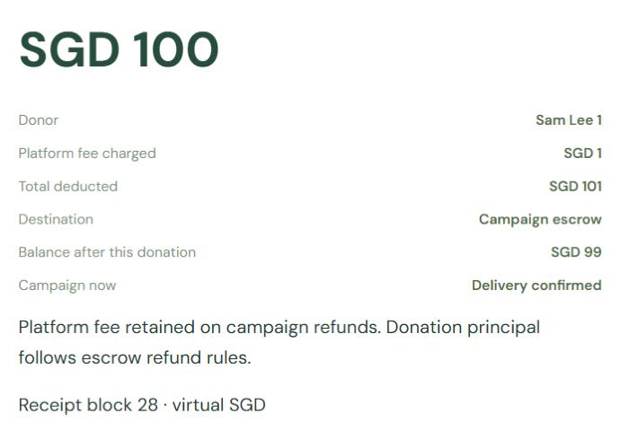
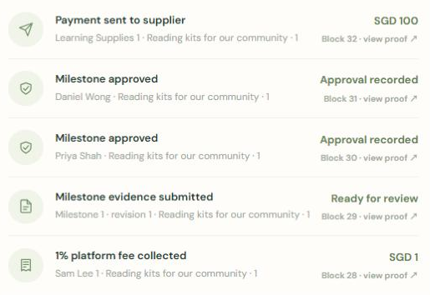
05 · DEMO & REFUND EXAMPLES
What the demo records, and how a refund is shared
RECORDED EXAMPLE · RECEIPT
LIVE DEMO SCENARIO
S$100 → campaign escrow
Learning Kits campaign
S$1 fee · S$101 deducted in total
S$400
paid
S$600
unspent
Wallet balance after: S$99
S$1,000 collected · S$10 fee kept
Recorded in a local block (here 28)
Alex gave S$600:
600 ÷ 1,000 × 600
= S$360 refunded
RECORDED EXAMPLE · BLOCKS VARY
Block 32 · S$100 paid to supplier
Block 31 · approval, reviewer 2
VERIFIED BY CONTRACT TEST
Block 30 · approval, reviewer 1
Mei can still claim S$240. Rule tested in contracts.test.mjs.
Block 29 · evidence, revision 1
Block 28 · S$1 fee collected
The supplier’s S$400 stays paid.
Notes:
SPOKEN SCRIPT (≈40 s + ≤45 s live demo)
Let me show the demo. … On the left is a recorded donation: 100 into escrow, a one-dollar fee, 99 left in the wallet, and a trail of evidence, two approvals and the supplier payment. Block numbers will differ in a live workspace. Now a live refund case, Learning Kits for a Fresh Start. It collected 1,000 dollars and paid 400 to its supplier before the deadline passed. Alex gave 600, so he received 360. Mei gave 400 and can still claim 240. The separate 10-dollar fee is kept, and the 400 already paid stays with the supplier.
DEMO CUE
Allow up to 45 seconds. Before presenting, open https://cleargive.pages.dev/demo?admin=1 → Demo controls → Prepared presentation scenarios, and check that ‘Learning Kits for a Fresh Start’ shows ‘Refunds available’. Live: click ‘Open campaign’ for Learning Kits and show raised / paid / refunded; then click ‘Mei’s donations’ and claim her SGD 240 — completed refunds become SGD 600 and the claimable amount becomes zero. If Mei has already claimed, use ‘Rebuild prepared examples’ beforehand (it asks for confirmation and advances the workspace clock by two days). Do not rely on specific block numbers. If the browser stalls, use the slide figures.
EVIDENCE STATUS
Left side: recorded screenshots from a guided walkthrough (virtual SGD); block numbers depend on workspace history. Right side: current prepared demo scenario ‘Learning Kits for a Fresh Start’ — SGD 1,000 collected, SGD 400 paid to the supplier, Alex refunded SGD 360, Mei SGD 240 claimable, SGD 10 fees retained. The same rule is tested in the code submission. A supplier payment confirms a token transfer only — not delivery acceptance or bank settlement.
SOURCES
ClearGive (2026) demo, Demo controls → Prepared presentation scenarios, accessed 17 Oct 2026; docs/DEMO-SCENARIOS.md (partial refund row).
ClearGive_Code.zip — pnpm test: 72 passed, 0 failed (17 Oct 2026); claim-to-test map in docs/SUBMISSION-VERIFICATION.md: tests/contracts.test.mjs — “partial spending refunds only the remainder, proportionally; no double claims or later releases”; tests/fees.test.mjs — “partial supplier payment refunds only the remaining principal and leaves the 60/40 fee reserves intact”.

Slide 12


06 · CONCLUSION / PROJECT VALUE
Payments follow agreed rules and approvals
Donors
Predefined spending rules
See where money may go; reclaim unspent funds
Review-linked payments
Organisers
ClearGive
Show discipline without holding the pool
rules → review → restricted payment
Traceable approvals & transfers
Sponsors
One shared record to check spending
Route to claim unspent funds
THE DEMO VERIFIED
NOT YET VERIFIED
Escrow, 1% fee vault, two-approval release, evidence hashing, pro-rata refunds — on a local chain
Reviewer independence, real-money payments, cost coverage, security, effect on donor trust
Notes:
SPOKEN SCRIPT (≈25 s)
To conclude, ClearGive links an agreed purpose, reviewer decisions and restricted payments. Donors can see where money may go and reclaim unspent funds. Organisers show discipline without holding the pool, and sponsors get one record to check. The demo verified the mechanics. It did not verify reviewer independence, real payments, cost coverage, security, or any effect on donor trust.
EVIDENCE STATUS
Value statements are design claims supported by the demo mechanics; no user study, pilot or fraud-reduction measurement has been done. ‘Verified’ items: demonstrated in the live demo or verified by the code submission’s test suite on a local single-operator chain. No claims of eliminating fraud, trustlessness or guaranteed impact.
SOURCES
ClearGive (2026) demo; ClearGive technical description §6; ClearGive_Code.zip — pnpm test: 72 passed, 0 failed (17 Oct 2026); claim-to-test map in docs/SUBMISSION-VERIFICATION.md.

Slide 13

06 · LIMITATIONS & FUTURE IMPROVEMENTS
Where it fits poorly, what could fail, what comes next
Poor scenario
Risks after launch
Local demo limits
The intended use of funds frequently changes
Aid needed immediately
Donations requiring a high level of privacy
Expenses that are difficult to verify
False off-chain evidence
Reviewer collusion or stalling
Privacy of public data
Key management, lost wallets
Contract vulnerabilities
Operating and gas costs
Payment and redemption links
History can be reset
No validator security
No real cash settlement
Role switching ≠ governance
Next steps, each mapped to a limitation
PROPOSED / NEXT STEP
Public testnet pilot
Independent review
Security review
Privacy design
Cost & payment test
→ reset history, validators
→ collusion, false evidence
→ contract bugs, keys
→ public data
→ fees, gas, settlement
Source: Ethereum.org (2026).
Notes:
SPOKEN SCRIPT (≈35 s)
ClearGive is not for every cause. It fits poorly without clear milestones, for aid needed immediately, when review costs more than the gift, or when outcomes are subjective. After launch, the risks include false evidence, collusion, privacy, lost keys, contract bugs, costs and payment integration. The demo itself can be reset, has no independent validators and settles no cash. Our next steps target each gap: a public testnet pilot, independent review, a security review, privacy design, and cost testing.
EVIDENCE STATUS
Limitations from the team’s analysis, the demo’s stated scope (‘How it works’ → ‘Taking ClearGive beyond the demo’) and Technical Description §6. All future improvements are PROPOSED; none is implemented. No legal or regulatory conclusion is drawn.
SOURCES
ClearGive demo, ‘How it works’ (accessed 17 Oct 2026). ClearGive technical description (team document) ClearGive Technical Description §6 Demonstration Scope and Limitations. Ethereum.org (2026) Ethereum.org (2026), Gas and fees, https://ethereum.org/en/developers/docs/gas/

Slide 14
REFERENCES
Reference list
Charities Aid Foundation (2025) World giving report 2025. London: Charities Aid Foundation. Available at: https://www.worldgivingreport.org (Accessed: 16 October 2026).
ClearGive (2026) ClearGive demo. Available at: https://cleargive.pages.dev/demo (Accessed: 17 October 2026).
Ethereum.org (2026) Ethereum gas and fees: technical overview. Available at: https://ethereum.org/en/developers/docs/gas/ (Accessed: 17 October 2026).
Giving.sg (2025a) Specific terms of use for donors and volunteers. Available at: https://www.giving.sg/doc/policy/2 (Accessed: 17 October 2026).
Giving.sg (2025b) Specific terms of use for registered charities, organisations and groundups. Available at: https://www.giving.sg/doc/policy/4 (Accessed: 17 October 2026).
Global Market Insights (2025) Non-profit crowdfunding platform market size, forecasts 2034 (Report GMI13303). Available at: https://www.gminsights.com/industry-analysis/non-profit-crowdfunding-platform-market (Accessed: 16 October 2026).
GoFundMe (2026a) Bank transfer deadlines. Available at: https://support.gofundme.com/hc/en-us/articles/204119238 (Accessed: 17 October 2026).
GoFundMe (2026b) Donor protection: the GoFundMe Giving Guarantee. Available at: https://support.gofundme.com/hc/en-us/articles/203604704 (Accessed: 17 October 2026).
National Volunteer & Philanthropy Centre (2024) Giving in Singapore remains resilient, according to NVPC’s National Giving Study 2023, 12 June. Available at: https://nvpc.org.sg/newsroom/national-giving-study-2023/ (Accessed: 16 October 2026).
Office of the Commissioner of Charities (2026) Commissioner of Charities annual report 2024. Singapore: Ministry of Culture, Community and Youth. Available at: https://www.charities.gov.sg (Accessed: 16 October 2026).
The Giving Block (2021) How to accept Bitcoin donations. Available at: https://thegivingblock.com/resources/accept-bitcoin-donations (Accessed: 17 October 2026).
The Giving Block (n.d.) What is The Giving Block’s donation refund policy? Available at: https://faq.thegivingblock.com (Accessed: 17 October 2026).
Wüst, K. and Gervais, A. (2018) ‘Do you need a blockchain?’, 2018 Crypto Valley Conference on Blockchain Technology (CVCBT). Zug, Switzerland, 20–22 June. IEEE, pp. 45–54. doi: 10.1109/CVCBT.2018.00011.
In-text citations use author–date form. Long report URLs are shown at publisher level; full links are in the speaker notes.
Notes:
SPOKEN SCRIPT (≈5 s)
Our sources are listed here, with full links in the notes.
EVIDENCE STATUS
External statistics and competitor statements are cited to primary or official sources. Internal material is separated.
SOURCES
National Volunteer & Philanthropy Centre (2024): https://nvpc.org.sg/newsroom/national-giving-study-2023/
Charities Aid Foundation (2025): https://cdn.prod.website-files.com/67d1838beb72321adb3f57fc/684fe35981883f8156643c23_b73e54c572856504aefb9b02749ab5a0_CAF%20World%20Giving%20Report%202025.pdf
Office of the Commissioner of Charities (2026): https://www.charities.gov.sg/PublishingImages/Resource-and-Training/Publications/COC-Annual-Reports/Documents/Commissioner%20of%20Charities%20Annual%20Report%202024.pdf
Global Market Insights (2025): https://www.gminsights.com/industry-analysis/non-profit-crowdfunding-platform-market
Giving.sg (2025b): https://www.giving.sg/doc/policy/4/For%20Registered%20Charities,%20Organisations%20and%20Groundups
Giving.sg (2025a): https://www.giving.sg/doc/policy/2/For%20Donors%20&%20Volunteers
GoFundMe (2026a; 2026b): https://support.gofundme.com/hc/en-us/articles/204119238 ; https://support.gofundme.com/hc/en-gb/articles/360056093332 ; https://support.gofundme.com/hc/en-us/articles/203604704 ; https://support.gofundme.com/hc/en-gb/articles/203604214 ; https://support.gofundme.com/hc/en-us/articles/360001980367
The Giving Block (2021; n.d.): https://thegivingblock.com/resources/accept-bitcoin-donations ; https://docs.thegivingblock.com/docs/daf-donations-nonprofit-onboarding-flow ; https://faq.thegivingblock.com/faq/frequently-asked-questions/what-is-the-giving-blocks-donation-refund-policy ; https://faq.thegivingblock.com/faq/frequently-asked-questions/how-long-should-it-take-for-my-receipt-to-arrive-transaction-to-show-on-dashboard
Wüst and Gervais (2018): https://doi.org/10.1109/CVCBT.2018.00011
Ethereum.org (2026): https://ethereum.org/en/developers/docs/gas/
ClearGive (2026): https://cleargive.pages.dev/demo
ClearGive technical description (team document): ClearGive Technical Description (team document supplied with this deck).
Code submission (ClearGive_Code.zip): contracts/*.sol, tests/*.test.mjs, docs/SUBMISSION-VERIFICATION.md. pnpm test: 72 passed, 0 failed (17 Oct 2026); rebuilt dist/ and artifacts match SHA256SUMS.txt.

Slide 15
Thank you
cleargive.pages.dev/demo
Notes:
SPOKEN SCRIPT (≈10 s)
Thank you. We are happy to take questions on the design, its limits and the proposed pilot.
EVIDENCE STATUS
Closing slide; reuses the cover artwork.
SOURCES
https://cleargive.pages.dev/demo

