Slide 1
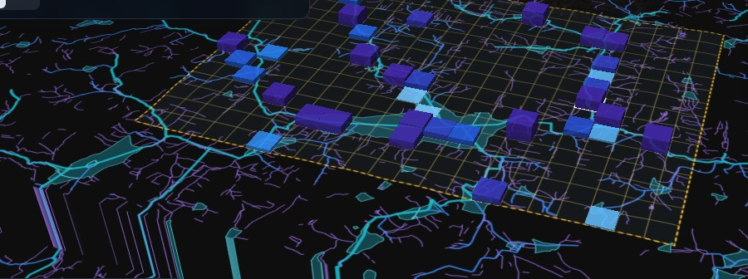
FlowShield
5 SEPTEMBER 2022
131.6 mm
Predict the flood. Protect the future.
Bengaluru's wettest September day since 2014. Bellandur, Marathahalli and the Outer Ring Road went under water; people were evacuated by boat.
Flood simulation, early warning and AI-assisted response planning for Bellandur–Marathahalli, Bengaluru.
Problem statement FLOWSHIELD · Theme VECTOR
10.5 × 7.5 km
315
0.5 s
Team [name] · [member] · [member] · [member]
real terrain modelled
cells of 500 m
per 3-hour simulation
Live simulation over the real drainage network — 29 cells critical, 5,955 buildings exposed at T+1:40
Live: flowshield-app.vercel.app · github.com/dingdongkkk/flowshield
Notes:
On 5 September 2022 Bengaluru recorded its wettest September day in eight years. FlowShield answers three questions for that exact area: where does the water go, how much warning would we get, and what actually helps.

Slide 2
Everything in the brief — plus all seven bonuses
CORE REQUIREMENTS
ALL 7 BONUS FEATURES
✓
Configurable rainfall — steady / heavy / cloudburst, 5–200 mm/h, or the real Sept 2022 storm
✓
Normal rainfall
✓
City as connected regions — 315 cells of 500 m, 4-neighbour flow, open boundaries
✓
Heavy rainfall
✓
Accumulation and movement — mass-conserving storage network, water balance to 10⁻⁶ m³
✓
Drainage failure
✓
Blocked drainage channel
✓
Drainage capacity and terrain — per-cell drains; 90 m Copernicus DEM, 9 samples per cell
✓
Scenario comparison
✓
Water levels over time — engine steps ≤ 1 s, saved frames played back in 3D
✓
Affected population (exposure)
✓
Safe / Warning / Critical — 10 cm and 30 cm depth thresholds, adjustable
✓
Interactive time slider
✓
Time-based visualisation — 3D atlas, time slider, flood-progression chart
78,375 buildings counted per cell as the exposure measure
✓
Critical regions and time to critical — warnings table with countdown and lead time
Real data: 6,839 mapped stormwater drains · 1,356 lakes and tanks · Copernicus elevation · OpenStreetMap buildings
Notes:
Everything in the problem statement is built, and all seven bonus items. The map is real: 6,839 mapped drains, 1,356 lakes, real elevation and 78,000 buildings.

Slide 3
What we added beyond the brief
1
AI surrogate
2
Response planning
Neural network trained on 4,000 of our own engine runs. Predicts peak depth within 5.6 cm on 572 held-out runs (R² 0.995) and scores 609 response plans instantly.
Drain upgrades, upstream detention, pumps and drain clearing, compared on the same storm: peak depth −21.5 cm, 0.85 million m³ less standing water.
3
Verification
4
Reality check
21 automated engine checks, water balance to 10⁻⁶ m³, convergence under a halved time step, and a sensitivity sweep: 29–31 cells whichever way assumptions move.
Replay of the real 4–5 Sept 2022 storm against reported flood sites: 3 of 5 hit, but 51% by chance — so we report it as not yet better than chance.
16 min
−21.5 cm
0.85 M m³
typical warning lead time before a block turns critical
peak depth with the response plan, same storm
less standing water after three hours
The AI proposes; the physics decides — every number shown comes from the engine.
Notes:
Four things beyond the brief: a real AI component, response planning, verification, and an honest reality check against the 2022 flood. Now the live demo.

