Slide 1
Percolator Demo
Presentation: 陈渤、黄思、秦培杰
Demo: 丁峰、徐华韬
Notes:
今天将由我、xx为大家作关于这篇论文的presentation，而demo的演示部分是由丁峰和xx负责。正如标题所示，这篇文章构建了一个大规模增量数据处理系统，这个系统的核心主要是分布式的xx，google根据设计了Percolator系统，用于取代原本基于MapReduce的搜索引擎indexing系统。

Slide 2
Contents
1
Motivation
2
Infrastructure
3
Improvement
4
Scene and Test Case
5
Conclusion

Slide 3
Contents
1
Motivation
2
Infrastructure
3
Improvement
4
Scene and Test Case
5
Conclusion

Slide 4
Motivation
Google
Big Table
GFS
Chubby
Open Source Community
HBase
HDFS
ZooKeeper
Percolator
Our Demo?
multi-row transaction, notification and observer

Slide 5
Contents
1
Motivation
2
Infrastructure
3
Improvement
4
Scene and Test Case
5
Conclusion

Slide 6

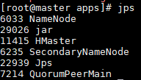

Infrastructure
Master
Extra:
Node | Address | Demo Apps
Master | 192.168.0.201 | SupprtServer
Slave1 | 192.168.0.202 | PercolatorDemo
Slave2 | 192.168.0.203 | PercolatorDemo
Slave1
Slave2
Software | Version
Centos | 7
Hadoop | 2.7.3
Hbase | 1.2.5
ZooKeeper | 3.4.6
JDK | 1.8
VM Info:
Info | Capacity
Memory | 1 ~ 1.5GB
CPU | 3192.606MHZ, 1 core
Disk | 35GB

Slide 7
Contents
1
Motivation
2
Infrastructure
3
Improvement
4
Scene and Test Case
5
Conclusion

Slide 8
Improvement
1. Transaction ID and its timeout ( 5s in our demo )
set start timestamp as Transaction ID, send it to Support Server
finer granularity (compared with client id)
2. Row transaction HBase
1. Get lock 2. Read row 3. AtomicWrite Row 4. Flush commits 5. Release lock
requirement: distributed non-reentrant lock (provided by ZooKeeper)

Slide 9
Contents
1
Motivation
2
Infrastructure
3
Improvement
4
Scene and Test Case
5
Conclusion

Slide 10
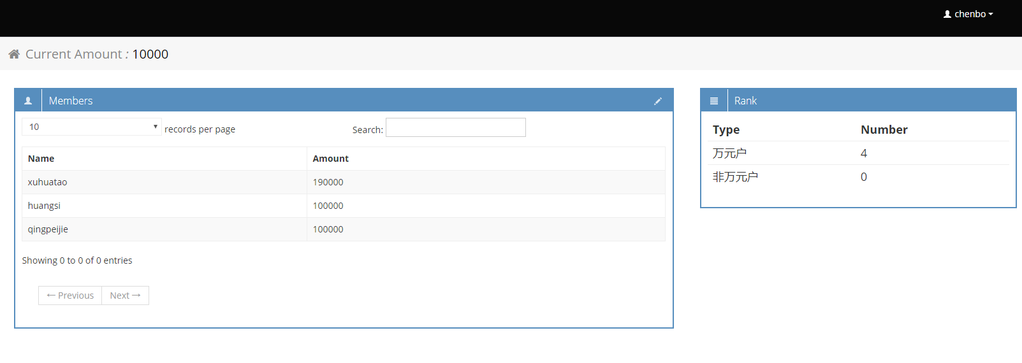
Scene
Transferring Account
notification

Slide 11
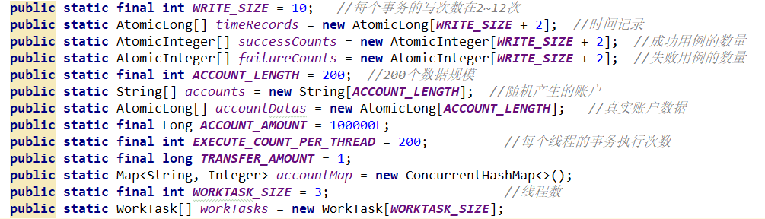
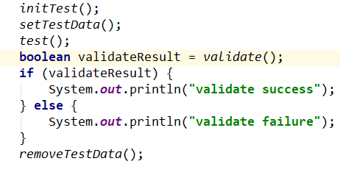
Test Case 1
Configuration:
Steps:

Slide 12
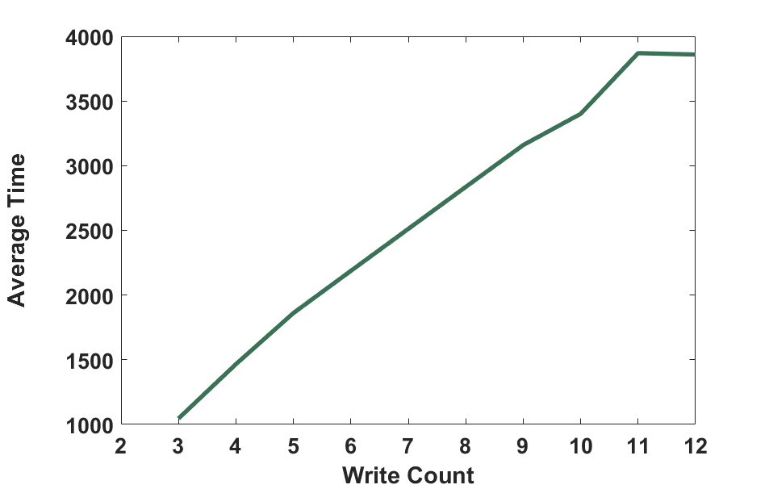
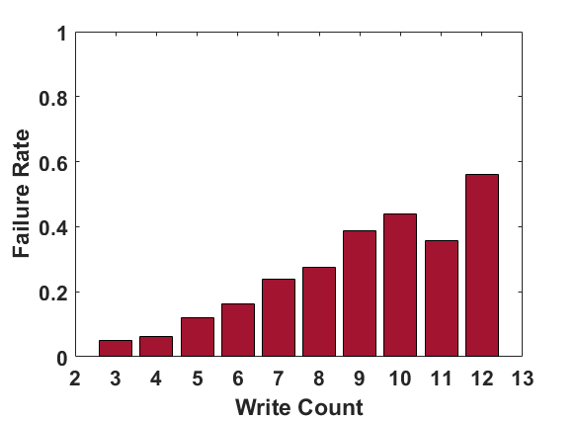
Result 1
Average Time – Write Count
Failure Rate – Write Count

Slide 13
Test Case 2
Normal Transaction A
operate account normally
view data from in 3D (row-col-version)
Abnormal Transaction A
set break point for A to cause its timeout
Transaction B cleans up A’s lock and commits successfully

Slide 14
Contents
1
Motivation
2
Infrastructure
3
Improvement
4
Scene and Test Case
5
Conclusion

Slide 15
Conclusion
Motivation
A open source version of Percolator
Scene and Test Case
High Concurrent Case
Normal Case
Abnormal Case
github: git@github.com:dingfeng/Percolator.git

