Slide 1
Restaurant management system for Oaxaca

Slide 2
Main ordering flow

Slide 3
Client interface

Slide 4
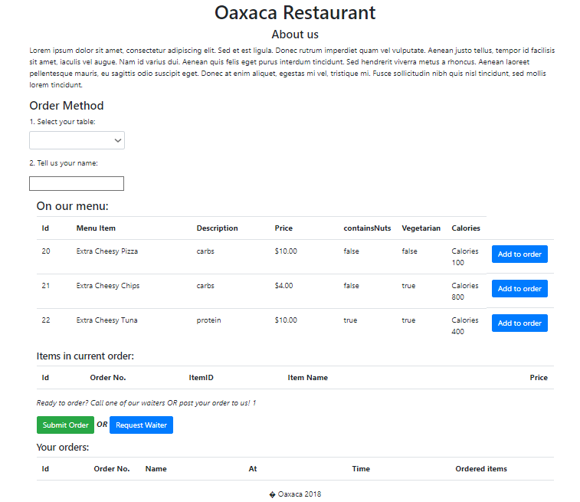

Slide 5
Client entering name and table

Slide 6
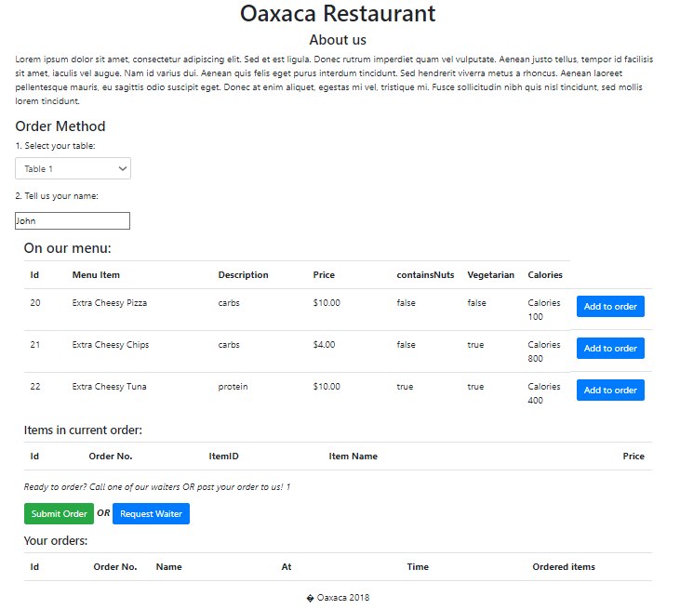

Slide 7
Client adding items to order

Slide 8
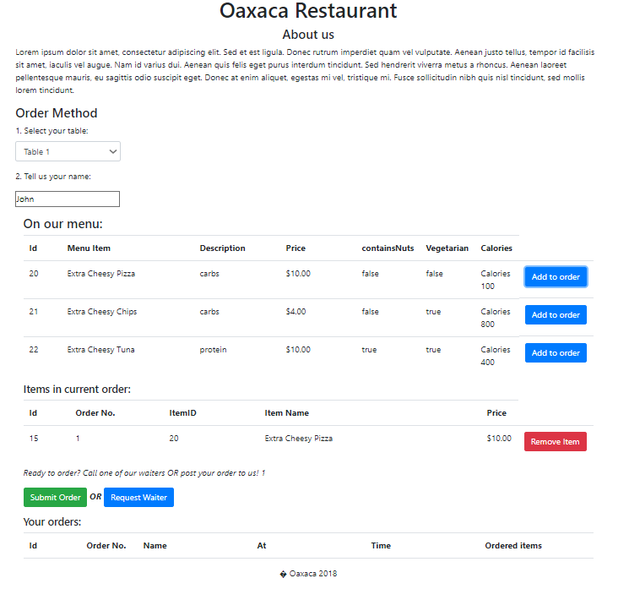

Slide 9
Client submitting order

Slide 10
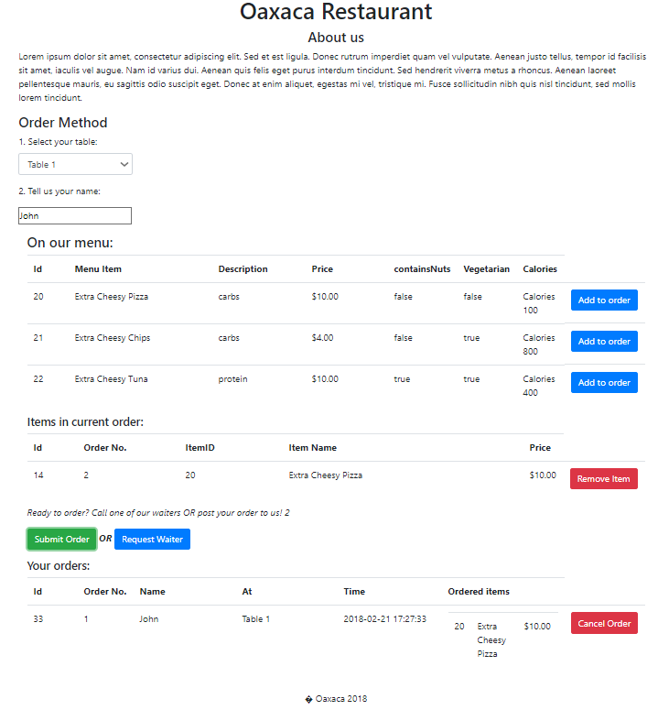

Slide 11
Waiter interface

Slide 13
Waiter receiving client order

Slide 14
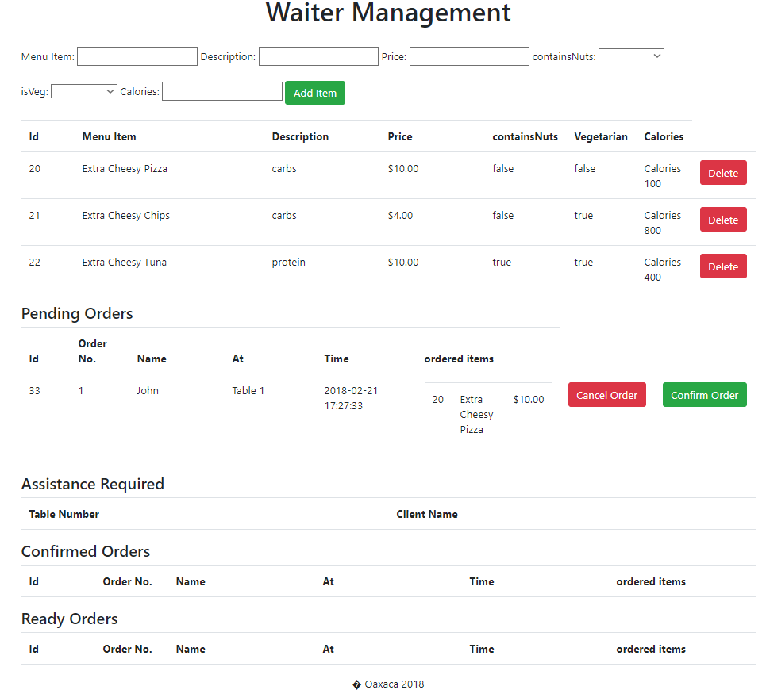

Slide 15
Waiter confirming order

Slide 16
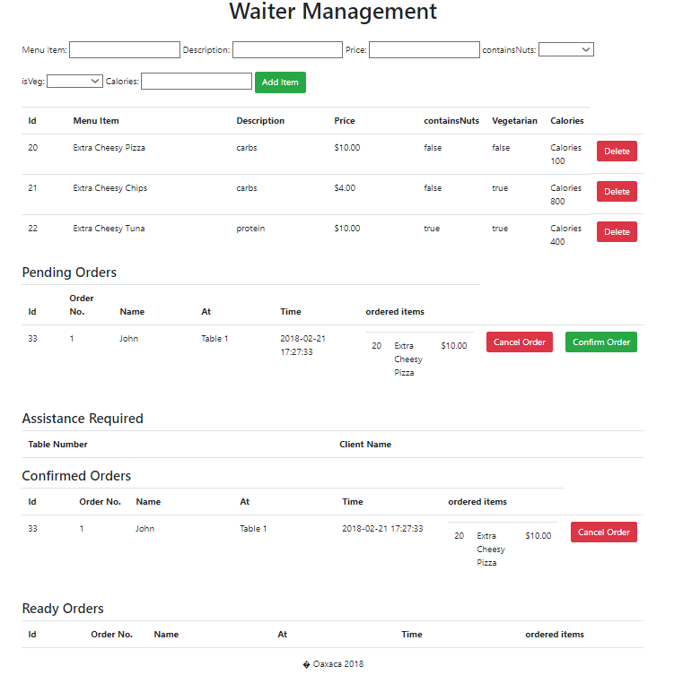

Slide 17
Kitchen staff interface

Slide 18
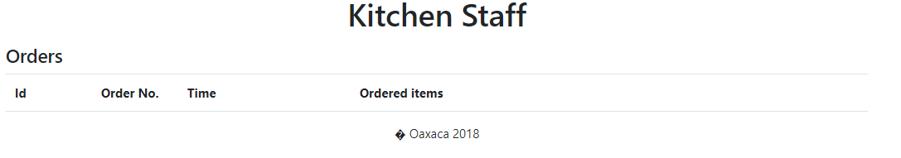

Slide 19
Kitchen staff receiving order

Slide 20
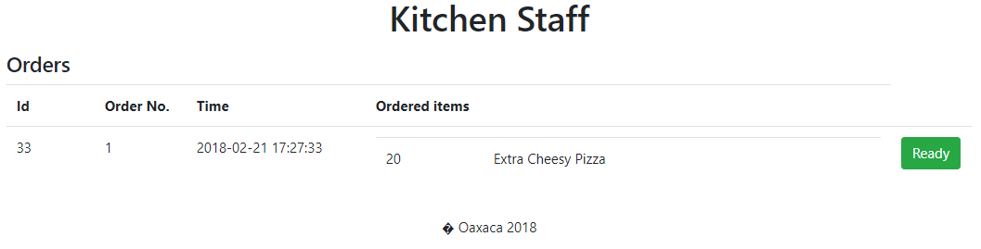

Slide 21
Kitchen staff finishing order

Slide 23
Waiter notified order is ready

Slide 24
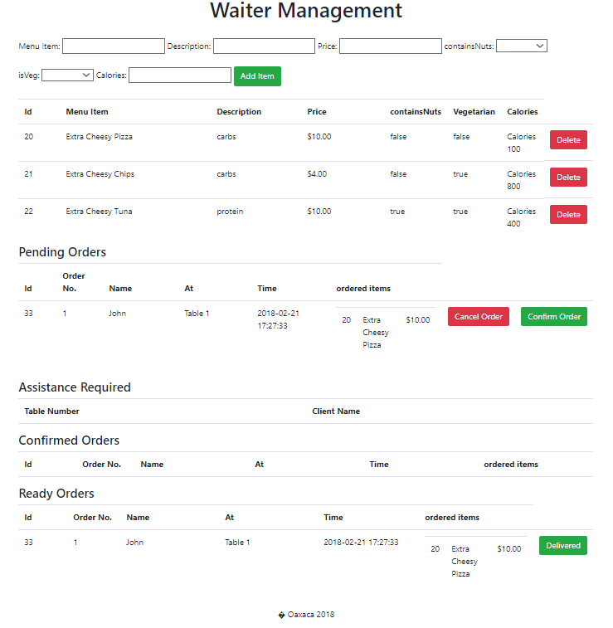

Slide 25
Waiter staff delivering the order

Slide 26
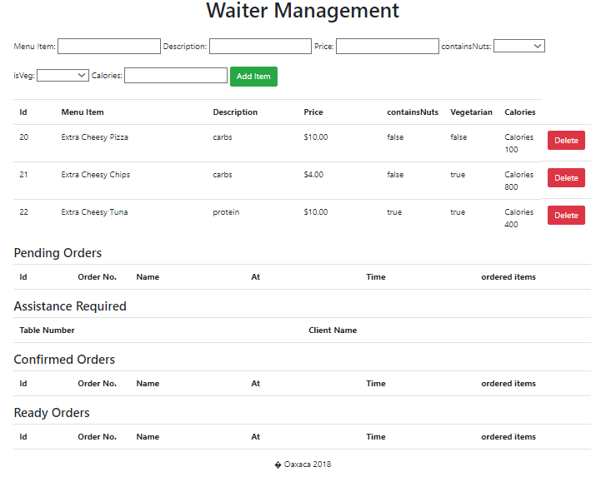

Slide 27
Client receiving order

Slide 28
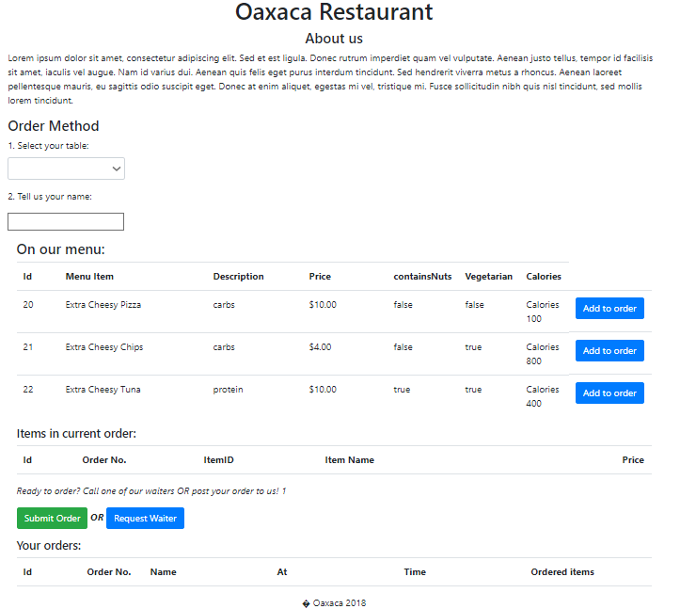

Slide 29
Side flows

Slide 30
Waiter adding item to menu

Slide 31


Slide 32
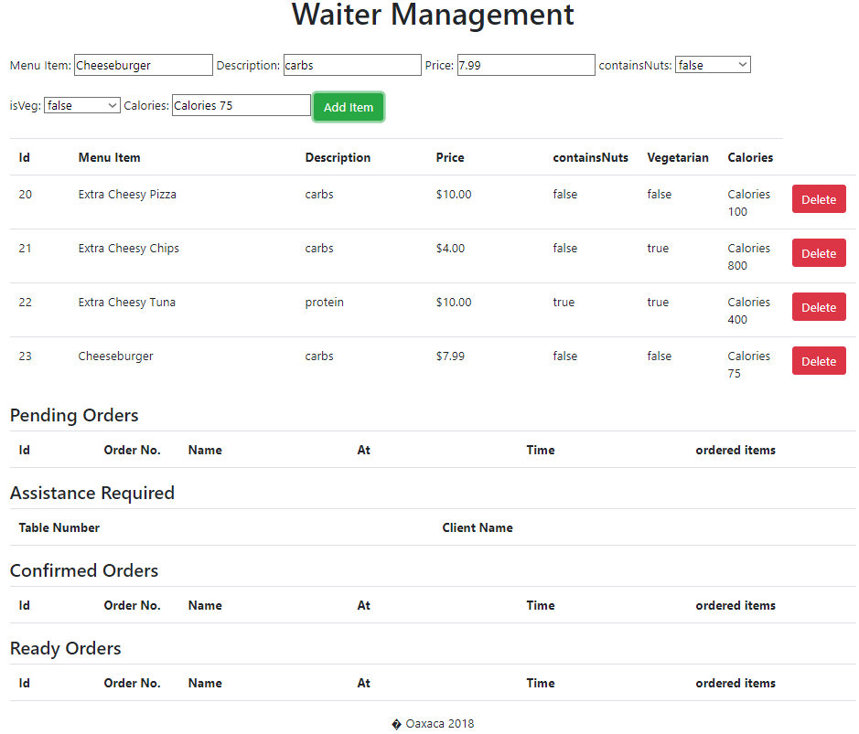

Slide 33
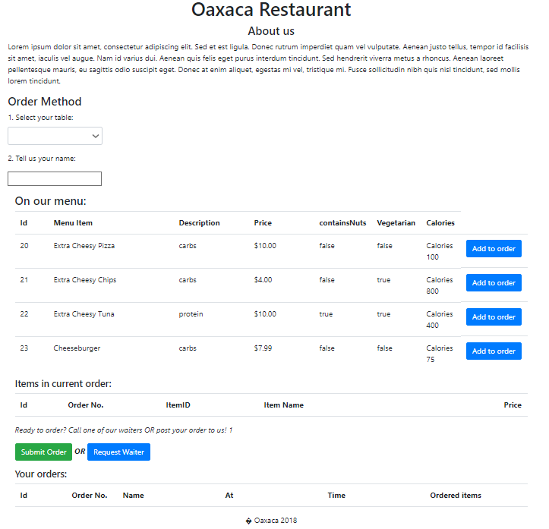

Slide 34
Waiter removing item from menu

Slide 35
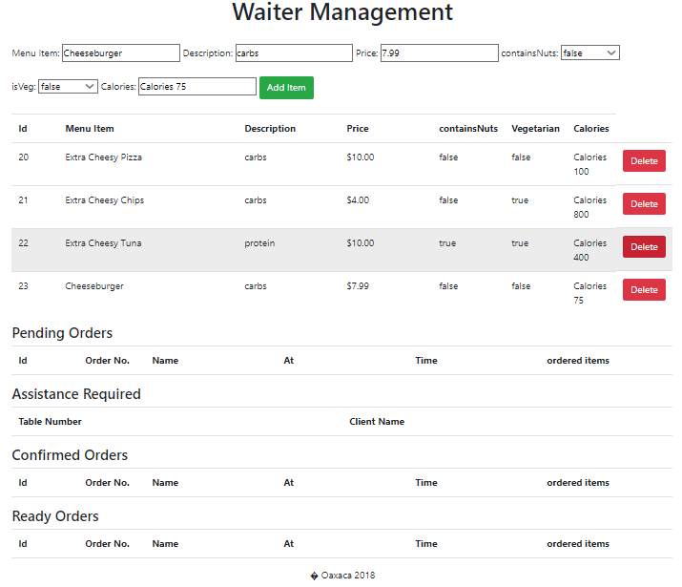

Slide 36
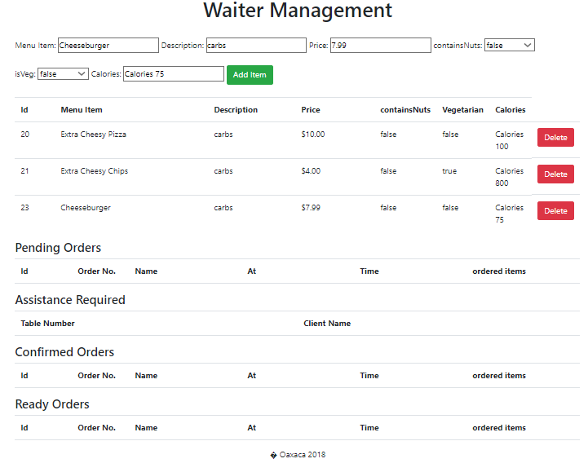

Slide 37
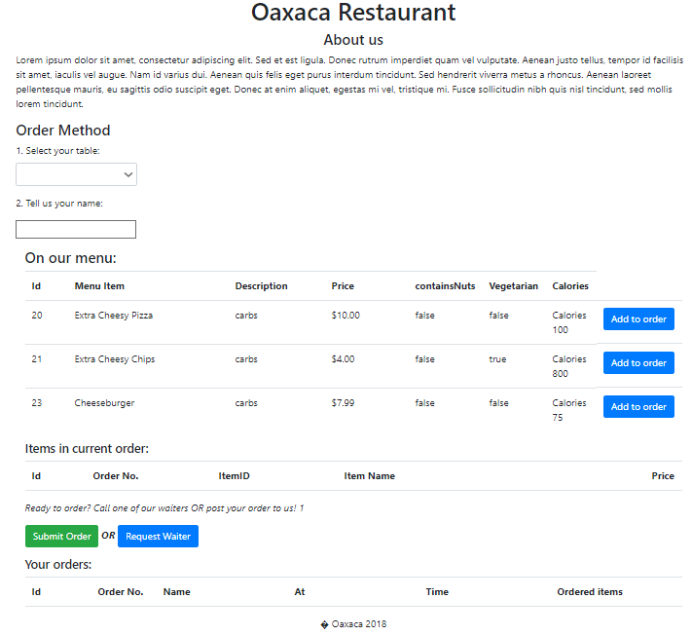

Slide 38
Client cancelling order

Slide 39
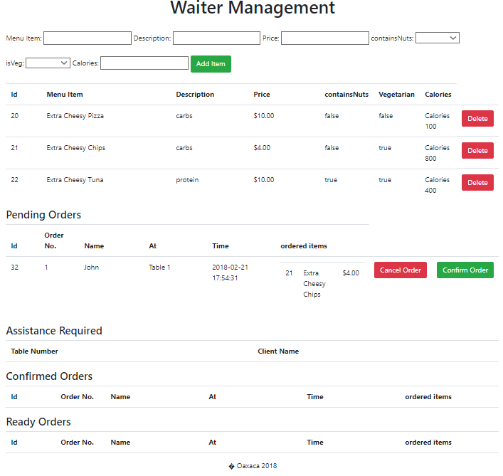

Slide 40
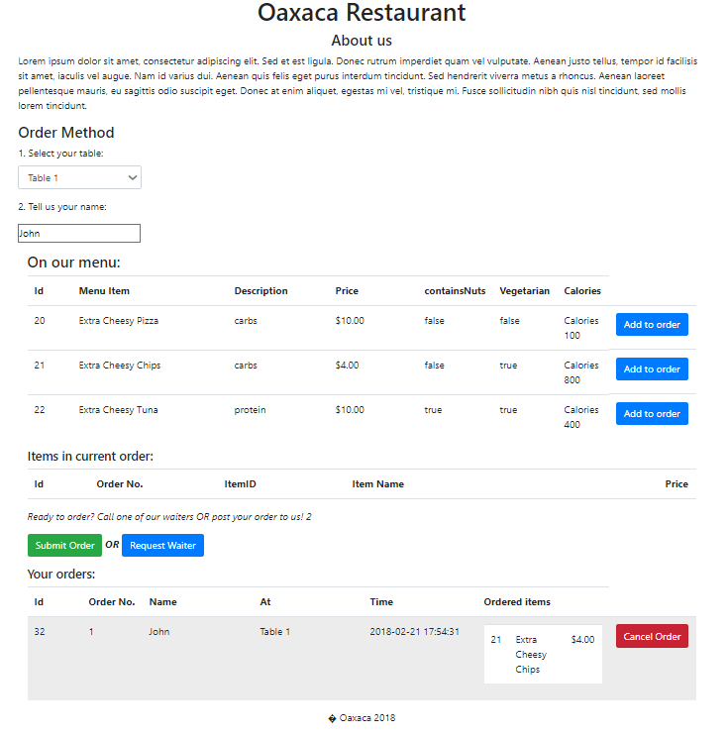

Slide 41
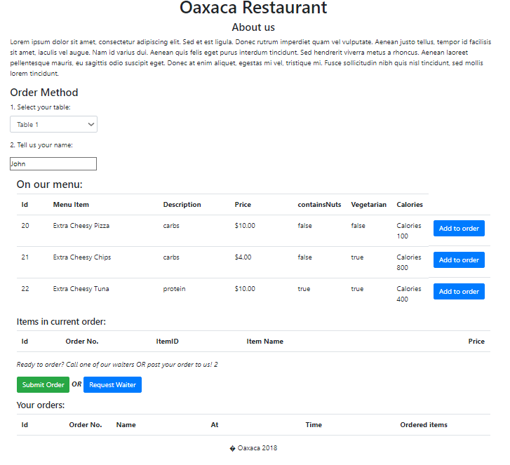

Slide 42
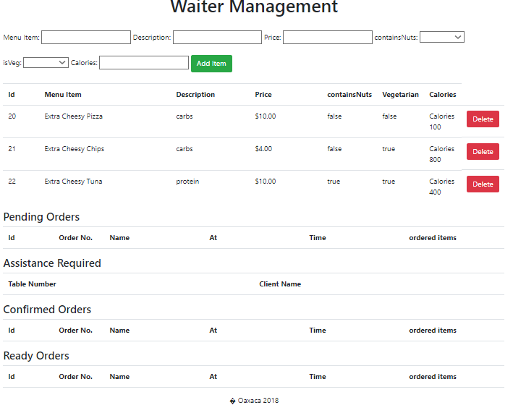

Slide 43
Waiter cancelling order

Slide 44
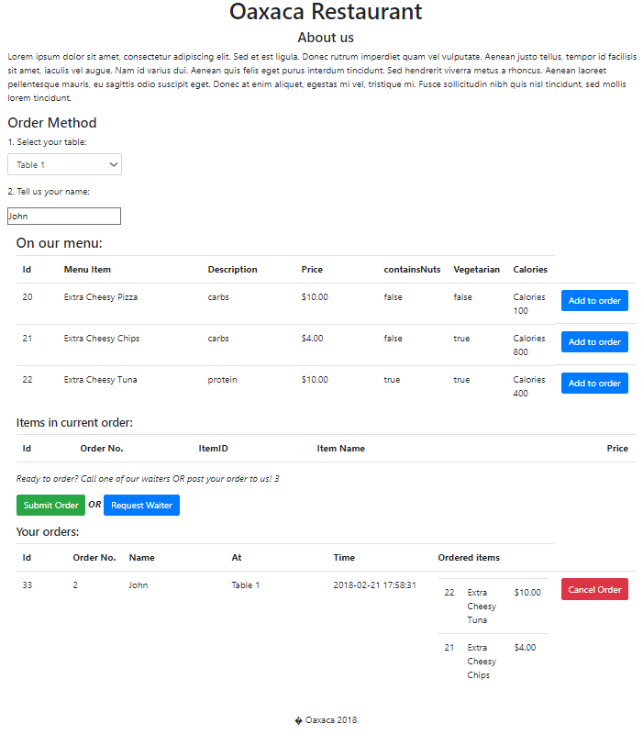

Slide 45
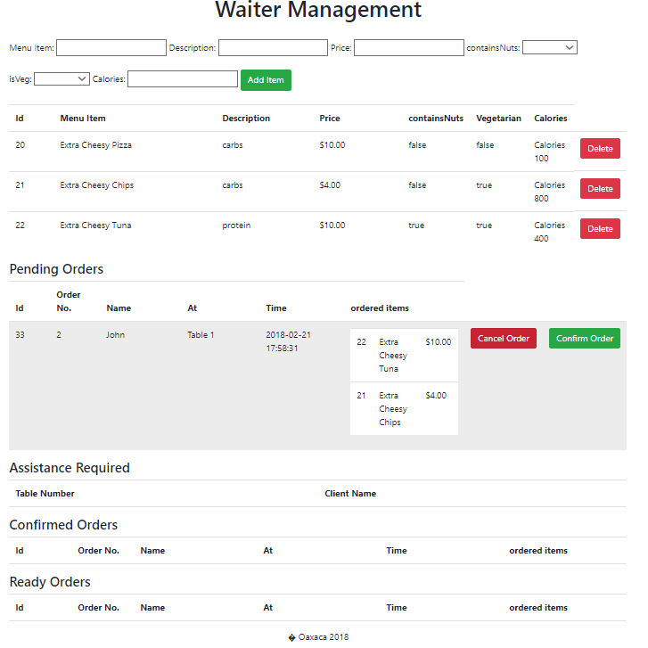

Slide 46


Slide 48
Client calling waiter

Slide 49


Slide 50
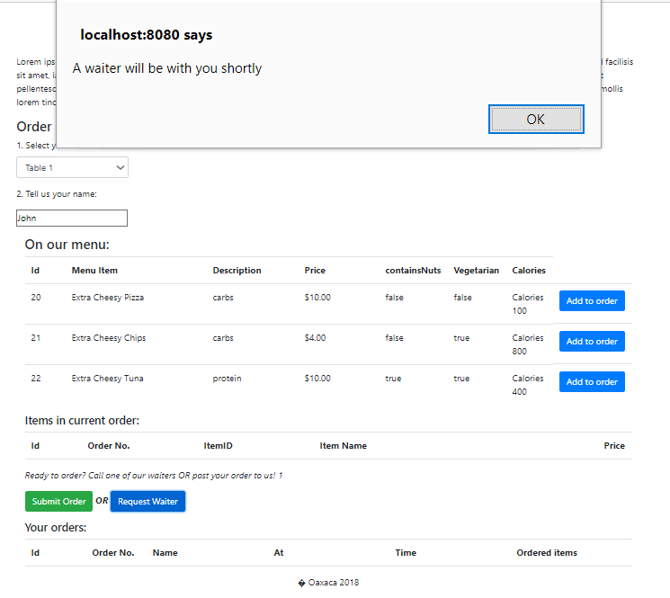

Slide 51
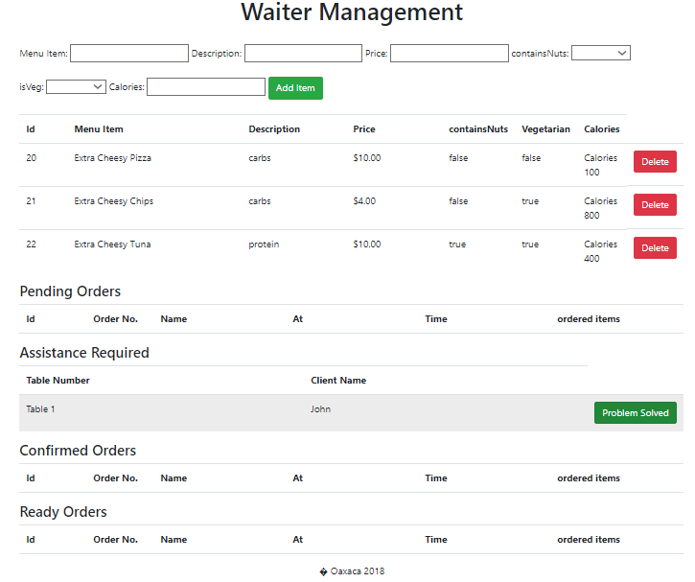

Slide 52


